Slide 1
Ink 31: An Introduction to Rotary’s Education Programs
Rotary’s Areas of Service

Slide 2
Why?

Slide 3
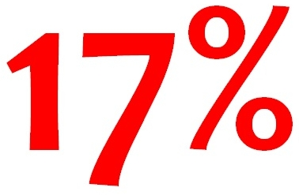
More than 775 million people over the age of 15 are illiterate.
That is…
…of the world’s adult population.

Slide 4
Rotary’s educational goal is to…
strengthen the capacity of communities to support basic education and literacy,
reduce gender disparity in education
increase adult literacy
We support education for all children, and literacy for children and adults.

Slide 5
Rotary takes action to empower educators to inspire learning at all ages
For example…

Slide 6
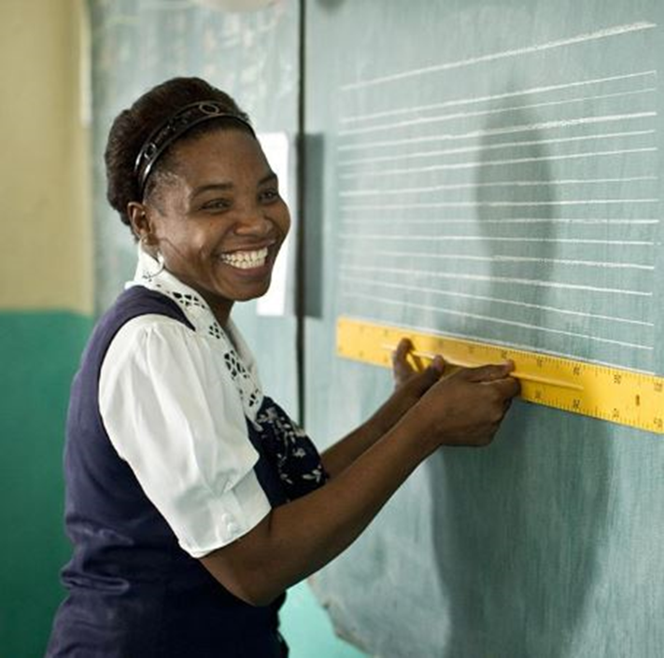
We train teachers and other professionals to work with vulnerable populations.

Slide 7
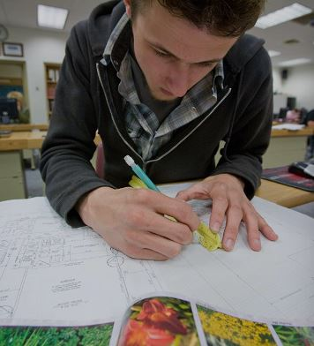
Rotary members invest in the future by giving scholarships to students who have the potential to change our communities.

Slide 8
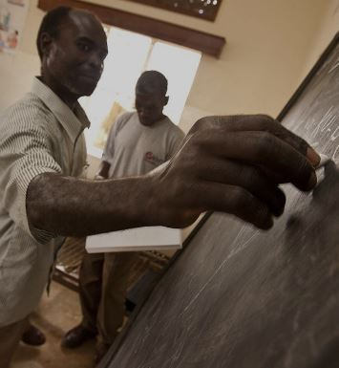
We fight adult illiteracy by working with local advocates to offer community literacy programs.
Examples…

Slide 9
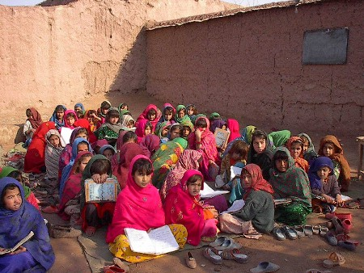
In Afghanistan, we started a girls school to break the cycle of poverty and social imbalance.

Slide 10
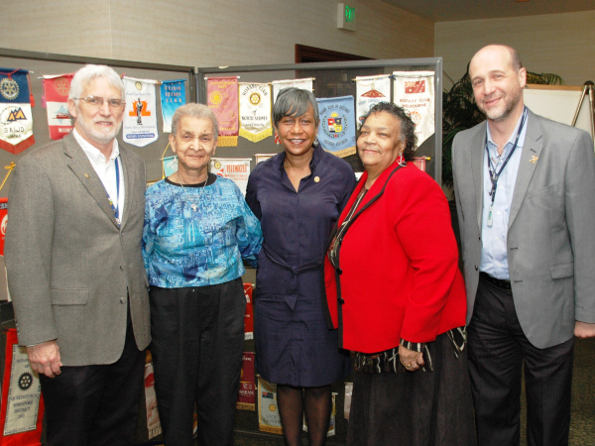
We started a “Pro Literacy” program in Detroit because half the local adult population was functionally illiterate.

Slide 11
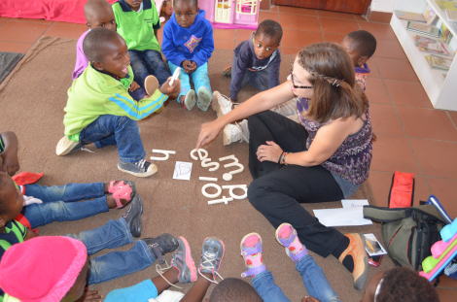
We started a “SOUNS” program in Sth. Africa to improve literacy by teaching children recognition of letters by sounds instead of names.

Slide 12
We provided water for schools in Lebanon so students can be healthier and get a better education

Slide 13
When you teach somebody how to read, they have that for a lifetime. It ripples through the community, one by one. Mark Wilson.
THANK YOU

