Slide 1
INK 23: 10 Insights Into Maternal & Child Health Month (April)

Slide 3
Maternal & Child Health is one of…

Slide 4
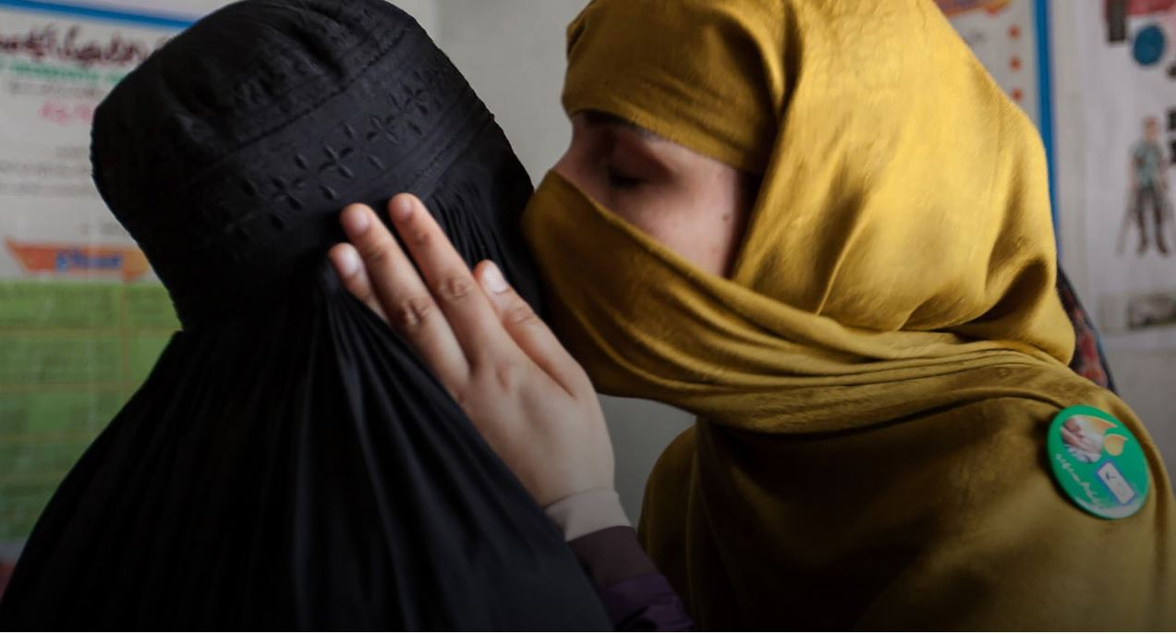
{01} Why Rotary Cares
Rotary makes high-quality health care available to vulnerable mothers and children so they can live longer and grow stronger.

Slide 5
{02} Why Rotary Cares
We expand access to quality care, so mothers and children everywhere can have the same opportunities for a healthy future. An estimated 5.9 million children under the age of five die each year because of malnutrition, inadequate health care, and poor sanitation — all of which can be prevented.

Slide 6
{03} Rotary Helps Mothers Take Control
So, Rotary provides education, immunizations, birth kits, and mobile health clinics. Women are taught how to prevent mother-to-infant HIV transmission, how to breast-feed, and how to protect themselves and their children from disease.

Slide 7
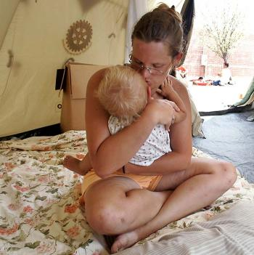
{04} Example - Education
Rotary members teach mothers how to breast-feed, promote immunizations and regular checkups, and distribute insecticide-treated bed nets.

Slide 8
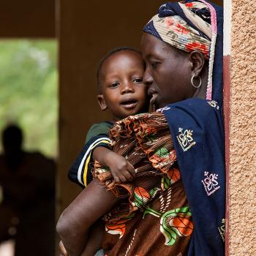
{05} Example - Improved Access to Care
Rotary programs improve women’s access to skilled health personnel: doctors, nurses, midwives, or community health care workers.

Slide 9
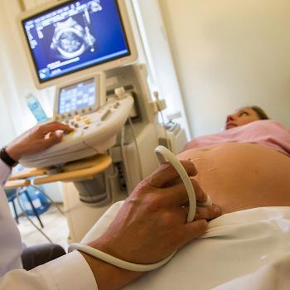
{06} Example - Clean Birth Kits
Rotary members distribute clean birth kits and train health workers in safe delivery of babies.

Slide 10
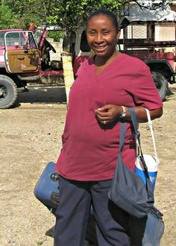
{07} Example - Mobile Pre Natal Clinics
Haiti has the highest maternal and infant mortality rate of any country in the western hemisphere. Rotary provided a fully equipped medical Jeep to volunteers and midwives to reach mothers and children in remote areas.

Slide 11
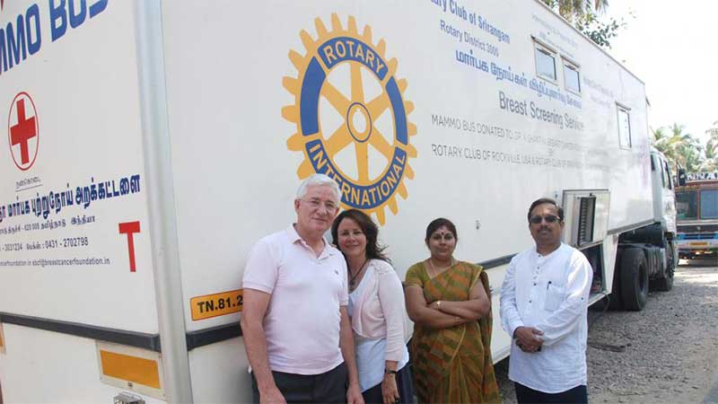
{08} Example - Cancer Screening
Rotarians provided a mobile cancer screening unit and awareness trainings around Chennai, India, where there is a high mortality rate of women with breast and cervical cancer due to late diagnosis.

Slide 12
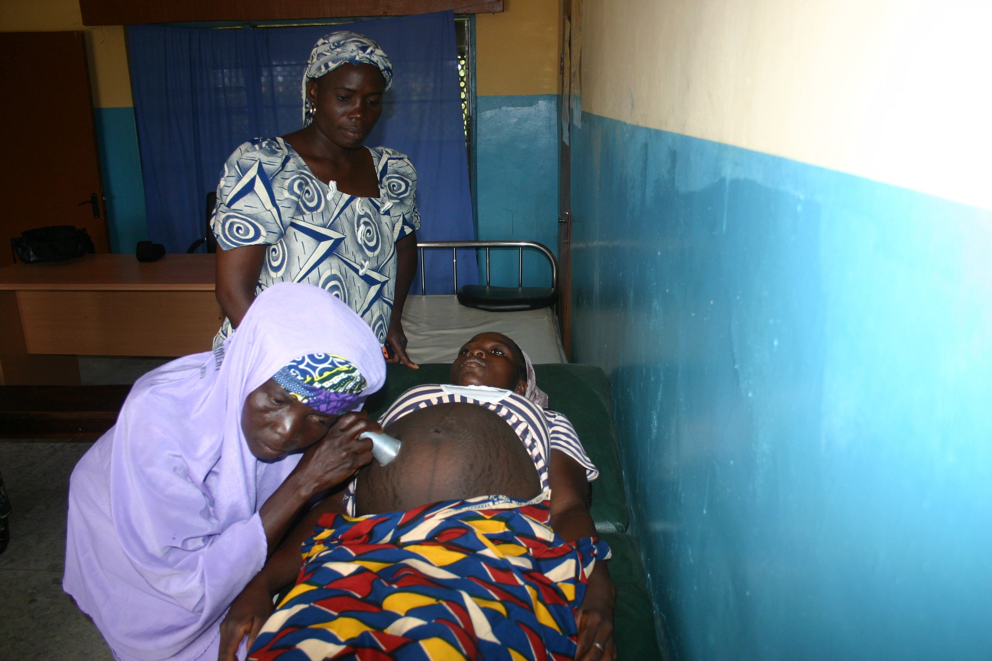
{09} Example - Safe Home Deliveries - Nigeria
Rotary members launched a $3 million, five-year pilot to save lives of mothers and children during home deliveries in Nigeria. Since 2005 — restoring dignity and hope to vulnerable mothers

Slide 13
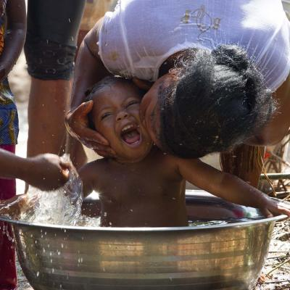
{10} Summary - We Empower Mothers
"If mothers are empowered and healthy, so are their families, leading to an alleviation of poverty and hunger.” Robert Zinser, co-founder of the Rotarian Action Group for Population and Development and retired president for Asia at chemical giant BASF

Slide 14
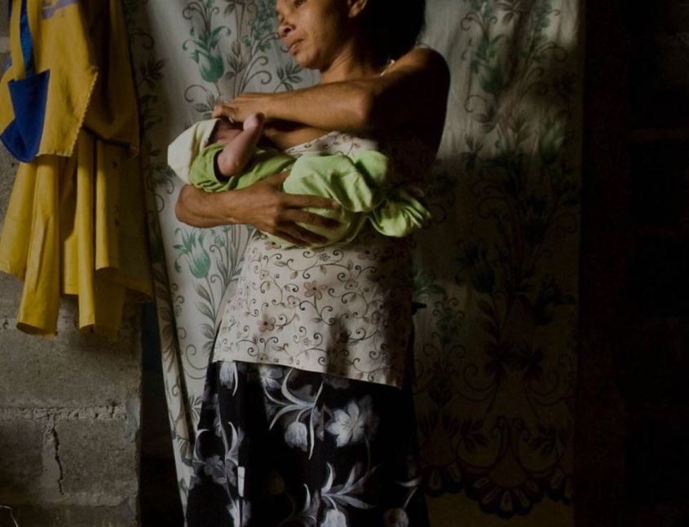
{11} So Spread the Word
Rotarians are urged to spread the word about Rotary’s work empowering mothers & children

Slide 15
Thank You

