Slide 1
Ink 67: The Early History of Rotary International

Slide 2
As the world's first service club, Rotary was formed on 23 February 1905 in Chicago, Illinois
February 23rd 1905

Slide 3
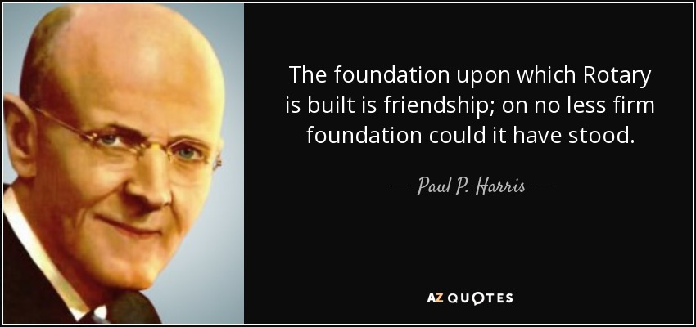
The Founder of the Rotary Club of Chicago was Paul Percival Harris - a lawyer

Slide 4
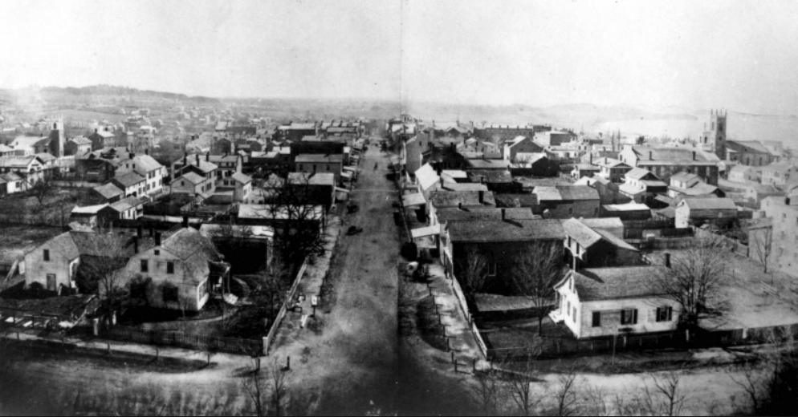
Harris, wished to recapture in a professional club the same friendly spirit he had felt in the small towns of his youth. (e.g. Vermont in 1880s)

Slide 5
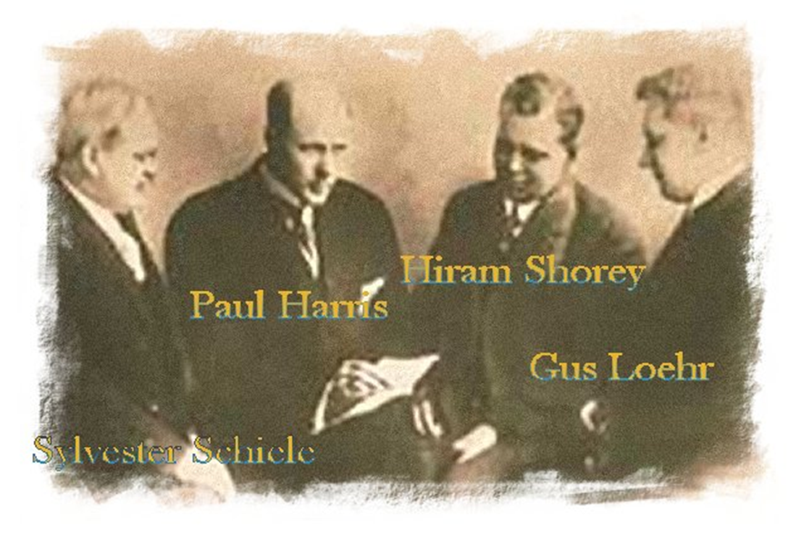
The first four members were Sylvester Schiele (coal dealer) Harris, Hiram Shorey (merchant tailor) & Gus Loehr (mining engineer)

Slide 6
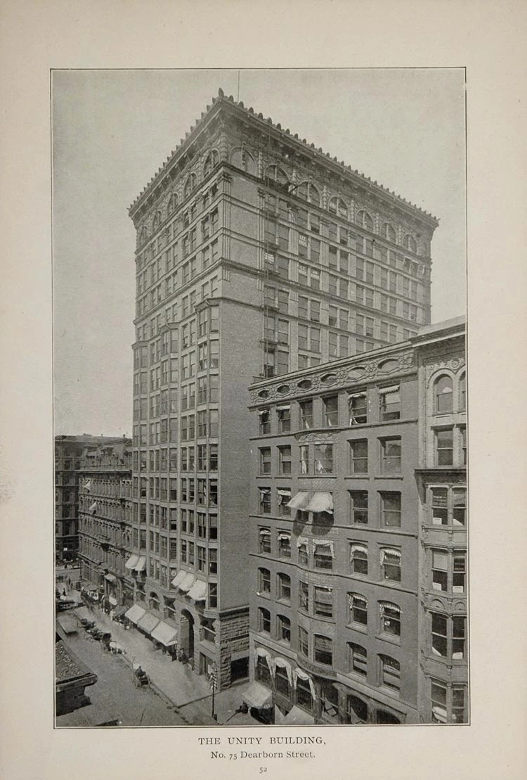
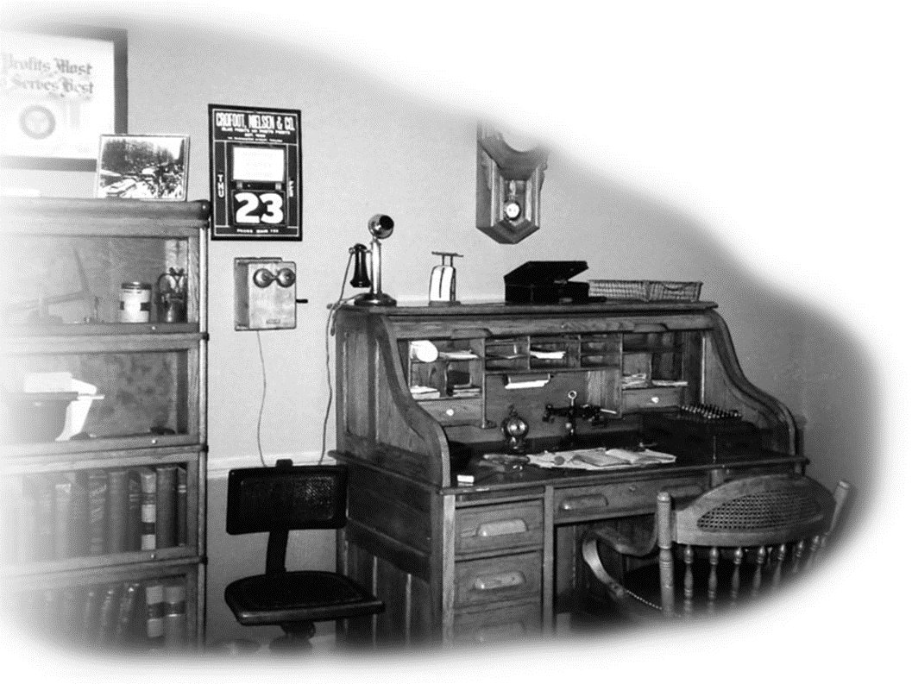
The group first met in Gus’ office in Room 711 of the Unity Building at 127 North Dearborn St, Chicago.

Slide 7
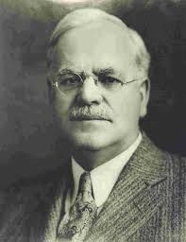
Sylvester Schiele was the 1st Rotary club president.

Slide 8
The name "Rotary" derived from the early practice of rotating meetings among members' offices.

Slide 9
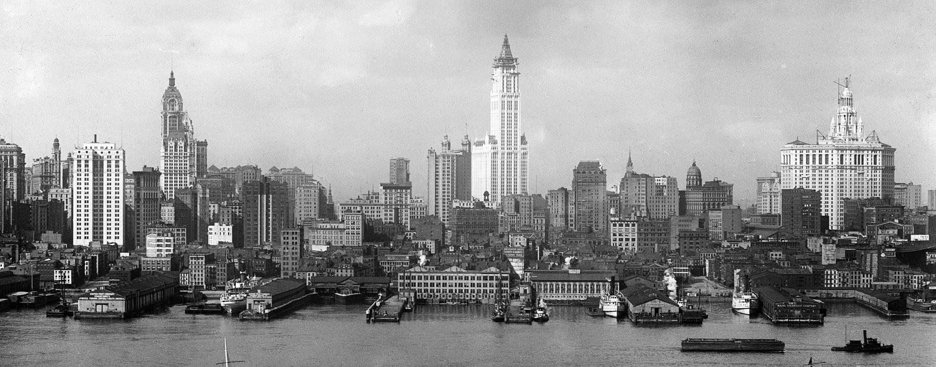
Rotary's popularity spread – by 1910, 16 clubs had been chartered from San Francisco to New York. (New York in 1910)

Slide 10
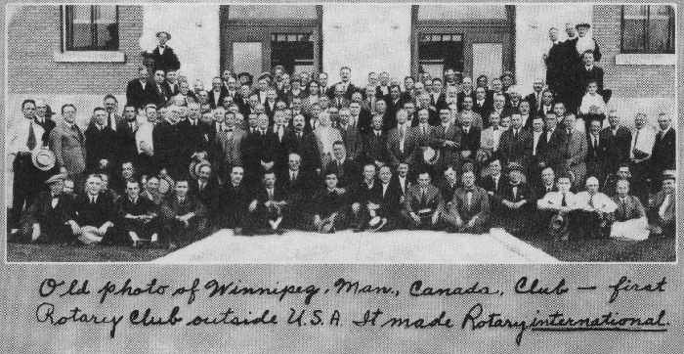
In 1911, Rotary became International with the charter of Winnipeg Rotary, in Canada

Slide 11
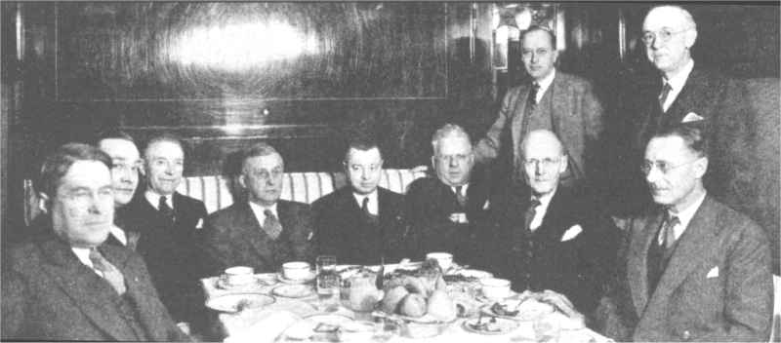
Paul Harris was elected as Rotary’s first International President in the same year

Slide 12
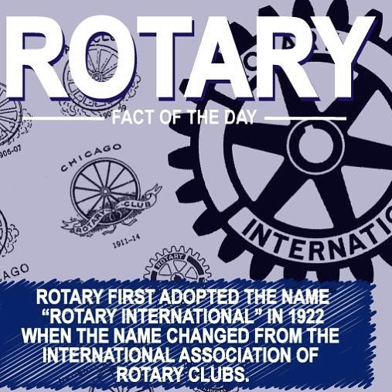
By 1921, Rotary clubs had been formed on six continents, and the organization adopted the name “Rotary International” a year later.(1922)

Slide 13
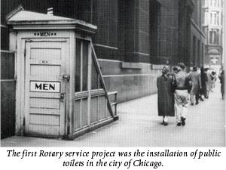
As Rotary grew, its mission expanded beyond serving the professional and social interests of club members.

Slide 14
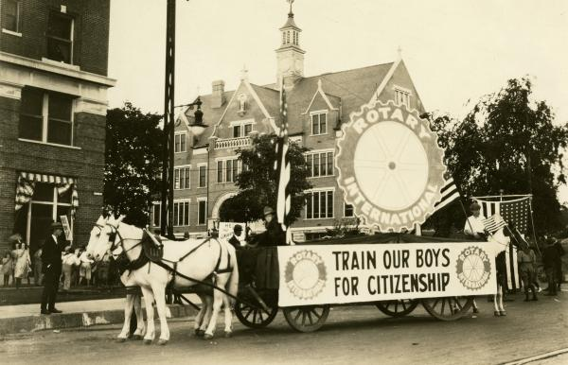
Rotarians began pooling their resources and contributing their talents to help serve communities in need.

Slide 15
The organization's dedication to this ideal is best expressed in its principal motto: Service Above Self (officially adopted in 1950).
Originally, “Service, NOT Self” (1911)

Slide 16
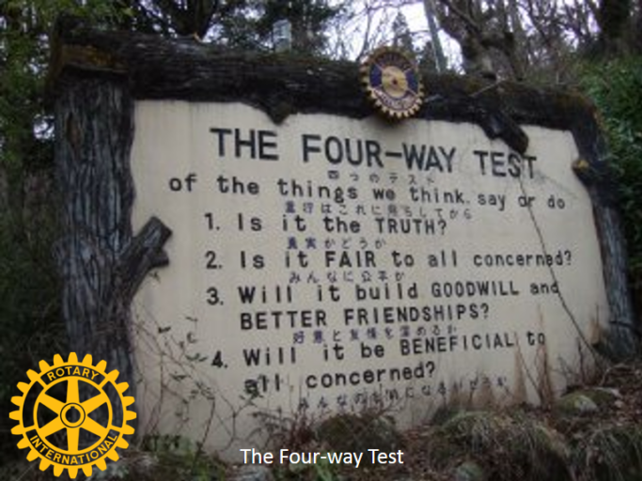
Rotary also adopted in 1943, a code of ethics, called The 4-Way Test, now translated into hundreds of languages.

Slide 18
Thank You For Watching

