Slide 1


Rotary Foundation Basics
for club foundation chairs
District 5440
April 2016

Slide 2
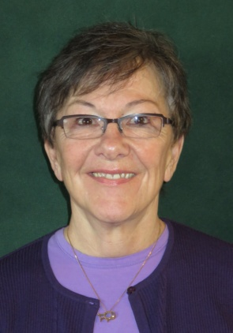
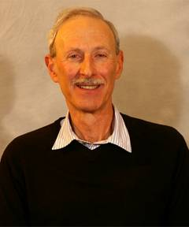
Introductions
http://www.rotary5440.org/SitePage/centennial-challenge
Nancy
Pettus
Jackson Hole
Breakfast
Rotary
Club
DRFC
2013-2016
Jim
Epstein
Fort Collins
Rotary Club
DRFC 2016-2019
Notes:
I’m Jim Epstein, chairman of the district 5440 grants committee, and I will be leading this webinar. We also have some of the grants committee members with us: Nancy Pettus, Wilton Lyles, Ron Hogan, Joe Schon and Krishna Murthy who will also be contributing.

Slide 3
Description of Training
This training is for club foundation chairs and club foundation committee members
It will cover the basics of the club foundation committee main responsibilities
It will not cover best practices since this will be covered at district assemblies and in online discussion groups

Slide 4
Agenda
Club foundation committee main responsibilities
How donations are used -Jim
The donation process - Nancy
Monitoring donations: reports - Nancy
Donation forms - Nancy
Recognizing donations - Jim
Recognizing clubs - Jim
Educating members - Nancy
Helping set goals - Nancy
Point contact for grant information - Nancy
Resources available - Jim

Slide 5
Club Foundation Committee Main Responsibilities
Educate
Foundation activities
Donation process
How funds are used
Options for participation
How to monitor your giving
Donations
Club accomplishments
Reaching goals
Celebrate
Participate
Donate
Centennial grants
District grants
Global grants
Mentor scholars
Polio events
Set goals
Establish process
Help with forms
Monitor donations

Slide 6
How Donations are Used
Rotarian Donations
DDoDonDonat
Matched 2 to 1 by
Gates Foundation
Specific global
grant
Annual Fund
Endowment/
Permanent Fund
Polio Plus Fund
Interest
Global grant
project specified
25%
District Grants
Annual fund of district specified
Polio plus grants
25%
Global Grants
Global grants with specific area of focus
50%
World Fund
Peace Centers
Global grants
Peace Centers
Polio Plus
RI Initiatives

Slide 7
The Donation Process
Important points about donations:
  To which Foundation fund can the money go?
    Annual Fund – this supports grants
    Polio – funds go to continue eradication efforts
    Endowment – our “savings account;” interest goes to grants
    Peace Centers (also an endowment) – supports the Peace Fellow scholarships
    Other – may specify a specific Global Grant but this does not count toward a club’s Annual Fund goal
Notes:
Donors must decide where they want their donation to go. Paul Harris credit is only given for donations to the Annual Fund or Polio. Only donations to the Annual Fund count toward a club’s goal. Clubs may also have goals for Polio and the Endowment Fund. There is a box on the Contribution Form which needs to be checked to specify where the funds go.

Slide 8
Donation Process cont.
  Member, club and district numbers are needed to be sure funds are credited correctly
    The best source is the Club Recognition Summary (club officers have access on the RI web site: www.rotary.org)
    Enter the member’s name as it appears on the Summary to prevent a new account being started for an existing member
  Members need to monitor their own donations at My Rotary on the RI web site
    90 days to correct an error
Notes:
Your role is to make sure members have the correct information to fill out the Contribution Form. The Club Recognition Summary is the best source of this information

Slide 9
Monitoring Donations - Reports
District reports give the big picture:
  Monthly Contribution Report contains club goals, membership number, progress in percent and dollars toward Annual Fund Goal, donations to Other (grants and polio), donations to the Endowment Fund
  Information in this report can be gotten from District 5440 Foundation Committee Chair – Jim Epstein for the 2016-17 to 2018-19 Rotary years
Notes:
If you want to monitor the club’s progress, request club information from the Monthly Contribution Report. This will not provide individual member information.

Slide 10
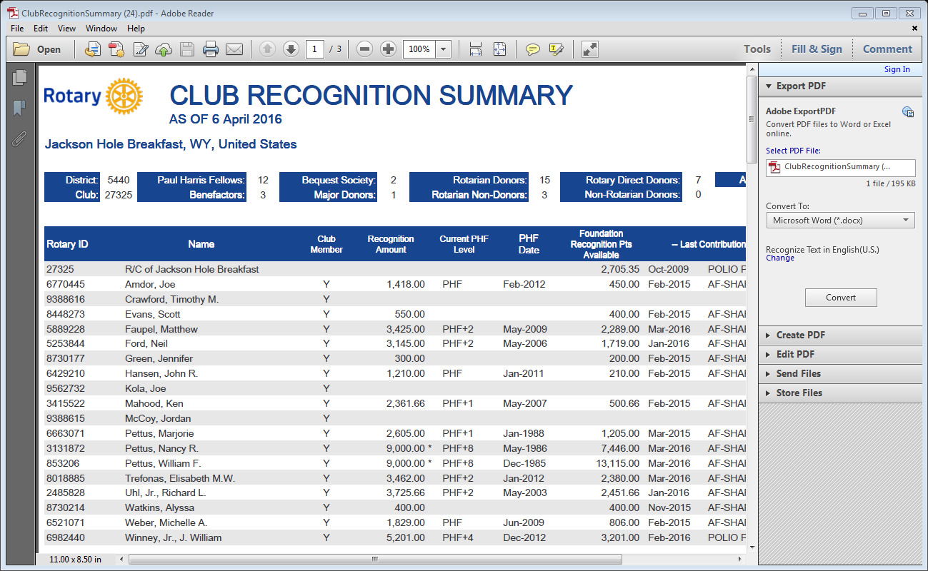
Club Reports
Notes:
This is a sample of a Club Recognition Summary. Look at the categories listed at the top for valuable information. Next, you can see if your club has any Recognition Points which might be used to challenge members to contribute or to match contributions. These may be used in amounts of 100 or more only. Now look for member ID numbers, then how members’ names are listed and then information about donatins and their recognition points.

Slide 11
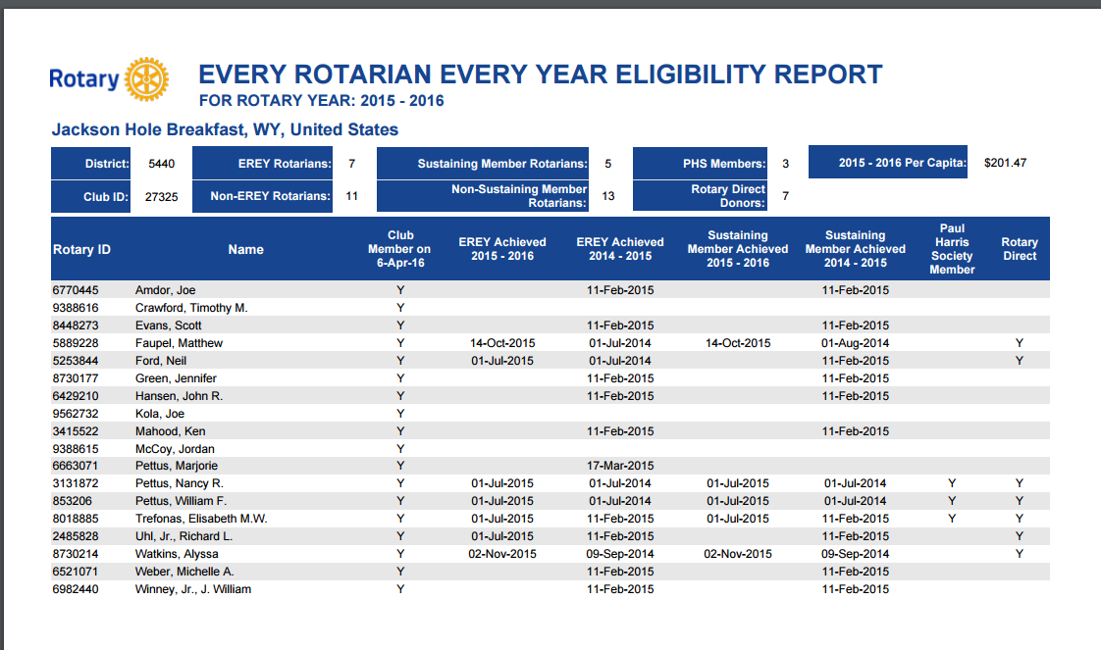
Notes:
This report is a quick way to see which members in your club have contributed this Rotary year.

Slide 12
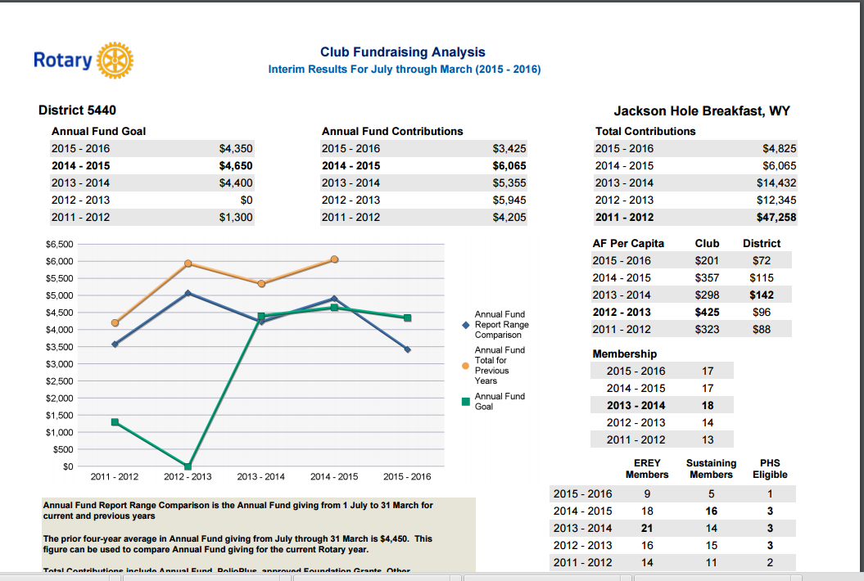
Notes:
A valuable picture history. You can see your club’s Annual Fund goal, what it actually contributed to the Annual Fund as well as total contributions, which would include polio, the endowment fund and donations to a grant. Look closely to see the per capita figure as this is the best way to see if your club’s contributions are rising or falling. All of this information gives a good picture of contributions to The Rotary Foundation over a 5 year period.

Slide 13
Summary - Reports help you:
Provide district, club and member ID numbers
Provide date of last contribution & where it went
Provide progress toward Paul Harris recognition
Provide information on club and member points
Show who has donated to the Annual Fund this Rotary year
Give a 5 year picture of goals and donations
Provide a per capita figure and membership data
Notes:
This slide reminds you of the wealth of information available from the club reports that are available to officers in your club.

Slide 14
Donation Forms
Available forms:
  Contribution form
  Recognition Transfer Request form
  Multiple Donor form
  Rotary Direct form
  Benefactor form
  Legacy Bequest brochure
  Memorial or tribute gift form
Notes:
There are several forms that are used for donations. The most widely used is the Contribution form. The first four listed are primarily for the Annual Fund although the Contribution form also allows the donor to specify any of the funds in The Rotary Foundation. The Benefactor and Legacy Bequest forms are for the Endowment Fund and the last allows a club or individual to make a gift donation.

Slide 15
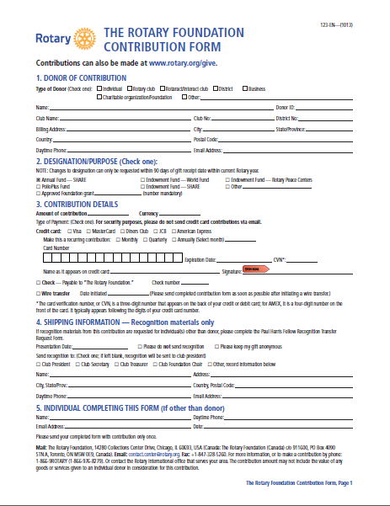
Individual Rotarian information
Choose where the money goes
Allows member to sign up for automatic contributions
Be sure to order recognition items if the member is completing a Paul Harris Fellow or a multiple Paul Harris Fellow level

Slide 16
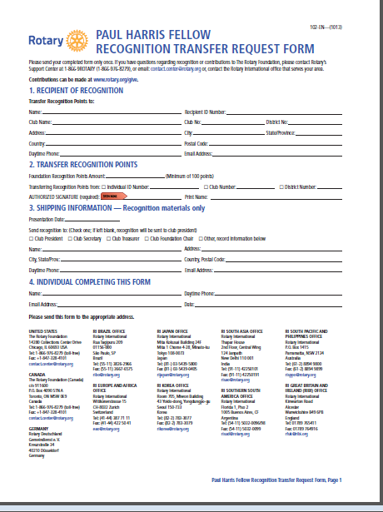
Use this form if transferring recognition points to a member or “purchasing” a Paul Harris Fellow using Recognition points
Must transfer at least 100 points
The member must sign if transferring personal recognition points. The club president signs if using club recognition points
Once again, be sure to order recognition items if needed
Notes:
This is on the back of the Contribution Form but can also be found separately on the RI web site

Slide 17
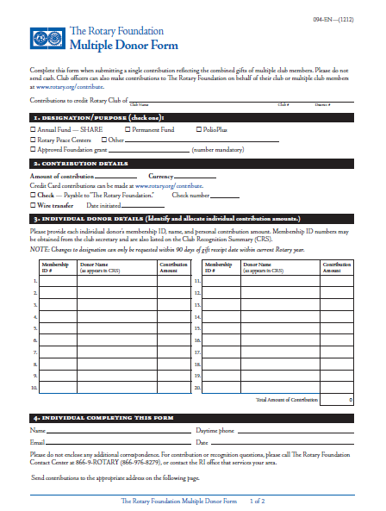
A club will use this form when it has collected funds from members and then sends the funds in to Rotary
Specify the desired fund, remembering that only Annual Fund contributions go toward the club’s AF goal
Only 1 check from the club for the total amount can be sent with this form
This manner of donating DOES NOT provide a clean paper trail of donations in case of an IRS audit
Notes:
As noted, this is the form used when the club has collected funds from members and then needs to send in the money. Clubs that have a fundraiser that is designed specifically to help with donations to The Rotary Foundation on behalf of members also use this form

Slide 18
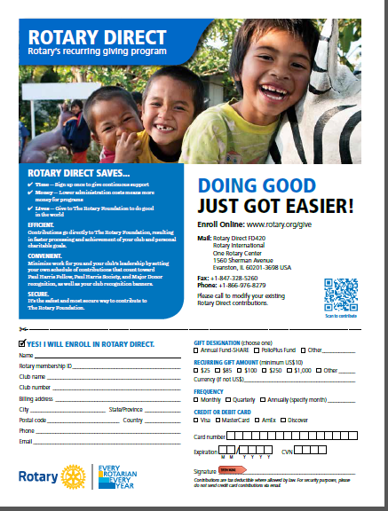
Either Section 3 of the Contribution Form or this form can be used by members to set up automatic contributions.
Automatic contributions are from a credit card and are set up at a specified time and a specified amount
The goal would be at least $50 per year to help the club qualify for grants. This is a district grant guideline.
Notes:
This is just another form to allow members to set up automatic contributions.

Slide 19
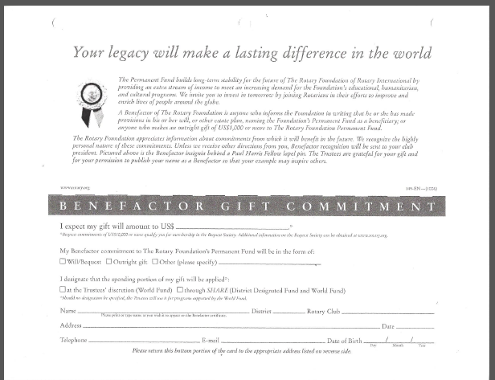
Notes:
A Benefactor can contribute either $1,000 in cash or to add a codicil into one’s will. A Benefactor contributes to the Endowment Fund in an amount of $1,000 - $9,999

Slide 20
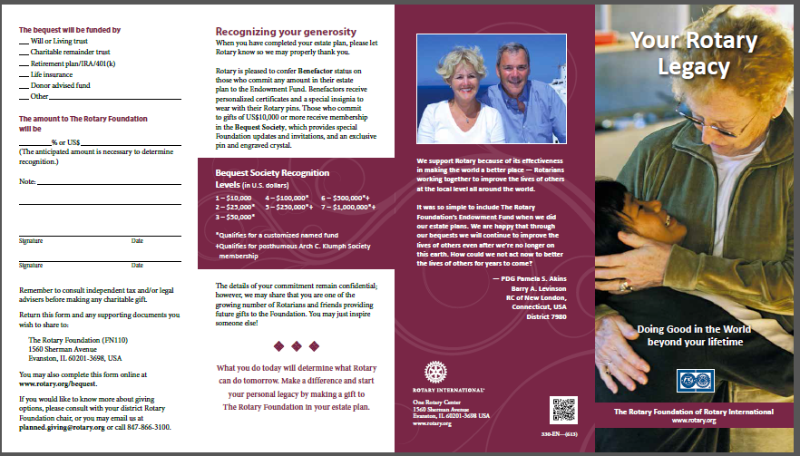
Notes:
A bequest to the Endowment Fund of $10,000 or more make the donor a Bequest Society member. This form is used to specify the amount. Rotary staff will assist donors who wish to set up anything other than a cash bequest in one’s will.

Slide 21
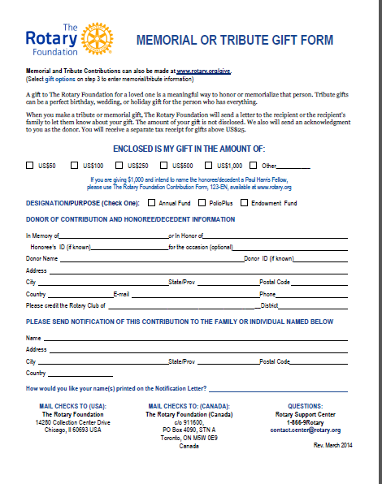
Want to honor someone?
This form allows a Rotarian or club to make a memorial or tribute gift.

Slide 22
Recognizing Individual Donors
Every Rotarian Every Year (any amount to the annual fund)
Sustaining member ($100 per year to annual fund)
Paul Harris Society ($1,000 per year to the annual fund)
Paul Harris Fellow (combined giving between $1,000 and $9,999)
Major donor (combined giving between $10,000 and $249,999)
Benefactor (Testmentary donation between $1,000 and $9,999)
Bequest society (Testemantary donation of $10,000 or more)
Arch Klumpf (Donation fo $250,000 or more)
Recognition Points
1 point for each $ donated to annual fund, Polio Plus or Global Grant
1000 points qualifies for a Paul Harris Fellow award
Can be earned by individuals, clubs, and districts
Can be transferred to Rotarians from other Rotarians, clubs or districts
Can be awarded to Rotarians or non Rotarians as Paul Harris Fellows
Can be awarded to business or organizations as Certificate of Appreciation

Slide 23
Recognizing Clubs
Every Rotarian, Every Year Club - $100/per capita plus 100% participation where every member gives something
100% Rotary Foundation Sustaining Member club
Top Three Per Capita Clubs in Annual Fund giving in each district
100% Paul Harris Fellow club
Presidential Citation
Governor’s Citation

Slide 24
Educating Members
Be sure members understand that The Rotary Foundation is not their club’s local foundation
Local foundation donations do not count toward a Paul Harris Fellow
Achieving Paul Harris Fellow level giving is not a destination but a milepost
Every Rotarian Every Year means that each member donates something to TRF each year
Money available for grants comes from Annual Fund donations
Notes:
Member frustration or lack of understanding equals a lower level of giving. It’s important that everyone understands that The Rotary Foundation is our international foundation and is not the club’s local foundation. Only contributions to The Rotary Foundation’s Annual Fund provide funds for both Rotary and the District to offer Global and District Grant funds to assist clubs with their projects. Ongoing donations are needed to sustain our Foundation. Donations to the Annual Fund are invested for 3 years and then become available to grants, so usually 100% of your donations is available for projects. Administrative costs are usually covered with the interest on the investments. Encourage all members to have an account in My Rotary so they can check their own donations.

Slide 25
Educating continued
Try to simplify the donation process for members
Provide forms, ID numbers and other data as needed for donations
Encourage Rotary Direct but if club collects, give members limited options to avoid confusion
Encourage members to monitor their own giving at My Rotary on the RI web site
If you are uncertain or need to clarify something, look at this presentation again, OR contact the District Rotary Foundation Committee Chair
Notes:
You should be a valuable resource in your club. You are both a cheerleader and a facilitator. Confusion is avoided if members sign up for automatic donations to The Rotary Foundation from a credit card. If the club collects, make sure members understand the difference between a local foundation and The Rotary Foundation. Remind club members that contributions to TRF are important so we have funds for grants and this allows clubs to leverage club funds to assist with projects. November is a great month to have a program about The Rotary Foundation. Spring is the time to identify possible grant projects. May is the month to try to send in the last of the current year’s donations if the club has been collecting so it gets credited appropriately and doesn’t get hung up in the year end crush.

Slide 26
Helping Set Goals
The best resource for setting goals is the Club Fundraising Analysis report
  5 year history of goals and actual contributions
  Per capita and membership data
Try to increase per capita giving each year
  $50 per capita needed for District & Global Grants
Polio and Endowment Fund are also goal areas
Goals are to be entered into Rotary Club Central
Clubs without goals usually have poor contributions
Notes:
Whether this is a club or board activity or the President Elect alone does it, goal numbers should not be pulled out of the air. Use the available reports to identify reasonable goals that show progress each year. A $50 per capita donation to the Annual Fund is needed for District and Global Grants but not the new Centennial Grants. Goals are to be entered into Rotary Club Central under the Foundation tab. Make yourself familiar with this location on the RI web site. Membership and activity goals may also be entered here and all members can access this information. Be sure that club members are advised of the goals and reminded periodically throughout the Rotary year.

Slide 27
Point Contact for Grant Information
Clubs need:
  Someone to make sure the club gets qualified each year so it can apply for grants
  Information on district and RI guidelines so time is not wasted planning or writing on something that won’t be approved
    Terms and Conditions
    Areas of Focus
    Sustainability

Slide 28
Point Contact continued
  The Club Foundation chair is the point contact for all grant information & needs to make sure it gets to the correct people in the club
  Monitoring timelines for applications and reports – there are often more requests than money available
  Knowledge about how to apply for District and/or Global Grants
    Both are online applications
  Each club has an assigned District Grants Committee member who will assist from application through a Final Report
    Know this person and get assistance whenever needed
Notes:
There are lots of resources available on the district web site (www.rotary5440.org) and the RI web site (www.rotary.org) regarding grants. Read through these documents so your club avoids wasting time on applications. District meetings usually have one or more sessions on grants. These are valuable for information and networking. Partners may also be found for projects.
You don’t need to be an expert, but you should know enough to help your club identify projects that would be appropriate for a grant. Talk with your District Grants Committee representative and ask for information and assistance as you need it.

Slide 29
Resources Available
District foundation committee
District Rotary foundation chair
Club foundation chair website (to be ready by July 1, 2016)
District 5440 web site (www.rotary5440.org)
Rotary international web site (www.rotary.org)

