Slide 1
FIVE REASONS WHY
THE ROTARY
FOUNDATION
IS UNIQUE
Notes:
Welcome Message

Slide 2
THE ROTARY FOUNDATION IS UNIQUE: REASON 1
Rotary clubs
select and implement
foundation programs worldwide
In 2015/16
Rotary clubs implemented
$70 Million in global grant projects
$26 Million in district grant projects
Notes:
They align Rotary with other international development efforts and advance the Foundation’s mission. Each of the areas listed has specific goals that are outlined in the corresponding area of focus policy statement.
Peace and conflict prevention/resolution
Disease prevention and treatment
Water and sanitation
Maternal and child health
Basic education and literacy
Economic and community development

Slide 3
THE ROTARY FOUNDATION IS UNIQUE: REASON 2
The Rotary Foundation has been rated 4 stars by Charity Navigator
for 10 years in a row
In comparison
The American Red Cross is rated 3 stars
The American Cancer Society is rated 2 stars
Notes:
They align Rotary with other international development efforts and advance the Foundation’s mission. Each of the areas listed has specific goals that are outlined in the corresponding area of focus policy statement.
Peace and conflict prevention/resolution
Disease prevention and treatment
Water and sanitation
Maternal and child health
Basic education and literacy
Economic and community development

Slide 4
THE ROTARY FOUNDATION IS UNIQUE: REASON 3
The Rotary Foundation is making lasting improvements in communities right here in district 5440
In 20161/7
$39,000 in local centennial grants
$38,795 in local district grants
$23,000 in scholarships to local students
Notes:
They align Rotary with other international development efforts and advance the Foundation’s mission. Each of the areas listed has specific goals that are outlined in the corresponding area of focus policy statement.
Peace and conflict prevention/resolution
Disease prevention and treatment
Water and sanitation
Maternal and child health
Basic education and literacy
Economic and community development

Slide 5
THE ROTARY FOUNDATION IS UNIQUE: REASON 4
The Rotary Foundation has established a network of peace centers at universities around the world
Thailand, USA, Japan, England, Australia, Sweden
On average
100 new peace fellows graduate each year
Notes:
They align Rotary with other international development efforts and advance the Foundation’s mission. Each of the areas listed has specific goals that are outlined in the corresponding area of focus policy statement.
Peace and conflict prevention/resolution
Disease prevention and treatment
Water and sanitation
Maternal and child health
Basic education and literacy
Economic and community development

Slide 6
THE ROTARY FOUNDATION IS UNIQUE: REASON 5
The Rotary Foundation can mobilize key partners to solve major world issues
In 2016/17
Rotary raised $1.2 Billion to end polio from partners such as
The Gates Foundation
The European Commission
Bloomberg Philanthropies
The United Nations Foundation
Notes:
They align Rotary with other international development efforts and advance the Foundation’s mission. Each of the areas listed has specific goals that are outlined in the corresponding area of focus policy statement.
Peace and conflict prevention/resolution
Disease prevention and treatment
Water and sanitation
Maternal and child health
Basic education and literacy
Economic and community development

Slide 7
11 District 5440 Rotary clubs are currently participating in International Service Projects
Disease Prevention and Treatment
Peace and Conflict Resolution
Maternal and Child Health
FC Breakfast - India
Loveland MV & TV, Windsor - Uganda
Fort Collins - South Africa
Teton Valley - Mali
Fort Collins - Burundi
Water and Sanitation
Six Areas of Focus
Education and Literacy
FC Breakfast - Ethiopia
Cheyenne - Tanzania
Scottsbluff/Gering - Kenya
Fort Collins - Guatemala
Laramie - Guatemala
Economic and Community Development
Estes Park - Guatemala
Greeley After Hours - Malawi

Slide 8
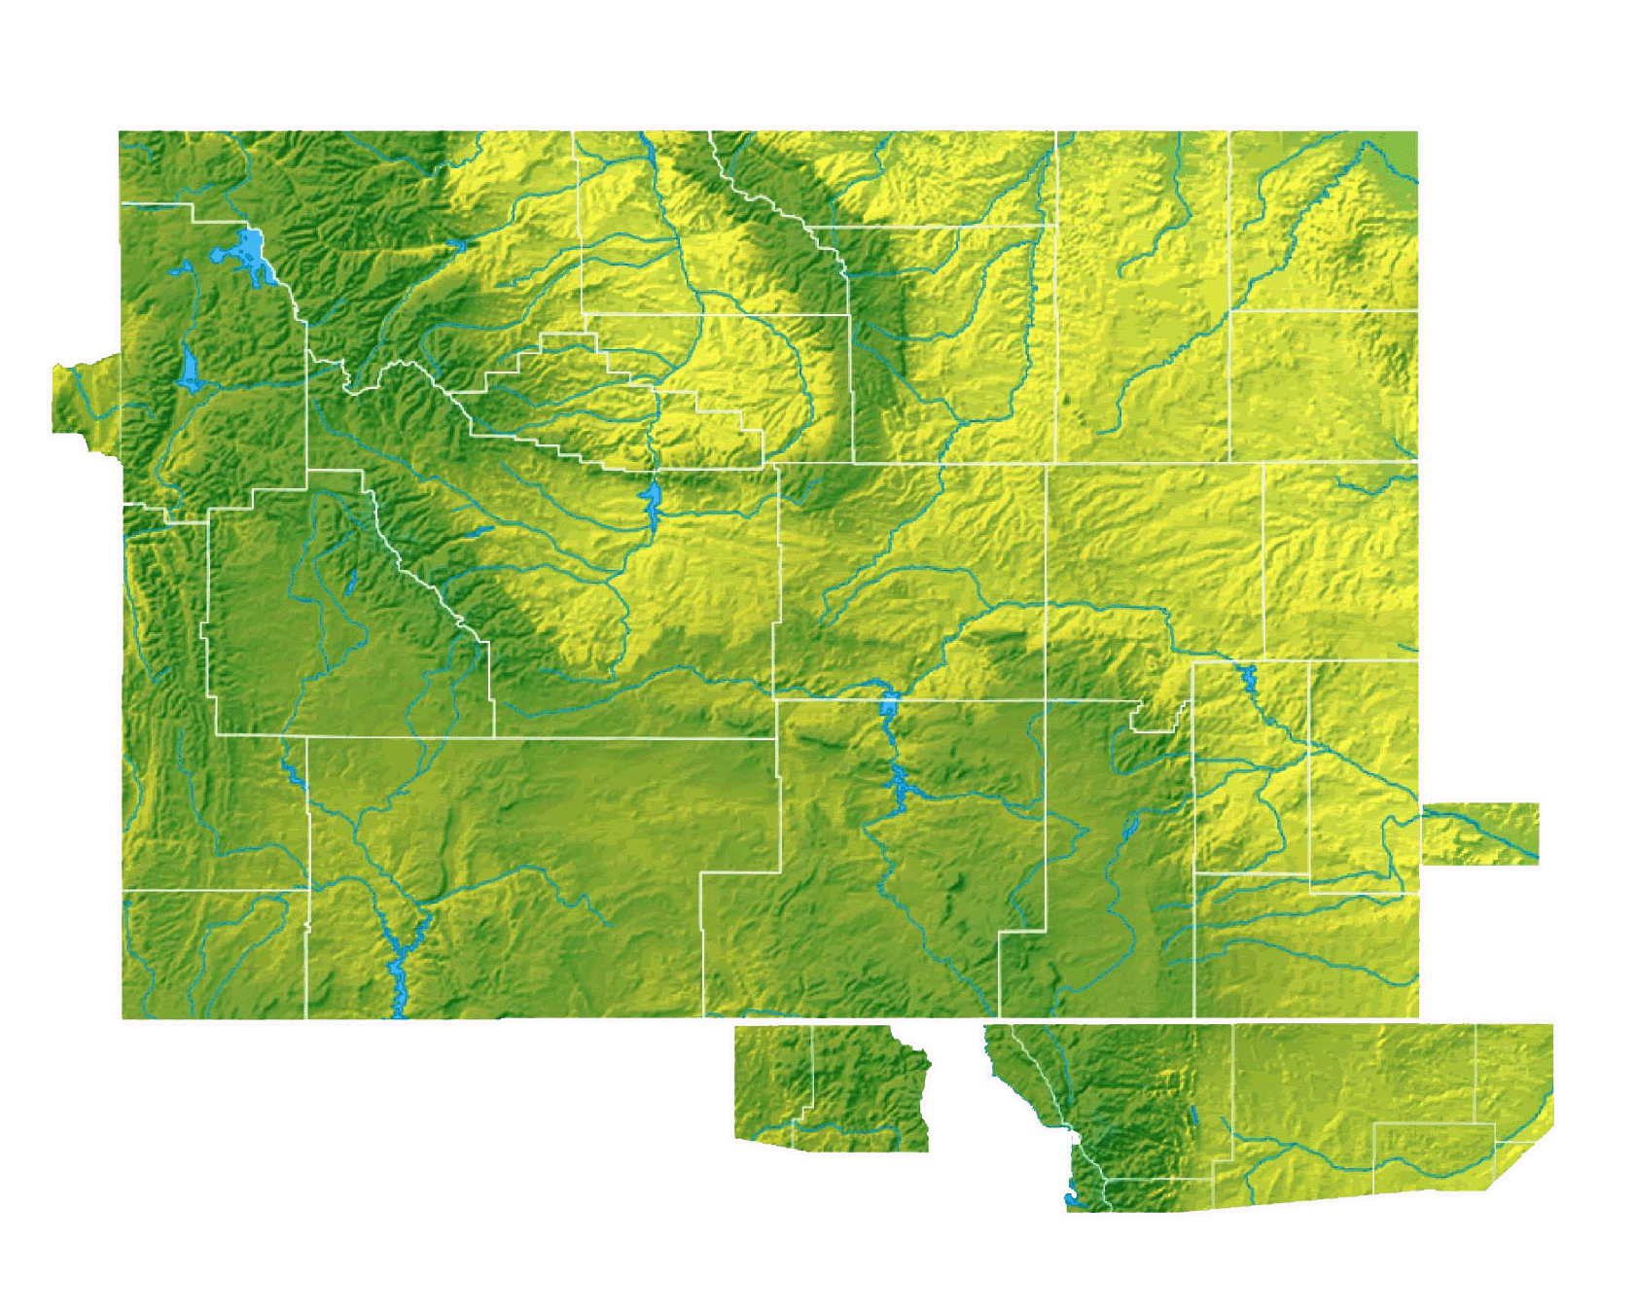
35 DISTRICT 5440 CLUBS PARTICIPATED IN CENTENNIAL PROJECTS IN 2016/17
Sheridan
Jackson Hole Breakfast
Jackson Hole
Gillette Energy
Gillette
Star Valley
Casper Reveille
Casper 5 Trails
Casper
Douglas
Casper Rotaract
Torrington
Kemmerer
Morrill
Scotts Bluff
Cheyenne
Cheyenne Sunrise
Cheyenne After Hours
Steamboat
Springs
Cheyenne Rotaract
Craig
Longs Peak
Ft Collins
Ski
Town
Estes Sunrise
FC After Work Work
Greeley
Estes Park
FC Foothills
Greeley Centennial
FC Breakfast
Greeley Redeyel
Loveland
Greeley After Hours
Johnstown-Milliken

Slide 9
DISTRICT 5440 CENTENNIAL PROJECTS IN 2016/17
Greeley, Greeley Centennial, Greeley Redeye, Greeley After Hours - Furnishings for the Poudre Learning Center
Casper, Casper Five Trails, Casper Reveille, Casper Rotaract - Public Plaza Enhancements
Douglas - Coloring for truth
Morrill - Screen, projector and sound system for the community to use
Jackson Hole - Pathway underpass public art
Estes Sunrise, Longs Peak - Adult ‘Catch up’ learning project
Craig - registration materials for Rural Philanthropy Days
Steamboat Springs, Ski Town - Narcan packs for RX task force
Johnstown/Milliken - Bench and trash receptacle
Kemmerer - Christmas food boxes
Estes Park - Services for new Americans
Torrington - Alzheimers support packets
Sheridan - Books for Raising Readers program
Loveland - Shelter air mattresses
Jackson Hole Breakfast - Good Samaritan deck building project
Fort Collins Breakfast, FC Foothills, FC After Work - Buddy benches for school playgrounds
Cheyenne, Cheyenne Sunrise, Cheyenne After Hours, Cheyenne Rotaract - Chemo Care packages
Notes:
They align Rotary with other international development efforts and advance the Foundation’s mission. Each of the areas listed has specific goals that are outlined in the corresponding area of focus policy statement.
Peace and conflict prevention/resolution
Disease prevention and treatment
Water and sanitation
Maternal and child health
Basic education and literacy
Economic and community development

Slide 10
DISTRICT 5440 GRANT PROGRAM
District 5440 will match club funds 2 to 1 for humanitarian projects with Rotarian involvement
Up to $1,000 from the district for Centennial grants
Up to $4,000 from the district for district grants
Up to $12,500 from the district for global grants
Notes:
They align Rotary with other international development efforts and advance the Foundation’s mission. Each of the areas listed has specific goals that are outlined in the corresponding area of focus policy statement.
Peace and conflict prevention/resolution
Disease prevention and treatment
Water and sanitation
Maternal and child health
Basic education and literacy
Economic and community development

Slide 11
IN 2016/17 44 DISTRICT 5440 ROTARY CLUBS PARTICIPATED IN THE ERADICATION OF POLIO
Clubs contributed $139,438 to the Polio Plus Fund
which was doubled by the Bill and Melinda Gates Foundation
for a total contribution of $278,876 to end polio
Many Rotarians in district 5440 participated in Polio awareness and fundraising events

Slide 12
7 ROTARY PEACE FELLOWS WERE SPONSORED BY DISTRICT 5440 CLUBS IN THE LAST 10 YEARS
Leah Aylward 2005-2007 University of Queensland
Lucas Wolf 2006-2008 Universidad del Salvador
Lucianna Storelli-Castro 2012-2014
University of Bradford
Jeff Runyan 2014 Chulalongkorn University
Anna Dechert 2013-2015 University of Queensland
Meena Pillai 2014-2016 University of Queensland
Cornelia Weiss 2015 Chulalongkorn University
Notes:
They align Rotary with other international development efforts and advance the Foundation’s mission. Each of the areas listed has specific goals that are outlined in the corresponding area of focus policy statement.
Peace and conflict prevention/resolution
Disease prevention and treatment
Water and sanitation
Maternal and child health
Basic education and literacy
Economic and community development

Slide 13
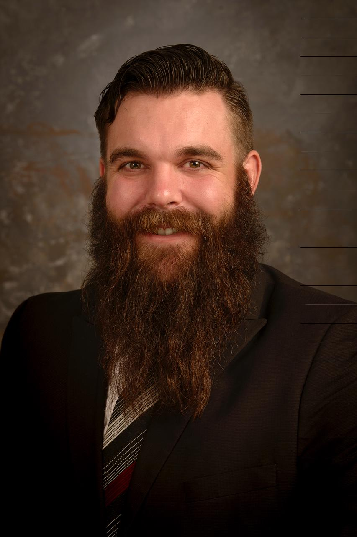
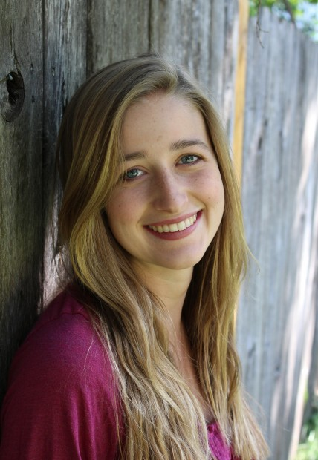
$30,000 GLOBAL GRANT SCHOLARS SPONSORED BY DISTRICT 5440 ROTARY CLUBS in 2016 and 2017
Kenneth Brenneman
Pforzheim Hochschule, Germany
Economic and Community Development
Sponsored by: Laramie Rotary Club
Lindsey Pointer
Victoria University of Wellington, New Zealand
Restorative Justice
Sponsored by: Rotary club of Fort Collins
Notes:
They align Rotary with other international development efforts and advance the Foundation’s mission. Each of the areas listed has specific goals that are outlined in the corresponding area of focus policy statement.
Peace and conflict prevention/resolution
Disease prevention and treatment
Water and sanitation
Maternal and child health
Basic education and literacy
Economic and community development

Slide 14
MAKE A COMMITMENT TO SUPPORT THE ROTARY FOUNDATION
Join the
Paul Harris Society
Today
Commit to donate $83/month to the Rotary Foundation and specify where your funds are directed
Annual fund (used for grants and scholarships)
Polio Plus fund
Directly to approved foundation grants
Notes:
They align Rotary with other international development efforts and advance the Foundation’s mission. Each of the areas listed has specific goals that are outlined in the corresponding area of focus policy statement.
Peace and conflict prevention/resolution
Disease prevention and treatment
Water and sanitation
Maternal and child health
Basic education and literacy
Economic and community development

Slide 15
DISTRICT 5440 PAUL HARRIS SOCIETY CHALLENGE
If you are one of the first 50 people who sign up before the end of the year, you will receive:
A $100 gift check from an anonymous 5440 donor
An additional 1,000 Rotary Foundation recognition points to be used towards a Paul Harris Fellow
A beautiful chevron to wear proudly with your Rotary pin
A personal certificate signed by DG Bill Emslie
Your name displayed on a special banner at district events
Invitations to special district and zone receptions
Brochure with application is available at http://www.rotary5440.org/sitepage/foundation-resources
Notes:
They align Rotary with other international development efforts and advance the Foundation’s mission. Each of the areas listed has specific goals that are outlined in the corresponding area of focus policy statement.
Peace and conflict prevention/resolution
Disease prevention and treatment
Water and sanitation
Maternal and child health
Basic education and literacy
Economic and community development

Slide 16
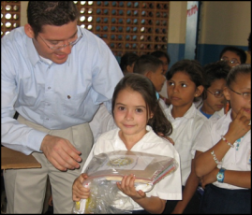
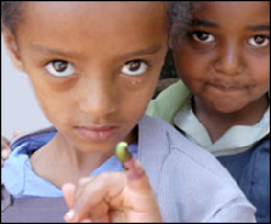
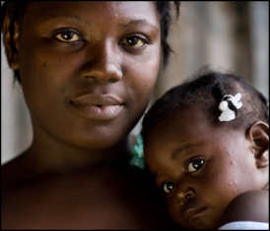
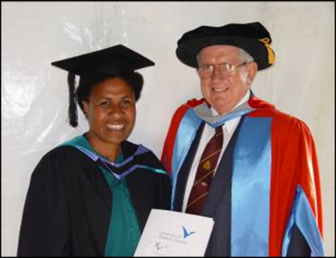
OTHER WAYS TO DONATE TO THE ROTARY FOUNDATION
Sustaining
member
$100/year
Annual Fund
Club Fundraiser
Polio Plus
Wills and Testaments
Endowment
Fund
Individual
Contributions
Peace Fellow Endowment Fund

Slide 17
Questions
Questions?

Slide 18
RESOURCES
District 5440 Paul Harris Society Chair: Liz Becher
lbecher@casperwy.gov
District Web Site
http://www.rotary5440.org/SitePage/foundation-resources
Foundation Mentors
http://www.rotary5440.org/
Under Grants/Foundation Info/Foundation Mentor Contact Info
Rotary International Web Site
https://www.rotary.org/en

