Slide 1
The Rotary Foundation
My Charity of Choice

Slide 2
Why is The Rotary Foundation my charity of choice?
TRF is highly rated and respected
TRF works with great partners
Rotarians get involved
TRF invests in the future

Slide 3
The Rotary Foundation is #1
97.3
Total
Score
Ethical practices
Financial health
Accountability
Transparency
91% of contributions
spent on programs
Four stars
every year
last 10 years

Slide 4
Why Rotary is able to work with great partners?
Top rated on Charity navigator
Not a religious or political organization
Extensive worldwide network
Experience working on global problems such as polio eradication and peace
Rotarians are key members of world organizations

Slide 5
How does the money come back for club projects?
District Grants
District Grant Projects
50%
club funds
District Designated
Funds
50%
Funds
donated
3 years ago to the annual fund
50%
Global Grants
50%
World
Fund
Global Grant Projects
club funds
Rotary Peace Centers
Special Projects

Slide 6
What about my club foundation?
Rotary Foundation
Club Foundation
Leverage club foundation funds with Rotary grants
2 to 1 match for district grants
3 ½ to 1 match for global grants
Local global grants for large local projects

Slide 7
$116,475 in District and Centennial Grant Projects in 2017/18

Slide 8
$576,632 in Global Grant Projects in 2017/18

Slide 9
$35,000 Local Global Grant Project in 2017/18
Project to improve
literacy at an affordable
housing complex in
Loveland, Colorado

Slide 10
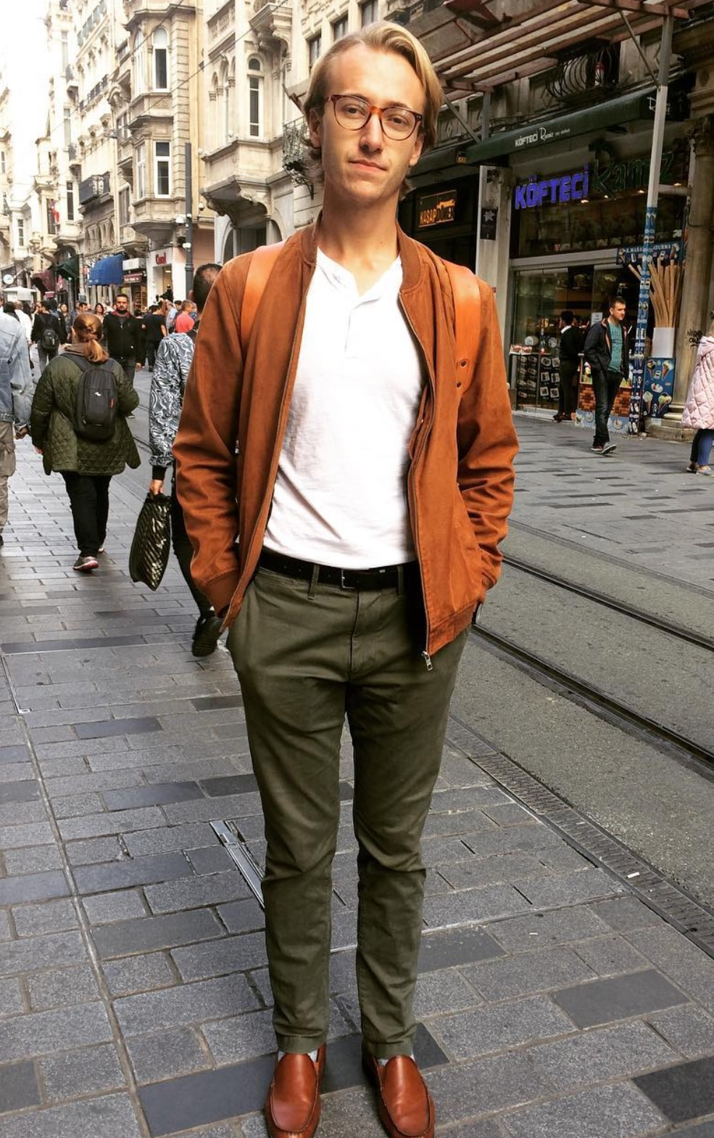
$30,000 Global Grant Scholarship in 2017/18
Awarded to
Matthew Lee Schneider
from the University of Wyoming
to study in a Master’s degree program
at Koc University in Instanbul, Turkey
to find ways to improve housing for refugees

Slide 11
How can I help?
Make the Rotary Foundation one of your charities of choice and pledge to support it annually

