Slide 1

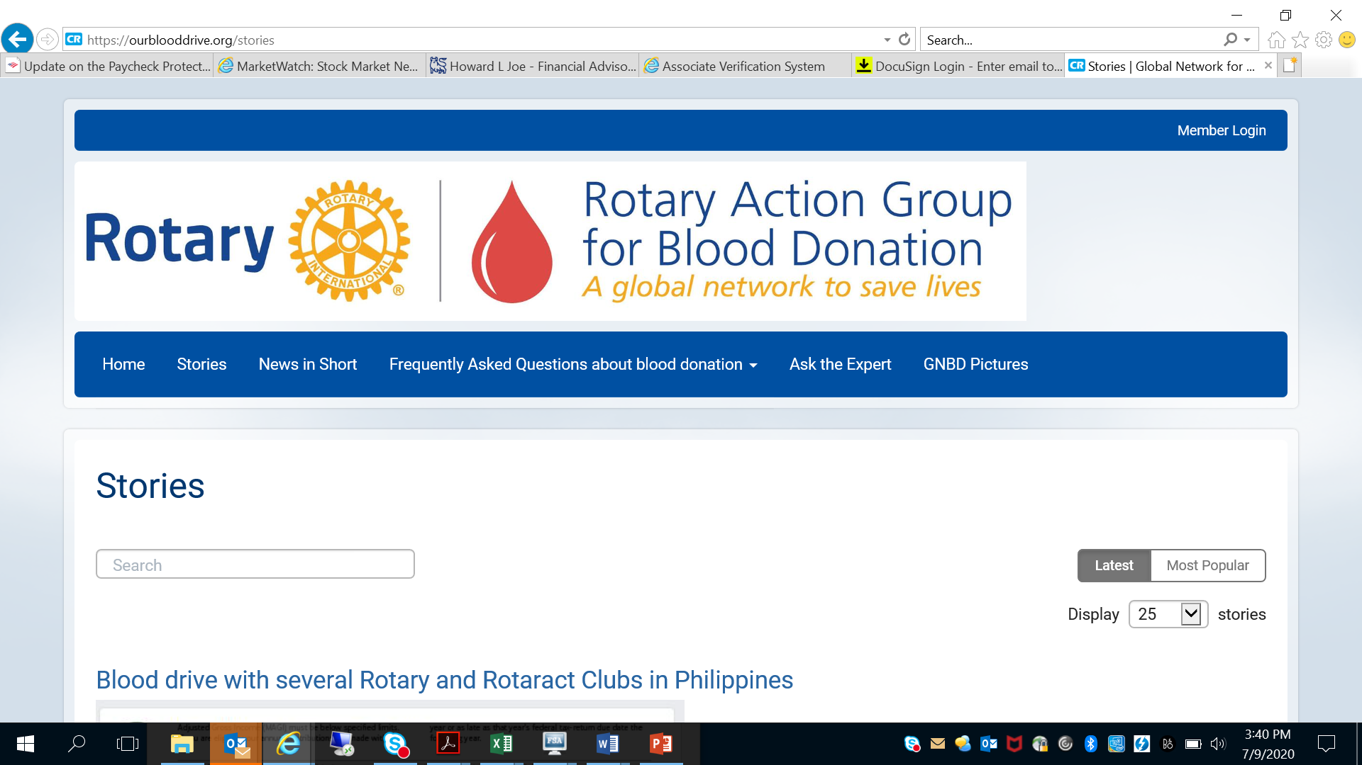





Rotary District 5790
URGENT CALL TO ACTION
COVID Plasma Donation Initiative
Blood Donation & Blood Challenge 2020-2021

Slide 2
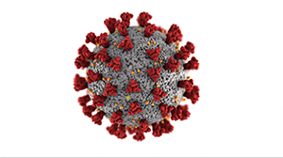
Understanding the Need for Action Locally
While we cannot live in fear- let’s address the real problems affecting communities in District 5790
COVID-19 cases in District 5790 have hit home – We have lost some of our brightest Rotarians!
  Regionally in our District, Johns Hopkins reports 120-160 new confirmed cases per 100,000 people per day in Tarrant, Denton, Wise, Parker, Bosque, Hood and Johnson Counties
  Daily death toll has stabilized at 1-3 deaths/day per 100,000 population
  Primary need is for those who get sick due to weakened pre-existing conditions, but some young healthy affected as well.
Plasma demand from hospitals has surged from requests for 40 units/day to 600/units per day – this is more than 1300% demand spike!
Just over 800,000 vaccine doses administered Texas-wide as of mid-January
Plasma & Blood can save lives but hospitals are not receiving requested inventories of BOTH Plasma & Blood Units

Slide 3
COVID 19 Update – OBI, American Red Cross & Carter BloodCare Efforts In Progress
Convalescent Plasma is being collected at all Carter locations (see next slide) – antibodies of COVID-19 survivors - URGENT
November 2020 – Carter Bloodcare was distributing 40 units/day of Plasma and now in January 2021 well over 3oo units/day to the sickest COVID patients
Local Blood Centers collecting approximately half of what the demand is in District 5790
Plasma is more urgent need BUT blood supplies also extremely depleted and in critical ‘emergency status’
  Ie. Typical 1000 ‘O’ blood units on shelf, NOW down to less than 100 inventory

Slide 4
Gift of Life: For many critical COVID patients, regional hospitals are using plasma to save lives after using all other means available
Plasma collected from recently recovered COVID-19 patients can provide hope to those who are currently hospitalized with COVID-19. The plasma from recovered patients is called convalescent plasma and it is being transfused to treat COVID-19.
This convalescent plasma contains antibodies that are believed to help fight the virus. This treatment has shown promise when used similarly against other infections in the past.
Antibody concentration has been shown to diminish over time. It is vital that eligible donors with these crucially needed antibodies attempt to donate their plasma every 14 days. Carter BloodCare is collecting this plasma for hospitals and their patients in our community.

Slide 5
Club Project/Action Needed
How to Bring People to Action
Club Leaders must pave the way by providing easy to follow instructions – this call to action is for Rotarians and non-members alike!!! Lives depend on action now!
ALL Carter BloodCare locations accepting donors – set appointment and educate your donors by sending them to: https://www.carterbloodcare.org/
American Red Cross Drives in region schedule at: https://www.redcross.org/local/texas/north-texas.html
May or may not be accepting plasma donations at various drive locations
**Note: American Red Cross does not send donors to physical office locations, must find a drive in your area before sending donors
Texas Blood Institute (Wichita Falls):
http://txbi.org/donor-centers/wichita-falls-donor-center/

Slide 6
Carter BloodCare Eligibility Guidelines
To be eligible to donate convalescent plasma, an individual must:
Have complete resolution of COVID-19 symptoms for 14 days
Meet the regular blood donation guidelines
Please consider this additional way to positively affect change for patients and help our community stay prepared for potential surges in the virus.
You can now schedule an appointment for any of our donor center locations, four different ways:
Call .
Text .
Email ConvalescentPlasma@CarterBloodCare.org.
Self-schedule online.
If you have any questions about your eligibility or scheduling please call Carter at 817-412-5830 or email ConvalescentPlasma@CarterBloodCare.org.

Slide 7

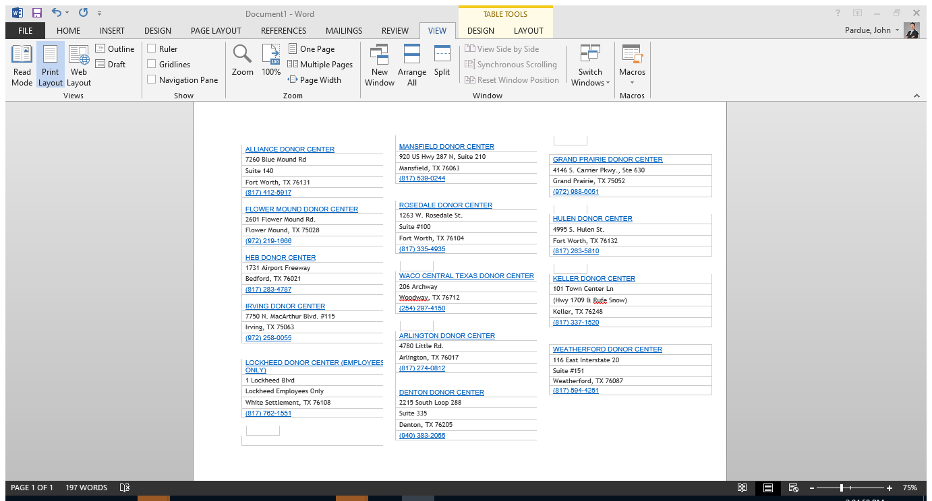
District 5790 - Blood Center Locations
Carter BloodCare in our District (Additional locations in other cities)
American Red Cross: https://www.redcross.org/give-blood.html
Texas Blood Institute: Wichita Falls Donor Center; located at 3709 Gregory St., Suite 109, 76308

Slide 8
Friendly Competition – Carter BloodCare Rotary Club Sponsor Codes
Donors may provide their respective codes below to receive credit toward Club awards and Governors’ Challenge
See Club Sponsor Codes as separate file on District 5790 Page:
https://rotary5790.org/sitepage/health-blood

Slide 9
Rotary Action Group:
Global Network for Blood Donation
https://ourblooddrive.org/
Stories, Newsletter, Contacts for other Blood Drive Initiatives
Rotary is one of the greatest sources of voluntary blood donation in the world through the efforts of Rotary Clubs and the blood centers in their community. We have been doing this since blood was discovered in Rotarian veins.
Thousands of local blood drives, throngs of Rotarian donors, dozens of major projects, Rotary blood centers, donor coaches, aepheresis technology…millions of lives saved and supported - a major Rotary story, largely untold.
As our actions are diffuse, working with blood centers and hospitals in thousands of communities, and do not involve money, they are largely uncounted and unrecognized, even within Rotary.
Let us now join, expand our life-saving gifts, our visibility, and tell Rotary’s story…

Slide 10
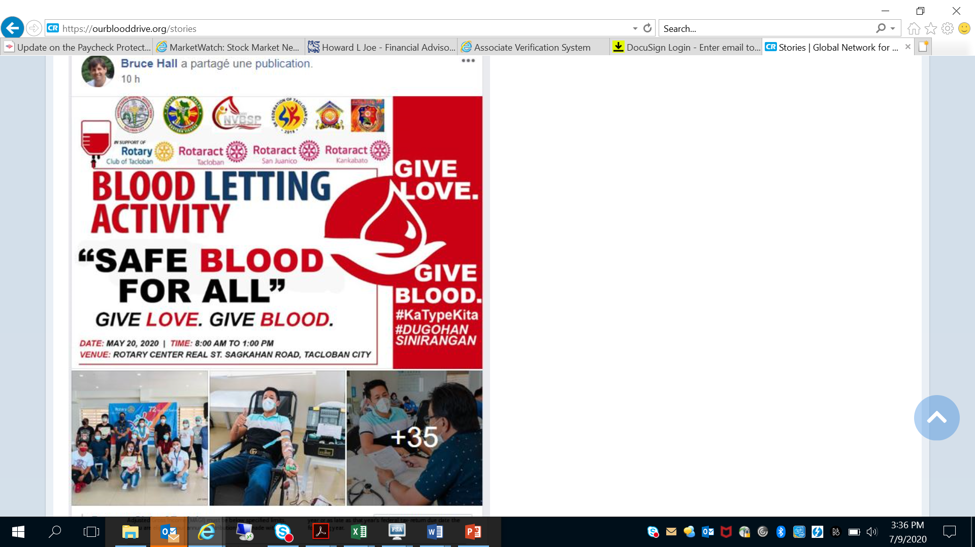
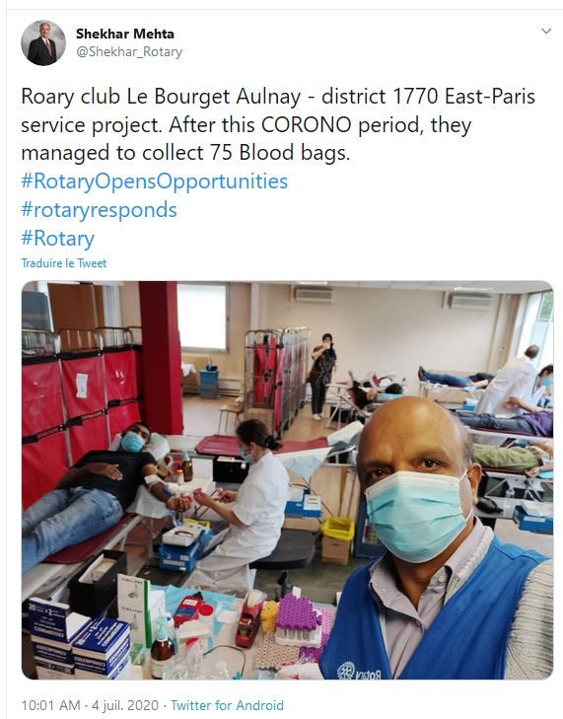
GNBD Updates from Around the World

Slide 11
Call To Action
Assign a Blood Drive Chair for your Club. The difference we can make is measured in lives.
Compete with all District 5790 Clubs AND help us continue a friendly Challenge with other large Districts in Texas!
All it takes is a little education and making ‘the ask’. Your club leadership is equipped for success and making a focused impact via District resources, skilled personnel and new reporting tools.
Can’t donate? ‘Earn your fangs’ - advocate and promote your Club’s drive to improve attendance (non-Rotarians welcome of course)
This is a work in progress and your feedback is critical to improvement & delivery of needed support.
Help encourage ‘bite sized’ facts and education about blood donation efforts in your community and worldwide. Social Media to play a bigger role
Take a moment to educate your Board & Club members about the pride of District 5790 – the Global Network for Blood Donation (GNBD) – we are part of something BIG.
Key Dates:
14 June 2016 - World Blood Donor Day
1 July 2015 - 31 July 2015 - Rotary Blood Donation Month
1 December 2015 - 31 December 2015 - Rotary Family Month - Blood Donation Initiative
1 July 2015 – 30 June 2015 - Governors’ Challenge Period
Key Dates & Deadlines
July 1, 2020- July 31, 2021 | Rotary Blood Donation Month
January 2021 | Rotary COVID Focus Month – Plasma AND Blood Donation Initiative
July 1, 2020 – June 30, 2021 | Governors’ Challenge Period
June 14, 2021 | World Blood Donor Day
Finally . . . . A Modest Goal: ONE UNIT OF BLOOD PER ROTARIAN PER YEAR

