Slide 1
2024-2025 DISTRICT GRANT TRAINING

Slide 2
Training Overview
Where do Matching Grant funds originate?
What projects can Matching Grant Funds be used for?
What are the Club eligibility criteria?
What resources are available for information?
How do I apply?

Slide 3
Gift of $100 to Annual Fund Share
$50.00 to DDF $50.00 to World Fund
$25.00 $25.00 $25.00 $25.00
District Grants Global Grants Rotary Grants
$1 matched .80 Peace Centers
Polio
World Projects

Slide 4
Grant Application Deadline is September 1, 2024
Applications will be considered based on the following criteria:
First
Any club asking for an amount equal to or less than the 25% of their APF SHARE (Annual Program Fund SHARE) giving for the 2021-22 Rotary year will be guaranteed funding. This amount can be found on the SHARE Contribution Detail report for 2025.
Second
If there are any funds remaining, any club applying for more than 25% of their APF SHARE will be considered based on the following table:

Slide 5
Matching District Grants up to the amount of $500 for club giving a three-year average per capita between $0-$50
Matching District Grants up to the amount of $750 for clubs giving a three-year average per capita between $51-$99
Matching District Grants up to the amount of $1500 for clubs giving a three-year average per capita between $100-$199
Matching District Grants to be determined by the Grants committee for clubs giving a three-year average per capita above $199, not to exceed $2500
Remember, these amounts are based on Funds Available and there are
NO GUARANTEES of any specific amounts.

Slide 6
Grants requested after September 1, 2024
If funds are available, additional grants will be considered using the criteria set forth in September. The additional grants will be considered on Nov. 1 and if funds are still available on January 1.
A Foundation Chair can help increase grant size by encouraging members to make annual contributions to the Annual Share Fund.
APPLY EARLY

Slide 7
Characteristics of District Grants
Administered by the District, not Rotary International
Short term service projects (must be completed within the Rotary year it was granted)
Address immediate needs at home or abroad
Types of activities:
Service Projects
Scholarships
Vocational Training
Youth Service

Slide 8
Pre-Approved Grants
For any club submitting a complete District Grant application by Sept 1. and not requesting more than their allotted DDF, the grant application
will be considered pre-approved for the following categories:
Dictionary Projects
Food Pantry Projects
Shelter Box

Slide 9
Club Eligibility Criteria
All Dues Paid (RI and District) and 990 IRS Filing Current
Club cannot have any district grants open from prior years.
Two people from the club must participate in District Grant Certification Training (must include President Elect and ALL grant writers).
Memo of Understanding and Addendums – Signed by President and PE
Clubs must enter 25 of 25 goals in Rotary Club Central including The Rotary Foundation goal.
Regular support of the TRF Annual Fund SHARE
Strongly recommend that the club have a Foundation Chairman

Slide 10
Resources
https://rotary5790.org/
http://www.matchinggrants.org/district/
Dusty Babitzke (District Grants Chair)
Email: dustybabitzke@yahoo.com
Phone: 817-297-2009

Slide 11
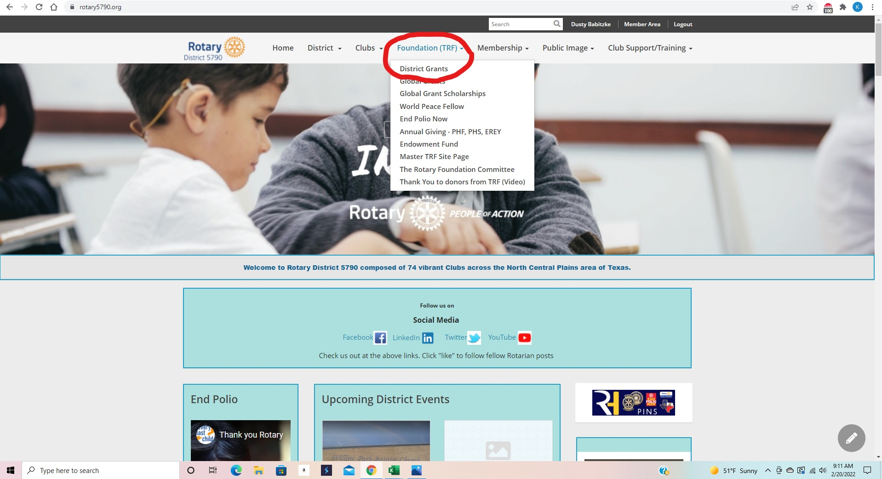

Slide 12
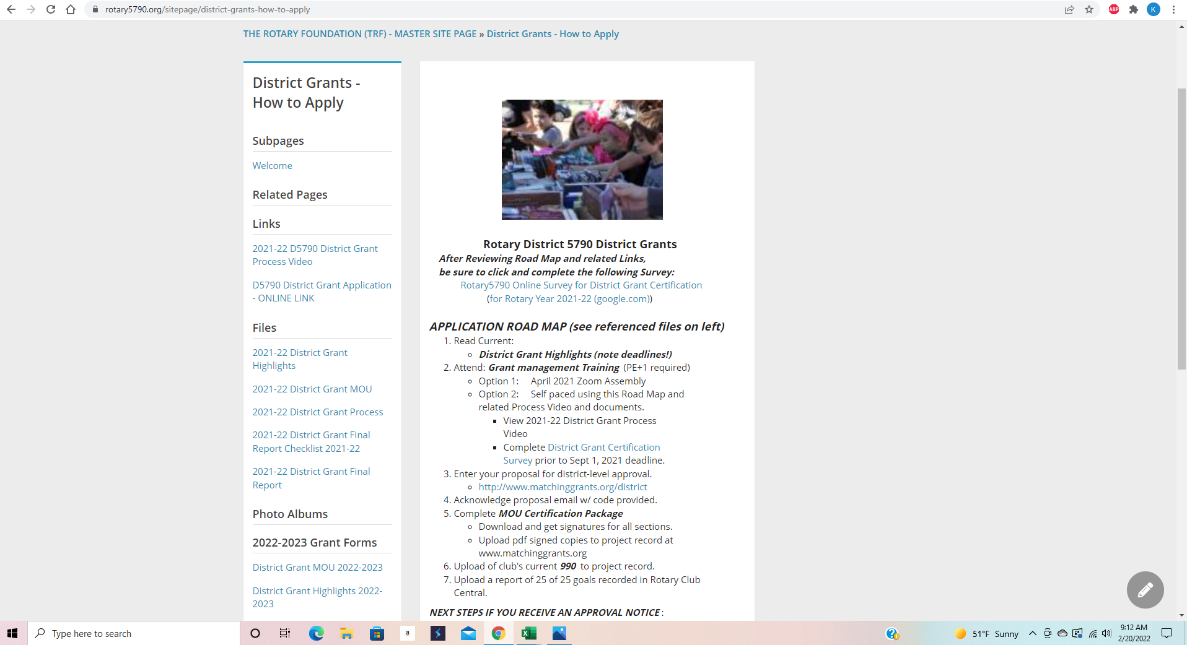

Slide 13
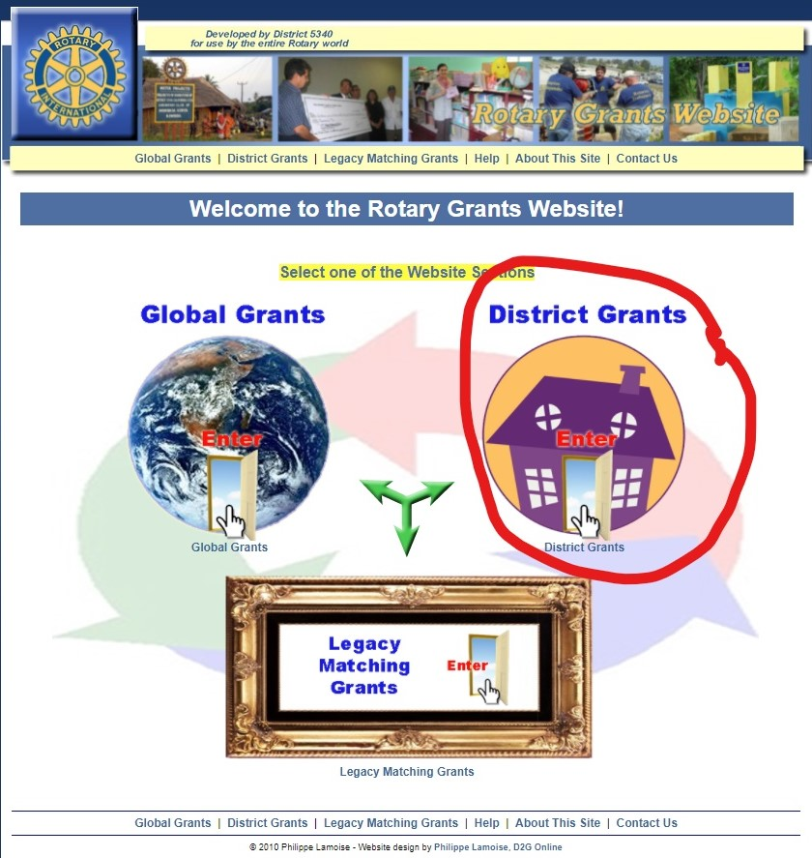

Slide 14
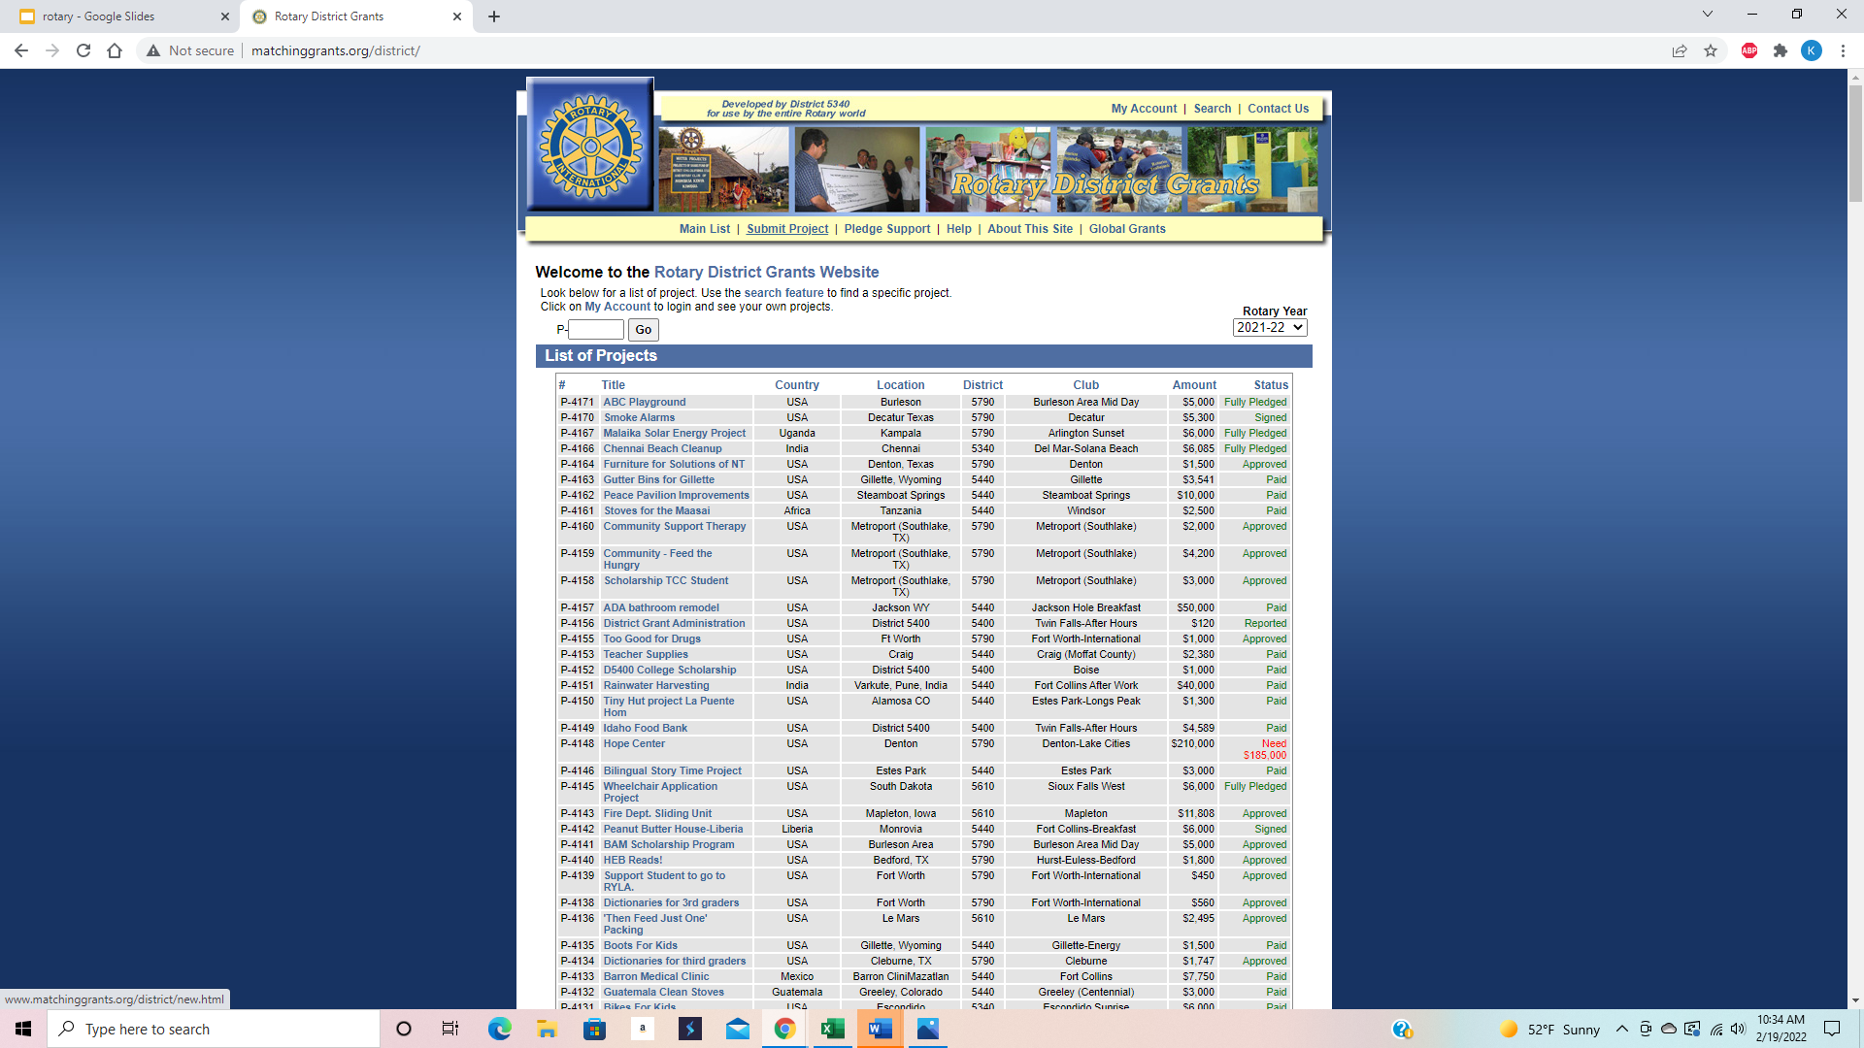
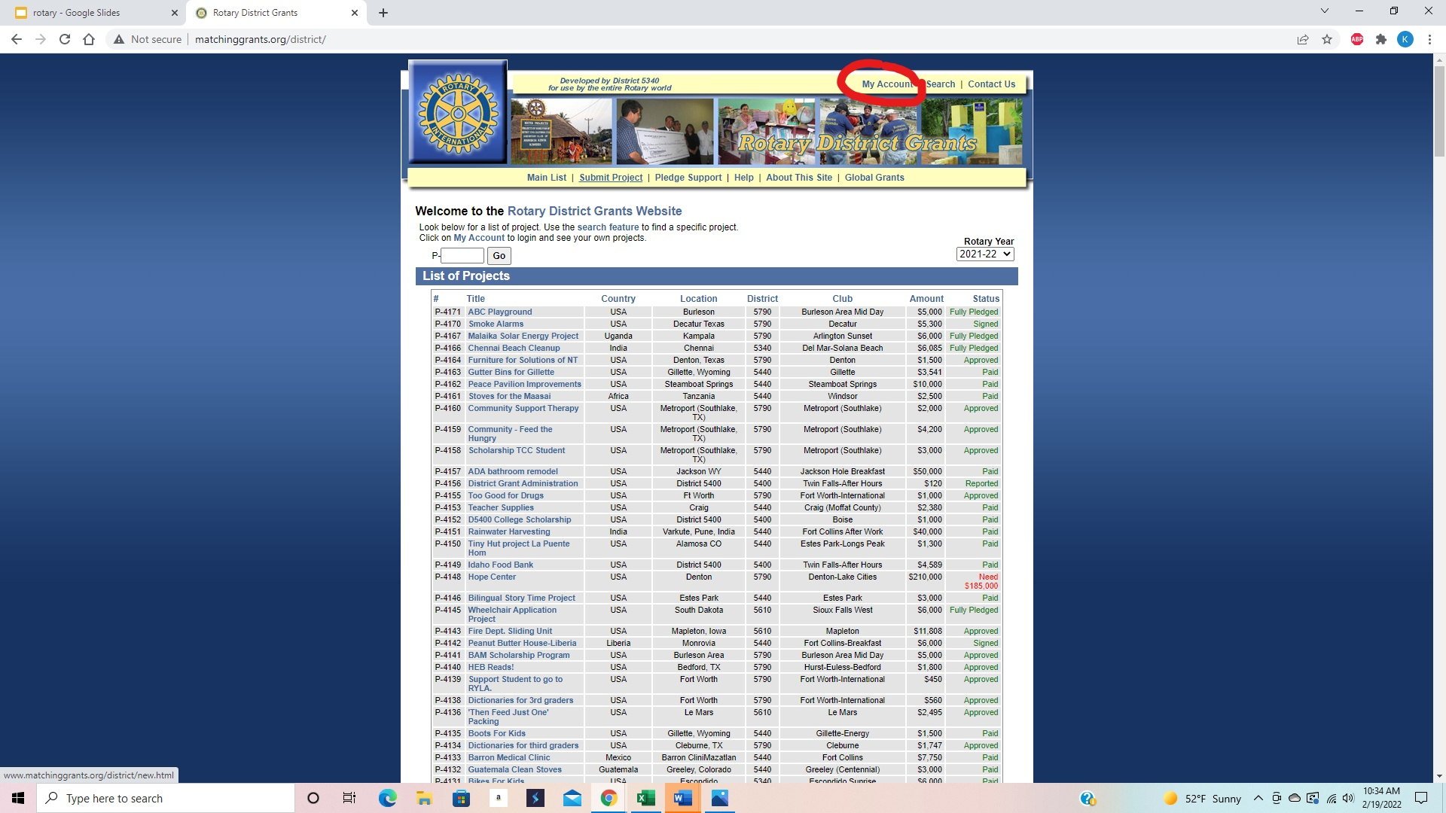

Slide 15
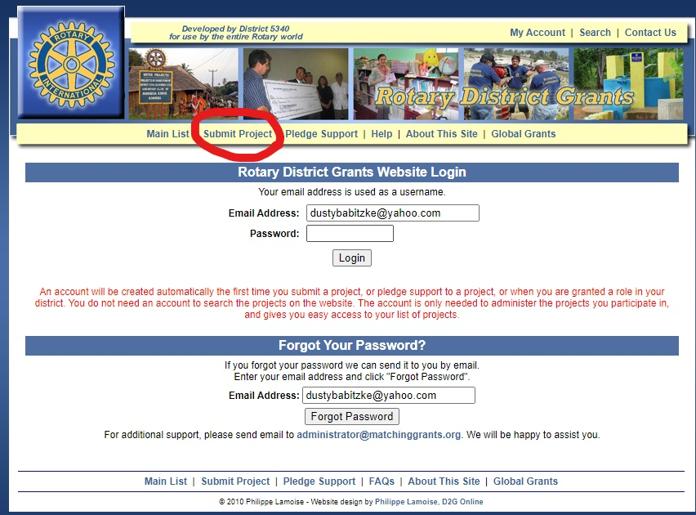

Slide 16
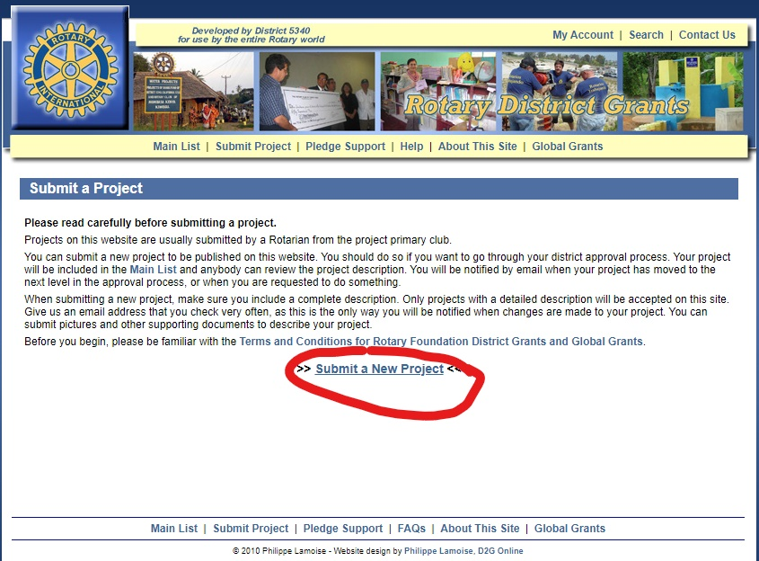

Slide 17
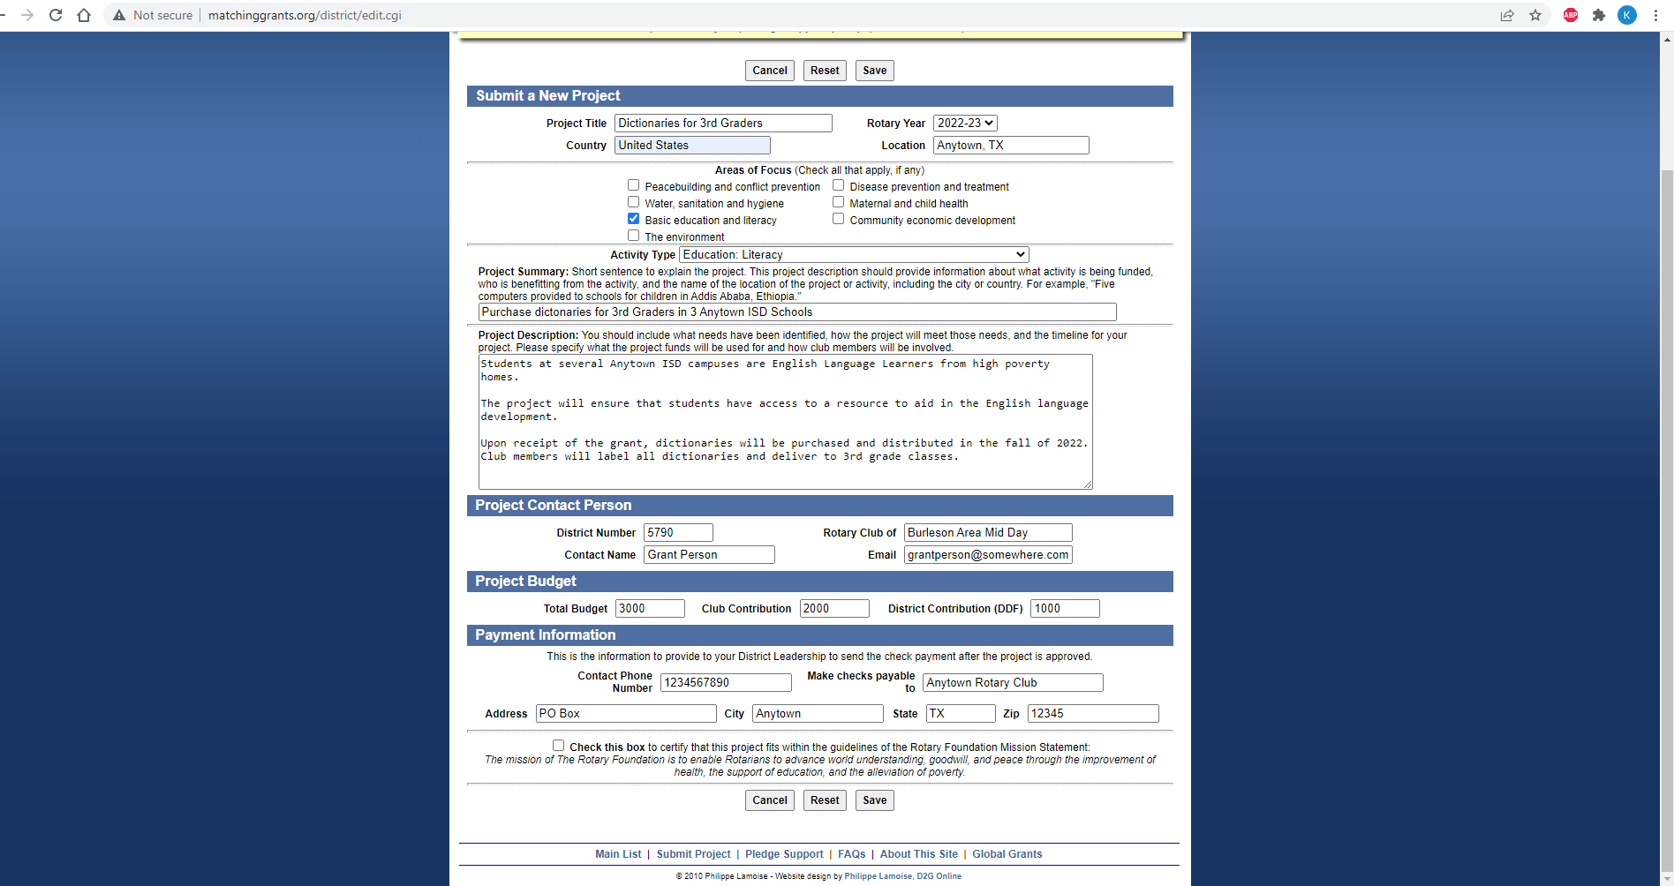

Slide 18
Go to www.rotary5790.org Foundation/District Grant Menu tab for the following forms:
2024-2025 District Grant Highlight Form
2024-2025 District Grant MOU Form
2024-2025 District Grant Checklist
2024-2025 District Grant Final Report
Sample Non-Profit Letter

Slide 19
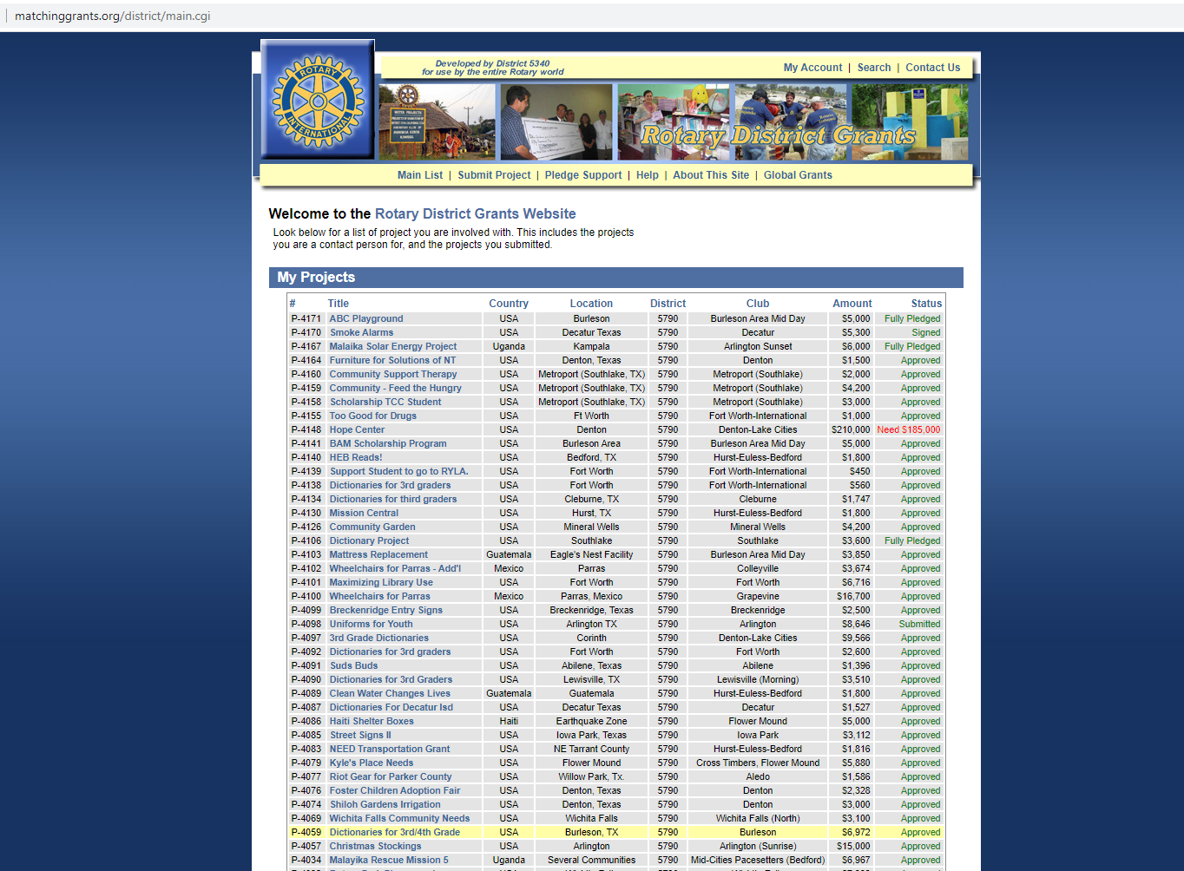

Slide 20
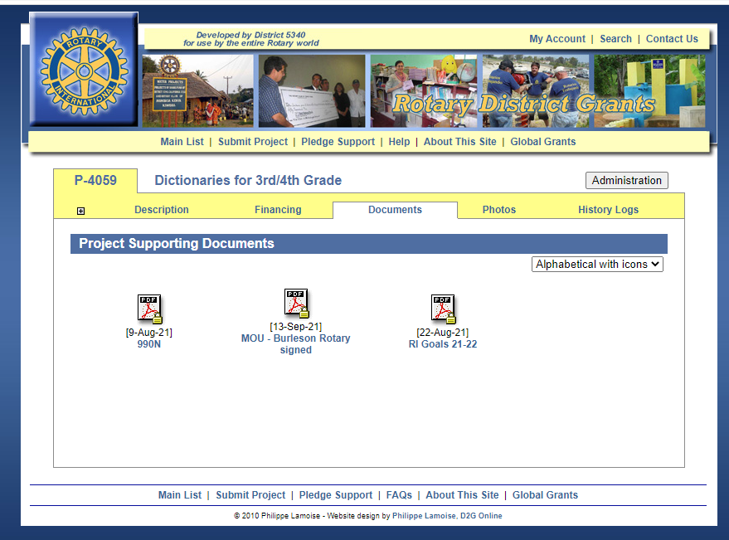

Slide 21
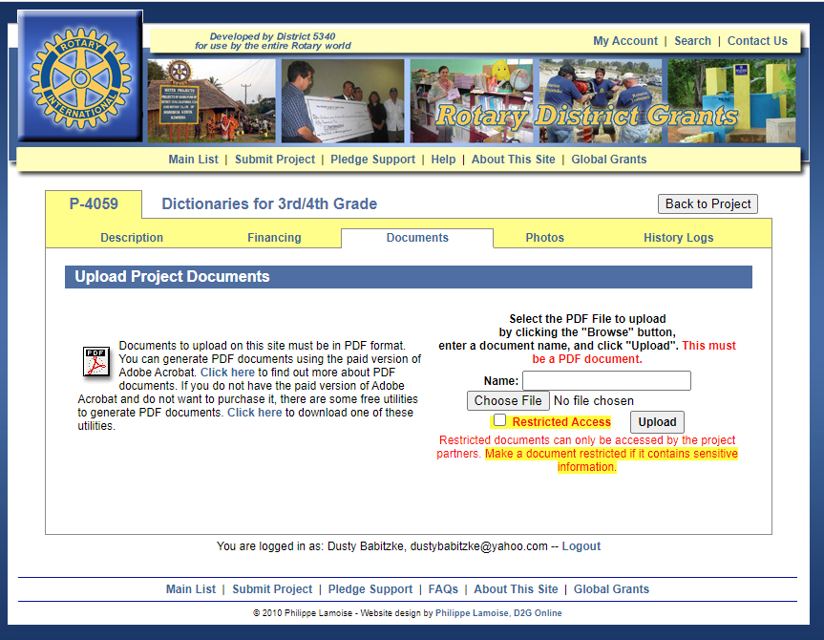

Slide 22
Payment of Funds
Clubs must request funds via dustybabitzke@yahoo.com when they are ready to do the project.
Payments will be made from September 1, 2024 to April 30, 2025

Slide 23
Reporting Online Only
Use the Grants Checklist!
Clubs submit final report 30 days after the completion of the project. (Final report deadline May 31, 2025)
Report needs to include:
• Completed Final Report form
• All receipts, cancelled checks, bank statements, letters from non-profit partners for the total project and pictures of the project

Slide 24
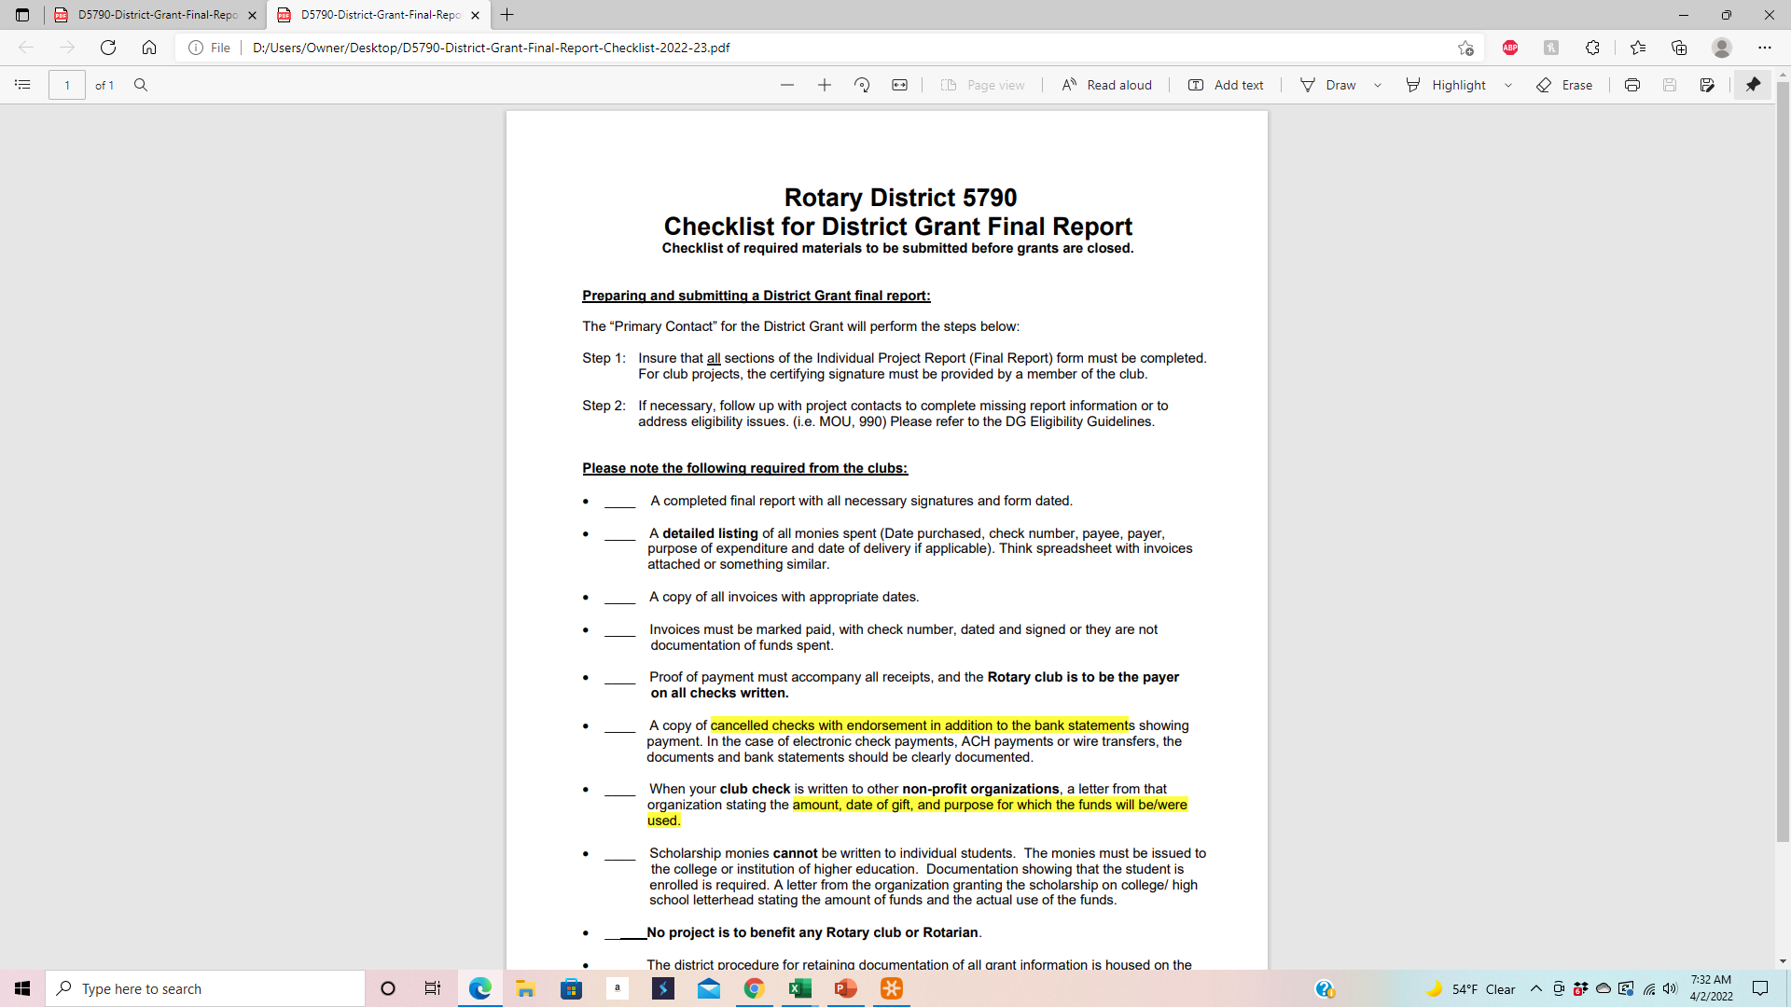

Slide 25
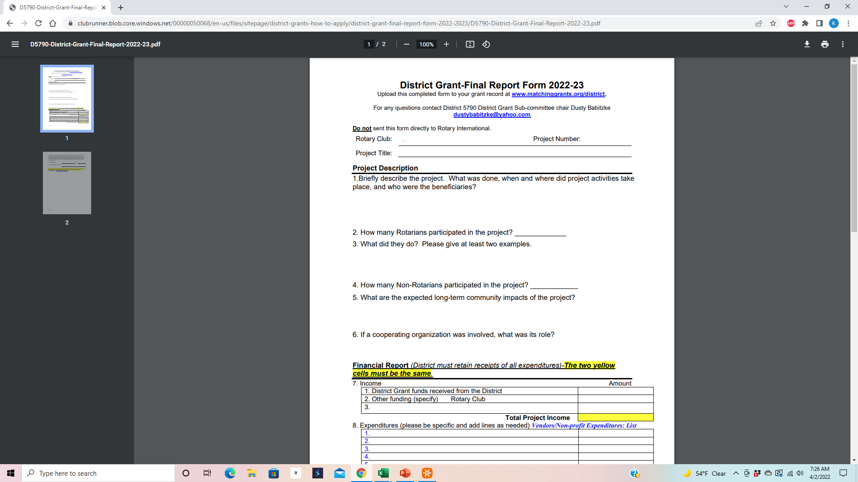

Slide 26
PREPARING AND SUBMITTING A DISTRICT GRANT REPORT
Please note the following required from the clubs (Use the Checklist)
1. A completed final report with all necessary signatures and dated form.
2. A detailed listing (i.e. spreadsheet) of all monies spent (Date purchased, check number, payee, payer, purpose of expenditure and date of delivery if applicable)
3. A copy of cancelled checks and bank statements showing payment or documentation of digital or debit checks on the bank statements.

Slide 27
4. A copy of all invoices with appropriate dates.
5. Proof of payment must accompany all receipts, and the Rotary club is to be the payer on all checks written.
6. In the instance of checks being written to other non-profit organizations, a letter from that organization stating the amount, date of gift, and purpose for which the funds will be used.
7. Scholarship monies cannot be written to individual students.The monies must be issued to the college or institution of higher education. Documentation showing that the student is enrolled is required.
8. Invoices that are not marked paid, with check number, dated and signed are not document of funds spent.
9. No project is to benefit any Rotary club or Rotarian
10. The club shall have a procedure for retaining documentation of all grant information (The district provides this through the Matchinggrants.org website)

