Slide 1
District 5790 Social media
Presented by: Randi Skinner

Slide 2
Maximizing the use of social media
District 5790 Topics
Creating An Effective Social Media Strategy
What Makes An Effective Post?
What To Post, When, Where
Effective Graphics and Photos
Identifying Your Target Audience

Slide 3
Rotary international strategic plan

Slide 4
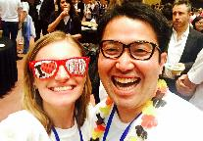
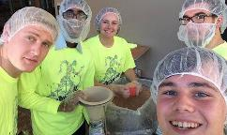
Let’s talk strategy
Goals| Awareness, Engage Members, Share Rotary
Highlights| Talk Your Club’s Key Events, Meetings, Projects
Content| Identify Top 5-10 Content Ideas
Members, Community, Projects, RI,
Platform| Designate Social Media Platform
Map It Out
Thursday Club Meeting
Saturday Service Project/Event
Monday RI Post
Wednesday Lunch Invite & Speaker

Slide 5
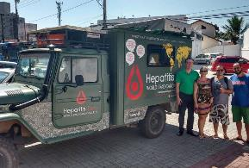
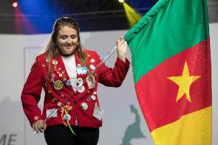
effective posts
What | Visual, Engaging/CTA, Current
When | Look At Facebook Insights for High Traffic Times
Where | Start With Facebook

Slide 6
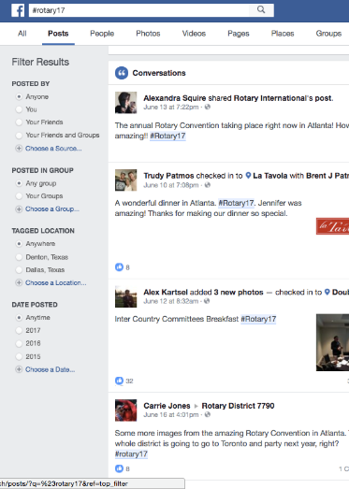
3 Tips To Create Buzz
According to Rotary International Blog by Rotarian Evan Burrell, Australia
Create Unified Hashtag – RI Conference In Atlanta #Rotary17
Share Visual Content – Photos & Videos
Get Everyone Involved – Check In, Tag Rotarians, Tag Businesses/Organizations, Encourage Members Posting

Slide 7
How are we doing on facebook

Slide 8
Talking facebook tools
Facebook Live
Milestones
Notes
Peer To Peer Fundraising

Slide 9
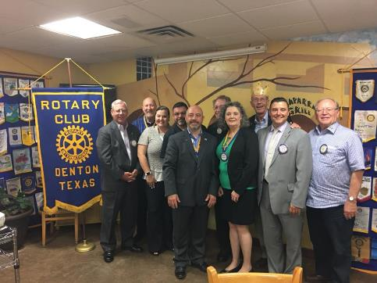
Target audience & paid ads on social
Start Here…
Current Members
Friends of Members
Hobby/Interest Similar To Club Culture
Large Corporation/Biz

Slide 10
Rotary pro-tips & Resources
RI Resources
Rotary Identity Guidelines (Brand Guide)
Brand Center
Rotary International Social Media Channels
Rotary International Blog
My Favorites Shortcuts
Canva.com to Create Images
Animoto to Create Video
Boomerang to Create GIFS
THANK
YOU!

