Slide 1
“LEARNING MATTERS”
Diana Phillips
President/CEO
1105 Holliday Street
Wichita Falls, TX 76301
PH 940.322.8638 FAX 940.322.8643
E-mail: dphillips@ntauw.org
Website: www.ntauw.org

Slide 2
http://youtu.be/R4KjV0d6HGY Literate Nation 6:16

Slide 3
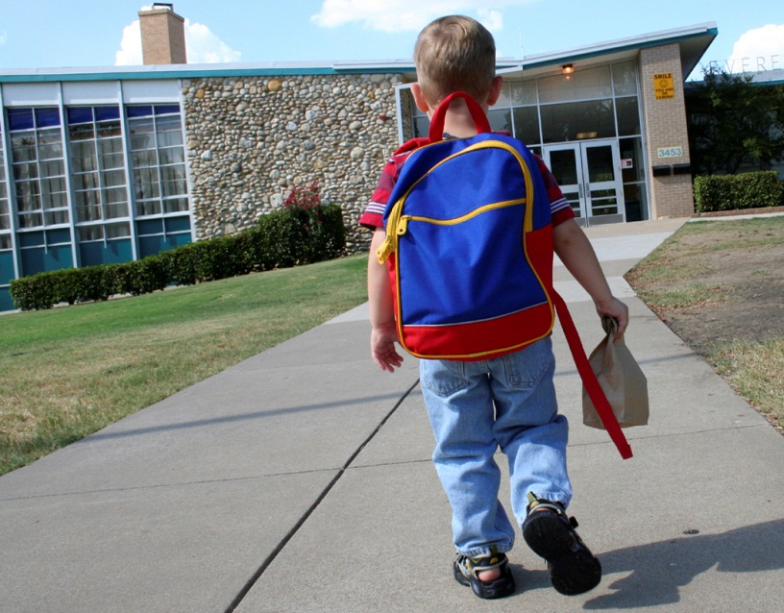
Education … the steps to peace, prosperity and health
Notes:
Thank you Deb. It is a pleasure to speak to you on a subject that as a mother and grandmother is very concerning to me and that is the plight of children in our country.
Peace, freedom and prosperity are all dependent on education and literacy. Unlike many parts of the world, education and illiteracy are part of the American culture. Yet education and literacy of our children is crisis in the United States …. a crisis which threatens our country’s economy, our national security and our global competitiveness.
Every parent’s dream is to for our children to succeed and for their success to surpass ours. But today’s young American’s are less likely than their parents to earn a high school diploma, a distinction not shared by any other industrialized country in the world.
1.2 million seniors will not graduate this year. That means 6,000 students will drop out today. The numbers are even worse for young people of color.
As a nation we can’t endure a 26% drop out rate if it is to thrive in the world.

Slide 4
Education: A National Perspective
26% of kids are dropping out of school
15% of young adults are
neither in school or working
46% of kindergartners are not ready for school
67% of third graders aren’t
reading on grade level
Notes:
Tackling high school drop out rate means reversing some very discouraging statistics.
46% of our kindergartners are not ready for school
67% of fourth graders aren’t reading on grade level –
25% of high school students fail to graduate on time
15% of young adults are neither working or attending school
High school dropouts are more than 12 years in the making. They usually start two years behind. And research shows they never catch up. If they don’t catch up by 3rd grade, It is unlikely they will .
3rd grade reading scores predict with 90% accuracy the dropout rates
3rd grade reading scores also are used to predict the beds for fufure prison population
The education challenge doesn’t just end with high school graduation. College professors and employers say today’s graduates don’t have the skills they need to succeed in college or in work. There is a growing skills gap in literacy, math, and critical thinking skills needed for today’s jobs.
CBS News recently produced a tv documentary on this issue stating that there are over 3 million jobs available in this country but not enough skilled manpower to fill them.
Conoco has also launched an awareness campaign about US’s declining international ranking in math and science.

Slide 5
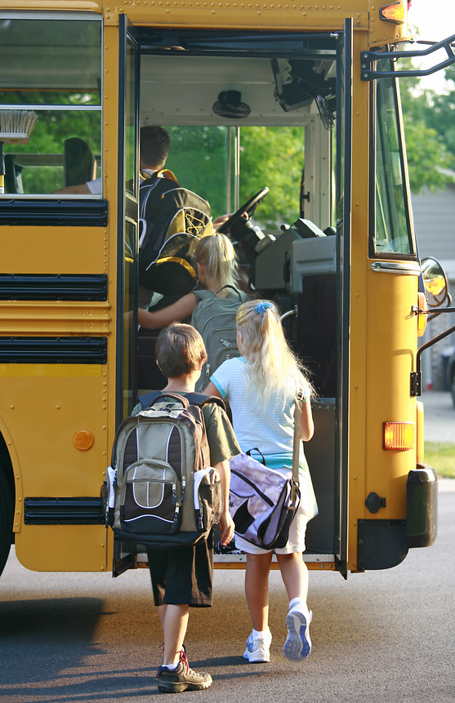
Getting on the bus for education?
Notes:
So what is being done and can be done?
To develop a strong workforce of the future --- one that will help America compete and help individuals be successful our investment in children’s education must start early and be sustained.
In 2008, United Way Worldwide made an unprecedented bold move for a non-profit. For the first time in its 120 year history the organization put stakes in the ground and set a national goal around education. The goal: to cut in half the number of high school dropouts by 2018.
The issues are daunting but United Ways are having success in mobilizing communities to take responsibility and ownership for solutions. The independent and interconnected system is promoting and nationally scaling the solutions of local United Ways. United Way as a system with 1200 local United Ways covering 95 percent of the country is positioned unlike any other organization in the country to actually be successful in stopping the cycles that if allowed to continue will have devastating outcomes for future local, state and national economies and viability.
The sense of urgency is unsurpassed. United Ways are taking ownership for the solutions that will provide for solutions.
North Texas Area United Way has become relentless in identifying and addressing the issues and designing and investing in evidence-based programs that help working families achieve educational success, income stability and good health. We rigorously evaluate our work and use lessons learned to inform and advance public policies and practices that prevent and alleviate poverty throughout our community.

Slide 6
Education: Local Perspective
50% of children are not ready for kindergarten
3rd grade reading scores are declining
Of 164 day cares, only 20 are accredited for quality
Notes:
In our community in Wichita Falls - Education of children is our top priority. Our major focus is on early childhood education because that is the area that is the weakest in our community the one that will have the biggest impact in achieving long term change.
Our local issue:
50% of our children are not ready for kindergarten and
3rd grade reading scores are declining.
164 day cares, only 20 are accredited for quality
Education starts at birth, research shows that 90 percent of a child’s brain is developed by age 5.⁹
Investing in early childhood education strategies, such as quality early childhood education and early literacy has an economic return on investment of $8 to dollars for every dollar invested.¹⁰

Slide 7
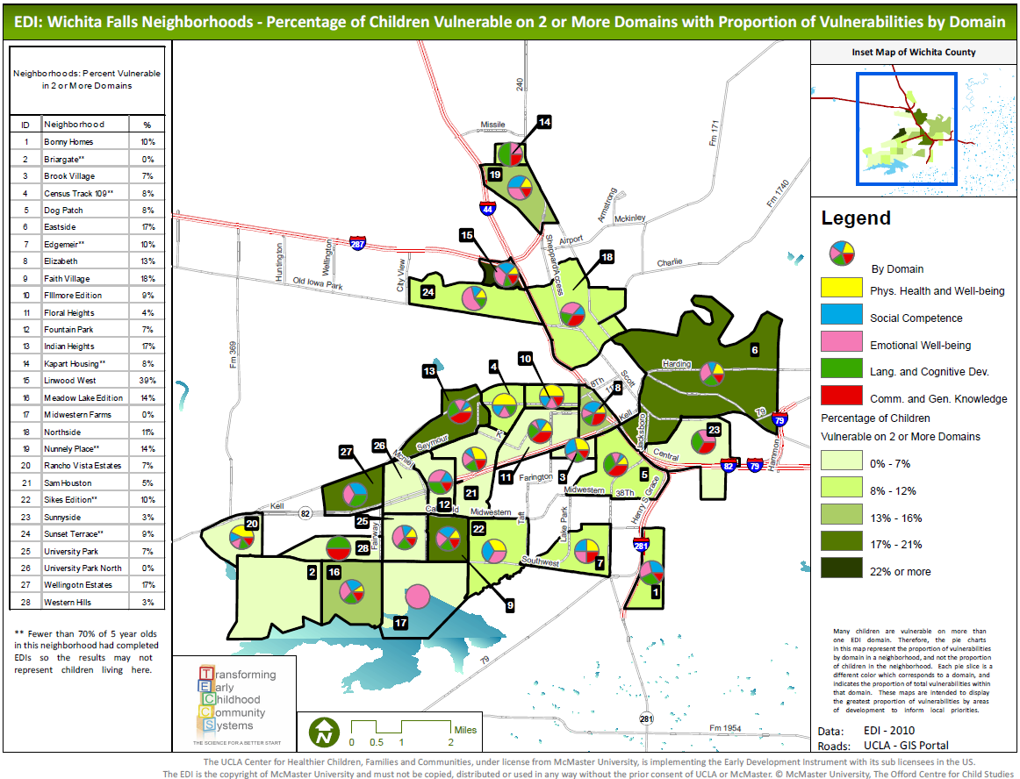
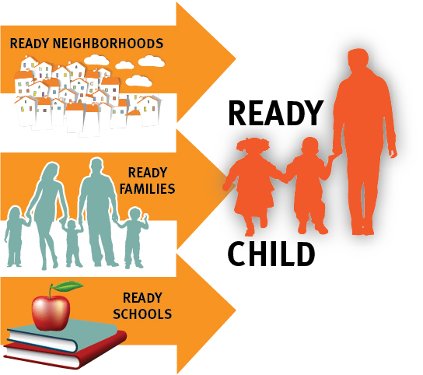
EDUCATION
Notes:
North Texas UW is partnering with the UCLA, W.R. Kellogg Foundation, and United Way Worldwide to access the five nationally identified vulnerabilities of school readiness by using the Early Development Instrument (EDI) . The population data is aggregated and geographically mapped by neighborhood which allows us a targeted approach in addressing the specific issues children by neighborhood. The surrounding school districts partner with us on the assessment and utilize the data for campus planning. The Texas Community Campaign for School Readiness (TCCSR) is replicating statewide the strategies developed at our local United Way using the EDI.
You have a map at your table that shows the population data that we use. These maps help us to design specific programs and mobilize neighborhoods and families to support the needs of children and address the ir weaknesses prior to entering school
Our school readiness work using the Early Development Instrument (EDI) identifying and GPS mapping school readiness vulnerabilities of children in our community neighborhood by neighborhood has garnered state and national attention and has put Wichita Falls on the map. United Ways and community organizations around the country are using EDI and the strategies we implemented to model similar strategies in their communities.

Slide 8
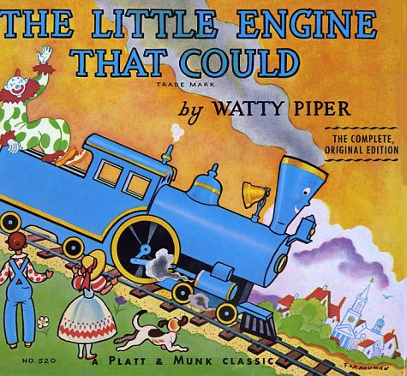
Imagination
Library
FREE age appropriate books to
over 2,300 children ages 0-5 in the mail every month!
Local parent survey results:
82.9% of parents read more often to their children.
86.7% of parents report their children’s interest in books has increased
94.7% of parents are more aware of the importance of reading in their child’s development
Notes:
1 in 2 children enter the classroom unprepared to meet the challenges of kindergarten. In 2001 & 2003, Texas was the most illiterate state in the country.
Early literacy is critical to success in reading which leads to success in mathematics and science.
Reading to a young child is the #1 most important thing you can do to prepare a child for school.
We enroll children in a free book program called Dolly Parton Imagination Library. United Way provides the funding and there is no charge to families. The program provides one free age appropriate book a month to children age 0-5.
82% of parents say they read more to their children as a result of the program
We also conduct Book Drives for Day care Ctrs Because there are never enough books
We are getting ready to launch Llama, Llama Red Pajama Parties around the community to create awareness for the importance of reading to children and to support Imagination
Children come in their pajamas and listen to the Llama, Llama Red Pajama story (an Imagination Library book) read by a local celebraty wearing his/her red pajamas

Slide 9
Quality Experiences
Quality Childcare
Educational Training/Coaching
Supportive Parents and Caregivers
Parent Cafe’s
Tax Prep
Job Skills
ESL & GED Classes
Connect Neighborhood Resources
Asset Mapping
Live n Learn Play Groups
Notes:
We focus on improving quality childcare in formal and informal settings’, providing support for day care providers & care givers and connecting neighborhood resources
–Quality Childcare
Educational Training/Coaching
Providing scholarships for daycare workers to improve skills
Providing early child care coaches to day care centers
Best practice exchange
Supportive Parents and Caregivers
Parent Cafe’s
Tax Prep
Job Skills
ESL & GED Classes
Connect Neighborhood Resources
Asset Mapping
Live n Learn Play Groups

Slide 10
http://youtu.be/66s3eAt9vAU Early Learning Matters 1.53 First Five Years

Slide 11
So what can YOU do?
Notes:
Get involved:
Local United Ways Become a United Ways have lots of options for involvement
join the 1 Million –Reader, Mentor, Tutor challenge at United Way
Serve on an education council of your local UW or get involved with their local work
Conduct children’s book drive for day care centers
Become an Imagination Library sponsor
Send money
Host Llama, Llama Red Pajama Party’s
Read at daycare centers
Volunteer at your school
Be a mentor tutor or reader with Big Brothers /Big Sisters or Adult Literacy
Support your schools & educators
Find out what they need
Find out what others are doing
Ready by 21
America’s Promise

Slide 12
Education is the
most powerful weapon
which can change the world.
Nelson Mandela
Notes:
Closing remarks:
America’s most recent heroe. Capt Sculley Schullenberger –
My airplane
These are our children. They hold our future and the future of our country in their hands. Drastic measures are needed and each of us have a moral obligation and a responsibility to do see that they do not fail.
Thank you.

