Slide 1
UNESCO PART 1

Slide 2


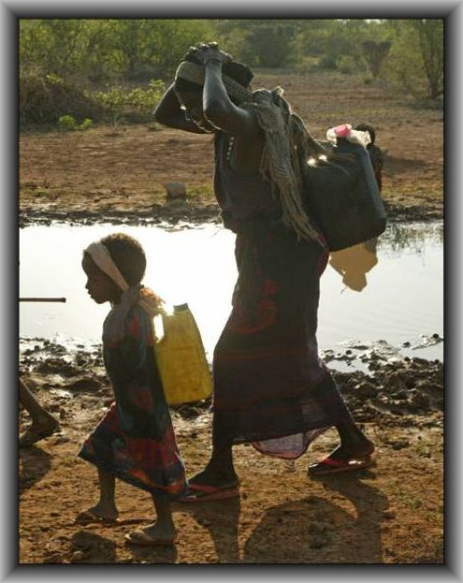
Water & Peace:
A challenge to Rotarians
Ron Denham, Chair
Water & Sanitation Rotarian Action Group
March 2012
Jim Goodrich, President, Rotary Club of Groveland, CA
Notes:
UNICEF/HQ06-0160/Michael Kamber
SOMALIA: A nomadic child and woman carry containers of water collected from a large puddle in the middle of the road near the town of Wajid in the southern Bakool Region.

Slide 3
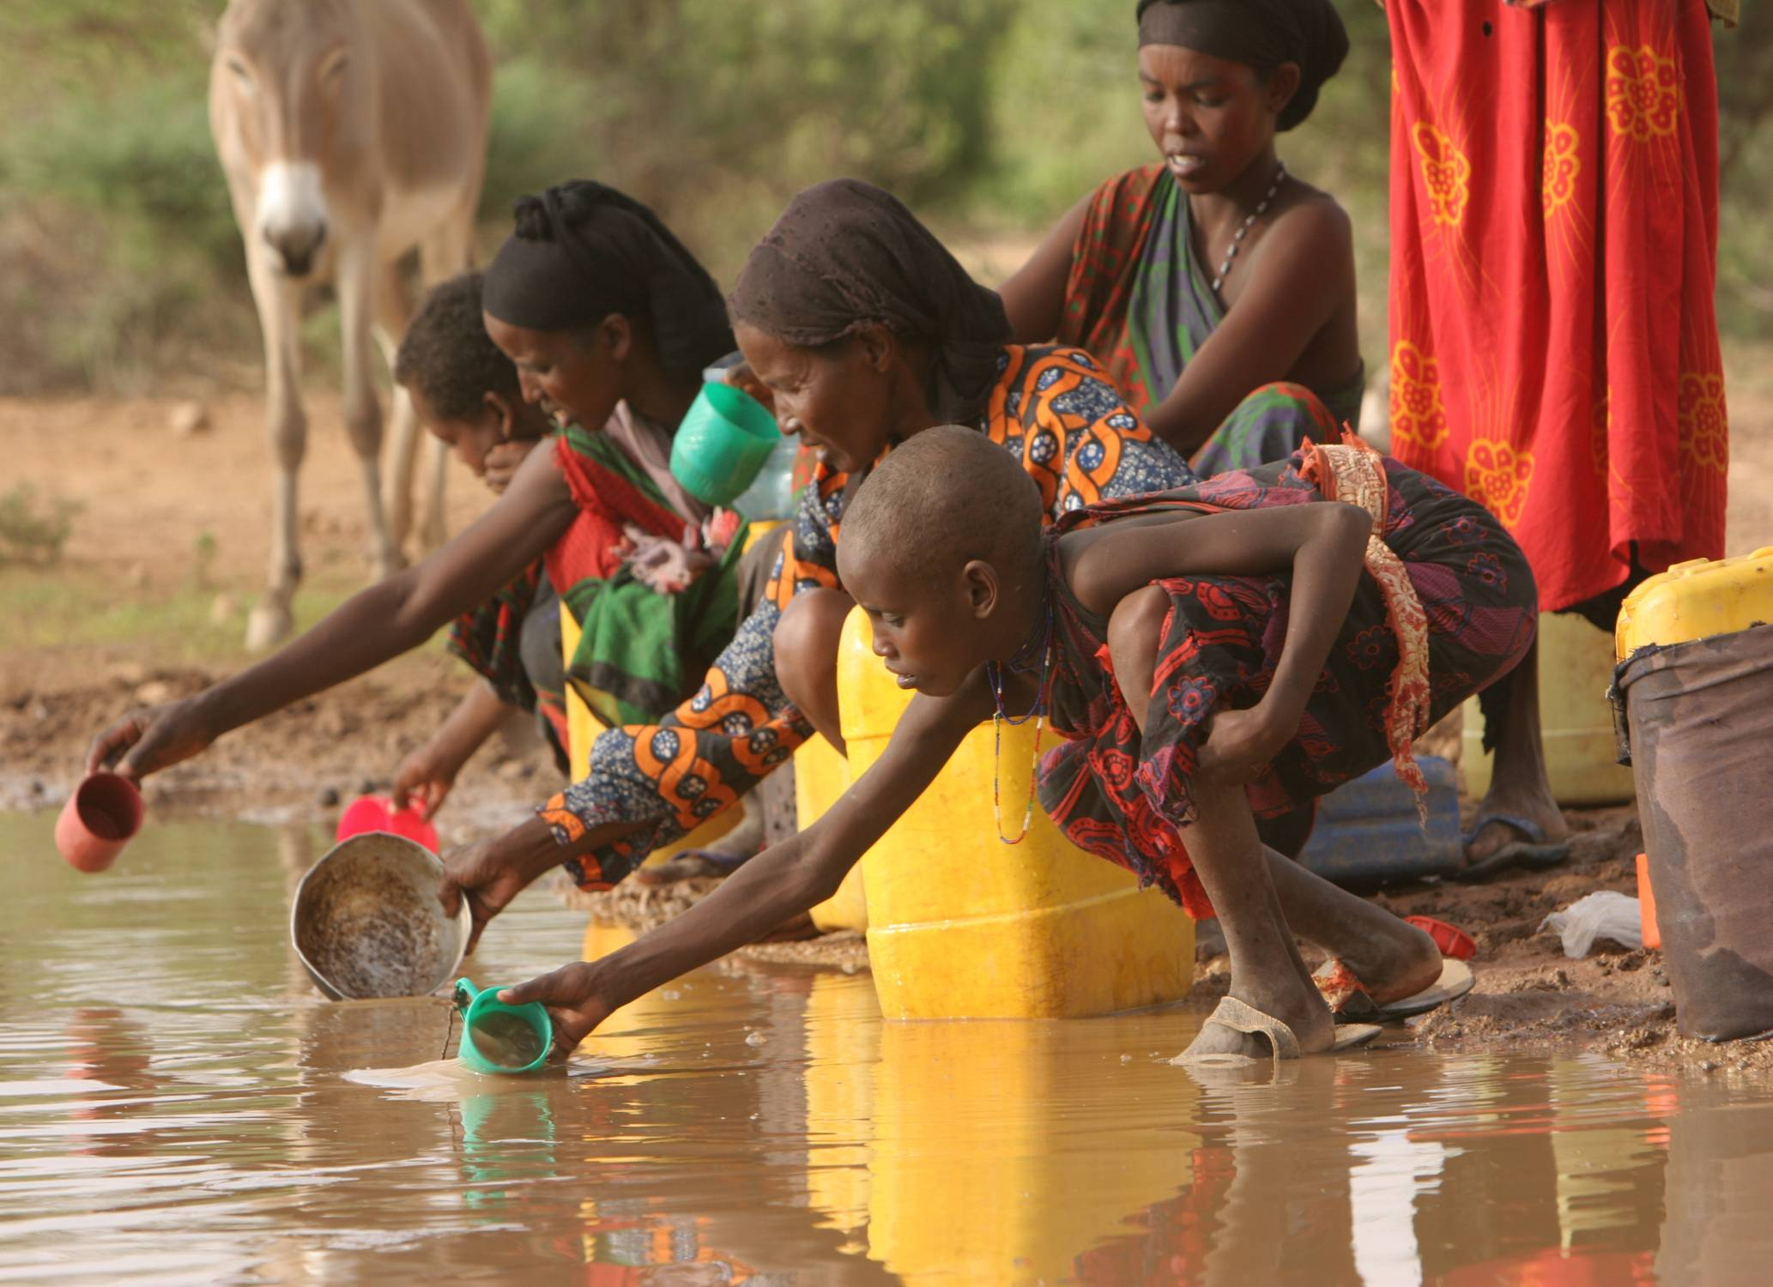
Notes:
UNICEF/HQ06-0149 Michael Kamber
SOMALIA: Nomadic girls and women carry containers of water collected from a large puddle in the middle of the road near the town of Wajid in the southern Bakool Region. The puddle, which appeared after a rare day of rain, is contaminated by waste products from the animals that also drink from it. Still, it is the only available water source and the people will camp nearby until it is gone.

Slide 4
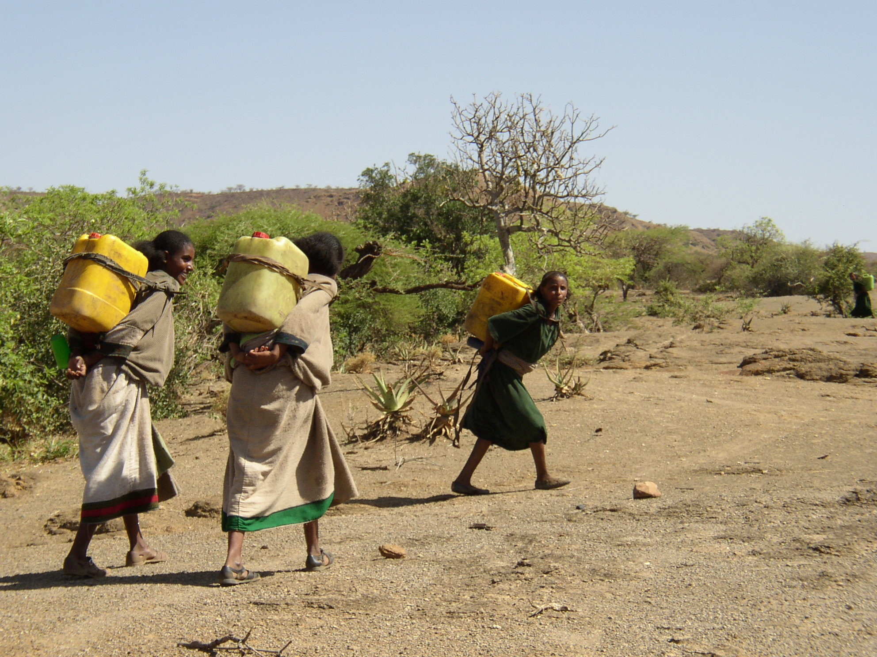
Notes:
Ron Denham file photograph (Kenya?)
Each day the women, and young girls set out from the villages to bring back water. They often walk an average 3 to 4 miles daily. ( several kms-an average of 6kms.)
The source may be a river, a creek, a pond, or maybe a well.

Slide 5
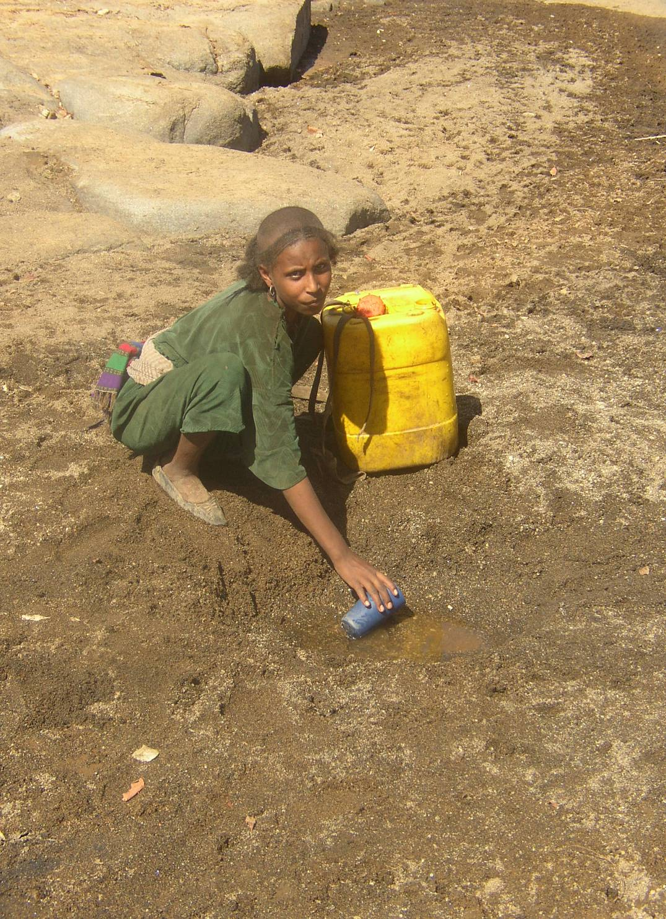
Notes:
In this case the source was a mud hole in the dried up bed of a river where she scoops up the muddy water into the jerry can ready for the trek back to the village.

Slide 6
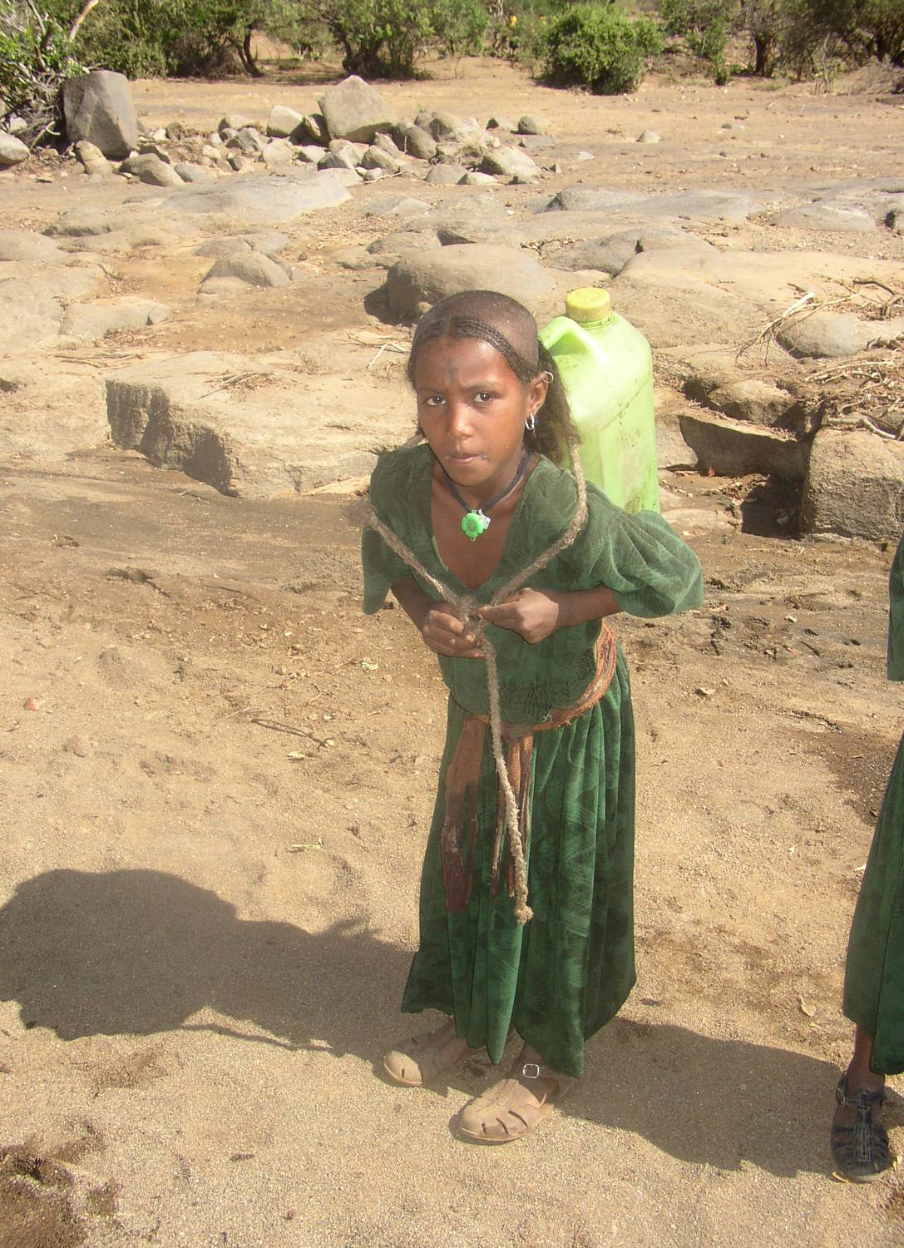
Notes:
And then begins the trek back to the village.
This is likely the first of several treks per day. The jerry can holds 20 litres of water, or a bit over 5.25 gallons, sufficient for one or two members of the family. But the typical family in Kenya has 10 members.
Think about it-at least five trips perday. 5 Gallons is 44 lbs.
Look at the poor girls face—exhaustion.
20 litres, 20 kgs, plus the weight of the can—more than many of us in this room could lift, let alone carry for almost 4 to 5miles Daily? Five to Six hours a day?
( 6kms ), several times a day

Slide 7
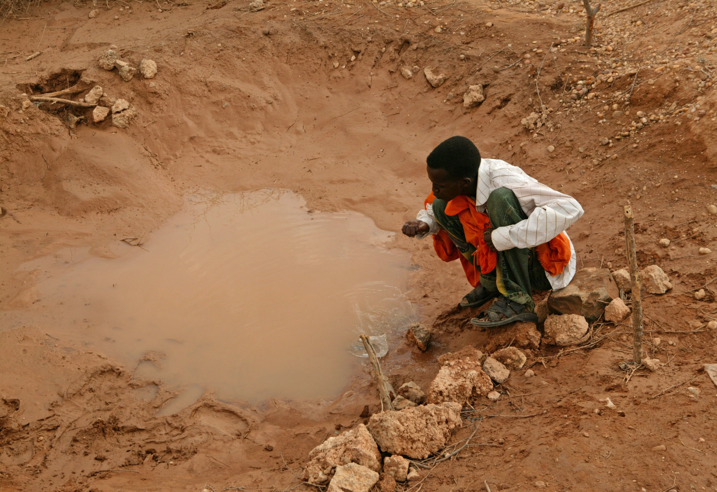
Notes:
Or, think of this poor boy, drinking directly from this polluted pond filled with all kinds of micro-organisms, pathogens, bugs etc.
Hardly surprising that the rate of infant mortality of children under age 5 is well over 100 per 1000 live births

Slide 8
How can there be Peace with such disparity?
900 million people (one in six) are denied access to safe water
2.5 billion have no safe sanitation
Those that have water, pollute and waste indiscriminately
Notes:
The statistics are alarming.
And when we say one in six lack access we do not mean that the other 5 in six have a faucet in the kitchen or bathroom or a water point in the back yard.
No, it means ONE water point for every 3 Football Fields or less than ¼ mile. 300 metres. So, even those who, according to WHO statistics have access, don’t have access the way you and I think about it

Slide 9
Or, when lack of safe water and sanitation leads to:
8,000 people dying every day
250 children dying every hour
50% of African hospital beds being filled with water-related cases
Notes:
These numbers invariably shock people. The media does not tell the story.
8000 people dying daily
FW – gone in 95 days (757,810 in 2012)
Arlington – wiped out in 46 days ( 365,860)
Grapevine – pop 46,420 (2012) wiped out in 6 days
If a jet plane were to crash killing 250 people we’d hear about it fpor years to come—witness Lockerbie, 28 years later.
Yet, every day the equivalent of 25 jumbo jets crash—but it is never reported.
One thing we, as Rotarians, can do is to talk to the ,media, tell them about this reality when ever we have the opportunity.
In africa, 50% of hospital beds are filled with people suffering from water-related disease.
And HHIV/AIDS for example—iit weakens a person’s immune system so they fall sick and die form an opportunistic infection.

Slide 10
Or, when:
African women spend an estimated 40 billion hours annually collecting and hauling water.
Women and children (usually girls) spend up to six hours per day fetching water.
Families often spend up to 25% of their income to purchase water.
Slum dwellers pay up to ten times more for their water than the upper classes!!!
Notes:
Read slide,
Comment-think what it would mean to Africa if these hours could be spent on value adding tasks-building the infrastructure, highways etc, cultivating the land, raising livestock, sewing garments, running the equivalent of a small convenience store
A 16oz bottle of water costs us $0.50 when purchased in bulk at Sam’s or Costco – This is an equivalent of a half day’s pay for most people in these regions.

Slide 11
What can be expected, when in:
Sub-Saharan Africa 47%
East Asia 29%
South Asia 28%
Middle-East 18%
Latin America 18%
are denied access to these essentials of life?
Notes:
After showing this slide I touch on some of the issues. I include the USA wher there is conflict between USA and Mexico over the Rio Grande. Ialso mention the Ogallala aquifer, being depleted egregiously.
Other transboundary issues-the nile (Ethiopia, Sudan, Egypt), Euphrates (Turkey, Syria, Iraq, Iran) wher conflict exists over allaocation
In India I mention conflict between farmers and industry (Orissa)
If you can think of local issues in the UK tht would add to the argument
Then speak to the need for every club to get involved in a project.
It could be small—putting 1000 pounds into a borehole project led by another club.
At the other extreme taking the lead role in a hundreds of thousands of pounds major program to bring safe water and integrated socio-economic development to a watershed, river basin, or country

Slide 12
“Many of today’s conflicts around the world are being fuelled by water shortages… Increasingly, fights are erupting over such basic human needs as water and arable land.
Ban Ki-moon, February, 2008
Notes:
Read slide,
Comment-think what it would mean to Africa if these hours could be spent on value adding tasks-building the infrastructure, highways etc, cultivating the land, raising livestock, sewing garments, running the equivalent of a small convenience store

Slide 13
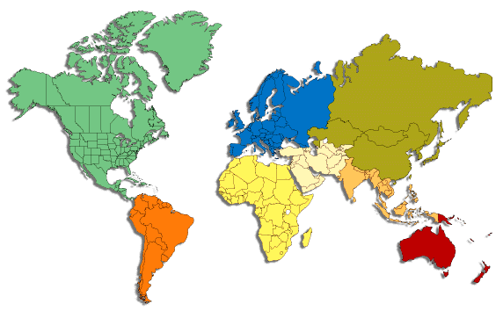
Rotarians’ WASH projects are bringing
peace to many communities:
Notes:
Just highlight the numbers.
This is to demonstrate the extent of our work.
Highlight some UK/RIBI projects if you can

