Slide 1
UNESCO Part 2

Slide 2
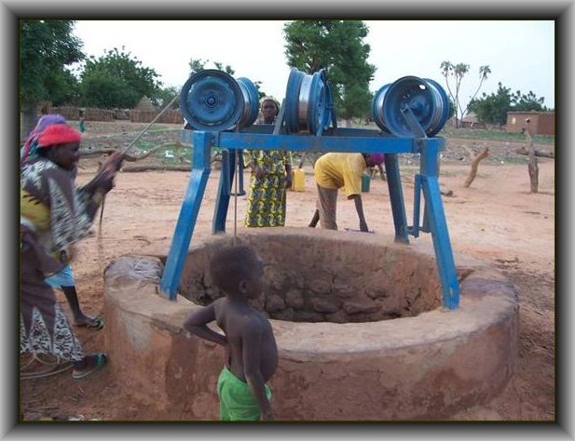
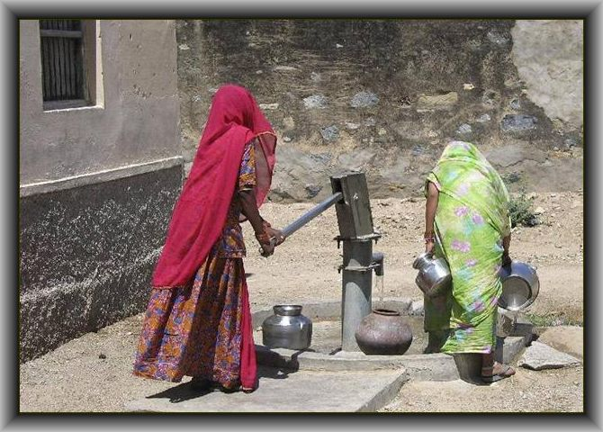
They are responding to every imaginable need:
Bore holes
Dug wells
Notes:
Qiuick read.
Then I speak about rainwater harvesting being the truly sustainable way of bringing water to people.-Rooftop catchment, school area catchment.
Recharging wells also important wher we use RWH
Under filters I often mention SODIS as an example that we do not have to spend big money to achive good results
Some major opportiunities for Toilets/latrines in schools as a means of encouraging girls to stay in school

Slide 3
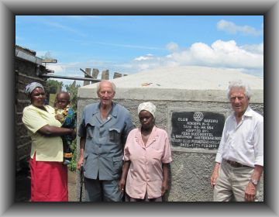
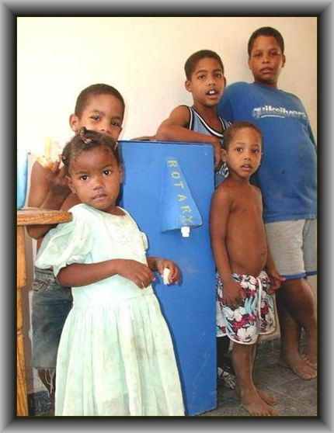
Rainwater harvesting
Household filters and purification

Slide 4
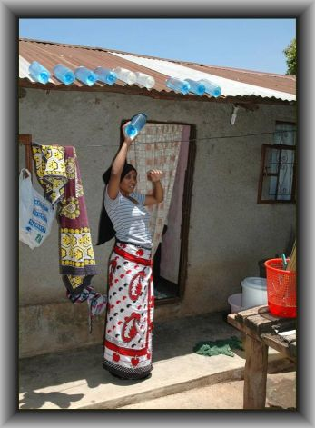
SODIS (Solar Water Disinfection)

Slide 5
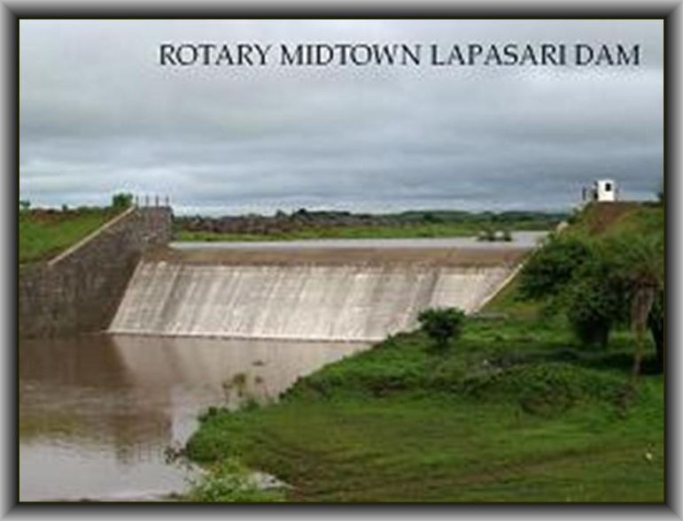
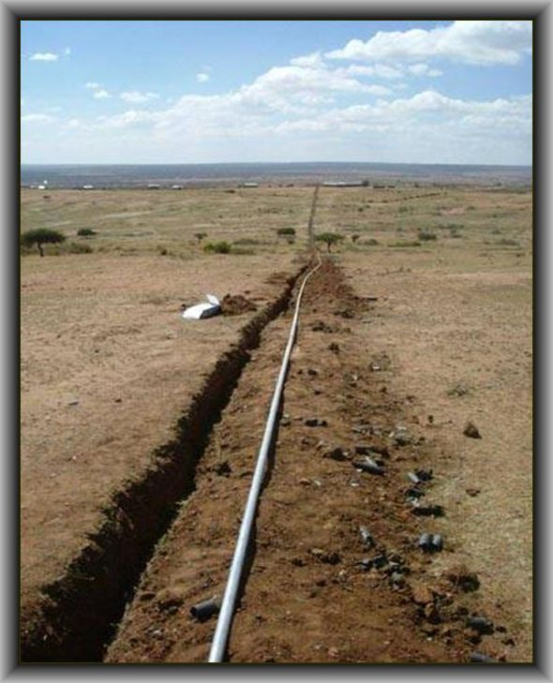
Building earth and concrete dams
Installing pipelines/ distribution systems

Slide 6
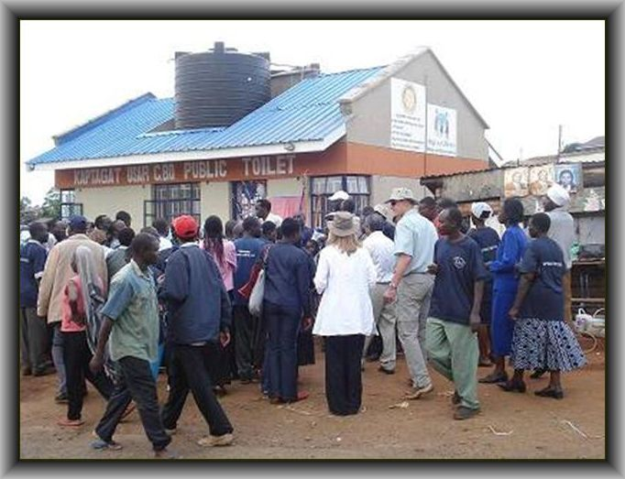
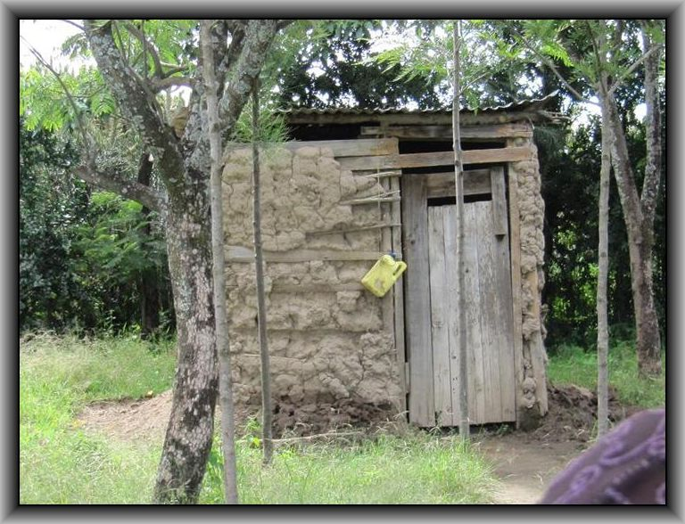
Toilet blocks
Latrines

Slide 7
In Togo Rotarians brought peace where previously there was hostility:
Insufficient water had led to conflict.
With Rotarian guidance, local people dug wells.
Women shared in the inauguration with libations and thanks to ancestors and to God.
Availability of sufficient water eliminated conflicts; peace prevailed
Notes:
President Ray Klinginsmith has exhorted us to do Bigger, better, bolder
What are the implications

Slide 8
A Rotarian-created oasis in Haiti enabled the community to resist guerrillas:
Land was flooded to make way for a power plant.
Farmers were forced up the mountain where they starved.
Rotarians helped install a hydraulic pump system.
Community became self-sufficient – able to resist Haitian guerrillas
The area has experienced sustained growth, other areas have floundered.
Notes:
As we saw earlier, water is the key to every aspect of human development.
But, how many of your clubs are so engaged (this is where I quote 20 of 65 clubs).
You need your own data—from oyur district, from RIBI whetever
But don’t use these numbers they will be irrelevant.
If you can’t get appropriate data delete this line
Isolated project—a well for example. No economies of scale, no standardisation of spares or proceses
Other organizations-you could mention WaterAid as a partner, or “Drop in the Bucket” or other NGO, or government agency DfID
RCC-extend the range of Rotary clubs to places wher no Rotary club exists
Outside funders aren’t interested in processing a few thousand pounds. But, ask for a million and a meaningful partnership evolves

Slide 9
Quality of life for Indian villagers dramatically improved by a Rotary water project:
A community eked out a bare existence growing rice, taking advantage of the monsoon rains.
The Rotary club of Mumbai built check dams, stopped the water and recharged the wells.
Villagers now grow three high-value cash crops.
This prosperity enabled the community to open a clinic and launch micro-businesses – the community is at peace.
Notes:
Unsustainability is Rotary clubs achilles heel. We go into a rural area, drill awell, build a pieline and then leave.
No consideration of behaviour change, training, supply chain for spares etc
We focus on an activity—drilling a borehole, without any thought to the horizontal benefits-health, literacy, economic self sufficincy etc
Too often the international partner will “own” the project, not letting the host club and community make the important decisions
Too often the international partner, e.g. a club in the UK decides what’s the best solution for a community they’ve never visited
No provision for follow-up after completion. How do we know whether the well is still functioning seven years later?
As was stated by the speaker from UNICEF 70% of water projects fail within the first 5 years.

Slide 10
A Rotary water-based development program in Kenya brought peace to the community:
The women of Nakuru trekked miles for water each day.
The local Rotary club helped the community to launch a rainwater harvesting program.
Obliged to share resources and work together, the villagers cooperated to install the systems.
Harmony replaced hostility; communities are at peace.
Notes:
Think multiyear programs to bring about the transformation of a watershed, or region.
Focus on outcomes-water is a means to an end, not the end in itself
Form consortiums, leverage other organisations
Even though Th=e Rotary Foundation doesn’t allow for paying a project manager, we must recognise that if we want someone, a Rotarian or other, to manage a program for several years w e need to changeour thinking re compensation
(Treat this gently, some diehard Rotarians may be in the audience. I get away with it because I can quote meny examples from our partners)

Slide 11
Rotary irrigation project in Andhra Pradesh brought peace to the village:
5000 villagers in perpetual conflict over shortage of resources.
Rotarians met with community leaders and agreed on the real needs.
Result: an $80,000 irrigation scheme bringing water to 300 acres and benefitting 100 families.
Peace came with Rotary intervention in a community water project.
Notes:
The things Wasrag can do to help.
This nis where you give the sales plug.
Add to it liberally from your own expeience and views of Wasrag

Slide 12
Rotarians bring peace to communities because they take a “bottom-up, holistic approach:
Focus on helping the community, not just supplying water and sanitation.
Understand and build on local culture.
Involve ALL stakeholders – especially women.
Empower the community
Ensure sustainability
Notes:
This where we tell the audience hat we want of them
Lay it on as thick as you feel comfortable
You might want to mention Start with Water
That’s about it.
Bets of luck—I know it will go well,
Ron

Slide 13
You can help to bring peace to the world:
Click on: www.wasrag.org
Join thousands of Rotarians improving life and livelihood through the provision of safe water and sanitation!!!
Notes:
This where we tell the audience hat we want of them
Lay it on as thick as you feel comfortable
You might want to mention Start with Water
That’s about it.
Bets of luck—I know it will go well,
Ron

