Slide 1
MAXIMIZING YOUR ROTARY BRAND
Creating Compelling, Consistent Messaging
PART I
Title Page Option

Slide 2
subhead
BRAND
MATTERS

Slide 3
subhead
BRAND
MESSAGING

Slide 4

What’s your story?
What makes your club unique?

Slide 5
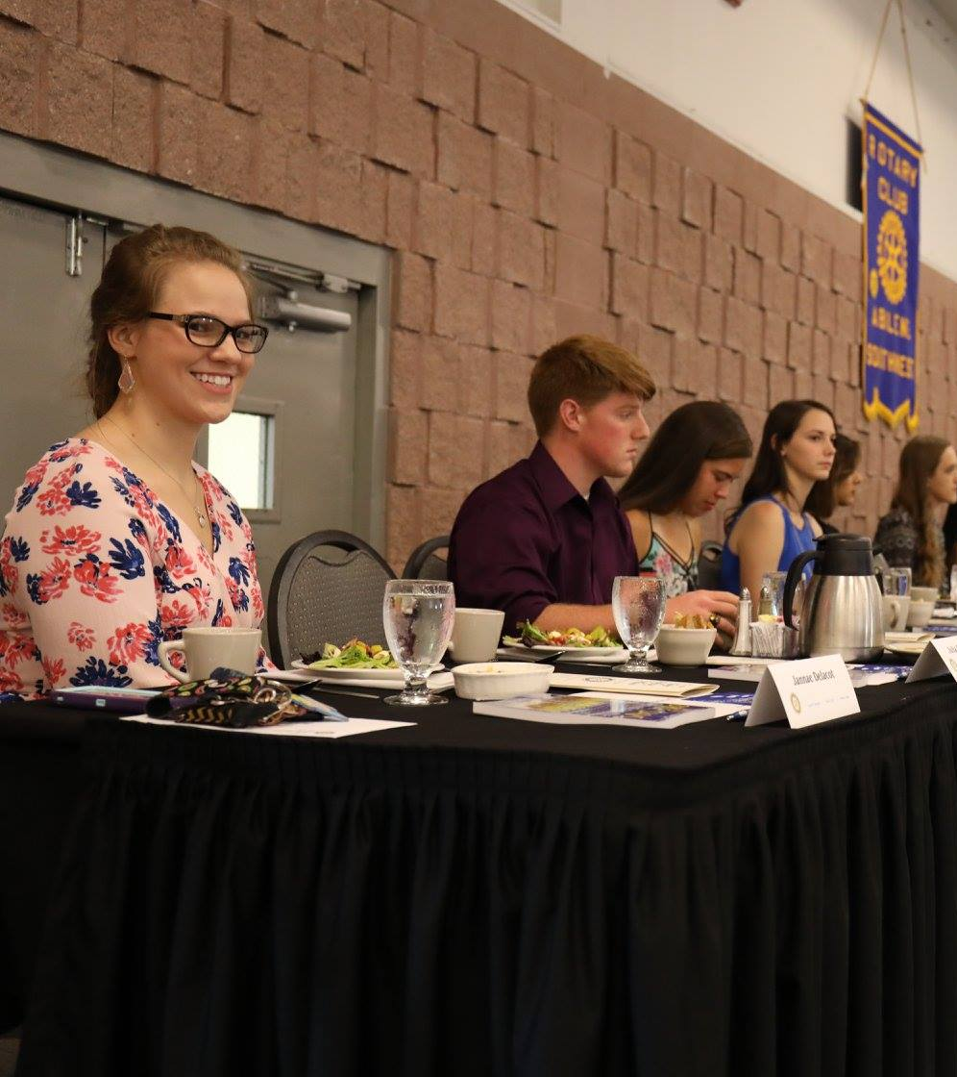

The education club!

Slide 6






6 areas of focus

Slide 7


Slide 8
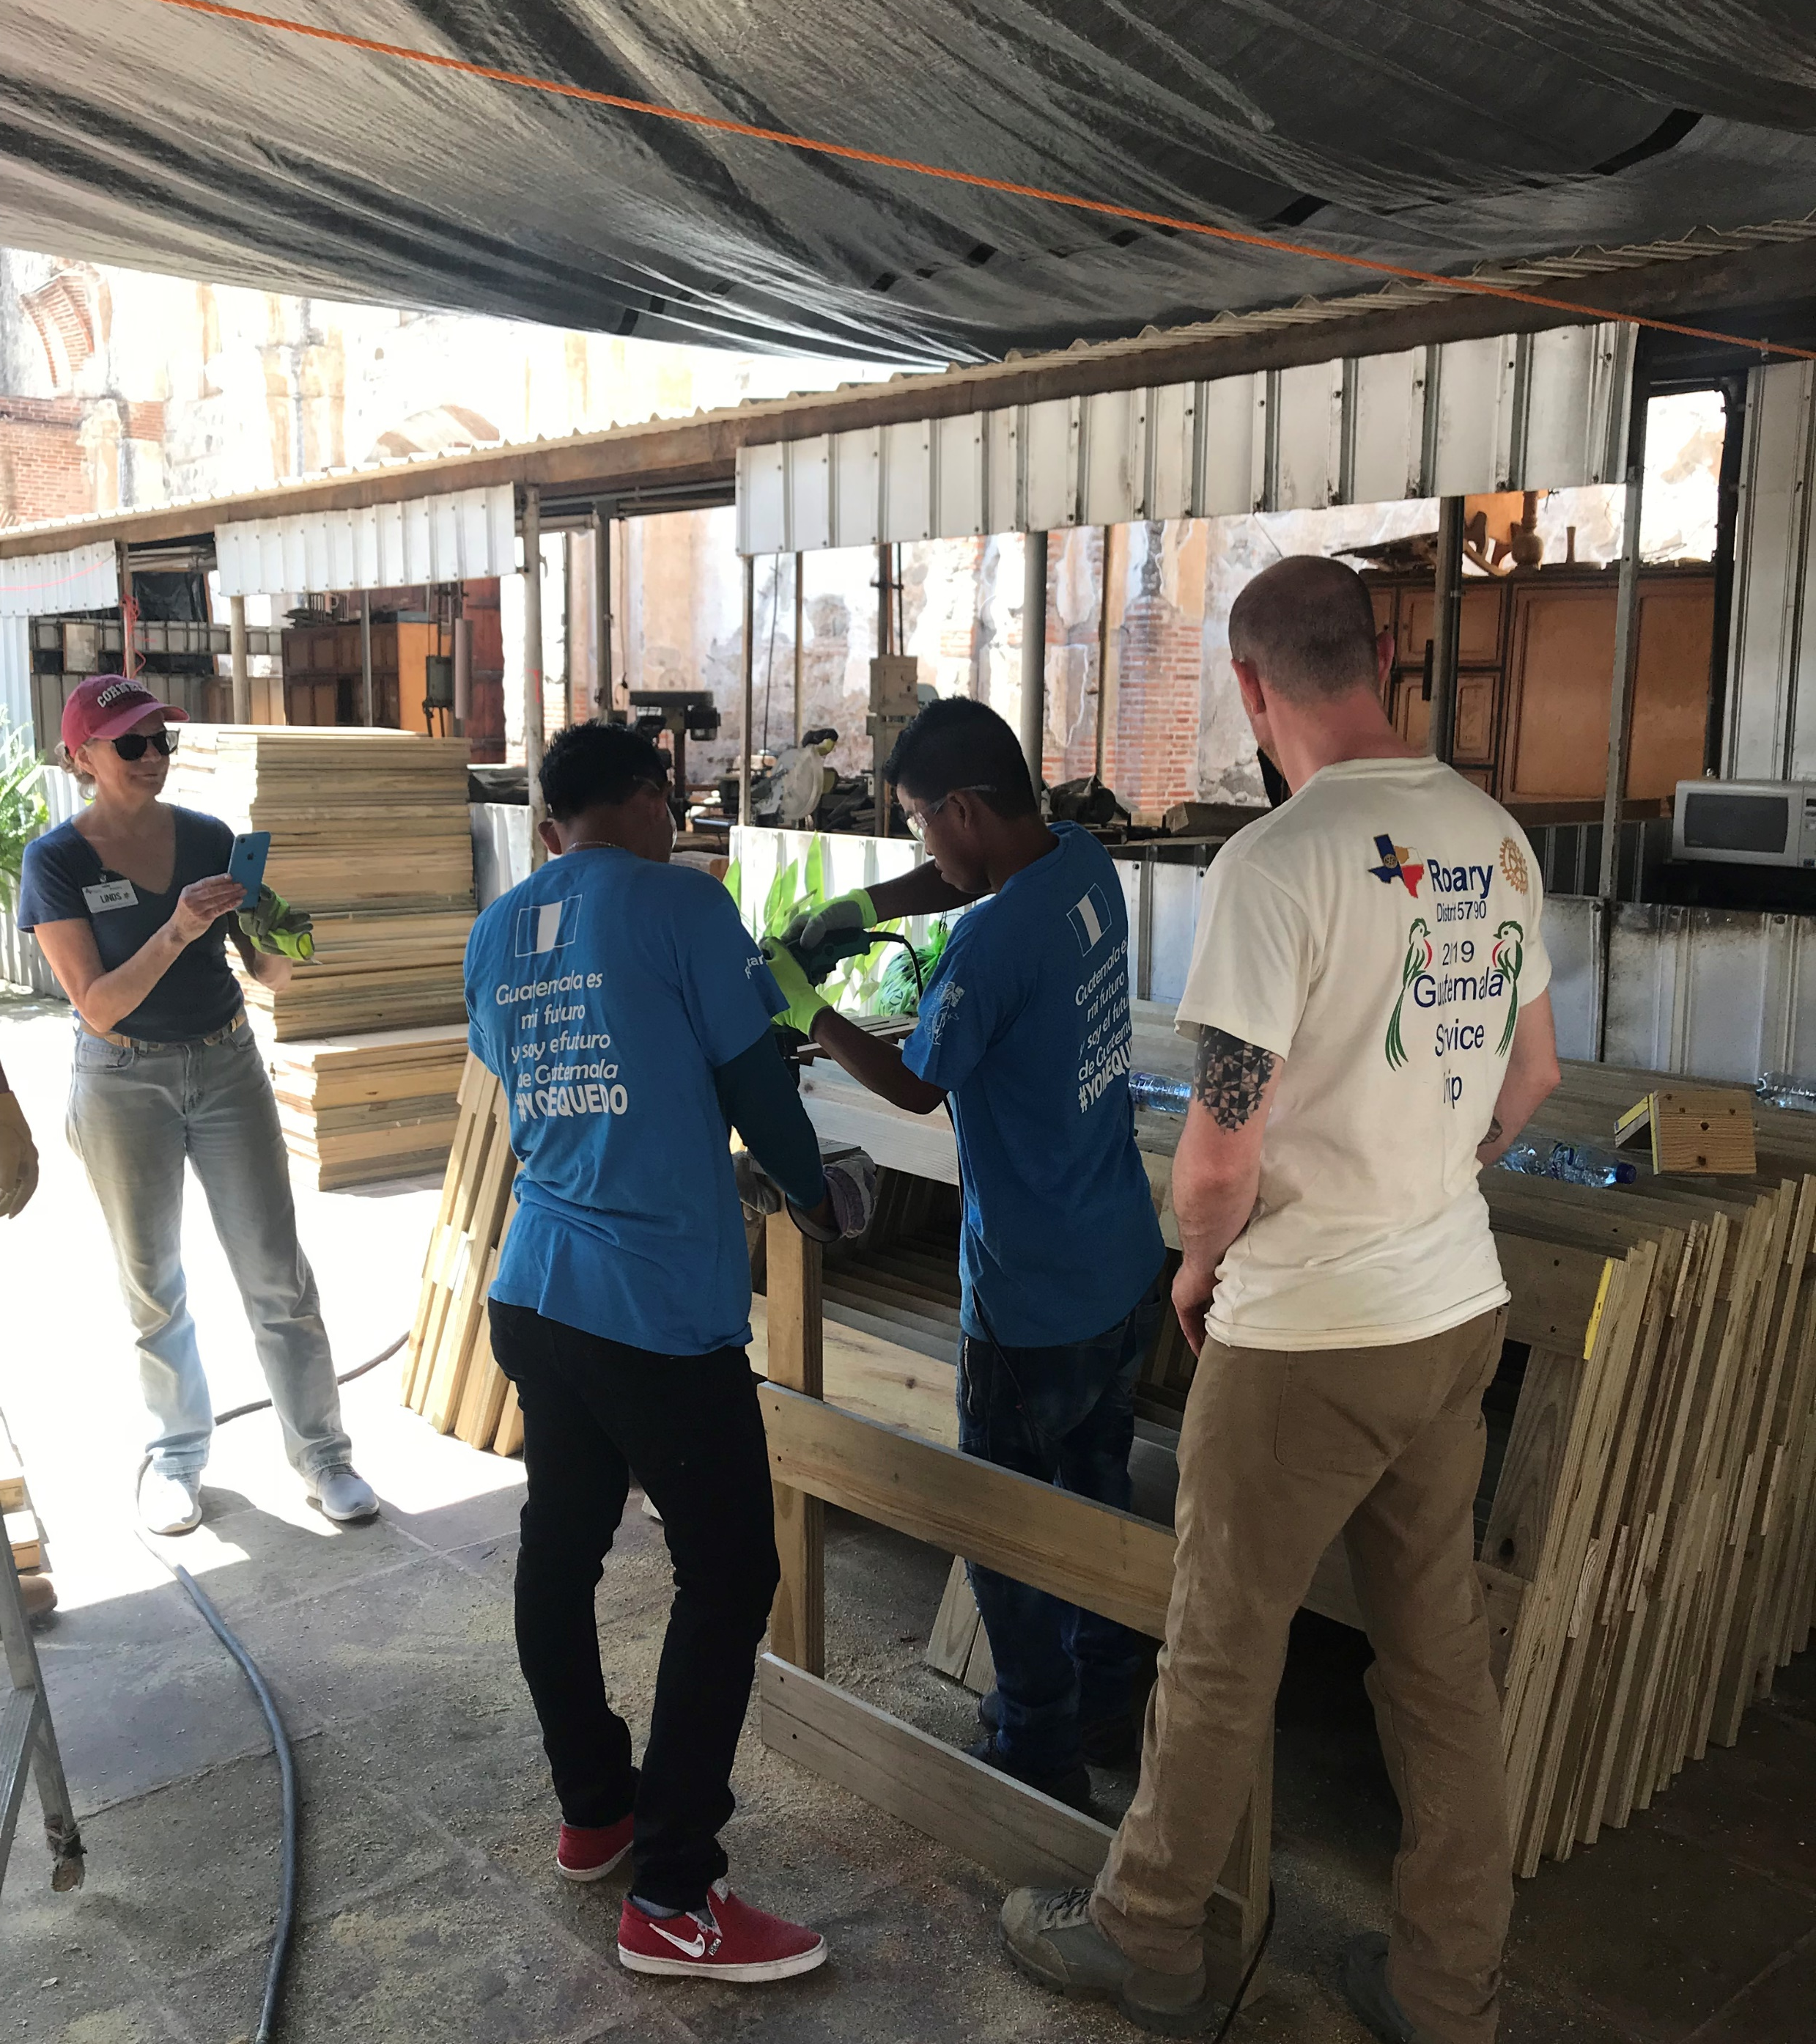
How do you tell your story?
Rotary Messaging Guide

Slide 9


Slide 10
Club?
Audience
District?
Public?

Slide 11
Audience

Slide 12
EREY
jargon

Slide 13
Knowledgeable
smart
Perceptive
Confident

Slide 14
BUT NOT
Obscure
smart
Disconnected
Arrogant

Slide 15
Thoughtful
Compassionate
Sincere
Engaging

Slide 16
BUT NOT
Lofty
compassionate
Sentimental
Weak

Slide 17
Bold
Persevering
Purposeful
Courageous

Slide 18
BUT NOT
Reckless
Persevering
Closed-minded
Stubborn

Slide 19
Upbeat
Inspiring
Hopeful
Visionary

Slide 20
BUT NOT
Hyper
Persevering
Zealous
Impractical

Slide 21
Primary Message
Effective messaging
Secondary Message
Evidence

