Slide 1
Striving to be a Vibrant Club
Managing your Club Goals in
Rotary Club Central

Slide 2
What’s in it for clubs?
One-stop shop
Eliminates paper forms
Fosters continuity in leadership
Enable clubs to track their progress
Creates transparency
Showcases the important work that Rotary clubs do worldwide
District-level Features
Notes:
Why should clubs use Rotary Club Central?
It’s a one-stop shop. It provides access to all the data that was previously available from several reports.
It eliminates some paper. It replaces paper forms for membership and Rotary Foundation goals as well as the Planning Guide for Effective Rotary Clubs.
It fosters continuity in leadership. Club leaders change annually, so by offering them the ability to see a history of goals and achievements, it creates consistency among leaders.
It enables clubs to track their progress. Club leaders can determine whether the goals they’ve set are realistic and make changes if needed.
It creates transparency. All club members are able to see club goals.
It showcases the important work that Rotary clubs do worldwide. Until now, Rotary has not had a vehicle for collecting information about the millions of service projects that Rotarians undertake. With Rotary Club Central, clubs can document the details of their projects, such as the number of volunteers and volunteer hours and a list of in-kind donations.

Slide 3
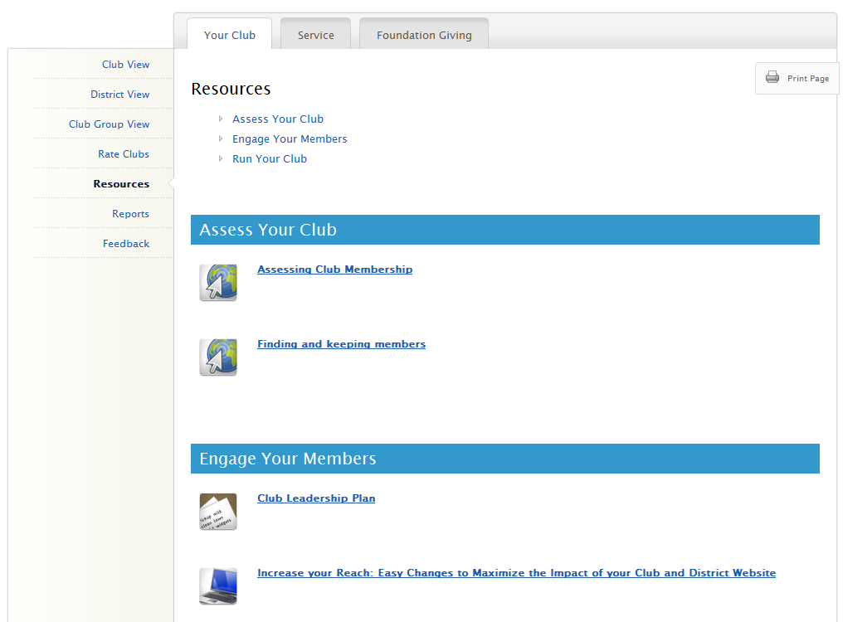
Brief Introduction to Rotary Club Central
Entering Goals
Questions
Notes:
I’m happy to be here today to show you the features of the online goal-setting tool, Rotary Club Central.
This new tool will help club and district leaders to monitor club progress and achievements in three key performance areas: membership initiatives, service activities, and Rotary Foundation giving.
Rotary Club Central is available to all Rotarians, but has additional features depending on your officer role.
Today, we will cover the following…
-We’ll start with a tour of what everyone can see in Rotary Club Central. (CLICK)
-Then, we’ll go into who can enter goals, and how to enter them. (CLICK)
-Next, we’ll explore the features available to district level officers. (CLICK)
-Finally, you’ll have the chance to ask any questions that weren’t covered. (CLICK)

Slide 4
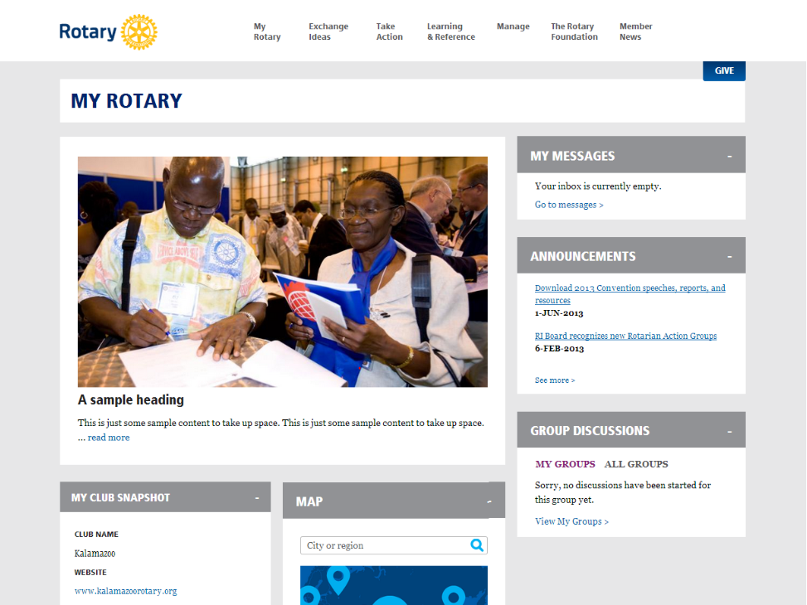
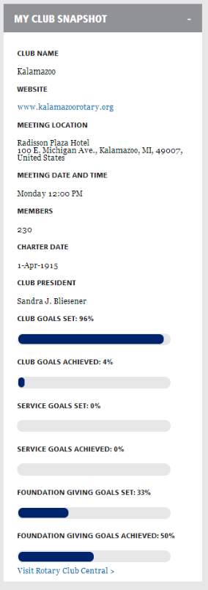
Notes:
There are a few ways to access Rotary Club Central from the new website. The most direct way is from the “My Rotary” page where you will see “My Club Snapshot.” (CLICK)
From here, you can see some of your club’s details (such as meeting location, website, charter date, members, etc.)
You can also see a summary of how many goals your club has set and achieved in each section of Rotary Club Central.
At the bottom of the club snapshot, you can click “Visit Rotary Club Central” to start viewing and editing goals. (CLICK) It can also be accessed from the “Project Lifecycle” under Take Action, or “Club and District Administration” under Manage.

Slide 5
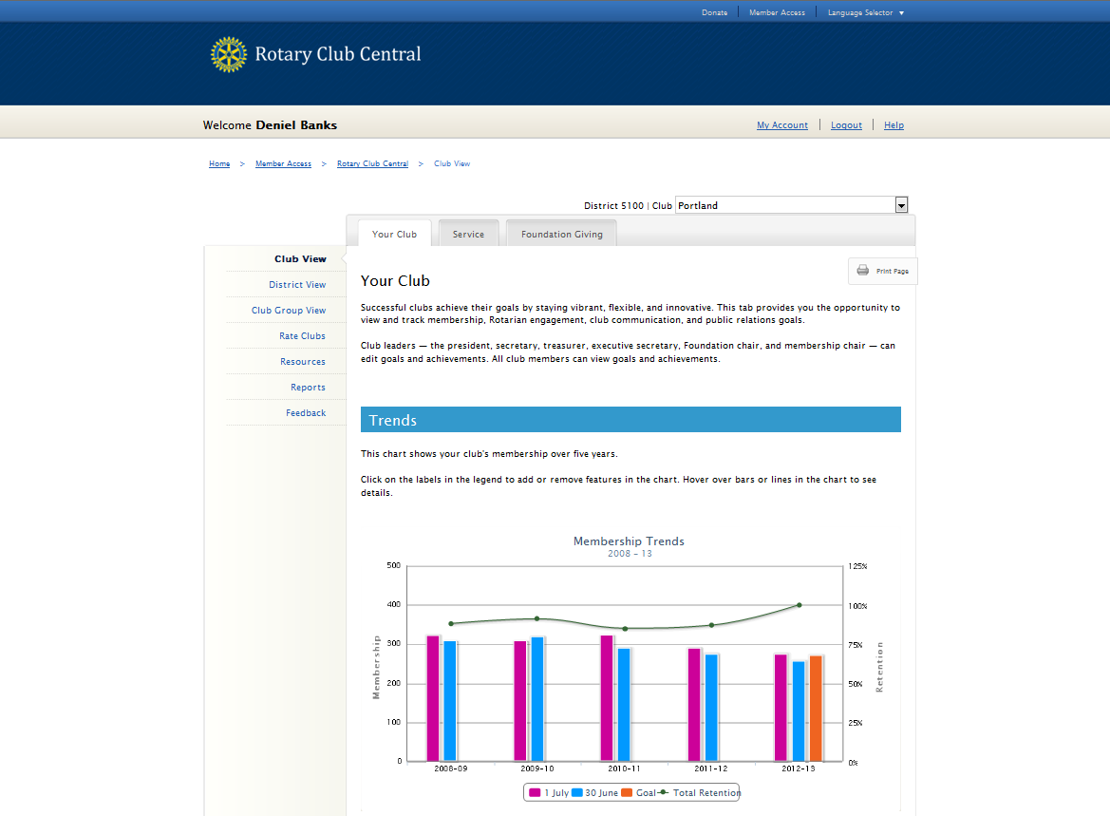
John Q. Rotarian
District: 0000 | Club: Your Club
Notes:
You will always begin at the Your Club tab.
(CLICK)
You can see that in addition to Your Club, there are tabs for Service and Foundation Giving
For Your Club, we start with the Trends section which shows your club’s membership retention over the last five years.

Slide 6
Introduction to Rotary Club Central
Entering Goals
Questions
Notes:
So, now that we’ve covered the basics, let’s talk about entering goals.

Slide 7
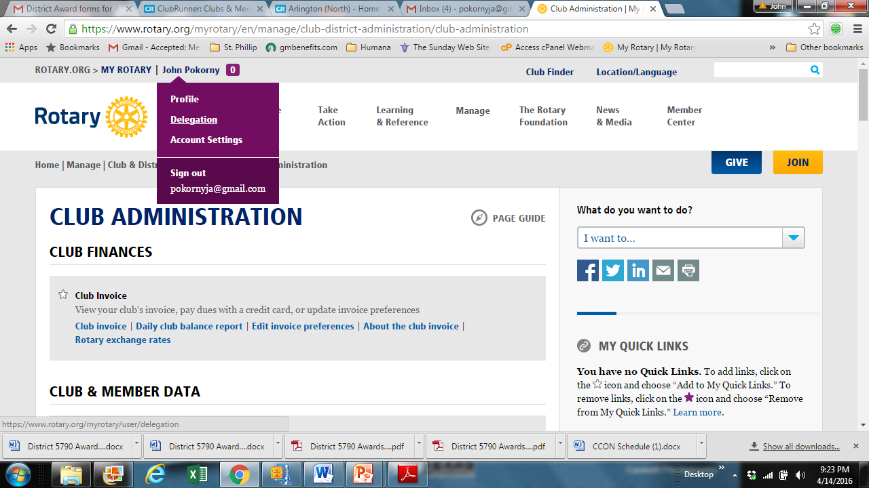
Who can Manage club goals?
CLUB
President Secretary
Treasurer
Foundation Chair Membership Chair Executive Secretary
For the club executives on this list to have access the club president must delegate them under the presidents MyRotary page.
Notes:
Everyone in the club can view goals, but who specifically can enter and edit goals?
(CLICK)
At the club level, the president, secretary, treasurer, Foundation chair, membership chair, and executive secretary can all enter goals for the year they are in office?
(CLICK)
At the district level, the district governor, committee chairs, and district executive secretary can view and edit the goals for all clubs in the district for their year. The assistant governors may view all goals but only edit the goals for the clubs in their club group. This is so district officers can assist a club with reporting its goals in case the club is unable to do so. When goals are set on behalf of a club, an automated email is generated and sent to the club president listing the goal change and who made the change.
Ideally, club officers will enter their club’s goals during their elect year.
(CLICK)
However, current, incoming, and immediate past officers can view all year tabs, and edit goals and achievements for their own year at any time (even after their year is over).
So, let’s take a look at two examples of a club entering a goal.

Slide 8
Entering your Goals
Set goals in each of these 3 tabs
Scroll down past various trend screens to enter goals

Slide 9
To enter goals, Click the
Button

Slide 10
Entering Membership Goals

Slide 12
percentag
Set your goals as a percentage of membership

Slide 13
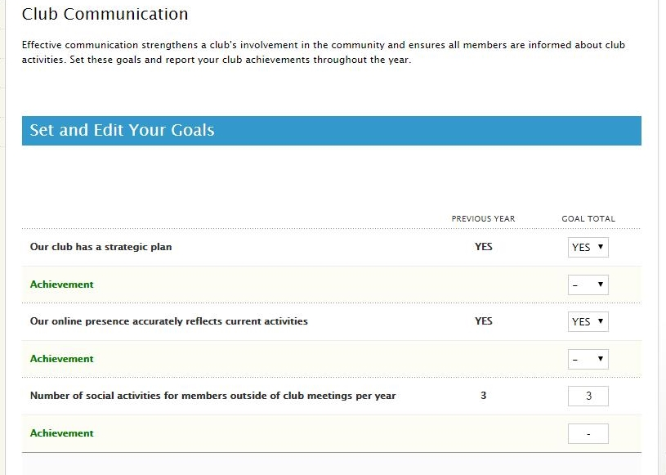

Slide 14
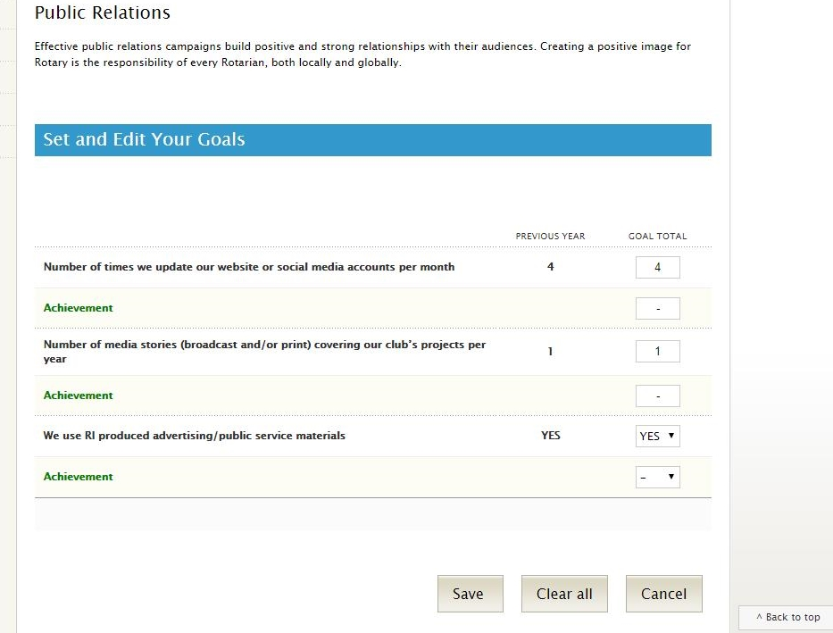
Make sure you SAVE!!!

Slide 15
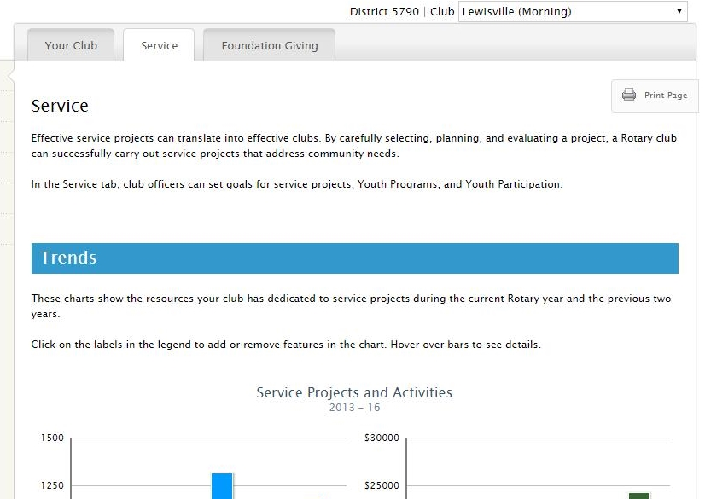
To enter Service Goals scroll past your clubs 3 year trends

Slide 16
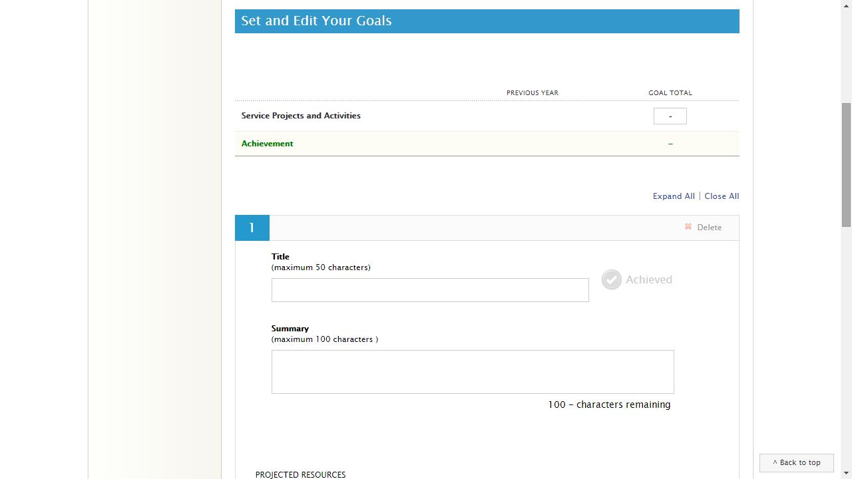

Slide 17
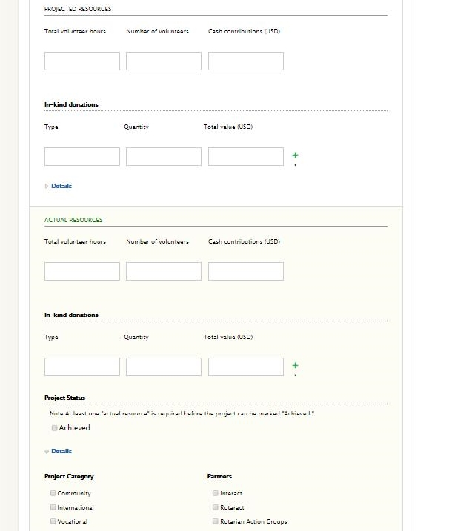
Click Expand project view to enter
Your Projected Goal
Actual Resources used
When project is complete

Slide 18
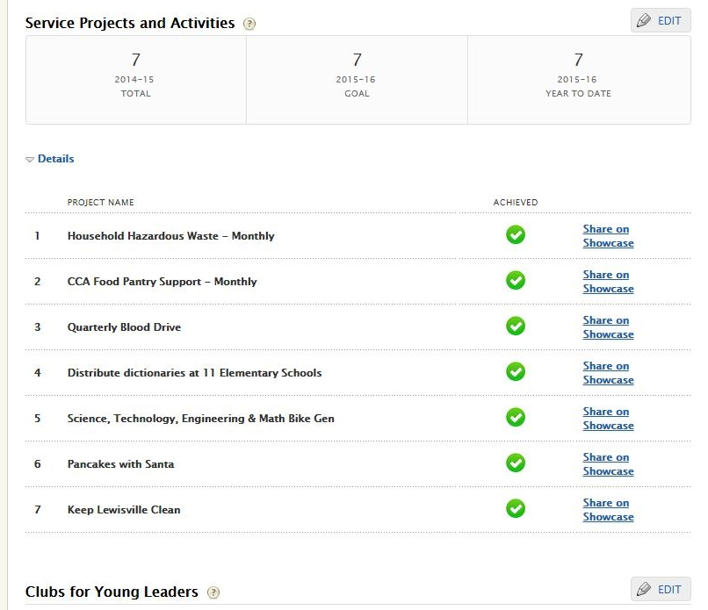

Slide 19
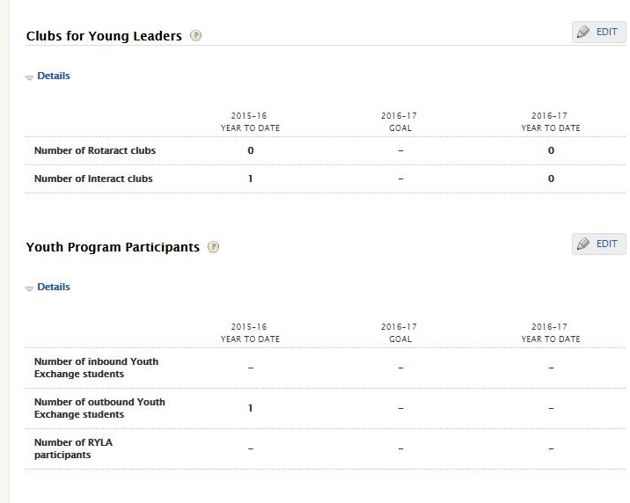
After entering Service Project Goals, enter clubs New Generations Goals
Don’t forget to save each goal you have edited before leaving screen for next goal…

Slide 20
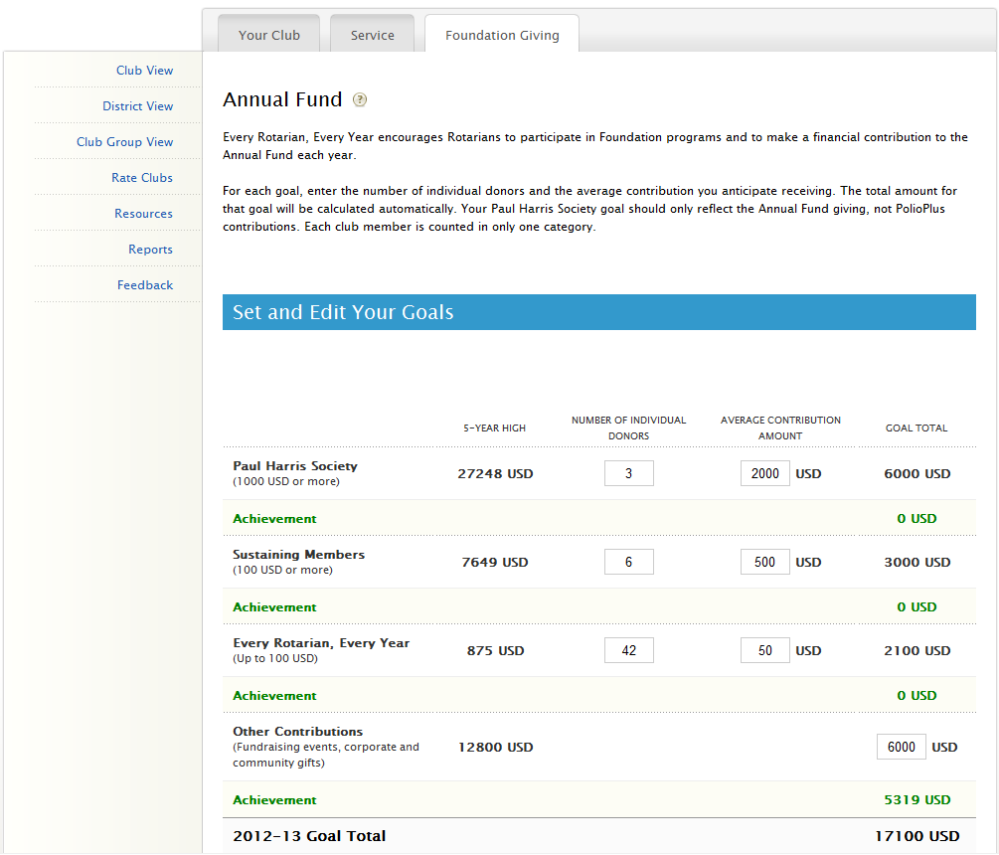
Last Step – set
Foundation Goals
Notes:
From the edit page, you have instructions to help you fill out the supporting goals. For even more information you can click the question mark next to Annual Fund.
So, for this goal you will have to estimate a number of individual donors and then the average contribution amount for each goal level. As you fill in these sub-totals, you will see them automatically added to reflect your club’s total Annual Fund goal.
(CLICK)
Underneath each sub-goal is the club’s achievement towards that goal. You’ll notice this achievement information is automatically populated from Rotary International’s database and does not need to be entered by the user. This is updated daily.

Slide 21
Presidential Citation
Eligibility for a Presidential Citation will be tracked
by Your Clubs Rotary Club Central Records
Membership & Foundation
Humanitarian Service, New Generations & Public Image
Membership Attraction and Engagement
Rotary tracks member records
You report engagement
Foundation Giving
Rotary tracks giving
On line tool Adoption
Membership reports skills
You prepare Rotary Showcase & report members in discussion Groups
Rotary tracks member involvement in RCC & RAG
You report member involvement in foundation seminar and working with partner clubs and agencies
Rotary tracks Interact & Rotaract but you report member activity
You report Public Image Progress in Rotary Club Central

Slide 22
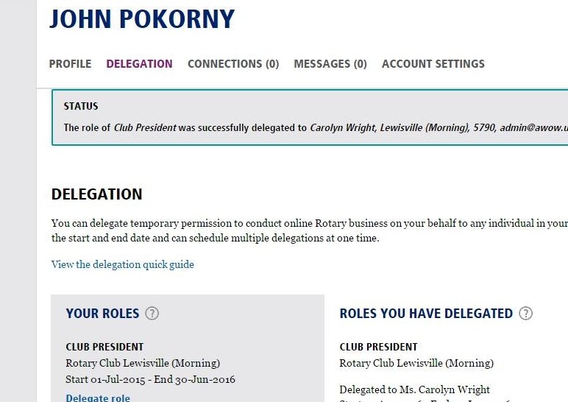
Updating Member professional Skills
Rotary Club Central
Roll Delegation
3
1
2

Slide 23
Questions?
Notes:
(Answer any questions possible)
For more specific details about each goal and achievement, please refer to the Club Reference Guide. The District Reference Guide provides further information about the district-level features we’ve covered. These are both available in the Learn module at the MyRotary website.
Any additional questions can be directed to the Contact Center or your Club and District Support Representative.
Thank you.

