Slide 1
Why Your Club Needs a Website
Why a Website is Important, and What it Does for You
B. R. Mullikin
4/16/16

Slide 2
Why Does Your Club Need A Website?

Slide 3
Why does your club need a website?
What problem are we trying to solve?
A public facing resource were visitors and guests (and potential members) can find information specific to your club.
A private resource to collect, store, and share information about committees, private events, & volunteer opportunities.
Why is this a problem worth solving?
Sometimes your own speakers won’t know what your club does.
Practically, visitors are limited to other Rotarians or those who are invited by members.
Answer the question: why should a visiting Rotarian visit your club, rather than another club in the area?
Volunteer opportunities are missed because of a “closed schedule.”
Information about various committees is difficult to obtain.
The public at large does not hear about all the great things that are going on at your club.

Slide 4
So What Are Some Good Goals?

Slide 5
Some Good Goals
To know what events are going on
A simple but organized way for Rotarians and visitors to know what events are going on at your club, their location, and other event information.
Provide an easier way for your club members to volunteer
To provide a way for club members to volunteer for events or services, and to be provided reminder notifications of their commitment.
Provide information to visiting Rotarians
To provide information for visiting Rotarians so that they may find and visit your club. (Who is speaking? When? Where? etc.)
Publicise club activities / Gain new Rotarians
To provide information and “marketing” materials to potential Rotarians, so that they can find out more about our club (not just about Rotary generally, but about your specific club.)
Make Your Rotary Club a Community Leader
Encourage other members of the community to become involved in Rotary projects (when appropriate) and to encourage others by our example to follow the 4-way test.

Slide 6
A Website for Your Club

Slide 7
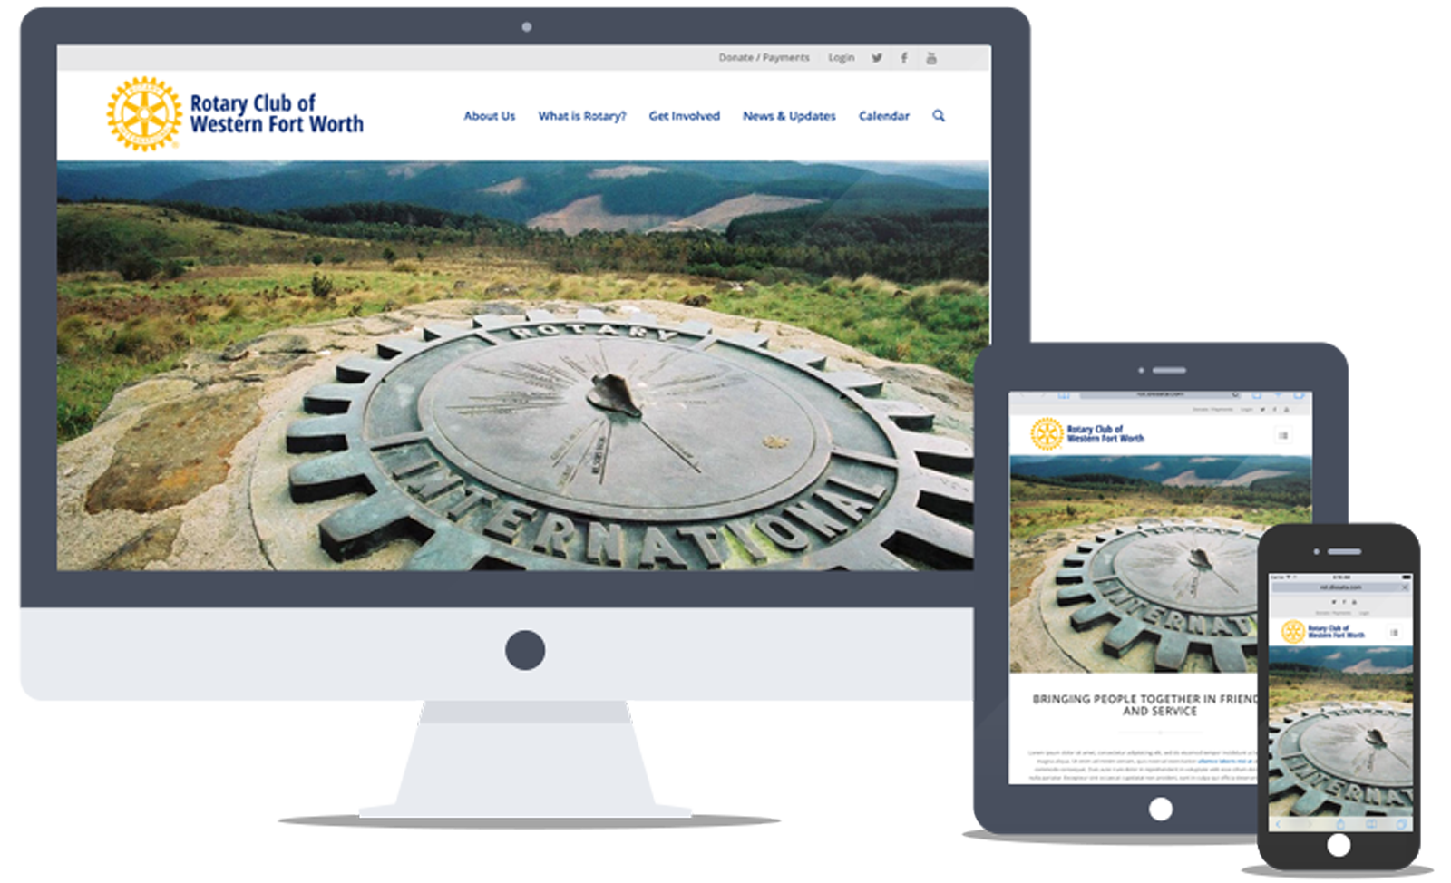
A Responsive Website for Your Club

Slide 8
Some Necessary Technical Features
A Responsive Design
Be sure that your website is able to be accessed and read on all various devices people use these days. This includes desktops, laptops, tablets, & phone.
Use Rotary’s Visual Style Guidelines
Your website should follow Rotary’s published visual guidelines. This includes what colors, fonts, logos, etc., you should use.
Clear Calls to Action (CTA)
Every visitor that comes to your website will want to know or do something. Make important information easy find. And if you want the visitor to do something, like, for example, register for an event, make the action clear and obvious.
Regular updates
Make sure you make regular updates to your website. A website without current information about your club, speakers, & events, is useless.

Slide 9
Some Common Features

Slide 10
Some Important Features
A Calendar
A calendar so that every Rotarian in your club knows what events are going on, a maps showing their location, and any relevant information.
Sign Up & Register for Events
Your calendar should allow members to sign up or register for both public and private events.
Information & Pictures
Present Information about your club, your speakers, events, & how people can become involved.
Newsletters & Social Media
Provide a recap of events by volunteers w/ pictures to interested Rotarians
Share our successes with interested community members
Distribute a weekly newsletter for your club and/or share on social media

Slide 11
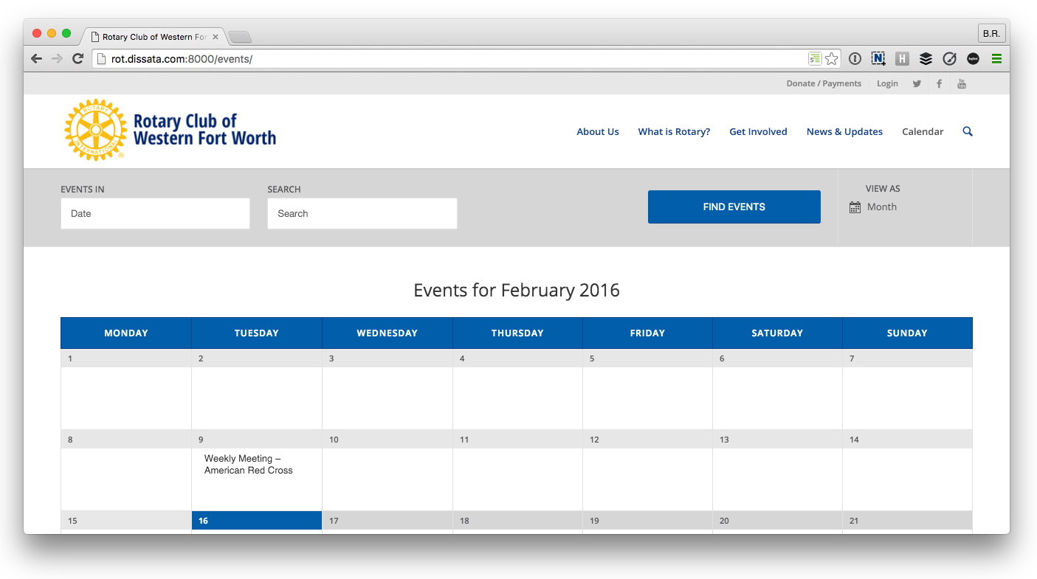
The Calendar

Slide 12
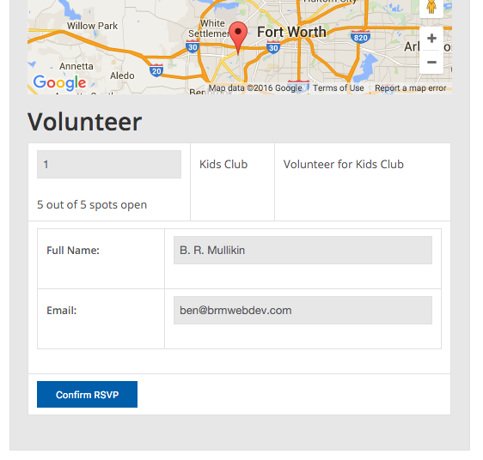
Calendar Feature Ideas
Register for Events
Subscribe to the calendar and receive automatic updates on Rotary events.
Sign up for time slots for events, and receive a notification email reminding you of your commitment
Organizers: know who is signed up, allocate “backups” and send emails to your volunteers

Slide 13
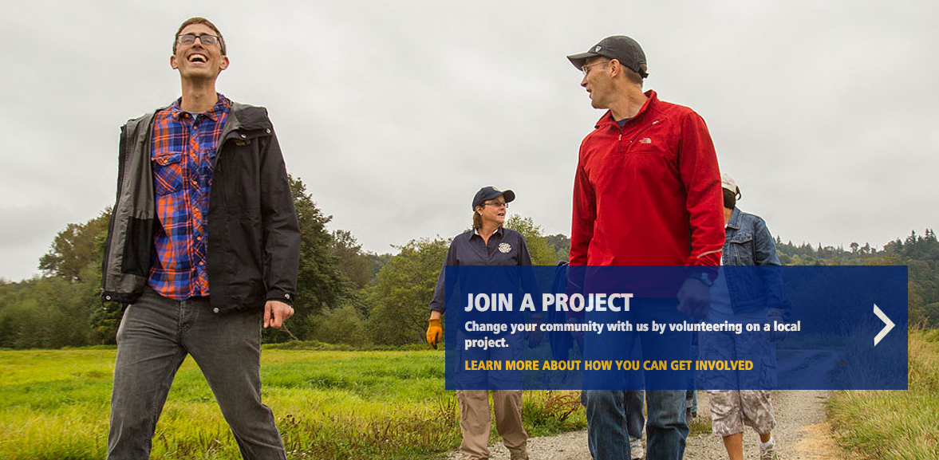
Provide Information to the Public
Information & Pictures
Share more about our Club
Establish Public Image
Share your successes with the community.

Slide 14
Newsletters & Social Media
Share the on Social Media
Your link to the Community
Publicise public events
Share the successes of other Rotarians
Better Public Image
Create a Newsletter
Have a mobile friendly version
Include archives
Share great content & articles with your members

Slide 15
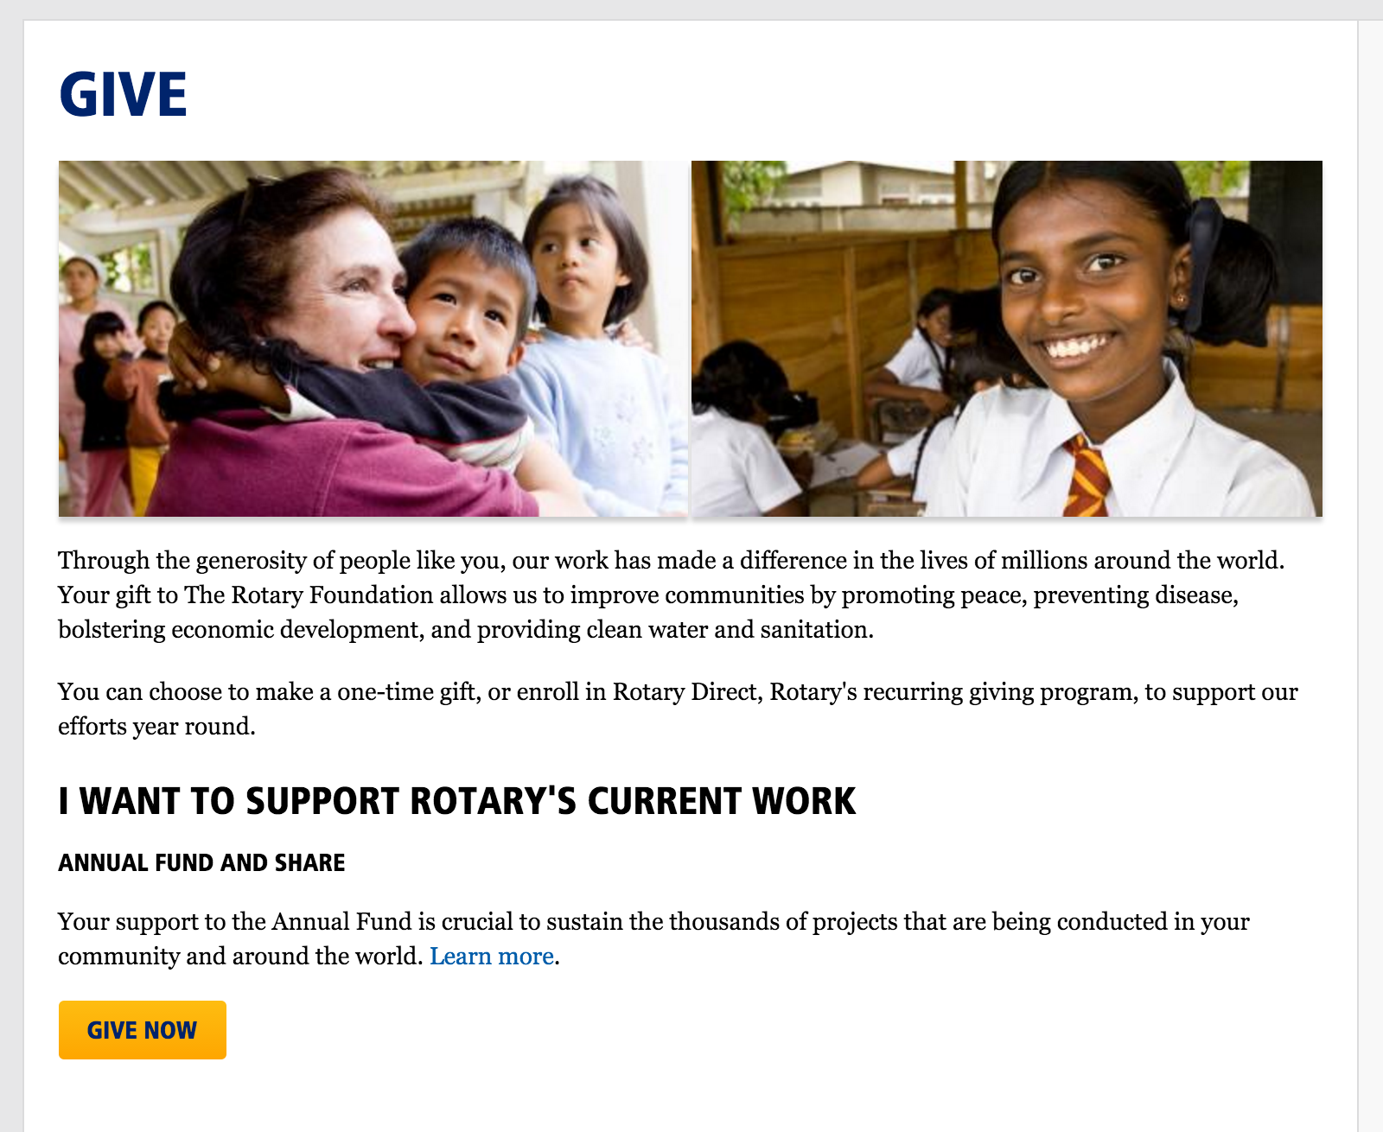
Pay your Dues or Donate
Make payments Online
Enable members to pay invoices online and payments online
Money automatically deposited into Club accounts.
Donations
Receive donations online
One-time & Recurring donations
Donations for specific events or causes, such as the Endowment Fund, PolioPlus Fund, etc.

Slide 16
So How Do I Get A Website?

Slide 17
Some Website Options
First of all, talk to other clubs!
There’s no need to reinvent the wheel. If your club doesn’t have a website, consider talking to members of other clubs who do have a website. Ask them what they use and if they are happy with their solution. Learn from their mistakes!
Recognize there are no perfect solutions
Every website option has it’s own set of pros and cons. Find a solution that works for the budget and needs of your club.
Clubrunner
Clubrunner is a website solution aimed at clubs who need a simple and easy way to manage their club’s affairs. Many clubs in our district use Clubrunner.
Wordpress, or a Custom Website
Clubrunner is not an ideal solution for every club. Many clubs prefer a more custom solution built on wordpress or from scratch that caters more specifically to their needs.

Slide 18
What if We Already Have a Website?
(That’s Great!)

Slide 19
If you already have a website...
Help your club create content
Collaborate with your club’s webmaster to add and regularly update content
Determine what photos and documents should be shared with Rotarians.
Central Database for Documents & Images (share your work!)
How much work is duplicated each year?
Let’s determine what photos and documents should be shared with Rotarians.
What photos and documents should be shared with the public?
Brochures, Photos, Word Documents, PDFs, Powerpoint Presentations, & more...
Share our work with other Rotarians

Slide 20
Let’s Make it a Reality
What each of us do at each of our clubs should be shared!
Bring your club’s “vision” of Rotary to the Community

