Slide 2
Larry Lohman, Rotary Club of Kent 2021-2022 District 6630 Governor

Slide 3
David Skrzynski, Rotary Club of Berea 1998-1999 District 6630 Governor
Pledge of Allegiance

Slide 4
Moment of Inspiration
Dr. Joseph Boysel, Rotary Club of Hudson

Slide 5
Update on the Vision of The Rotary Foundation Kevin Kelly, The Rotary Foundation
Major Gifts Officer

Slide 6
2020-2021 District 6630 Foundation Awards Ceremony
Patricia Myers, Rotary Club of Hudson Clock Tower
2020 – 2021 District 6630 Governor
Jim Lechko, Rotary Club of Lakewood-Rocky River
Chair, District 6630 Foundation Committee

Slide 7
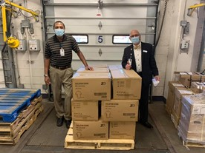
Responding to COVID-19
Akron donates gowns to hospitals

Slide 8
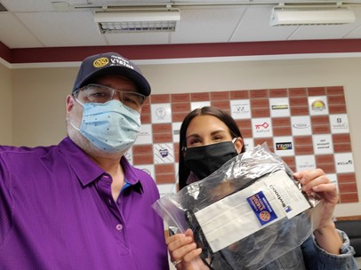
Responding to COVID-19

Slide 9
Responding to COVID-19
Bedford delivers PPE

Slide 10
Responding to COVID-19
Cuyahoga Falls provides PPE

Slide 11
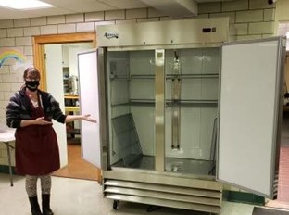
Feeding our Neighbors in Need
Ashtabula provides a new Freezer

Slide 12
Feeding our Neighbors in Need
Cuyahoga County NW – Lorain County Cluster

Slide 13
Feeding our Neighbors in Need
Medina Sunrise Food Bank

Slide 14
Our Clubs Continued to Support our Communities
Burton-Middlefield providing new bedroom furniture to Next Step

Slide 15
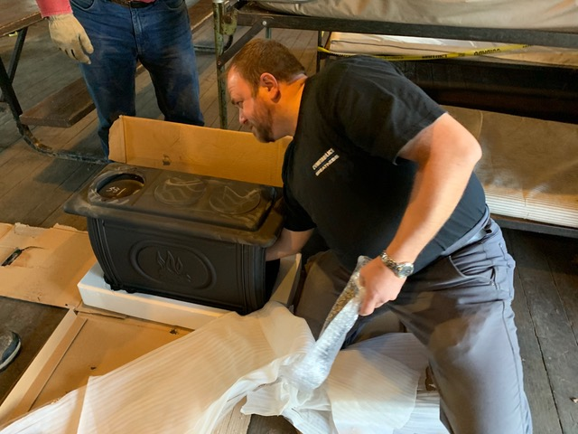
Supporting our Communities
North Summit Cluster installing heaters in Camp Manitoc Scout Cabins

Slide 16
Akron Hope

Slide 17
Our Clubs Continued International Service
Kent – CoCoDa, Haiti
Shoeboxes for the Children of the Dump – Nicaragua
Shelterbox
Gift of Life
Haitian Vision Foundation
Happy School Project – India
Pediatric Improvements – Haiti
St. Thomas, Virgin Islands Literacy

Slide 18
Rotary Polio Plus

Slide 19
Major Donor Awards

Slide 20
Major Donor 2018-19
Akron:
W. Stewart Buchanan
Burton-Middlefield:
Leonard Golding
Cleveland:
William B. La Place
Kent:
David B. Hansford
Nordonia Hills:
John Bosco & Rebecca Ann Milia
Robert W. Smith (MD Level 4)

Slide 21
Major Donor 2019-20
Cleveland:
Julie Brouhard
Jerold R. Smith
E-Club NEO & Akron:
Stephen P. & Cheryl Ann Warren
Geneva:
Hal D. Cooper
Hudson Clock Tower:
Patricia A. Myers & John Laird
Stow-Munroe Falls:
Ronald Taggart

Slide 22
Major Donor 2020-21
Burton-Middlefield:
James T. Eldridge
Cleveland:
Association of Indian Physicians of Northern Ohio
George H.L. Porter (MD Level 4)
Fairlawn:
Arne van der Heyde (MD Level 2)
Hudson:
Joseph S. Zapytowski
Kent:
Kenneth E. Wertz (MD Level 2)
Mantua & E-Club NEO:
Stephen L. Zabor & Kathryn M. Craig (MD Level 2)
Strongsville:
Neal A. Kablunde
Westlake-Bay Village:
Herbert John Hoppe Jr.
Joseph W. Hudak

Slide 23
Bequest Society

Slide 24
Bequest Society
Berea:
Matthew & Jennifer Lombardi (BS Level 2)
Geauga County West:
John Zachariah
Lakewood-Rocky River:
Vicki Foster (BS Level 2)
Mentor:
Dale Smith (BS Level 4)
Strongsville:
Fareed Siddiq (BS Level 4)
Willoughby:
Stephen David Atkins

Slide 25
Paul Harris Society

Slide 26
Paul Harris Society
Akron:
Nathanael Billow
W. Stewart Buchanan
John R. Daily
Lynda L. Farkas
William J. Manby Sr.
John Margida
Robert McGregor
Sandy Naragon
John L. Reyes
Cheryl Ann Warren
Aurora:
Alan C. Conners
Brady Krebs
Berea:
Mathew Gian Lombardi
Donald E. Voigt
Chagrin Highlands:
Karl Amstadt
Chardon:
Dan LeScoezec
Trevor Wilson
Cleveland:
Julia R. Brouhard
Howard Lichtig
George H. L. Porter
Jerold R. Smith
Julie A. West
Cuyahoga Falls:
Dale S. Lazar
E-Club NEO:
Stephen P. Warren
Fairlawn:
Gurinder Rana
Arne van der Heyde
Geauga County West:
John Zachariah
Hillcrest Sunrise:
Ryan Wenger
Hudson Clocktower:
Patricia A. Myers
Hudson:
Thomas Tobin
Lakewood-Rocky River:
Douglas O. Cooper
Matthew Daugherty
James D. Lechko
Lakewood-Rocky River Sunrise:
Kathryn Jayne Berkshire
W. Todd Kiick
William A. Minnich
Mantua:
Stephen L. Zabor
Medina Sunrise:
Toby R. Butt
Mentor:
Wayne Brodnan
Richard Cooper
Lee Quignano
Nordonia Hills:
John W. Bosco
John Graves

Slide 27
Paul Harris Society
Northampton Cuyahoga Valley:
David E. Jones
Painesville:
Suzanne Ellis
Don Lucker
Stuart Lucker
Stow-Munroe Falls:
William Choler
Ronald Taggart
Strongsville:
Eddy Bond
Fareed Siddiq
Richard C. Voigt
Tallmadge:
Kimberly F. Ray
Wadsworth:
John C. Whitlam IV
Westlake-Bay Village:
Herbert John Hoppe Jr.
Joseph W. Hudak
Willoughby:
Thomas Ruple
Timothy W. Wright Sr.

Slide 28
Club Awards 100% Every Rotarian Every Year (EREY) & 100% The Rotary Foundation

Slide 29
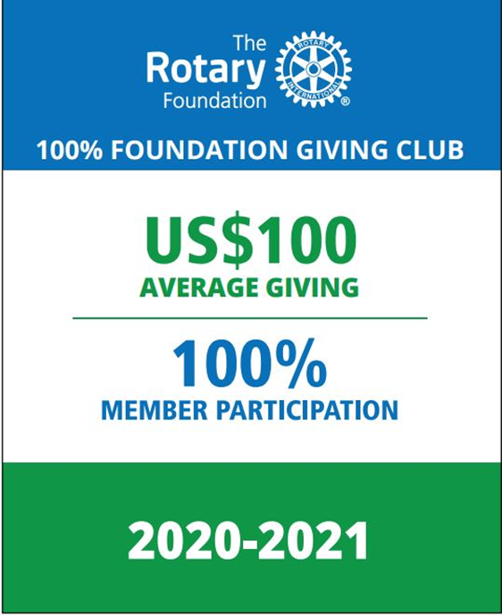

Slide 30
Club Awards 100% Every Rotarian Every Year(EREY) & 100% The Rotary Foundation
Burton-Middlefield
Larry Fox – President
Chagrin Valley
Kathaleen McWilliams – President
Cuyahoga Falls
Richard S. Pollak – President
Hillcrest Sunrise
Scott Andrew Mills – President
Medina Sunrise
Kevin Wermer – President
Northampton Cuyahoga Valley
Joseph D’Avello – President

Slide 31
Polio Plus Clubs

Slide 32
Polio Plus Clubs
Chardon
Glenn Pisching – President
Cleveland
Ronald Felgenhauer – President
Mantua
Dean Olson – President
Wadsworth
Joe Ertl – President

Slide 33
Top Giving Clubs

Slide 34
Top Giving Clubs
3rd Place
Stow-Munroe Falls
Linda Trevorrow – President $274.63 Annual Per Capita

Slide 35
Top Giving Clubs
2rd Place
Westlake-Bay Village
Dr. Scott Goggin Sr. – President $304.58 Annual Per Capita

Slide 36
Top Giving Clubs
1st Place
Lakewood-Rocky River Sunrise
Eric Jolly – President $345.89 Annual Per Capita

Slide 37
Paul Harris Fellow Recipients

Slide 38
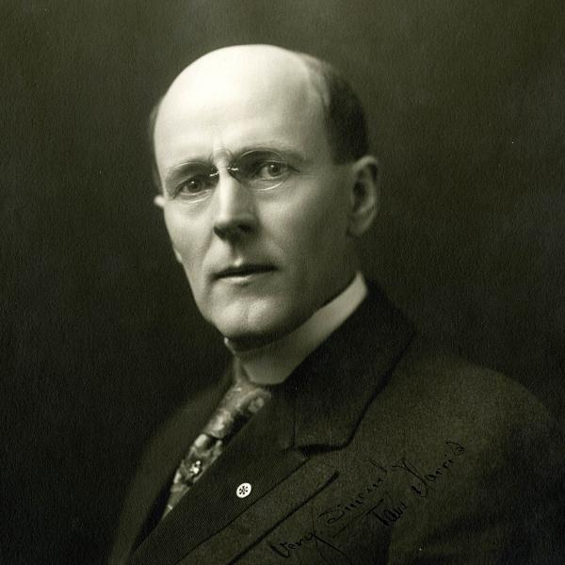
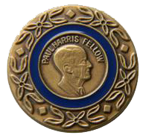
Robert Smith
for your donation of
10,000 Paul Harris Fellow points.
Paul Harris

Slide 39
Paul Harris Fellow Recipients
Rotary Club of Ashtabula Trevor S. Sprague – President
Bruce Schlosser

Slide 40
Paul Harris Fellow Recipients
Rotary Club of Burton-Middlefield Larry Fox – President
John Stoddard

Slide 41
Paul Harris Fellow Recipients
Rotary Club of Chagrin Valley Kathaleen McWilliams – President
George Pogan

Slide 42
Paul Harris Fellow Recipients
Rotary Club of Cuyahoga Falls Richard S. Pollak – President
Tom C. Nolan

Slide 43
Paul Harris Fellow Recipients
Rotary Club of Hillcrest Sunrise Scott Andrew Mills – President
Alan Semethy

Slide 44
Paul Harris Fellow Recipients
Rotary Club of Medina Sunrise Kevin Wermer – President
Krista Wasowski

Slide 45
Paul Harris Fellow Recipients
Rotary Club of Northampton Cuyahoga Valley Joseph D’Avello – President
Tom Morehouse

Slide 46
Paul Harris Fellow Recipients
Rotary Club of Port-Summit Richard Cole Jr. – President
Tracy (Fast) Sayers

Slide 47
Paul Harris Fellow Recipients
Rotary Club of Ravenna Shawna Borkoski – President
Michael Tontimonia

Slide 48
Paul Harris Fellow Recipients
Rotary Direct Recipient
Sandra Croft - Rotary Club of Strongsville

Slide 49
Thank You!

Slide 50
Special Thanks to…
Event Sponsor:
Rotary Club of Burton-Middlefield
Foundation Gala Committee:
Jim Lechko, Rotary Club of Lakewood-Rocky River
IPDG Pat Myers, Rotary Club of Hudson Clocktower
DG Larry Lohman, Rotary Club of Kent
PDG Beverly Ghent-Skrzynski, Rotary Club of Cleveland
DGE David Jones, Rotary Club of Northampton-Cuyahoga Valley
Celeste Rininger, Rotary E-Club NEO
DGN Julie Brandle, Rotary Club of Akron
Registration:
Karen Melton, District Treasurer, Rotary Club of Cleveland
Kathy Berkshire, Rotary Club of Lakewood and Rocky River Sunrise
PDG Cheryl Warren, Rotary Club of Akron

Slide 51
Special Thanks to…
Facilities:
PDG Beverly Ghent-Skrzynski and Sheron Lerch, Rotary Club of Cleveland
Photography:
Maureen Garnett, Rotary Club of Hillcrest Sunrise
Windows on the River:
Chef, Kris, Bobbi, Theresa and the Banquet Staff
The Rotary Family:
To all who have made this night possible and each of you in attendance tonight

