Slide 1
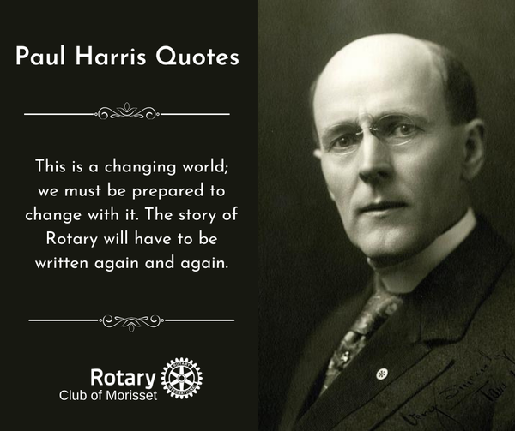

Slide 2
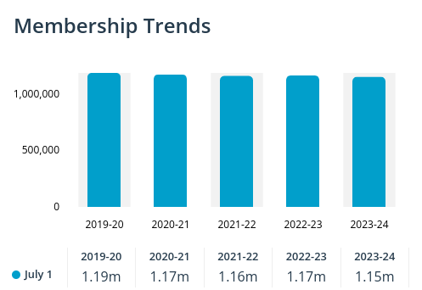
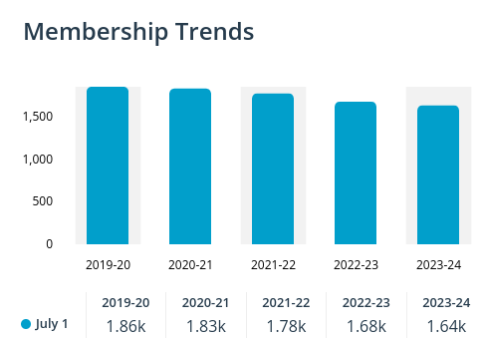
Membership Trends
Global
Our District

Slide 3
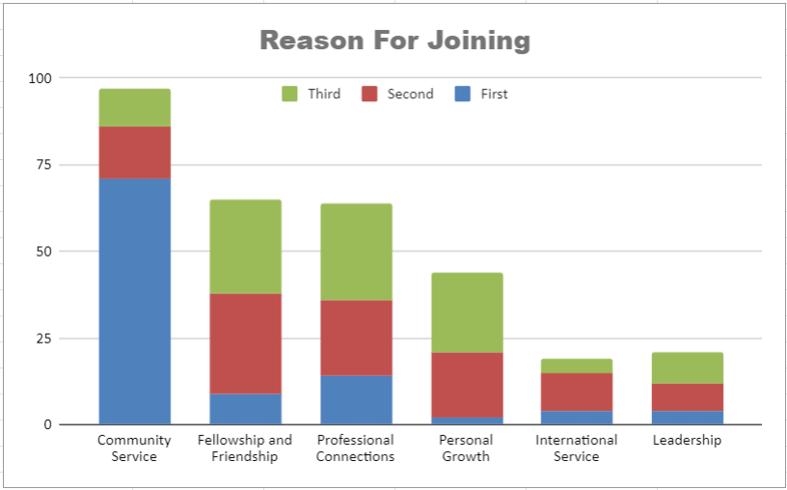
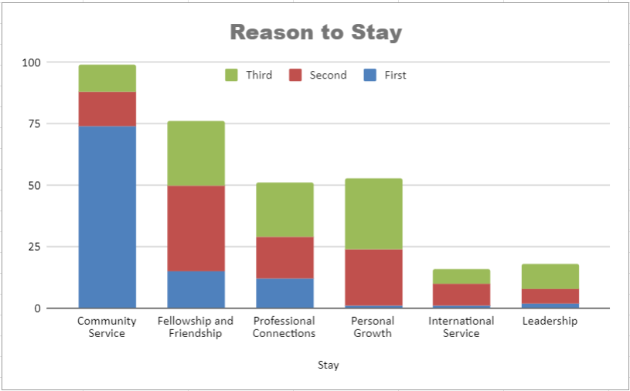
Why do people join Rotary?
Why do Members Stay in Rotary?
Notes:
Question one: Which of below describes why you joined your Rotary Club?
Community Service, Friendship and Fellowship, Professional Connections, Personal Growth, International Service, Leadership
The respondents ranked them from 1 to 6.
Here are the results of 104 respondents to our survey of District 6630 new members.
Blue on the bar graph represents their first choice, red second and green 3rd for each category
Community Service, Fellowship and Professional Contacts were the top three reasons.

Slide 4
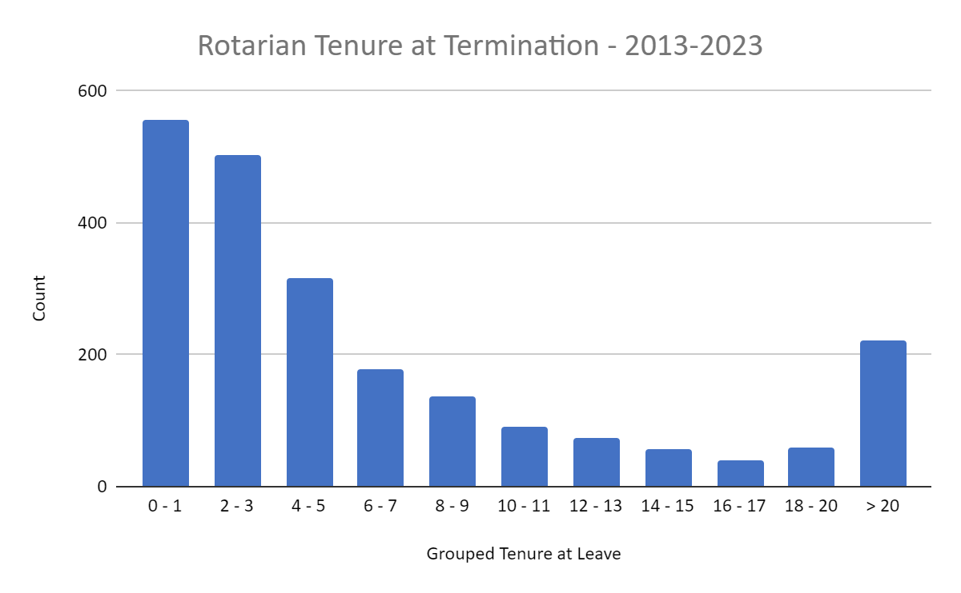
Who is leaving Rotary?
Notes:
The data is based upon District 6630 terminations and demonstrates that the greatest number of terminations occur in the first three years of membership.(approximately 50%)
This is very similar to national RI data for the US. As you can see members leaving in their first and second year are significantly greater than all other years.

Slide 5
What the data suggest to you ?
Notes:
As we reviewed the three charts what thoughts do you have regarding attracting and retaining new members? Try to be brief and we will record them.
Prompts:
50% of new members leave in their first three years.
Keep members engaged through service projects.
Have frequent opportunities for fellowship
Engage new members
Need Consistent effort to admit new members.
Engage members in service.

Slide 6

Notes:
Our hope and goal for every member!

Slide 7
Intentional and Engaging Leadership
Reimagine Rotary.
Pursue the vision with members
Get people to yes. It is the members’ club.
Listen and be fluid.
Communicate, communicate, communicate
Encourage members to be open to change to better serve our communities and provide new paths to service and fellowship as Rotarians.
Notes:
Have and embrace a vision. Reimagine Rotary.
Pursue the vision in such way that members are motivated and engaged.
Get people to say yes. It is the members club.
Listen and be fluid.
Encourage members to be open to change to better serve our communities and provide new paths to service and fellowship as Rotarians.

Slide 8
Clear Membership Goals and a Growth Plan
Make growth a top priority
Active Membership Committee
Retention is as important as attraction!
Engage Club Members
Develop a plan
Net Membership = trailing metric
Manage leading metrics (service projects, community events, social media activity, partner involvement, etc.)
Track progress regularly and adjust
Notes:
Make membership growth a top priority - it starts with you!
Enter your goals in Rotary Club Central.
Have an active Membership Committee with active members.
Keep in mind that on average we lose 15% each year when setting goals.
Membership goals must include active intentional member engagement (new and experienced) as well as new member attraction
Engage Club Members in planning and goal setting.
The plan should include community partnerships, regular service and fellowship events, and intentional member engagement.

Slide 9
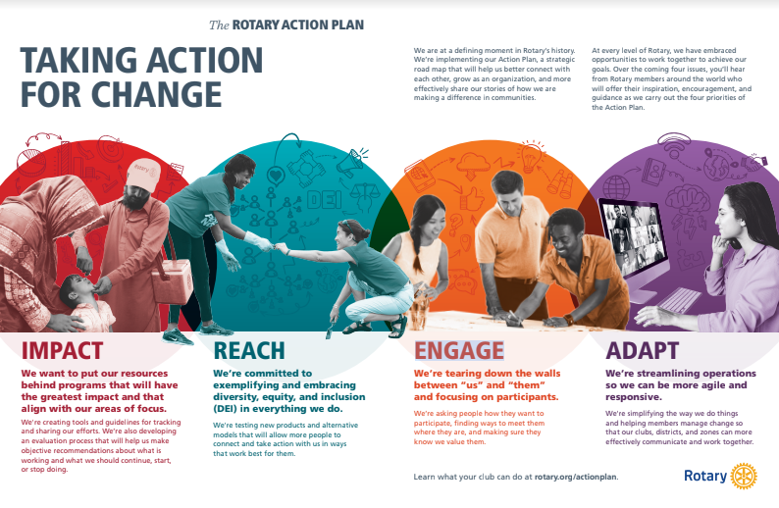

Slide 10
Increase Our Impact
Add to your signature projects!
Have many service events - as frequent as twice per month
Measure your impact - number people affected, dictionaries delivered, lives saved, books purchased, dollars invested, actions taken, cases averted, etc.
Use the metrics to tell your story!
Active, Sustained Local Public Image strategy
Help can be found on 6630 website: toolkit
  Social Media
  Webpage
  Traditional Media
  Event Visibility
Wear Rotary Gear! Make your Rotary Club brand visible!

Slide 11
Expand Our Reach
Develop relationships with those who share a desire for service and fellowship.
Have many service events - as frequent as twice per month
Partner with other organizations - chamber of commerce,Leadership, United Way Agencies, Lions, Kiwanis, schools, Habitat for Humanity, community leaders,etc.
Keep new and potential members in mind - what are the needs of the members and community?
Wear Rotary Gear! Make your Rotary Club brand visible!
Social media usage has been a key to growth.
Community pages
Follow, Follow, Follow
Share, Share, Share

Slide 12
Enhance Participant Engagement
(Experienced Members)
Friendly, Fun and Inclusive Meetings and Events
Strong Meeting Programs
Engage Members in Community Projects, meetings, and socials
Recognition
Match Service to Interests
Make fellowship a priority
Invite and welcome family and friends
Have Fun

Slide 13
Enhance Participant Engagement
(Prospective and New Members)
Invite common travelers
Welcome and acquaint them with us and our club.
Include informal fellowship events (happy hours, coffee, fireside chat)
Survey new members - what do they want from their membership experience? and then meet their expectations!
Find hosts for all new members
Engage them - they were motivated to join; do not allow that energy to wane

Slide 14


Slide 15
Increase Our Ability to Adapt
Flexible meeting options
Frequency
Virtual/in person/hybrid
Two events monthly (meeting, service, social)
Cause-based clubs - LGBTQA, Veterans, Literacy, STEAM
Rotaract - Young Professionals, University
Satellite Clubs
branch of the legacy club
meets at a different place/ time/format
may have different dues structures
minimum 8 members

Slide 16
Increase Our Ability to Adapt - Impact Clubs
For those who want to serve but cannot meet
May start as a membership type
Impact members pay dues. Impact members are invited and welcome to attend club meetings and socials
Monthly (More Frequent) Service Opportunities
Monthly social get-togethers of the members is recommended.
Impact Club members will likely move to the legacy club as they discover the friendship and fellowship there.
Marketing to the target demographic is key to growth!
https://mcmurrayrotary.com/impact/
Notes:
There are many in our communities who want to serve but are not able to attend meetings. They want to help their community. An Impact club is a group of members who cannot come to meetings but want to be part of Rotary to serve their community. This has been formed by other clubs as a satellite.
One could also envision this as a membership type
Impact members pay dues. The amount would be up to individual clubs.
Impact members are welcome (but usually unable) to attend club meetings and socials
Monthly get-togethers of the members is recommended. An example is a monthly pizza beer happy hour where an experienced Rotarian also shares Rotary history or other orientation in a light atmosphere. Fireside chats, weekend coffee meetups or other get togethers are recommended.
It is expected that a number of these Impact Club members move to the legacy club as they discover the friendship and fellowship there.

Slide 17
Next Steps
Decide whether you want to continue as is or increase our service to our communities and the world
Develop a plan with key leaders and members
Many social and service events
Active Public Image and Community Visibility
Develop More Partnerships
Intentionally Engage New and Experienced Members
Reimagine Rotary - Satellite Clubs, Impact Clubs, Something else?
Lead to the Plan, Take Risks, Adjust and Adapt
Resources - Your District 6630 Membership Committee can connect you

Slide 18
Getting Started Example 1 (Traditional, Incremental)
Establish Membership Committee
Brainstorm “missing members”
There are RI Tools to Help Brainstorm new members:
  Representing Your Community's Professions (classification assessment)
  Diversifying Your Club (member diversity assessment)
  Finding New Club Members (prospective member exercise)
Assign Rotarians to missing members to make contact, invite, etc.
Hold informational event for missing members (happy hour, fireside chat, coffee talk).
Determine expectations/needs of missing members - legacy, satellite, impact, other?
Followup and implement to meet expectations
Followup with “missing members” to closure
Establish new member engagement program
This is an example, not a recipe. You need to determine what works with your club!

Slide 19
Getting Started Example 2 - Action Plan…
Establish Membership Committee
Brainstorm community partners (Chamber of Commerce, city gov’t and first responders, United Way, Leadership of Anytown County, Board of DD, Kiwanis)
Assign Rotarians to meet/discuss with potential partners
Develop monthly service and community events with community partners
Create social media links with partners and community pages
Publicize monthly events to partner members, club, and community pages. Connect with traditional media as well.
Carry out service events in Rotary gear and distribute cards, brochures, invitations, etc to non-Rotarians. Collect contact info from interested people. Measure and promote your service impact
Hold informational event for interested people (happy hour, fireside chat, coffee talk).
Determine expectations/needs of interested people - legacy, satellite, impact, other?
Followup and implement to meet expectations
This is an example, not a recipe. You need to determine what works with your club!

