Slide 1


Slide 2
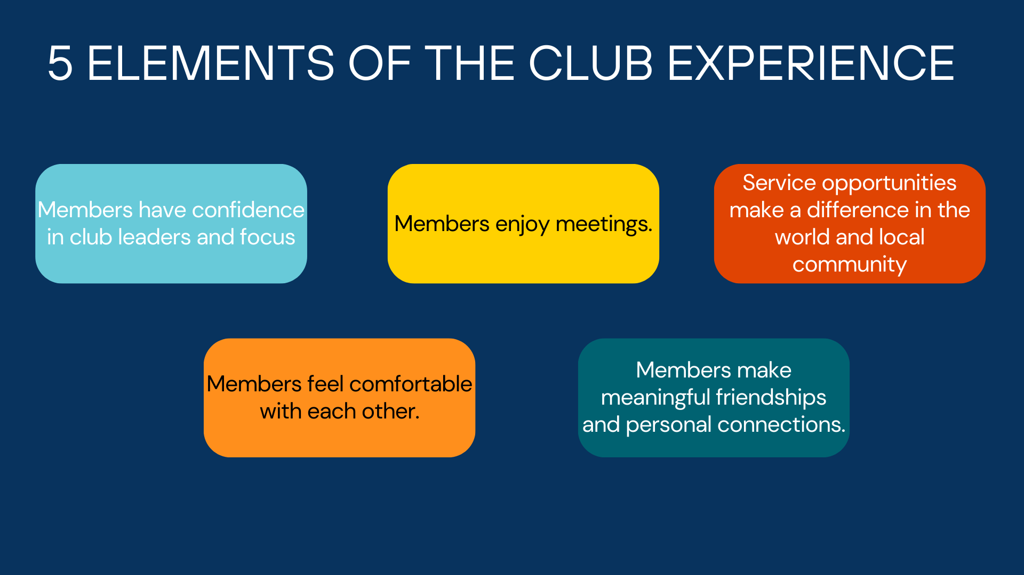

Slide 3
Session One - Meetings
Ideas for making meetings fun and to improvement engagement between members
Happy bucks ( informed of what is happening in others lives)
Trivia
Student Recognition
Anything that gets members engaging
Rotary Guess the Member
Birthday Topic (Members with a birthday in a given month have to answer a standard question like what is your favorite childhood memory? Question changes annually)
Singing Club
Rotarian Spotlight
Speaker Variety
Rotary Trivia
Quiz Show instead of Queen of Hearts/50/50
Interview members
Service Learning with Students
Stuff The Bus (School Supplies)
Invite parents and sponsors
Book Club
Share your speaker
Dictionary donations

Slide 4
Session One - Meetings
Favorite Programs/Speakers
Be The Match - transplant recipient experience
Foreign Exchange Student
Celebrity/Local Celebrity
Nonprofit friends and information
Law Enforcement
Collectors
Healthcare
Sports
Interact/RYLA
District Governor (pretty sure this was in jest - lol)
Service Projects
Education- collect school supplies
Experts on topics
4 Way Test Contest Presentations
Community impact of service projects
Use Zoom to get remote and new speakers
Use Youtube to broadcast speakers
Student of the month - recruit parents
Next slide is a link to share speakers and find speakers. Works in slideshow. Go to rotarydistrict6630.org. “Find & Share a Speaker” is in the Club and Member Resources menu

Slide 5
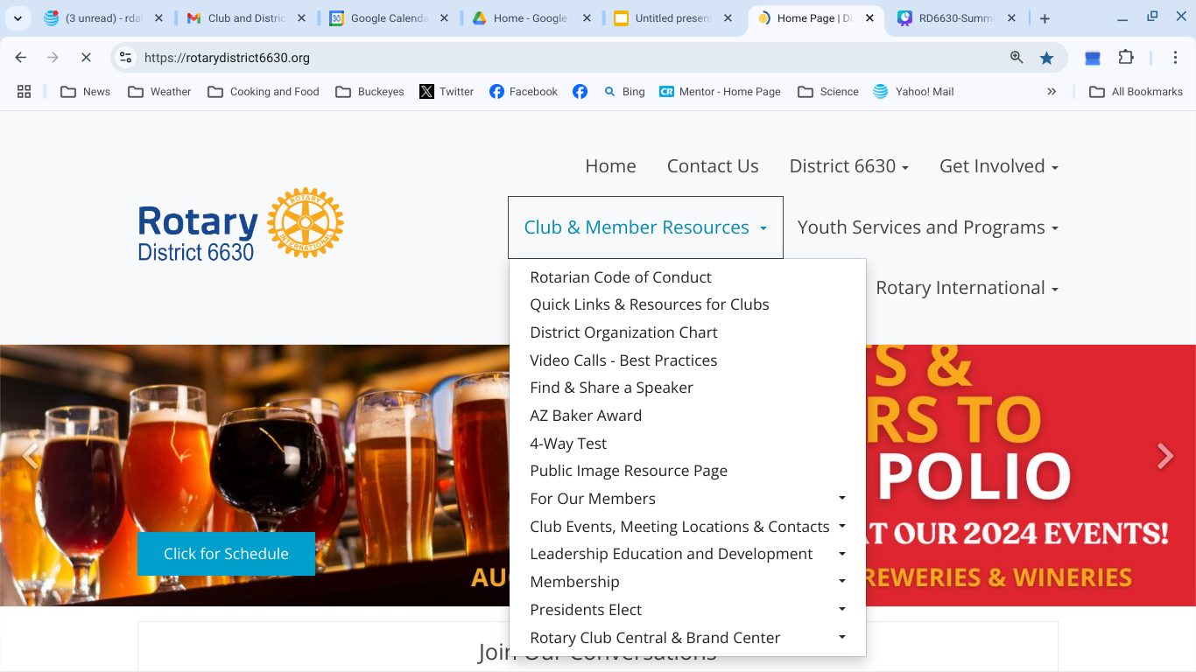

Slide 6
Session 2 - Club Growth - Stow-Munroe Falls
Held a membership Drive - $5000 Investment
Created a membership drive event with food and drinks
Used a social media campaign as well as brainstorming with members for invitees
Included a presentation on how to be involved, what we do, how to give back
Members shared personal Rotary stories
Created a digital online application (Google Form)
Follow up with attendees to “Yes”
Nineteen new members were the result with more friends of theirs still coming in
Have business cards with offer of a free breakfast to hand out

Slide 7
Session 2 - Club Growth - Medina Sunrise
Understand current club membership trends and attrition
Focus on existing members first - why a member, reinforce, engage
Consider and develop - what is the club offering to cultivate/recruit/retain members
Keep this front and center
Active PI Committee is necessary - self-promotion is very important
Many visible service opportunities
What orgs/businesses are not represented - recruit from them
Offer what is interesting to potential members
Educate about and around Rotary
Have meetings focused solely on membership retention and growth

Slide 8
Session 2 - Club Growth - Jefferson
Develop relationships with not-for-profits
Be involved with youth and schools
Consider Stay at home moms
Create family memberships to get the full family involved
Promote on Facebook
Scholarships/artist of the month/4 Way Test Contest
Do service projects and work in some meetings instead of speakers
Get the logo out - Promote and label what we do
Fundraisers
Have meeting location more visible in the community
Kids fishing derby - many service projects include/for family and youth
Be visibly active and a partner in the community (DG Note)

Slide 9
Session 2 - Club Growth - Northampton-Cuyahoga Valley
Treat membership growth like sales - inform, find a connection, ask to join
Involve new members right away
Re-engaged Interact
Get the word out - invite people to meetings
Market your best assets, mission and goals
Seek out retirees to serve
Offer service opportunities early in membership
Keep meetings interesting
Share what clubs do!
Align opportunities to serve with member interests

Slide 10
Club Growth Panel - Bedford and Twinsburg Zoom Recording
Note: The subject above is a link to the recording of the Bedford and Twinsburg presentations.

Slide 11
Session 3 - Tips from New Members - Attraction
Use technology (like QR code) to direct people to your site/FB page
Strong use of committees and involvement of members on committees
Be much more flexible in membership efforts and outreach
Follow-up is critical
Seek to diversify membership
Consider different membership types - corporate, family, at home parent
Wave membership application fee
Consider a discount (50%?)” for younger members

Slide 12
Session 3 - Tips from New Members - Retention
Social Media - 1. Tag members to create ongoing connection
2. Tag other community organizations
3. Show how we make a difference
4. Show how we are special
Seek areas of interest from new members. Use new member interest survey
Give new members opportunities to shine
Show/List everything you do
Socialize after service projects and events
Make them feel welcome
Keep people involved - listen to current members too
Build networks for all members
Use technology to engage/promote
Rotary should be a member-led organization. Flow should be from member up to leadership (This promotes faith in leadership)
Mentorship/hosting program

Slide 13
