Slide 1
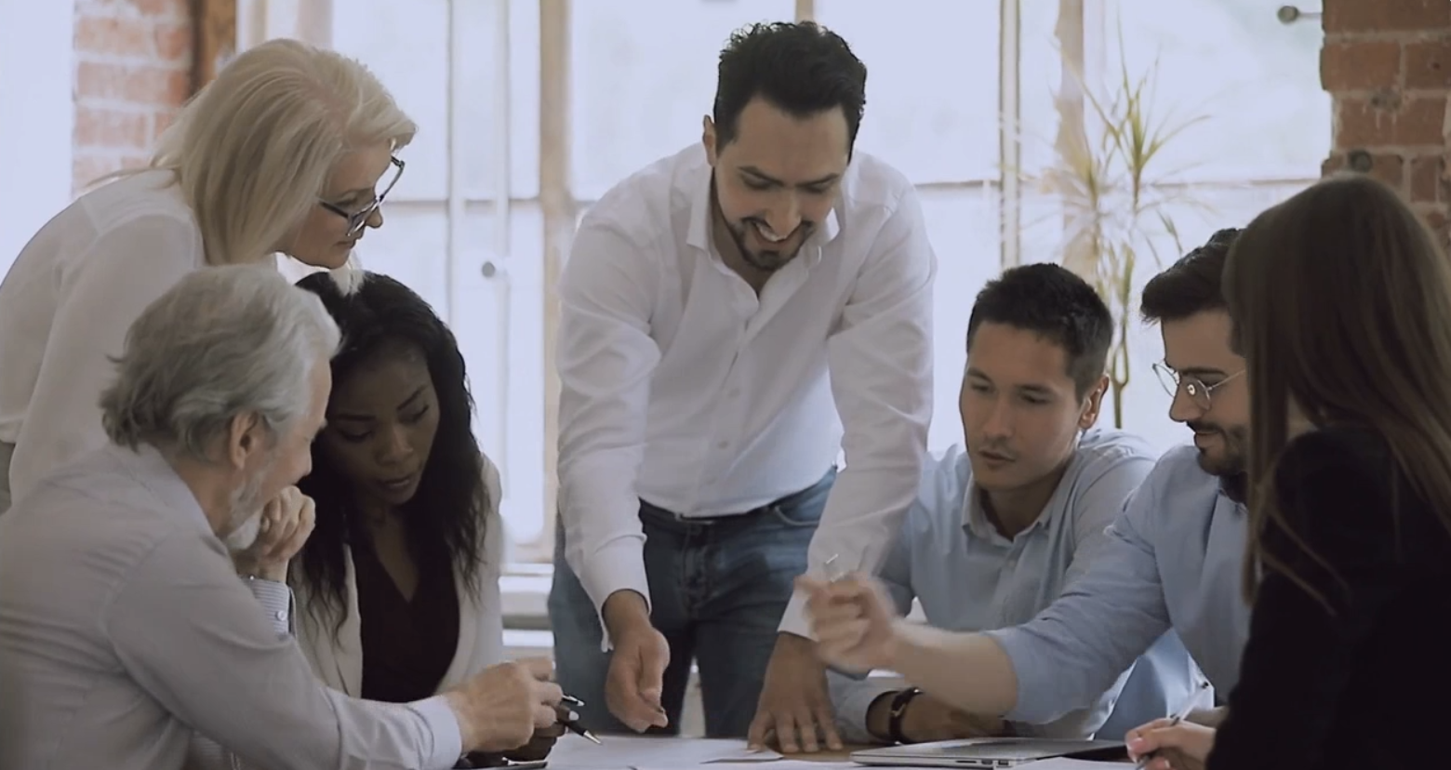


New Member Engagement and Recruiting
January, 2025

Slide 2


Table of Contents
Who and How to Engage
They’re Interested, What Do I Do Now? Upcoming Welcome to Rotary Event
Rotarian Resources
1
2
3
4

Slide 3
Who and How to Engage

Slide 4
Potential New Members
Think of your network! Family, friends, former or current business colleagues, community leaders
Ask yourself “do they exude the qualities of a Rotarian?”
Kind, thoughtful, empathetic
Community-minded
Inclusive
Service-oriented
Their physical, verbal, and online presence reflects what Rotary strives to represent and achieve
Not everyone is a good candidate, and that’s okay!

Slide 5
How to Engage
Review “Welcome to Rotary” PDF and have an elevator pitch
Provide them with the “Welcome to Rotary” one-pager
Not comfortable reaching out personally?
That’s OK!
Provide their information to the Membership Committee and we will be happy to reach out on your behalf and clearly state that you thought they would be a great Rotary member
1
2
Sample:
Rotary is a community group that focuses on fellowship, service, and initiatives that directly help our city and it’s residents, as well as all initiatives around the world!
You can give as much or as little time as you have; it’s a wonderful way to meet new people and be a helpful, active part of the community.
Gives essential information about Rotary and our group
Has a QR code to the Welcome to Rotary pdf
Has link to membership pricing
Provides Membership Committee contacts

Slide 6
They’re Interested!
Now What Do You Do?

Slide 7





Next Steps
Invite them to our Membership event
Digital and physical business cards and flyers available to give to potential members
Thursday, February 13th @ 6pm at VFW Post #4738
Old Carolina BBQ and beverages
Trivia
Intro to Rotary and meet with current members
Invite them to a Wednesday breakfast meeting
Digital and physical business cards available to
give to potential members

Slide 8
Resources and FAQs

Slide 9

Rotarian Resources
Welcome to Rotary PDF (for current Rotarian review)
Welcome to Rotary one-pager (for prospective Rotarians)
WTR Membership Event digital flyer and RSVP
Wednesday meeting “Have Breakfast On Us” RSVP
Rotary Digital Application Link, PDF Application, and Membership Pricing Information

Slide 10

Stay in touch
Membership Committee Chair: Brad Ruth | 330.524.8205 |bruth@glbainc.com

