Slide 1
TRI-DISTRICT
MEMBERSHIP
SUMMIT
Haris Sofradzija
Regional Membership Officer
October 2018

Slide 2
WHY MEMBERSHIP MATTERS
Low(er) public image = Reduced interest in joining and declining membership
Most donors are members
Declining membership = fewer donors
Membership
Public Image
Foundation Giving and Programs
Unfunded or poorly funded programs and projects = Reduced public image
Fewer donors =
Bigger contributions required to avoid funding shortfalls
Notes:
Let’s first discuss why membership matters.
It’s crucial to understand how Rotary’s membership trends affect the entire organization, including Rotary’s public image and Foundation giving and programs.
If you start anywhere on this chart, you can see how weakness in one area affects membership. Nearly all of our donors are members. So as membership declines, one of two things has to happen: Remaining donors have to contribute more to maintain current program funding levels, or if remaining donors are not able or willing to increase contributions, program funding wanes.
As program funding wanes, projects may not succeed. Members and beneficiaries lose enthusiasm and this leads to lower public image. Lower public image further hampers interest in joining, lowering membership further, and so on, and so on… It’s a self-reinforcing cycle.
This is why membership is so important at the club level. Clubs need more members in order to participate in all the activities and programs they wish to take part. With more members, there are more membership dues coming in. With more membership dues coming in, there are more funds available for allocation. That means more programs and services can be created at the club, district, and international level for members to get involved with. The more involved the club and club members are – the better our organization and respective communities.

Slide 3
5-YEAR MEMBERSHIP TRENDS, 1 JULY
2015
1.204
2016
1.203
2017
1.202
1.2 Million Members
2018
1.195
2014
1.188
Notes:
Over the past five years, we’ve stayed at around 1.2 million members. Although we experienced a decrease last year, our membership remains strong.
But if we hope to accomplish all the good in the world that we want, we need to continue to grow. We need a commitment and a continued emphasis on developing membership from our club, district, and zone leaders.
Keeping Rotary relevant and thriving into our second century while continuing to enhance our members’ lives takes a willingness to be innovative, seek out diversity, and adapt to changing needs. It starts by understanding where we are and knowing what resources and tools we have that can help us accomplish our goals.

Slide 4
DISTRICT 6600 MEMBERSHIP TRENDS

Slide 5
DISTRICTS 6630 & 6650 MEMBERSHIP TRENDS

Slide 6
78%
GENDER SUMMARY:
22%
AGE RANGE
Under 40 | 6%
40-49 | 10%
50-69 | 28%
Over 70 | 15%
UNREPORTED | 41%
AGE SUMMARY:
Notes:
Our demographic information also shows some interesting trends. Currently, 78 percent of members worldwide are male, while only 22 percent are female. Approximately 7,000 new female members join Rotary each year, though as with all global trends, these percentages vary by region, district, and even club.
The age of our members is harder to gauge, because 41 percent don’t include their age in their membership profiles. But the information in Rotary Club Central suggests that the majority of our members are between ages 50 and 69. Last year, we did see a slight increase in members under 40 years old.
Diversity is one of Rotary’s core values. It enables us to connect different perspectives and approach problems from many angles. To make sure that Rotary is still here 100 years from now, we need to look for ways to make our membership reflect the communities we serve. Making Rotary attractive to younger professionals and those reaching the age of retirement is equally important to Rotary’s future. Think about what Rotary offers them that is unique or better than what our competitors offer.
NOTE TO SPEAKER: You can view the gender and age summaries for your clubs and districts for the past five years on Rotary Club Central. Members can add their age information in their My Rotary profile.

Slide 7
3485 MEMBERS
-71 from 2015
63 CLUBS
+/-0 from 2015
DISTRICT 6600:
TREND, AS OF 1 JULY 2018 | DISTRICT | WORLDWIDE
Male / Female | 71% / 29% | 78% / 22%
New Member Retention | 79% | 69%
Existing Member Retention | 72% | 72%
Members Under Age 50 | 20% | 16%
Members 50+ | 53% | 43%
Age Unreported | 27% | 41%
Notes:
NOTE TO SPEAKER: Age and gender trends are found on the dashboard of Rotary Club Central.
ONLY DISTRICT-LEVEL LEADERS AND ABOVE CAN ACCESS THE ADDITIONAL REPORTS LISTED BELOW.
Where you see Xs on the slide and in the notes below, replace them with data from Rotary Club Central, or delete them. Unhide the slide (use the Slide Show menu) so it’s visible during the presentation. Draw comparisons between regional and global trends, and add your observations.
Under “Reports” in Rotary Club Central:
“Clubs in a District“ provides current club and member counts
“Member Viability and Growth” calculates retention trends over three years
“5-Year History of Rotary Club Membership Figures” provides membership trends
“Club Viability and Growth” tracks club development trends over five years
SPEAKER:
DISTRICT PROFILE FOR Dxxx, AS OF (date)
GENERAL MEMBERSHIP TREND Currently there are xx clubs and xxxx members.
RETENTION The district’s retention profile from July 2015 to June 2018 (three years) is shown in the following: New member retention is xx percent; existing member retention is xx percent.
Retention is calculated on a three-year cycle, so we are treating a “new” member as someone who joined within the last three years:
xx percent of members who joined prior to 1 July 2015 are still members
xx percent of members who joined after 1 July 2015 are still members
[Add your observations:]
AGE AND GENDER PROFILE The district’s current age and gender profile is xx percent men and xx percent women, and this has changed [greatly/a little/somewhat] over three years. xx percent of members are age 50 or more.
[Add your observations:]

Slide 8
1908 MEMBERS
-188 from 2015
53 CLUBS
+/-0 from 2015
DISTRICT 6630:
TREND, AS OF 1 JULY 2018 | DISTRICT | WORLDWIDE
Male / Female | 73% / 27% | 78% / 22%
New Member Retention | 76% | 69%
Existing Member Retention | 72% | 72%
Members Under Age 50 | 11% | 16%
Members 50+ | 53% | 43%
Age Unreported | 35% | 41%
Notes:
NOTE TO SPEAKER: Age and gender trends are found on the dashboard of Rotary Club Central.
ONLY DISTRICT-LEVEL LEADERS AND ABOVE CAN ACCESS THE ADDITIONAL REPORTS LISTED BELOW.
Where you see Xs on the slide and in the notes below, replace them with data from Rotary Club Central, or delete them. Unhide the slide (use the Slide Show menu) so it’s visible during the presentation. Draw comparisons between regional and global trends, and add your observations.
Under “Reports” in Rotary Club Central:
“Clubs in a District“ provides current club and member counts
“Member Viability and Growth” calculates retention trends over three years
“5-Year History of Rotary Club Membership Figures” provides membership trends
“Club Viability and Growth” tracks club development trends over five years
SPEAKER:
DISTRICT PROFILE FOR Dxxx, AS OF (date)
GENERAL MEMBERSHIP TREND Currently there are xx clubs and xxxx members.
RETENTION The district’s retention profile from July 2015 to June 2018 (three years) is shown in the following: New member retention is xx percent; existing member retention is xx percent.
Retention is calculated on a three-year cycle, so we are treating a “new” member as someone who joined within the last three years:
xx percent of members who joined prior to 1 July 2015 are still members
xx percent of members who joined after 1 July 2015 are still members
[Add your observations:]
AGE AND GENDER PROFILE The district’s current age and gender profile is xx percent men and xx percent women, and this has changed [greatly/a little/somewhat] over three years. xx percent of members are age 50 or more.
[Add your observations:]

Slide 9
1806 MEMBERS
-128 from 2015
47 CLUBS
+/-0 from 2015
DISTRICT 6650:
TREND, AS OF 1 JULY 2018 | DISTRICT | WORLDWIDE
Male / Female | 70% / 30% | 78% / 22%
New Member Retention | 76% | 69%
Existing Member Retention | 72% | 72%
Members Under Age 50 | 12% | 16%
Members 50+ | 44% | 43%
Age Unreported | 45% | 41%
Notes:
NOTE TO SPEAKER: Age and gender trends are found on the dashboard of Rotary Club Central.
ONLY DISTRICT-LEVEL LEADERS AND ABOVE CAN ACCESS THE ADDITIONAL REPORTS LISTED BELOW.
Where you see Xs on the slide and in the notes below, replace them with data from Rotary Club Central, or delete them. Unhide the slide (use the Slide Show menu) so it’s visible during the presentation. Draw comparisons between regional and global trends, and add your observations.
Under “Reports” in Rotary Club Central:
“Clubs in a District“ provides current club and member counts
“Member Viability and Growth” calculates retention trends over three years
“5-Year History of Rotary Club Membership Figures” provides membership trends
“Club Viability and Growth” tracks club development trends over five years
SPEAKER:
DISTRICT PROFILE FOR Dxxx, AS OF (date)
GENERAL MEMBERSHIP TREND Currently there are xx clubs and xxxx members.
RETENTION The district’s retention profile from July 2015 to June 2018 (three years) is shown in the following: New member retention is xx percent; existing member retention is xx percent.
Retention is calculated on a three-year cycle, so we are treating a “new” member as someone who joined within the last three years:
xx percent of members who joined prior to 1 July 2015 are still members
xx percent of members who joined after 1 July 2015 are still members
[Add your observations:]
AGE AND GENDER PROFILE The district’s current age and gender profile is xx percent men and xx percent women, and this has changed [greatly/a little/somewhat] over three years. xx percent of members are age 50 or more.
[Add your observations:]

Slide 10
≈ 160,000 PEOPLE JOINED
1 JULY MEMBERSHIP
1,195,107
≈ 170,000 MEMBERS LEFT
> 1 year | 22%
1-2 years | 30%
3-5 years | 17%
6-10 years | 12%
10+ years | 19%
LENGTH OF MEMBERSHIP
Notes:
Rotary clearly has a lot to offer to the nearly 160,000 people who join each year: the opportunity to create positive change around the world, take action in their communities, make new friends, and develop skills.
But an equal number of members leave each year. Of the members who leave our clubs, 52 percent were in their clubs less than two years.
Members are particularly vulnerable during two phases: before their third year and again after their tenth. But members can leave or become unhappy in Rotary at any time. To ensure that the club experience remains relevant and worthwhile to members, many clubs are shifting their emphasis from perfect attendance to “perfect” engagement.

Slide 11
Too expensive/ too much time
Club environment
Unmet expectations
WHY DO MEMBERS LEAVE?
31%
21%
15%
43%
Would NOT recommend their club
35%
Would NOT recommend Rotary
Notes:
Here’s what we know about the members who are leaving Rotary.
The majority gave one of three reasons for leaving: cost or time demands, general club environment, or unmet expectations. The expectations that aren’t met include volunteering and community involvement, friendship, networking, and service projects and events.
When we surveyed former members, 43 percent said they would not recommend their former clubs, and 35 percent said they would not recommend Rotary at all.
The three things that Rotarians value most are community service, networking, and friendship. Many prospective members are also seeking global service opportunities. If they don’t get those things from Rotary, they might leave.
Rotary offers countless opportunities for involvement at all levels, whether it’s serving on a committee, joining a Rotarian Action Group or Rotary Fellowship, mentoring, or doing hands-on service. What we need to do is make sure we’re connecting each member with the parts of Rotary that mean the most to them and allow them to pursue their passions. Keeping our members actively involved is our best engagement strategy.

Slide 12
MAKE MEMBERSHIP A PRIORITY
ASSESS YOUR CLUB
TAKE ACTION ON MEMBERSHIP LEADS
EMBRACE & ENCOURAGE FLEXIBILITY
ROTARY.ORG/MEMBERSHIP
Notes:
There is no one approach to membership that works for all clubs, but Rotary International offers tools and strategies for keeping our clubs relevant throughout our second century of service. Here are three ways you can take action:
Assess your club. Ask yourself: Does the makeup of our club reflect our community? Are we doing projects that serve and inspire our communities? Are we having fun? Are our current members satisfied? And why do members leave? My Rotary offers club assessment tools, online courses, and webinars to help you answer these questions and learn what’s working in your club and what needs improvement.
Take action on membership leads. Follow up on prospective members who use Rotary’s online form to ask about joining. The Manage Membership Leads page of My Rotary is available to all club leaders.
Be flexible. Rotary clubs have more freedom than ever to meet the varied needs of their members. You can decide how, when, where, and how often your club meets, as well as which membership types to offer.
If you’re not sure where to start, check out the resources on Rotary.org/membership. You’ll find materials to help you engage current members, connect with prospective members, and make new members feel welcome.
The following slides go into detail about some of these resources.

Slide 13
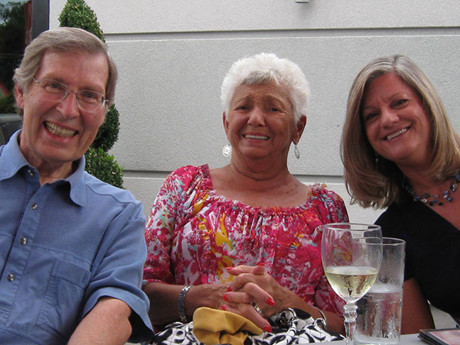
IS YOUR CLUB HEALTHY?
For a club to thrive, it’s important to assess what’s working well and what needs attention.

Slide 14
IS YOUR CLUB HEALTHY?
Members who have a positive experience are more likely to stay
Participating in service and having fun with fellow members are the primary reasons people join and stay in Rotary
Involving members and giving them a voice in their club’s future will strengthen the club’s and members’ commitment to Rotary
A positive public image improves your club’s relationship with your community and prospective members.
Having good leadership will ensure your club’s future

Slide 15
IS YOUR CLUB HEALTHY?

Slide 16
IS YOUR CLUB HEALTHY?
Rotary Club Health Check
Tool for club leaders to take their club’s pulse
Includes checklists to quickly diagnose what needs extra attention
Suggests resources and ideas that can help remedy problem areas

Slide 17
MEMBERSHIP LEADS
Membership Leads
Prospective Members
Relocating/ Rejoining Members
Referred Members
Notes:
Though many of you may be familiar with Membership Leads, I’d like to give a brief overview of the program and why you would want to participate.
The Membership Leads program directly supports membership growth and retention at the club level in the following ways:
[click] Enables prospective members to express interest in joining a Rotary club
[click] Offers the opportunity for current members to connect with new clubs if they’re relocating and former Rotarians to reconnect
[click] Allows current members to refer others to Rotary, whether it be for their club or another club, even if it’s not in the same region
Simply put, Membership Leads is a comprehensive prospective member management tool for clubs and districts. No more local spreadsheets and databases, no more mystery about what’s happening with a prospective member, and an easy to remember web address for Rotarians to promote and prospective members to find.

Slide 18
MEMBERSHIP LEADS
District reviews information and matches candidate with a club
Club contacts candidate and establishes a relationship
Club invites candidate to join and updates status
Notes:
We’ll go into detail about the path to membership later, but here’s an overview.
District leaders are notified that a member lead has been assigned to the district. They use the Manage Membership leads page to review the candidate’s form and assign the lead to the club that best suits the person’s needs. They consider the potential member’s preferred meeting time, club environment, and location.
Club leaders are notified by email that a new lead is waiting. After reviewing the candidate’s information on the Manage Membership Leads page, the club contacts the lead and invites them to visit the club. If it’s a good match for both the club and the candidate, the club invites the candidate to join.
If the candidate accepts, club leaders can use the Manage Membership Leads page to admit the new member. If the club or the candidate decides that the match isn’t a good fit, the club can ask the district to assign the lead to another club.

Slide 19
MEMBERSHIP LEADS - STATS
 | MEMBERSHIP LEADS | CURRENT MEMBERS
Under 40 | 63% | 5%
Women | 35% | 21%
50% hear about Rotary through a personal connection
Notes:
Of the people who ask to join a Rotary club:
63% are under 40
35% are women
How do these numbers compare with current Rotary membership?
5% of Rotarians are under 40
21% are women
Half of the potential members indicate that they heard about Rotary through a personal connection. Engaging with them offers your club a real opportunity to diversify and better reflect the community you serve.

Slide 20
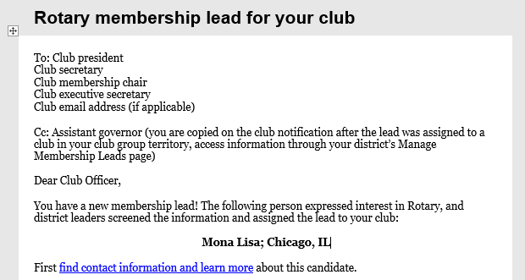
MEMBERSHIP LEADS – EMAIL ALERTS
Notes:
How will you know if you have a lead? You’ll receive an email with the subject “Rotary membership lead for your club.” The link in the message will take you to the Manage Membership Leads page, where you can find information about your candidate.

Slide 21
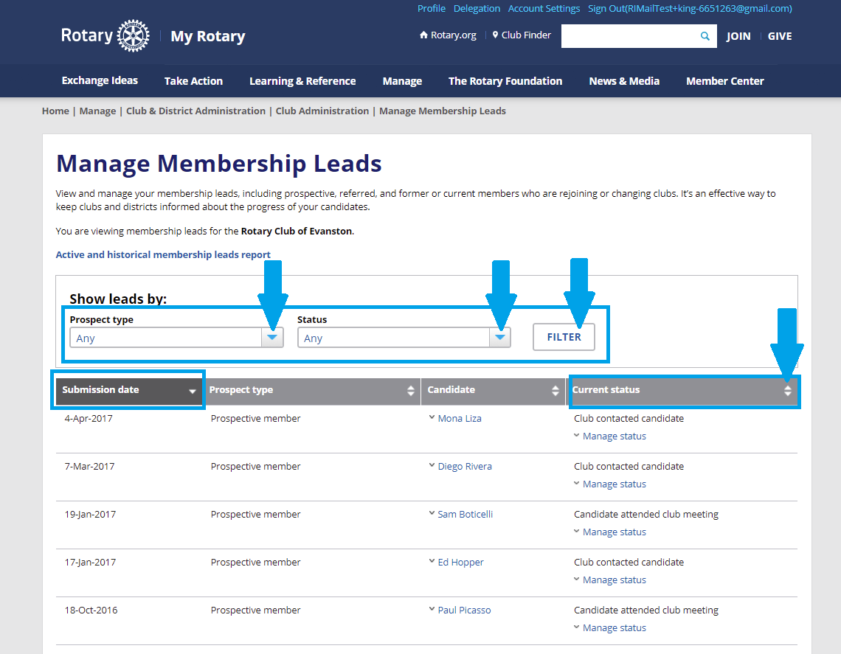
MEMBERSHIP LEADS – FILTER AND SORT
Notes:
Sort by submission date to see the leads that were most recently assigned to your club or district. You can also use the down arrow to see older leads and their status.

Slide 22
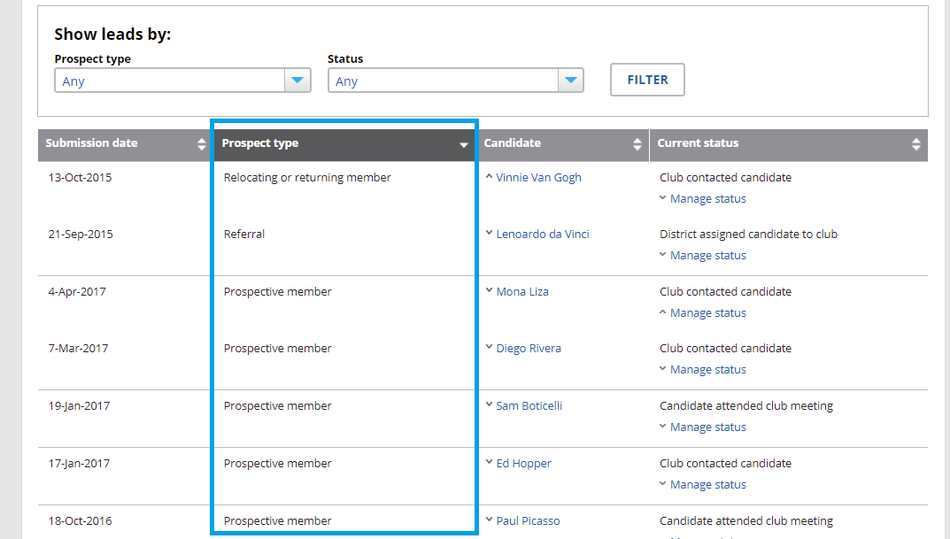
MEMBERSHIP LEADS - TYPES OF CANDIDATES
Notes:
You can also sort by prospect type: relocating or returning member, referral, or prospective member.

Slide 23
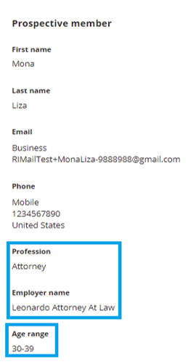
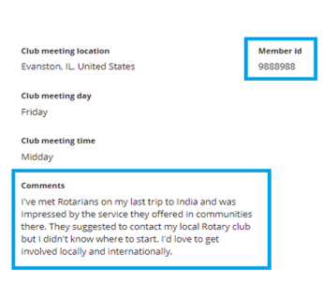
MEMBERSHIP LEADS – INDIVIDUAL RECORD
Notes:
When you click on the lead’s name, you’ll see the person’s profession, age range, gender, contact information (email address and phone numbers), preferred meeting location and time, and comments.
The Rotary ID is a tracking number that is assigned to the lead. If a lead eventually becomes a Rotary member, it will become their member ID. If you use a third-party system, such as DacDB or ClubRunner, to track your leads, be sure to use the same ID so that you don’t create a duplicate record. This also saves you time because you won’t have to enter information Rotary already has.

Slide 24
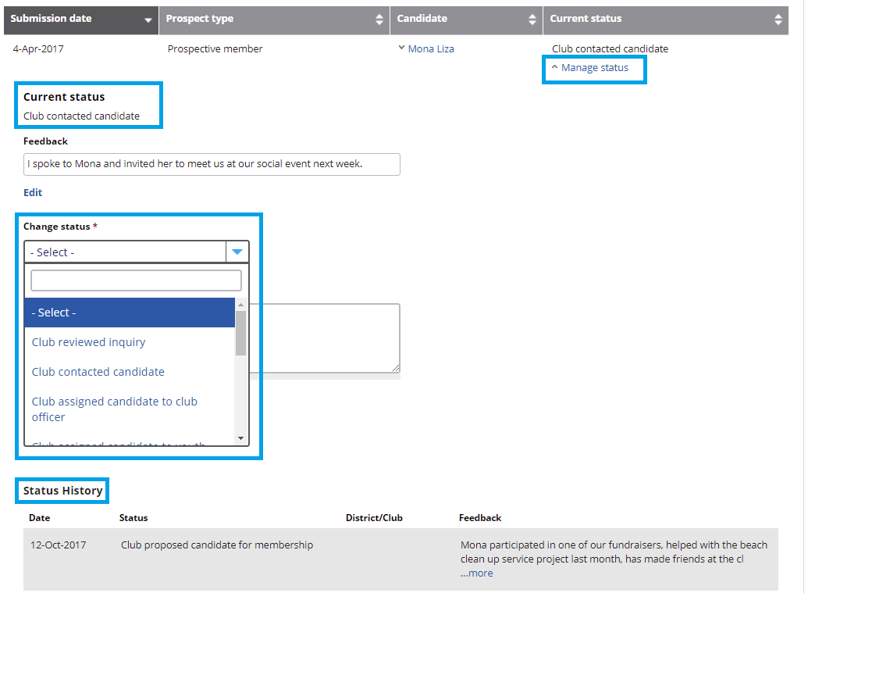
MEMBERSHIP LEADS - MANAGING A STATUS
Notes:
And here’s how each status change was noted. When you’re ready to update the status of a lead, use the menu under Change Status. It has many options for both club and district users, as you’ll see in the next slide.

Slide 25
STATUS OPTIONS | DISTRICT | CLUB
Reviewed inquiry | X | X
Contacted candidate | X | X
Assigned to district or club officer | X | X
Sent back for reassignment* | X | X
Determined candidate not interested in club or Rotary* | X | X
Assigned candidate to club | X
Attended club meeting |  | X
Proposed for membership |  | X
Admitted to club* |  | X
*These options remove a lead from the page
Notes:
Status options include:
Reviewing the inquiry (you can make notes about the candidate’s interests or who should contact the candidate next)
Contacting the candidate (you can make notes about the conversation or your next steps)
Assigning a prospective member to another officer (this is a great option to use if other leaders, like assistant governors, are helping you follow up with a lead)
Reassigning the candidate to the district or determining that the candidate is not interested in your club or Rotary
Assigning the candidate to a club (when a district leader selects this status, a list of all available clubs appears, and the leader can select the one they think would be the best fit)
Clubs can also indicate that:
A candidate has visited the club for the first time
A candidate is proposed for membership, letting the district leaders know they may soon become a new member.
A candidate has been admitted to the club
Any lead that is removed from your active leads page will still be visible in your membership leads reports. These reports are available to club and district officers and summarize what has happened to each lead assigned to a club.

Slide 26
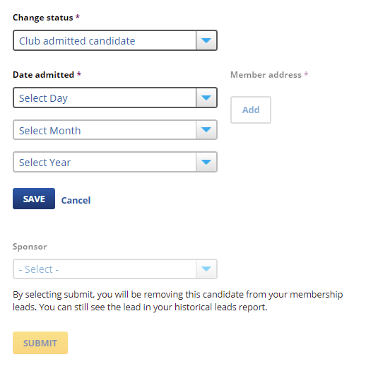
MEMBERSHIP LEADS – ADMITTING A CANDIDATE
Notes:
Clubs can admit candidates directly through their Manage Membership Leads page by changing the their status to “Club admitted candidate” and reporting some basic demographic information.
If your club admits candidates this way, your district and Rotary will know that the candidate has joined a club, and the lead will be removed from both the club’s and the district’s Manage Membership Leads pages.
Keep club and district officers informed about your membership leads by reporting changes in their status promptly. This prevents leaders from approaching candidates with incorrect information in mind, for example, talking to a candidate about joining a club that has already been determined not to be a good fit.

Slide 27
MEMBERSHIP LEADS – DISTRICT MANAGEMENT
Role (if reported to Rotary International) | Receives email | Can manage (update status, admit) | Can view
District governor | X | X | X
Assistant governors | X | X | X
District membership chair | X | X | X
Executive secretary | X | X | X
Other current district officers |  | X | X
Officers-elect |  |  | X
Immediate past officers |  |  | X
Notes:
This chart shows who in the district can view and manage its leads. When Rotary receives a membership inquiry, a staff member assigns the candidate to a district. An email is sent to the district governor, all assistant governors, the district membership chair, and the executive secretary, if one was reported to Rotary. They and all other current district officers can update the lead’s status through the Manage Membership Leads page. Officers-elect and past officers can view the district’s leads.

Slide 28
MEMBERSHIP LEADS – CLUB MANAGEMENT
Role (if reported to Rotary International) | Receives email | Can manage (update status, admit) | Can view
President | X | X | X
Membership chair | X | X | X
Secretary | X | X | X
Executive secretary | X | X | X
Other current officers |  | X
Club’s assistant governor | X |  | X
Officers-elect |  |  | X
Immediate past officers |  |  | X
Notes:
In a club, the president, membership chair, secretary, and executive secretary have the most access. They receive an email notification when the district has assigned a lead to their club. They can update leads’ status, make notes, admit prospective members to membership, and run reports, all from the Manage Membership Leads page. It’s important to note that, if officers aren’t reported to Rotary, they can’t do these things.
Other club officers reported to Rotary (such as the club treasurer) can also manage leads. Immediate past and future officers can view leads.

Slide 29
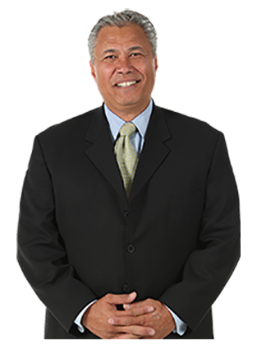
MEMBERSHIP LEADS – ROLE PLAY
District Membership
Chair Eve
Prospective member
Nick
Club president
Tom

Slide 30
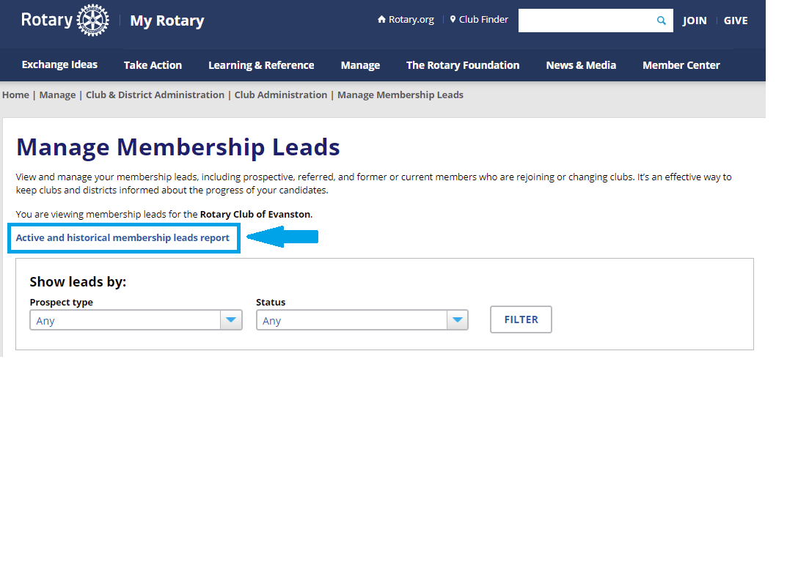
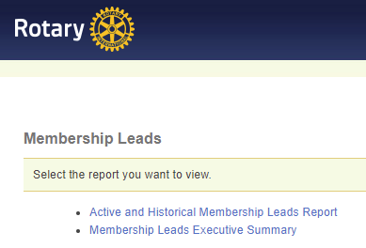
MEMBERSHIP LEADS – VIEWING CURRENT & PAST LEADS
Notes:
At the top of the Manage Membership Leads page is a link that club and district officers can use to view the Active and Historical Membership Leads Report, which shows all leads that are currently assigned and any leads that are no longer active.

Slide 31
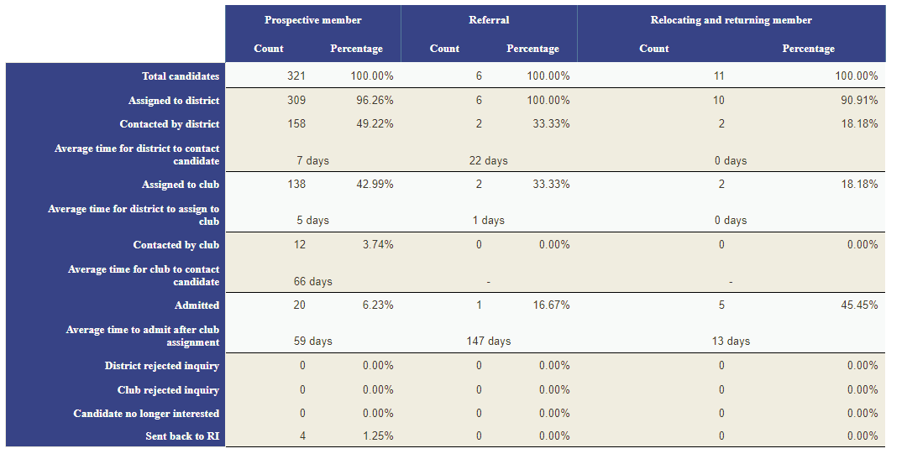
MEMBERSHIP LEADS - EXECUTIVE SUMMARY
Notes:
The Membership Leads Executive Summary lets both clubs and districts see how well the district is managing its leads, including how much time, on average, it takes district leaders to contact candidates, assign them to clubs, and admit them. Other parts of the report show how candidates heard about Rotary and track your media outreach, program, event, and other public relation campaign successes.

Slide 32
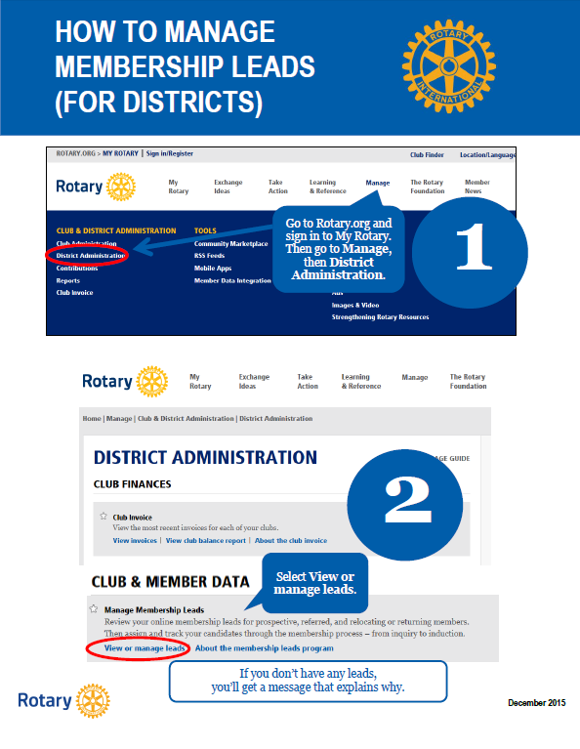
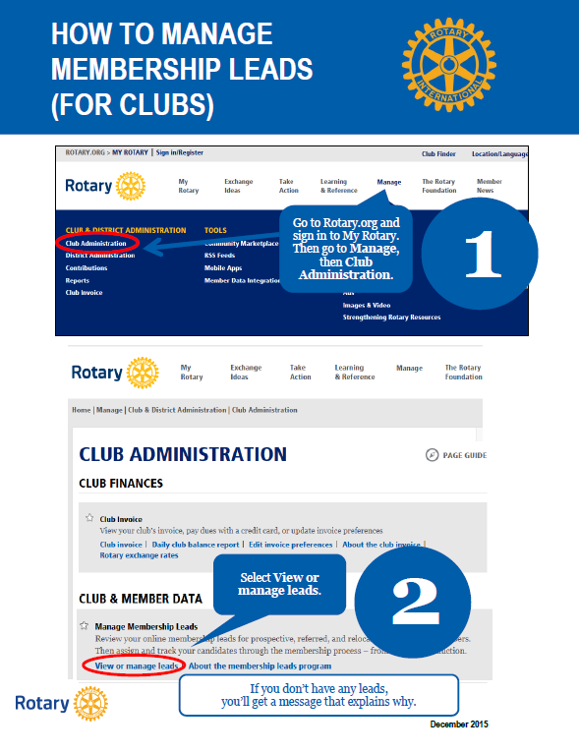
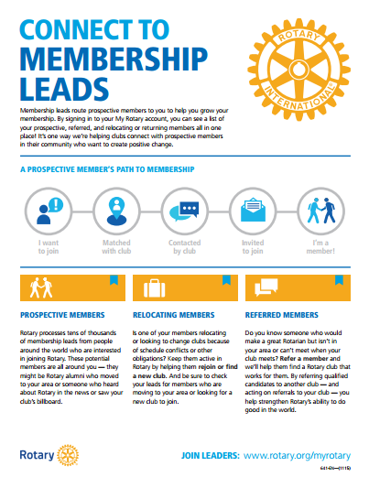
MEMBERSHIP LEADS – RESOUCES
Connect to Membership Leads
For club and district leaders
Explains how membership leads flow from rotary.org to clubs
Details responsibilities for managing leads
Links to how-to guides online
Membership Leads webinars for districts and clubs are available at https://vimeo.com/channels/rotarymembership
Notes:
The Connect to Membership Leads guide provide greater details on this flow from the Rotary website to the club, details the responsibilities for managing leads at the district and club levels, and provides links to downloadable “how to” guides for district and club leaders. There are also one hour webinars on managing Membership Leads for districts and clubs available for viewing and download on Rotary Membership’s Vimeo page.

Slide 33
MEMBERSHIP LEADS – NEXT STEPS
Tell others about the advantages of managing leads online
Tell your district that your club is looking for leads
Make sure your district leaders know what your club offers candidates
Make a plan for managing leads
Encourage new leads by linking to rotary.org/join on your website and social media pages and including it in brochures and other materials
Notes:
We’ve covered a lot today. I hope you have a better understanding of what using membership leads can do for your club and district. Here are some steps you can take to get the most out of your leads:
Show this presentation to others in your district or club to help them understand the value of using membership leads. Talk about the types of prospective members that may be looking for you.
If you’re a club officer, let your district leaders know that you’re interested in having leads assigned to your club.
Make sure your district leaders have a clear idea of the experience your club can offer candidates. The better district leaders know a club, the more successful they’ll be in assigning candidates that are a good fit.
Make a plan for how you’ll manage your leads. Include who will contact candidates first and who will update the status of leads.
Continue to promote Rotary and encourage people to go to rotary.org/join to ask about joining a club.

Slide 34
QUESTIONS?
QUESTIONS?

Slide 35
RI MEMBERSHIP SUPPORT
Questions on policy/procedures? Looking for ideas? Successes to share? Contact me! I’m here to help!
Haris Sofradzija
RI Regional Membership Officer
haris.sofradzija@rotary.org
1.847.866.3105

