Slide 1
Think you could persuade others by speaking?
Are you passionate about something?
Ready to challenge yourself?
Interested in improving critical thinking and ethical decision making skills?
Would you want to inspire and motivate others?
Would you like to have a positive influence and make a difference in this world?

Slide 2
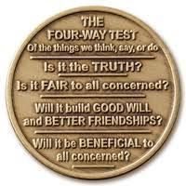
What is The 4 Way Test?

Slide 3
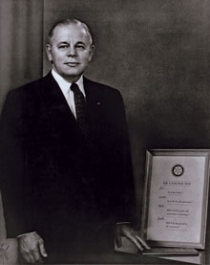
Rotarian Herbert Taylor
● Written by Herbert Taylor in 1932 during the Great Depression ● Club Aluminum company was facing bankruptcy ● Taylor believed that if employees did the right thing, the company would survive ● He promoted the test as a way of life and model for doing business ● Five years later, Club Aluminum was profitable again
Notes:
The 4-Way Test

Slide 4
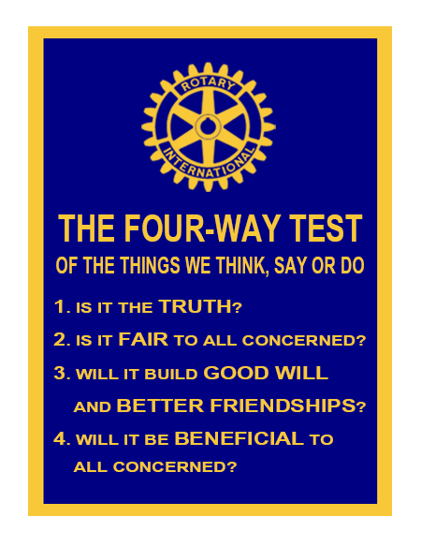
Notes:
The 4-Way Test

Slide 5
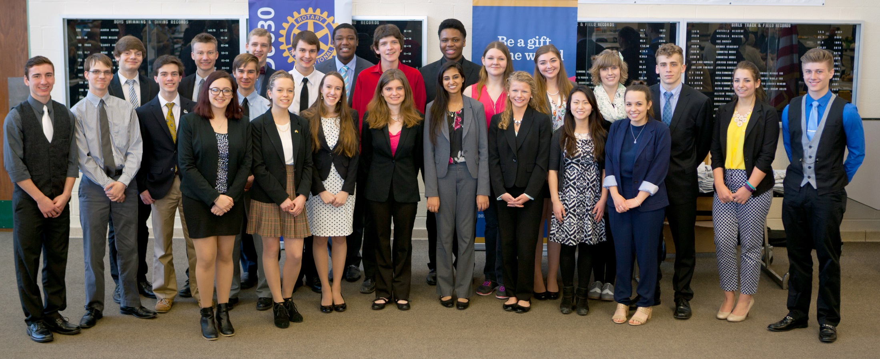
What is The 4 Way Test Speech Contest?
An opportunity for high school students to win attractive prizes by applying principles of the 4 Way Test to a current ethical issue and gain valuable public speaking experience.

Slide 6
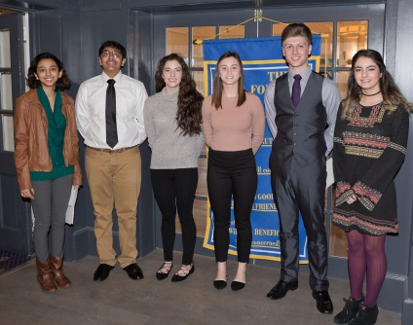
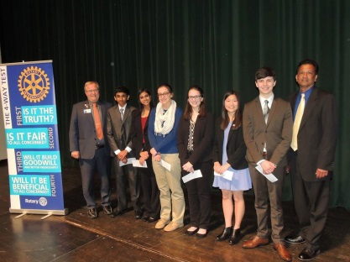
Contest takes place at 3 Levels
School Level Contests originate at High Schools and is open to all students in Grades 9 to 12
Club Level Clubs are eligible to advance 1 winner per school to the District level contest
District Level The District contest is held in two rounds, a semi-final round and the finals. Both rounds take place on the same day

Slide 7
Contest Rules
ELIGIBILITY All students from Grades 9 to 12, in participating High Schools SPEECH TOPIC The purpose of the speech is to apply the principles of Rotary’s 4 Way Test to a current ethical issue.
Students are challenged to identify a topic they feel passionate about and to adopt a point of view from which they will seek to persuade others. Each part of the Four-Way Test should be addressed during the speech. It should be something from the speaker’s personal experience or general knowledge.

Slide 8
Contest Rules
TIMING OF SPEECH Speeches shall be from five (5) to seven (7) minutes. Penalty points at the rate of 2 points for every 15 seconds will be subtracted for infractions over or under the minimum or maximum time limits SPEAKER AIDS / PROPS Note cards may be used to recover from a mental blank out and avoid an embarrassment. Even if a speaker chooses not to use note cards, they may have them at hand in case of an emergency Use of Props should be limited All speakers will speak from the same platform or designated area

Slide 9
How do they judge?
CONTENT (35%) Practical Application of the 4 Way Test (20%) Speech Value (10%) Clarity and expressiveness of language and vocabulary (5%) ORGANIZATION (15%) Introduction (5%) Development (5%) Conclusion (5%) DELIVERY (50%) Eye Contact (15%) Energy/Passion (10%) Body Language (10%) Voice (10%) Fluency (5%)

Slide 10
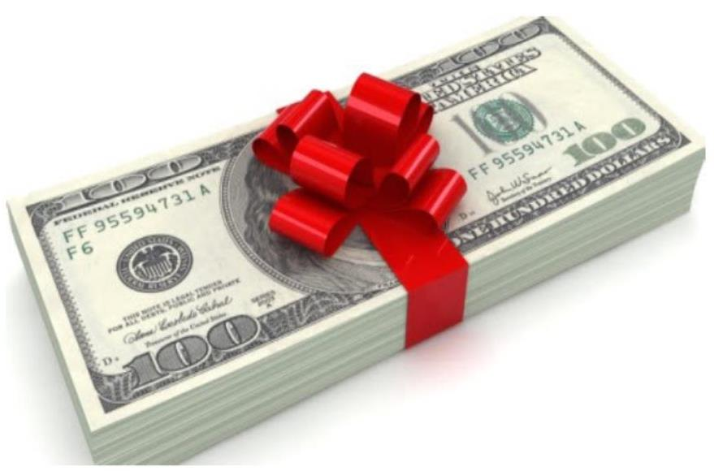
What’s in it for you?
1st Prize: $1200/- 2nd Prize: $900/- 3rd Prize: $700/- Honorable Mentions: $200/-
Win Cash Prizes and Recognition that could make your resume stand out!

Slide 11
When are the Contests?
SCHOOL CONTEST Feb XX, 2024 2:00PM to 4:00PM (Fill in the date and place of School contest)
CLUB CONTEST March XX, 2024 2:00PM to 4:00PM (Fill in the date and place of club contest)
DISTRICT CONTEST April 12, 2025 10:00AM to 3:00PM
Springfield High School 1880 Canton Rd., Akron, OH 44312

Slide 12
How do I enter?
Contact your teacher Ms. Xxxxxx Tel: E-mail: OR Contact your local Rotary Club Chair Name: Tel: E-mail:
The District contest Guide along with videos of previous winning speeches is available on www.rotarydistrict6630.org under the 4 Way Test Speech Contest tab

Slide 13
Questions?

