Slide 1


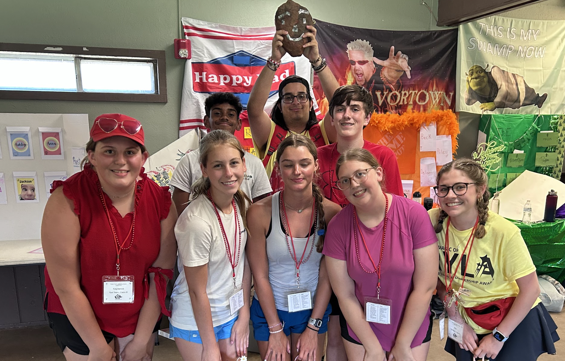

Rotary Youth Leadership Awards
Convocation: July 12, 2026, 1-4 pm (Online)
Camp RYLA: July 17-20, 2026

Slide 2

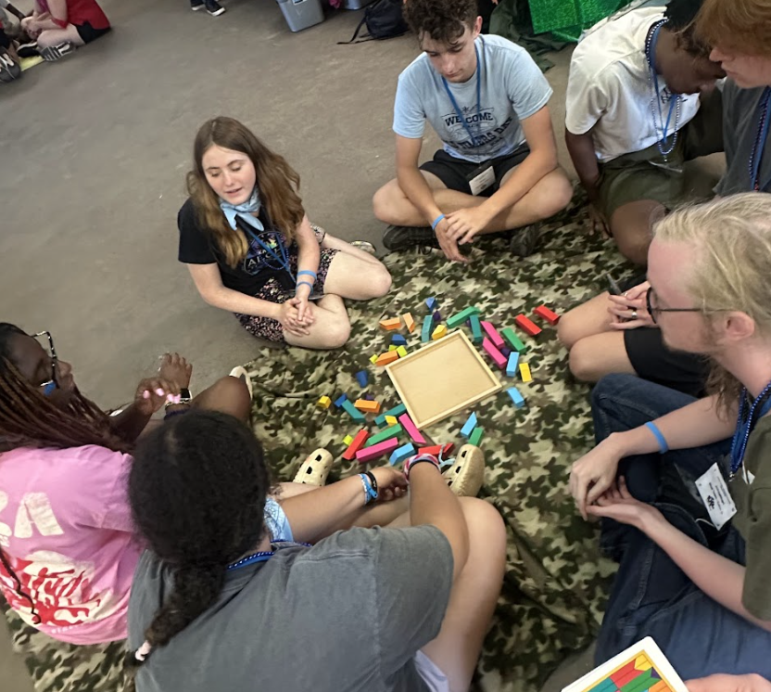
Leadership Retreat
Student Applications
Created specifically to address the needs of today’s students to prepare them for their future.
Our 2026 campers were born between 2008-2010. They have always had devices and smart phones around them. They have always been able to text messages to someone sitting nearby, or far away.
Because of this tech surge, our students today are unique. We are constantly updating our curriculum to fit with the current needs and this year is no exception.
We must prepare students for job that don’t yet exist. We do know that no matter what they do, students need certain skills to be successful now and in the future.
Application Deadline is August 31st
*These are students that you have recruited (including alternates) interested in being selected to attend RYLA.
*If you do not have any alternates or students from your area, your sponsorships will be used to send students from surrounding areas that are listed as alternates.

Slide 3

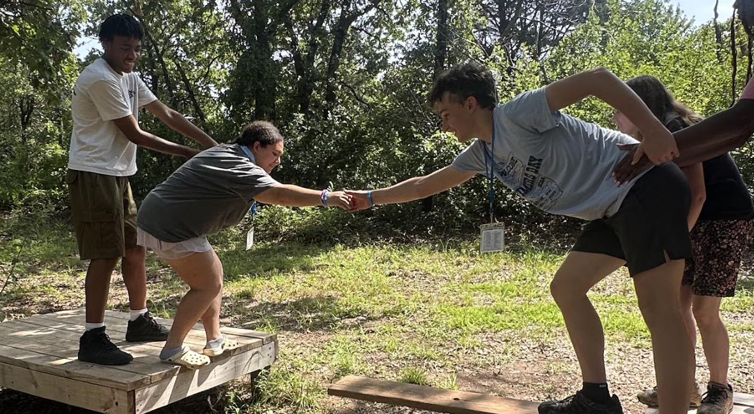
Target Skills:
Problem-Solving
Innovation
Communication
Collaboration
Adaptability
Navigating Ambiguity
Decision-Making
Critical Thinking
Teamwork
Community Engagement

Slide 4
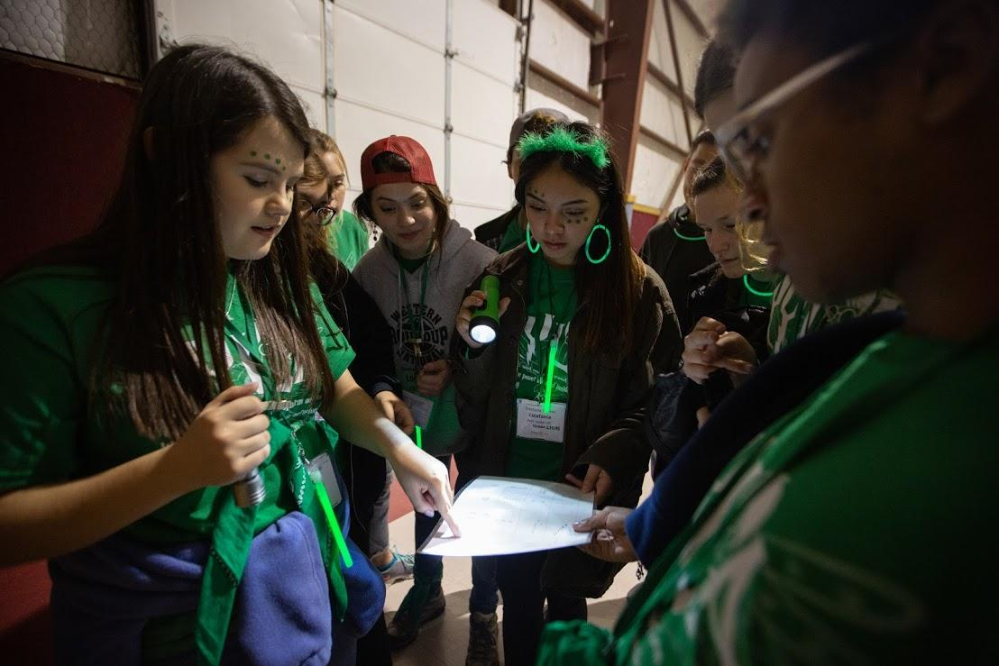
Students Build Skills Through:
Engaging problem-solving activities, both online & in-person.
Introspective reflection, sharing and non-judgmental discussion and support.

Slide 5
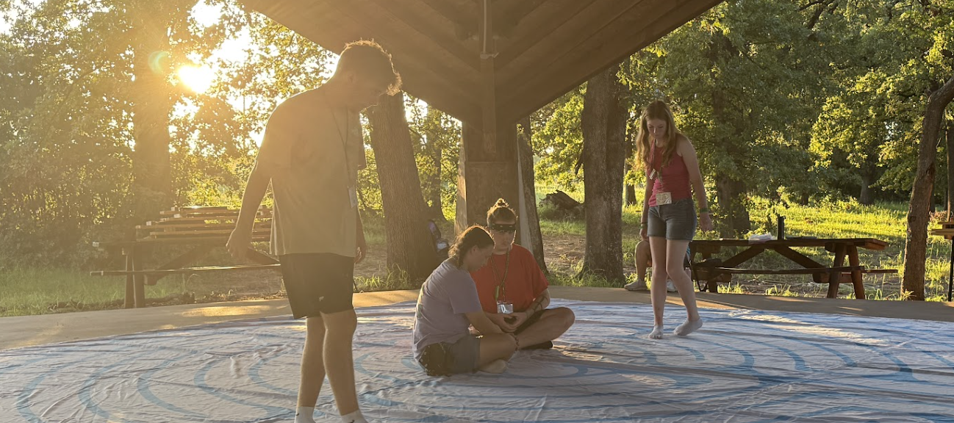
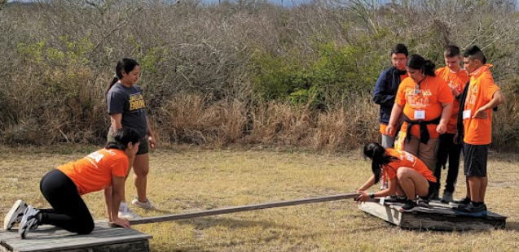
Ropes & Challenge Course
Pushes students out of their comfort zones, challenges them, builds trust and teamwork skills and helps students develop a growth mindset.
Labyrinth Walk
Allows students time and space to reflect on their lives, their values and their goals.

Slide 6
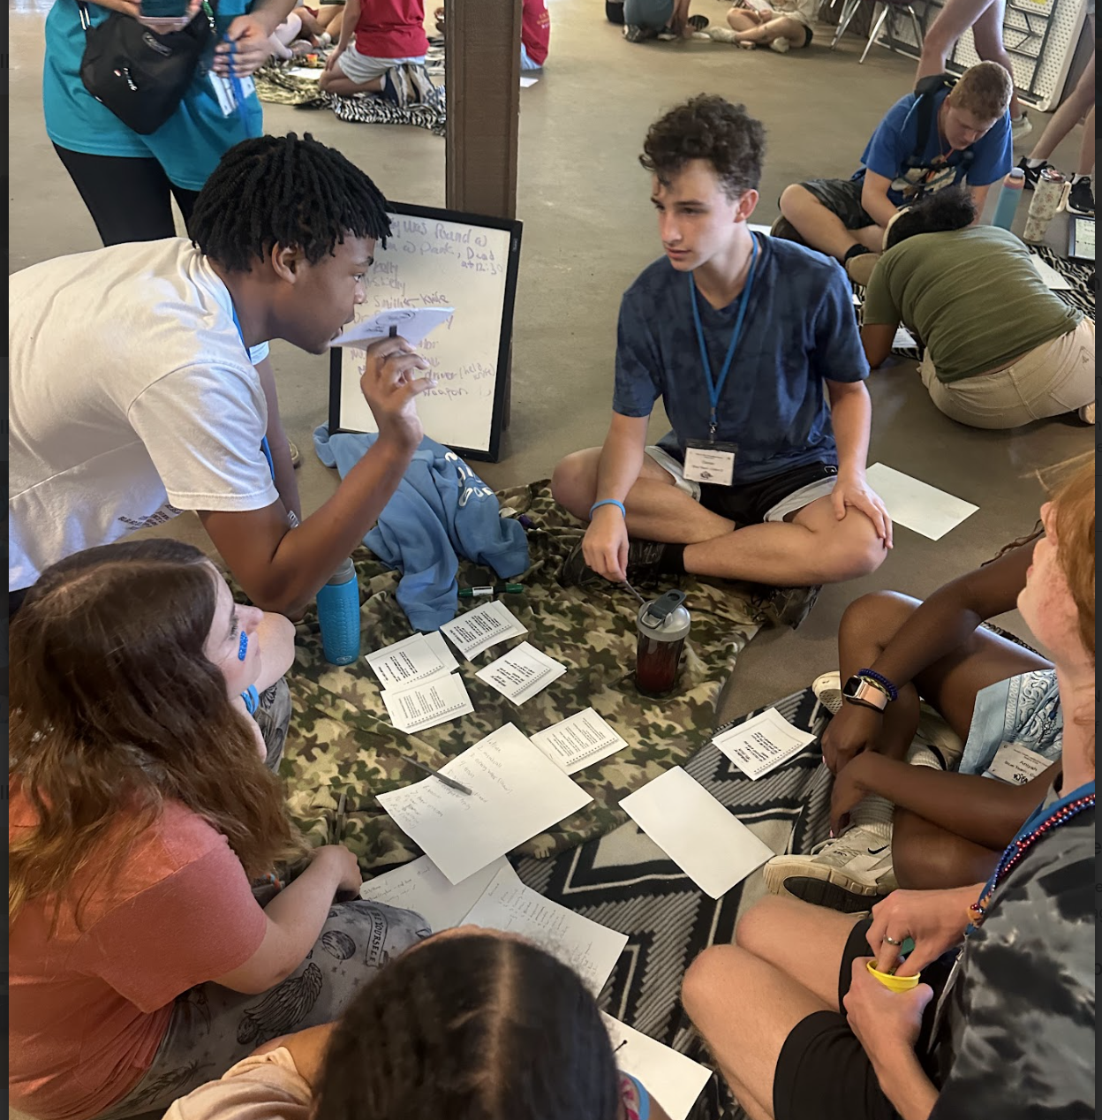
Who are the Student Participants?
Current Leaders
Potential Leaders
Those who have overcome challenges
Students needing a boost/support
“RYLA changes lives”

Slide 7
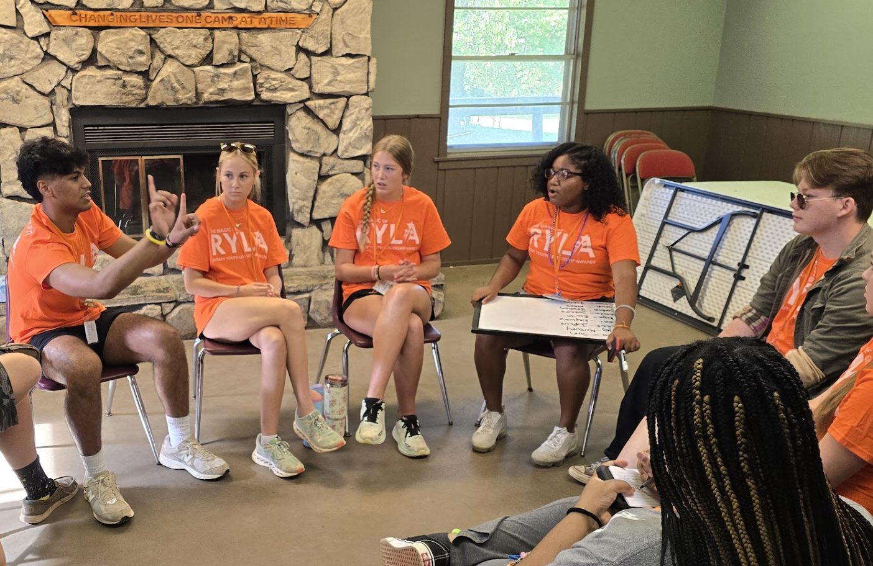
How You Can Help:
Find & Sponsor Local Students
Reach out to local schools, churches, and student activities.
Counselors, Interact Advisors, Teachers, Coaches can all help connect you with students who are interested in leadership.
Determine your club’s selection criteria, how many students you would like to send, and set up interviews with the applicants. (Though interviews are not required by the district, having students interview helps them learn interviewing skills.)
Selected students will be sent an offer letter for acceptance and will be able to register online.
Parental approval required.
You may also wish to volunteer during RYLA. If interested, please contact the committee.

Slide 8
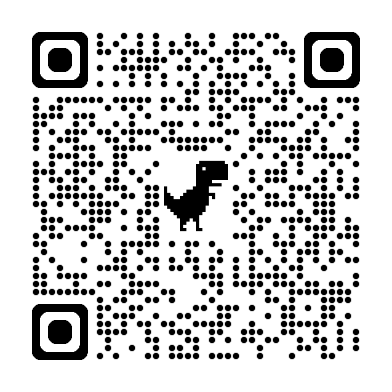
Applications are Live
Easy for your students to apply through phones, tablets or computers.
Application for campers can be sent directly through text messages and emails, via QR code.
Submitted applications are sent directly to your club’s contact for your club to review and make final selections.
QR code is also
on the flyers

Slide 9
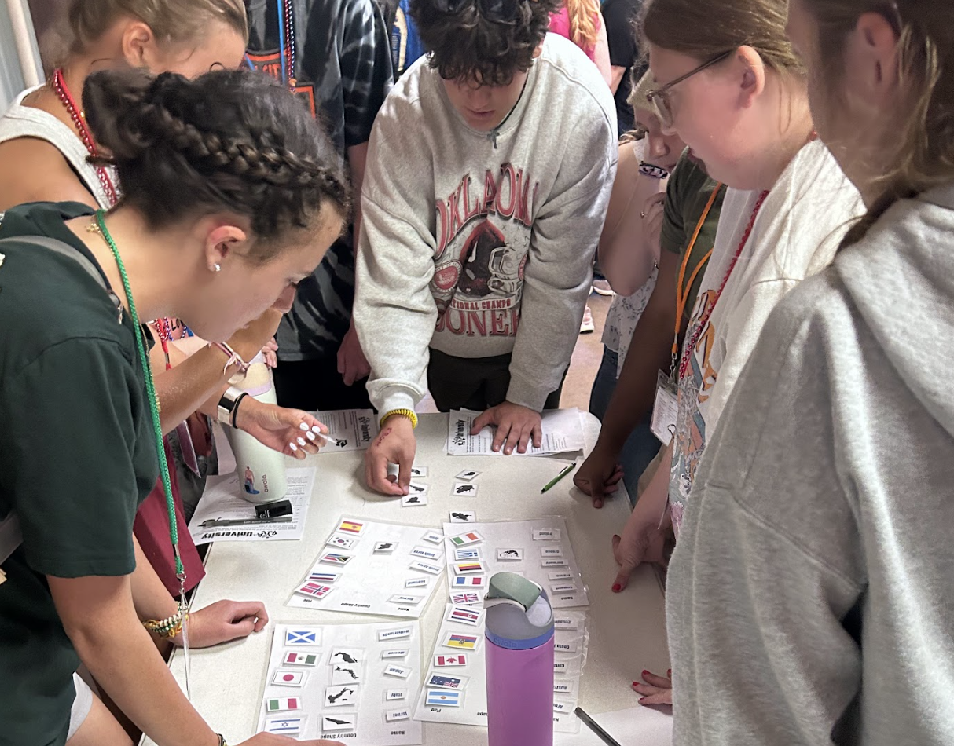
Club Sponsorship
Funding must be received for student spots to be secured.
Applications & Funds due 1/31/26
$500/Camper

Slide 10
