Slide 1
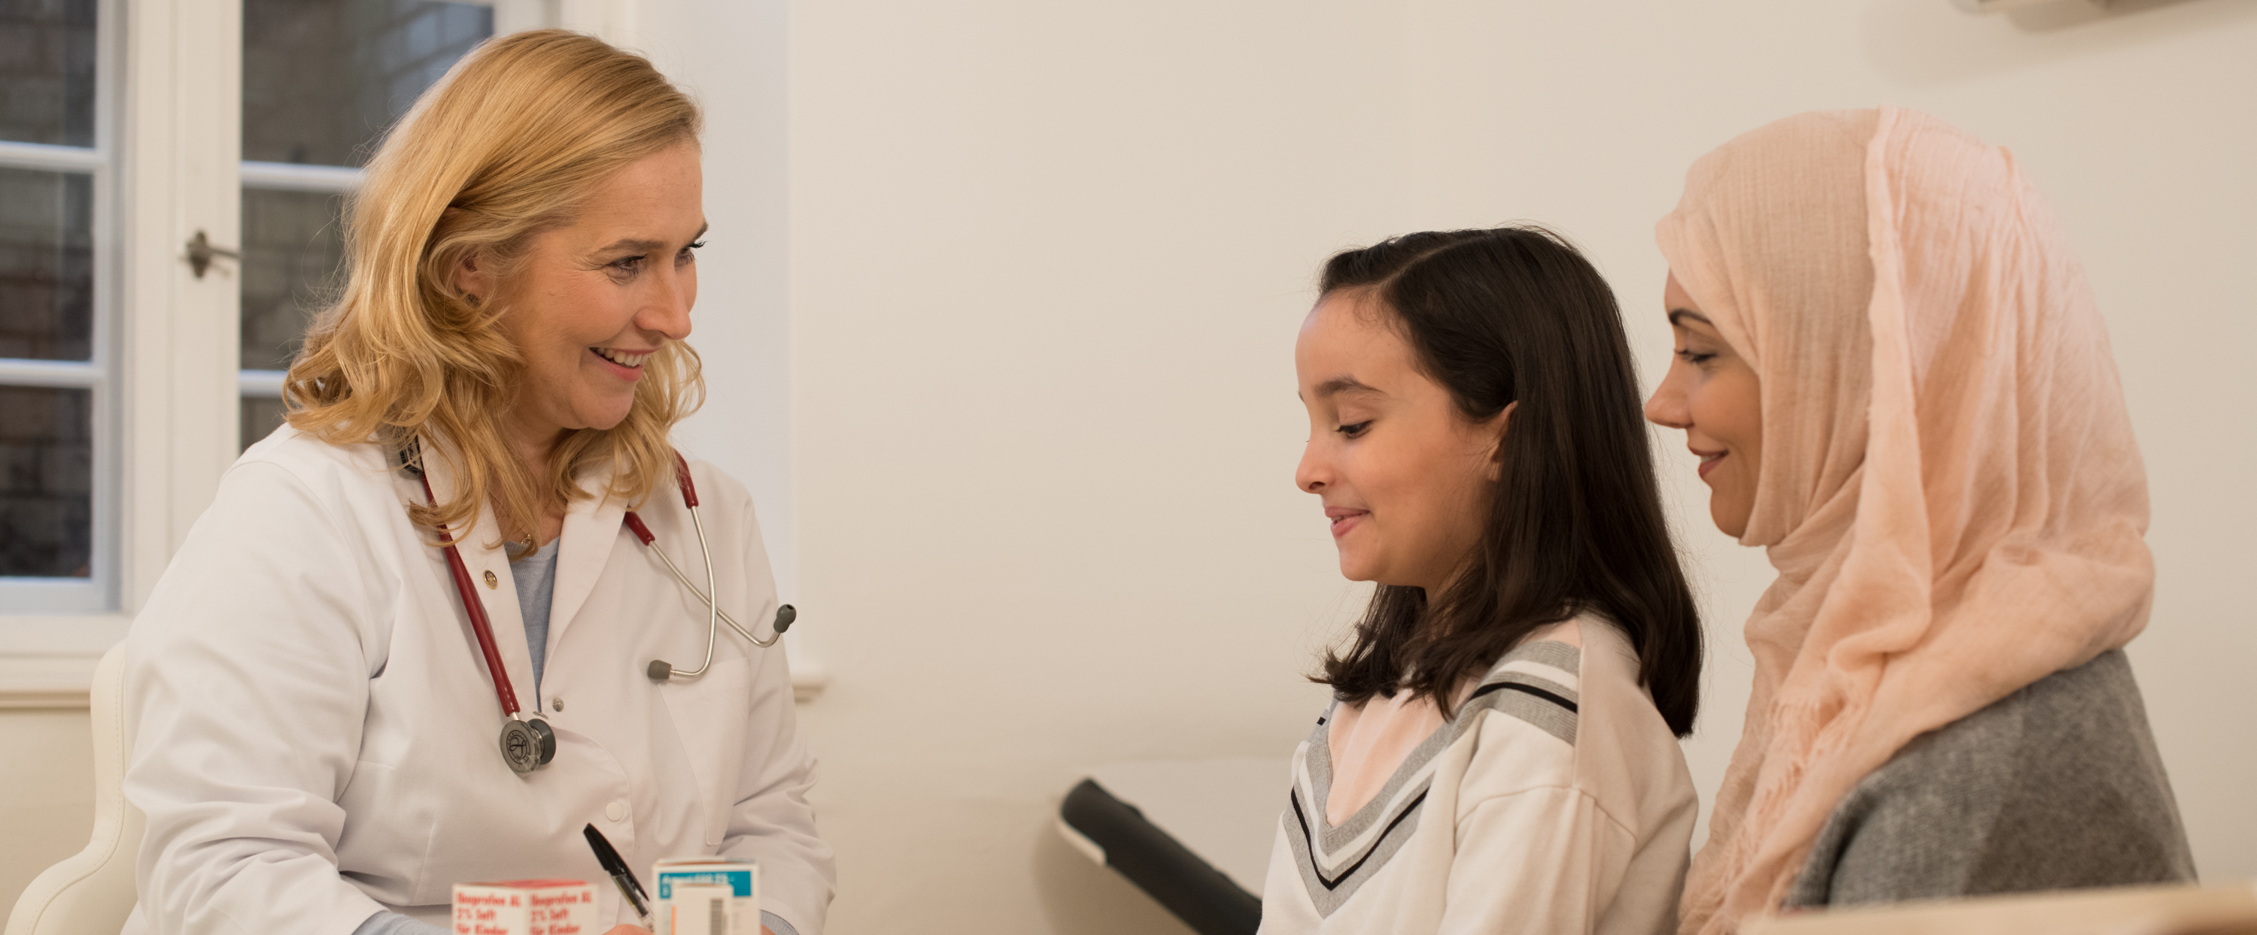
THE ROTARY FOUNDATION
Doing Good in the World

Slide 2
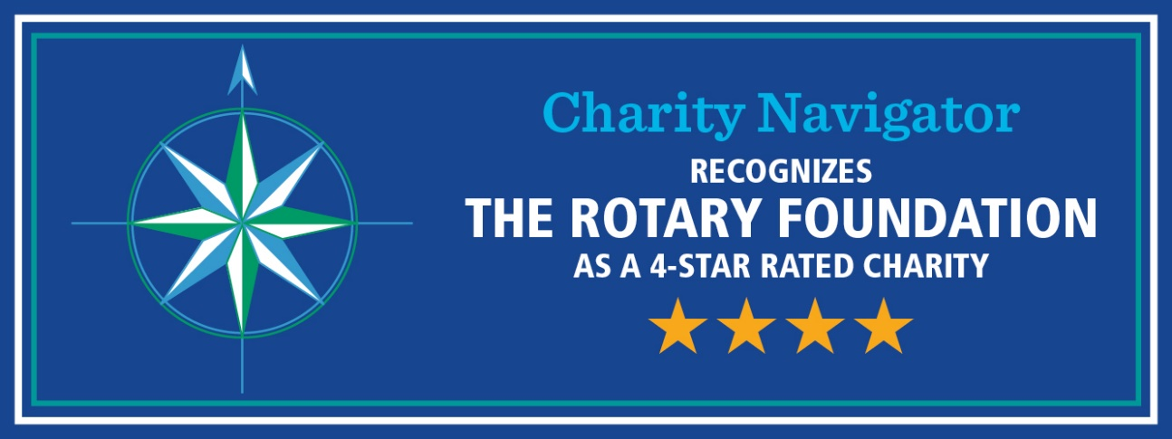
Outstanding performance
88% of funds are spent on program awards and operations
Named to Charity Navigator’s Best Charities Everyone’s Heard Of 16 years in a row
We’re an organization you can support with confidence. We’ve dedicated about 90 percent of our total spending to programs over the past 16 years, far exceeding the efficiency standards set by independent charity-rating services.
Notes:
Our Foundation is carefully overseen by your fellow Rotarians, the Trustees of The Rotary Foundation. They ensure that your donations are invested well and spent wisely so they’ll do good in the world.
The generosity of our members and the good work that Rotary does haven’t gone unrecognized. We received top ratings from Charity Navigator, the leading evaluator of nonprofits in the U.S. It rated the Foundation No. 1 of “10 of the Best Charities Everyone’s Heard Of,” in recognition of our exceptional impact, accountability, and transparency.
And for the second consecutive year, CNBC named us one of the top 10 charities changing the world.
In addition to these accomplishments, the Foundation celebrated its centennial in 2016-17 — a milestone that few other organizations reach.
*Statistics are from Rotary’s 2018-19 annual report.

Slide 3
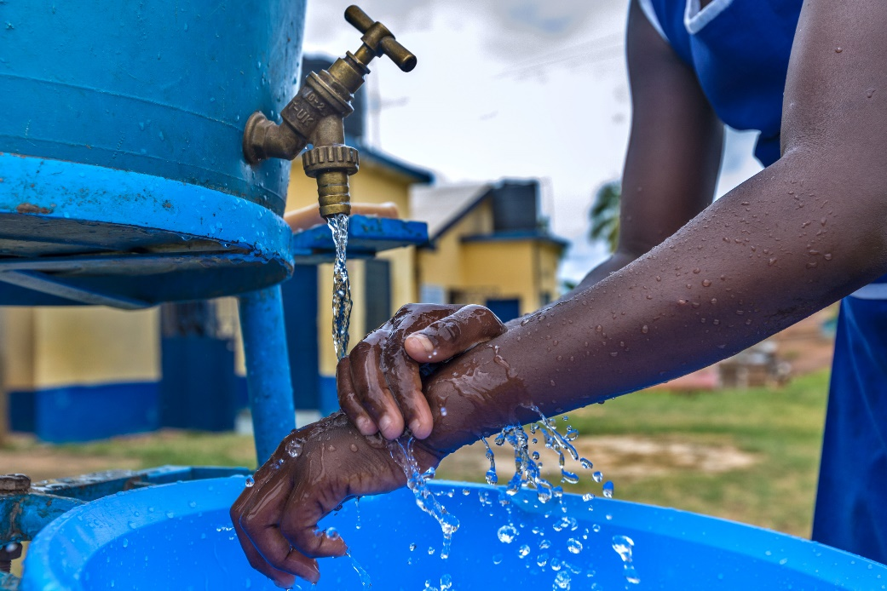


Our causes
WATER, SANITATION, AND HYGIENE
BASIC EDUCATION AND LITERACY
DISEASE PREVENTION AND TREATMENT
Notes:
Our Foundation is dedicated to seven causes — or areas of focus — that build international relationships, improve lives, and promote a more peaceful world.
Which of these causes resonates with you? What are you passionate about?
The Rotary Foundation can help you turn your passion for a cause into action and lasting change. Rotarians are encouraged to lead efforts in these seven areas, and The Rotary Foundation is here to support those efforts with grants.
In fact, the very mission of our Foundation is to enable Rotarians to advance world understanding, goodwill, and peace by improving people’s health, supporting education, and alleviating poverty.
(Note: The Environment will join our Areas of Focus as the 7th on July 1, 2021).

Slide 4
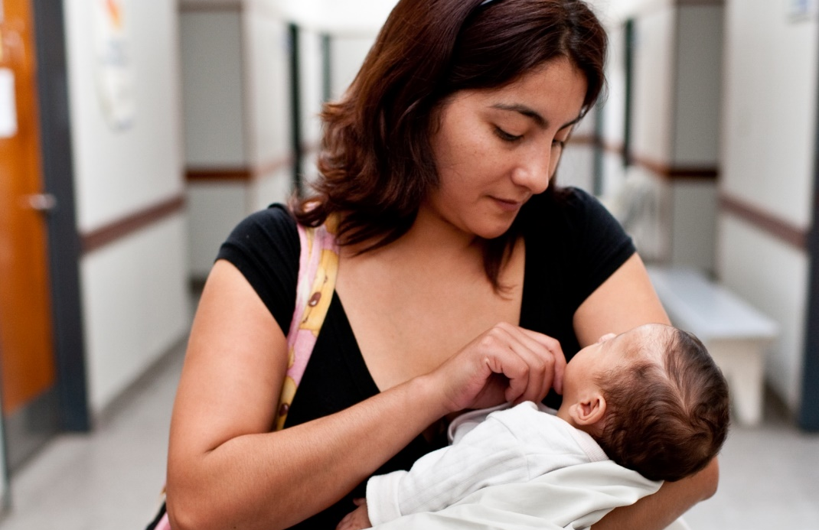
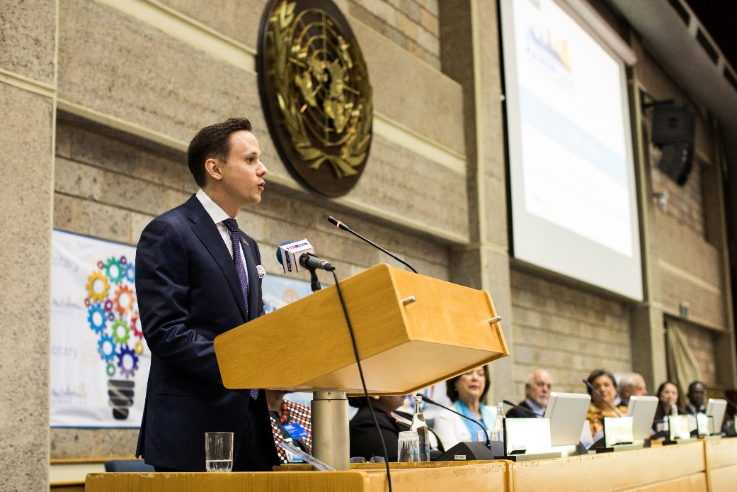
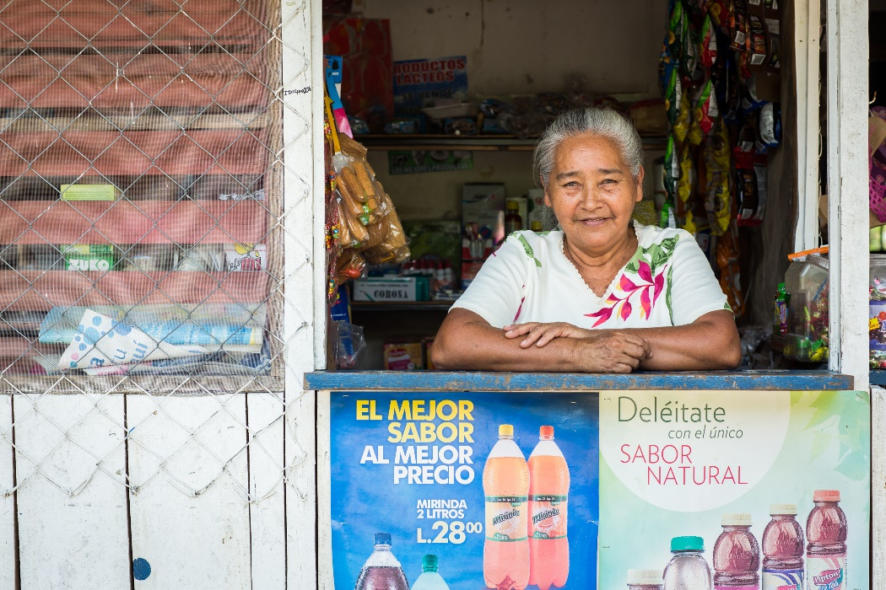

OUR CAUSES
MATERNAL AND CHILD HEALTH
PEACEBUILDING AND CONFLICT PREVENTION
COMMUNITY ECONOMIC DEVELOPMENT

Slide 5
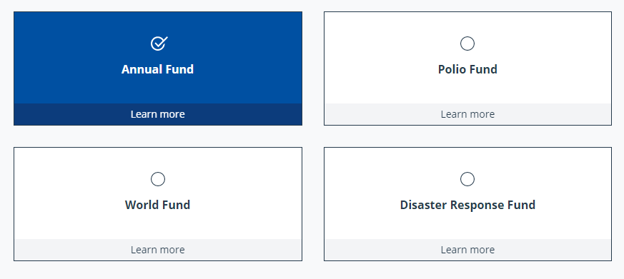
Many Ways To Give (SHARE)
Notes:
This is an image from the Rotary.org website showing just a few of the different ways to donate to the Rotary Foundation SHARE.
The one we are going to focus on today is the Annual Fund.

Slide 6
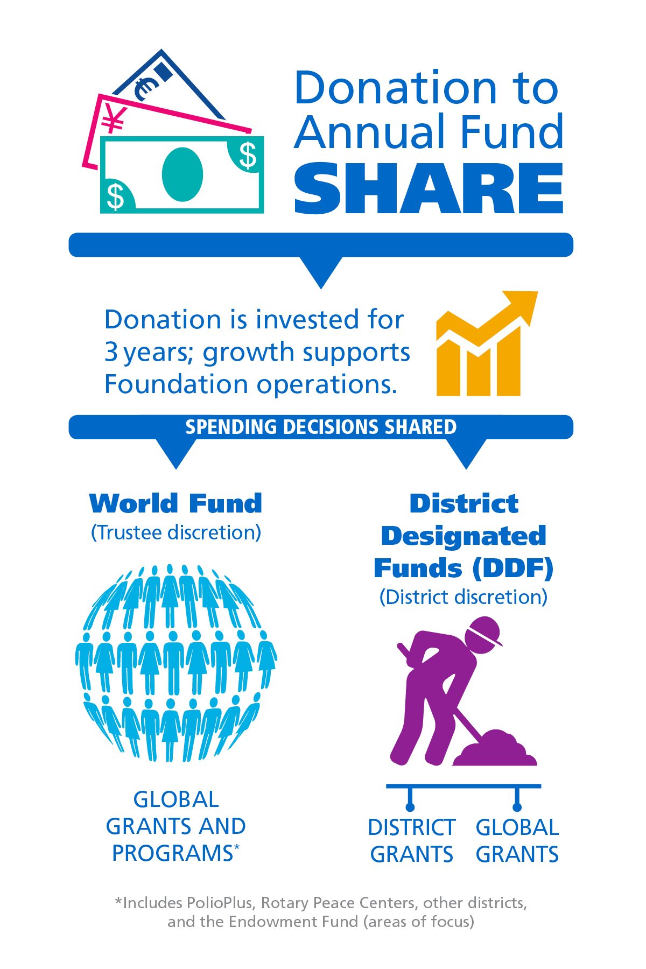
Annual fund – share
Your gift at work
The Rotary Foundation transforms your gifts into service projects that change lives close to home and around the world.
The Annual Fund is the main funding source for Foundation programs. Your gift empowers Rotarians to carry out sustainable service projects in your community and around the world.
Notes:
When I ask people why they support the Annual Fund, many say it’s because, with our Foundation, you get something back when you give. When you contribute to the Annual Fund-SHARE, half of your gift becomes available for your district and clubs to use however they want.
[Consider giving this example, depending on the audience.]
For example, if you make a gift of $1,000 to the Annual Fund-SHARE:
For three years, your contribution is invested. The investment earnings historically have been used to pay for the Foundation’s operating costs.
After three years, that money is made available to fund your projects.
Half the contribution, or $500
in this case, becomes part of your district’s District Designated Funds (also known as DDF). This is the money your district uses to help fund local and international projects. Your district decides how to use it.
The other half goes to the World Fund. These funds are used for worldwide grants, Foundation programs available for all Rotary districts, grant matches, or aid where the Trustees determine the need is greatest.
Districts that are active with both district and global grants get the full impact of gifts made by their members.
How many of you have participated in a global grant?
The World Fund is the source of the Rotary funding for your global grants.
And how many of you have participated in a district grant?
Those grants, too, are possible because Rotarians in your district gave to the Annual Fund.
The funds we have access to this year come from contributions made three years ago. (For example, funds available in 2020-21 are from contributions made in 2017-18.) That’s why it’s so important for your members to support the Foundation consistently.

Slide 7
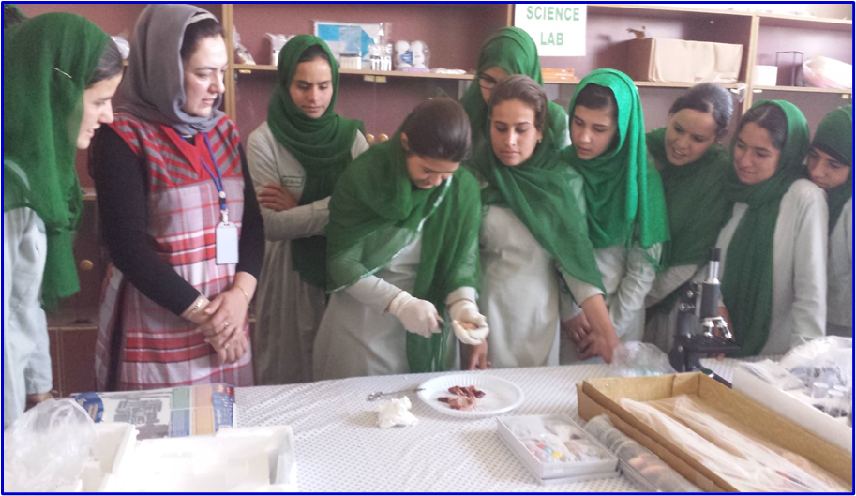
Global grants make a BIG impact
Some Recent District 5650 Global Grants:
Omaha Suburban has one grant in progress in Togo West Africa a two applications pending in Nigeria and India
Shenandoah participated in a VTT grant in Peru
Lincoln East Has 2 grants in Zambia
We have 10 Global grants either pending or approved and 1 global scholar
Notes:
Our District participates in both Global and District Grants, which helps us see the full impact of gifts you make to Our Foundation.
I’ve listed a few Recent Global Grant Projects sponsored by clubs in our District.
Medical equipment for the Koutiala Women’s Hospital in Mali supported by Omaha Night Rotary dramatically and measurably improved maternal and child health and welfare for thousands of women and children served by the hospital.
Our Seward Rotary Club will provided beds for a hurricane-ravaged hospital in The Bahamas.
And featured in the photograph, a project by Suburban Rotary established a science curriculum for girls at the Zabuli education center in Afghanistan. Girls who participated in the curriculum competed in a nationwide science competition and won the top prize.

Slide 8
Here’s what rotary did
Global grants
479 global grants ($31.4 million in total funding) approved for projects that fight disease
162 global grants ($12.3 million in total funding) approved for projects that provide clean water, sanitation, and hygiene
127 global grants ($6.9 million in total funding) approved for projects that grow local economies
102 global grants ($5.6 million in total funding) approved for projects that save mothers and children
101 global grants ($5.8 million in total funding) approved for projects that support education
64 global grants ($2.9 million in total funding) approved for projects that promote peace
57 global grants ($3.3 million in total funding) approved for projects that protect the environment
*As of 1 July 2023; all monetary amounts are in U.S. dollars
Notes:
You’ve seen what our distict has done recently but here’s what the global impact of our donations make when our global grants are matched by the world fund.

Slide 9
District grants address local needs
$53,449
The total of District Grant funds applied for and received by District 5650 for 2023-24
30 Grant Projects
Notes:
District Grants are for projects right here at home. Our District supports dozens of such grants every year. This year we had two rounds of grants because we had money left over from the first round. Unfortunately, we could not fund All of the requests from the second round of applications.

Slide 10
District grants – Next Year
Your Club should apply for a District Grant in 2024-25
Start now planning for the next Rotary year
Matching Grants up to $1,500 (or more if partnering with other clubs)
Form a committee to think about needs in the community
Two or more Club Members attend District Grant Management Seminars in April and May 2024 (via Zoom)
Sign Memorandum of Understanding
Set Foundation, Polio and Membership Goals in Clubrunner
Finalize your grant application and submit by May 31
Notes:
And you should start now thinking about next year’s District Grant project. If you need ideas for District projects go to our District website and click on My Rotary, then click the Rotary Foundation tab at the top of the page, then click on grants. A listing of all of our District grants are listed so just click any year and the grants done that year will appear.

Slide 11


Every rotarian, every year
Did you know that donors who gave a gift between $100 - $249 contributed over $25 million to the Foundation last year? When every Rotarian gives every year, it makes Doing Good in the World possible through life-changing, sustainable projects.
$427 million raised by the Foundation (*2022-2023 unaudited figures)
$278.8 Million in Program awards
More than 30% of Rotarians supported the Annual Fund
Notes:
These projects we’ve just discussed are possible because Rotarians supported the Foundation and participated in Foundation grants.
Several years ago, we started a fundraising initiative for the Annual Fund called Every Rotarian, Every Year. The goal of Every Rotarian, Every Year is to encourage support of the Annual Fund and increase Rotarian engagement with the Foundation.
How many of you have heard of Every Rotarian, Every Year?
This effort is based on the idea that if every Rotarian gave at least $25 every year to the Annual Fund, the possibilities of what the Foundation could accomplish would multiply.
With nearly a third of Rotarians making a gift to the annual fund and becoming EREY eligible worldwide, we’ve achieved a lot and improved the lives of many. Can you imagine how many more lives could be changed through grant projects if we encourage even more Rotarians to contribute at least $25 to the Annual Fund every year?

Slide 12
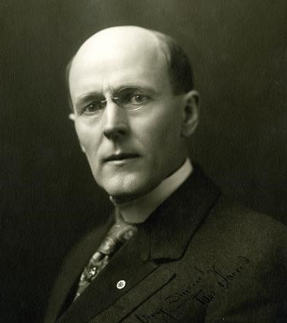
subhead
PAUL HARRIS FELLOW
Individuals become PHFs when they obtain 1,000 recognition points.
This can be done a few ways:
  Contributing $1,000 to an eligible fund.
  Reaching 1,000 points through a combination of outright giving and points.
  Naming an individual a PHF by transferring points to them.
Notes:
We recognize our generous donors who give $1,000 or more to the Annual Fund, PolioPlus Fund, or an approved Foundation grant as Paul Harris Fellows. Donors receive one Foundation recognition point for every U.S. dollar they contribute. They can use those points to name someone else as a Paul Harris Fellow. It’s the Foundation’s most well-known individual recognition level.
The $1,000 contribution can be achieved through one gift or several gifts. Endowment Fund contributions, however, don’t count toward Paul Harris Fellow recognition.
Donors receive a pin and certificate at level one. Those who give $1,000 at subsequent levels receive Multiple Paul Harris Fellow recognition, including a pin with stones that correspond to the recognition amount.
[Speaker may choose not to read every multiple Paul Harris Fellow level with corresponding amount and pin details.]
Level +1 - $2,000 to $2,999 – 1 sapphire
Level +2 - $3,000 to $3,999 – 2 sapphires
Level +3 - $4,000 to $4,999 – 3 sapphires
Level +4 - $5,000 to $5,999 – 4 sapphires
Level +5 - $6,000 to $6,999 – 5 sapphires
Level +6 - $7,000 to $7,999 – 1 ruby
Level +7 - $8,000 to $8,999 – 2 rubies
Level +8 - $9,000 to $9,999 – 3 rubies
[Thank any Paul Harris Fellows in the audience.]

Slide 13

Paul harris society
Leaders in philanthropy
A group of more than 25,700 philanthropic leaders around the world
Pledge to give at least $1,000 each year to The Rotary Foundation
PHS members gave approximately 18.4% of all Annual Fund donations (*2019-20 unaudited figures)
Donations fund both local and international projects and earn recognition for donors
Notes:
The Paul Harris Society recognizes those generous donors who express their intent to give US$1,000 each year to the Annual Fund, the PolioPlus Fund, or approved Foundation grants.
Paul Harris Society membership has grown from about 10,600 in 84 countries in 2013-14 to more than 25,700 in 145 countries in 2022-23.
In 2013-14, society members accounted for nearly 11 percent of Annual Fund giving. That reached 18.4% percent in 2022-23.
Society members’ consistent support is incredibly important to the district. It means that each year, the district can rely on gifts from these donors to fund meaningful district and global grant projects.
Find more resources at rotary.org/phs

Slide 14
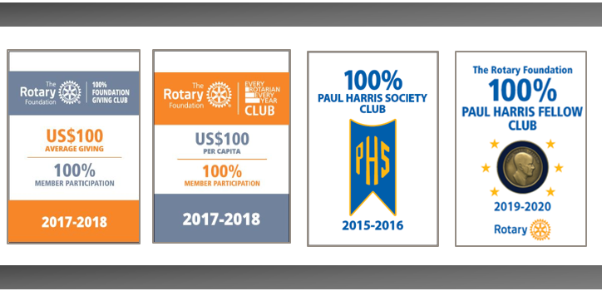
Club recognition
Notes:
We award Foundation banners to clubs that achieve outstanding giving:
The Every Rotarian, Every Year Club banner recognizes clubs with an average of $100 in giving per member, with every member contributing at least $25 to the Annual Fund.
The 100% Foundation Giving Club banner recognizes clubs with an average of $100 in giving per member, with every member contributing at least $25 to any Foundation fund.
The 100% Paul Harris Fellow Club banner recognizes clubs in which every active member is a Paul Harris Fellow at the time the district governor requests the banner. This banner can be earned only once.
The 100% Paul Harris Society Club banner recognizes clubs in which all members contribute at least $1,000 to the Annual Fund, PolioPlus Fund, or an approved global grant during a given Rotary year..

Slide 15
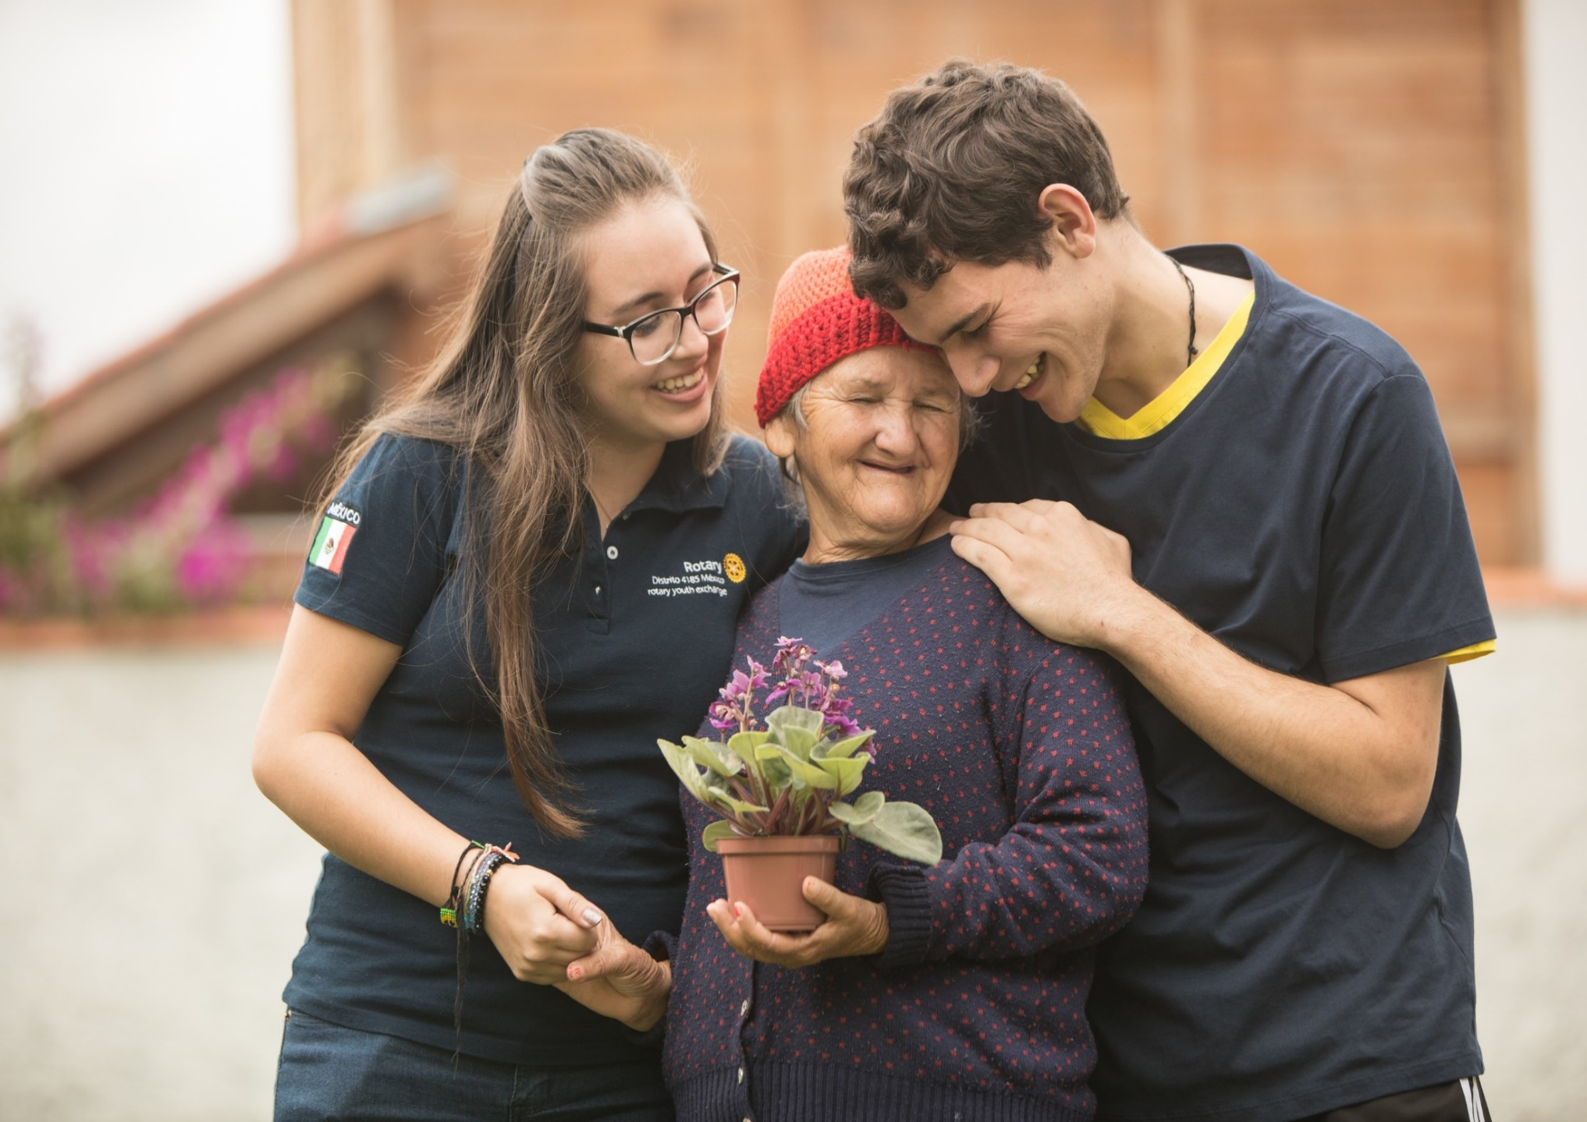
ROTARY DIRECT
Rotary Direct is easy, fast, and secure.
Enroll today: my.rotary.org/rotary-direct
Notes:
Who here is enrolled in Rotary Direct?
Of those who aren’t, have you considered the benefits of automating your giving through Rotary Direct?
[Speaker: If you’re enrolled in Rotary Direct, explain your reasons for automating your giving.]
One of the easiest and most secure ways for us to support our Foundation is through Rotary’s recurring giving program, Rotary Direct. You choose the amount, contribution method, and frequency that works for you — monthly, quarterly, or annually.
Rotary Direct offers many benefits to donors, with convenience top among them. By automating your giving, you no longer have to remember to donate multiple times, and you make steady progress toward your philanthropic goals.
You enroll through the Foundation’s secure online contribution system, which can accept 14 currencies. If your country’s currency isn’t listed, you can use a U.S. credit card to enroll.
Note the quick link to enroll: my.rotary.org/rotary-direct
[Please note: Recurring giving programs may differ by country. Contact the Rotary office in your area for more information.]

Slide 16
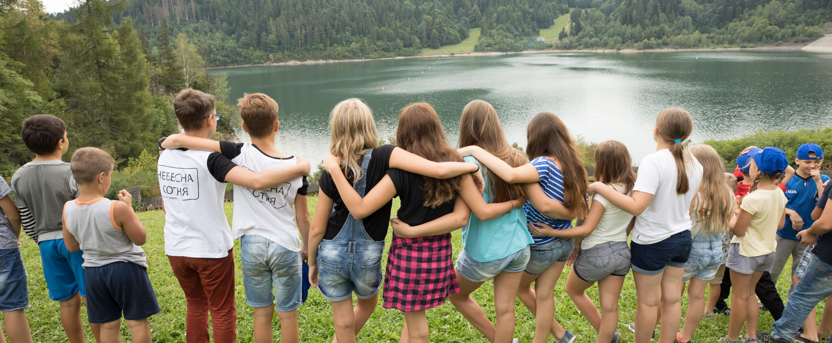
THANK YOU for doing good in the world

Slide 17
QUESTIONS

