Slide 1
OPENING SESSION
GETS & GNTS Workbooks p2
Louis Turpin and Melissa Ward
Notes:
Louis & Melissa (30 mins total)
Louis (3mins, 2 slides)
GOOD MORNING DGE's & DGN's, and welcome to GETS & GNTS!
As many of you might already know, I'm Louis Turpin, but we're going to come back to introductions in a moment....

Slide 2
GOALS
What is one specific goal you have for the year that you serve as District Governor?
Notes:
Louis (3mins, 2 slides)
….To show how we're all about ACTION at Learning To Lead 2022, we're going to hit the ground running with this question:
What is the one specific goal you have for the year that you serve as District Governor?
You were previously assigned that question, so presumably you've thought about your answer, so if you haven't already done so, please take two minutes to write your answer in your Workbook on page 2.

Slide 3
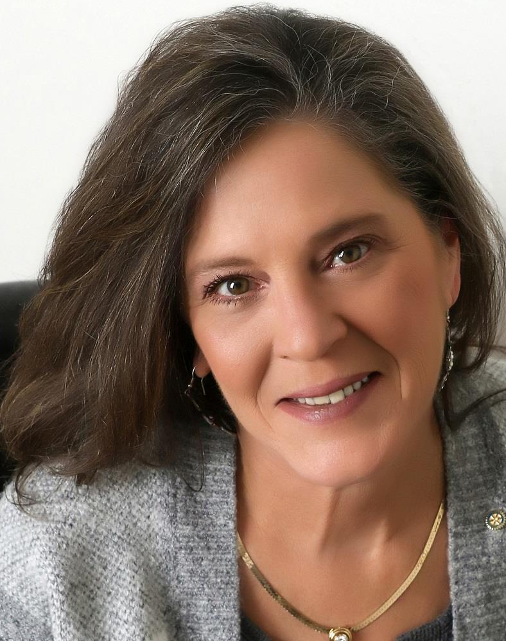
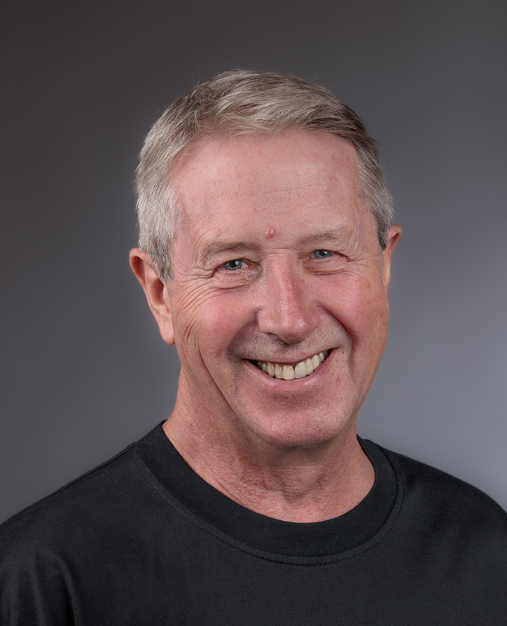
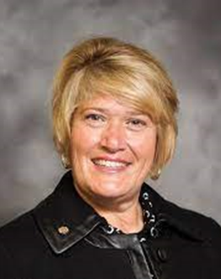
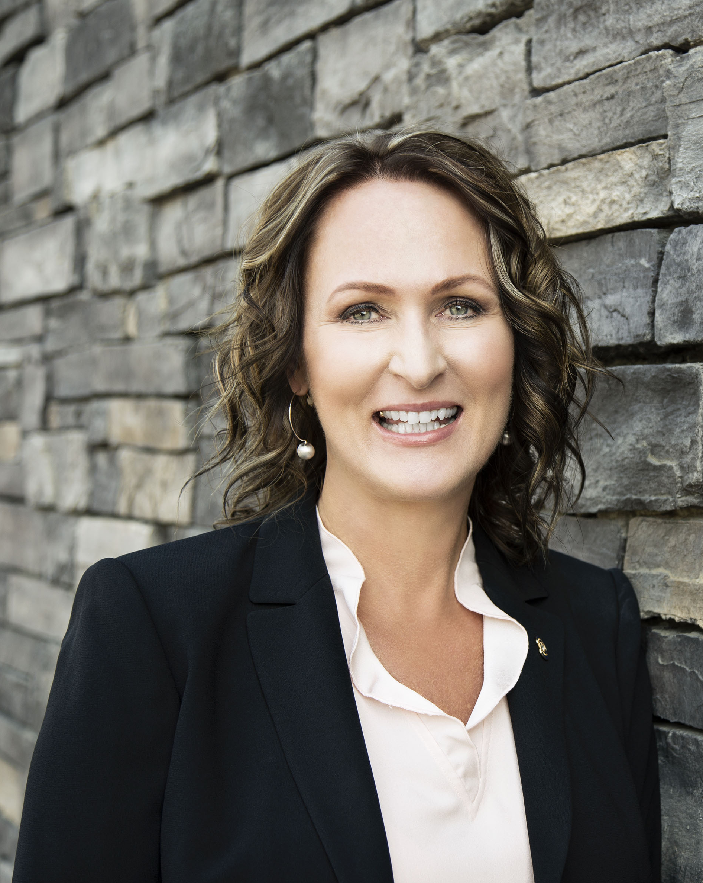
LL TEAM INTRODUCTIONS
J. Louis Turpin
GETS LL
D7210
New York, USA
Melissa Ward-Rathbun
GNTS LL
D7190
New York, USA
Peter J. Schultz
GETS LL
D5060
British Columbia, CA
Sue Goldsen
GETS LL
D6400
Connecticut, USA
Tracey Vavrek
GNTS LL
D5370
Alberta, CA
Notes:
Louis & Melissa (3mins)
Great, now let's step back and introduce your GETS & GNTS Learning to Lead Team:
Louis intros himself, then hands off to Melissa, who introduces herself, then Tracey, then hands back to Louis to into Sue & Peter.

Slide 4
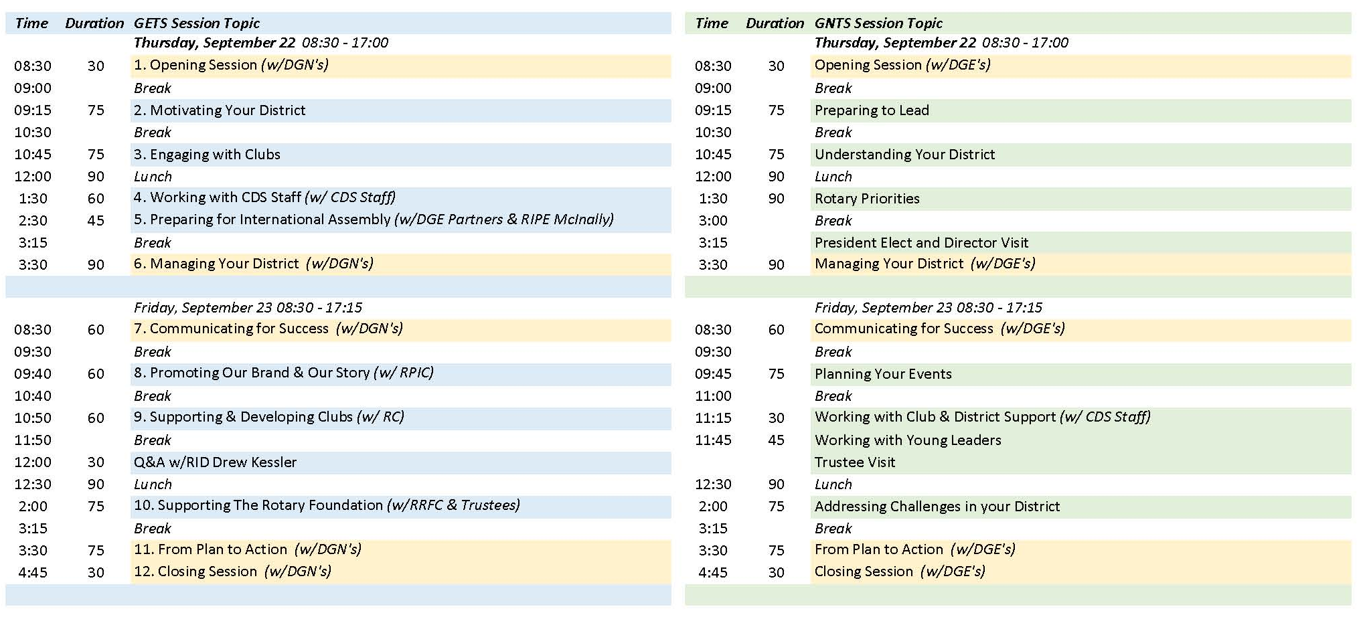
GETS & GNTS SCHEDULES
Notes:
Melissa (4mins)
Hopefully you each have taken the time to carefully review the information available on the Learning to Lead 2022 webpage: https://portal.clubrunner.ca/50077/page/2022-learning-to-lead , as well as the information that you were provided at registration.
Basically we begin each day with breakfast & a Speaker together at 7am (as we did today with TRF Trustee Akira Miki).
Then promptly at 8:30am GETS & GNTS will enjoy a joint session here together, followed by a two or three sessions separately.
Then we have lunch together (today at 12noon, tomorrow at 12:30pm) with another exciting Speaker, followed by one or two more sessions separately.
Then GETS/GNTS ends our portion of each day with a session or two together, concluding at 5pm today/5:15pm tomorrow, followed by a quick break for most (DGE Graduation practice tomorrow immediately after our sessions), until a 7pm dinner with amazing Speakers (RID Drew tonight & RIPE Gordon McInally and DGE Graduation on Friday).
As you can tell, we're packing A LOT of learning into two short days (Saturday is all about the DISC training), so we're depending upon you to be prompt in arriving, especially during the very short breaks. Take it away Louis

Slide 5
PARTICIPANT EXPECTATIONS
We will work together with our fellow Learning to Lead participants to ensure the maximum benefit for all!
We will...
be prepared for each session, take notes in your Workbooks.
remain engaged, listening carefully when others are speaking.
when speaking, remain on topic and be brief to allow others to speak.
be respectful of others at all times; encourage and motivate others.
be open to new ideas; we are here to learn from each other.
avoid distractions (silence your devices, no texting).
Notes:
Louis (3mins)
So I'm sure that we don't really need to remind a group of soon to be District Governor of the appropriate expectations for Rotarians participating in a collaborative team session like Learning To Lead, but you know that we're gonna do that anyway.... can I get seven volunteers to quickly read and summarize what they mean to you aloud?
* Work together for the benefit of all
* Be prepared, use your Workbooks
* Remain engaged, listen carefully
* Be respectful at all times, encourage and motivate others (good practice for working with Clubs!)
* Be open to new ideas; learn from your peers!
* Avoid distractions (silence devices, no texting, unless it's an emergency, wait for a break)

Slide 6
ROTARY'S ACTION PLAN
Notes:
Louis (5 mins)
Earlier I asked you to write down one specific goal for your year as DG, but what about Rotary's Goals?
Rotary International's goals are represented by Rotary's Action Plan (you'll find this in Appendix 1 of your Workbooks), which includes Rotary's Vision Statement, Rotary's Strategic Priorities and Objectives, and Rotary's Core Values.
Can I have a volunteer to read Rotary's Vision Statement aloud for us?
Thank you! I have a confession; I am totally committed to, in fact in love with, this Vision Statement, so you're probably going to hear me repeat it over and over. Together People Create Change.
In fact, just last week when we had our virtual DGE Meet & Greet, I told the DGE's that by committing yourselves fully to the Learning to Lead experience, we will be uniting to take action that will create lasting change in our District, in our Club’s communities, and most definitely in ourselves.
THANK YOU for making that commitment!
So if our Vision Statement applies to Learning To Lead, it certainly applies to setting goals for your District, particularly in the context of Rotary's four Strategic Priorities; Can I get four volunteers to read Rotary's Strategic Priorities aloud (just the priorities, not the objectives below them)?
Wow, those are all great; personally I'm particularly liking that increasing our ability to adapt is included, because I hear us talking a lot about adapting, but TAKING ACTION on that seems to be a bit of a challenge, doesn't it?
(as/if time allows) Would anyone like to share the one specific goal that you wrote down and explain how it applies to a RI Stategic Priority?
Thanks, back to you Melissa!

Slide 7
WORKING WITH THE ACTION PLAN SMALL GROUP ACTIVITY
8 minutes: DGE & DGN answer 3 questions (p2).
How does the Action Plan encourage you to think about Rotary in a different way?
Which aspects of the Plan are you most excited about? Which will excite Club members?
How can these Priorities and Objectives help you achieve the specific goal you wrote for yourself?
Notes:
Melissa (10min)
For this activity, participants will consider how Rotary’s Action Plan can help them talk about Rotary in new ways and achieve their districts’ goals. Ask participants to refer to Appendix 1 while answering the questions on the Opening Session worksheet. The governor-nominee and governor-elect from the same district should work together. For districts that do not have both present, pair participants or create groups of three as appropriate.
Ask participants to answer the questions in their workbooks. They should work individually for 2-3 minutes and then discuss their responses with their partner or group for 5 minutes, noting any similarities or differences.
If you have time, ask participants to share with the larger group what they discussed.

Slide 8
QUESTIONS?
Notes:
Louis (as/if time allows)

Slide 9
BREAK….BE BACK PROMPTLY PLEASE!
Notes:
Melissa
We will now have a brief Break (scheduled for 15 minutes max),
DGE's return here in A+B, DGN's move to Room C next door.
Be back in your seats ready to roll NLT 9:15am!

Slide 10
MOTIVATING YOUR DISTRICT
GNTS/GETS workbook page number 3-4
Louis Turpin and Sue Goldsen
Notes:
Sue (5mins total, 2 slides)
Very important topic--- Sue 5 minutes total
Your number one job as a DG will be to be a cheerleader to members.
And of course making sure the district is fiscally responsible.

Slide 11
OUR LEARNING OBJECTIVES:
Describe how you will motivate Clubs and District Leaders.
Develop specific strategies to make your learning events engaging, innovative and inclusive.
Notes:
Sue Review
Learning Objectives
At the end of this session participants will be able to……
Describe how you will motivate Club and District Leaders
Develop specific strategies to make your learning events engaging, innovative and inclusive.

Slide 12
MOTIVATING YOUR DISTRICT
What motivates you to be a volunteer leader?
Notes:
Sue (30 mins total, 2 slides)
Motivating your district ----- Sue 30 minutes total
In some ways motivation is your most import leadership responsibility as a governor you will motivate your district team to expand their rotary knowledge and help clubs better engage their members and community.
‘Volunteers are enthusiastic and the work of their organization-but they also value their time.
Take advantage of club visits and learning events to inspire members,
Use Rotary’s Commitment to Diversity, Equity and Inclusion to inspire your district to challenge its assumptions about who we are, who we help and who we see as potential leaders.

Slide 13
MOTIVATING YOUR DISTRICT
What are your responsibilities to your team?
How can you emphasize team building and inclusion in all your district events?
How can you continue to motivate your team throughout your year as governor?
How can you involve and motivate volunteers who lack time?
Notes:
Motivating your district ----- Sue
So as it pertains to motivating your district-----What are your responsibilities to your team?
How can you emphasize team building and inclusion in all your district events?
How can you continue to motivate your team throughout your year as governor?
How can you involve and motivate volunteers who lack time? Or those who have been disappointed recently in a project or an activity.
How can you demonstrate the openness and appeal of Rotary to your local community? How can you motivate your community to participate in the work of Rotary?

Slide 14
DEVELOPING YOUR TEAM
What makes an effective leader?
Notes:
Louis (35 mins total, 3 slides) (5 mins)
Key points
Cultivate leaders: Rotary and Rotaract clubs create opportunities for their members to develop skills and connections. If members are enjoying their club experience, they are more motivated to seek leadership roles. You and your district team must identify and cultivate those potential leaders.
Conduct engaging Learning Events: Your learning events are some of your best opportunities to interact with proven and potential leaders. Consider how you and your training committee will make each event an engaging and valuable experience for attendees.
Broaden outreach for diverse & inclusive potential Leaders: Encourage club and district leaders to seek out new members or those from underrepresented groups for leadership roles, to take risks, and to be innovative with club meetings and activities. Model this behavior at the district level by appointing a diverse group of members to lead your events.
Strengthen relationships with Rotary alumni: Use your year as governor as an opportunity to strengthen your relationship with alumni in your district. Keep them involved as volunteers and partners in service so they are ready for leadership roles in the future.

Slide 15
DEVELOPING YOUR TEAM:
Skill building and leadership learning opportunities.
Including Rotaractors in your Team.
Learning events that are appealing, innovative and relevant for participants.
Ensuring that participants continue to learn and stay engaged after the event.
Preparing Leaders for future roles in Rotary.
Notes:
Louis (10 mins)
Discussion questions
From your responses to this question about being an effective Rotary Leader, you understand the importance of recruiting and developing your District Leadership Team.
What skill-building and leadership opportunities will you include in your District Team Training Seminar, PETS, or District Training Assembly?
Including Rotaractors: How will you include Rotaractors in these events?
Appealing Learning Events: How can you help ensure that the learning events you’ll convene during your year as governor are appealing to participants? How can you make sure the training is relevant? Innovative?
Continued Learning: How can you help your training committee ensure that participants continue to learn and stay engaged after a learning event?
Preparing Leaders for future roles: How can you help prepare participants for future leadership opportunities in Rotary?

Slide 16
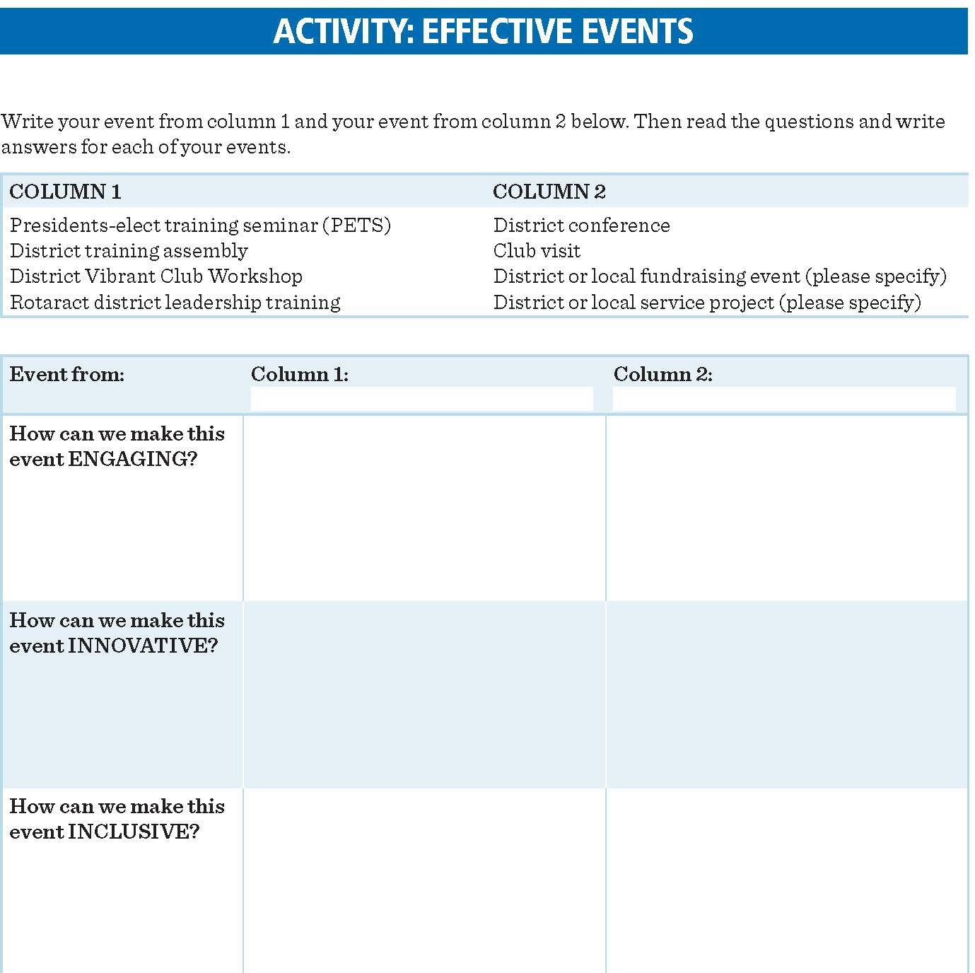
ACTIVITY INSTRUCTIONS FOR MOTIVATING YOUR DISTRICT
Column 1 Column 2
Table 1 1 1
Table 2 2 2
Table 3 3 3
Table 4 4 4
Table 5 1 4
Table 6 2 3
Table 7 3 2
Table 8 4 1
Table 9 2 4
Notes:
Louis (20 mins)
Small Group Activity: Effective Events
Making events engaging, innovative and inclusive:
In this activity, participants will discuss strategies for making learning events and other district events engaging, innovative, and inclusive.
Divide participants into 9 groups of 4-6 people. Complete the chart on page 3 of the Workbook, assign one event from column 1 and one event from column 2 to each group.
(9 mins) Each small group to discuss the questions and develop responses for their assigned events.
(9 mins) Each group has 1 minute to share their best responses with the whole group.

Slide 17
QUESTIONS/ REFLECTIONS
Notes:
Sue (3 mins)
First---any questions or comments on this session
Our Learning objectives were:
Describe how you will motivate Club and District Leaders
Develop specific strategies to make your learning events engaging, innovative and inclusive.
Louis (2 mins)
So as we close---take 2 minutes and reflect on the following question in your workbook
What motivates you to support and develop leaders in your district

Slide 18
BREAK….BE BACK PROMPTLY PLEASE!
Notes:
Louis
Thank YOU, that was a GREAT session!
We now have a brief break scheduled for 15 minutes max, DGE's return here to A+B.
Be back in your seats ready to roll NLT 10:45am
Next session: Engaging with Clubs led by Sue & Peter

Slide 19
ENGAGING WITH CLUBS
GNTS/GETS workbook page number 5-6
Peter Schultz and Sue Goldsen
Notes:
Timeline
Introduction 5 minutes PS
Creating a positive Rotary experience 30 minutes SG
Inspiring action with your club visit 20 minutes PS
Activity 15 minutes Intro PS / Wrap SG
Review and reflection 5 minutes SG
Review the resources for this session on My Rotary:
Club Planning Assistant
Creating a Positive Experience for Prospective Members
Enhancing the Club Experience member satisfaction survey
Club Health Check
Participant preparation
To prepare for the session activity, ask participants to consider the goals of their club visit speech and think of a 2- to 3-minute story that might motivate a club member to take action toward those goals.

Slide 20
LEARNING OBJECTIVES
Define and explain the importance of positive club experiences.
Plan Club visits that make an impact.
Notes:
Introduction (5 minutes - PS)
Introduce yourself to participants, if you have not already done so.
Refer to workbook page 5.
Review the learning objectives and show participants the resources in the appendixes.

Slide 21
CREATING A POSITIVE ROTARY EXPERIENCE
How would you describe a positive Rotary experience?
Notes:
Key points Sue (30 min)
Successful clubs engage each participant in a way that is meaningful to them. Working with your district team, emphasize the district’s role in supporting clubs to better engage both members and the community.
Positive, inclusive clubs emphasize core values like fellowship, diversity, and leadership. They promote personal and professional connection, leadership development, and recognition. They actively create a welcoming environment that encourages more people to engage with us. Refer to Rotary’s Commitment to Diversity, Equity, and Inclusion for guidance on how we can contribute to creating and maintaining collaborative, positive, and healthy environments for all.
Encourage club leaders to assess their members’ experiences using the Enhancing the Club Experience member satisfaction survey. With your team, help clubs provide members the chance to contribute and lead using their skills and interests.
Help clubs connect their members to engagement opportunities that can provide a positive Rotary experience in other ways, such as Rotary Action Groups, Fellowships, and Friendship Exchanges.
Showing the public the good work of The Rotary Foundation and promoting the service opportunities and other experiences Rotary offers can inspire communities to engage with us.

Slide 22
CREATING A POSITIVE ROTARY EXPERIENCE
Who is eligible to join Rotary? Do clubs in your district add qualifications that could be barriers for potential members?
What does being inclusive mean in your district? What processes do you have in place to ensure that all your clubs are inclusive?
How can clubs commit to more diversity, equity, and inclusion in their officer or board positions?
Notes:
Sue

Slide 23
CREATING A POSITIVE ROTARY EXPERIENCE
What opportunities and activities do your clubs offer for members and the community to become more engaged and involved?
How can you help clubs — even clubs that are growing and thriving — to recognize the need for a self-assessment? How can you ensure that clubs act on the results of an assessment?
Notes:
Sue

Slide 24
CREATING A POSITIVE ROTARY EXPERIENCE
How can you lead changes that enhance the club experience and make Rotary more appealing to more people?
How can you help clubs recognize their strengths and communicate their values to current and potential participants?
Notes:
Sue

Slide 25
INSPIRING ACTION WITH YOUR CLUB VISITS
How can a club visit
engage members?
Notes:
Key points Peter (20 min)
One of your key responsibilities as governor is to visit clubs. Club visits are an effective way to inspire and motivate clubs, recognize their efforts in the community, and engage members.
Your visit also gives you a chance to encourage club presidents and other leaders to promote positive Rotary experiences. It is your opportunity to emphasize the benefits of being welcoming and inclusive and listening to member feedback.
Since assistant governors work closely with clubs, consult with them to review club data in Rotary Club Central and to determine the strengths, weaknesses, and needs of each club. This will help you tailor your visit to the club and create a positive experience.
Be sure you visit clubs in a way that meets their needs, such as by attending projects, events, or ceremonies that are important to them. You do not need to visit every club in your district at the beginning of your term or visit each club individually.
Discussion questions
What is the purpose of the talks you’ll give during your club visits?
What goals, initiatives, or actions do you want to emphasize to your audience?
What will you do to prepare for your club visits?
How will you tailor your visits to address the needs of each club?
How will you plan your visits to Rotaract clubs?
What are the benefits of bringing clubs together for the governor’s visit?
If you are changing how club visits are conducted in your district, whose support do you need for that change to be successful?
How will you make sure club members’ needs are heard and addressed?

Slide 26
ACTIVITY INSTRUCTIONS FOR ENGAGING WITH CLUBS
Write 1 or 2 of the goals you have for your club visits (3 min).
Pair-and-Share: Each one practice 2-min portion of your presentation, 1-min feedback on what was effective (8 min).
Facilitated: Volunteers to share successful speech elements they heard from their partners (4 min).
Notes:
Activity: 15 min
Peter intro activity / Sue debrief
Participants should have thought about the goals of their club visit speech and a story they want to tell to engage their audience. In this activity, they will practice a portion of their speech and receive feedback from a partner.
Ask participants to briefly write one or two of the goals they thought about while reflecting on their club visit speech before the training.
Pair up participants and ask them to practice a portion of their club visit speech. Tell them to focus on a specific experience that might motivate a club member to take action, and to imagine that their own club members are the audience.
Ask the first participant to speak for 2 minutes. Then ask their partner to provide feedback for up to 1 minute, saying what was effective about the speech as well as anything they think could help improve it.
Have the participants switch roles and repeat the exercise.
In the time remaining, ask 2-3 participants to share elements of a successful club visit speech or something they heard from their partner that they thought was effective.
Alternative: If participants did not think about their speech goals or prepare a story before GETS, they might use this time to draft a few key points and gather suggestions from their partners.

Slide 27
QUESTIONS / REFLECTIONS
Notes:
Sue – 5 min
Ask if there are any questions.
Review the learning objectives to ensure that all topics were covered sufficiently.
Define and explain the importance of positive club experiences.
Plan Club visits that make an impact
Allow participants 2 minutes to respond to these reflection questions in their workbooks:
What strategies for engagement is your district already using?
How can you enhance what is working? How can you improve what is not working?

Slide 28
LUNCH. SEE YOU AT 1:30PM

Slide 29
WORKING WITH CDS STAFF
GNTS/GETS workbook page number 7
Peter Schultz and Sophie Dangerfield

Slide 30
PREPARING FOR INTERNATIONAL ASSEMBLY
GETS workbook page number 8
R.I.P.E. Gordon McInally, Peter Schultz and Louis Turpin
Notes:
Louis (5 mins, 2 slides + up to 15 mins for RIPE Gordon R. McInally)
Introduction
Our next session, from page 8 of your Workbook, is Preparing for the International Assembly, which takes place when & where?
Answer anyone?
IN-PERSON in Orlando, Florida next January 8-12, 2023.
Our special guest for this session is none-other than our host for IA 23, Rotary International President-Elect Gordon R. McInally, a member of the Rotary Club of South Queensferry, in West Lothian, Scottland. Welcome Gordon!
We're going to ask Gordon to share his vision for IA23 in a moment,
but before he does, let's preview our Learning Objectives for this session...
PREPARING FOR THE INTERNATIONAL ASSEMBLY
(45 mins total)
Introduction 5 minutes – LT & GM
The International Assembly program 10 minutes - PS
Preparing for the International Assembly 10 minutes – LT
Open Q&A 15 minutes – Panel (all)
Review and reflection 5 minutes - LT
Meeting with Kaitlin 2022-08-24
4-day event (M-Th)
Property very different from San Diego – not in middle of city
Many restaurants on site, some casual or fast-food
Every day 2 general sessions (Mon theme reveal)
Breakouts late morning & afternoon
Emphasis on Action Plan – each priority will be one day
Sunday evening welcome event (casual)
Tuesday night – “International Dinner” - Scottish themed (formal national dress or cocktail attire)
Wednesday – Cultural Exchange afternoon, before dinner
Food treats (local, SMALL, packaged only)
Gifts to share discouraged
Biz cards
then – “Night of Culture” – Casual National dress
COVID: Both proof of vaccination and negative test within 72 hours
Thursday “Closing” black-tie optional
No official theme jacket
520 districts
All receive up to 2 items (theme tie, scarf, etc) as gift
Partners:
Similar structure (joint, then breakouts)
Round-table discussion sessions different from DGE sessions (4x)
Participating in a “creative” project
Thursday afternoon farewell party (informal networking)
Expected to participate if Rotary paying
If travelling with children can attend, welcome to general sessions and meals (must register), vaccination requirement applies AND must have caregiver who is not the DGE or a Rotary-paid partner

Slide 31
OUR LEARNING OBJECTIVES
At the conclusion of this session, you will be better able to:
Understand the program and goals of the International Assembly.
Start preparing for the International Assembly.
Notes:
Louis (continued 5 mins Intro)
Learning Objectives
Can I get two volunteers (remember they're in your Workbook on page 15)?
At the conclusion of this session, participants will be able to:
Understand the program and goals of the International Assembly.
Start preparing for the International Assembly.
Thank you! So those are our Objectives for this session.
Gordon (up to 15 mins)
So now Gordon, tell us about your vision for IA23, for example:
What are your goals,
How would you prepare if you were a DGE, and
What are YOU most looking forward to during International Assembly 2023?

Slide 32
THE INTERNATIONAL ASSEMBLY PROGRAM
What are you most looking forward to during the International Assembly?
Notes:
The International Assembly program
Opening question (Peter ~3 min)
What are you most looking forward to during the International Assembly?

Slide 33
THE INTERNATIONAL ASSEMBLY PROGRAM
What, Where, When?? (all in Participant Handbook or Rotary.org)
4 days Mon 8 Jan to Thurs 12 Jan
Rosen Shingle Creek, Orlando FLA (big resort!)
Arrive Sunday 8 Jan before 3pm (check in begins 15:00)
Depart Friday 13 Jan
Register NOW, travel when RITS contacts you
Good to Know…
Attest (by 3 Oct) & upload proof of vaccination by 15 November
Negative test 72 hours or less before arrival (or proof of recovery)
2-track Partners program
What to wear?
Notes:
The Program (Peter ~3-4 min)
Quick Notes:
Gifts to share discouraged
Biz cards
What to wear:
International Dinner Tuesday – Scottish themed / formal national dress or cocktail
Night of Culture Wednesday – Casual national dress
Closing banquet Thursday – Formal / Black-tie optional

Slide 34
THE INTERNATIONAL ASSEMBLY PROGRAM
Common features for DGE’s & partners include:
General sessions
Breakout sessions
Cultural exchange
The Rotary Resource Center
Networking events
At I.A. you will receive materials:
Governor-elect workbook
Presidential theme materials
Governor-elect partner workbook
Notes:
The Program (Peter ~3-4 min)
Key points
The program for the International Assembly is developed throughout the year by the International Assembly Committee, which includes the Rotary president-elect, the assembly moderator, their partners, and Rotary staff members.
Some elements of the assembly change every year. For complete information about programming and what to expect, please read communications from the Rotary president-elect and your registration materials.
The International Assembly usually has its own mobile app with program information, maps, and social networking capabilities. You will receive more information and a link to download the app before the assembly.
Don’t bring specific regional or district promotional materials and publications, because distribution of these items is not allowed. Do bring lots of business cards!

Slide 35
PREPARING FOR INTERNATIONAL ASSEMBLY
Ways to prepare for IA Learning:
IA MyRotary page & Participant Booklet download
Be up-to-date on Rotary programs
The Learning Center DG Courses
My Rotary Reports & Resources
Know your Club & District Support team
Need partners for International Projects or Exchanges?
Notes:
Louis (6 mins)
Preparing for International Assembly
Key points
You can prepare for the International Assembly Learning experience in many ways.
Can I get some thoughts from anyone here who is familiar with some of these resources?
MyRotary IA page & Participant Booklet download
Being up-to-date on Rotary programs and initiatives
Taking courses in the Learning Center
Familiarizing yourself with the reports and tools on My Rotary
Getting to know your Club and District Support staff members
Creating a list of districts or parts of the world that you might want to connect with for projects or exchanges during your year as governor

Slide 36
PREPARING FOR INTERNATIONAL ASSEMBLY
For partners (if attending):
Communications from RIPE partner & staff
Talk with Current DG’s partner
Know about Projects in your District
Make a list of questions for which to seek answers
Up-to-date contact info to RI
Cultural exchange, coordinate with RID partner
Notes:
Louis (4 mins)
Preparing for Partners
Key points
The partner role varies from region to region and person to person, and every level of experience is welcome. If your partner plans to attend, they can prepare for the International Assembly by:
Talking with the current governor’s partner about the assembly (if that person attended)
Learning about Rotary projects in your district to share with other partners
Preparing questions about Rotary programs and initiatives
Reading communications from the president-elect’s partner (Gordon & Heather McInally) and Rotary staff members
Ensuring Rotary has up-to-date contact information for them by providing it to a trainer or Rotary staff member
Connecting with your director’s partner (Drew & Vicki Kessler) to help with the cultural exchange (exhibits are offered by zone, not individual country)

Slide 37
Open Q & A…
What questions do you have
about International Assembly?
Notes:
Louis (3 mins, depending upon Gordon's time)
Our Learning Objectives were:
Understand the program and goals of the International Assembly.
Start preparing for the International Assembly.
Louis, Peter, Susan & Gordon in Panel format (if/as time allows)
Any final questions or comments on these Learning Objectives?
Peter (2 mins)
So as we close---take 2 minutes and reflect on the following questions in your Workbook:
What is something I want to learn before the International Assembly?
What is something I want to ask at IA23?

Slide 38
BREAK….BE BACK PROMPTLY PLEASE!
Notes:
Louis
Thank YOU, that was a GREAT session!
Before we take our break, we're going to distribute blank cards on which you can write questions that you want to ask RID Drew during our Q&A with him tomorrow. Drew is our featured speaker tonight, so you may want to prepare your questions after you've heard his presentation.
If you write your name on your card (but you can choose for the question to be anonymous), and then keep a copy of your question for yourself, we may be able to call upon you to ask Drew your question directly (if you want). Bring these cards back tomorrow morning, and we will collect them during our second session (with just the DGE's).
We now have a brief break (scheduled for 15 minutes max),
DGE's return here to A+B, we'll be joined by our DGN peers, so arrange your stuff accordingly.
Be back in your seats ready to roll NLT 3:30pm
Next session (and the final one for today):
Managing Your District led by Peter & Tracey

Slide 39
MANAGING YOUR DISTRICT
GNTS/GETS workbook page number 9-10
Peter Schultz and Tracey Vavrek
Notes:
MANAGING YOUR DISTRICT
(90 MINUTES – Peter & Tracey)
Timeline
Introduction 5 minutes (PS)
Managing district finances 20 minutes (TV)
Visit from CFO Julie Burke 10 minutes (Julie)
Planning for continuity 20 minutes (PS)
Managing conflict 20 minutes (TV)
Conflict Activity 10 minutes (PS)
Review and reflection 5 minutes (TV)

Slide 40
OUR LEARNING OBJECTIVES
Create or refine your district financial management plan.
Develop a plan for leadership continuity.
Apply conflict management strategies.
Notes:
Introduction (3 minutes - PS)
Introduce yourself to participants, if you have not already done so.
Refer to GNTS workbook page 9 and GETS workbook page 9.
Review the learning objectives and show participants the resources in the appendixes.
Explain that this session will focus on three aspects of district management: managing finances, planning for continuity and succession, and managing conflict.

Slide 41
INTRODUCTION
Does your district have a DLP
(District Leadership Plan)?
Notes:
Intro Continued – Peter (2 min)

Slide 42
MANAGING DISTRICT FINANCES
How is your district’s budget prepared?
Notes:
Managing Finances - Tracey (20 min)
Key points
Governors are responsible for:
Working with their district finance committee to manage their districts’ finances and getting a budget and levy approved by clubs
Understanding procedures for the disbursement of district governor funding from Rotary
Encouraging proper stewardship of funds by club and district leaders
Ensuring that the district complies with all applicable local laws, including tax and nonprofit laws
You should work with the finance chair and your clubs to submit the annual statement and report of district finances to RI by the due date. The submission should include your district governor funding from Rotary and confirmation that the statement and report have been independently reviewed and approved by your clubs.
Discussion questions
When is the budget approved by the clubs in your district?
How do you determine if the per capita levy is sufficient for district needs? How do you decide if it is too high or too low?
Where and when is the annual statement and report of district finances reviewed, discussed, and approved by the clubs?
What systems or resources does your district use to make sure its finances are managed properly? What procedures exist for protecting district funds?
How does your district confirm which tax documents are required by the local government? Who is responsible for filing them?
GUEST VISIT: R.I. CFO Julie Burke (~10 min)
Tracey introduces Julie. Share that we have 10 minutes. If we do not get to your questions, we encourage you to connect with Julie during this weekend’s sessions.

Slide 43
PLANNING FOR CONTINUITY
Does your district have a succession plan for its leaders, including committee chairs, assistant governors & governors?
Notes:
Planning for Continuity - Peter (20 min)
Key Points:
Succession planning helps improve continuity. Collaborating with each other, your current governor, and your successors supports district goals and club strategic plans over time.
Create district succession plans and encourage clubs to do the same. Be sure club and district bylaws are updated and that all officers have a copy. Doing this annually can help you be prepared if a crisis arises.
When developing a succession plan, identify potential new leaders by asking club leaders and your team to recommend people with demonstrated leadership abilities or potential for growth, including Rotaractors. Diversify your district’s leadership, creating opportunities for more participants to be heard.
Make volunteer positions meaningful and their goals achievable. Simplify the district structure and focus on supporting the core functions of a club such as service, fellowship, leadership development, fundraising, and expanding the club’s reach in its community.
Assistant governor and district committee appointments should be reported on My Rotary by 31 December of your year as governor-elect. Rotary can then send the district team members specific information and resources for their roles.
Discussion questions
How can you help ensure the continuity of your district’s plan from one governor to the next? How can you incorporate succession planning into your district’s plan?
How do you prepare successors to take over the leadership role? Does this vary by position?
How do you keep talented people engaged in leadership roles? How are you motivating and rewarding them?
How are you getting more diverse perspectives in leadership and decision making? How are you involving Rotaractors in district leadership?
How can you simplify your district’s structure and operations? How will this help you make your goals more achievable?

Slide 44
MANAGING CONFLICT
What are some types of conflict that you’ve encountered in your own club or district?
Notes:
Managing Conflict - Tracey (20 min)
Key points
Part of your role is being prepared to handle challenging situations, including disagreements between members. It’s important to prepare for situations that may arise when managing members who have different work styles, cultures, and personalities.
Strategies for managing conflict vary greatly depending on your leadership style, the customs of your culture, and even the type of conflict. For certain types of conflict, you might need to make a decision that others don’t agree with. For others, you may have the opportunity to collaborate on a solution that satisfies everyone.
Consider appointing a committee or panel of experts to help prevent and address conflict at the district level.
Conflict doesn’t have to be viewed negatively. Debate and competition can often lead to better understanding, ideas, and outcomes.
However, some conflicts are much more serious, such as harassment. Rotary has specific procedures for how to address harassment, and Rotary staff can support you through that process. Be sure that you and your team are trained in preventing and addressing harassment, and that the district has procedures in place to address this issue.
Courses on managing conflict and harassment are available in the Learning Center.
Discussion questions
Before you start your term as governor, how can you prepare to address issues that might cause conflict in your district?
How would you handle a situation in which someone tells you they were offended by a member’s words or actions?
What procedures does your district have in place to prevent and address harassment?
What skills do you need in order to mediate or address conflict? How can you practice these skills or teach them to others?
What factors go into deciding your timing and method of addressing conflict?
What would you do if you felt like you could not effectively resolve a conflict?
How can you simplify your district’s structure and operations? How will this help you make your goals more achievable?

Slide 45
ACTIVITY: Real Conflict!
2 lines, face each other 1 meter apart
TASK: Convince your partner to come over to your side
NO Touching!
All else allowed… bribery, pleading, etc!
Notes:
Conflict Activity (10 minutes - PS)
Participants in 2 lines across from each other
TASK: Convince your partner to come over to your side
No Touching!
All else allowed: bribery, pleading, etc.
After couple minutes, stop and ask who succeeded
Debrief Key Points:
Did they move? Why?
Are they winners or losers?
Note – instruction did NOT include the need to stay on your own side
Too frequently we assume one must lose for the other to win

Slide 46
QUESTIONS / REFLECTIONS
See “Reflection” Questions on page 10
Notes:
Review & Reflection – Tracey (5 min)
Ask if there are any questions.
Review the learning objectives to ensure that all topics were covered sufficiently.
Create or refine your district financial management plan.
Develop a plan for leadership continuity.
Apply conflict management strategies.
Allow participants 2 minutes to respond to these reflection questions in their workbooks:
Which topics discussed during this session do you feel most knowledgeable about? Which will you need to learn more about?
What questions do you have about these topics? How can you discuss these questions with your governor or past governors after the training?

Slide 47
END OF DAY… SEE YOU TOMORROW!

Slide 48
COMMUNICATING FOR SUCCESS
GNTS/GETS workbook page 11-12
Sue Goldsen & Melissa Ward-Rathbun
Notes:
Sue Total 5 minutes

Slide 49
LEARNING OBJECTIVES
1. Determine a strategy for monthly communications
Distinguish between messaging for Rotary participants and the general public
Notes:
Sue
Review objectives
1. Determine a strategy for monthly communications
Distinguish between messaging for Rotary participants ant the general public

Slide 50
OPENING QUESTION
What is the most memorable district communication that you’ve ever seen?
What made it appealing?
Notes:
25 minutes --- Melissa
Working with your district team, develop or refine a communication plan that addresses how the district shares information and promotes the work of all of its participants. Ask club members how they like to receive information.
In communicating about Rotary business, you may choose to have assistant governors share information from committees with clubs and members, or have district committees work directly with club committees.
Your monthly communication is an important opportunity to inform and inspire your members. It can take many forms, such as a newsletter, video, blog post, or other method. Consider using more than one approach during the year.
Don’t simply report on membership numbers or progress toward fundraising goals. Tell a story that will inspire others to take action. Find content for your messages from a variety of sources, including club and RI social media posts, newsletters and blogs, and regional magazines.
Focus your communications on a few things that are done well rather than asking clubs to take on too many activities, which will have less impact.

Slide 51
Discussion Question
What kinds of messages do you expect to send to clubs in the coming year? How will you know that club members are listening?
What information might you hear from club members that you’ll want to convey to a larger audience? How will you indicate that you are listening to club members?
What new ideas do you have for your district’s communication methods?
Notes:
Melissa
What kinds of messages do you expect to send to clubs in the coming year? How will you know that club members are listening?
What information might you hear from club members that you’ll want to convey to a larger audience? How will you indicate that you are listening to club members?
What new ideas do you have for your district’s communication methods?

Slide 52
ACTIVITY INSTRUCTIONS
Respond to one of the three questions in their workbooks. 3-5 minutes.
Partner with another district to briefly discuss your message and what makes it motivational or a call to action.
Share your partner’s response with the group
Notes:
Sue
Activity: Communicating with your district (10 minutes)
In this activity, participants will begin to develop a district message that can motivate and inspire their audience to take action.
Ask participants to respond to one of the three questions in their workbooks. Allow 2 minutes.
Pair participants with a partner (not from their district) to briefly discuss their message and what makes it motivational or a call to action. In the time remaining, ask for a few volunteers to share their partner’s response with the group. (4 minutes)
4 minutes report out to group

Slide 53
Building a Rotary Community
Would the communication you started developing appeal to people in your community who don’t know much about Rotary?
If so, how?
Notes:
Sue
Key points
Think about how your messages will address everyone who participates in Rotary activities, not just members. Use your communications to demonstrate how clubs can engage participants and their community.
For communications seen by the public, such as social media posts, work with your district’s public image chair to develop a communications strategy that builds awareness of our impact and our brand.
Consider how you and your team are using your social media channels to tell the Rotary story in your district. Focus on experiences and opportunities that could make Rotary more appealing to the community.
Maximize interest in your district website by keeping it updated. Your site should be visually appealing, use Rotary logos correctly and consistently, and be easy to navigate. It should not only provide information and resources for members but encourage other community members to become involved.

Slide 54
DISCUSSION QUESTION
Who is in charge of your district website? How are they making it appealing to Rotary participants and the general public?
Does your website follow Rotary’s brand guidelines?
Do any current district communications include information or stories you would share with a friend who is not a Rotary member? What makes that communication appealing?
How might a message promoting a big district event differ depending on whether your message is for Rotary members or the general public?
Notes:
Sue

Slide 55
ACTIVITY INSTRUCTIONS
Activity: Building a Rotary community (10 minutes)
In this activity, participants will refine the messages they
started in the previous activity.
Ask participants to think about the communication they developed earlier and answer the two questions in their workbooks. Allow 5 minutes.
Allow them 3 minutes to discuss their answers with the same partner. In the time remaining, ask for a few volunteers to share their partner’s response with the group.
Notes:
Melissa
Activity: Building a Rotary community (10 minutes)
In this activity, participants will refine the messages they started in the previous activity.
Ask participants to think about the communication they developed earlier and answer the two questions in their workbooks. Allow 5 minutes.
Allow them 3 minutes to discuss their answers with the same partner. In the time remaining, ask for a few volunteers to share their partner’s response with the group.

Slide 56
QUESTIONS
Notes:
Questions

Slide 57
subhead
REVIEW
What part of your district’s communication plan is most effective?
What part needs more development?
Notes:
Melissa
Review Learning Objectives
Determine a strategy for monthly communications
Distinguish between messaging for Rotary participants and the general public
Give you a couple of minutes to reflect on these questions:
What part of your district’s communication plan is most effective?
What part needs more development?

Slide 58
subhead
RESOURCES
Discussion Groups
Rotary blogs, newsletters, and social media
Rotary Club Central
Rotary Showcase
Your region’s Rotary magazine
Notes:
Melissa

Slide 59
BREAK….BE BACK PROMPTLY PLEASE!

Slide 60
PROMOTING OUR BRAND & OUR STORY
GNTS/GETS workbook page 13-14
Sue Goldsen & Mary Lou Harrison
Notes:
Sue, remember to collect the "Questions for Drew" cards at the beginning of this session. THANKS!

Slide 61
LEARNING OBJECTIVES
Communicate the importance of promoting the Rotary Brand
Use Storytelling to expand our reach
Notes:
Mary Lou----- 5 minutes
Review Learning Objectives
Communicate the importance of promoting the Rotary Brand
Use Storytelling to expand our reach
Resource for them:
explain how RPIC’s can work with districts on their goals and projects mention team that can help 5 minutes

Slide 62
OPENING QUESTION
What are the benefits of clubs and districts using Rotary’s brand in a consistent way?
Notes:
Mary Lou Harrison - key points: Rotary Branding total time 25 minutes
consistent brand presence lets people know how to think and feel about Rotary, what types of experiences we can provide.
Peoples perception of Rotary comes from their experience with our clubs and programs. Brand center offers many resources.

Slide 63
PUBLIC IMAGE DISCUSSION
What are some misperceptions that the public may have about Rotary in your district.
What aspects of your district’s current public image are encouraging? What would you like to change?
Why is it important for our logo and visual identity to be consistent?
Notes:
Other questions MaryLou
what challenges do you see clubs encounter with their logo’s?
How can you and your team help clubs get up to date with Rotary’s visual identity?
How can your team help clubs to use the brand center?
And to tell them the importance of promoting Rotary?

Slide 64
EXPANDING OUR REACH THROUGH STORYTELLING
What stories do clubs share about the impact they’ve had in their communities?
How do they share these stories?
Notes:
Sue: Key points 25 minutes
Work with your public image chair and committee to tell stores that highlight community impact.
People of action materials give clubs a framework for talking and themselves in a way that helps the public see Rotary the way we do.
Messages that highlight what we do build a positive image of our clubs and our members, inspiring potential members, partners and donors to engage with us. 25

Slide 65
STORY TELLING DISCUSSION
How are Rotary and Rotaract members and participants people of action?
How do clubs in your district currently share messages and success stories with your community?
How are clubs in your district using people of action materials? Have you received any feedback about their effectiveness?
Notes:
Other questions: Sue
what strategies for sharing people of action stories will you discuss with your district public image chair.
How is people of action related to Rotary’s action Plan?

Slide 66
ACTIVITY INSTRUCTIONS
Promoting our brand and story:
Think about a recently completed service project in your community
And let’s think about how you can promote that story to raise awareness of Rotary and the local impact of that project.
Answer questions in workbook on your own
Break into pairs and discuss your story with each other
Notes:
Mary Lou---- 15 minutes total
Explain exercise
Promoting our brand and story:
Think about a recently completed service project in your community
And let’s think about how you can promote that story to raise awareness of Rotary and the local impact of that project.
Answer questions in workbook on your own We’ll do this for about 7 minutes
then
Break into pairs and discuss your story with each other 3 minutes
3-5 minutes 2-3 people share their story

Slide 67
REVIEW / REFLECTIONS
Notes:
Ask if there are any questions. 5 minutes Sue
Review the learning objectives to ensure that all topics were covered sufficiently.
Communicate the importance of promoting the Rotary Brand
Use Storytelling to expand our reach
Allow participants 2 minutes to respond to these reflection questions in their workbooks:
1. WHAT ABOUT YOUR ROTARY EXPERIENCE INSPIRES YOU?
2. WHAT OPPORTUNITIES DO YOU HAVE TO COMMUNICATE YOUR EXPERIENCES IN A WAY THAT
ENGAGES COMMUNITY MEMBERS AND MAKES THEM WANT TO LEARN MORE

Slide 68
BREAK….BE BACK PROMPTLY PLEASE!

Slide 69
SUPPORTING AND DEVELOPING CLUBS
GNTS/GETS workbook page 16-17
Peter Schultz and Herb Klotz
Notes:
SUPPORTING AND DEVELOPING CLUBS
(60 MINUTES – Peter & Herb)
Timeline
Introduction 5 minutes
Supporting existing clubs 20 minutes
Developing new club models 20 minutes
Activity (pair-and-share) 10 minutes
Review and reflection 5 minutes
Intro (Peter – 2 min)
Facilitate Intro: How can we ”Grow Rotary” as PRIP Mark Maloney asked us to do?
Participant preparation
Ask participants to review their district membership trends using reports in My Rotary and Rotary Club Central, particularly:
District Membership Progress to Goal
5-Year History of Membership Start Figures
Club Viability and Growth

Slide 70
LEARNING OBJECTIVES
Address Membership Challenges in existing clubs
Develop a plan to support new club development in your district
Notes:
Intro Continued – Peter (3 min)
Learning Objectives: (WB 16-17)
Address Membership Challenges in existing clubs
Develop a plan to support new club development in your district
Introduce Herb: Classmate, RC for Z32 (partner Doug Logan Z28)
They are here to help – Ask, Herb… how can you help these DG’s?

Slide 71
Supporting Existing Clubs
How will you know which clubs are having difficulty keeping members engaged or attracting new members?
How can you help your district leaders to help clubs?
Notes:
Supporting Existing Clubs – Herb (20 min)
Key points
The club experience is key to member engagement. Members have to find the experience valuable enough to invest their time and money.
Clubs that use self-assessments are in a better position to determine if they should maintain their traditions and requirements or make changes to improve the club experience in order to ensure that each member finds value in their experience.
To broaden their appeal to the community and potential members, clubs should consider varying their meeting formats and the types of membership they offer. Encourage clubs to use the Club Health Check and Membership Assessment Tools and to make changes based on their findings.
Some clubs that need to change may be resistant to doing so. Think about how you, as the leader of your district, can help clubs through that process.
Other Discussion questions
How will you determine whether a club’s membership is engaged? What people or resources can help you make that determination?
How can you and your team recognize when a club might need additional support? What are some ways you can offer support?
What examples have you seen of clubs that increased engagement by changing their rules and practices?
Why might some members resist change? How can you help club leaders manage that resistance?

Slide 72
Developing New Clubs
What are your opportunities to start new clubs in your district?
Notes:
Developing New Clubs – Peter (15 min)
Key points
***Objections to “Satellite Club” – Impact Club? Companion Club? Partner Club?
One of your primary responsibilities is to look for opportunities to start clubs in your district that meet the needs of potential members — including those who may be ready to leave their current clubs.
Your district team can help look for opportunities to start different kinds of clubs that engage new groups in different ways. Review Club Types, Formats, and Models in Appendix 2 for some examples.
Prospective members may be more likely to join a club that accommodates their busy schedules, reflects the diversity of their community, and supports a cause they are passionate about.
Many people contribute to the success of new clubs, including new club advisers, district membership committee members, Rotaractors, and advocates for diversity and innovation.
Help new clubs succeed with a district plan to support them over time. Demonstrate your commitment to continuity by supporting new clubs started by your predecessor, and ask your successor to support new clubs that you start.
Other Discussion questions
What is your experience with starting clubs in your district? When is the last time your district chartered a club?
What obstacles have you encountered in starting clubs? What is essential to starting a club?
Looking at Appendix 2, which models or formats are in place in your district? If your district hasn’t adopted new club formats, which does your district seem ready for?
How can different club types, meeting formats, and models lead to membership growth and increased diversity in your district? For example, how could a cause-based club have a positive impact on membership and participation in your district?
Who can help you look for opportunities to start clubs? Who can help you support new clubs?

Slide 73
ACTIVITY for Supporting & Developing New Clubs
Small group, review the scenario assigned.
Consider questions in the Workbook pgs 16+17.
Facilitated: Feedback from all groups in each scenario.
Notes:
Peter – 15 min
Activity: Supporting and developing clubs (15 minutes)
In this activity, participants will determine how they can support existing clubs and develop new clubs in their districts.
Divide participants into groups of 2-3 people.
Assign one scenario to each group.
Ask each group to read the scenario, then allow participants 5 minutes to answer the questions that follow the scenarios.
After 7-8 minutes, ask for responses for each Scenario. Ask all groups that shared same one to comment (allow 2 min per scenario).
Depending on what strategies participants suggest, refer them to a resource that can help them, such as the Membership page on My Rotary or the Starting a Club or Nurturing New Clubs courses in the Learning Center.

Slide 74
QUESTIONS / REFLECTIONS
See “Reflection” Questions on page 17
Notes:
Review & Reflection – HERB (5 min)
Ask if there are any questions.
Review the learning objectives (WB-16) to ensure that all topics were covered sufficiently.
Allow participants 2 minutes to respond to these reflection questions in their workbooks:
How and when would you follow up with the club to determine whether it tried your suggestions and made any progress?
What do you think will make more of an impact on membership in your district — improving the experience in existing clubs, or developing new clubs? Why?

Slide 75
BREAK….BE BACK PROMPTLY PLEASE!

Slide 76
Q & A WITH RID DREW KESSLER
Notes:
Louis, Sue & Peter with Drew
(30 mins total)
Round-robin Q&A with Drew, working from selected Question Cards submitted by DGE's during session 8
Louis
It is now my pleasure to introduce the man that needs no introduction, our friend and RI Director, Drew Kessler.
Drew, we've asked the DGE's to prepare and submit questions for you, suggesting that they do so after your inspiring presentation last evening, and then Sue, Peter and I have chosen (somewhat at random, frankly) those that we thought were interesting, insightful, and/or maybe even potentially a little bit embarrassing (hopefully, but I know that you're nearly impossible to embarrass). So here goes...
Take turns, Louis, Sue, Peter, etc. until we're out of time!
If possible, allow the DGE's to ask their questions directly.
THANK YOU DREW! That was fantastic, of course!

Slide 77
LUNCH. SEE YOU AT 2:00PM
Notes:
Louis
We will now break for Lunch, where our featured Speaker is Taylor Huie, a dynamic young Rotary leader from Kalamazoo, Michigan in District 6360.
After lunch, DGE's return here to A+B.
Remember to rearrange yourselves so that you're sitting with some fellow DGE's with whom you've not yet sat during GETS.
Be back in your seats ready to roll BEFORE NLT 2:00pm
because we have three TRF Trustees joining us immediately after Lunch!
Next session:
Supporting the Rotary Foundation led by Louis & RRFC Eileen Rau, the third of our Regional Reps for today.
With Special Guests, TRF Trustees Akiri Miki, Dean Rohrs and Marty Helman

Slide 78
SUPPORTING THE ROTARY FOUNDATION
GETS Workbook p15
Louis Turpin, RRFC Eileen Rau and TRF Trustees
Notes:
Louis (5 mins, 2 slides + up to 15 mins for Eileen & the Trustees)
Introduction
Welcome back from lunch everyone! Isn't Taylor Huie an incredible young Rotarian!
Our next session, from page 15 of your Workbook, is Supporting The Rotary Foundation, and as you can see we have many very special TRF guests here for this session; I've been thinking of them as Eileen & The Trustees (it kinda' sounds like a 60's Motown group doesn't it...?)
I'm going to ask Eileen to introduce our Guests, and we'll hear from them in just a moment,
but before she does, let's preview our Learning Objectives for this session...

Slide 79
OUR LEARNING OBJECTIVES
At the conclusion of this session, you will be better able to:
Support and recognize giving to The Rotary Foundation.
Build support for District Grants and Global Grants.
Notes:
Louis (continued 5 mins Intro)
Learning Objectives
Can I get two volunteers (remember they're in your Workbook on page 15)?
At the conclusion of this session, participants will be able to:
Support and recognize giving to The Rotary Foundation.
Build support for District Grants and Global Grants.
Thank you! So those are our Objectives for this session, BUT FIRST,
Eileen, could you please introduce yourself and our guests?
(up to 15 mins) RRFC Eileen describes her role, and then introduces and turns it over to TRF Trustees:
Akira Miki: Trustee 2021-25, Rotary Club of Himeji, Japan
Hendreen Dean Rohrs: Trustee 2020-23, Rotary Club of Langley Central, British Columbia, Canada
Martha (Marty) Peak Helman: Rotary Club of Boothbay Harbor, Maine, USA

Slide 80
RAISING FUNDS TO CREATE LASTING CHANGE
How can you show donors that their contributions to The Rotary Foundation will contribute to lasting change?
How is, or will, your District…
encourage giving to the Annual Fund, Polio Fund, etc.?
attracting new donors and recognizing all donors?
involving Rotaractors in your fundraising efforts?
matching donor interests with Grant opportunities or activities?
encouraging and sharing progress on fundraising goals?
using the work of the Foundation as a member engagement tool?
Notes:
Louis (25mins)
Opening question
How can you show donors that their contributions to the Foundation will contribute to lasting change?
Key points
The Rotary Foundation can help your District make a difference in your community and the world.
Contributions to the Annual Fund are used to improve communities around the world.
Contributions to the PolioPlus Fund
Rotary hopes to build the Endowment to $2.025 billion by 2025 to ensure that members have the resources they need for meaningful projects year after year.
Remember to show appreciation for donors’ gifts. Use club visits, the district conference, and other events to recognize and appreciate donors.
Discussion questions
See slide above

Slide 81
CHANGING COMMUNITIES WITH DISTRICT & GLOBAL GRANTS
What is your District’s plan for spending current contributions three years from now?
How does, or will, your District…
administer and allocate DDF?
encourage Clubs to apply for District & Global Grants?
involve Rotaractors in your District & Global Grants?
promote use of project planning resources such as Cadre or RAG’s?
use the Areas of Focus to engage your members in giving & grants?
ensure proper stewardship of Foundation funds?
Notes:
Eileen (25mins)
Opening question
What is your district’s plan for spending current contributions three years from now?
Key points
The district Rotary Foundation committee decides how DDF will be used. The district’s policy for DDF should be shared with clubs early and should encourage them to apply for grants to fund their efforts to improve the community.
Starting 1 July 2026, DDF that has been held for more than five years will be applied at the district’s discretion to PolioPlus, areas of focus, the Endowment, Rotary Peace Centers, the Disaster Response Fund, or the World Fund at the end of each Rotary year. Review the changes to the funding model on My Rotary.
Rotaract clubs can now serve as either international or host sponsors of global grants, if they have previously partnered with a Rotary club on a global grant project.
Rotary has also updated the areas of focus to better align with what Rotary members want to do. This includes the newest area of focus, environment, to support activities that strengthen the conservation and protection of natural resources, advance environmental sustainability, and foster harmony between people and the environment.
Just like you have a plan to manage your district’s finances, your process for handling Foundation funds should be fair and transparent. Having financial controls in place supports fundraising efforts, because it shows donors that the district has a plan for spending and reporting on the money raised.
Good stewardship of Foundation funds doesn’t simply mean verifying that payments are issued on time and accounts are managed appropriately. It also means using those funds to support meaningful projects with measurable outcomes.
Discussion questions
How does your district administer DDF? What aspects of your current policy work well? What do you plan to change, if anything?
When and how are clubs in your district notified that DDF is available and that they may submit grant proposals to the district?
How can you encourage clubs to apply for district grants?
Have clubs in your district been involved in a global grant? How can you help those clubs tell their stories so that other clubs might want to pursue a global grant?
Are you aware of any Rotaract clubs in your district that might apply for a global grant? How can you help them with that process?
Have clubs in your district used any of the project planning resources available to them, such as The Rotary Foundation Cadre of Technical Advisers, district international service chairs, or Rotary Action Groups? How has access to those resources enhanced their projects?
How do you talk about Rotary’s areas of focus? Do the areas of focus influence how your district fundraises or chooses service projects? How does the new area of focus, environment, align with your clubs’ activities and interests?
How does your district ensure proper stewardship of Foundation funds? What processes are in place to help you ensure transparency? What processes would you like to have in place?

Slide 82
QUESTIONS / REFLECTIONS
See “Reflection” Questions on page 15
Notes:
Louis (5+ mins, depending upon Trustee's time)
Our Learning objectives were that at the conclusion of this session, participants would be able to:
Support and recognize giving to The Rotary Foundation.
Build support for District Grants and Global Grants.
Any final questions on these Learning Objectives?
So as we close---take 2 minutes and reflect on the following questions in your Workbook:
Are there any opportunities to use DDF or Foundation funds that your district isn’t taking advantage of?
How will you raise awareness of, or take action on, these opportunities?

Slide 83
BREAK….BE BACK PROMPTLY PLEASE!
Notes:
Louis
Thank YOU everyone, and particularly THANK YOU to our special guests, that was a GREAT session!
We now have a brief break (scheduled for 15 minutes max),
DGE's return here to A+B, we'll be joined by our DGN peers, so arrange your stuff accordingly.
Be back in your seats ready to roll NLT 3:30pm
Next session:
From Plan to Action led by Louis & Tracey

Slide 84
FROM PLAN TO ACTION
GETS Workbook p18-19 / GNTS Workbook p20-21
Louis Turpin and Tracey Vavrek
Notes:
Tracey

Slide 85
OUR LEARNING OBJECTIVES
At the conclusion of this session, you will be better able to:
Understand how to support Clubs in their strategic planning process.
Align their strategic plan with Rotary's Action Plan.
Notes:
(5m) Tracey
Welcome!
Louis and I are excited to share time with you today to dive into strategic planning and understand how to support clubs in their strategic planning process and to help them align their strategic plan with Rotary’s Action Plan

Slide 86
ROTARY'S ACTION PLAN
Notes:
Louis (3 mins)
Yesterday we discussed how Rotary International's goals are represented by Rotary's Action Plan (you'll find this in Appendix 1 of your Workbooks), which includes Rotary's Vision Statement, Rotary's Strategic Priorities and Objectives, and Rotary's Core Values.
Can I once again have a volunteer to read Rotary's Vision Statement aloud for us?
Thank you! Together People Create Change.
So as we discussed, our Vision Statement, and particularly the Rotary's four Strategic Priorities, applies to everything that we've been doing here at Learning To Lead, as well as to setting goals for your District, so …....

Slide 87
SUPPORTING CLUBS IN THE PLANNING PROCESS
How will you communicate Rotary's Action Plan to Clubs?
How does, or will, your District…
work to ensure that all Clubs have, & follow, Club Strategic Plans?
help Clubs to understand how a Club's Stategic Plan differs from the District's and/or Rotary's Action Plan?
demonstrate to Clubs that they are already working toward some of the Objectives in Rotary's Action Plan, and help them to build upon that work.
Notes:
Louis (22 mins)
…...How will you communicate Rotary’s Action Plan to clubs?
Key points
Consider asking for examples of how they will help Clubs achieve specific Objectives of the Strategic Priorities.
As district leaders, part of your role is to help clubs understand Rotary’s vision statement and Action Plan — and how the Action Plan can support club success. Focus on the aspects of the Action Plan that are most relevant and meaningful for each club. Remind clubs that they already do many of these things, and that they can build on their successes by increasing their activities that are aligned with the Action Plan.
As you promote Rotary’s Action Plan, emphasize that welcoming, innovative, flexible, and positive club environments will help both clubs and the district increase their impact. Clubs with engaged members are more successful in achieving their goals.
Rotary offers several resources to help clubs evaluate themselves and develop long-term goals, including the Strategic Planning Guide.
Discussion questions
See slide above

Slide 88
INSPIRING ACTION
What's one change that you can make to help your District be more successful & how can you lead that change?
What works well in your current District Strategic Plan, and what would you like to see change?
How can you motivate your District leadership team to engage in strategic planning aligned with Rotary's Action Plan, as well as promoting continuity in planning for future leadership?
Did the specific goal you set in the Opening session change? How confident are you that you can achieve that goal?
Notes:
(10m) Tracey
Exploring your district's current plan, are there areas you desire to shift and move ahead, to change? What is that one area of the Rotary Action plan that you are hungry to engage your district in at a deeper level or to change?
Table discussions - take 3 minutes at your table to explore the three questions
Discussion questions
What works well in your current district strategic plan? What would you like to see change?
How can you motivate your district leadership team to engage in strategic planning aligned with Rotary’s Action Plan? How can you promote continuity in planning for future leadership?
Did the specific goal you set for your year as governor change between the Opening Session and now? Why or why not? How confident are you that you can achieve that goal?

Slide 89
FROM PLAN TO ACTION SMALL GROUP ACTIVITY
10 minutes: DGE & DGN answer 4 questions (p18-19).
10 minutes: Groups of 4-6 review & identify "best" idea(s).
Based on what you've learned at GETS, what changes do you want to make to your District's Goals or Strategic Plan?
Who will help you make these changes & why?
How will you begin to communicate these changes to your Clubs?
Do you think that you will encounter resistance to these changes?
Notes:
(25m) Tracey
Let’s explore how you will incorporate what you have learned into your district strategic plans.
DGE -
For this activity, participants will discuss what they’ve learned and how they’ll incorporate it into their district strategic plans, guided by worksheet questions. All available trainers should help answer questions and suggest strategies.
Divide participants into district pairs. The governor-nominee and governor-elect from the same district should work together.
Ask each group to discuss the questions on the worksheet.
After 10 minutes, combine district groups into larger groups of 4-6 people and ask them to share their most interesting ideas and questions with each other for 10 minutes.
If you have time, ask each group to report one idea or question to all participants.
Ask participants to contribute any additional answers or suggestions (optional).
ortunities and action steps you can and will take to

Slide 90
QUESTIONS / REFLECTIONS
See “Reflection” Questions on pages:
DGE's 18-19, DGN's 20-21
Notes:
Louis (10 mins)
Review and Reflection
Our Learning objectives were that at the conclusion of this session, participants would be able to:
Understand how to support clubs in their strategic planning Process.
Align their strategic plan with Rotary's Action Plan.
Any final questions on these Learning Objectives?
So as we close---take 3-5 minutes and reflect on the following questions in your Workbook:
What is the next thing you will do to prepare for your year as Governor?
What is one thing you need to learn more about before your next training meeting (International Assembly)?
After 3-5 minutes, introduce Sue & Tracey for final Closing Session (no break).

Slide 91
CLOSING SESSION
GNTS/GETS workbook page 16-17
Sue Goldsen and Tracey Vavrek
Notes:
This session is 30 minutes total!
Sue 5 minutes
The objectives of this session are simple
---We’re gonna summarize the seminar’s key learning moments,
---We all want to encourage you to build upon what you have learned here….
.reflect on things you’ve heard and how you might apply them in your District

Slide 92
TRAINING OBJECTIVES
Notes:
Sue--- review
Do you have a plan now on how you are going to Motivate your District?
Do you understand the importance of positive club experiences?
Did the CDS session help you understand the governor funding timeline, best practices for district responsibilities and operations?
Was the session on International Assembly and sitting with RIPE Gordon helpful?
Are you comfortable with the session on Managing your district are you confidant in a plan for leadership continuity? Do you feel comfortable in managing conflict?
What’s your plan for monthly communication?
Do you feel comfortable with the importance of promoting the Rotary Brand and how you will do it?
Supporting the Rotary Foundation is so important---are you comfortable here?
Do you feel good about your plan to work with membership, with existing club and having a plan to support new club development
Does your strategic plan align with Rotary’s Action Plan?

Slide 93
DISCUSSION QUESTIONS
Notes:
Tracey - 15 minutes
What was the most interesting thing you learned about Rotary during this Training? How will you communicate this information to your district?
What’s the most interesting thing you learned about yourself during the training and how will you put it into action?
Did your opinion of the most exciting aspects of Rotary Action Plan (since opening session) change?
What change do you hope to bring to your district during your term as governor?
Are there any outstanding questions that you have for any of the facilitators here or for each other?

Slide 94
REVIEW
--The goal you wrote at the beginning opening session has it changed?
--Any questions for the facilitators who have been with you the last two
days.
--Any last ideas or thoughts that you would like to share?
--Remember collaborate with your leadership teams back in your
district for continuity.
Notes:
Tracey – 10 minutes total to end
---Ask participants if the goal they wrote in their workbooks during the Opening Session has changed. If so note it below your original goal
---Rotary will send an evaluation to participants electronically after the training
--Thank the training team members and all of the DGN’s and DGE’s for their participation and outstanding work during the seminar
We wish you all great success. All of us who have been District Governors---truly enjoyed it and thought it was the best year of our Rotary Life.

Slide 95
Next Steps
Continue exchanging ideas with one another
Work to motivate, inspire, and lead their district teams and clubs
Set challenging goals and use all available resources to help achieve them
Collaborate with the current governor and each other to ensure continuity and continued improvement for the district
Governors-elect should prepare to share ideas from their region at the International Assembly and seek new ideas that could help them in their district
Governors-nominee should prepare for their year as governor-elect and complete the recommended courses in Rotary’s Learning Center
Notes:
SUE
Continue exchanging ideas with one another
Work to motivate, inspire, and lead their district teams and clubs
Set challenging goals and use all available resources to help achieve them
Collaborate with the current governor and each other to ensure continuity and continued improvement for the district
Governors-elect should prepare to share ideas from their region at the International Assembly and seek new ideas that could help them in their district
Governors-nominee should prepare for their year as governor-elect and complete the recommended courses in Rotary’s Learning Center

Slide 96
You’ve made it!
Notes:
Sue
Sue says thanks and congrats! Sue
We wish you all great success. All of us who have been District Governors---truly enjoyed it and thought it was the best year of our Rotary Life.

