Slide 1
TELL YOUR ROTARY STORY
Notes:
Use all forms of communication - from social media, to traditional media to the way that Rotarians do best - person to person, one on one with a handshake or a hug.

Slide 2
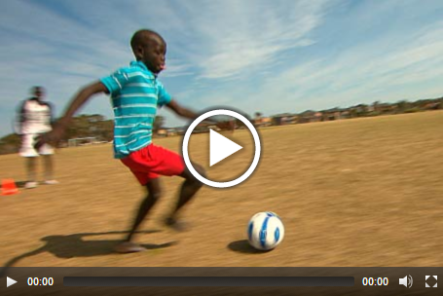
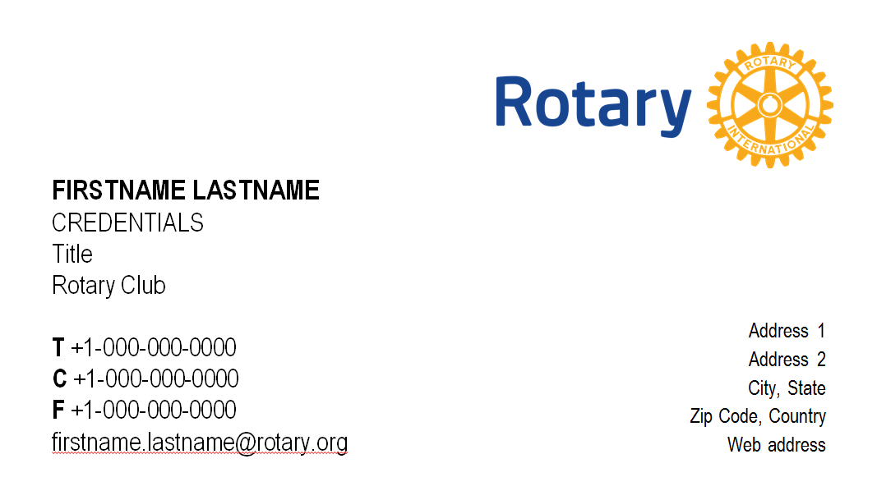
ROTARY BRAND CENTER
www.rotary.org/brandcenter
Notes:
You can find many of these in the Rotary Brand Center.
You will find our new logos, download our guidelines and learn more about our voice and visual identity.
The Brand Center gives you access to images, videos and ”This Close” advertisements.
You can download templates for PowerPoint, letterhead, business cards, news releases, and club newsletters.
You can create a customizable club brochure and flyers.

Slide 3
ZONE WEBSITE RESOURCES
www.rotaryzones24-32.org
Notes:
You will find even more resources at our Zone website on Public Image, Membership and the Rotary Foundation.
We are part of Zone 24 and partner with Zone 32 so we have resources from 70 Districts across Canada, Washington State, Alaska and the north-eastern United States.

Slide 4
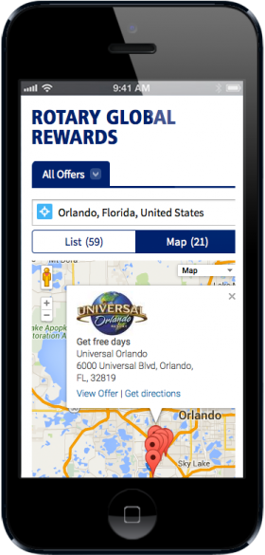
ROTARY RESOURCES
Rotary Ideas
ideas.rotary.org
Discussion Groups
My Rotary under Exchange Ideas
Rotary Showcase
My Rotary under Take Action
Notes:
Rotary has created a video channel on YouTube and Vimeo and is active on Facebook, Twitter and other social media sites, as well as specific Rotary sites such as Rotary Ideas, Rotary Showcase and Discussion Groups.
And the newest program created by President Ravi is Rotary Global Rewards where we partner with many companies - both Rotary members and non-Rotarian organizations - to offer membership rewards, either as discounts to you or in the form of donations to The Rotary Foundation.

Slide 5
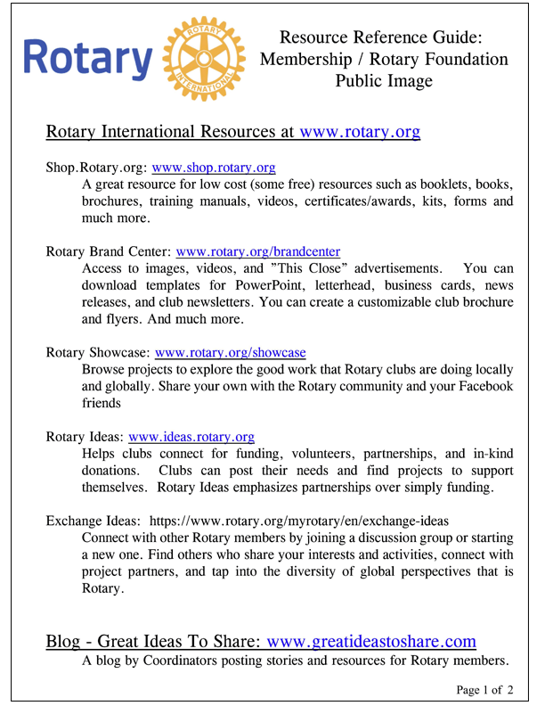
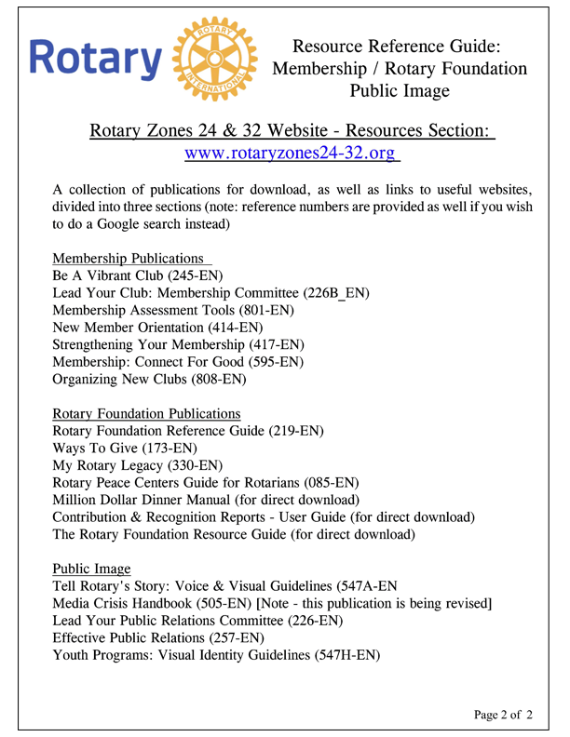
RESOURCES HANDOUT
Resources Handout
Notes:
Information on all of these resources is available on a double sided handout available to each of you.
So with all of these tools at your disposal - what is the most powerful tool for the Rotary brand?

Slide 6
YOUR DISTRICT CHAIR / COMMITTEE
Professional background in journalism or public relations
Has relationships with journalists or the ability to cultivate them
Can effectively convey the essence of Rotary to an external, non-Rotarian audience
Excellent speaking, presentation, and writing skills
Knowledge of media relations, the news industry, and electronic and social media
A good news sense and understanding of the kinds of stories that interest local or regional media
Thorough knowledge of club and district activities

Slide 7
ROTARY PUBLIC IMAGE SURVEY
Rotarian Mike Reddington (mikered@shaw.ca)
will design, run and provide results.
All you have to do is promote it!
Notes:
Results of District 5050 survey (Points 1 & 2)

Slide 8
SURVEY SAYS:
1. Awareness of new logo & branding but not in depth knowledge or use of Rotary resources.
2. High interest in training & information – especially to use for websites, Facebook and club projects, fundraisers & events
Notes:
Results of District 5050 survey (Points 1 & 2)

Slide 9
SURVEY SAYS:
3. Interest in multi-club public image projects and building public relations plan.
4. Preferred method of training – Area seminars.
5. Over 120 potential volunteers identified.
Notes:
Results of District 5050 survey (Points 3 – 5)

Slide 10
DISTRICT TRAINING
Facebook & Social Media
ClubRunner & websites
Marketing & Strategic Planning

Slide 11
COMMUNICATIONS PLAN
Discuss and develop a plan
to promote Rotary’s Public Image

Slide 12
REPORT BACK TO GROUP

Slide 13
MEASURE IMPACT
Did membership and contributions, or interest in them, increase?
Are current members more engaged?
Does your Facebook page have more followers?
Does your website get more views?
Has event attendance increased?

Slide 14
REVIEW LEARNING OBJECTIVES
Plan how you will use communications strategies to achieve your public image goals
Consider how to create and implement both an internal and external communications plan for your district
Use the public image resources available to enhance your communications efforts

Slide 15
TELL YOUR ROTARY STORY
Notes:
Tell your Rotary story
When you tell your story, remember these three essential elements:

