Slide 1
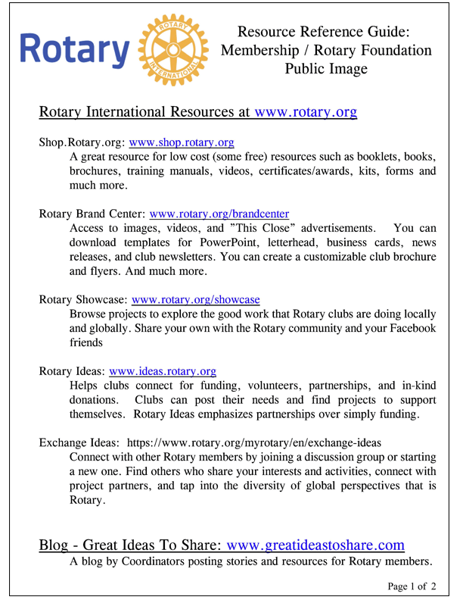
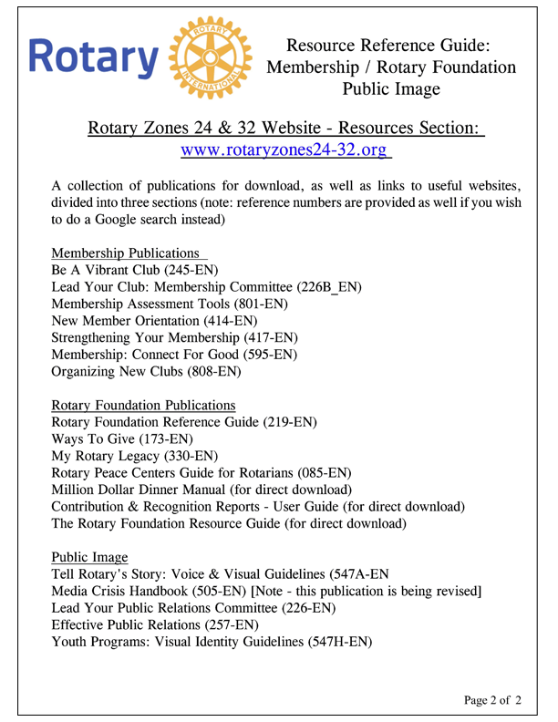
RESOURCES HANDOUT
Resources Handout
Notes:
Information on all of these resources is available on a double sided handout available to each of you.
So with all of these tools at your disposal - what is the most powerful tool for the Rotary brand?

Slide 2
CONTENT
Communicate as it happens
Promote District events
Share pictures and stories about service projects and fundraising events
Get support for projects and events

Slide 3
CONTENT
Grab attention with the subject line and first paragraph
What do members want to hear?
Keep it brief –short articles with links to the full story
Use existing Rotary content
Use pictures and videos!

Slide 4
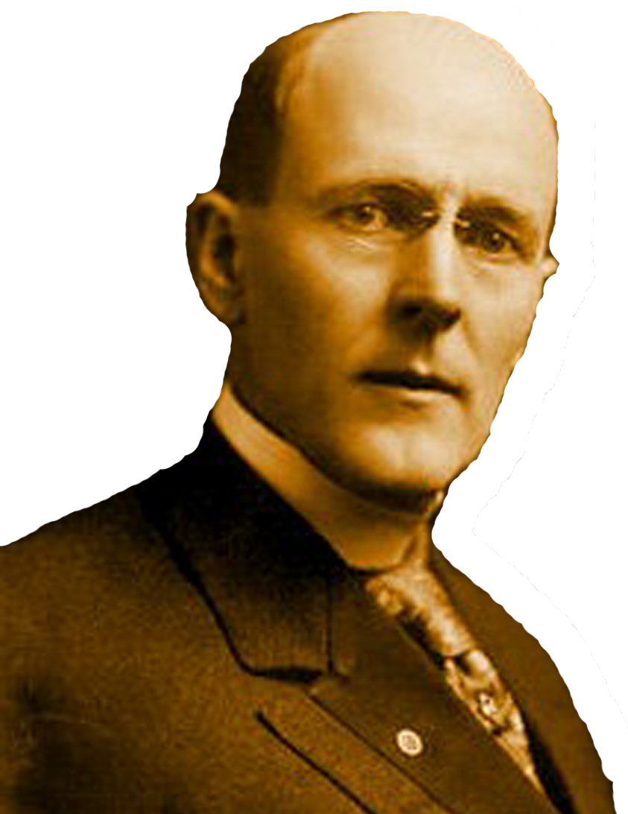
DEVELOPING A PLAN
Solo Planning

Slide 5
DEVELOPING A PLAN

Slide 6
LEARNING OBJECTIVES
Identify your audience
Determine the message and content
Format & delivery of the message
Create or refine an external communication plan

