Slide 1
EXTERNAL COMMUNICATION
WORKBOOK SESSION 17

Slide 2
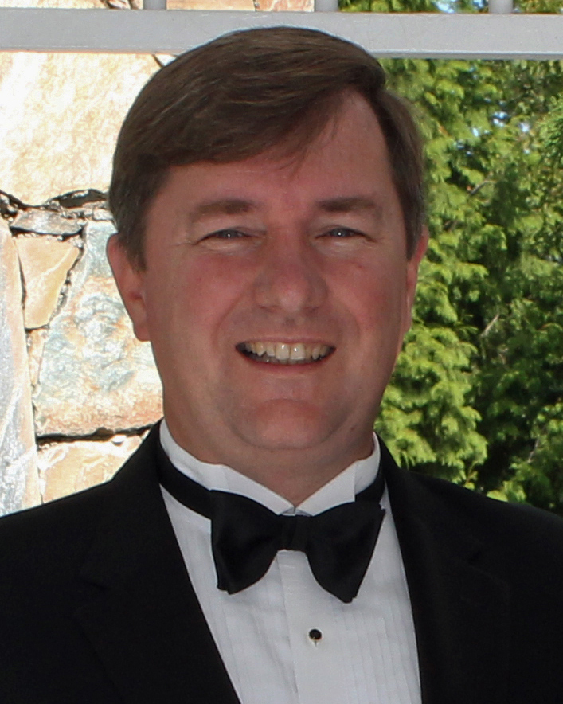
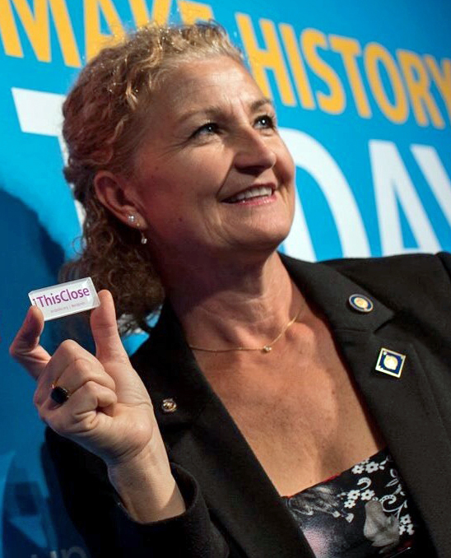
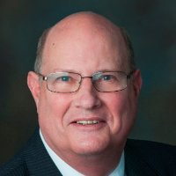
ROTARY PUBLIC IMAGE COORDINATORS
Zone 24 West
Zone 24 East
Zone 32
Sean Hogan, RPIC
Ken Miller
Assistant RPIC
Tanya Wolff, RPIC
Guy Bissonnette,
Carrie Jones,
Brian Thompson
Assistant RPICS
Dan Ceglia, RPIC

Slide 3
LEARNING OBJECTIVES
Identify your audience
Determine the message and content
Format & delivery of the message
Create or refine an external communication plan

Slide 4
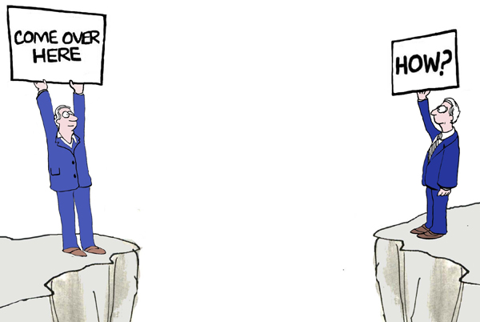
EXTERNAL COMMUNICATIONS

Slide 5
EXTERNAL COMMUNICATION
Audience - Content - Format
Who? What? How?

Slide 6
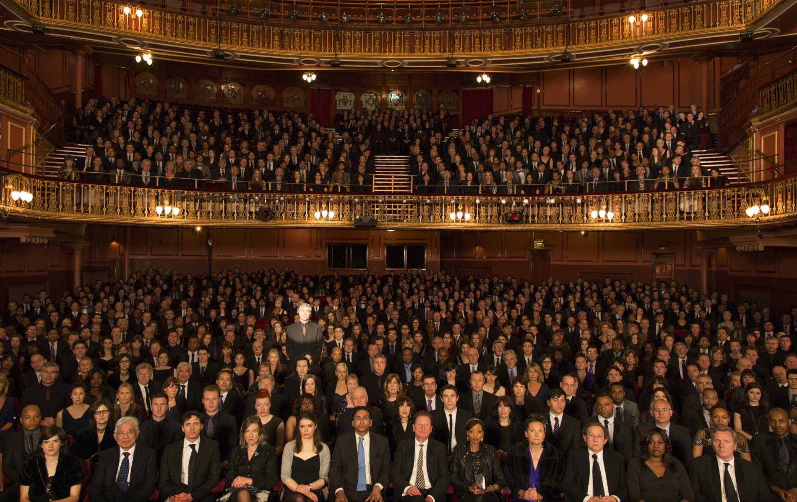
AUDIENCE
Who
Do You
Need To
Talk
To?
Potential Members & General Public

Slide 7
MESSAGE
What’s Your
Message?
Inform: What is Rotary
Invite: Join Rotary
Involve: Youth
Support: Fundraiser
Promote: Event

Slide 8
MESSAGE
Never Heard of Rotary
Know Name Only
Some Familiarity
Notes:
Almost nothing
Four in 10 have never heard of us.
Another four in 10 have heard of our “name only.”
Only two in 10 claim to have “some familiarity” with Rotary. Unfortunately what much of this group knows is colored by misperceptions and half-truths.
To help us change this lack of perception, Rotary has been undertaking a revitalization of our brand.
For too many years, Rotary was a humble organization. We did our work quietly and without any fanfare. But we have come to realize this was a mistake because people don’t know about us and if they don’t know who we are and what we do, they won’t become Rotarians.
We now realize we have to tell our Rotary stories - we have a lot to brag about and we need to share those stories - not for our own benefit but so that we can do the work that needs to be done and help the people who need our help.
To assist us, Rotary has created a number of new tools.

