Slide 1
INTERNAL COMMUNICATION
WORKBOOK SESSION 5

Slide 2
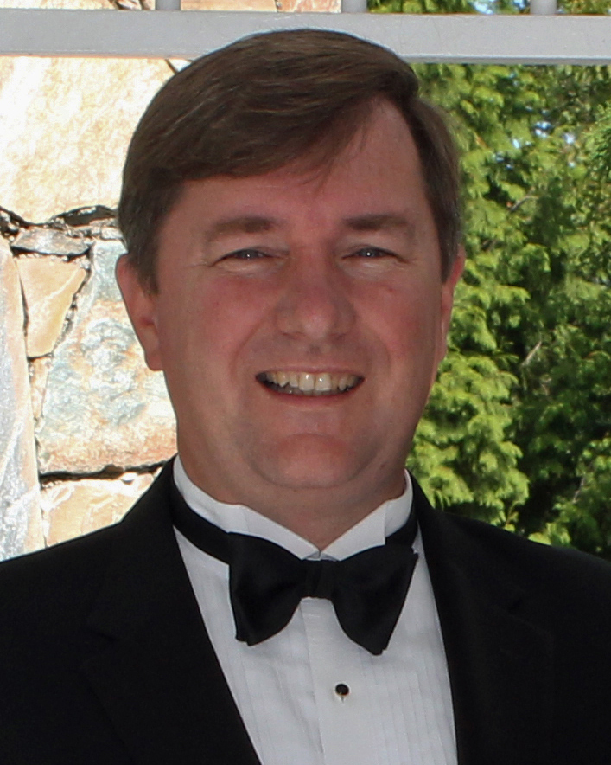
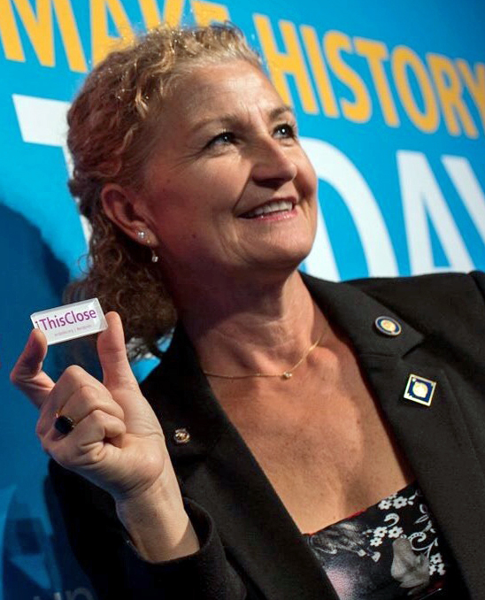
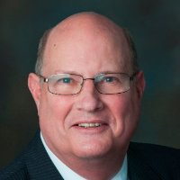
ROTARY PUBLIC IMAGE COORDINATORS
Zone 24 West
Zone 24 East
Zone 32
Sean Hogan, RPIC
Ken Miller
Assistant RPIC
Tanya Wolff, RPIC
Guy Bissonnette,
Carrie Jones,
Brian Thompson
Assistant RPICS
Dan Ceglia, RPIC

Slide 3
LEARNING OBJECTIVES
Identify your audience
Create or refine an internal communication plan for your District
Communicate with clubs regularly and effectively

Slide 4
INTERNAL COMMUNICATION
Internal

Slide 5
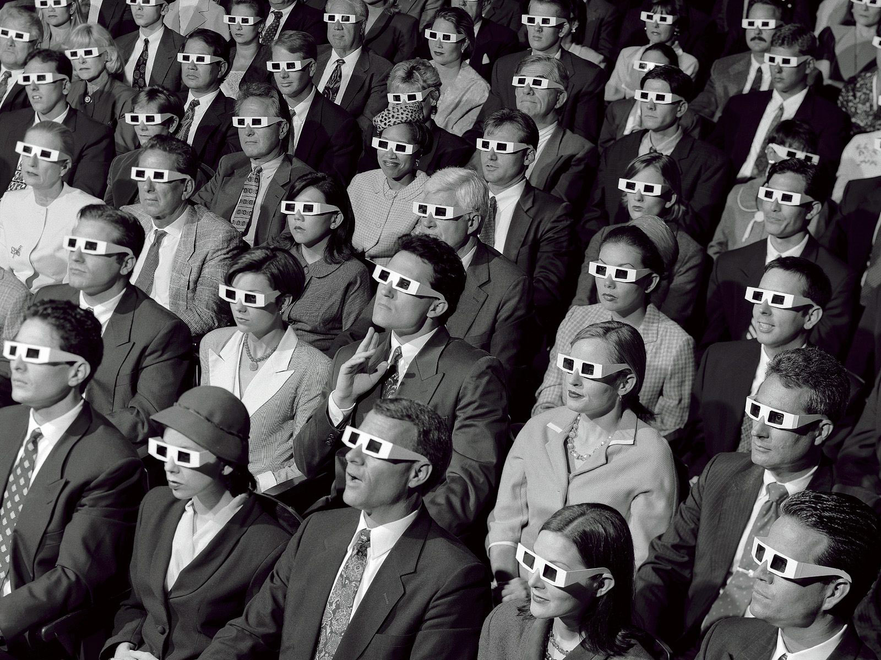
INTERNAL COMMUNICATION
Who
Do You
Need To
Talk
With?

Slide 6
INTERNAL COMMUNICATION
Governor
Governor-Elect
Governor-Nominee Designate
Assistant Governors
District Trainer
District Administrator
Committee Chairs
Club Presidents-Nominee
Past District Governors
Club Rotarians
Spouse/Partner /Children
Dog / Cat
Counsellor / Psychologist
Who
Do You
Need To
Talk
With?

Slide 7
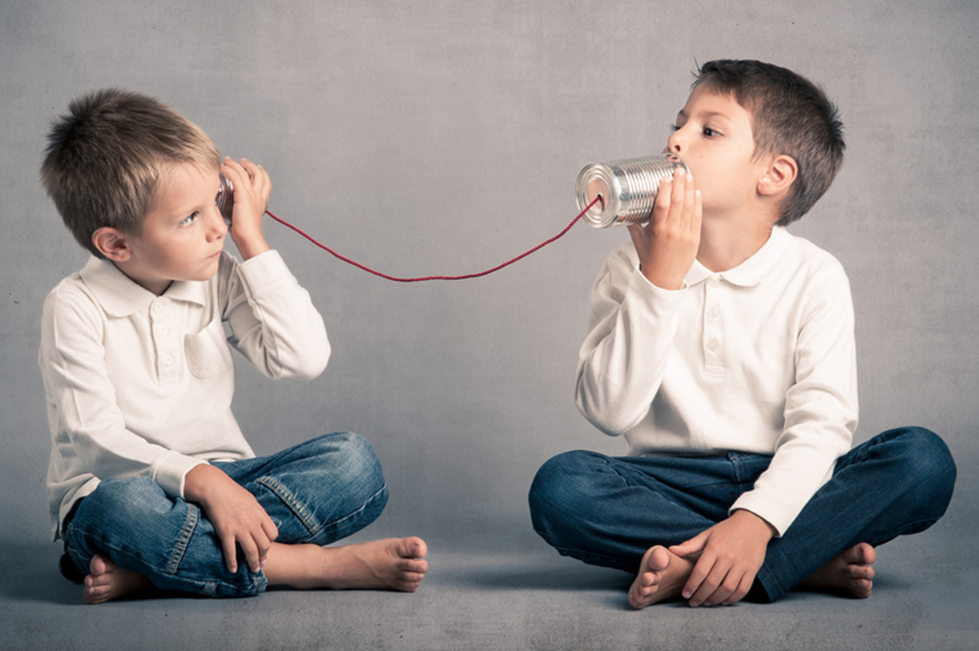
INTERNAL COMMUNICATION
How
Do You Talk
To
Them?

Slide 8
INTERNAL COMMUNICATION
In Person
Telephone
Email
Website
Facebook
Twitter
District Newsletter
GoTo Meeting
Skype
Letters
Thank You Cards
Which Are More Effective?
Why
&
When?
How
Do You Talk
To
Them?

Slide 9
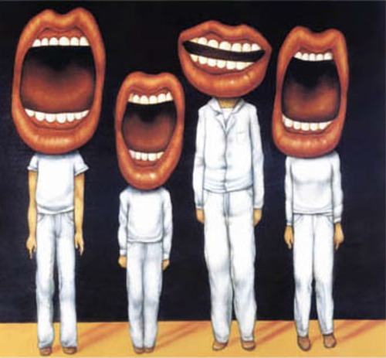
INTERNAL COMMUNICATION
Who
Else
Talks?

Slide 10
INTERNAL COMMUNICATION
Governor
Governor-Elect
Governor-Nominee Designate
Assistant Governors
District Trainer
District Administrator
Committee Chairs
Club Presidents-Nominee
Past District Governors
Club Rotarians
Spouse/Partner /Children
Dog / Cat
Counsellor / Psychologist
Who
Else Talks?

Slide 11
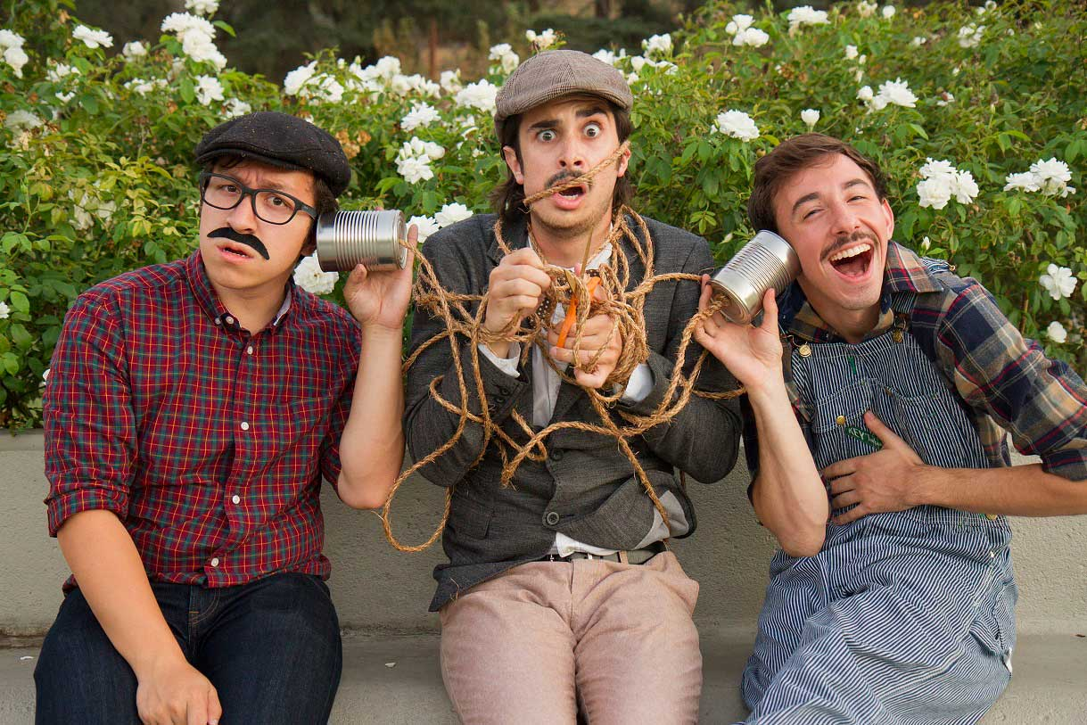
INTERNAL COMMUNICATION
Who Else Talks?

Slide 12
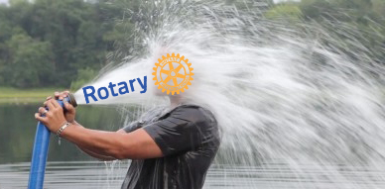
INTERNAL COMMUNICATIONS
Who Talks To You?
Drinking From The Firehose

Slide 13
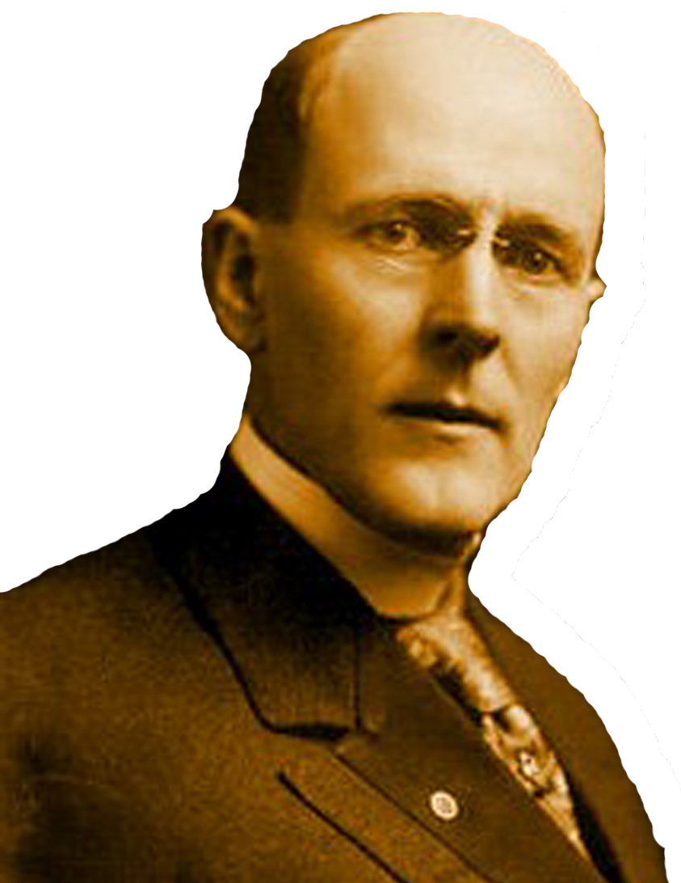
DEVELOPING A PLAN
Solo Planning

Slide 14
INTERNAL COMMUNICATION
How Will You Manage
It?

Slide 15
INTERNAL COMMUNICATION
How Will You Manage
It?

Slide 16
REVIEW OF LEARNING OBJECTIVES
Identify your audience
Create or refine an internal communication plan for your District
Communicate with clubs regularly and effectively

