Slide 1
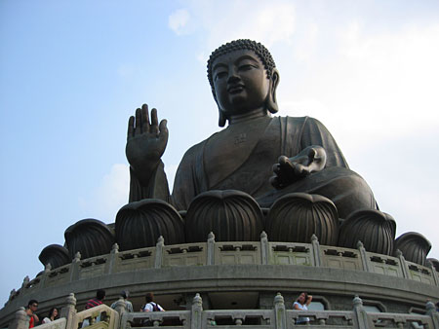
International Service Committee
Invitation
Rotary Club of Chatswood
International Dinner Night
Korean
Wednesday, 25th Feb. 2015
JONG GA JIP BBQ Restaurant
13 Railway Parade, Eastwood
Korea
All proceeds
to:
6.30pm for 7.00pm
BYO $40pp
Call / email Dieter
0413 539 209 / dietor@bemad.co

