Slide 1
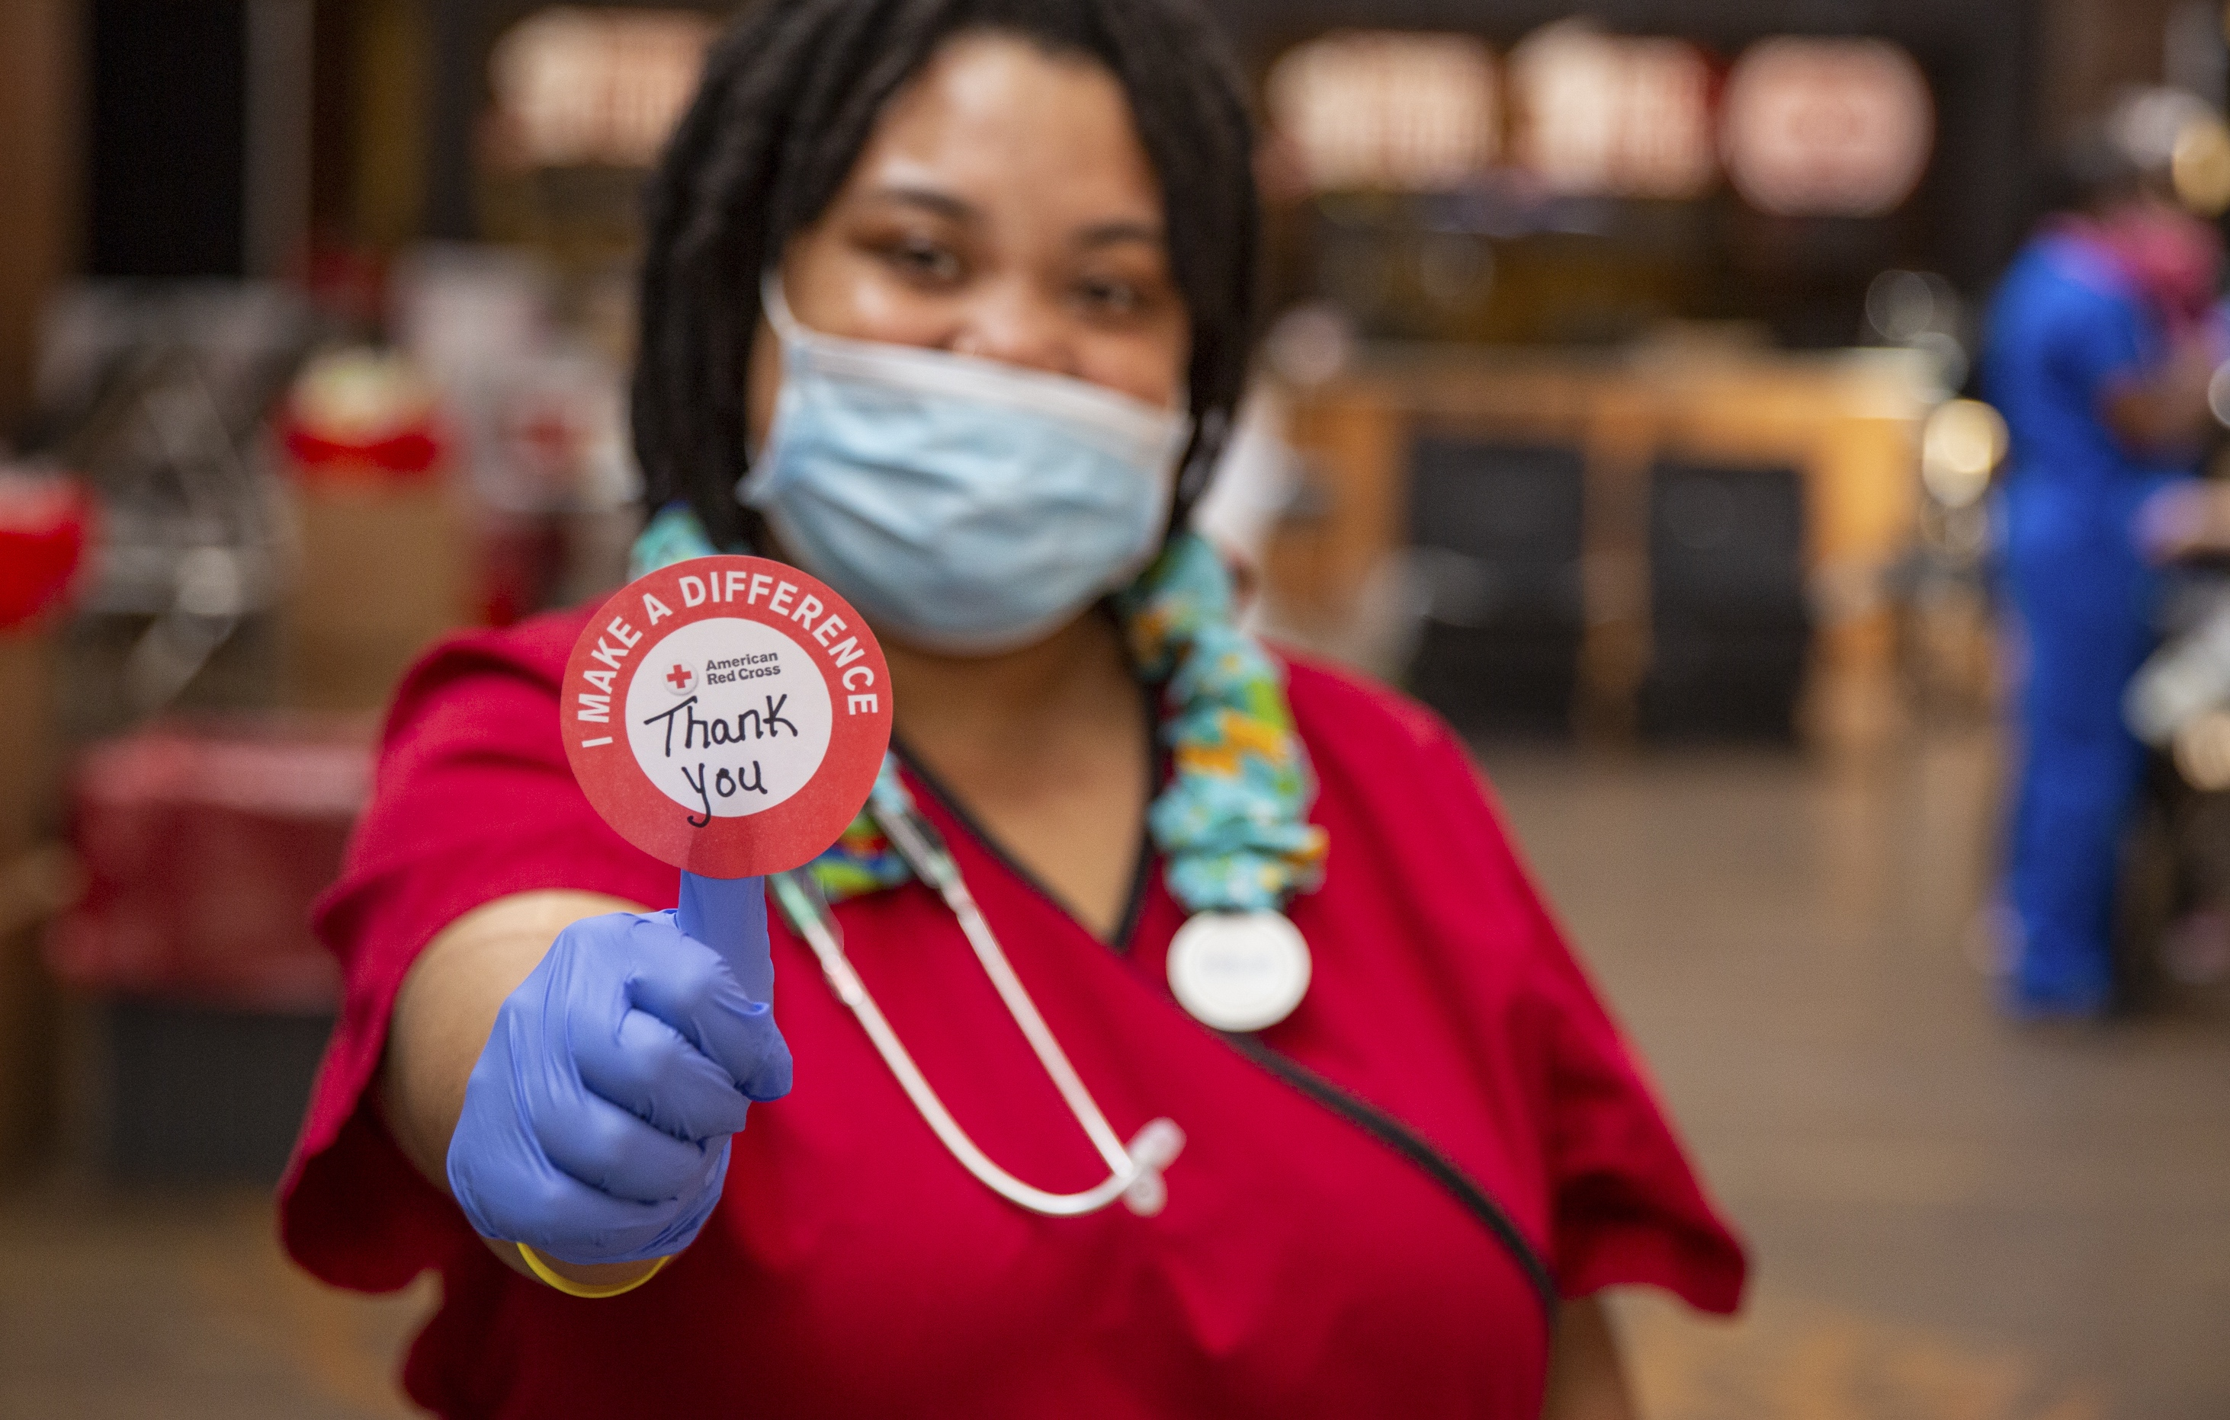



Slide 2

Sponsor a Blood Drive or Donate Blood
Promote and support Blood Donations – we can schedule them out for the year
Every two seconds, someone in the U.S. needs blood, and generous blood donors are the only source.
When you sponsor an on-site blood drive, you provide an opportunity for each donor to save up to three lives.
Redcrossblood.org
https://www.redcrossblood.org/hosting-a-blood-drive/learn-about-hosting/how-hosting-a-blood-drive-works.html
Contact: Camilla Boolootian: Camilla.boolootian@redcross.org
Phone:831-421-1146

Slide 3
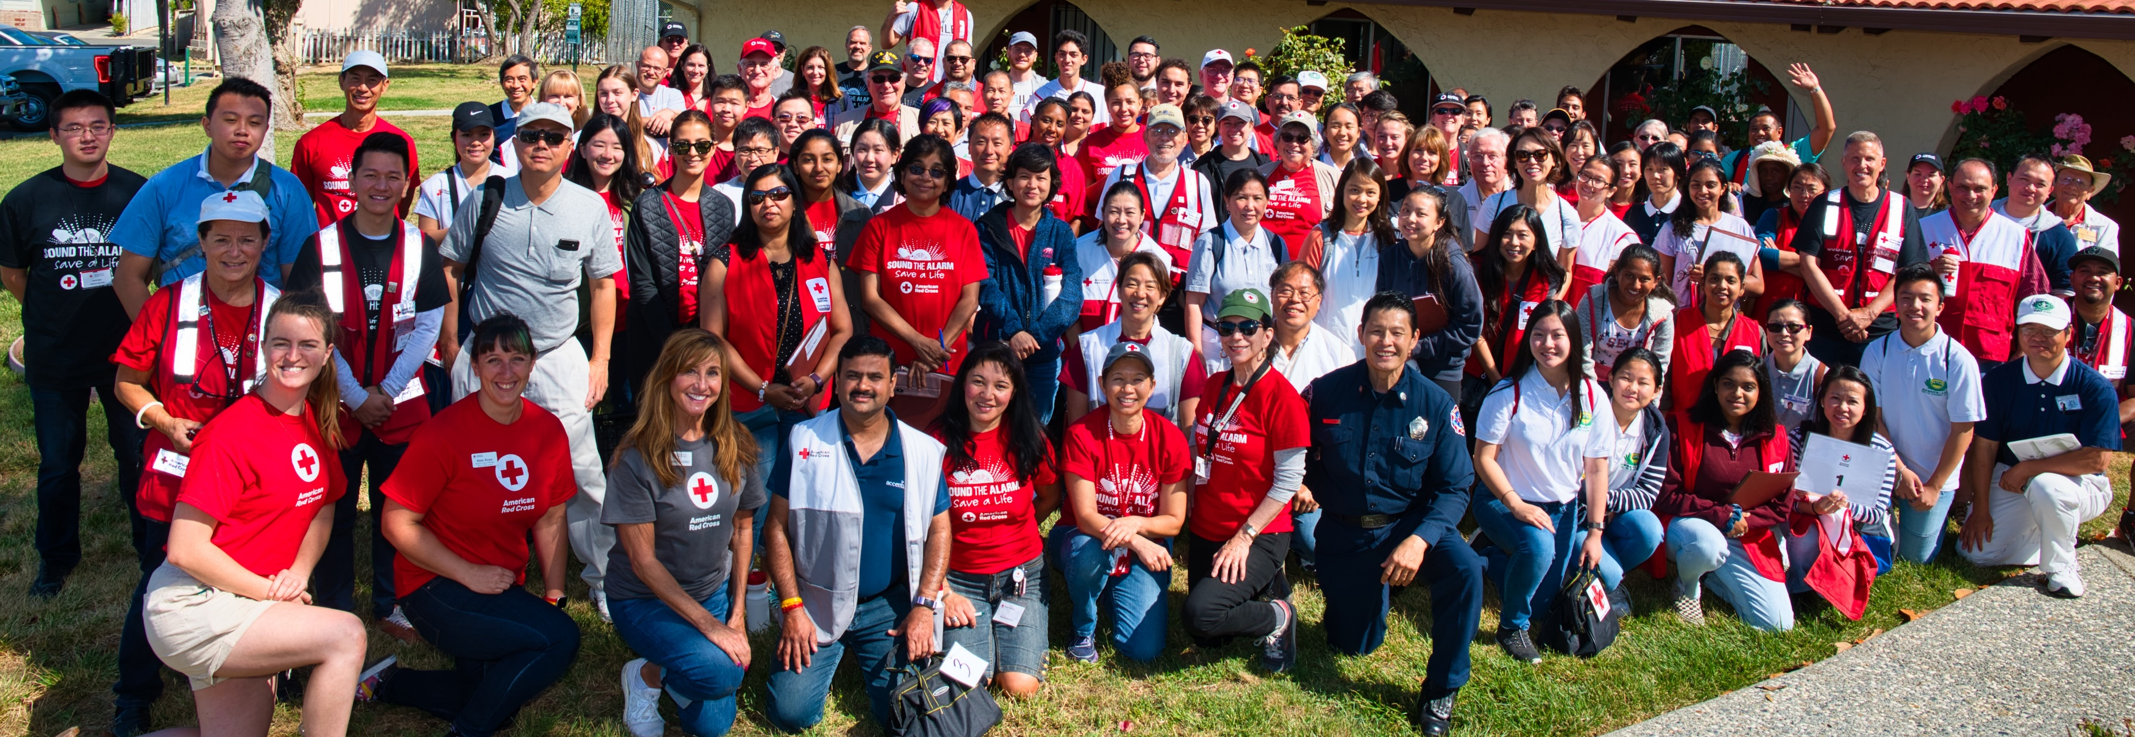
Become a
Volunteer
Make a difference! Become a Trained Volunteer. Become trained because #Help Can’t Wait!
All prospective individuals need to go through the volunteer portal to become volunteers. All Red Cross volunteers are background checked and sent through training. All Red Cross Disaster and Blood Services volunteer trainings are free. There are extensive online classes that can be taken virtually.
Rotary District 5170 Entry point:
https://volunteerconnection.redcross.org/?nd=intake&organization_id=2791
Ana Romero Volunteer Services | Recruitment Manager (408) 202-5614 (c) Ana.Romero@redcross.org

Slide 4
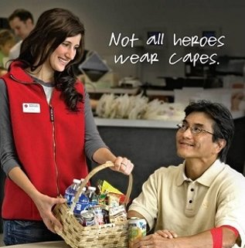
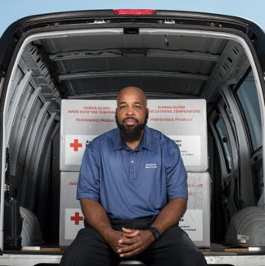
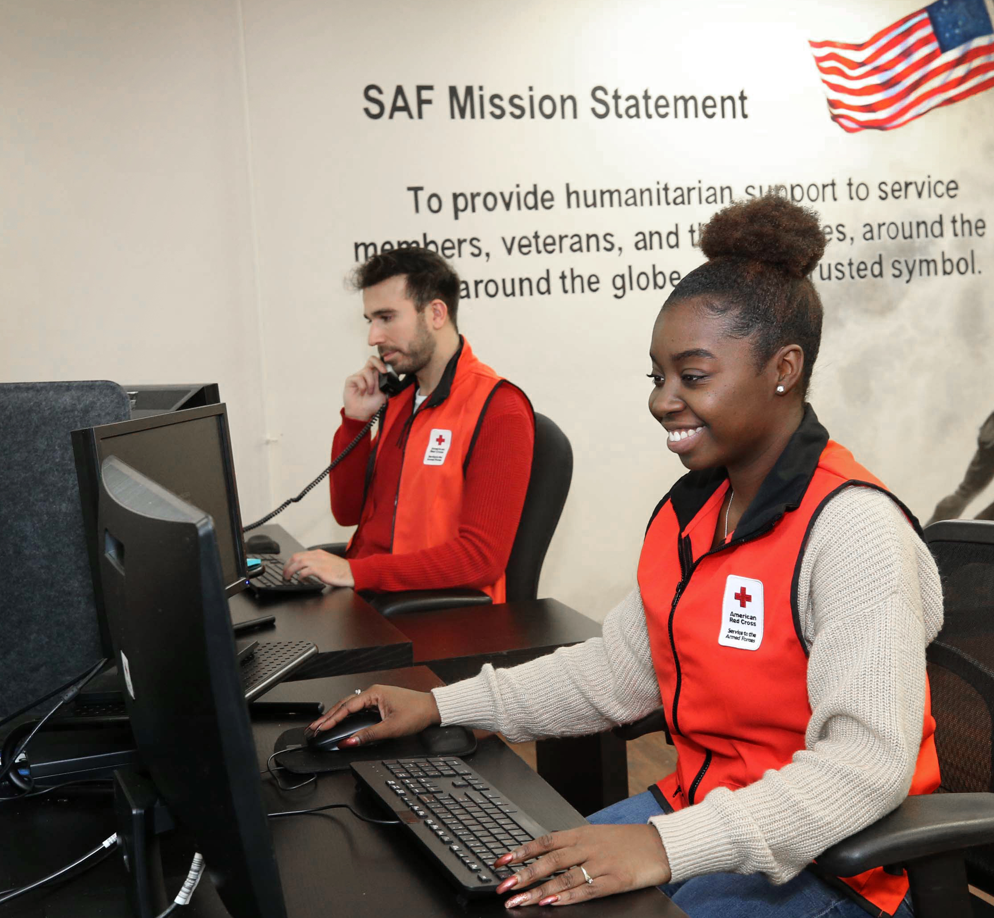
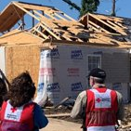

What are the most urgent needs this month ?
DONOR AMBASSADORS:
Alameda(23)
Santa Clara(11)
San Joaquin (10)
Stanislaus (14)
Gilroy/Morgan Hill
TRANSPORTATION SPECIALIST:
SF (12)
San Jose
Stockton (4)
SAF CASEWORKER:
Family Follow-up (1)
DAT:
Alameda (8)
SF (6)
Napa (3)
San Joaquin (2)
Merced, STA & SCR (1)
PHOTOGRAPHERS:
Marin-Solano (3)
Merced, San Joaquin, Stan.(2)
Napa-Sonoma (2)

Slide 5
Important Notice Regarding COVID-19: The American Red Cross is closely monitoring the outbreak of coronavirus disease 2019 (COVID-19). Our need for volunteers is constant and continues to evolve as we navigate this health crisis. Please rest assured that we are working with public health officials to help keep local communities and our volunteers safe.
 | Position Name | Description | Requirements | Ideal for Anyone
Blood Services | Donor Ambassador Actively Recruiting In: -Alameda -Contra Costa -Merced -Monterey (weekdays) -San Joaquin -San Francisco (weekdays only) -Santa Clara (weekdays 18+) -Sonoma -Stanislaus | Provide great customer service to donors at local blood centers (Oakland, Pleasanton, Newark, Pleasant Hill, San Jose) or community drives. Greet & register donors, staff the canteen area, execute donor temperature screening on potential donors prior to their entry into the blood drive. Overall making donors feel appreciated. Time commitment: Minimum 1 shift (4-6 hours) per month. Able to commit for at least 6 months | One 2-hour online training followed by a shadow shift Able to commit for at least 6 months (for reactive counties) | Available weekdays Interested in a set weekly shift Looking for a youth-friendly position 16+ yrs.
 | Transportation Specialist Recruiting In: San Francisco Santa Clara San Joaquin | Transport life-saving blood products to local hospitals using a Red Cross owned vehicle located at the Oakland Blood Center, San Jose Blood Center, or San Francisco Pier 54. Time commitment: 2 shifts (4-5 hours) per month. Current high need shifts: San Francisco – Early mornings (5am) or evening (6:30pm) Santa Clara –Afternoon/evenings (3pm on) Stockton – OPEN recruitment | 2 “ride-a longs” driving Red Cross van Valid driver’s license Move boxes < 45 lbs. | Who enjoys driving Clean driving record for 3 years Available weekdays, evenings, or weekends 18+ only

Slide 6
Preparedness Resources
These tools can save lives. Send them in emails or share them on your intranet, blog or social media channels.
Coronavirus safety resources: Tips to help prevent the spread of COVID-19.
Kids Activity Kit: COVID-19: Easy games and exercises that teach kids to wash hands, not spread germs, cope with stress and more.
Caring for Pets During COVID-19: While it’s uncommon, for pets to contract coronavirus, these simple tips help protect them.
Psychological First Aid: Supporting Yourself and Others During COVID-19: This online course helps people manage stress and support others during this challenging time.
Returning to Work During COVID-19: Safe Work Practices: This online course helps make the transition back into the workplace safer during this pandemic.
First Aid/CPR/AED Care During COVID-19: During emergencies, it’s still possible to help while minimizing the risk of contracting coronavirus. These tips are especially helpful for caregivers and those who work with the public.
Coronavirus Prevention and Safety Information for Our Students: Considering an in-person Red Cross class? Learn about the steps we’re taking to help prevent the spread of COVID-19.
Professional Responder Safety: Medical professionals and responders can protect themselves from COVID-19 while caring for patients.
FREE mobile apps: Put preparedness in people’s pockets.
Common Natural Disasters: Learn how to prepare for common local disasters
Summer Safety: Keeping your family safe is more important than ever during summer:
Water safety
Heat wave safety
Home fire safety
Hurricane safety

Slide 7
When Disasters Strike
How to Get Help
Find a shelter for a safe place to stay, food, water, basic health/emotional services and more.
Find loved ones during an emergency (or register themselves as “safe”) through Safe and Well.
Download the Red Cross Emergency App for real time weather alerts, shelter locations, preparedness information and safety tips.
People without internet access may call 1-800-RED CROSS for assistance.
How to Help Others
Financial donations are the quickest way to help people harmed by a disaster.
Your relationship manager will let you know if you can help fulfill bulk in-kind needs. Please discourage employee collections of goods. Unsolicited in-kind donations are challenging because they must be sorted, cleaned, and worked into service delivery.
While blood donations are appreciated, disasters rarely require significantly more of it. Donations do typically drop in the summer though, making it a great time to encourage employees to schedule a blood donation at RedCrossBlood.org.
Special Access For You
Following major disasters, your relationship manager will share immediate updates. You may receive emails, invitations to exclusive disaster leadership calls and communications resources.
If you receive questions from your employees, leadership, social followers or customers about the Red Cross, your relationship manager can share simple responses.

Slide 8
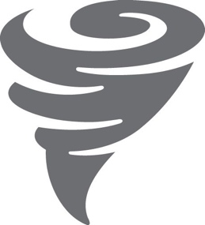


We Impact Lives Every Day
Over 30,000 people are assisted by the American Red Cross daily.
30,000
170
13,000
people are assisted by the American Red Cross daily.
times a day, Red Cross
workers help a family
affected by a disaster.
times a day, the Red Cross must collect blood donations to help patients in need.
1,300
621,000
13,000
times a day, we
provide services to military members, veterans and their families.
times a day, a child
receives a measles or rubella vaccination from the Red Cross and our partners.
times a day, a person
receives lifesaving
Red Cross training.

Slide 9

Ever Evolving, Incredibly Efficient
We constantly adapt, using new technology
and refined methods to do more with less.
90% OF OUR
WORKFORCE IS VOLUNTEER.
20 OUT OF 20 STANDARDS
FOR CHARITABLE
ACCOUNTABILITY MET.
90¢ OF EVERY
DOLLAR THAT WE SPEND
DELIVERS CARE.

Slide 10

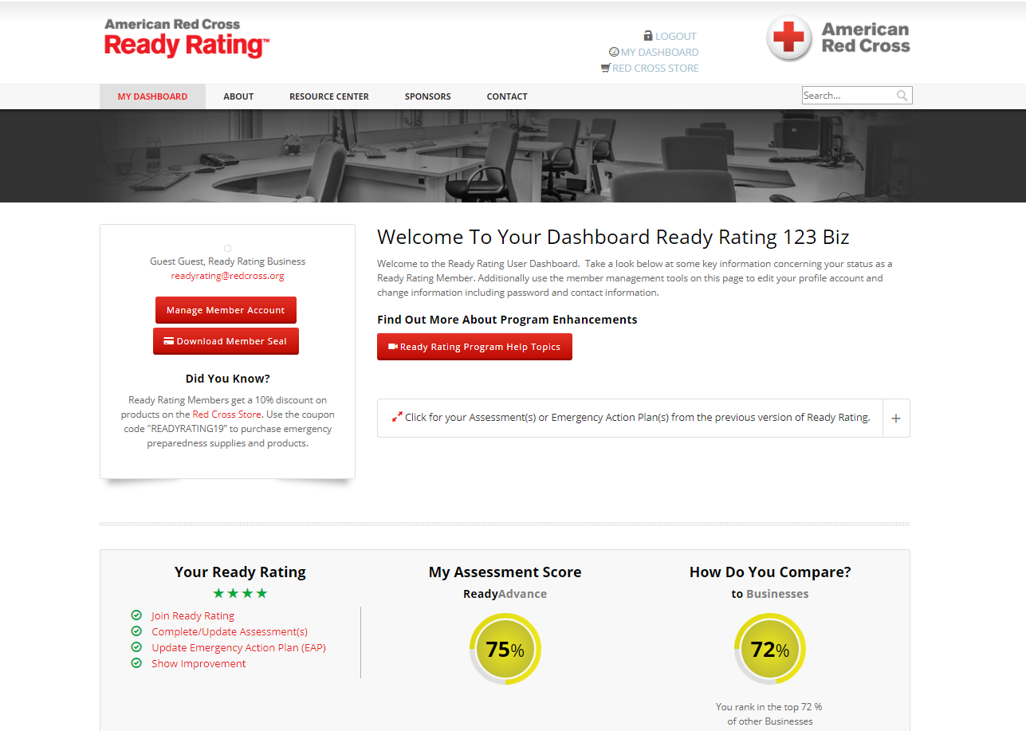
A Prepared Workplace
You, of course, care about the safety of your employees. Prepare your workplace for all kinds of emergencies through American Red Cross Ready Rating™.
Free membership
Self-paced assessments that quantify your company’s preparedness level
Custom next steps report for planning preparedness improvements
Template emergency response plans
Resource Center with forms, templates, white papers, training videos and more

Slide 11
For more information, contact Camilla Boolootian
Camilla.boolootian@redcross.org or call 831-421-1146
I

