Slide 1
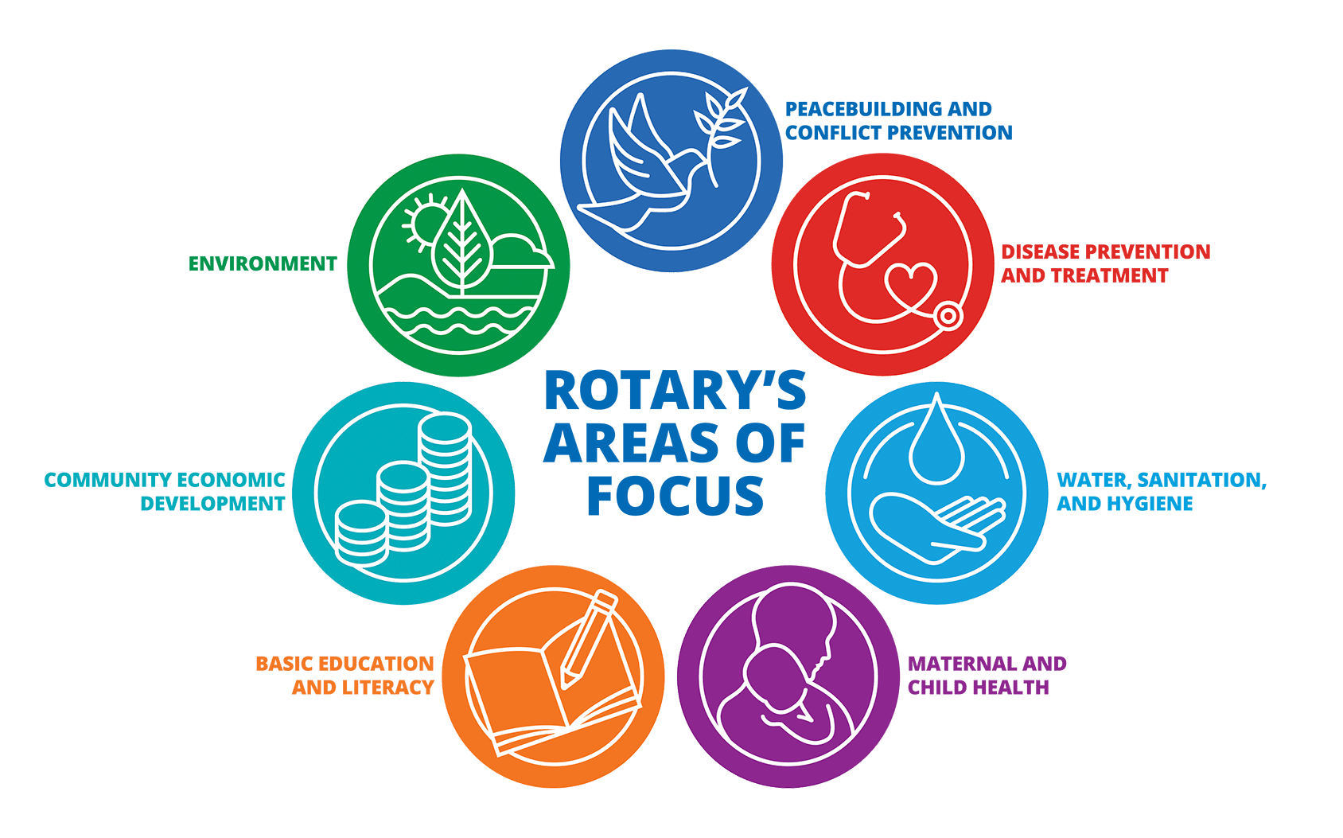
What does Rotary do?
What is Rotary?
No Challenge too big; No project too small. We put “Service above Self”.
1.4 million strong volunteer organization
We transform communities by volunteering for 47 million approximate volunteer hours each year
We fund sustainable projects: $333 million awarded for global service initiatives in 2020-21
Visit District 5170 website to find out more:
www.RotaryDistrict5170.org
District Membership Contact:
Camilla.Boolootian@redcross.org
Geeta.kadambi@gmail.com
You can have a positive impact in your community – local and global – working side-by-side with people like you. Find the inner Rotarian in you!

Slide 2
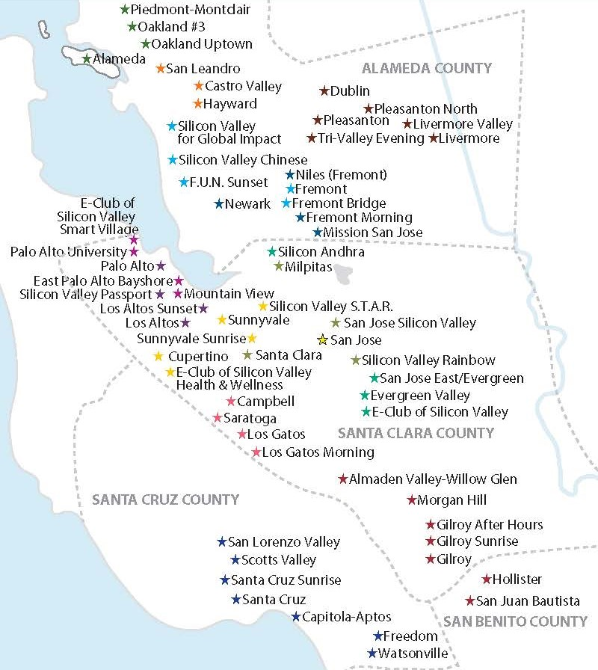
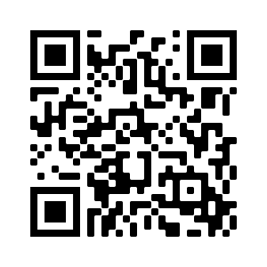
Come Explore Rotary
We have 62 clubs in Bay Area and counting. Take your pick. Let us know what time, place and date suits you. We will help identify a club for you.
District Governor Savita Vaidhyanathan
welcomes you
Scan using cell phone and submit interest to explore any Rotary club:

