Slide 1
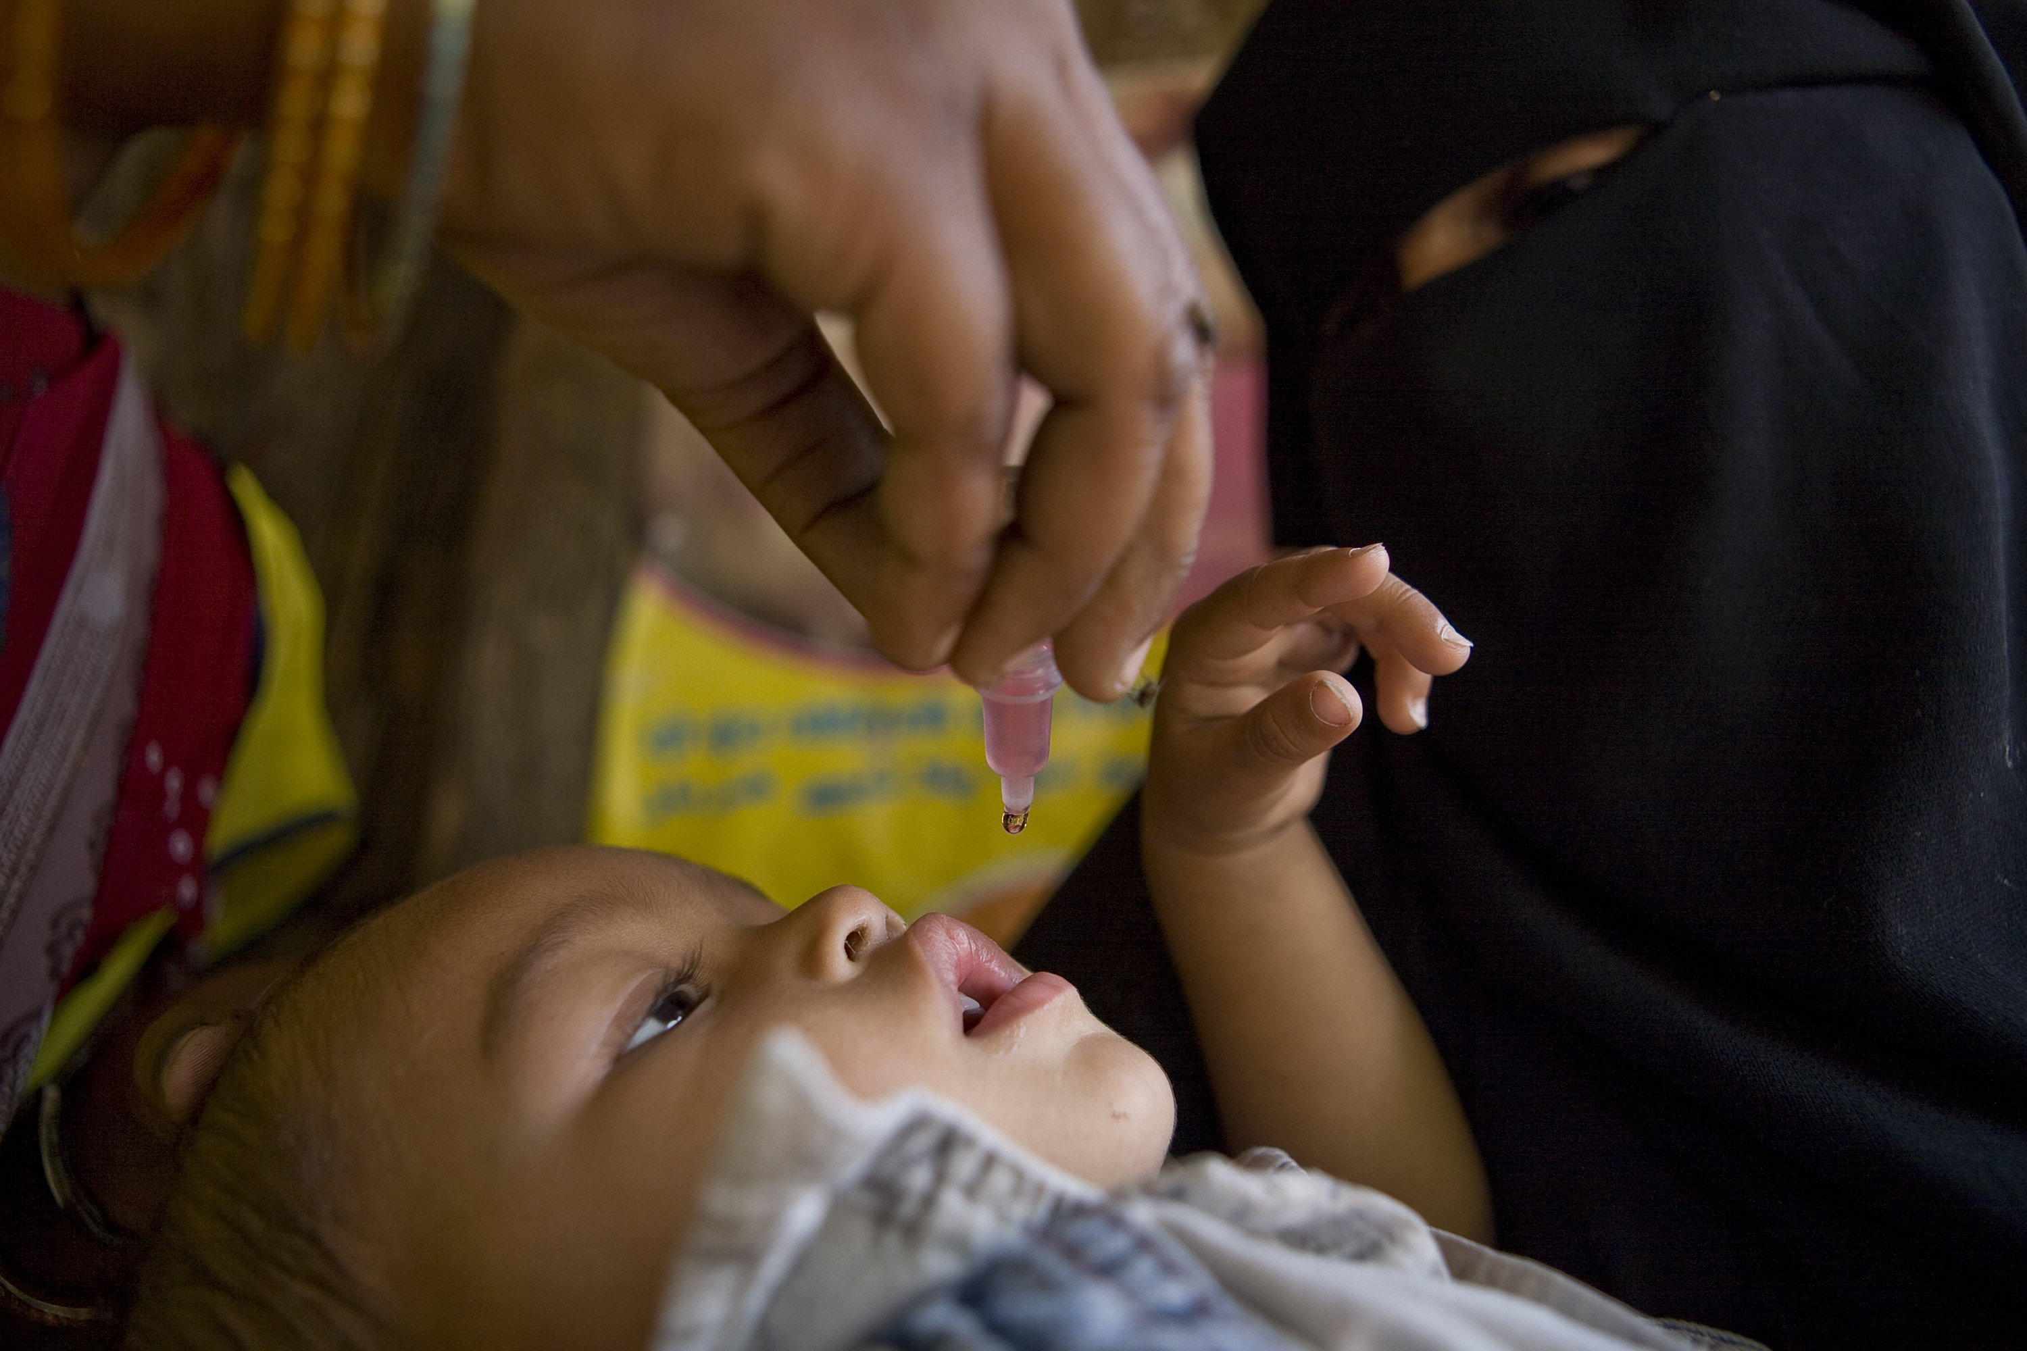
Together, We End Polio!
“Together,
We End Polio”
District 5170
PolioPlus Drive
Spring, 2025

Slide 2

Rotary has been working for more than 30 years to eradicate polio worldwide through its global PolioPlus program.
Since 1988, Rotary and its partners, including the World Health Organization (WHO), UNICEF, and the U.S. Centers for Disease Control and Prevention (CDC), have reduced polio cases by more than 99.9%, from an estimated 350,000 cases in 1988 to just 12 reported cases in 2023.Unfortunately, 2024 saw an increase to 99 cases.

Slide 3
But the work is clearly not done
Because of Rotary and our partners:
- 20 million people can walk today who would otherwise be paralyzed
- 1.5 million childhood deaths prevented
But polio is still ready to erupt:
- It still circulates in small numbers
- It can spread easily from its hiding places to anywhere in the world
- It can still infect the unvaccinated
We must continue to vaccinate, even in difficult parts of the world
We must monitor for outbreaks
We must improve public health resources

Slide 4
End Polio Now Weekly Update March 27, 2025
Wild Polio Virus - Only Endemic in 2 Countries
Year | Pakistan | Aghanistan | Total
2023 | 6 | 6 | 12
2024 | 74 | 25 | 99
2025 | 6 | 1 | 7
Variant Polio Virus Caused Cases
Total |  |  | Leading Countries Previous 12 Months
Year | Total |  | Country | Total | Last Onset
2023 | 539 |  | Nigeria | 87 | 8-Feb-25
2024 | 308 |  | Chad | 40 | 1-Feb-25
2025 | 15 |  | Ethiopia | 38 | 8-Dec-24
 |  |  | Yemen | 29 | 24-Oct-24
 |  |  | Niger | 15 | 17-Dec-24

Slide 5
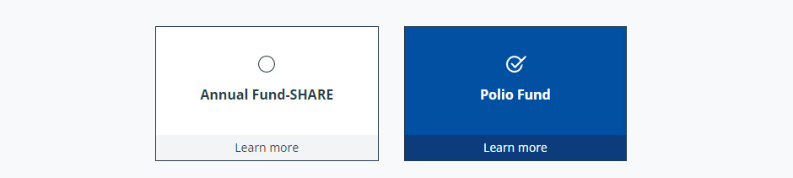
How to finish the job
Donate On-line at Myrotary.org/donate
Donate by check
Join the Polio Plus Society

Slide 6
District 5170 Polio Plus Society (PPS)
Pledge a minimum of $100 per year until the world is certified Polio Free by the World Health Organization.
District 5170 has 95 PPS members – 26 added this year
Receive a Special PPS Pin. Your Donations count towards Paul Harris Society and are mateched 2:1 by the Gates Foundation.
Complete a Polio Plus Society Pledge Form and scan and email to District 5170 PPS Chair Cindy Murphy at cllmurphy@hotmail.com

Slide 7


