Slide 1
WEBSITE/FACEBOOK DISCUSSION:
MAGGIE PADOVANI

Slide 2



How do you make use of your Website and Facebook in promoting your club

Slide 3
Your Website
Is your digital presence to the public
Information about your club
Where your club meets weekly
Guest speaker of the week
Special Events or Fundraisers
Rotary Community Projects
How to become a member, who to contact
Photos of club events, fellowship

Slide 4

CLUBRUNNER
Your Club Website
Should link to:
Related Rotary sites
  Rotary.org
  Rotarydistrict5170.org
  Events.rotarydistrict5170.org
  dc.rotarydistrict5170.org
  Interact5170.org
  RYLA5170.com
  Rotaract5170.com
  And can complement your
  FACEBOOK PAGE ACTIVITIES
A content placeholder. Use for text, graphics, tables and graphs. You can change this text or delete it.
  Here is a placeholder for more text. You may delete this text
  Here is a placeholder for more text. You may delete this text
4
Back to main
Notes:
Website—your digital presence really is your face to the world, and is a powerful tool to engage your own members. A website can complement your social media activities, and also provide the information prospective members are seeking before visiting your Club.
Link to your Facebook Page , and have links available to our other related Rotary sites, i.e.

Slide 5
Facebook usage and benefits

Slide 6

SOCIAL MEDIA LANGUAGE/SYMBOLS

Slide 7
YOUR FACEBOOK PAGE & POSTING
Best to assign 2 Admins to manage posting
Regular posting draws viewers to your website more frequently
Suggested Posts – Guest Speaker
A new red badge induction
Holiday event at your club
District Event your club members attend
Weekly posts are good!

Slide 8
PROMOTE EVENTS ON FACEBOOK
Promote your fundraisers on Facebook!
Create an Event Page
Link to your website– brings viewers to your site for more information
Creates more awareness for your Club
GENERATE MORE “LIKES”
BUILD UPON YOUR COMMUNITY!

Slide 9
ADVERTISE ON FACEBOOK
ADVERTISE ON FACEBOOK! Great for your Fundraising Events and creates awareness
Boost posts means-- Advertise!
Way cheaper than print advertising and more effective
Facebook provides end- result reports at the end of your campaign

Slide 10
WHAT ABOUT A PLAN?
Think about what you are trying to accomplish and your target audience
Create a calendar, this can take the form of a doc, spreadsheet, or even an actual calendar—and map out important events throughout the year, particularly those that you want to create content around.
For example, your fundraisers, community projects, Rotary Polio Day, etc.

Slide 12
FACEBOOK RESULTS?
Ask yourself:
What content got the most likes?
What content got the most comments?
What content got the most shares?
What content got the most views?
What content got the highest engagement rate?
FACEBOOK PROVIDES ANALYSIS REPORT:

Slide 13
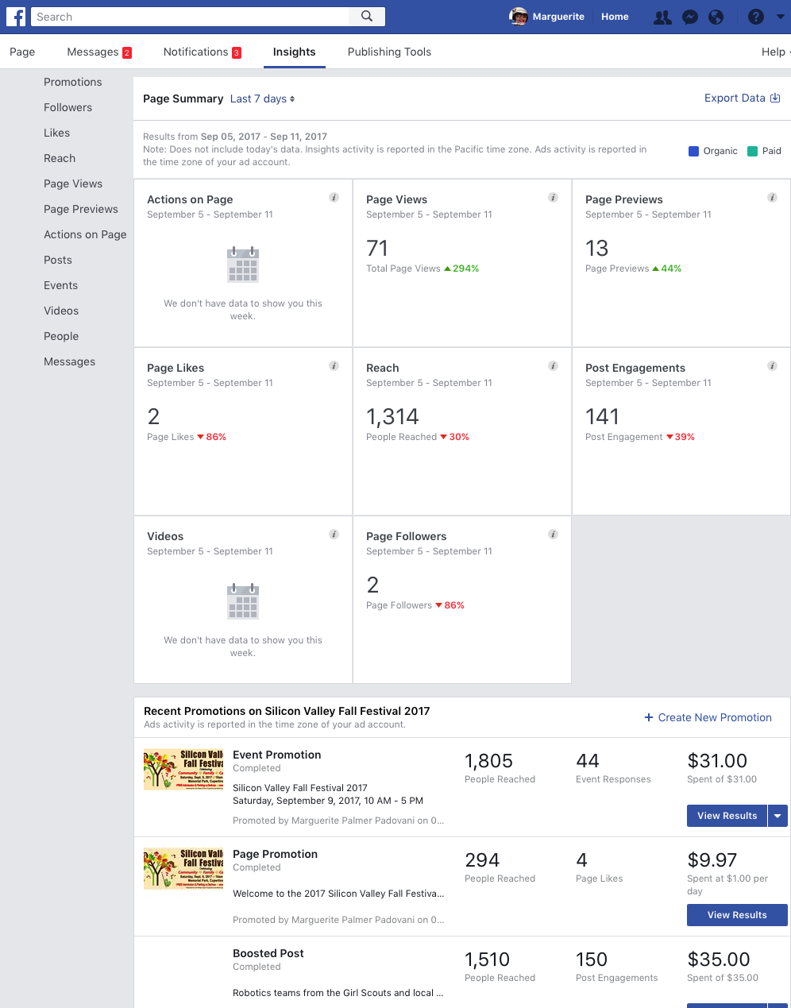

Slide 14
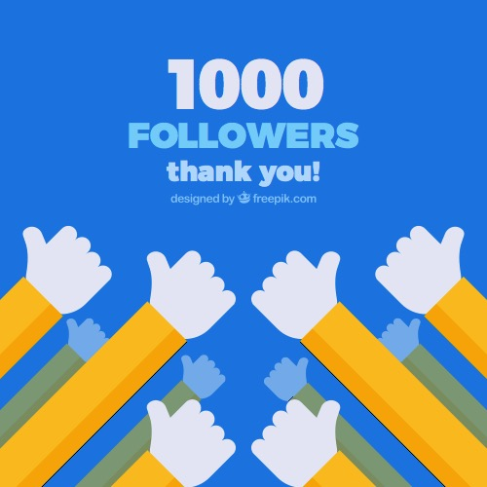

“LIKE” OUR PAGE

