Slide 1
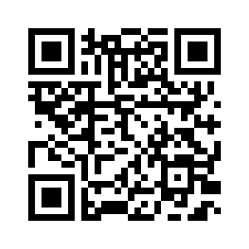
Rotary District 5170
and
Ambassadors of Compassion
Helping to solve the mental and emotional health crisis
facing our youth in the Bay Area
More information and materials on Rotary District 5170 and Ambassadors of Compassion

Slide 2
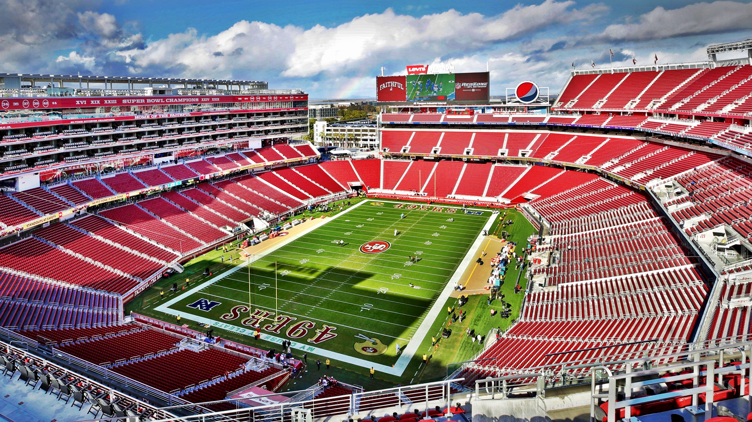
Levi’s Stadium - 10,000 Students
Creating the largest Mental and Emotional Resiliency Building
Kickoff in the Nation

