Slide 1
CHAC OVERVIEW
Rotary District 5170
Notes:
10 minutes to introduce his/her work on Mental Health, providing a Resource List as well as recommendations that Rotary Clubs can take actions to support Mental Health issues and/or Projects that Rotary Clubs can champion.

Slide 2
Youth Mental Health Crisis
Santa Clara County Board of Supervisors declared in January 2022 Mental Health & Substance Abuse Public Health Crisis
Gov Newsom in August 2022 rolled out a master plan for Youth Mental Health
US Surgeon General Vivek Murthy has issued advisories:
2021 Youth Mental Health
2023 Social Medial Advisory
2023 Epidemic of Loneliness & Isolation
Among U.S. adolescents
(ages 12-17):
1 in 6 experienced a major depressive episode
3 million had serious thoughts of suicide
31% increase in mental health-related emergency department visits
In California
Suicide rates for California youth ages 10 to 18 increased by 20% from 2019 to 2020.
“Americans are more lonely and socially disconnected than ever, and it’s a serious threat to their physical and mental health that demands urgent policy action.”

Slide 3
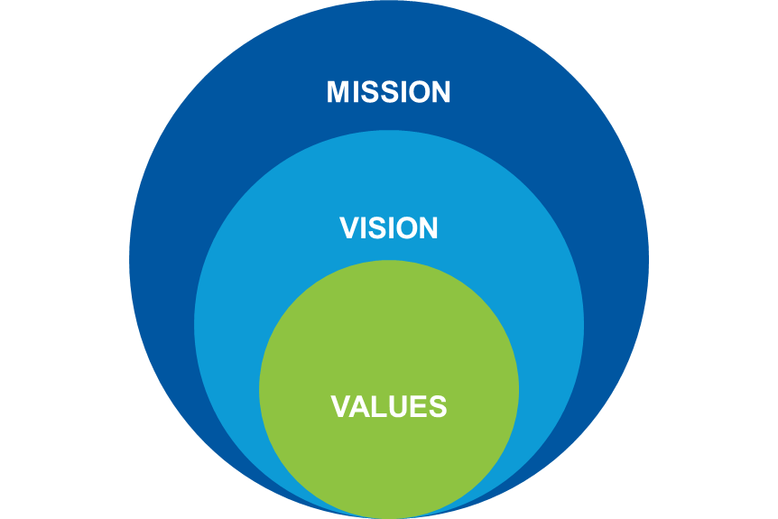
CHAC Mission, Vision & Values
Our Vision
Our Mission
Responsive Respectful
Commitment to Excellence
Ethical Inclusive
Our community embraces mental health and wellness as integral to a healthy fulfilled life. Universal access to a continuum of mental health services that includes prevention and intervention. The result is an increasing healthy, resilient, and understanding community.
To improve lives and strengthen communities through access to comprehensive and culturally
responsive mental health services
in Northern Santa Clara County.

Slide 4
MOUNTAIN VIEW
SUNNYVALE
CUPERTINO
CHAC’s Family Resource Centers (FRCs) collaborate with FIRST 5 Santa Clara County to offer programs that help parents and other caregivers understand the importance of physical and social-emotional development during early childhood, along with the family and community engagement needed to build strong communities.
Mercy Street Family Resource Center
748 Mercy Street, Mountain View, CA 94041
(650) 967-4813
Vargas Family
Resource Center
1054 Carson Drive. Room 15
Sunnyvale, CA 94086
(650) 967-4813, ext 144
Northwest YMCA Family Resource Center
20803 Alves Drive.
Cupertino, CA 95014
(650) 967-4813, ext 142

Slide 6
School Services
Addressing the Whole Child by:
Providing MTSS via Tier I and II (Universal & Targeted Support);
Meeting children where they are and highlighting the importance of the school community;
Promoting and training for culturally sensitive support;
Normalizing mental health as part of the school day;
Establishing positive relationship connection with trusting adult

Slide 7
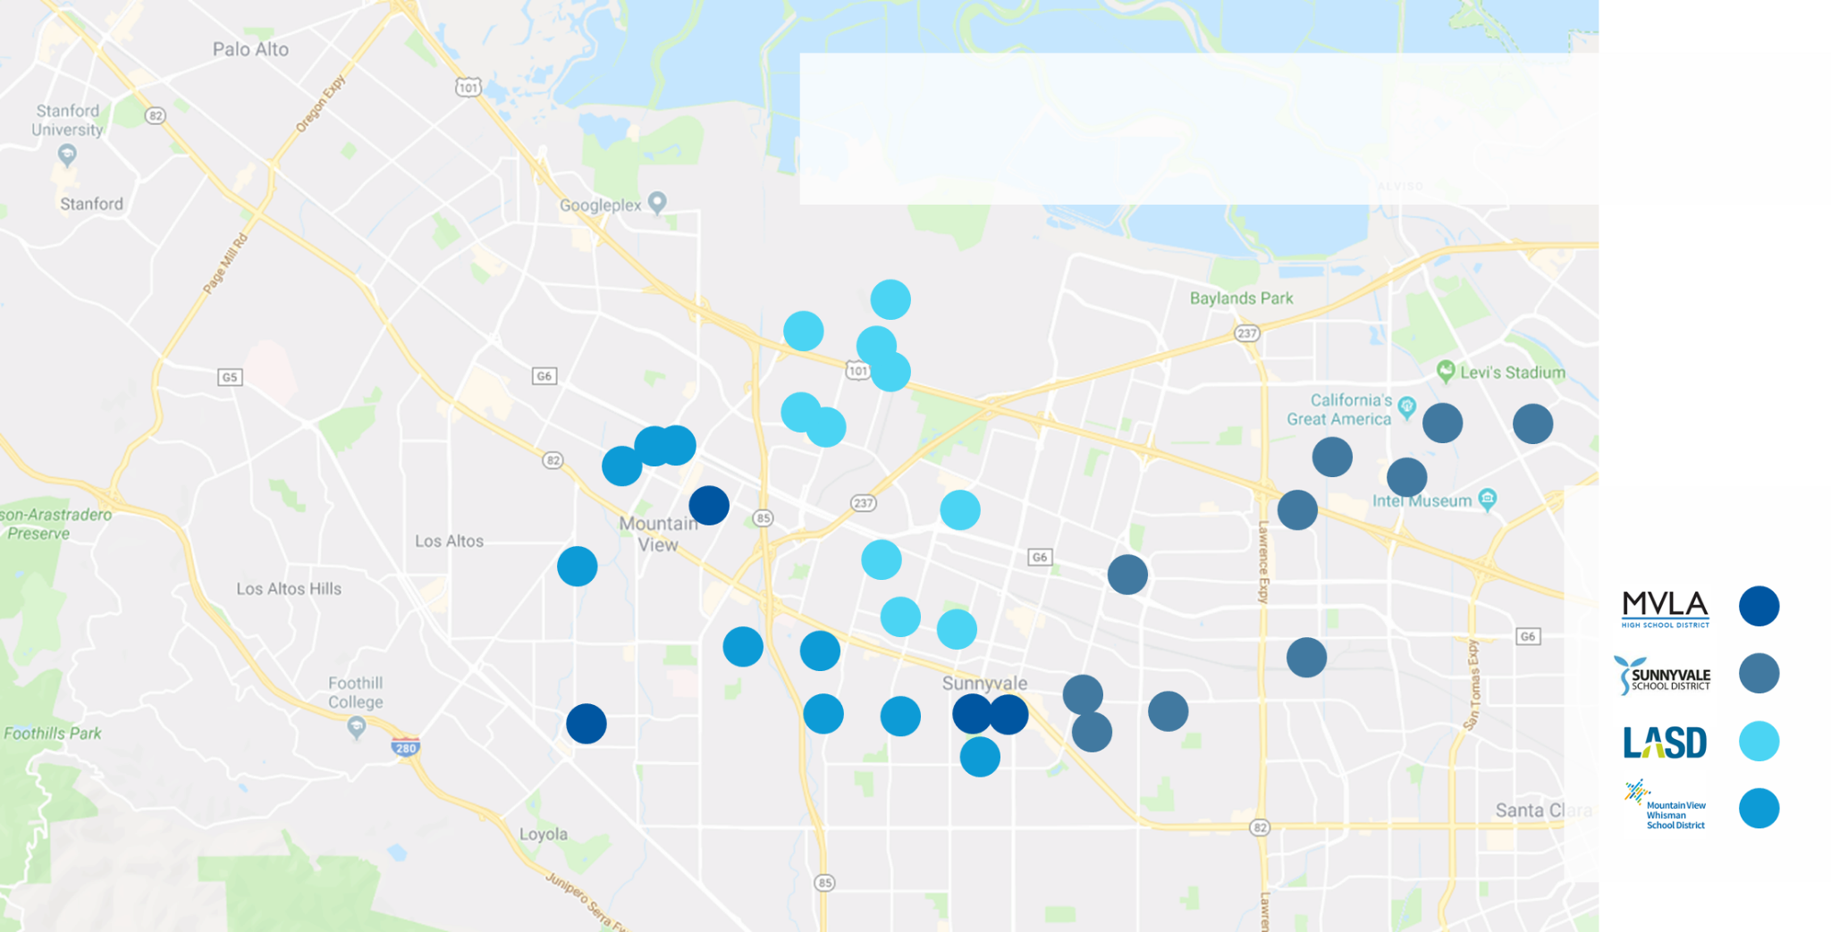
Providing access to counseling/prevention to 20,000+ Students
Schools Serviced

Slide 8
ABC Model
ACCESS:
Increased availability of mental health services for all students
BRIDGING:
The connection between school, family, and community systems
COLLABORATION:
Integration with school team and guardians toward common goals

Slide 9
Top Reasons for Referral
School District | #1 Reason | #2 Reason | #3 Reason
MVLA High School District | School- Related Anxiety (43%) | Depressed/Unhappy (36%) | General Anxiety (24%)
MVWSD | Friendships or Social Issues (40%) | Family Issues (31%) | General Anxiety (28%)
LASD | Friendships or Social Issues (65%) | General Anxiety (26%) | Depressed/Unhappy (23%)
SSD | Friendships or Social Issues (50%) | Depressed/Unhappy (38%) | General Anxiety (31%)

Slide 10
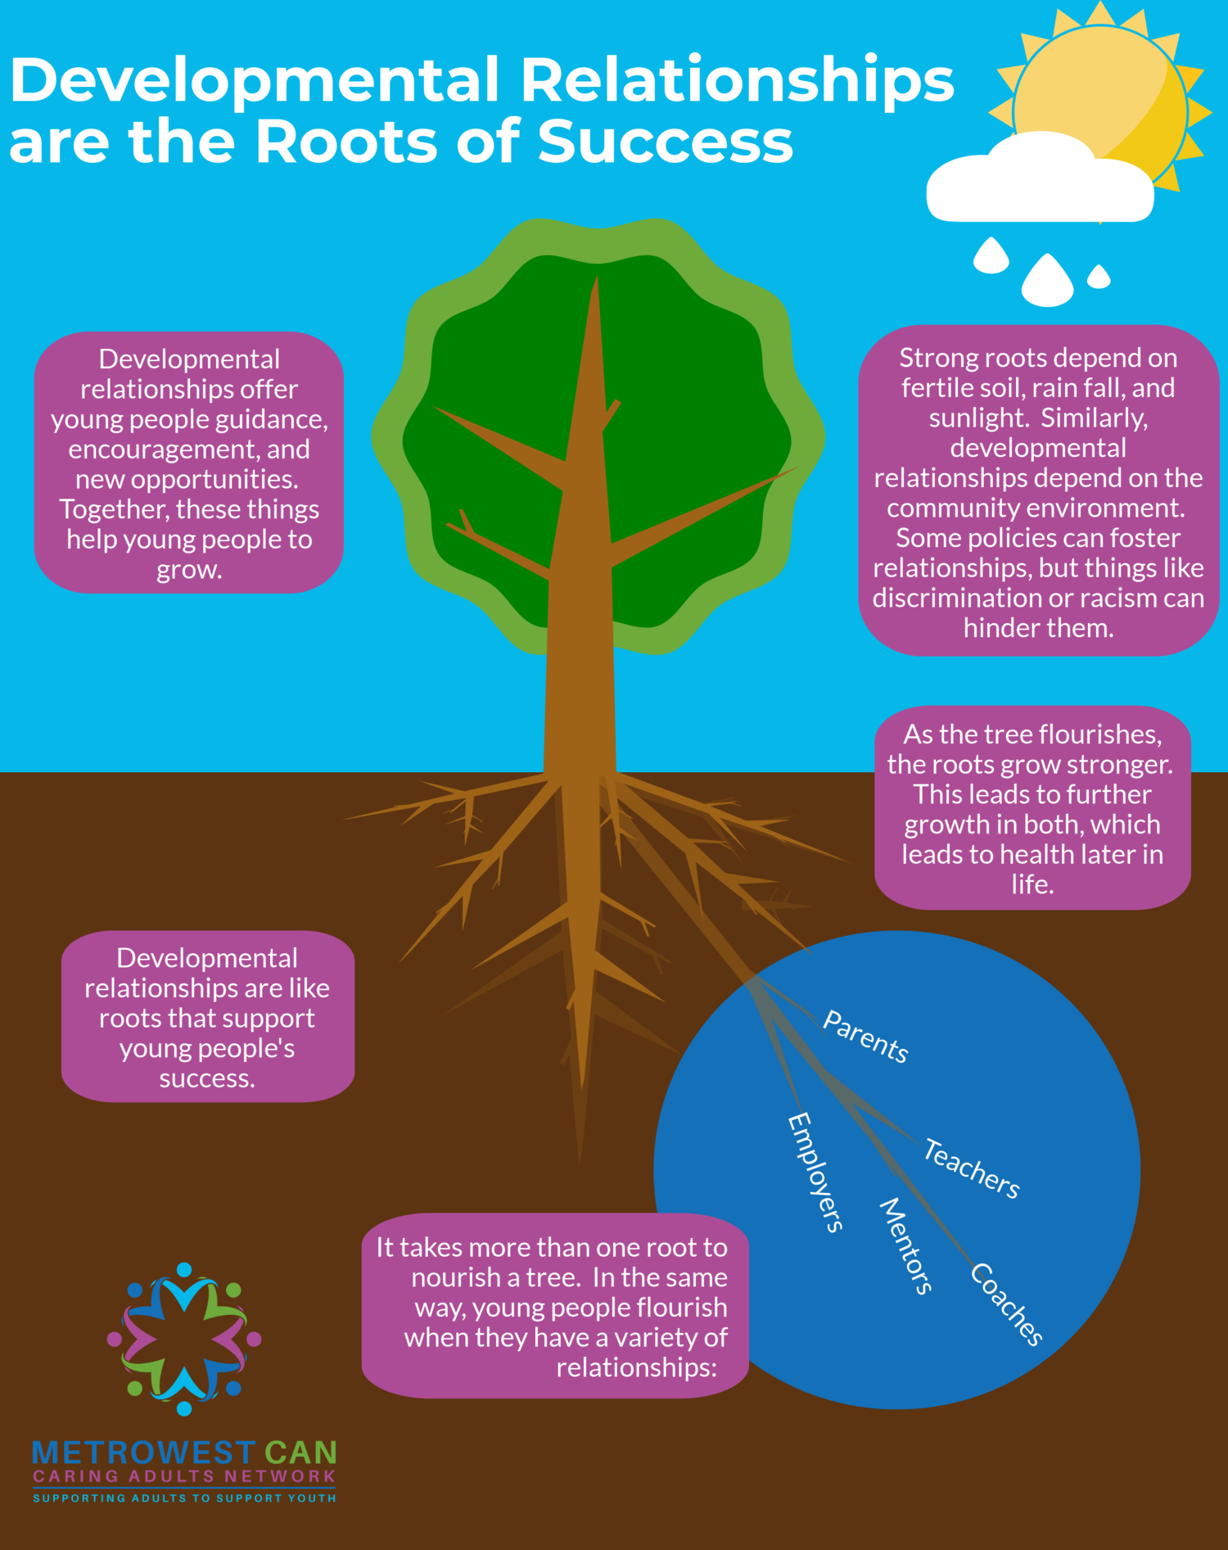
WEB OF SUPPORT
Every Child
Five Caring Adults
What can you do?

Slide 12
Anne Ehresman, MSW
Interim Executive Director
www.chacmv.org

