Slide 1
Connection & Collaboration:
Rotary Club Opportunities in Suicide Prevention

Slide 2
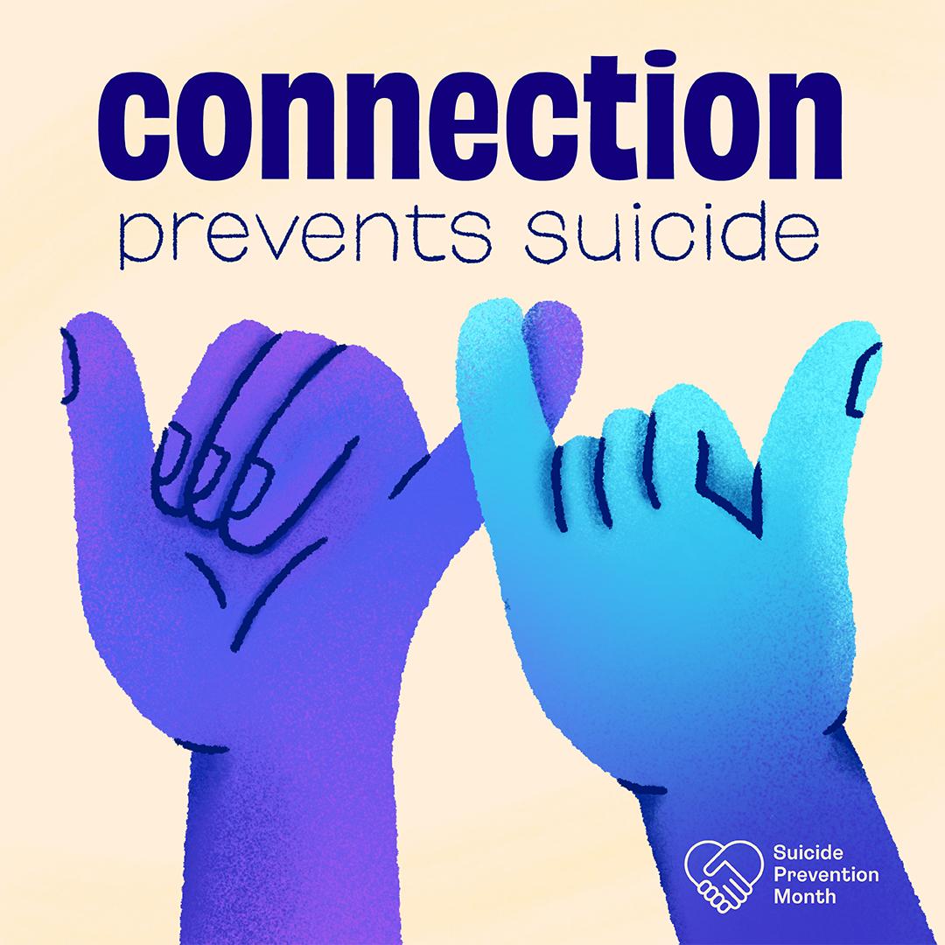
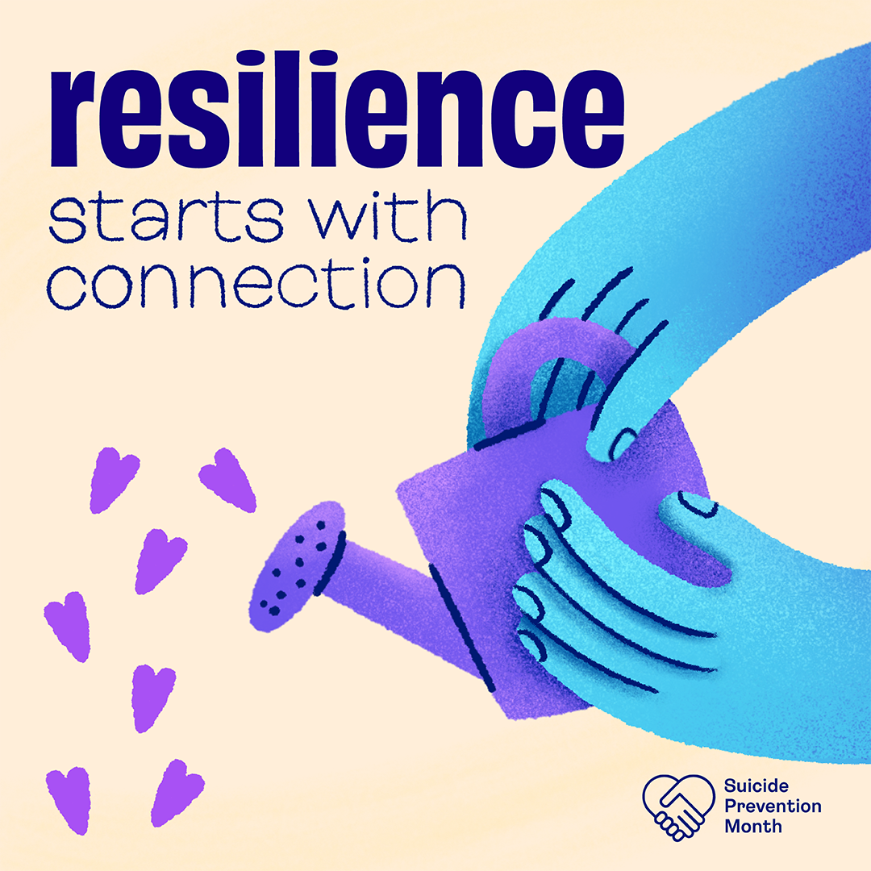
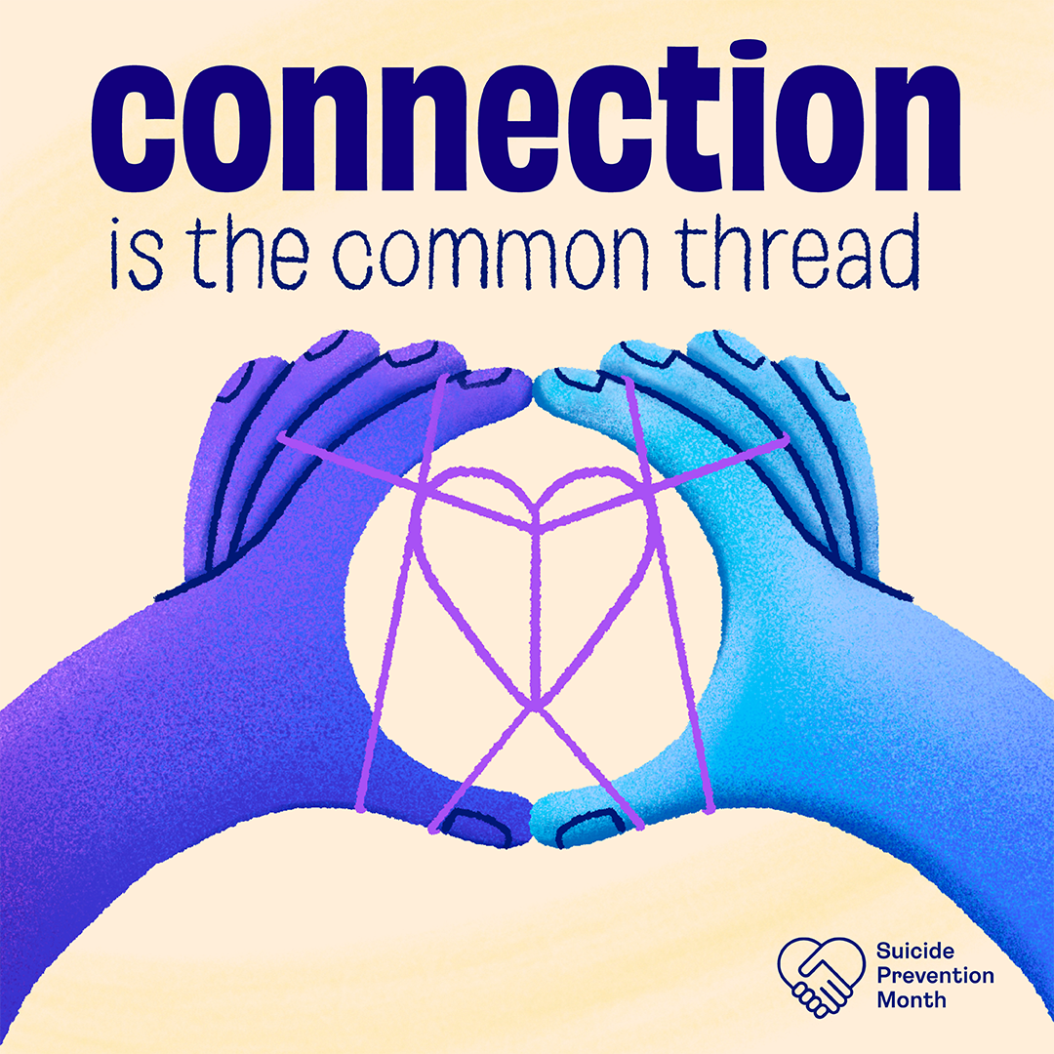
ROTARY Principles, Actions & Suicide Prevention:
“the development of Acquaintance as an opportunity for service”
Notes:
Linda - using Rotary’s first Guiding Principle - “the development of acquaintance as an opportunity for service” - rotarians and their efforts to CONNECT with young people (or support others in need) are ALREADY engaged in suicide prevention. While a number of rotarians may want to more actively engage in specific suicide prevention activities or volunteer with mental health organizations, it is critical to recognize how important EVERY effort to connect with others is to this work.
Rotary’s guiding principles “serve as a foundation for our relationships with each other and the action we take in the world”. And we thank you!! (attempt to say that Rotarians are already engaged in this work by virtue of their guiding principles and resulting actions towards building connections (especially with youth). Beyond that Rotarians may want to engage in more specific activities and trainings that focus on mental health awareness and suicide prevention activities. But I had suggested you start with this acknowledgement (and appreciation) for their long history of building connection (and its recognized importance in suicide prevention work)!

Slide 3
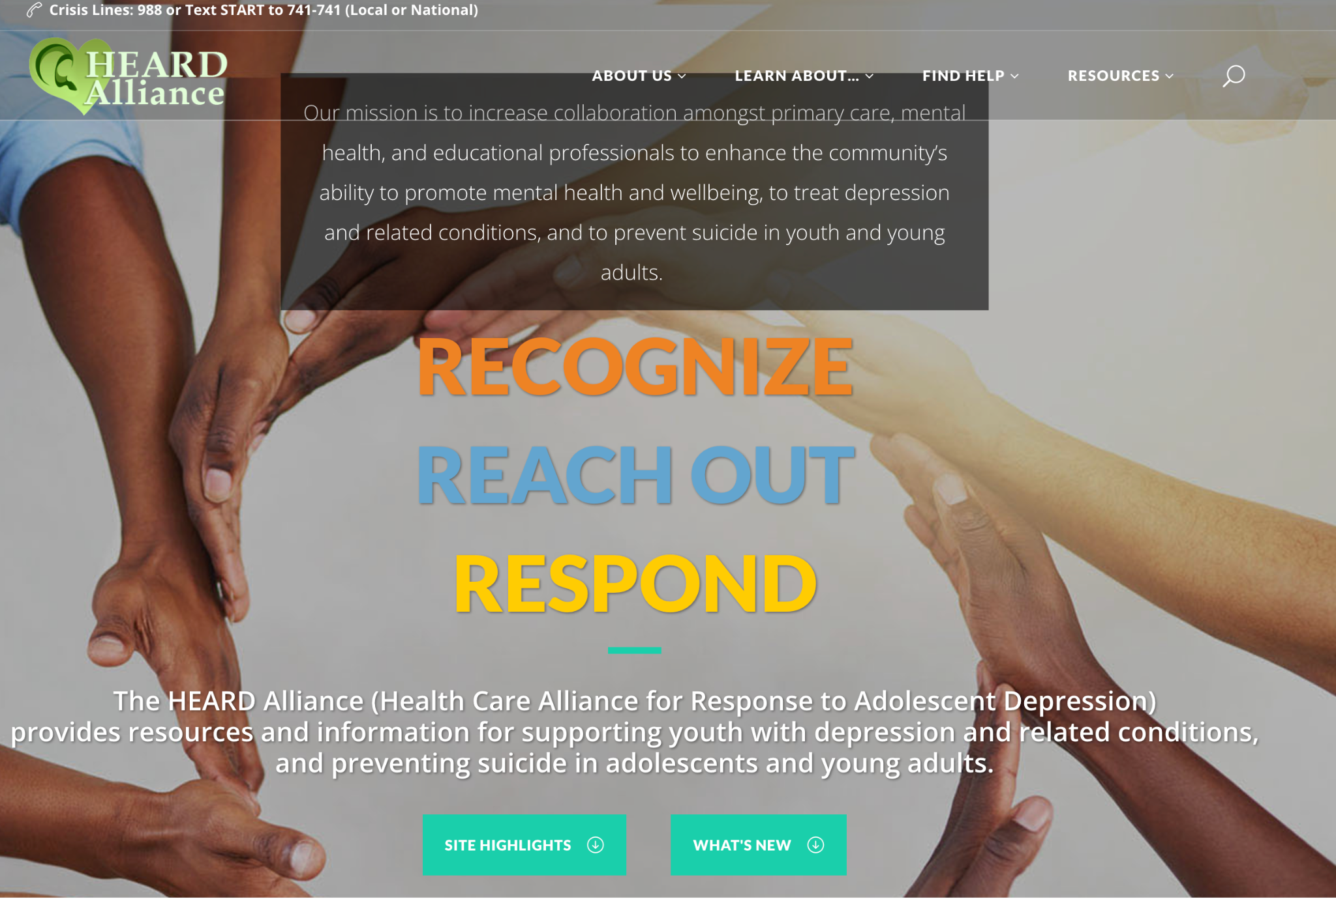
The HEARD Alliance website

Slide 4
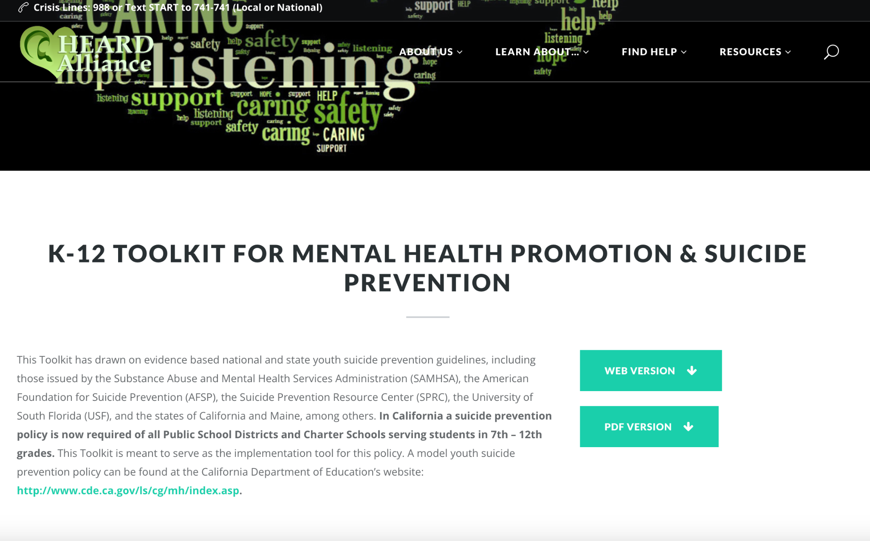
Compiled by:
Shashank V. Joshi, MD, FAAP, DFAACAP
Mary Ojakian, RN
Linda Lenoir, RN, MSN, CNS
Jasmine Lopez, MA, NCC
www.heardalliance.org
Notes:
This Toolkit was created in 2013 in response to school communities’ need to address student mental and emotional wellness in order to prevent suicide and to provide evidence based information about how to intervene in a crisis or after a suicide loss. In 2016, California enacted Assembly Bill 2246 requiring public schools serving grades 7 to 12 to have a “Pupil Suicide Prevention Policy” by the 2017-18 school year. The intent of this easily navigated partial version of the Toolkit is to simplify access to the range of information the PDF contains for school administration, staff, parents/guardians and students. Promotion, Intervention and Postvention are all interconnected. However, schools and districts will vary in the services they already have and in those they identify as needed to implement the required policies. The web version is designed for schools to enter at any point in the process of promoting student behavioral health, intervening in a crisis or responding to a loss due to suicide.

Slide 5
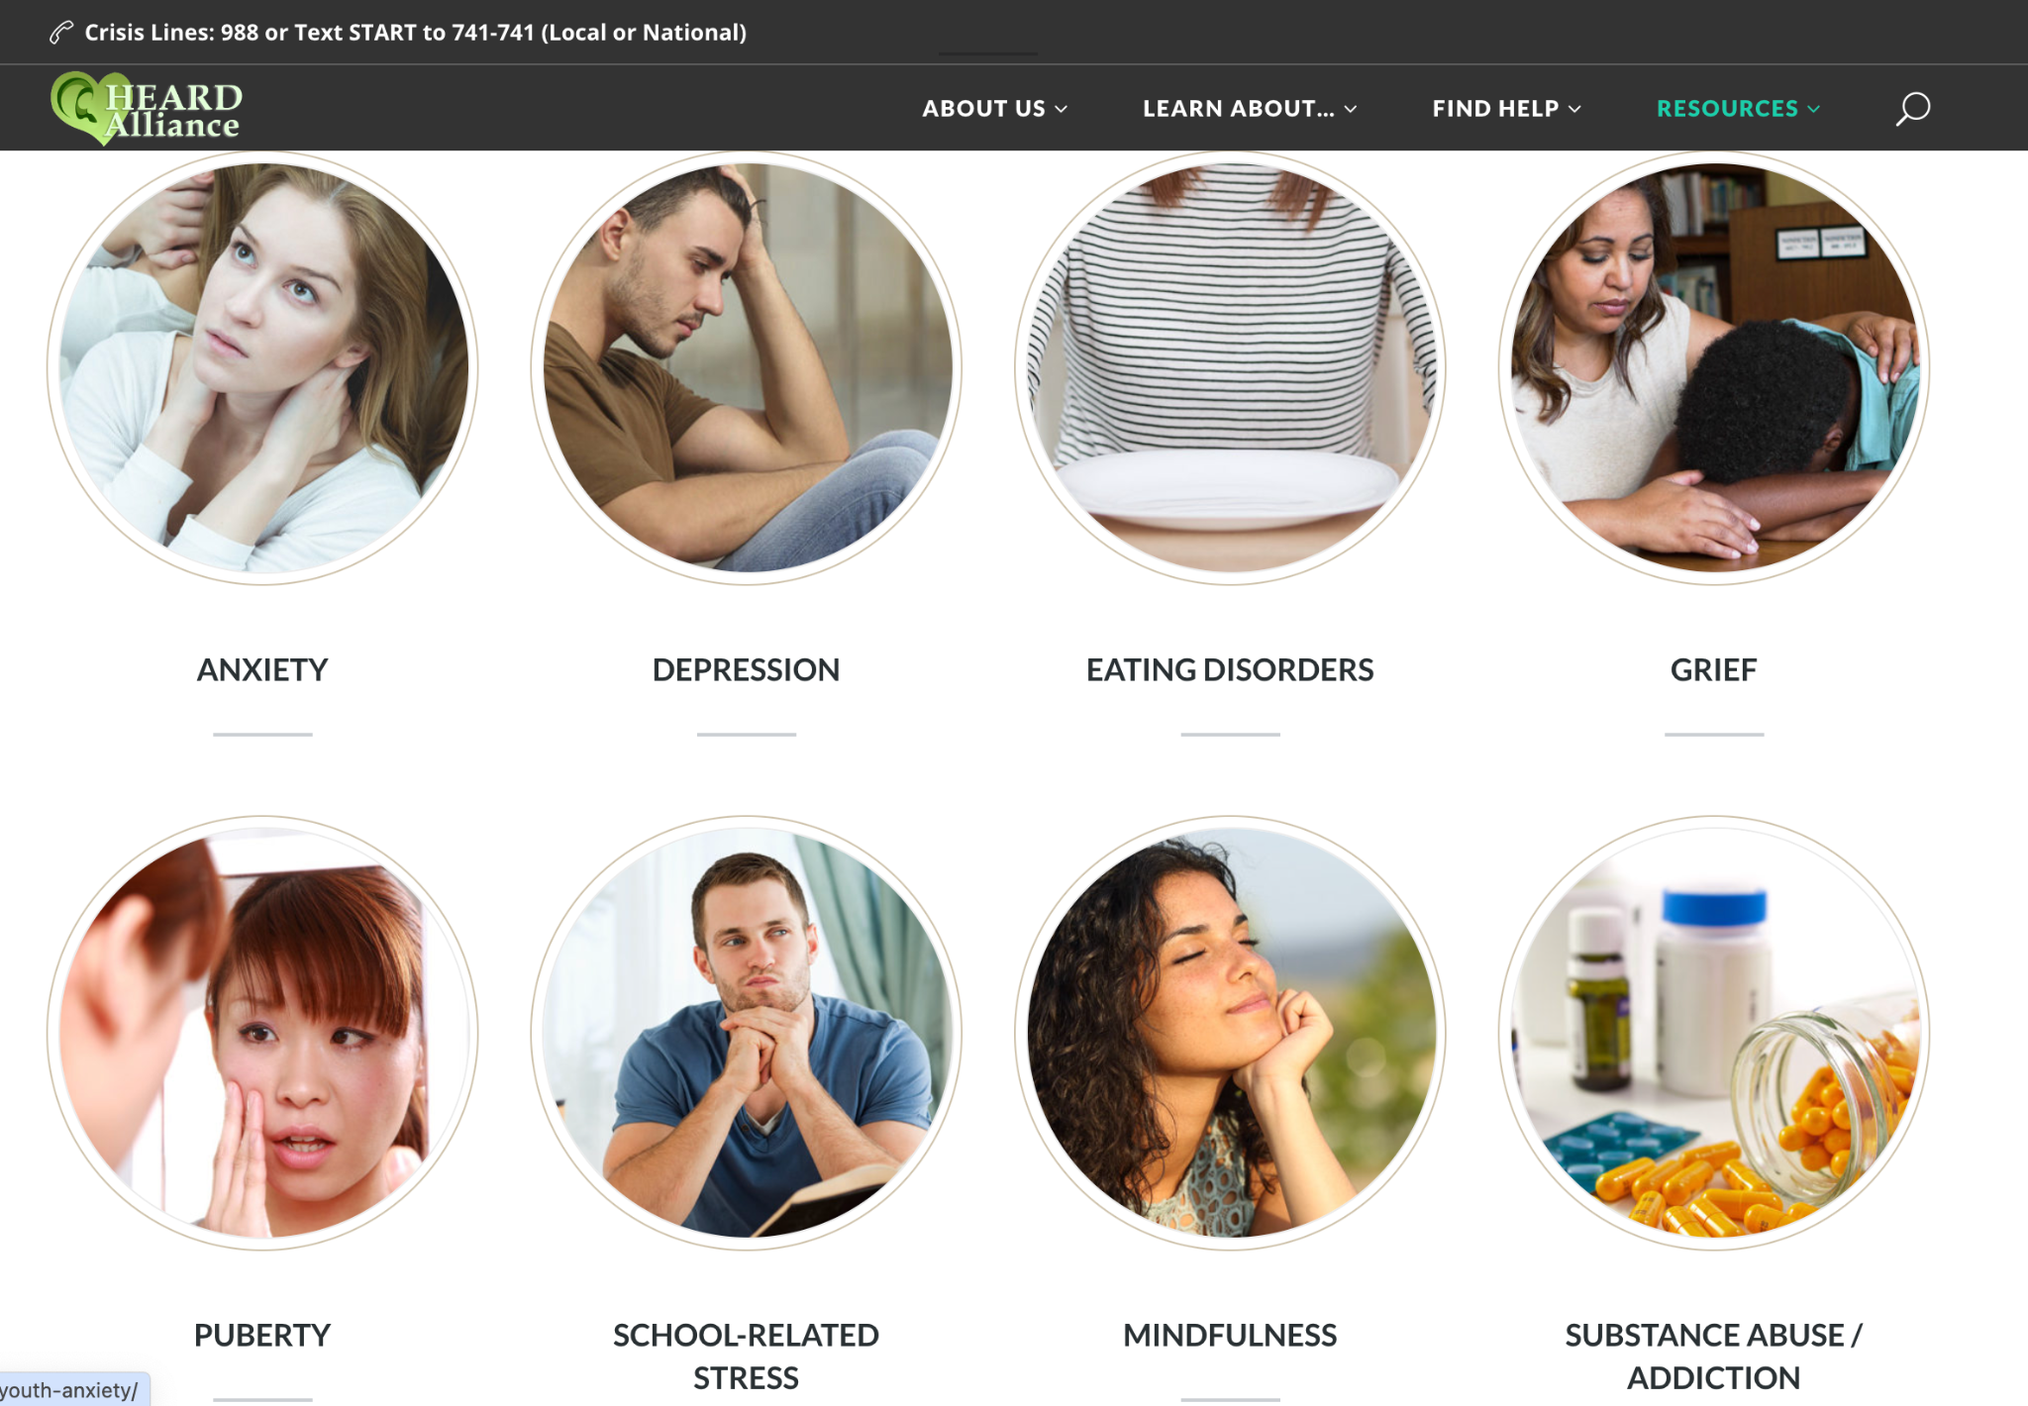
Resources for Youth
heardalliance.org

Slide 6
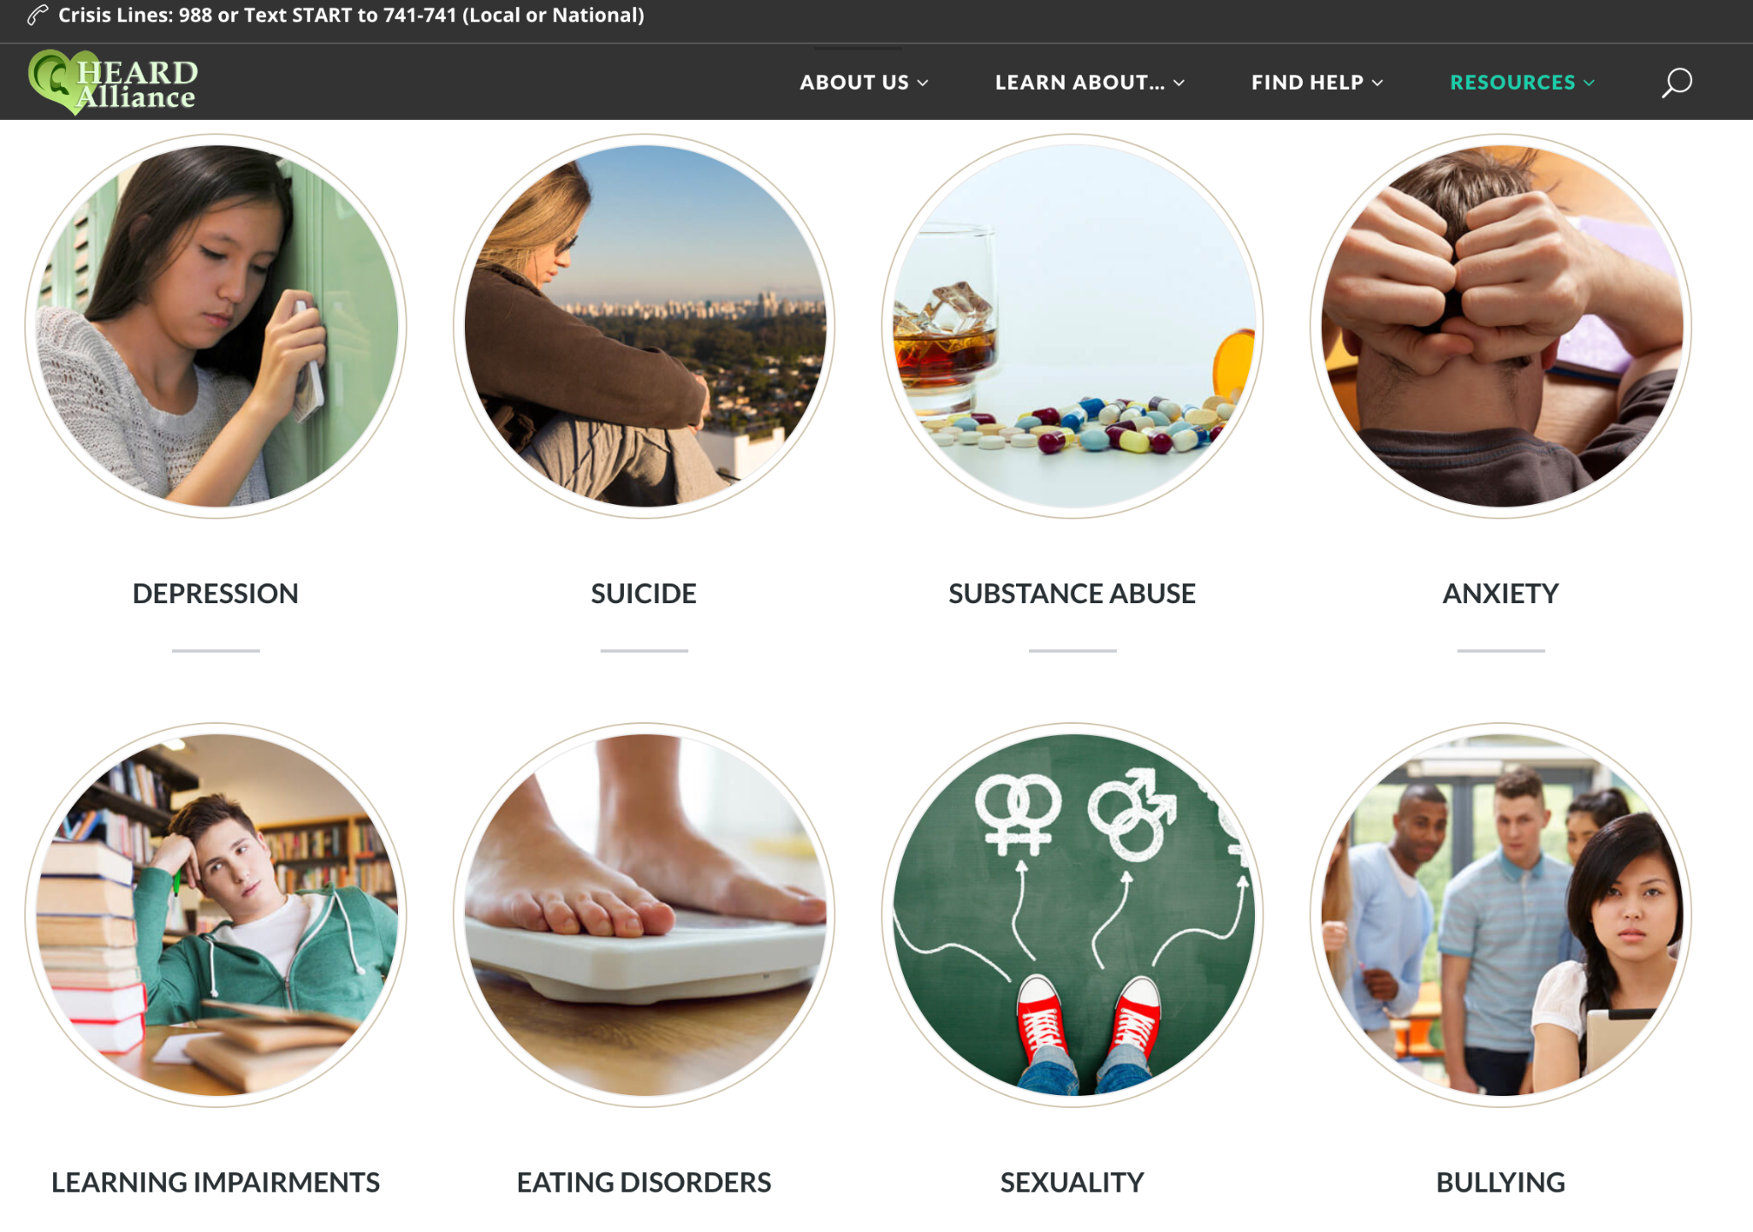
Resources for Families
heardalliance.org

Slide 7
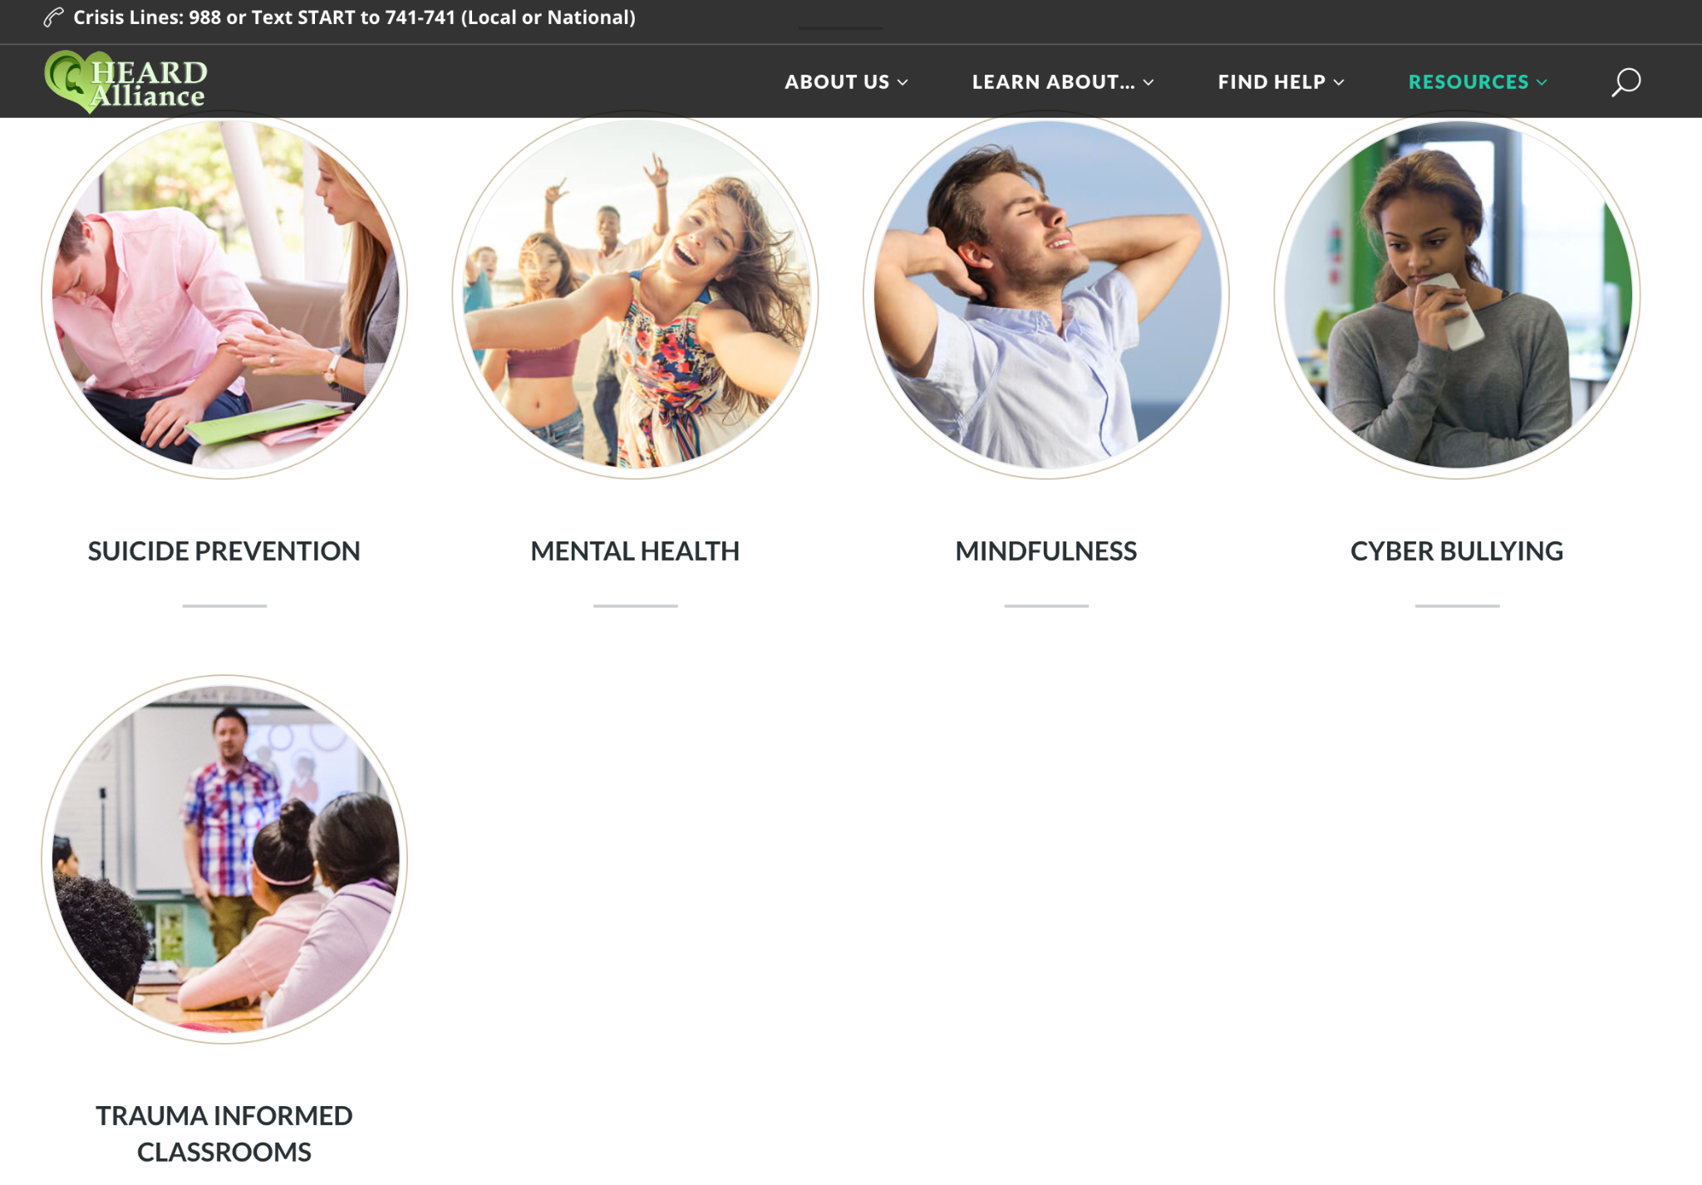
Resources for Educators
heardalliance.org

Slide 8
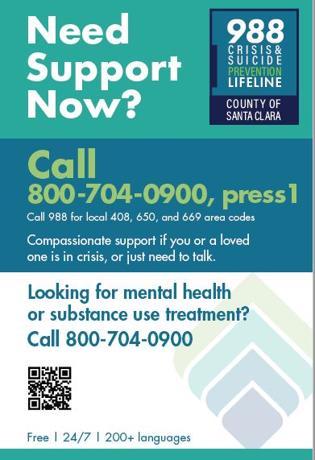
Mental Health Resources
HEARD Alliance - Parent Toolbox
Children’s Health Council (CHC)
The HEARD Alliance COVID-19 Resources
Mental Health Resources Toolkit
School Community Mental Health & Suicide Prevention Trainings/Programs for School Communities
Santa Clara County Grief Support Resources
Mental Health Community Resources for SCC and SMC
The HEARD Alliance
K-12 Toolkit for Mental Health Promotion & Suicide Prevention
The Jed Foundation
The Trevor Project
National Alliance on Mental Illness (NAMI)
American Foundation for Suicide Prevention
Columbia Suicide Severity Rating Scale (C-SSRS) - Screener with Triage Points for Schools
Suicide Risk Screening in Schools (Stan Collins)

Slide 9
