Slide 1



Slide 2
WHAT IS THE ROTARY FOUNDATION?
The mission of The Rotary Foundation is to enable Rotarians to advance world understanding, goodwill, and peace through the improvement of health, the support of education, and the alleviation of poverty.
Rotary’s charitable arm
( 501c3)
Notes:
The Rotary Foundation is a primary source of funding for Rotary’s humanitarian activities and Rotary’s effort to eradicate polio worldwide.
Our Foundation is able to achieve its mission through the generous contributions and active participation of Rotarians and friends of Rotary.

Slide 3

Areas of Focus

Slide 4

Areas of Focus
The Environment

Slide 5
Three basic TRF elements
Annual Fund
(SHARE)
Polio Plus
Fund
Endowment

Slide 6

Annual Fund

Slide 7
Annual Fund
The primary funding mechanism for local and international projects
One half of all money donated comes back to the District (and the Clubs) in the form of District Designated Funds (DDF)
The rest is used to match funding for Global Grant projects
The more you give, the more you get
Notes:
The Rotary Foundation is a primary source of funding for Rotary’s humanitarian activities and Rotary’s effort to eradicate polio worldwide.
Our Foundation is able to achieve its mission through the generous contributions and active participation of Rotarians and friends of Rotary.

Slide 8
It seems like magic
What charity can you give to where you get more back than you donate?

Slide 9
The Rotary Foundation and Leverage
The Rotary Foundation
Donated by Club Members to the Rotary Foundation
$20,000
Half returned to Clubs as District Designated Funds (DDF) $10,000
TRF Match
$18,000 for DDF for a Global Grant
Club uses $10,000 cash for a Global Grant to buy $8,000 of DDF
$36,000 International project
$18,000 DDF
$18,000 TRF DDF match

Slide 10




Slide 11
RotaryDirect:
“Fill it, Sign it, Send it, and Forget it!”
An Easy $25/month = $300 per year!

Slide 12
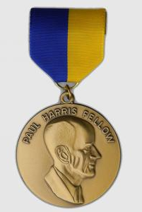
Paul Harris Fellow
The Paul Harris Fellow recognition acknowledges individuals who
contribute, or who have contributions
made in their name, of $1,000 to
The Rotary Foundation.
Rotary established the recognition in 1957 to encourage and show appreciation for substantial contributions to what was then the Foundation’s only program, Rotary Foundation Fellowships for Advanced Study, the precursor to Ambassadorial Scholarships.

Slide 13
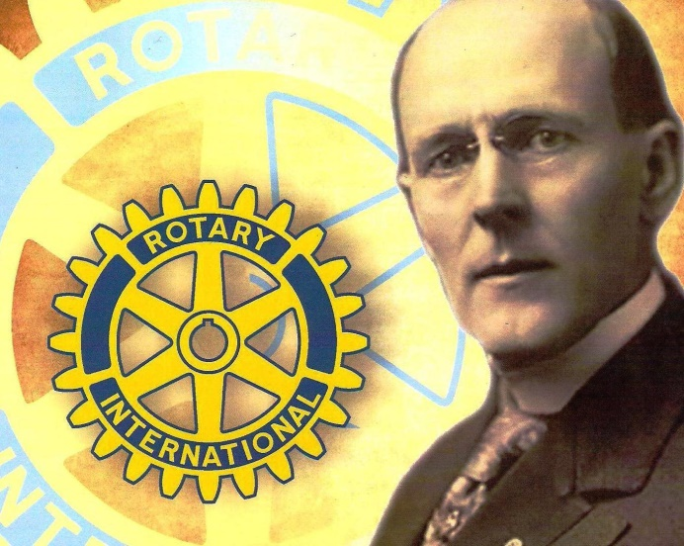
Paul Harris Society
The Paul Harris Society is
named for Rotary’s founder,
and is made up of dedicated
supporters who annually
contribute $1,000 or more to
the Annual Fund, PolioPlus or a Global Grant.
319 PHS members last year (40% of our total Annual Fund donations)
Special recognition, including event at the District Conference

Slide 14
TRF 2020-21 Drawing
Club competition rather than individual with two drawings
Overall Annual Fund
1 point for every $100 contribution to the Annual Fund
Prize is $5,000 in DDF. Worth $10,000 if used in a Global Grant
EREY Drawing
Each Club has an equal chance if they achieve EREY status.
Prize is $2500 in DDF. Worth $5,000 if used in a Global Grant
Contributions as of Feb 1, 2021
Drawing at the February Leadership Meeting

Slide 15
Polio Plus

Slide 16
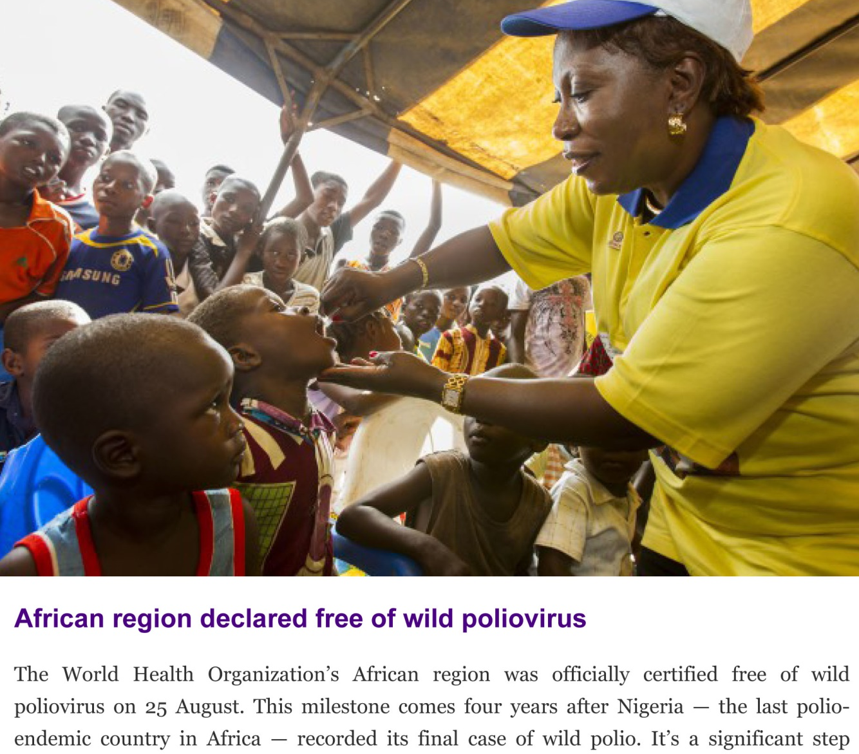
Polio- Good News

Slide 17
Polio Plus
Campaign is done annually in the spring
Just finished implementing this years campaign by visiting Clubs with slides and video
DDF for polio now matched by TRF
Polio Plus infrastructure being utilized for Covid-19 pandemic

Slide 18
Endowment

Slide 19
Endowments and Legacy Giving
Be a Major Donor – When your cash donations to the Foundation total at least $10,000.
Be a member of the Bequest Society – When you commit a total of $10,000 or more to the Permanent Fund of the Foundation via your Estate Plan.

Slide 20
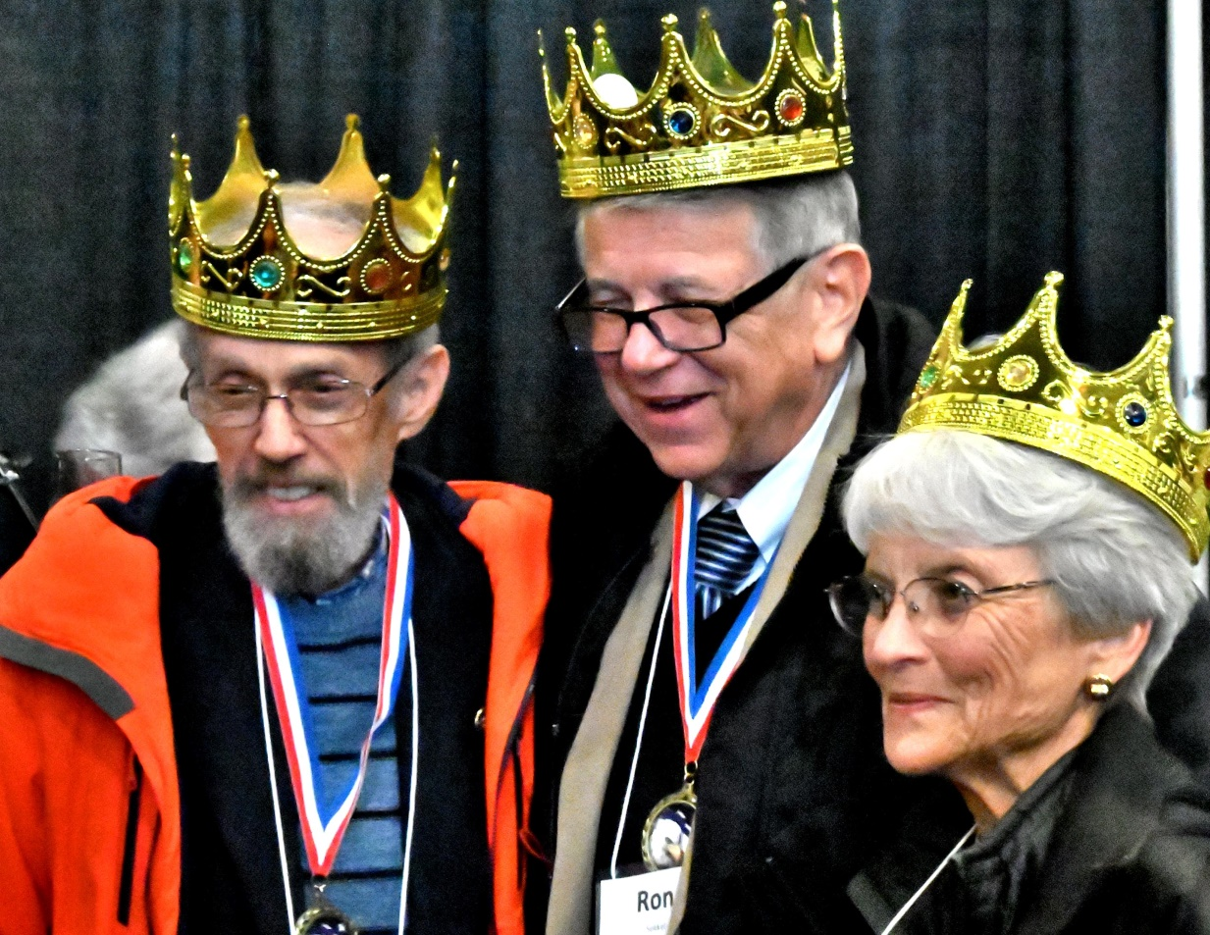
TRF Triple Crown
Be a Major Donor
Be a member of
the Bequest Society
Be a Paul Harris
Society member

Slide 21
Grants

Slide 22
What is DDF?
DDF stands for District Designated funds
Roughly 50% of the Districts Annual Fund Contribution
Allocated back to the Clubs in proportion to previous giving

Slide 23
DDF can be used for two types of grants
District grants
Managed by the district
No minimum $
Can be Local or International
Minimum paperwork
May get a Max the Match bonus
No TRF matching
Global grants
Must be International
Minimum project $30K
Formal grant process
Needs Assessment required
Sustainability required
Must fit Areas of focus
DDF matched $ for $
Cash no longer matched

Slide 24
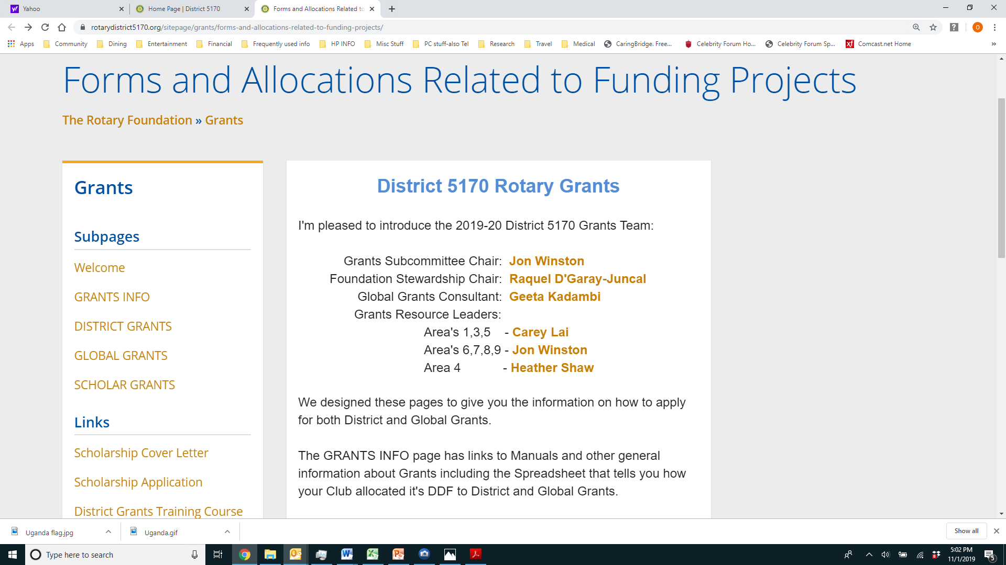
Grant Section on the District Website
Everything you need to know

Slide 25
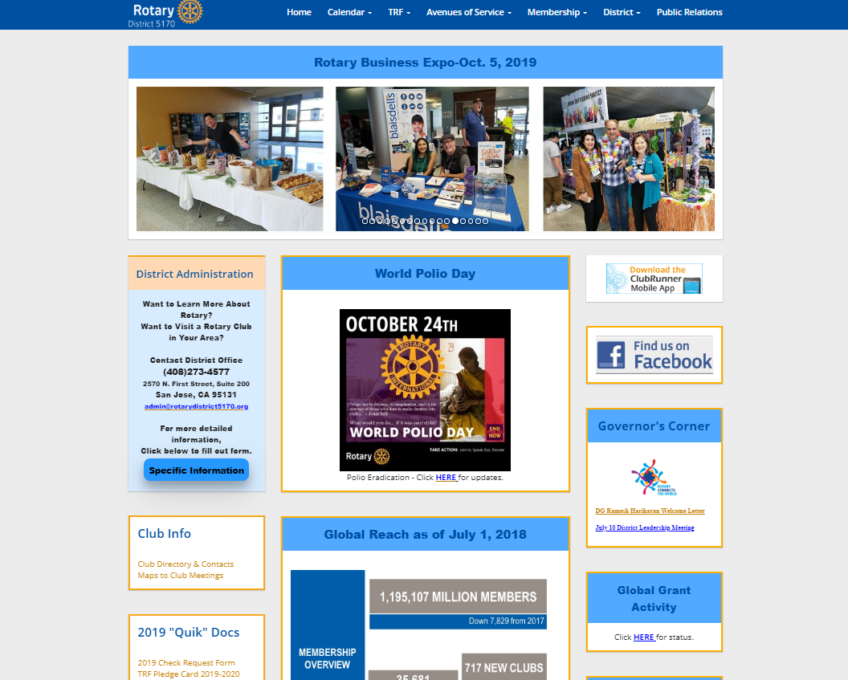
Grants

Slide 26
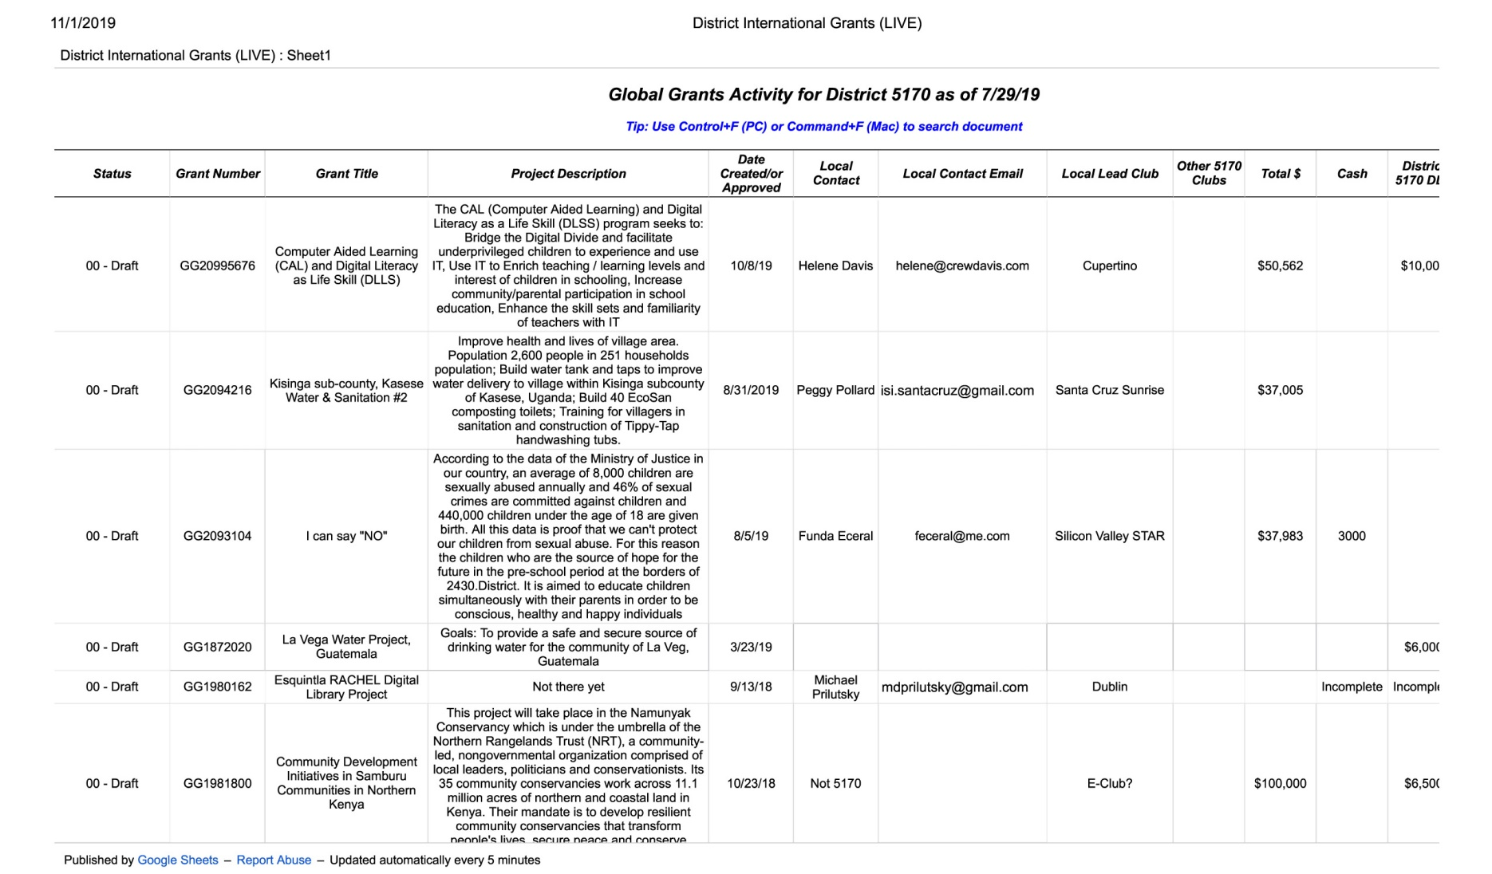
Global Grants

Slide 27

Global Grant Scholarships
Graduate study at an International University
$30,000 per student, including TRF match.

Slide 28
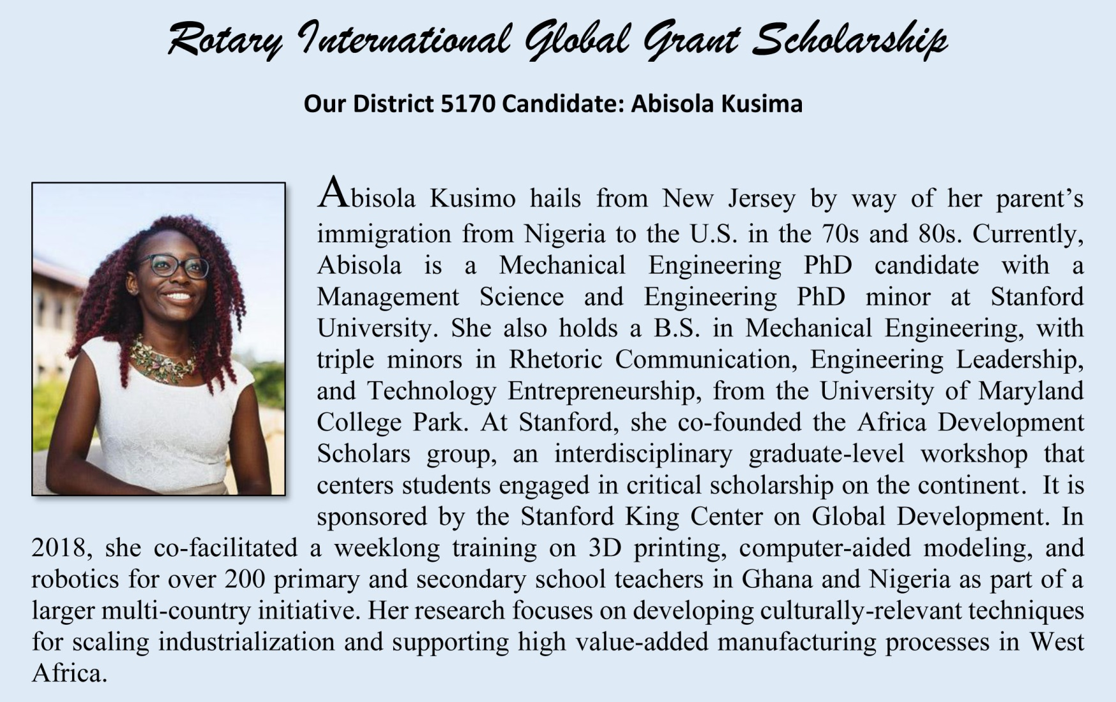

Slide 29
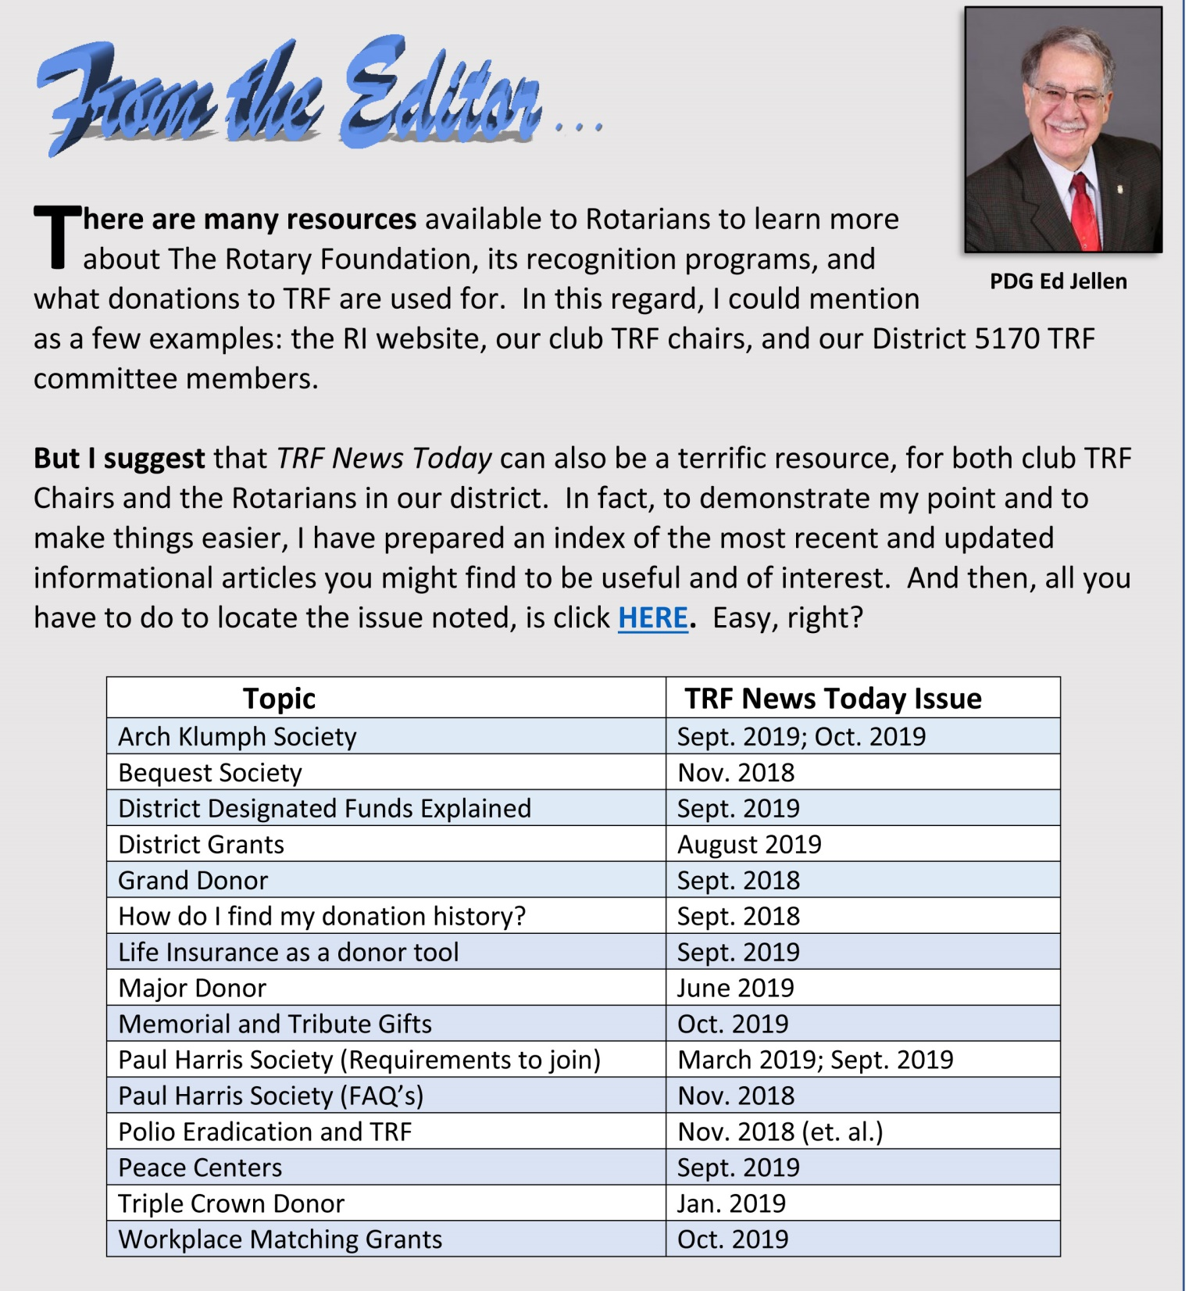

Slide 30
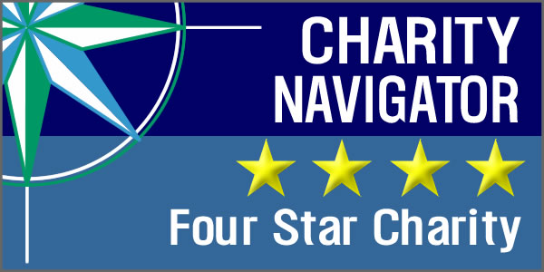
12 Years in a Row

Slide 31
Thank you for Your Support of

