Slide 1
Rotary District 5950 Grant Management Seminar Rotary Grant “Refresher” Fiscal year 2024-2025

Slide 2
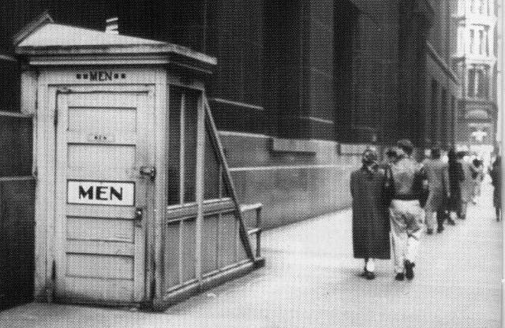
Housekeeping
Notes:
Facilitator (Tim Deets/Don Stiles/Fred Semmer)
Welcome
Thank you for your participation … acknowledge team
Rest rooms, 1st global grant project in Chicago / breaks – transitions
Goal for every club to participate … 100%
Requirement to garner grant funds … also requirement that club PE enter TRF goal
Put notions aside … no “stupid” questions … here to get all ?? Answered
Interactive … WANT you to participate

Slide 3
Virtual Meeting Best Practices
Minimize noise distraction, mute
We love to see you! Rename/add Club Name
Ask questions: Raise your hand or interrupt
Say name when you speak
Offer Feedback
Notes:
Facilitator (Tim Deets/Don Stiles/Fred Semmer)
Bear with us as we launch our GMS virtual learning
first attempt … may have some snags
share your feedback
Review controls … had not planned to use the chat box … Richard can you monitor it?
Review process & remind of feedback

Slide 4
Objectives
Review TRF & District 5950 requirements
Discuss Changes
Practice writing and evaluating ?
Qualify Your Club!
Notes:
(Tim Deets/Don Stiles/Fred Semmer)

Slide 5
DGE Sharon Bloodworth’s Welcome Message
Notes:
Facilitator (Tim Deets/Don Stiles/Fred Semmer)
Offer Jewelie's acknowledgment for taking the time to attend
Encouragement to use the grant process

Slide 6
Introductions
Name
Club
How many GMS have you attended?
Notes:
Facilitator (Tim Deets/Don Stiles/Fred Semmer)
All make introduction to the entire group
ONE word will help us identify the emotional state of the group … we can assess how to manage that
Write or remember it … we’ll come back to it later

Slide 7
Harvest the Knowledge
District Grants
Local
Small International
Notes:
Program Chair (Steve Johnson)
Scribes assist
Ask and record what they know about each … we’ll fill in the blanks based on what we hear
Re TRF
Funds donated returned to district after 3 years
Funds matched by TRF
Re Global Grants … be sure
Collaboration
Sustainability
Separate Bank Account
What else new in 2023-2024???
Re District Grants
Complete by June 30
Both Current reporting deadlines /parameters

Slide 8
The Knowledge
TRF
District
Global
Notes:
Facilitator
Record knowledge on slide / use annotate

Slide 9
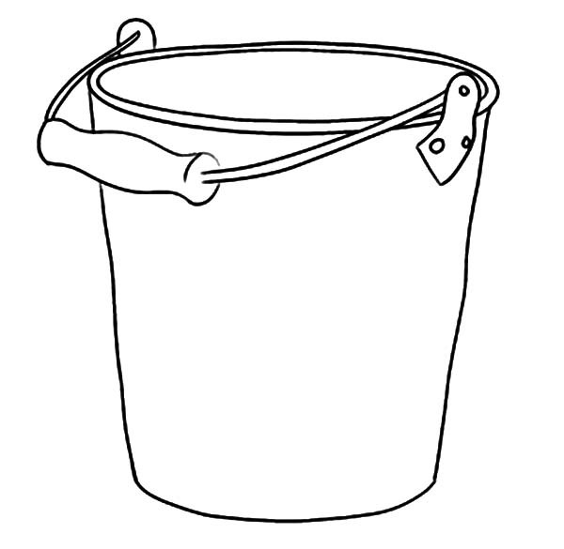
Grant Definitions
Distinguish the Foundations
Your Club Foundation
Rotary 5950
Foundation
The Rotary Foundation
(TRF)
Notes:
Program Chair (Steve Johnson)
Your club may have a foundation
Our district has a foundation for clubs that do not have one and want of offer a tax-deductible advantage for donors
The Rotary Foundation (TRF) is the bucket where we contribute funds in one Rotary year and receive ½ of the contributions three years later to fund our grants.
Example: 5950 Rotarians contributed $ 790, 000 in 2017-2018
$ 395,000 will be returned to 5950 in 2020-2021 to fund grants
In 5950, we allocate 50% each to district and global grants

Slide 10
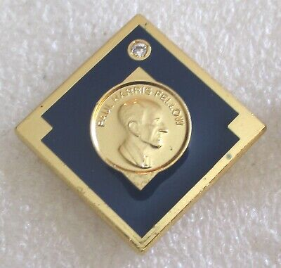
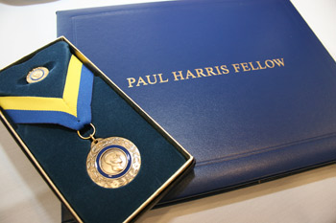
TRF … How funds accumulate
Paul Harris Society
Major Donor
Notes:
Program Chair (Steve Johnson)
All Rotarians are requested to contribute to The Rotary Foundation.
TRF suggests that clubs become Every Rotarian Every Year (EREY) … ALL members make SOME donation
5950 has set a goal of $365 per member though any amount is acceptable
Paul Harris Society: Individuals who pledge to contribute $1,000 per year for as long as s/he is able
Major Donor: individuals who contribute outright or cumulative gift of $10,000 to any of the Rotary accounts
Since contributions to The Rotary Foundation are source of dollars to fund grants & those dollars allow us to match funds for projects, it is important that all Rotarians consider contributing. We suggest that as a GMS participant, you become a TRF champion in your club. Spread the word about the relationship of contributions to grant awards.

Slide 11
How Does The Rotary Foundation Work?
INTEREST FUNDS
TRF OPERATIONS
50% TO
WORLD FUND
.8:1 MATCH
DDF
3 years pass
50% TO
GLOBAL
GRANTS
MONEY
IS DONATED
TO TRF
50% TO
DISTRICT DDF
50% TO
DISTRICT
GRANTS
Notes:
Program Chair (Steve Johnson)
How the dollars flow to TRF and back to districts

Slide 12
Available DDF 2024-2025
TRF Allocation (Total) | $300,000
50% Global Grants | $150,000
50% District Grants | $150,000
Notes:
Program Chair (Steve Johnson)
So let’s look at our 5950 funds for 2023-2024
Remind how the funds are collected and returned to the district
Explain how funds are allocated in our district

Slide 13
Grant Definitions
District: Small International Grants
Vocational Training Teams (VTT)
Global Scholars
Notes:
Program Chair (Steve Johnson)
Invite questions only … no narrative offered

Slide 14
How 5950 Clubs Qualify
Grant Writing Certification Requirements
District Grants
At least one club member attends a GMS annually
Incoming Club President files Club MOU + Addendum with District 5950 by May 15th
Incoming Club President must register at least Club TRF Annual Fund Goal online by May 15th
All collaborating Clubs must be GMS Certified as set forth above, and current on all reporting requirements
Notes:
Program Chair (Steve Johnson)
This is a reminder (it was shared at the beginning … remind now)
Define what qualifies the club
These apply to global and district grants
I want to draw attention to the fact that the District does not make grants to other non-profit organizations, i.e., it has to be a club service project that ultimately benefits the community local or international

Slide 15
DISTRICT Grant Essentials
Notes:
District Grant Chair Kris Dirks
Just the essentials – there are resources outside of this GMS – see this website, which has applications, PowerPoint, project examples, etc.
https://portal.clubrunner.ca/50084/sitepage/district-local-small-international-grants
We are expecting you will still have questions about grants after the presentation. Don’t be scared, we will be there to answer any of your questions and guide you through the process.

Slide 16
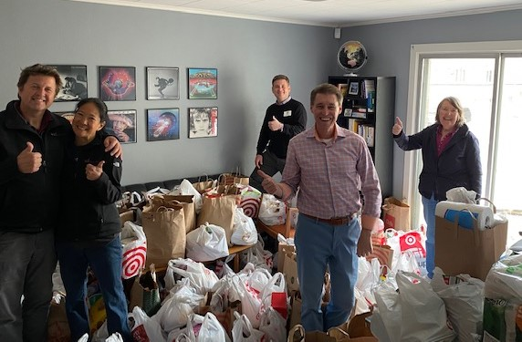
DISTRICT Grant Project Essentials
Requirements
Notes:
District Grant Chair Fred
Must be a Rotary project … NOT funds to another organization
Must involve sweat equity
Must complete by June 30, 2024
Club’s must be in good standing – Non-Delinquent, updated president signature, fundraising goals, and Grant Management Seminar Attended

Slide 17
DISTRICT Grant – Single Club
Single Club Formula
$ 2,000 | Outright District Grant
1,000 | Club A Contribution
2,000 | 2:1 District Match (max with 1 Club)
$ 5,000 | Total Project
NOTE: Minimum club contribution = $500
Maximum District Contribution: $4,000
Notes:
This is simply a hypothetical for a max contribution for a single club
A single club can contribute $500 and receive $3,000 from the District as well

Slide 18
Multiple Club Formula
$ 2,000 | Outright District Grant
1,000 | Club A Contribution
1,500 | Club B Contribution
500 | Club C Contribution
1,000 | Club D Contribution
8,000 | 2:1 District Match (max with 4 Clubs)
$ 14,000 | Total Project
NOTE: Minimum club $500,
Maximum District contribution $10,000
Notes:
4 clubs with total contributions of $4,000 = $10,000 from the District – min club contribution of $500 still

Slide 19
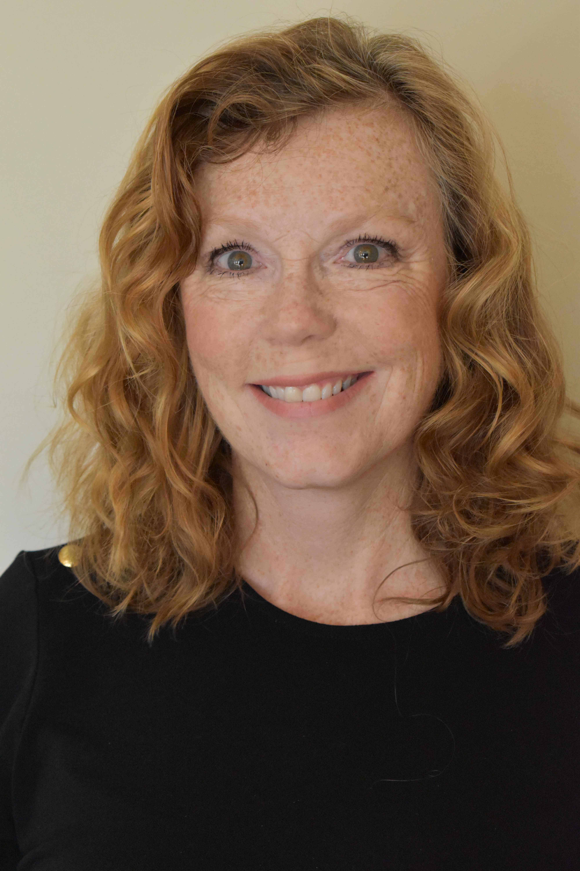
Ready to Get Started?
The Steps
Contact District Grants Chair Kris Dirks wkdirks2@gmail.com 763-443-9935
2. Chair will assign you a mentor, But!!!!!
READ ENTIRE APPLICATION AND REQUEST A MENTOR FOR COACHING BEFORE DRAFTING YOUR GRANT!
Each Club may be the primary sponsor for (1) one grant:
Local OR Small International through November 2024
NEW Rotary project; not part of an operational budget
Complete application with budget, pro-forma receipts, non-profit partner MOU, and
President Signatures
Notes:
District Grant Chair Kris
Steps to prepare and submit a grant
#2. https://portal.clubrunner.ca/50084/sitepage/district-local-small-international-grants - use this website to access application and additional resources
#3. Committee meeting (December 1 applications) … after Nov. can sponsor more
#4. Grants must be for NEW Rotary project (not part of an operational budget) for one fiscal year; future funding can be supported by the club. When the same benefiting organization receives Grants several years in succession, it may be considered a planned annual income source for the organization rather than a Rotary project, and may be subject to additional scrutiny.
#5. Don’t forget all the accompanying information. Check with Mentor if you are concerned if anything is missing.

Slide 20
Sample Memorandum of Understanding (MoU)
An MOU is an agreement between the Rotary Club and the cooperating grant partner that spells out the roles and responsibilities of the cooperating grant partner / organization. See the following example:
Non-Profit Partner’s Official Letterhead
Today’s Date
Cooperating Partner XYZ (could be a non-profit, governmental entity, NGO, etc) is partnering with ABC Rotary Club to install / receive (list all equipment or items purchased through grant relative to this partner - you may have more than one partner per grant, if so then a MOU is needed with each partner that is benefiting in a material way from this grant).
Cooperating Partner XYZ will grant access to the location, assist with permits and provide site preparation. (list all applicable)
Cooperating Partner XYZ will be financially responsible for the site preparation, permits, ongoing maintenance, and any liability insurance required. (list all applicable)
Cooperating Partner XYZ will be sole owners of the (list items or equipment). (Rotary cannot own the items / equipment purchased by a District Grant.)
Sincerely,
Executive / Leadership Individual
Cooperating Partner XYZ
Contact Information

Slide 21
Sample Proforma Invoice

Slide 22
DISTRICT Grant Process
The Steps (continued)
6. Applications and required documentation due on the 15th of the month previous to be considered/reviewed during the next District Grants Committee meeting
7. June meeting approval; project may start prior to July 1
Funding available later in the summer when TRF transfers funds.
8. Projects can only start after approval; District Funds will be wired to applicant’s club after
approval and up to applicant to request contributions from partnering clubs
9. Applicants are responsible for implementing and monitoring their project and for
communicating updates to mentor in a timely manner.
10. Final Reports due within 30 days of completion or by June 30th
Notes:
District Grant Chair Fred
6. Incomplete applications submitted will not be up for review by the committee
7. Club funds and non-district contributions can be used to start project until receiving TRF funds. Applications submitted June 1st will be reviewed on June 17th, July 1st on July 15th,
8. Do not start projects until they are approved by the District Grants Committee. Otherwise, they will be ineligible to receive District Grant funding
9 & 10. Projects are expected to be completed with final report submitted as indicated on the application. If delayed for any reason, it is incumbent upon applicant to notify mentor & chair. Otherwise club will delinquent and committee may require that District Grant Fund contributions be returned.

Slide 23
2019-20 DISTRICT Grants Summary
2022-23 DISTRICT Grants Summary
19 projects involving 51 different Clubs
7 local projects
12 small international projects
$101,567 Club Funds → $ 281, 055 Total
Leverage 2.7 times
Notes:
Highlights the effectiveness of partnerships, club collaborations, and District Grant Funds
2022-2023 Grant Funds were distributed by November, historically funds have lasted through January, but we strongly encourage applicants to submit as early as possible to ensure funds are available and to give you enough time to complete the project before June 30th.

Slide 24
2018- 2019 DISTRICT Grants
Local vs. Small International 2023-2024
Local projects | $ 119,831
Small (<$30K) Int’l projects | $ 161,224
TOTAL | $ 281,055
Notes:
The budget has historically been allocated about 50/50 between local and district small international grants
International projects are only eligible for District Grant funds if the project totals less than $30k.
2023-2024 Budget is expected to be about $200,000

Slide 25
Application Essentials DISTRICT
Club goals entered
Rotary project and Rotary recognition
Sweat Equity
Complete by June 30, 2025
Notes:
Reach out to Chair if you have any questions as you consider embarking on a project
Work with your mentor if you have any questions as you go through your applications

Slide 26
GLOBAL Grant Essentials

Slide 27
GLOBAL Grant Essentials
Needs assessment
Training
Collaboration
Sustainability
Notes:
Global Grant Chair Dave Senness/Steve Johnson
Grant Essentials … Needs Assessment Collaboration Sustainability Training Template
Collaboration … goal is to emphasize importance
Ask for examples from those who have worked on a project; OR ask for personal professional examples; grant assessment is similar …
Establish a relationship with the Host Club. They are your EYES and EARS…
Build partnerships for Rotary grants – Cooperating Organizations…
Share examples from your experience / other grants that have been awarded
How do you conduct a needs assessment?
Ask the group if anyone has conducted one; be prepared to offer example if not
Template will be provided with instructions.
Conducted by Host Club. NGO
Community Participation is a MUST. – Rotary Grants are built from the GROND UP.
Team fill in missing pieces … Point out any things to be especially aware of
Sustainability … goal is to define sustainability; make clear what it entails
Ask for a definition …
Confirm that it fits RI’s definition re grants; Share RI’s definition
Examples from our district … pose an example situation; is it sustainable or not? clarify
Training Component … VERY important …
Contributes to sustainability -Training Template with instructions provided
What does it look like? What does it include? How do you create if for a specific project?
Wrap up … Short summary
A step by step flow sheet will guide you through the process. incorporating these elements

Slide 28
Areas of Focus
Seven Areas of Focus
Notes:
Global Grant Chair Dave Senness/Steve Johnson
A global grant must fit one of the Areas of Focus … hard not to!

Slide 29
Global Grant – Single Club
How it Works: Single Club
$ 7,500 | One 5950 Club
15,000 | District 5950 Match (2 to 1)
12,000 | TRF District Match ( .8 to 1)
$ 34,500 | Club & DDF Match
NOTE: Minimum club contribution = $7,500
Maximum District Contribution: $20,000
Notes:
Global Grant Chair Dave Senness/Steve Johnson
Here is how it works

Slide 30
Global Grant – Collaborating Clubs
How it Works: Multiple Clubs
$ 7,500 | 2 (or more!) 5950 Clubs
22,500 | District 5950 Match (3 to 1)
18,000 | TRF District Match (.8 to 1)
$ 48,000 | Club + DDF + TRF Match
NOTE: Minimum club contribution = $7,500
Maximum District Contribution: $30,000
Notes:
Global Grant Chair Dave Senness/Steve Johnson
Here is how it works

Slide 31
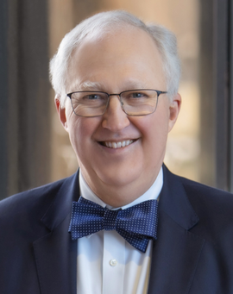
Ready to Get Started?
Ready to Get Started?
Contact Global Grants Chair, Dave Senness
dsenness@cap-mgt.com or 952-215-6826
2. Connect with assigned Grant Mentor
3. Start online application Do not "LOCK "or "AUTHORIZE" until 5950 approval
4. DO NOT START project until approved by TRF
5. Each Club may be the primary sponsor for (1) one grant:
through November 2024
Notes:
Global Grant Chair Dave Senness/Steve Johnson
Steps to prepare and submit a grant
Follow the detailed chronological Process Guide - Downloaded to you

Slide 32
Global … AFTER TRF Approval
AFTER TRF Approval …
Receive TRF approval letter
Collect Club Contributions into your Separate Account
TRF will wire World Fund match and DDF
Implement project; retain all receipts
File progress or final reports with TRF
Notes:
Global Grant Chair Dave Senness/Steve Johnson
Once approved … next steps in order to be compliant

Slide 33
2020-21 Global Grants Summary
2022-2023 Global Grant Summary
4 projects involving 16 clubs
$51,000 Club Funds → $676,598 Total
Leverage13.37 times
All four projects were collaborations
Notes:
Global Grant Chair Dave Senness/Steve Johnson
Lots of leverage this year because of partnering with other Districts and communities
Explain special donor

Slide 34
Application Essentials GLOBAL
Rotary Project
Rotarian Involvement … Host Club critical
Cooperating Organization vs. Vendor
Strong Measurement and Sustainability
Notes:
Global Grant Chair Dave Senness/Steve Johnson
Review
Project checklist to be sent post session

Slide 35
Application Attachments GLOBAL
Community Assessment Results
Memorandum of Understanding (MOU)
Curriculum for Training
Proforma Invoices – Estimated Expenses
Notes:
Global Grant Chair Dave Senness/Steve Johnson
Review continued
What is needed to complete application

Slide 36
Delivering Value to Club Members
Share your learning
Encourage global travel
Club engagement in projects
Notes:
Facilitator (Tim Deets/Don Stiles/Fred Semmer)
How to provide value to your club
Ask for a few minutes after you have attended this GMS to let club members know what you learned, how it provides value
Suggest global travel
Get members engaged in projects
Ex. Create video of projects , invite another member to work with you to author a grant

Slide 37
Grant Ideas
District Grant Ideas
Medical Help w/Covid-19
Youth Drop-in Shelter
Park equipment
District: Small International Grant Ideas
Water Pumps in India
Days for Girls Project
Global Grant Ideas
Covid PPE Minnesota
Dental Equipment in Tanzania
Prenatal Education for Young Women
District: Small International Grants
Notes:
Facilitator (Tim Deets/Don Stiles/Fred Semmer)
Time to get to work DOING … what will that be
Remind distinction re District / District SM Int’l & Global
Share ideas … encourage participants to share personal ideas for consideration
Remind ideas importance of collaboration on projects with other clubs in their communities AND with organizations in addition to other Rotary clubs.

Slide 38
How 5950 Clubs Qualify
Grant Writing Certification Requirements
District Grants
At least one club member attends a GMS annually
Incoming Club President files Club MOU + Addendum with District 5950 by May 15th
Incoming Club President must register at least Club TRF Annual Fund Goal online by May 15th
All collaborating Clubs must be GMS Certified as set forth above, and current on all reporting requirements
Notes:
Program Chair (Steve Johnson)
This is a reminder (it was shared at the beginning … remind now)
Define what qualifies the club
These apply to global and district grants
I want to draw attention to the fact that the District does not make grants to other non-profit organizations, i.e., it has to be a club service project that ultimately benefits the community local or international

Slide 39
Choose your Grant focus!
Breakout Rooms
Questions?
Review!
Notes:
Facilitator (Tim Deets/Don Stiles/Fred Semmer)
Work on Global or District as preferred … use the ideas generated to create a list of items to be included in application
Arrange by pairs or traids
Develop idea from list
Review the application to notice what questions arise
What is not clear?
What would cause you to get “stuck”
What else do you need?
Allocate time to generate questions
Each group will share their chosen project & questions that would cause them to be “stuck”

Slide 40
Rotary Websites
Rotary.org
Club Runner
RI and TRF Worldwide
Showcase
Learning Resource Center
Global Application
Personal Profile
Club Goals
Clubs and District detail
Grants
Calendar
Club Support/Club President Toolkit
Member login same for club & district site
May or may not be for RI site
Questions? Contact Alexa : Alexa@rotary5950.org
Notes:
Facilitator (Tim Deets/Don Stiles/Fred Semmer)
Review continued
What is needed to complete application
Calendar for district training

Slide 41
How do I find International Host Partner Clubs?
Find International Host Partner / Source Project Ideas
Relationships with clubs in the International Rotary Community / RI Club Finder
Rotary Showcase https://map.rotary.org/showcase
Attend District Training events/Rotary International Convention/other club meetings
Assistant Governors
Collaborations with other Clubs/Districts
District 5950 Project list www.Rotary5950.org – Grants
Rotary Youth Exchange Students
Notes:
Facilitator (Tim Deets/Don Stiles/Fred Semmer)
Best Projects are developed by relationships your club members have in the International Community you wish to work

Slide 42
Resources – beginning July 1, 2019
Resources – beginning July 1, 2024
5950 Leaders
DRFC Don Stiles stiles.don@gmail.com
Programs Steve Johnson steve.johnson@ix.netcom.com
Global Grants Dave Senness dsenness@cap-mgt.com
District Grants Kris Dirks wkdirks2@gmail.com
Website Resources
Global Grants: www.Rotary.org / Take Action / Apply for Grants
District Grants: www.Rotary5950.org / Grants / Grant Management Seminars/ District (or Global)
Notes:
Facilitator (Tim Deets/Don Stiles/Fred Semmer)
For reference … slides will be on the 5950 website

Slide 43
Tell us how we delivered!
Feedback!
TRF & District Requirements?
Grant writing skills?
Practical application?
Notes:
Facilitator (Tim Deets/Don Stiles/Fred Semmer)
Final Thoughts and Comments

