Slide 1
Longmont Twin Peaks Rotary
TITLE
Member Orientation

Slide 2


Slide 3
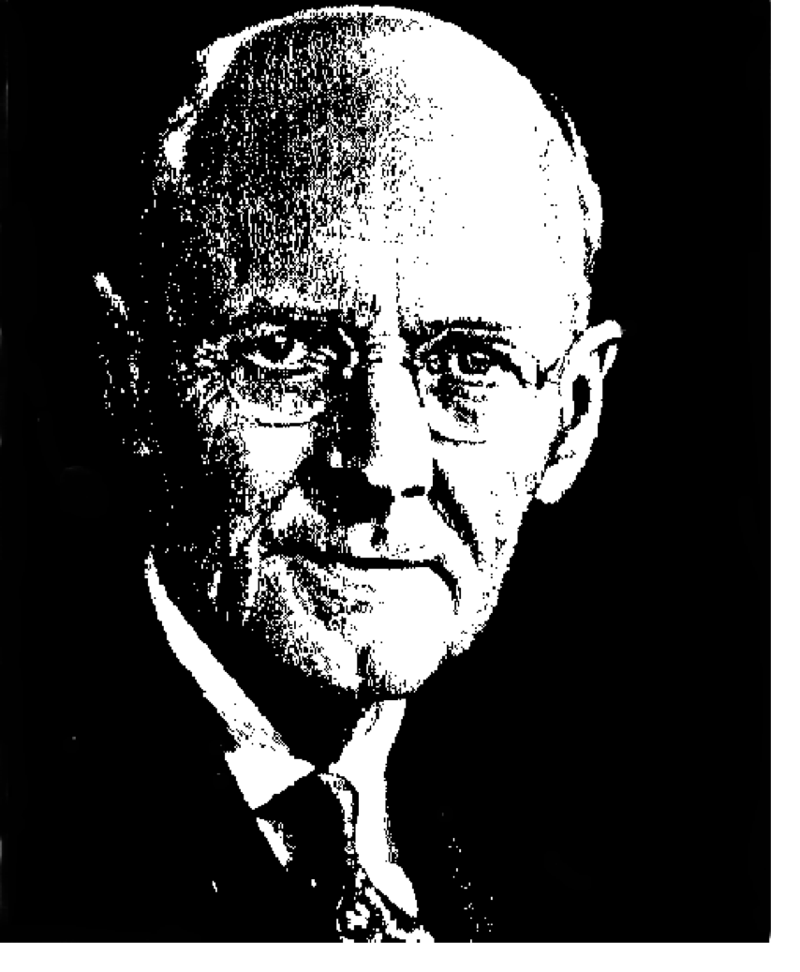
IN THE BEGINNING…
The first Rotary Club was organized in Chicago in 1905 by Paul P. Harris.
  The club, with four members, met in rotation at the offices of the members, thus the name Rotary.
  Rotary recognized fellowship and business benefit alone would not keep a group together—there needed to be a purpose.
  The first service project was public restrooms in downtown Chicago, IL.
Rotary Founder
Paul Harris

Slide 4
  Service Above Self
is the Rotary Motto

Slide 5
ROTARY INTERNATIONAL TODAY
What Is Rotary?
      We join leaders from all continents, cultures, and occupations.
      We exchange ideas.
      We take action.
Notes:
Rotary connects 1.2 million members.
35,114 Rotary Clubs in 209 countries and geographical areas.
Rotary brings together a global network of volunteer leaders who dedicate time and talent to tackle the world’s most pressing humanitarian challenges.
Rotarians provide humanitarian service, encourage high ethical standards
and help build goodwill and peace in the world.

Slide 6
MEMBERSHIP SNAPSHOT
WHO
WHERE
WHAT
Notes:
WHO: Rotary brings together the kind of people who step forward to take on important issues for local communities worldwide. Rotary members hail from a range of professional backgrounds. Rotary connects unique perspectives and helps leverage it’s members expertise to improve lives everywhere.
WHERE: From Haiti and Greenland to Nigeria and Singapore, Rotary unites a truly diverse set of leaders from across the world. Currently, the largest number of clubs comes from the United States, India, Japan and Brazil. The fastest growing Rotary regions included Southeast Asia and Africa.
WHAT: Rotarians contribute their time, energy and passion to sustainable, long-term projects in local communities across the globe. Projects focus on important issues like peace and conflict resolution, disease prevention and treatment, water and sanitation, maternal and child health, basic education and literacy and economic and community development.

Slide 7
THE OBJECT OF ROTARY
The Object of Rotary is to encourage and foster the ideal of service as a basis of worthy enterprise and, in particular, to encourage and foster international understanding, goodwill, and peace.
Notes:
First. The development of acquaintance as an opportunity for service.
Second. High ethical standards in business and professions; the recognition of the worthiness of all useful occupations; and the dignifying of each Rotarian’s occupation as an opportunity to serve society.
Third. The application of the ideal of service in each Rotarian’s personal, business and community life.
Fourth. The advancement of international understanding, goodwill and peace through a world of fellowship of business and professional people united in the ideal of service.

Slide 8
THE FOUR-WAY TEST
Of the things we think, say or do:
Is it the TRUTH?
Is it FAIR to all concerned?
Will it build GOODWILL and BETTER FRIENDSHIPS?
Will it be BENEFICIAL to all concerned?

Slide 9
ROTARIAN CODE OF CONDUCT
The Rotarian Code of Conduct provides a framework for ethical behavior that all Rotarians can use, together with The Four-Way Test, in their business and professional activities.
Notes:
As a Rotarian, I will
Act with integrity and high ethical standards in my professional and personal life.
Deal fairly with others and treat them and their occupations with respect.
Use my professional skills through Rotary to: mentor young people, help those with special needs, and improve people’s quality of life in my community and the world.
Avoid behavior that reflects adversely on Rotary or other Rotarians.
Not seek special business or professional advantages from other Rotarians.

Slide 10
ROTARY INTERNATIONAL
How is Rotary organized?
  Rotary Clubs
    Rotary Districts
      Rotary Zones
        Rotary International
Notes:
Role/Function of:
Rotary Clubs: The club is the basic unit of Rotary activity, and each club determines its own membership and leadership. It is through clubs that projects, activities, and socials and developed and enjoyed. Each club elects its own president and officers for one-year terms. The club enjoys considerable autonomy within the framework of the standard constitution and bylaws of RI. Rotarians may attend any Rotary club around the world (or on-line through eClubs) at one of their weekly meetings. Currently there are 35,114 clubs in the Rotary world.
Rotary Districts: A district governor, who is an officer of RI and represents the RI board of directors in the field, leads his/her respective district. Each governor is nominated by the clubs of his/her district, and elected by all the clubs meeting in the annual RI District Conference held each year. The district governor appoints assistant governors from among the Rotarians of the district to assist in the management of Rotary activity and multi-club projects in the district. There are 535 districts all over the world.
Rotary Zones: Approximately 15 Rotary districts form a zone. A zone director, who serves as a member of the RI board of directors, heads two zones. The zone director is nominated by the clubs in the zone and elected by the convention for the terms of two consecutive years. The purpose of the zone is to training Rotary officers (e.g., district governors) and elect the RI president. There are a total of 34 zones of approximately the same number of Rotarians in each.
4. Rotary International: RI is governed by a board of directors composed of the international president, the president-elect, the general secretary, and 17 zone directors. The nomination and election of each president is handled in the one- to three-year period before s/he takes office, and is based on requirements including geographical balance among Rotary zones and previous service as a district governor and board member. The international board meets quarterly to establish policies and make recommendations to the overall governing bodies, the RI Convention and the RI Council on Legislation. The chief operation officer of RI is the general secretary, who heads a staff of about 600 people working at the international headquarters in Evanston and in seven international offices around the world.

Slide 11
ROTARY LEADERSHIP
A Rotary International President is elected annually and selects a theme for the year of service.
Each Rotary District elects a District Governor annually.
We are District 5450 and our District Governor is Bill Downes.
Our Assistant Governor is Dan Gust.

Slide 12
SIX AREAS OF FOCUS
Rotary International and the Rotary Foundation have identified specific causes to target to maximize our local and global impact while understanding that each community has its own unique needs and concerns. They are:
          Peace and Conflict Prevention/Resolution
          Disease Prevention and Treatment
          Water and Sanitation
          Maternal and Child Health
          Basic Education and Literacy
          Economic and Community Development
Notes:
The work of Rotary begins in the community, and every community has its own unique needs and concerns. While we serve in countless ways, we’ve focused our efforts in six key areas to maximize our impact. These areas encompass some of the world’s most critical and widespread humanitarian needs, and we have a proven record of success in addressing them.

Slide 13
AVENUES OF SERVICE
Rotary channels its commitment to service at home and abroad through five Avenues of Services, which are the foundation of club activity:
        Club Service
        Vocational Service
        Community Service
        International Service
        Youth Service
Notes:
Club Service focuses on making clubs strong. A thriving club is anchored by strong relationships and an active membership development plan.
Vocational Service calls on every Rotarian to work with integrity and contribute their expertise to the problems and needs of society.
Community Service encourages every Rotarian to find ways to improve the quality of life for the people in their communities and to service the public interest.
International Service exemplifies our global reach in promoting peach and understanding. We support this service avenue by sponsoring or volunteering on international projects, seeking partners abroad, and more.
5. Youth Service recognizes the importance of empowering youth and young professionals through leadership development. Programs include Interact, Rotaract, Community Corps, Rotary Youth Leadership Awards (RYLA, Young RYLA, and RYLA Plus), and Youth Exchange.

Slide 14



EXPANDED SERVICE OPPORTUNITIES
Interact
Rotaract
Rotary Community Corps (RCCs)
Rotary Youth Leadership Award (RYLA)
RCC logo is that of sponsoring club
NOTE: D. 5450 RYLA Logo undergoing redesign. Here is the former logo.
Notes:
Interact: Interact: a service organization sponsored by Rotary clubs for young adults aged 12-18. There are more than 12,300 Interact clubs in 133 countries.
Rotaract: Rotaract groups organized by Rotary clubs to promote leadership, professional development, and service among young adults aged 18-30. There are more than 8,000 Rotaract clubs in 167 countries.
Rotary Community Corps: Rotary Community Corps (RCCs): groups of non-Rotary members who work to improve their communities. There are more than 7,500 RCCs in 80 countries, all organized and sponsored by Rotary clubs.
4. RYLA: RYLA is a leadership development program run by Rotary. While participants can be any age, most events focus on secondary school students, university students, or young professionals. In District 5450 Young RYLA is for students between 7th & 8th grades; while RYLA is for students in the 10th through 12th grade. RYLA Plus is for high school aged students with physical disabilities. Around the world the training can run between 3-10 days (District 5450 is week-long) and includes presentations, activities, and workshops that cover a variety of topics include: leadership fundamentals and ethics; communication skills; problem solving and conflict management; and community and global citizenship.

Slide 15

THE ROTARY FOUNDATION
Notes:
The Rotary Foundation is a not-for-profit corporation that supports the efforts of Rotary International to achieve world understanding and peace through international humanitarian, educational, and cultural exchange programs.
Mission: The mission of the Rotary Foundation is to enable Rotarians to advance world understanding, goodwill and peace through the improvement of health, the support of education and the alleviation of poverty.

Slide 16
THE ROTARY FOUNDATION GIVING
Donations can be directed to one of these three funds:
      Annual Programs Fund
      Permanent Fund
      PolioPlus
Notes:
Annual Program Fund: Your ongoing financial gifts throughout the Rotary Year go into the Annual Fund. The Annual Fund helps Rotary clubs take action today to create positive change in communities at home and around the world. Your contributions help us strengthen peace efforts, provide clean water and sanitation, support education, grow local economies, save mothers and children, and fight disease. Fifty percent of the funds raised in a District come back to the donating District in three years for distribution to clubs. Therefore, encouraging annual contributions through such programs as "Every Rotarian Every Year” at a $100/year level helps build the amount of money available for club projects.
Permanent Fund (a/k/a Endowment): The Permanent (or Endowment) Fund is grown from the planned gifts of Rotarians, their friends, and families. Not only is this money help for strategic investments In particular, a portion of available earnings from our Endowment Fund supplements Foundation activities and helps strengthen our future commitments. Your contributions are invested in perpetuity. A percentage of the total value of the Endowment Fund is spent annually to benefit current and future Foundation grants and programs. The Foundation has set a goal of $2.025 billion in Endowment Fund assets and gift commitments by 2025.
3. PolioPlus: (separate slides/discussion)

Slide 17
THE ROTARY FOUNDATION: How to Give/Recognition
The Rotary Foundation is funded through contributions in one of two ways:
1. ANNUAL FUND
          A. “EREY” (Every Rotarian Every Year) – Total meets or exceeds $100 from every Rotarian in a club
          B. There are easy ways to give!
2. PLANNED GIVING
      A. Benefactor - $1000+ gift or bequest
      B. Major Donor - $10,000+ total contribution
      C. Bequest Society - $10,000+ bequest
      D. Arch C. Klumph Society $250,000+ total contribution
Notes:
Annual Fund Recognition: “Sustaining Member” ($100+ annual contribution) and/or “Paul Harris Fellow” (increments of $1000+ total contribution), and Paul Harris Society (more than $1,000 annually to the Annual Fund, PolioPlus, or an approved Foundation grant). Other ways to give:
A. Automatic addition to quarterly club dues
B. Credit card contribution at www.rotary.org
C. Mail payments to: The Rotary Foundation, 14280 Collections Center Dr. Chicago, IL 60693
Planned Giving Recognition: Bequest Society earn en engraved crystal recognition piece and a pin; Major Donor pin or pendant in 4 levels; and Arch Klumph Society including an induction at RI headquarters and invitations to society events along with pins and crystals commemorating the giving levels.

Slide 18
THE ROTARY FOUNDATION PROGRAMS
        Grants (District, Global)
        Rotary Peace Fellowships
        PolioPlus
        Rotary Alumni
Notes:
Grants: In 2013, Rotary launched its improved grants program. The Rotary Foundation offers grants that support a wide variety of projects, scholarships, and training (e.g., Vocational Training Teams, formerly Group Study Exchange) that Rotarians are doing around the world. The new grant process addresses the six areas of focus and ensures sustainability:
Peace and Conflict Prevention/Resolution
Disease Prevention and Treatment
Water and Sanitation
Maternal and Child Health
Basic Education and Literacy
Economic and Community Development
Rotary Peace Fellowships: Each year Rotary selects up to 100 individuals from around the world to receive fully funded academic fellowships at one of our peace centers. These fellowships cover tuition and fees, room and board, round-trip transportation, and all internship and field study expenses. In just over a decade the Rotary Peace Centers have trained more than 900 fellows for careers in peace building. There are two types of fellowships: A Master’s Degree lasting 15-24 months (Duke University and University of North Carolina at Chapel Hill; International Christian University, Japan; University of Bradford, England; University of Queensland, Australia; or Uppsala University, Sweden) and a Professional Development Certificate at Chulalongkorn University, Thailand.
PolioPlus: The first initiative to tackle global polio eradication through the mass vaccination of children. Rotary has contributed more than $1.5 billion and countless volunteer hours to immunize more than 2.5 billion children in 122 countries. In addition, Rotary’s advocacy efforts have played a role in decisions by donor governments to contribute more than $9 billion to the effort through a public-private partnership including Rotary, World Health Organization, U.S. Centers for Disease Control and Prevention, UNICEF, and Bill & Melinda Gates Foundation, and governments around the world.
Rotary Alumni: Rotary Alumni are defined as any individual who has participated in any of the following programs: Interact, Rotaract, Youth Exchange, RYLA, Rotary Peach Fellowships, Rotary Scholarships (funded by global or district grants), vocation training teams (members and leaders), Ambassadorial Scholarships, Grants for University Teachers, former members/leaders of Group Study Exchange, and Rotary Volunteers. The Rotary Alumni program fosters the connection of alumni through geographical alumni associations, discussion groups, Rotary Community Corps, a Rotary Action Group, or a Rotary Fellowship.

Slide 19
  POLIO PLUS HISTORY
1985
1988
Today
  Rotary launched its Polio Plus program
  Global Polio Eradication Initiative with its partners the World Health Organization, UNICEF and the U.S. Centers for Disease Control and Prevention.
  Polio eradication remains Rotary’s top priority. To date, Rotary has contributed more than US$1.2 billion and countless volunteer hours to help immunize more than two billion children against polio in 122 countries resulting in a 99% eradication.
We are THIS close!!!

Slide 20

  POLIO PLUS UPDATE
Polio Eradication Status
Currently, Rotary is working to raise $35 million per year through 2018 for polio eradication, which will be matched 2 to 1 by the Bill & Melinda Gates Foundation.

Slide 21

ABOUT OUR CLUB

Slide 22
TWIN PEAKS ROTARY
Chartered as a Rotary Club May 18, 1985
  Initial membership was 35 on Charter Night.
  Holiday Ball was club’s signature event through 2004.
  Chuckwagon Breakfast has been a summer signature event since 1995.
  Christmas Giving Tree participant through 2008.
  Twin Peaks and other Rotary clubs participate in Water & Sanitation Projects in Nicaragua.
  Membership was 68 in 2010.

Slide 23
TWIN PEAKS ROTARY
Who are we?
  We are a diverse membership from a variety of occupations.
  We have 85 members in March 2016.
  We encourage members to take an active role in club.
  We acknowledge outstanding high school seniors in SVVSD with our Students of the Month recognition.
  We have 44 Paul Harris Fellows (a member who donates $1000 to The Rotary Foundation). Ten of those have more than one Fellow.
  We host an international exchange student every year.
  Matching grants from RI help us support local projects.
  The Club organizes and participates in a variety of service projects and fundraisers throughout the year.

Slide 24
TWIN PEAKS ROTARY
What are your obligations as a member of Twin Peaks Rotary?
    First, and most important is to attend our weekly meetings on Thursday at noon and stay to hear the program speaker.
    Second, you will be encouraged to be active and involved on a club committee that fits your talents and interests.
    Third, you will be expected to support, with your time and dollars, the fundraisers and service projects we engage in throughout the year.
    Fourth, you will pay quarterly dues in a timely manner that includes the cost of the delicious luncheon served each week.
    Fifth, engage in the principle of “Service Above Self.”

Slide 25
TWIN PEAKS ROTARY
Your financial obligations:
    Dues are billed quarterly $190/qtr
    Rotary Foundation Contribution $25+/qtr
    New Member Orientation Fee is $54
    Meals for guests are $12. (A prospective member receives three complimentary lunches as the club’s guest.)
    Your support with fundraising events as you are able

Slide 26
TWIN PEAKS ROTARY
Service Projects
      Scholarships: The Club provides scholarships annually for local high school seniors to attend in-state colleges and universities.
      Chuckwagon Pancake Breakfast: An annual summer event serving up breakfast before the Boulder County Fair parade on Main St. Proceeds benefit the scholarship fund.
      Mike McDonough Memorial Greenway Clean-Up: The Club has adopted a portion of the St. Vrain Greenway and helps keep it clean.
      World Community Projects: The Club participates in a variety of international projects addressing issues such as literacy, clean water and medical needs.

Slide 27

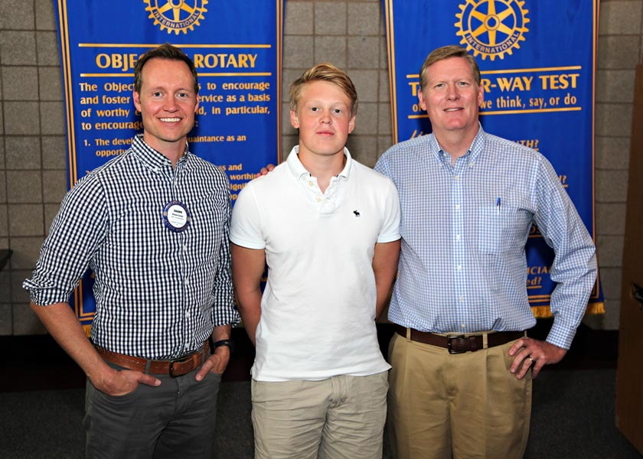

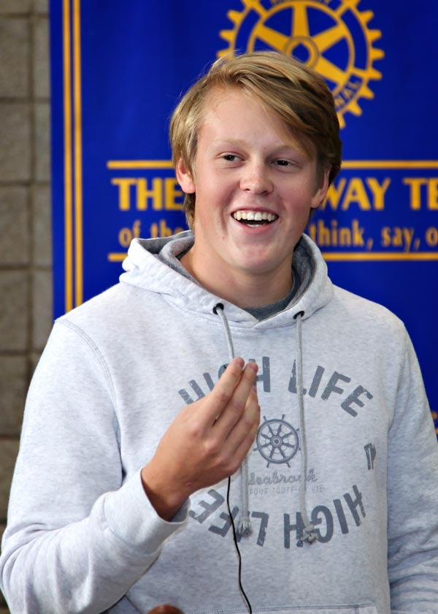
TWIN PEAKS ROTARY
Youth Exchange
    Our Club hosts an exchange student every year.
    Host families are needed for a three month commitment.
Kasper Thorslund from Sweden
2015-16 Youth Exchange Student

Slide 28
TWIN PEAKS ROTARY
Club committees are organized into six groups:
              Club Administration
              Foundation
              Fundraising
              Membership
              Service
              Public Relations

Slide 29
TWIN PEAKS ROTARY
2015-2016 Board of Directors
President - Rich Schenker
Vice President - Thaxter Williams
President Elect Nominee - Mike Pipis
Past President - Terry Schueler
Treasurer - Wendi Nafziger
Secretary - Debbie Adams
2015-2016 Committee Chairs
          Club Admin - Kirsten Pellicer
      Foundation - Open Position
      Fundraising - Steve Benscheidt
      Membership - Dietra Porter
      Service Projects - Shawn Lewis
      New Generations - PK Schnegelberger
      Public Relations - Debbie Adams

Slide 30
IMPORTANT LINKS
Websites for more information:
  Longmont Twin Peaks Rotary: twinpeaksrotary.org
  District 5450: rotary5450.org
  Rotary Zones 21b-27: rizones21-27.org
  Rotary International: rotary.org
  Rotary eClub One: rotaryeclubone.org
  The Rotarian Magazine: rotary.org/myrotary/en/news-media/magazines/rotarian

Slide 31

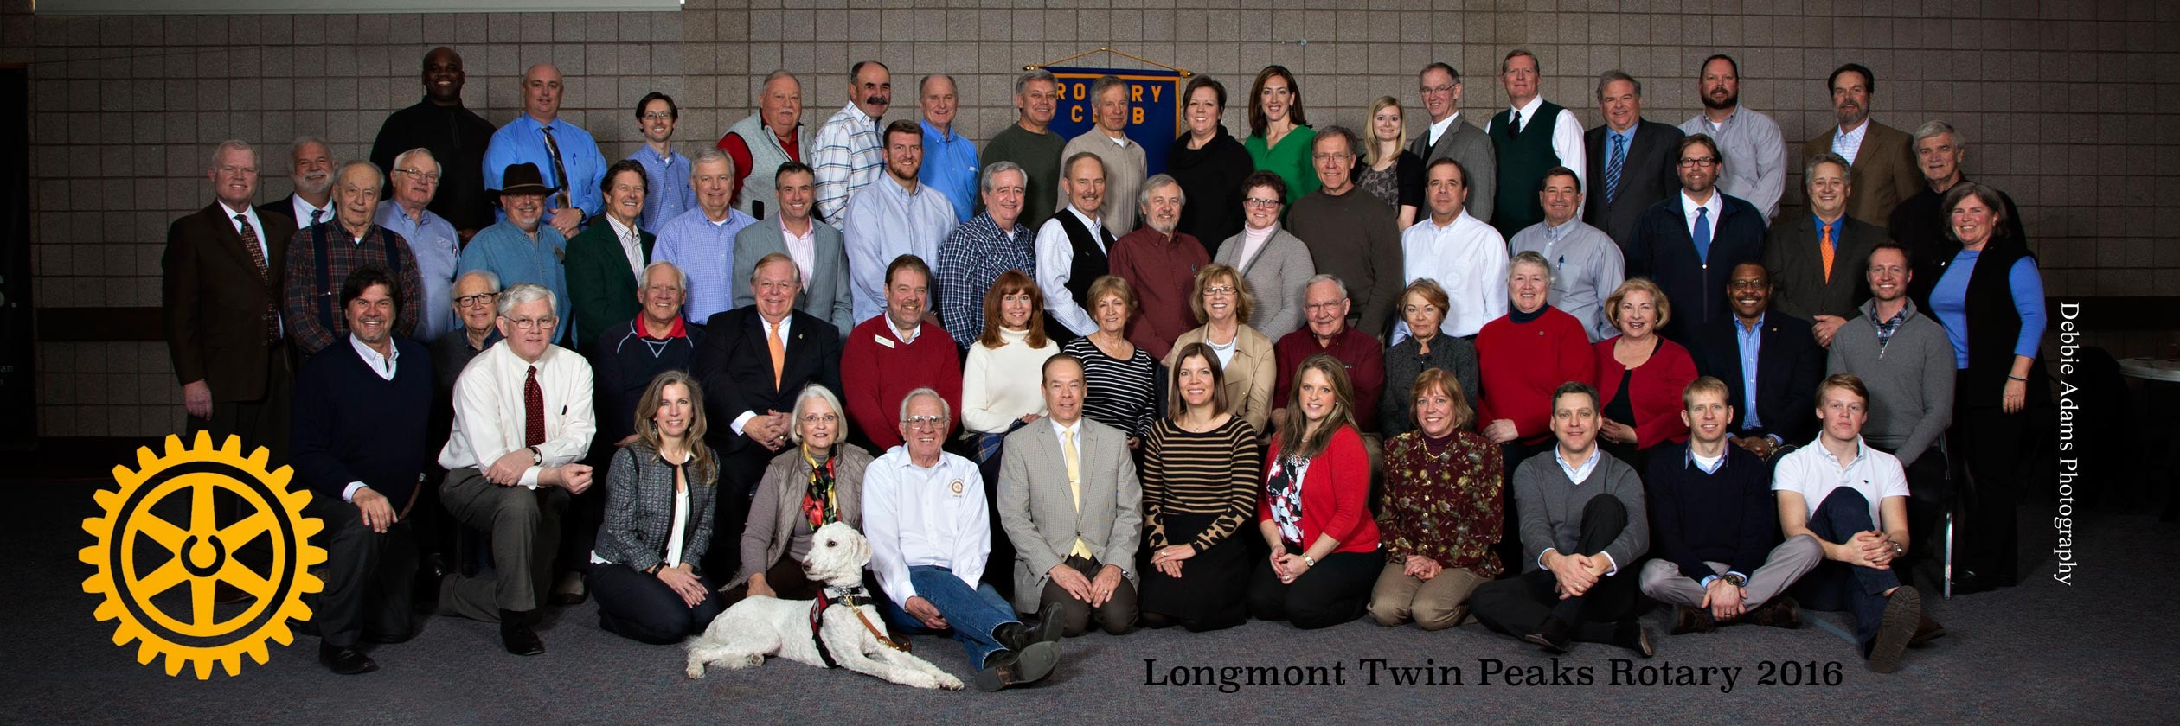
Welcome!

Slide 32


