Slide 1
Let’s Go Virtual!
Rotary District 6440 Guide to using Zoom
Version 1.2 nl 4-1-20

Slide 2
VM Committee Mission
Assist club VMCs, Presidents, AGs and other leaders in successfully implementing virtual meetings into their Rotary club activities.

Slide 3
Table of Contents
Before we begin
Basic vs. Pro User License
Getting your members ready for Zoom
Create a Zoom Account
Upgrade to Pro
Get the App
PC & MAC
Mobile Devices
Log onto the App
Join a Meeting
In meeting controls for Attendees
PC & Mac
Mobile Devices
Keyboard shortcuts
PC
Mac
iPad
Meeting etiquette and best practices
Schedule Meetings
Host Meeting Control Video Tutorials
Excellent video on Host Meeting Controls
Video tutorial on Managing Participants
Tutorial on using Polls in Meeting
Tutorial on using Break Out Rooms

Slide 4
Before We Begin
You can participate in Zoom meetings with a PC, Mac, smartphone or old fashion cell phone or landline.
For the best experience, use a PC, Mac or Chromebook that is equipped with built-in camera and microphone, high speed internet connection, and Chrome, Firefox or Safari. Avoid using Internet Explorer, Microsoft Edge or AOL browser.
For best experience, download and utilize the Zoom app. It is possible to join meetings without the app, if the host has enabled joining through a browser” for the meeting. This may cause audio feedback issues,
No account is required to use the app, but a free account will let you host 40 minute meetings with up to 100 attendees.

Slide 5
Basic vs. Pro User
Basic is free. Can join any meeting. Can host meetings up to 100 people for 40 minutes. People can not join via phone.
Users with a Pro license can host long meetings for up to 100 people. Additional attendees can be purchased. People can join by phone. Cost, $120 for first year with “zoomrotary” code. Can record to cloud.
Business license- Enhanced features for larger organizations with many licensed users.

Slide 6
Getting your members ready for Zoom
Club VMC should offer practice zoom sessions for small groups of members and provide individual phone assistance to those having trouble, or contact your Virtual Meeting Committee Member for assistance.
Contact District VC member for assistance if need.

Slide 7
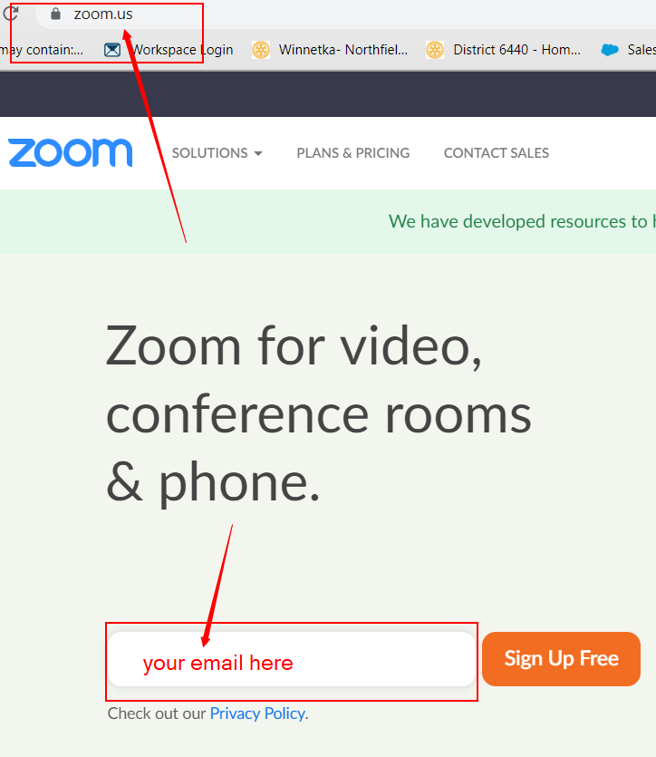
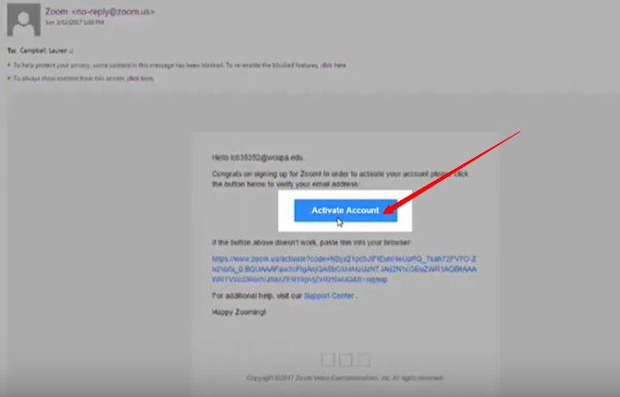
Create an Account
Create an Account (if you don’t have one)
Go to zoom.us, and enter email address.
Go you your email, and click on the Activate Account button.
Here are YouTube tutorials https://youtu.be/4y_puMRsjTQ https://youtu.be/qsy2Ph6kSf8

Slide 8
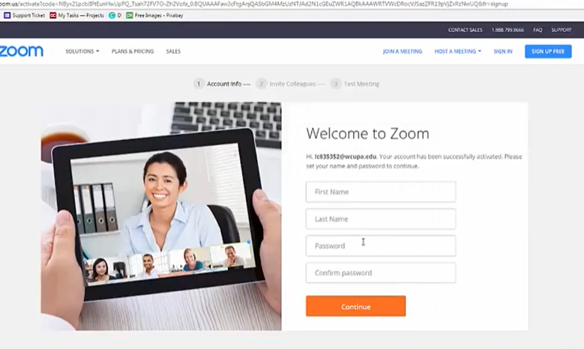
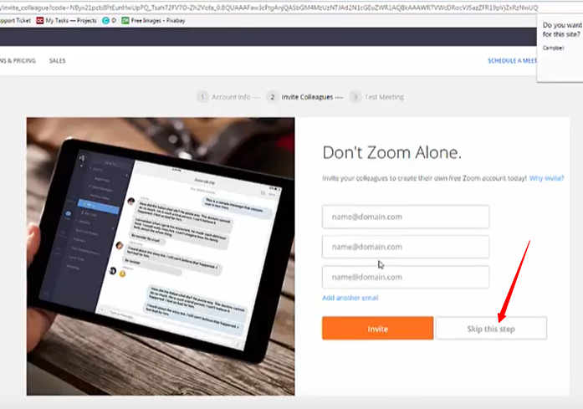
Create an Account
Fill in first name, last name and create a password (you will need to enter this twice).
At next screen, click on Skip this step

Slide 9
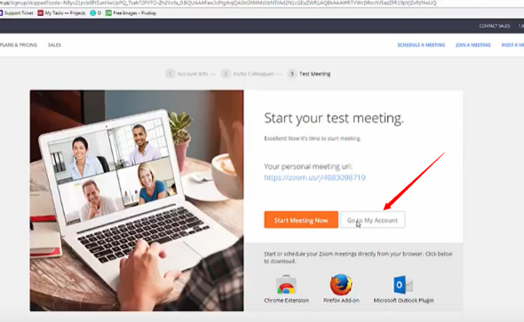
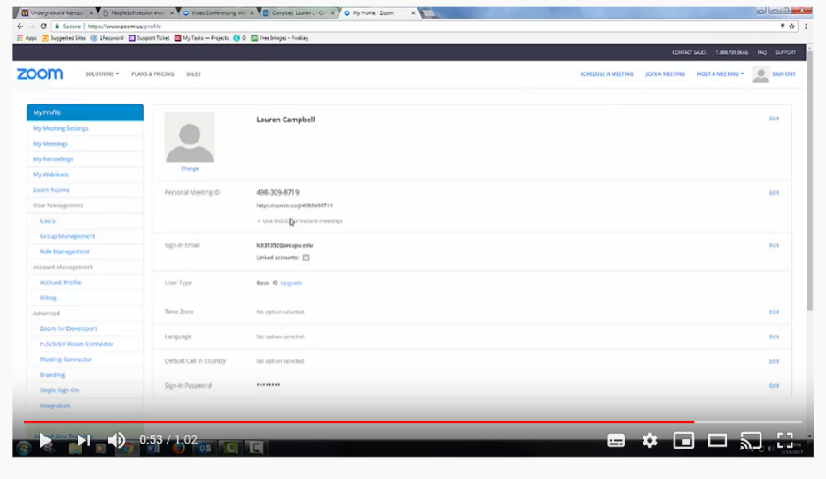
Create an Account
Click on Go to My Account button
Here you can upload a photo of yourself and configure your account settings. None of this is required at this time.

Slide 10
Upgrade an Account to Pro
Log onto to Zoom.us. Click on “Plans and Pricing” link at top of page

Slide 11
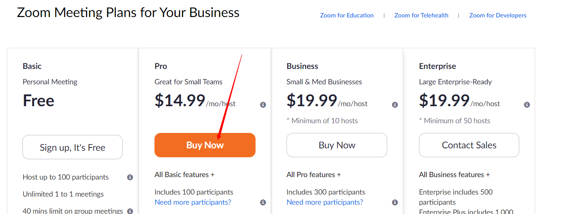
Upgrade an Account to Pro
Click on Buy Now for Pro Plan

Slide 12
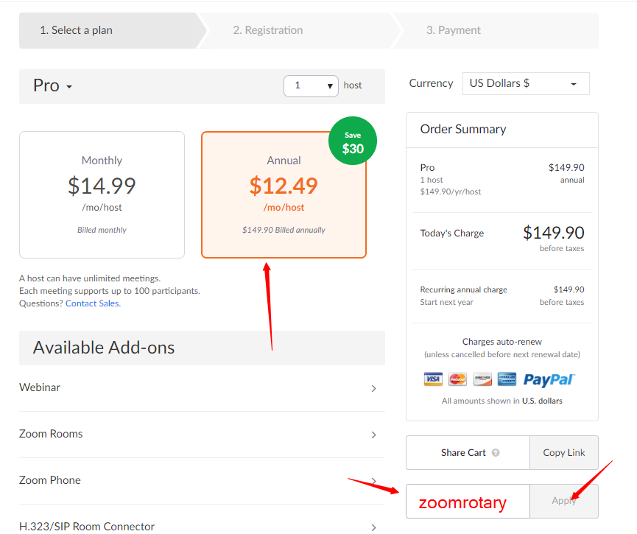
Upgrade an Account to Pro
Click on Annual
Enter “zoomrotary” in coupon code box, and click apply
Check price to see if discount was applied (total should be under $120)
Complete the rest of the form, agree to terms and check the captcha box and finish the purchase.

Slide 13
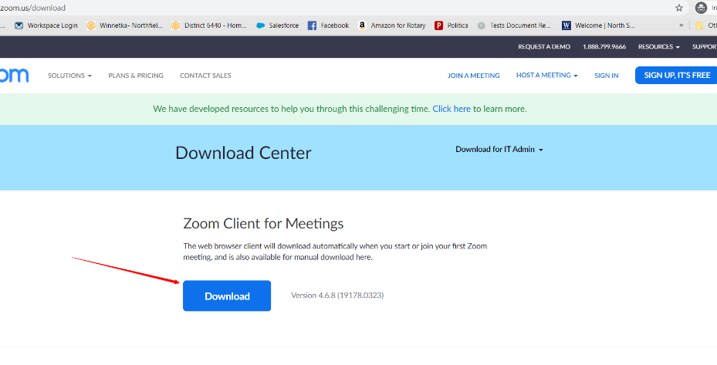
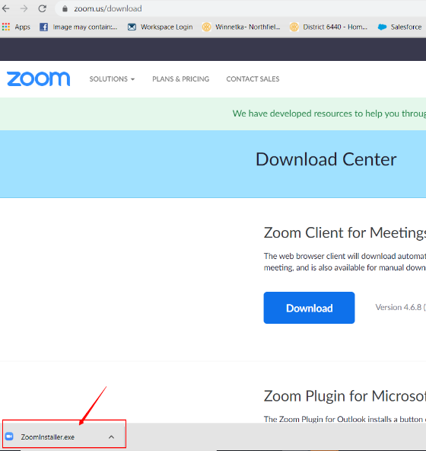
Get the App
Go to zoom.us/download
Click on blue Download button under Zoom Client for Meetings
File downloads to your computer. In chrome, you will see icon in lower left. Click on it.

Slide 14
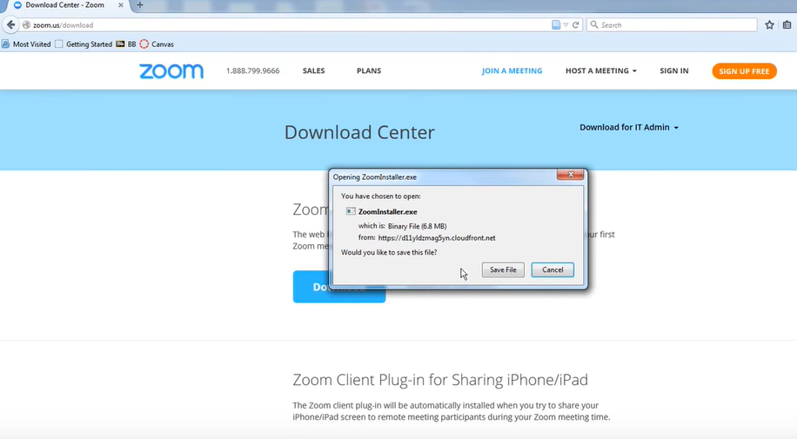
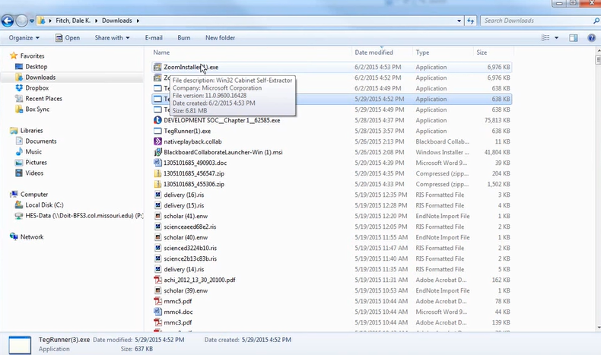
Get the App
In Firefox or Safari, click on blue download button, then Save File in the box that appears.
Then go to Downloads file folder, and double click on file zoominstaller.exe. Click on yes button to authorize the installation
Here’s a YouTube tutorial video https://youtu.be/UAa3MADuvsg

Slide 15
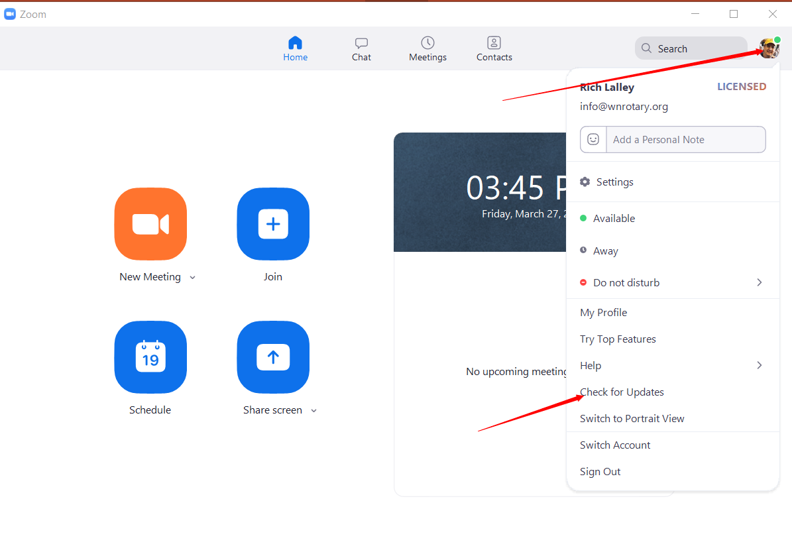
Get the App
Pro Tip: If you already have the app, make sure you have the up to date version.
Open the Zoom App, click on your icon in upper left, then click on Check for Updates.
If updated version is available, install it.

Slide 16
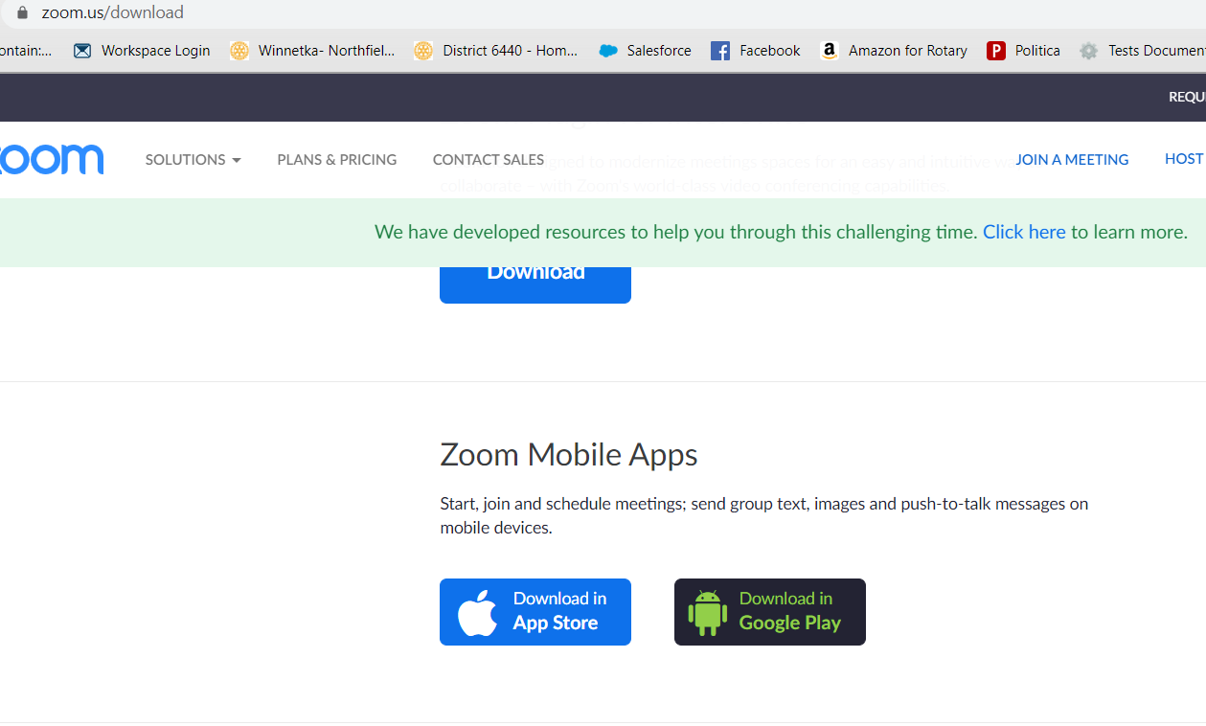
Get the App- Phones and Tablets
You can also install Zoom on Android or IOS phones and tablets.
In app store, search for Zoom and install the mobile app.
Or go to zoom.us/download on your phone or tablet browser and scroll down to the Zoom Mobile Apps headline and click on the App Store or Google Play button.

Slide 17
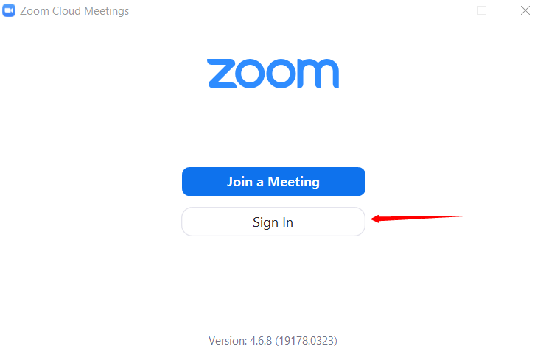
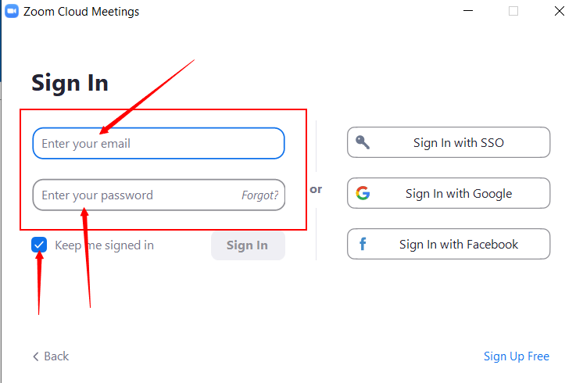
Log on to the App
While not required, it is best to join meetings with your Zoom app and to be logged in when you do.
After downloading the app, open the app (click on Zoom icon on desktop or in list of apps).
Click on Sign In
Enter email and password
If desired, click on “Keep me signed in” box to avoid needing to sign in again. (Best to not use if sharing your license).

Slide 18
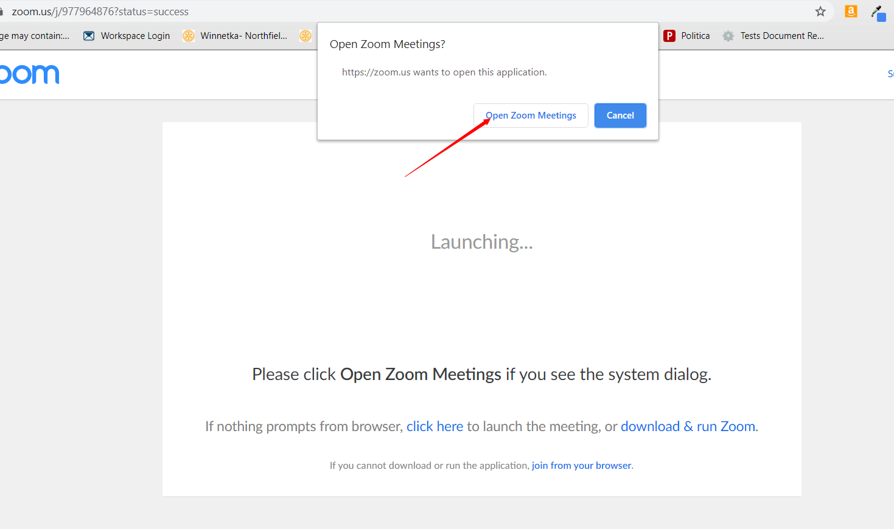
Join a meeting
If you received a meeting invitation, click on the link htpps://zoom.us/j/xxxxxxxxx (all x’s replaced with meeting numbers)
A browser will open, and box appears. Click on Open Zoom Meeting button.

Slide 19
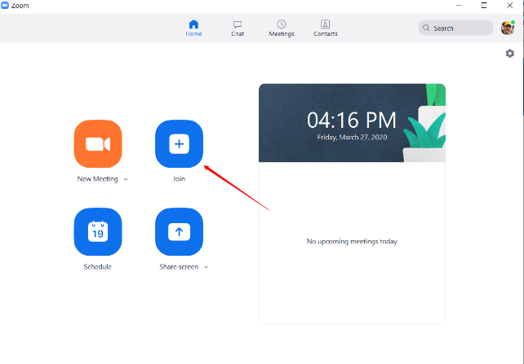
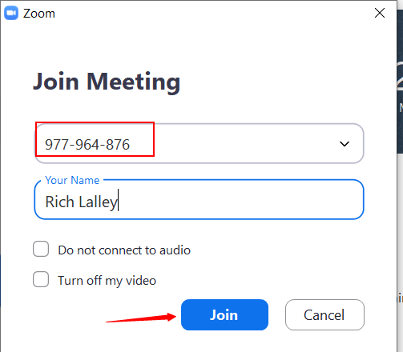
Join a meeting
Or open Zoom App. Log in if needed.
Click on Join Meeting
Enter Meeting ID, the 9 digit number in the meeting invitation. Then click Join.
htpps://zoom.us/j/xxxxxxxxx
If asked, click to okay join with camera on and join with computer audio

Slide 20
How to Join a Meeting Tutorials
Helpful videos for members just starting:
How to join a zoom meeting (by Zoom) (1:09 video and written instructions).
How to join a Zoom meeting (by a small church) (3:08 video)
How to Join a Zoom Meeting by How-To Geek (excellent written instructions on various ways to join, including by phone)
Joining & Configuring Audio & Video (this video reviews how to test audio and video settings on your computer and make adjustments if needed)

Slide 21
In Meeting Controls for Attendees
PC Controls (the following assumes you have joined with the app, not via a browser). Depending on you app version and the host’s meeting settings, you may see more or fewer buttons)
Mic Control- Mute and unmute yourself. Access advanced audio settings.
Video Control- Start and stop your camera.
Invite- Invite to others to join the meeting
Participants- Opens Participants window on right with list of participants
Share- Allow you to share your screen or an open app on your pc
Chat- Opens chat window on the right
Record- Starts recording of the meeting.

Slide 22
In Meeting Controls for Attendees
Android Controls- tap screen to bring up controls tool bar. Depending on you app version and the host’s meeting settings, you may see more or fewer buttons
More: Non-verbal feedback icons (if enabled by the host). Tapping an icon will notify the host by placing the icon beside your name in the participants list. For example, the hand icon places the raise hand icon beside your name and simulates a hand raise.
Leave meeting is in upper right corner of screen.

Slide 23
In Meeting Controls for Attendees
Android and iOS Controls- at bottom of screen. Depending on you app version and the host’s meeting settings, you may see more or fewer buttons
More: Non-verbal feedback icons (if enabled by the host). Tapping an icon will notify the host by placing the icon beside your name in the participants list. For example, the hand icon places the raise hand icon beside your name and simulates a hand raise.
Leave meeting is in upper right corner of screen.

Slide 24
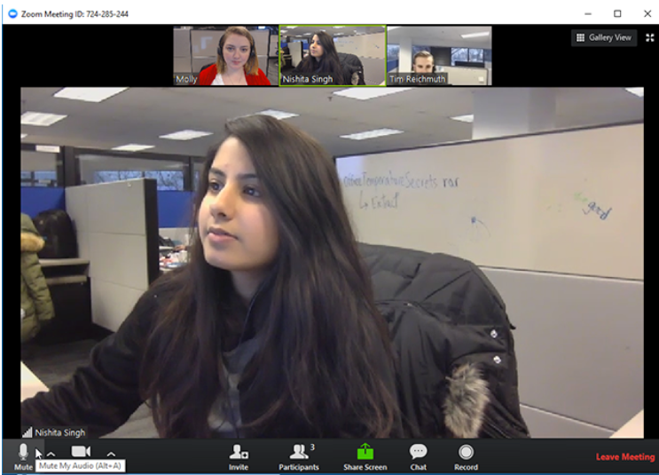
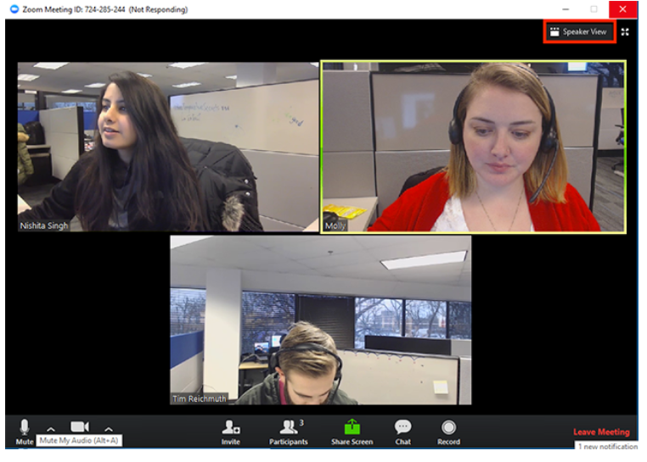
In Meeting Controls for Attendees
Speaker View vs. Gallery View. On PC or MAC, toggle between views with these buttons.

Slide 25
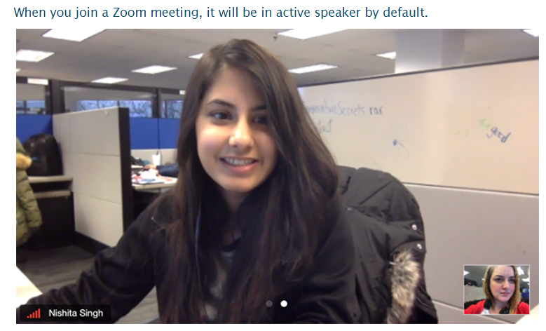
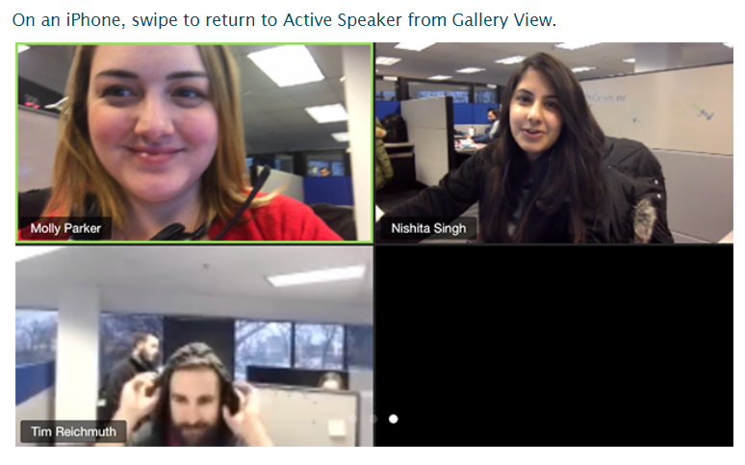
In Meeting Controls for Attendees
Speaker View vs. Gallery View. On iOS phone, swipe between views.

Slide 26
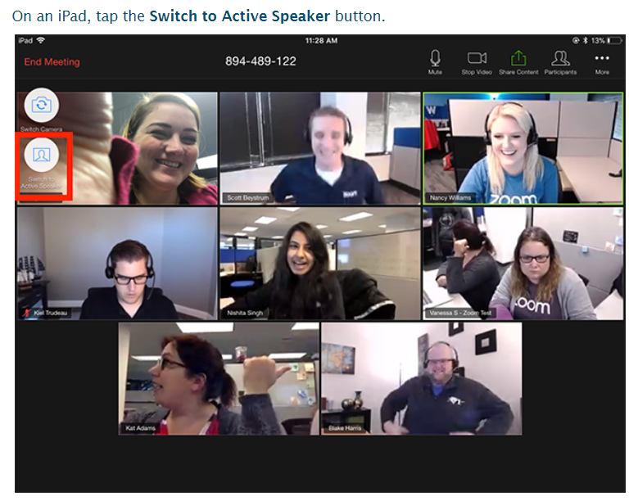
In Meeting Controls for Attendees
Speaker View vs. Gallery View. On iPad, tap the button in upper left to switch. Meeting controls are also on the top right.

Slide 27
In Meeting Controls for Attendees- Keyboard Shortcuts
PC Shortcuts
Unmute/Mute: Hold space bar down while talking. Toggle mute/unmute with Alt+A
Always show meeting control tool bar: Toggle on/off with Alt key
Active Speaker View: Alt+F1
Gallery View: Alt+F2
Show/Hide Chat panel: Alt+H
Show/Hid Participants Panel: Alt+U
Raise Hand: Alt+Y
Screen Shot: Alt+Shift+T

Slide 28
In Meeting Controls for Attendees- Keyboard Shortcuts
Mac Shortcuts
Unmute/Mute: Hold space bar down while talking. Toggle mute/unmute with Command(⌘)+Shift+A
Always show meeting control tool bar: Toggle on/off with Ctrl+\
Active Speaker/Gallery View: Command(⌘)+Shift+W
Show/Hide Chat panel: Command(⌘)+Shift+H
Show/Hid Participants Panel: Command(⌘)+U
Raise Hand: Option+Y
Screen Shot: Command(⌘)+T

Slide 29
In Meeting Controls for Attendees- Keyboard Shortcuts
iPad with Keyboard
Unmute/Mute: Command+Shift+A
Show/Hide Chat panel: Command+Shift+H
Show/Hid Participants Panel: Command+U
Close front window: Command+W

Slide 30
In Meeting Etiquette & Best Practices
Arrive early to be sure everything works.
Quiet background (no tv, disruptive pets, music).
Check your video background and video framing. Use virtual background if your room background is not becoming. Avoid camera looking too much up or down.
Mute when not speaking, especially if there is any background noise near you.
Use non verbal communication if available. Raise hand. Chat to everyone or privately. PC/MAC Android/iOS

Slide 31
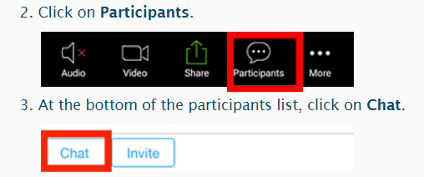
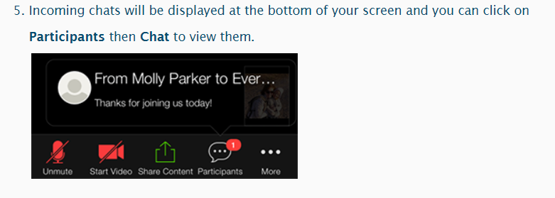
In Meeting Etiquette & Best Practices
Chat
In PC, click on chat icon to open chat.
On mobile device, tap screen to see controls. Click on Participants then.
Choose to send to everyone or host. Type name in search bar to find someone.
Type message and press enter or touch send on mobile device to send.
On PC, messages appear in chat window. On mobile device:
Note, meeting settings may limit who can send chats to whom.

Slide 32
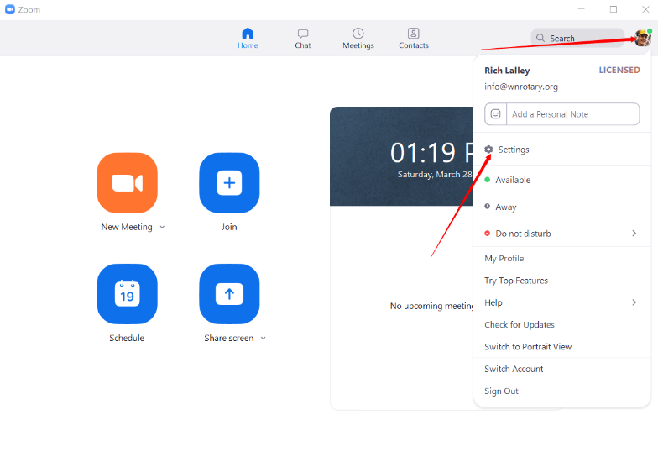
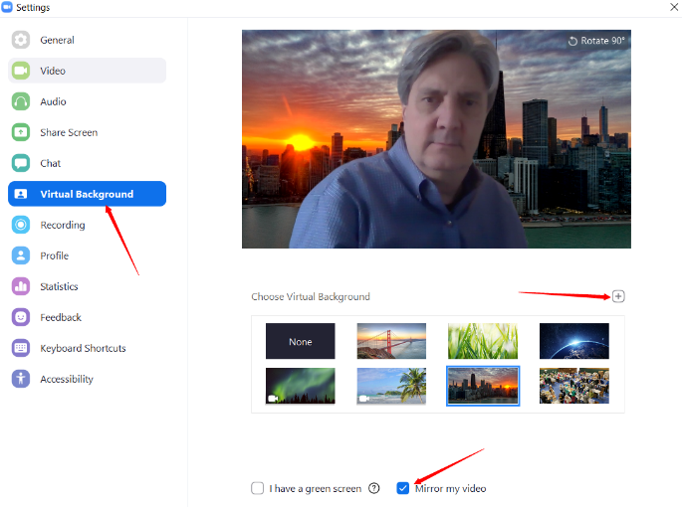
In Meeting Etiquette & Best Practices
Virtual Background
Open Zoom app and sign in if needed
Click on your photo/icon in upper left
Click on Settings
Click on Virtual Background
Click on desired photo or click on + to upload an image
Pro Tip: make sure Mirror My Video is checked
Pro Tip 2: Consider the impact on your personal brand/image when choosing a background

Slide 33
Scheduling a Meeting
Can do through app or website
Can make recurring
Instant meetings
Meetings settings
Invitations
Schedule reminder emails

Slide 34
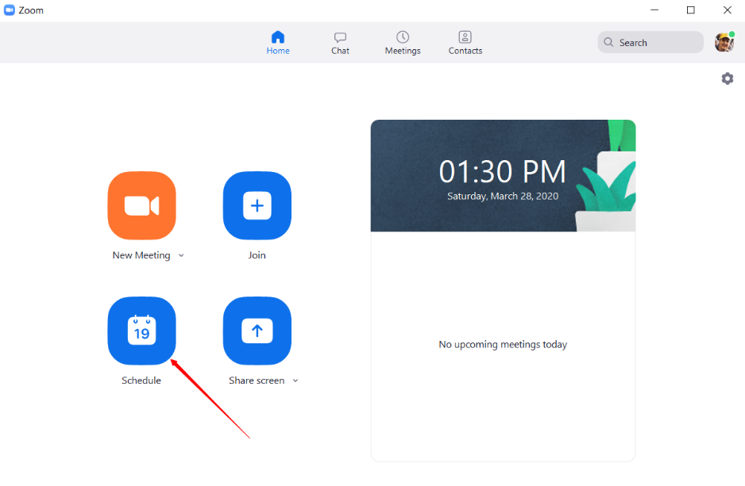
Scheduling a Meeting- App
Open Zoom App, sign in if needed
PC Pro Tip, pin Zoom icon to task bar if using often

Slide 35
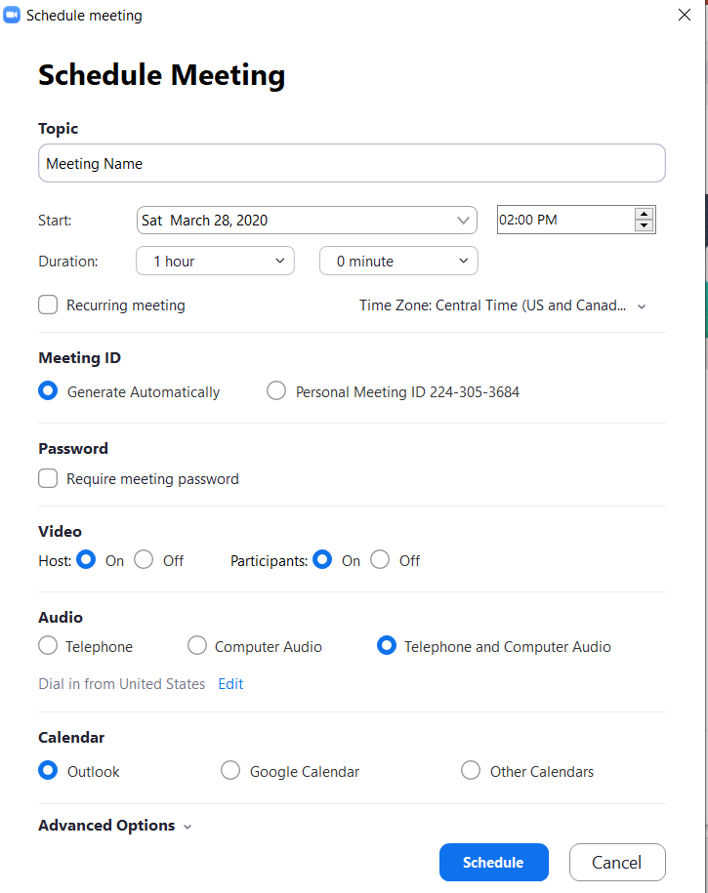
Scheduling a Meeting- App
Fill in all form fields
Note, can make recurring, so meeting occurs regularly with same meeting ID
Recommend Host & Participant Video be on
Best sound quality if only using computer audio
Select Calendar type to save meeting notifications

Slide 36
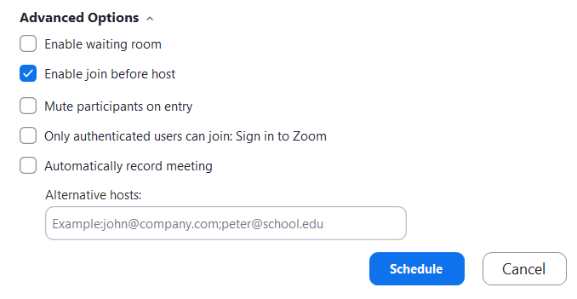
Scheduling a Meeting- App
Click Advanced Options for more settings.
For most Rotary meetings, okay to let people join before host (note: meeting links/IDs are always available and are not time sensitive unless the scheduler deletes the meeting from Zoom).
Waiting room has attendees holding until host joins.
Alternative hosts can be assigned, but if Pro user schedules, alternative hosts must have a Pro (paid) license.

Slide 37
Scheduling a Meeting- Website
Go to zoom.us, and sign in if needed
Click on My Account
Click on Schedule a meeting
Complete as previous instructions
Here a few tutorial videos:
https://www.youtube.com/watch?v=XhZW3iyXV9U

Slide 38
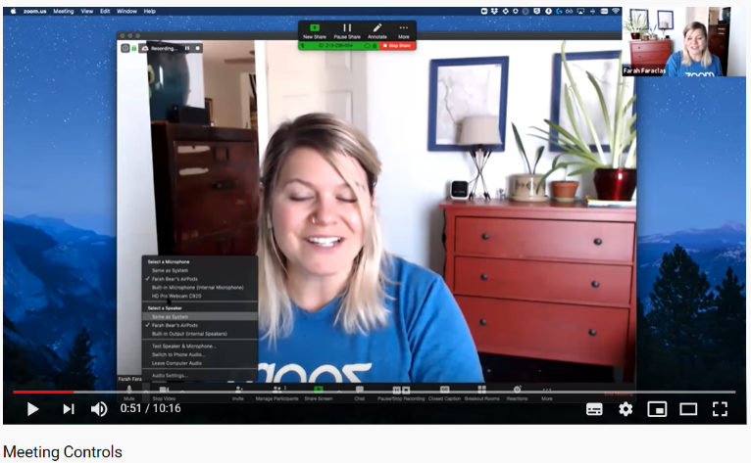
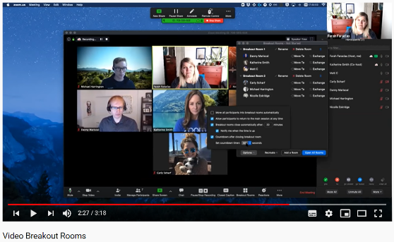
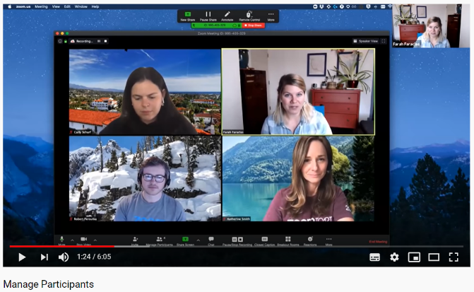
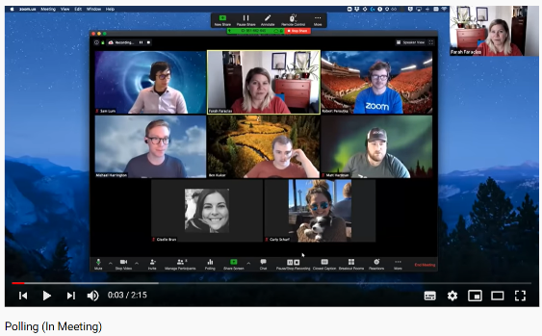
Zoom Meeting Controls
Excellent video on Host Meeting Controls
Video tutorial on Managing Participants
Tutorial on using Polls in Meeting
Tutorial on using Break Out Rooms

Slide 39
Next Steps
Sector work sessions over next 3 days
Work to get your club online
Training session
Club and/or social meetings
One on one help for those in need
Phone tree to reach those not responding to emails
Expand use to committees
Share successes with your AG

