Slide 1
Rotary Club of Fort Collins Breakfast
International Service Committee
Global Grants:
Potable Water in Ethiopia
District 5450 WASH Committee
June 5, 2017

Slide 2
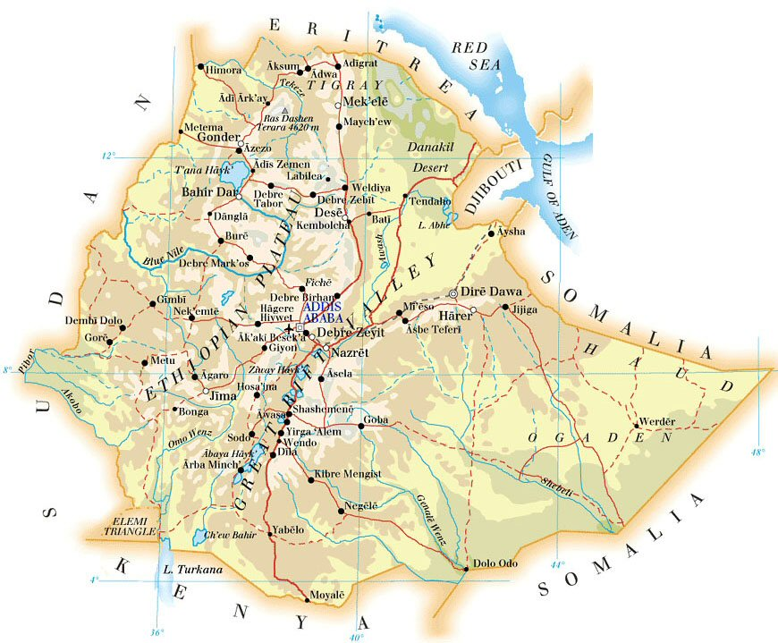

Slide 3
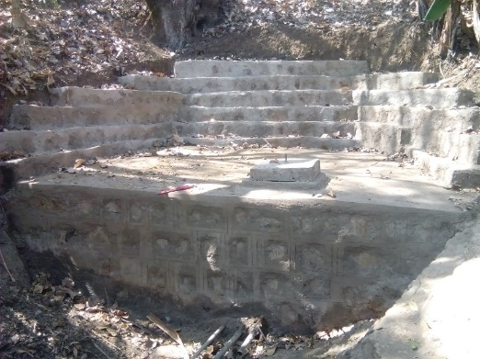
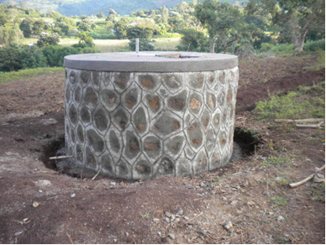
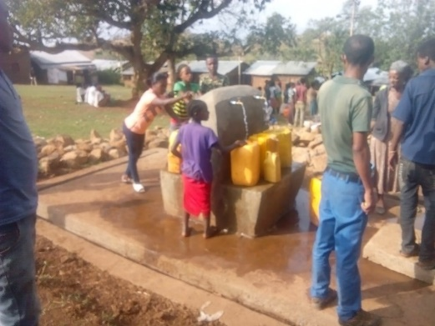
Global Grant 1524109
Aba-Reri, Bezabih Bayu, Channa
3 Springs - Gravity System
Spring Cap Reservoir Distribution Points
Benefits: 8,000 People
WASH Training
Cost: $73,650

Slide 4
Global Grant Proposal
Shota, Tulama, Nakire
3 Springs - Gravity System
Spring Cap Reservoir Distribution Points
Benefits: 1,700 People; 5,500 Livestock
WASH Training
Cost: $69,760
Need: $4,073

Slide 5
Requests
Identify Rotarians in District 5450 who have ties
to Ethiopia and preferably, Ethiopians:
Assist with communication
Ideas for new projects
Identify WASH training personnel in Ethiopia.
3. Partner with one or more clubs to participate
in a Global Grant: International Club and funding.

Slide 6
