Slide 1
Peace Corps Response SERVICe In the Country of Georgia and WASH IN Schools
An overview of how to continue your international volunteering through Peace Corps and address an urgent health need through Rotary service

Slide 2
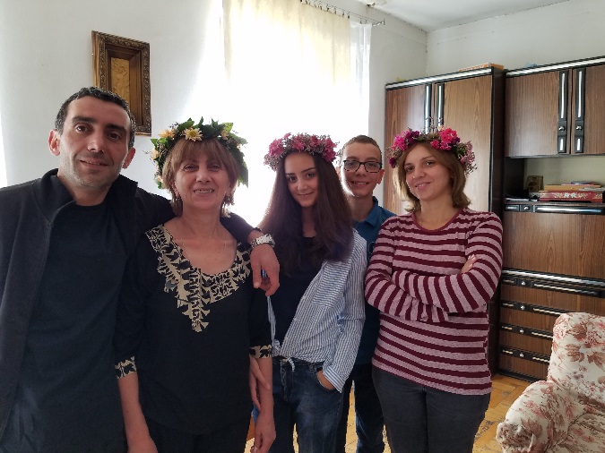
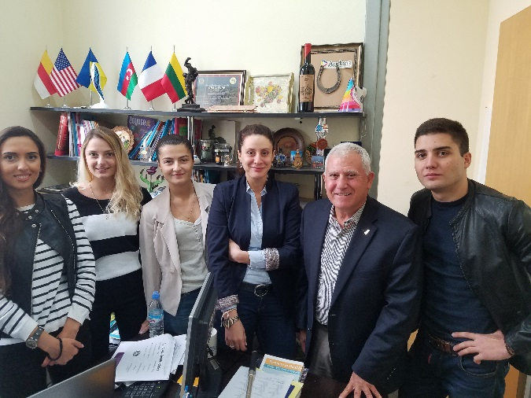
Peace Corps Response & WASh in Schools
Peace Corps is in about 90 countries around the world including Georgia
Many volunteers with experience serve as Peace Corps Response volunteers
Georgia would be considered an emerging nation
Volunteers live with a host family and work with counterpart staff
I worked at the Ministry of Sport and Youth Affairs

Slide 3
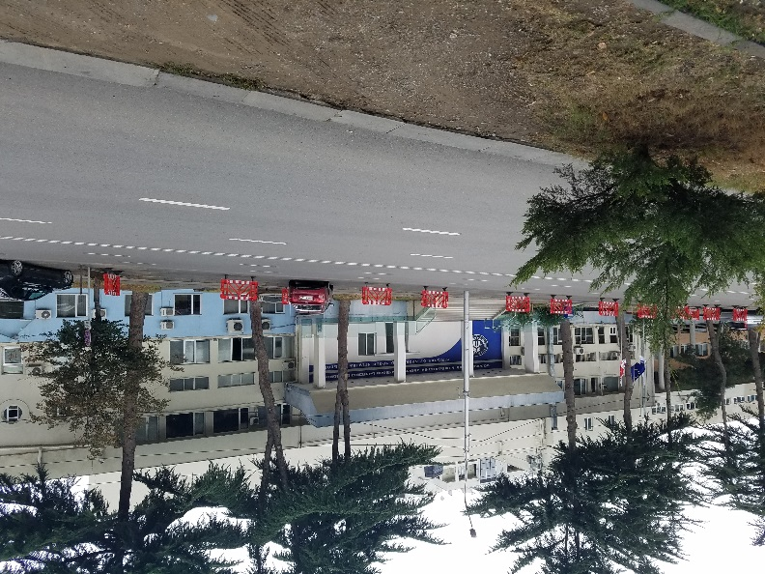
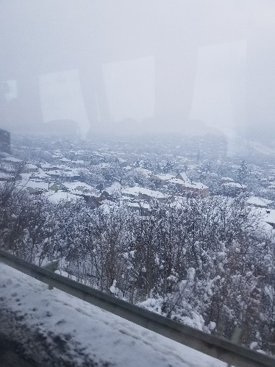
Peace Corps Response & WASh in Schools
Georgia is a pretty country with an interesting background since it is still overcoming 70 years in the Soviet Union
My primary service was teaching capacity- building to grow youth programs
My secondary project was helping to grow a USAID WASH in Schools program
Volunteers face challenges with the living conditions, weather and travel
But most challenges are connected to work and being away from family and friends

Slide 4
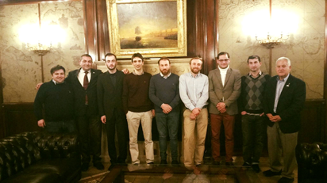
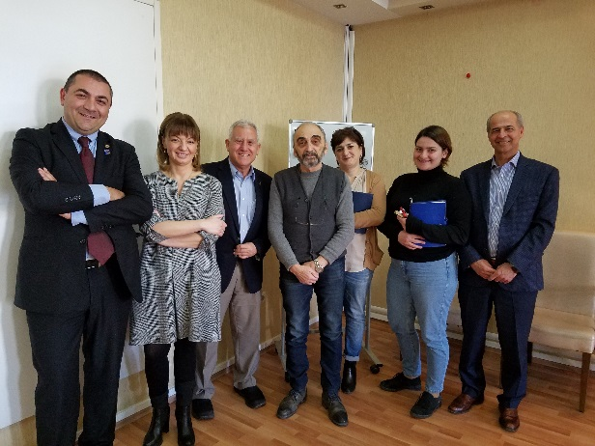
Peace Corps Response & WASh in Schools
Georgia is water rich country, but without any wastewater treatment
Drinking water is mainly snow melt but I would still filter the water because of frequent water stoppages.
Bottled water is plentiful, but they are just starting recycling of plastics and glass
Rotary has five clubs* in Georgia
They are doing many projects including helping with WASH in Schools

Slide 5
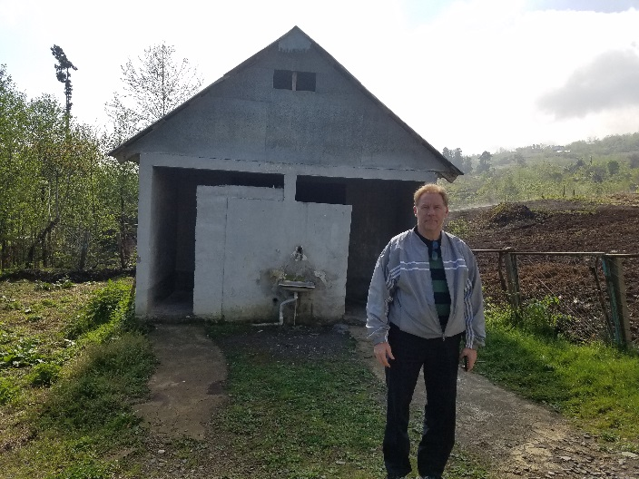
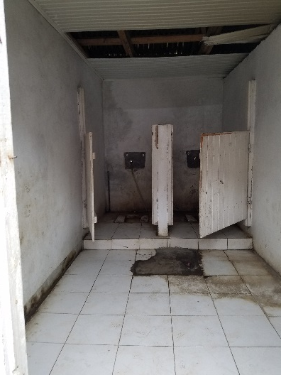
Peace Corps Response & WASh in Schools
Georgia is water rich country, but without any wastewater treatment
Drinking water is mainly snow melt but I would still filter the water because of frequent water stoppages.
Bottled water is plentiful, but they are just starting recycling of plastics and glass
Outdoor toilets and handwashing stations like in underdeveloped countries
Pit latrines poorly located and little education

Slide 6
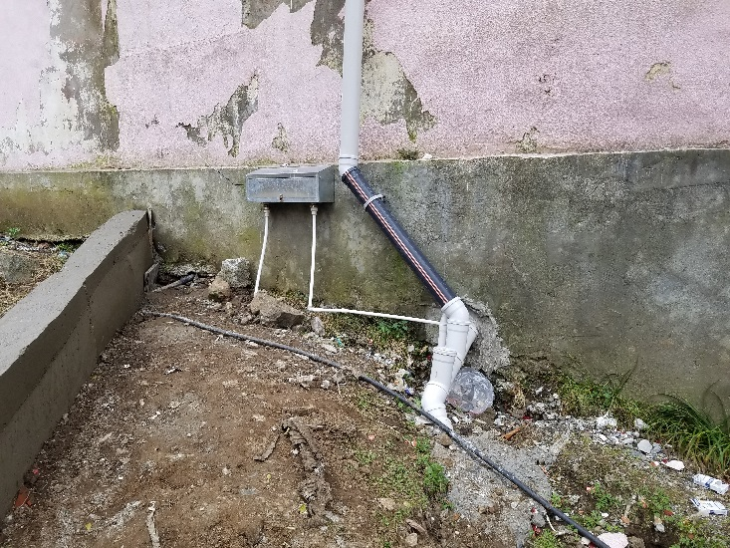
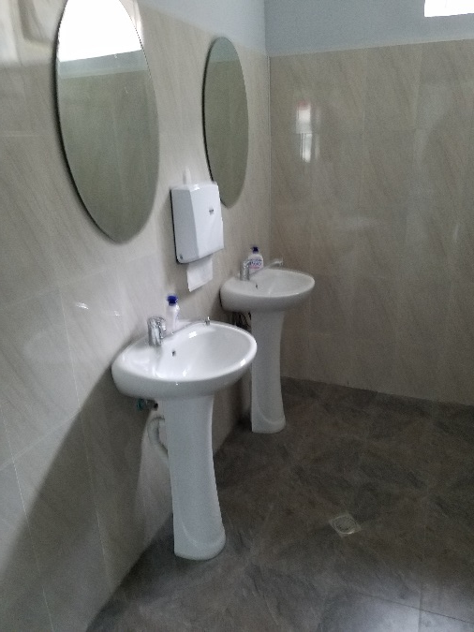
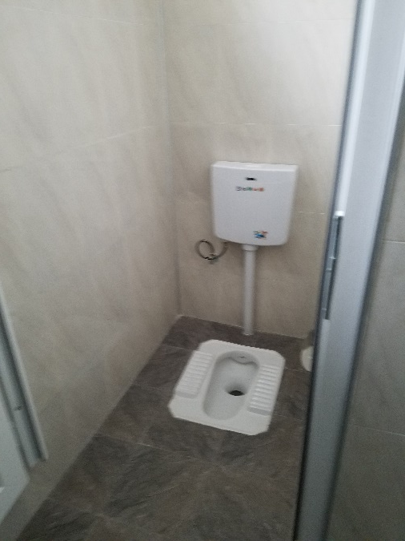
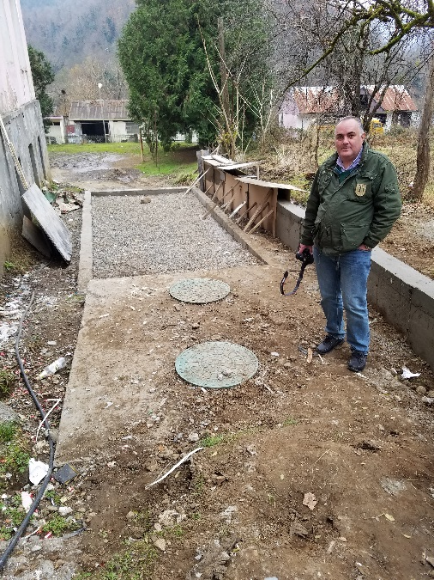
Peace Corps Response & WASh in Schools
Georgian Medical Group is focusing on community mobilization, hygiene education and improving infrastructure
Since there is no wastewater treatment, septic tanks and leach fields have been constructed.
Drinking water is mountain springs but treated with UV light.

Slide 7
Peace Corps Response & WASh in Schools
Georgian Medical Group has strong support from the Adjara Regional Government, primarily through the ministries of education and health.
GMG also works with municipal leaders, school staff and community leaders.
GMG also creates health clubs where older students teach younger students.
Other medical schools and associations provide volunteers and help.

Slide 8
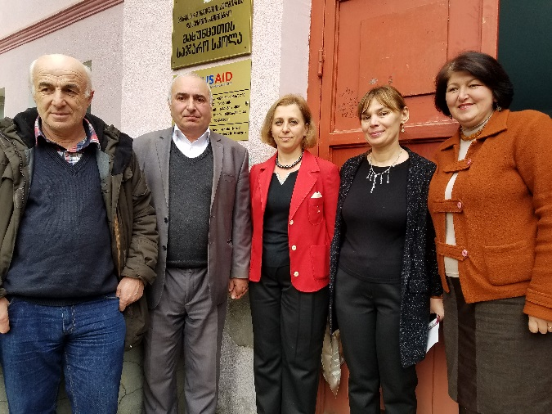
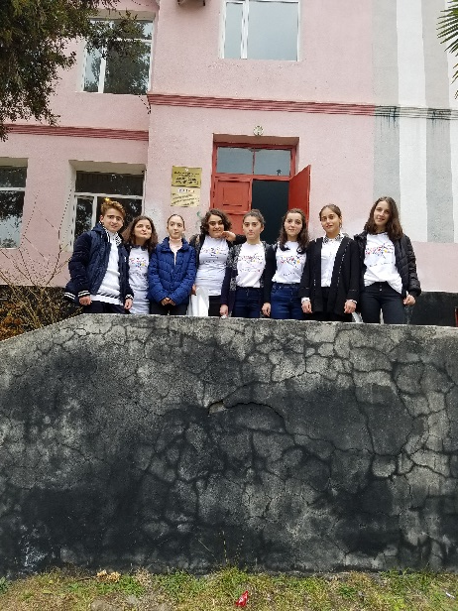
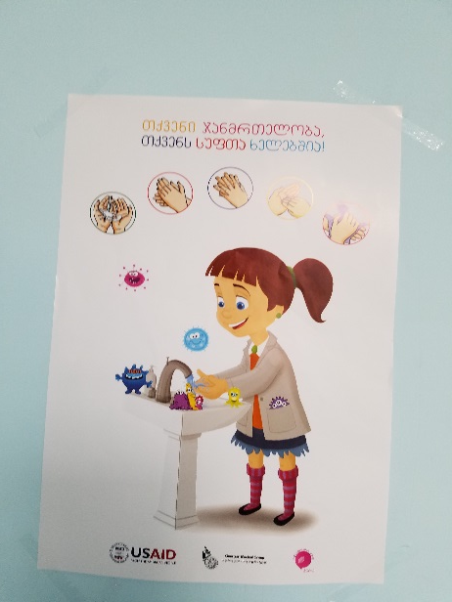
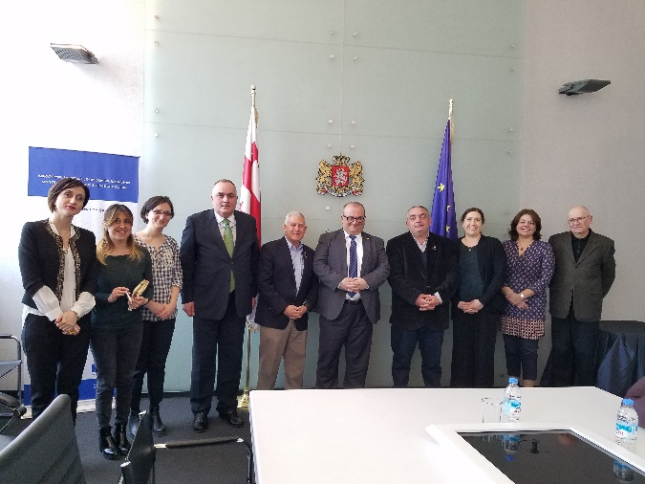
Peace Corps Response & WASh in Schools
To expand the work of the Georgian Medical Group within Adjara and to garner support after the USAID grant ends, a coalition was formed that includes Rotary clubs of Georgia, Rotary clubs of Colorado, CARE International and World Vision.
The idea of addressing needs beyond the Region of Adjara came about when the National Minister of Education, who is also a Deputy Prime Minister, publicly stated that he wants every school to have safe drinking water, proper sanitation and hygiene education leading to behavior change.

