Slide 1
District Rotary Grant
“Catch the Water”
Spring protections of 12 springs begun Sept. 2016 finished March 2017. $10,00 District Grant-$3000 Interact clubs= Total budget: $13,000

Slide 2
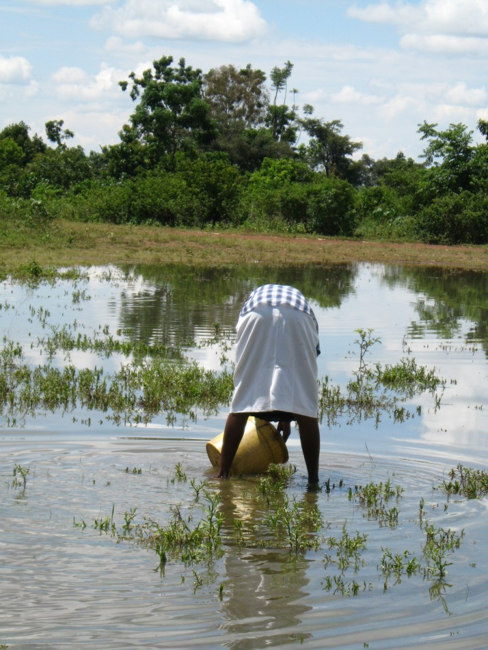
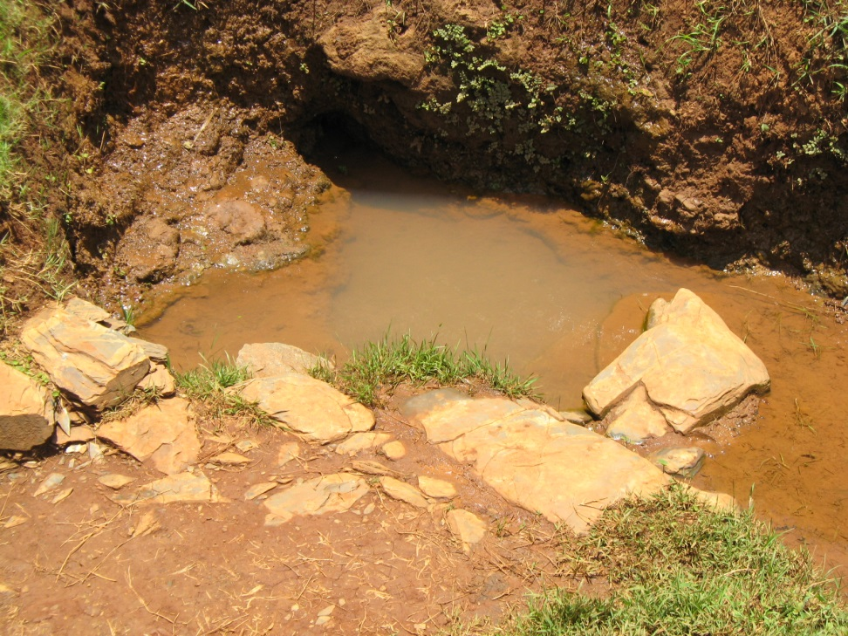
Before
All 12 springs not potable

Slide 3
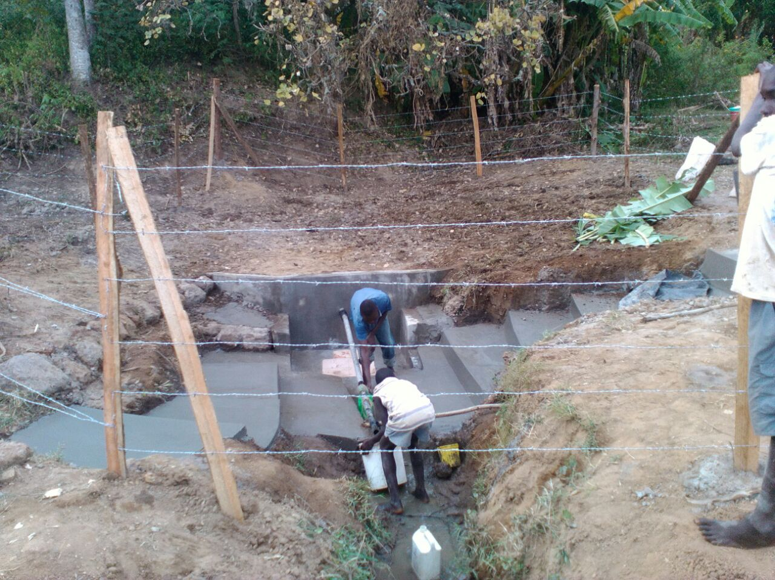
Finished Springs All Tested no Ecoli!

Slide 4
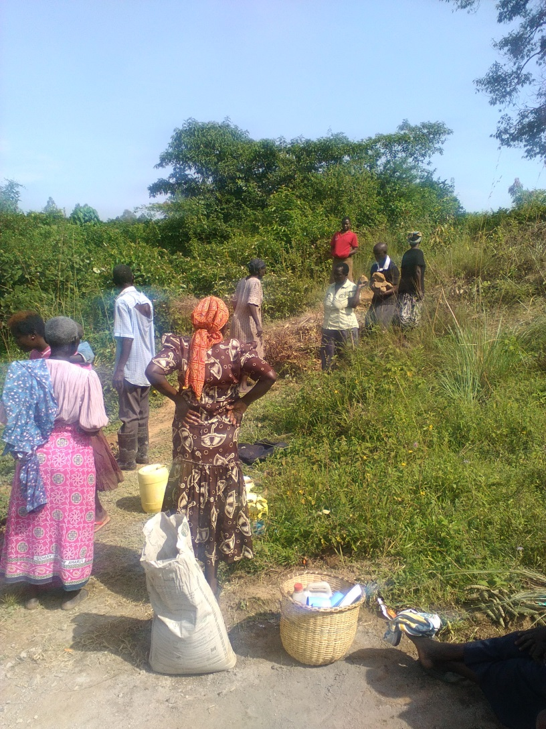
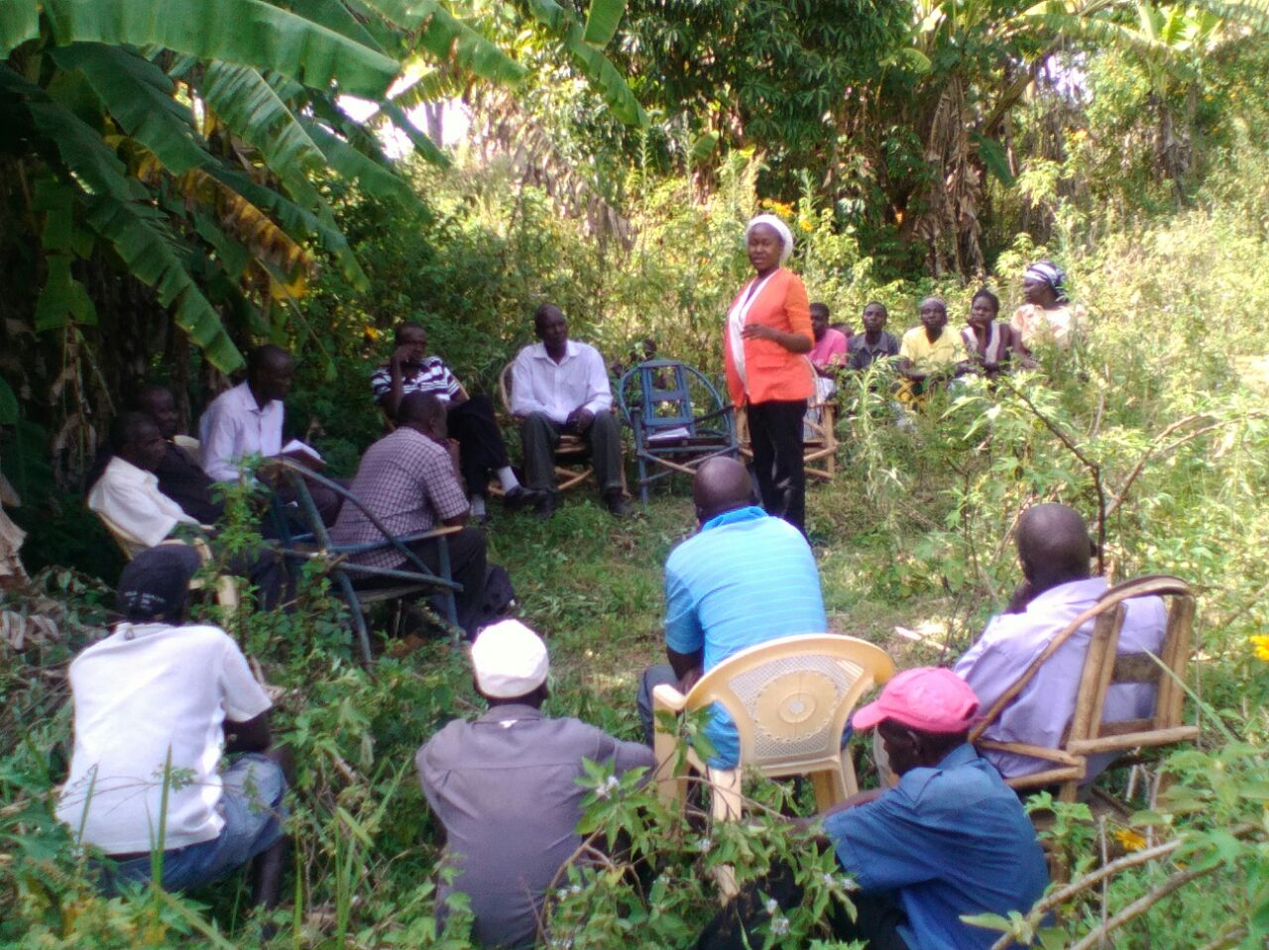
Owners Participate

Slide 5
Health Outcomes
1546 households served
Over 10,000 people served
Springs all test potable
Diarrhea down 67% after 6 months
Mortality down 63% after 6 months
Lunjere Spring after one year has dropped from 30 deaths in six months to two.

