Slide 1



Youth & At-Risk Protection
Fostering Safe Environments for all at-risk
Notes:
Introduce the session, note the audience (e.g., Presidents, Youth Chairs, Volunteers) Image: 2017 Ukraine Well-Being for Kids project
This presentation should provide some education,

Slide 2
Agenda
Why This Matters
Historical Importance
Rotaries Commitment
Yearly Compliance
Leadership Roles
NO, NOs & Suggested
Recognizing & Reporting
Real Consequences
Creating a Culture of Safety
Partnering Safely
Resources & Support
Contacts & Action Item

Slide 3
Why This Matters
Over 300,000 youth served annually by Rotary worldwide
Approximately 1 in 4 girls and 1 in 13 boys in the U.S. are estimated to experience child sexual abuse by the age of 18. (CDC, YMCA)
While precise "sexual harassment by volunteers" statistics are not always neatly isolated, the broader data on sexual abuse and misconduct in youth-serving organizations strongly indicates that volunteers contribute to these numbers. The risk is significant due to the nature of trust and access afforded to volunteers. This underscores the absolute necessity for robust youth protection policies, comprehensive background checks, mandatory training, and clear reporting mechanisms for all volunteers who interact with youth or at-risk individuals.
Abuse often occurs in trusted environments. Knowledge of the Perpetrator: A significant percentage of children who are sexually abused know their abuser.
Notes:
Emphasize why this policy exists, cite real stats, and connect to local relevance
Knowledge of the Perpetrator: A significant percentage of children who are sexually abused know their abuser. 90% of child victims know their abuser, 30% are abused by family members, 60% by people the family trusts, and 10% or less by a stranger.
Among adolescents who experienced sexual abuse in their lifetime, 5.3% of them were victims of sexual abuse by a coach, according to the National Institutes of Health (NIH). This highlights the potential risks even within seemingly safe and trusted environments. Knowledge of the Perpetrator: A significant percentage of children who are sexually abused know their abuser. 90% of child victims know their abuser, 30% are abused by family members, 60% by people the family trusts, and 10% or less by a stranger.

Slide 4
Historical Importance
Youth-serving groups are prime targets for abusers
Most abuse cases involve long-trusted adults
Rotary has seen past cases and adjusted policies to protect youth
Notes:
Provide real-world context to underscore policy evolution

Slide 5
Rotary’s Commitment
• Zero tolerance for *abuse and harassment
*“Abuse” means any willful act or threatened act that results in any physical, mental, or sexual abuse, injury, or harm that causes or is likely to cause the child's physical, mental, or emotional health to be significantly impaired.
• **Statement of Conduct for Working with Youth
• Applies to youth and at-risk individuals under 21
Side note: (please do not forget about our older adults that are at risk due to cognitive impairment)
**Rotary International strives to create and maintain a safe environment for all youth who participate in Rotary activities. To the best of their ability, Rotary members, their partners, and other volunteers must safeguard the children and young people with whom they come into contact and protect them from physical, sexual, and psychological abuse.
Notes:
Discuss Rotary International’s position and the weight of local responsibility

Slide 6
Yearly Compliance Procedures
1) If you are not going to be even incidentally working with an at-risk population then directly go to the Compliance Form on the District Website and complete such prior to August 20^{th.}
2) If you are possibly going to be even incidentally working with an at-risk population or will be sponsoring a program, then directly go to the review the Club Eligibility Requirement Flowchart and complete requirements prior to August 20^{th.}

Slide 7
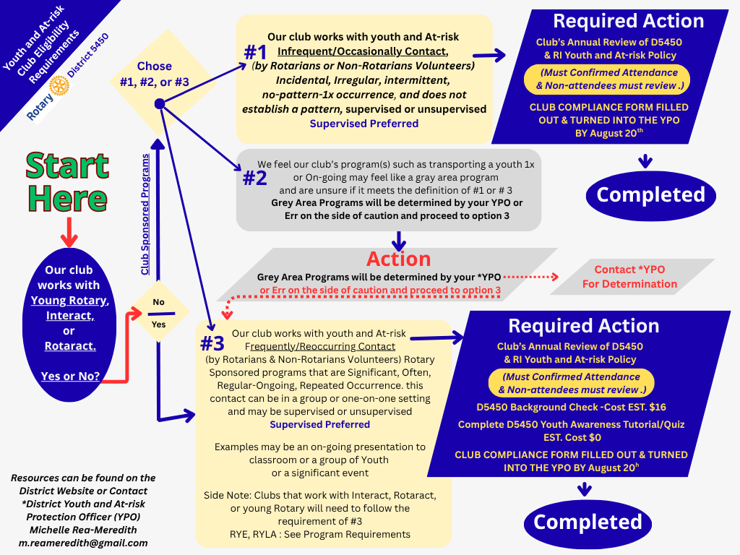
Notes:
Walk through each step, emphasizing consequences for missed deadlines

Slide 8
Leadership Roles & Accountability
• District Governor: oversight
• Youth Protection Officer: Educating, screening, investigations
• Club Presidents: implementation, volunteer supervision
Notes:
Emphasize shared responsibility, highlight escalation paths

Slide 9

What’s Not Allowed & few suggested best practices
NO, NOs
No unsupervised one-on-one adult-youth interactions
No private overnight stays with youth
No grooming behaviors or favoritism
SUGGESTED:
Two-Deep Leadership
Rule of Three
No Private Contact: Avoid one-on-one interactions, including digital communications. Communications should include a parent or another adult, ensuring no private exchanges occur via email, text, or social media.
Physical Boundaries: Avoid unnecessary physical contact and always respect personal space.
Transport Rules: Youth should not be transported alone by a single adult.
Overnight Stays: Require written parent/guardian consent and approved supervision for overnight activities.
Social Media Guidelines: Communicate only through approved channels with parent oversight and treat all online interactions as public.
Notes:
Provide examples and make this practical for event volunteers

Slide 10
Recognizing & Reporting
First priority: Ensure youth safety
Emergency? Call local law enforcement
Call your YPO - ASAP
Reports must be submitted within 72 hours
Report to: youthprotection@rotary.org | +1 866-976-8279
Notes:
Normalize reporting, remove fear of reprisal, encourage early action

Slide 11
Real Consequences
Noncompliance = suspension or loss of Youth Exchange certification
Abusers permanently banned from Rotary participation
By not educating our Clubs we put our members non-members at-risk for possible criminal and civil litigation
By not being in compliance we put our District and RI at risk and possibly liable
Notes:
Policies are serious and enforced—your actions matter

Slide 12

Creating a Culture of Safety
Education early, often, and with transparency
1
Reinforce respectful communication and inclusiveness
2
Monitor volunteers and environments regularly
3
Notes:
Focus on creating a community, not just enforcing rules

Slide 13

Partnering Safely
Partner organizations must:
Have equivalent policies
Educate & vet volunteers
Share responsibilities through written MOU (Memorandum of Understanding)
Notes:
Don’t assume external groups are safe—verify and formalize

Slide 14
Resources & Support
Rotary Youth Protection Guide
Youth Protection Quiz and Tutorial
The District Crisis Management Plan and Clubs’ Plan
Online Classes with RI and Zone
Online courses: Harassment Prevention, DEI, LGBTQ+ Support
District YPO
D5450 Youth & At-Risk Protection Policy
Rotary Code of Policies, section 2.120
Electronic and Online Safety Considerations
Developing a Crisis Management Plan
District Crisi Policy
District 5450 Website –Youth Protection
Notes:
Show where to get help—point to website or give printed handouts

Slide 15
Contacts & Action Item
Rotary Youth Protection: youthprotection@rotary.org | +1 866-976-8279
District 5450 Youth& At Risk Protection Officer (YPO) Michelle Rea-Meredith|
M.ReaMeredith@gmail.com
• Submit compliance by August 20th to YPO
Notes:
End with a call to action—'Who here is responsible in your club?'

