Slide 1



Youth & At-Risk Protection
Fostering Safe Environments for all at-risk
Notes:
Introduce the session, note the audience (e.g., Presidents, Youth Chairs, Volunteers) Image: 2017 Ukraine Well-Being for Kids project
This presentation should provide some education. Note: this presentation is heavy Youth being at risk but there are several populations that can be at risk and need are moral armor.

Slide 2

Agenda
Why This Matters
Historical Importance
Rotaries Commitment
Yearly Compliance
Leadership Roles
NO, NOs & Suggested
Recognizing & Reporting
Real Consequences
Creating a Culture of Safety
Partnering Safely
Resources & Support
Contacts & Action Item

Slide 3
Why This Matters
Our Moral Armor: Protecting youth and at-risk populations is a vital duty for all Rotarians. A Universal Crisis: National data shows 1 in 4 girls and 1 in 13 boys experience abuse before adulthood. Heightened Vulnerability: At-risk groups, including Older Adults and Developmental At-risk face significantly higher threats than their peers. The "Trust" Factor: 90% of abuse is committed by known individuals (family, teachers, or volunteers) rather than strangers. The Circle of Care: For seniors and those with disabilities, abuse most frequently occurs within their trusted daily networks. Rotary’s Impact: Serving 300,000 youth annually, we must act to protect the thousands statistically at risk within our reach. Prevention Power: Mandatory training, background checks, and robust policies are essential to safeguard the trust given to volunteers.
Notes:
Point out that if Rotary works with over 300,000 youth and 1 in 4 girls and 1-9 boys will be victimized the math is alarming 15,000 girls and 23,000 boys for a total of 38,000 youth, and mind you this is only one forms of abuse and one population.
Emphasize why this policy exists, cite real stats, and connect to local relevance
Knowledge of the Perpetrator: A significant percentage of children who are sexually abused know their abuser. 90% of child victims know their abuser, 30% are abused by family members, 60% by people the family trusts, and 10% or less by a stranger.
Among adolescents who experienced sexual abuse in their lifetime, 5.3% of them were victims of sexual abuse by a coach, according to the National Institutes of Health (NIH). This highlights the potential risks even within seemingly safe and trusted environments. Knowledge of the Perpetrator: A significant percentage of children who are sexually abused know their abuser. 90% of child victims know their abuser, 30% are abused by family members, 60% by people the family trusts, and 10% or less by a stranger.

Slide 4
Historical Importance
Youth-serving groups are prime targets for abusers
01
Most abuse cases involve long-trusted adults
02
Rotary has seen past cases and adjusted policies to protect youth
03
Notes:
Provide real-world context to underscore policy evolution

Slide 5
Rotary’s Commitment
• Zero tolerance for *abuse and harassment
*“Abuse” means any willful act or threatened act that results in any physical, mental, or sexual abuse, injury, or harm that causes or is likely to cause the child's physical, mental, or emotional health to be significantly impaired.
• **Statement of Conduct for Working with Youth
• Applies to youth and at-risk individuals under 21
Side note: (please do not forget about our older adults that are at risk due to cognitive impairment)
**Rotary International strives to create and maintain a safe environment for all youth who participate in Rotary activities. To the best of their ability, Rotary members, their partners, and other volunteers must safeguard the children and young people with whom they come into contact and protect them from physical, sexual, and psychological abuse.
Notes:
Discuss Rotary International’s position and the weight of local responsibility

Slide 6

Compliance Requirements: Every Club, Every Year
Mandatory Review: All clubs must review the Club Eligibility Requirement Flow Chart and the D5450 & RI Youth & At-Risk Policy.
Annual Compliance Form: Every club must submit the Online Compliance Form for the 2026–2027 Rotary year.
Exemption Process: Clubs with no anticipated youth or at-risk contact must still file by selecting the "Exemption" box, listing service projects, and signing.
Ongoing Responsibility: If your club begins working with these populations later in the year, you must immediately contact Youth Protection.
Notes:
EVERY CLUB-EVERY YEAR: All clubs with or without Programs must review the Club Eligibility Requirement Flow Chart,
and complete the Online Compliance Form
Even if your club anticipates no contact with youth or at-risk adults for the 2026–2027 Rotary year, you are still
required to submit the online Club Compliance Form. To do so, simply select the "Exemption" box, provide your club’s
name and current service projects, and complete the signature section. Additionally, all clubs must review the D5450 & RI
Youth & At-Risk Policy; please confirm your attendance or, if you missed the session, ensure you review the policy
independently. No further action is needed unless your club begins working with these populations, at which point you
must immediately contact Youth Protection.

Slide 7
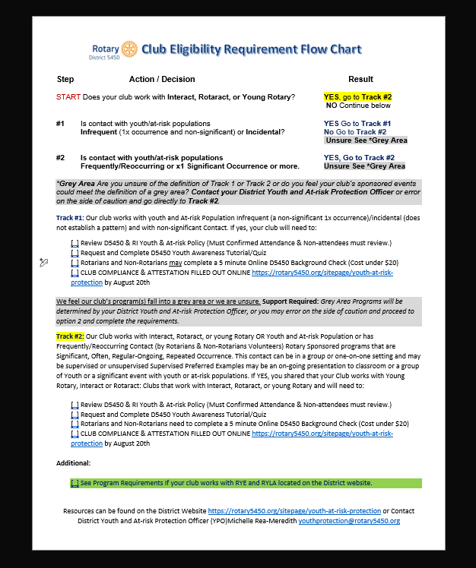
Start with this form can be
found on the
District 5450
Website (Click Here)
Notes:
This basically the first step and can be found at https://clubrunner.blob.core.windows.net/00000050085/en-ca/files/sitepage/youth-at-risk-protection/club-eligibility-requirement-flow-chart/Club-Eligibility-Requirement-Flow-Chart-2026-2027.pdf

Slide 8
Leadership Roles & Accountability
• District Governor: Oversight
• Youth Protection Officer: Educating, screening, investigations
• Club Presidents: Implementation, volunteer supervision
Notes:
Emphasize shared responsibility, highlight escalation paths

Slide 9
Best Practices
Category | RI / District Mandates (Required) | Suggested Best Practices (Recommended) | “NO, NOs”
Supervision | Two-Deep Leadership: At least two vetted adults must be present at every Rotary activity. | The "Rule of Three": Aim for three people at all times (e.g., two adults and one youth, or one adult and two youth). | No unsupervised one-on-one adult-youth interactions
Communication | Transparency: All digital contact must include a parent or a second vetted adult. | Public Channels Only: Use official club platforms or group chats rather than personal cell phone numbers. | No private overnight stays with youth
Transport | No Solo Transport: An adult cannot drive a youth/at-risk adult alone. | Central Drop-off: Require parents to drop off/pick up at a public location to avoid home visits. | No grooming behaviors or favoritism
Environment | Visibility: Meetings must be observable (open doors or windows). | Public Spaces: Whenever possible, hold meetings in high-traffic areas (libraries, cafes, community centers). | No "Off-Book" Communication: Private messaging or social media interaction without parent/guardian inclusion is strictly prohibited.
Physicality | Zero Inappropriate Contact: Strictly follow the Statement of Conduct. | The "Handshake Rule": Limit physical contact to professional gestures like handshakes or high-fives.
Notes:
NO, NOs
No unsupervised one-on-one adult-youth interactions
No private overnight stays with youth
No grooming behaviors or favoritism
No "Off-Book" Communication: Private messaging or social media interaction without parent/guardian inclusion is strictly prohibited.
Two-Deep Leadership
Rule of Three
No Private Contact: Avoid one-on-one interactions, including digital communications. Communications should include a parent or another adult, ensuring no private exchanges occur via email, text, or social media.
Physical Boundaries: Avoid unnecessary physical contact and always respect personal space.
Transport Rules: Youth should not be transported alone by a single adult.
Overnight Stays: Require written parent/guardian consent and approved supervision for overnight activities.
Social Media Guidelines: Communicate only through approved channels with parent oversight and treat all online interactions as public.
rovide examples and make this practical for event volunteers

Slide 10
Recognizing & Reporting
First priority: Ensure youth safety
Emergency? Call local law enforcement
Call your YPO - ASAP
Reports must be submitted within 72 hours
Report to: youthprotection@rotary.org | +1 866-976-8279
Notes:
Normalize reporting, remove fear of reprisal, encourage early action

Slide 11
Real Consequences
Noncompliance = suspension or loss of Youth Exchange certification
Abusers permanently banned from Rotary participation
By not educating our Clubs we put our members non-members at-risk for possible criminal and civil litigation
By not being in compliance we put our District and RI at risk and possibly liable
Notes:
Policies are serious and enforced—your actions matter

Slide 12

Creating a Culture of Safety
Education early, often, and with transparency
1
Reinforce respectful communication and inclusiveness
2
Monitor volunteers and environments regularly
3
Notes:
Focus on creating a community, not just enforcing rules

Slide 13


Partnering Safely
Partner organizations must:
Have equivalent policies
Educate & vet volunteers
Share responsibilities through written MOU (Memorandum of Understanding)
Notes:
Don’t assume external groups are safe—verify and formalize

Slide 14
Resources & Support
Rotary Youth Protection Guide
Youth Protection Quiz and Tutorial
The District Crisis Management Plan and Clubs’ Plan
Online Classes with RI and Zone
Online courses: Harassment Prevention, DEI, LGBTQ+ Support
District YPO
D5450 Youth & At-Risk Protection Policy
Rotary Code of Policies, section 2.120
Electronic and Online Safety Considerations
Developing a Crisis Management Plan
District Crisi Policy
District 5450 Website –Youth Protection
Notes:
Show where to get help—point to website or give printed handouts

Slide 15
Contacts & Action Item
Rotary Youth Protection: youthprotection@rotary.org
+1 866-976-8279
District 5450 Youth& At Risk Protection Officer (YPO) Michelle Rea-Meredith
youthprotection@rotary5450.org
Submit compliance by
August 20th to YPO
Notes:
End with a call to action—'Who here is responsible in your club?'

