Slide 1
Global Grants
Ronald Smith, PDG VTT Team Leader
D-7430 In’tl Service Committee
Notes:
This presentation will provide an overview of global grants and present ten ways that you can improve your global grant application.

Slide 2


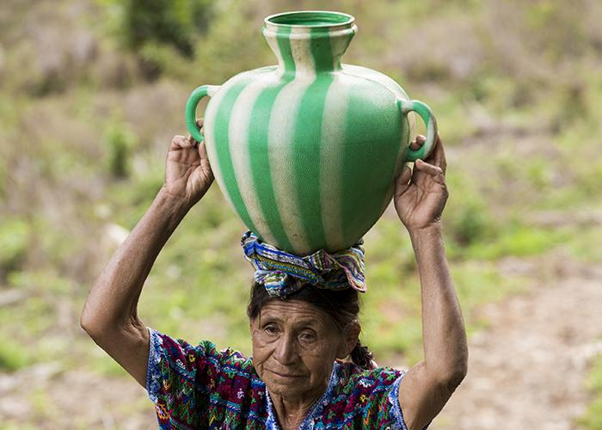
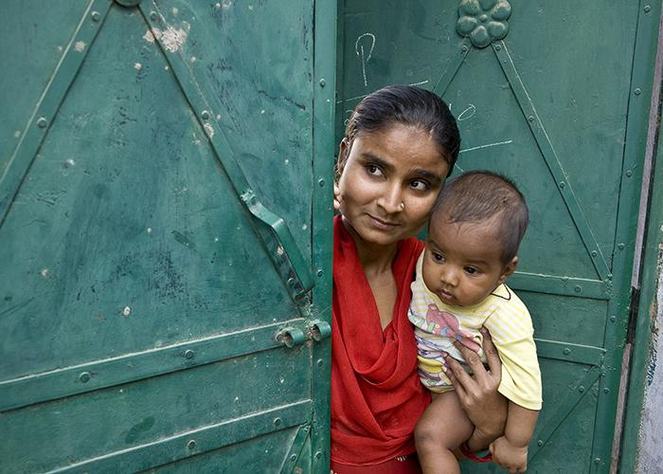


ROTARY’S CAUSES / AREAS OF FOCUS
Providing
Water.Sanitation
& Hygiene
Promoting Peace
Preventing
Disease
Saving Mothers & Children
Supporting Education
Growing
Economies
Notes:
We have identified specific causes to target to maximize our local and global impact. Through global grants we help clubs focus their service efforts in the following areas:
Peace and conflict prevention/resolution
Disease prevention and treatment
Water and sanitation
Maternal and child health
Basic education and literacy
Economic and community development

Slide 3

GLOBAL GRANTS
Large, long-term projects > $30K
Alignment with areas of focus
International partnership
World Fund match
  1:1 for DDF
  $0.50 / $1.00 for Cash
Sustainable, measurable outcomes
Notes:
Global grants support large international activities with sustainable, measurable outcomes in Rotary’s areas of focus. A key feature of global grants is partnership, between the district or club where the activity is carried out and a district or club in another country. Both sponsors must be qualified before they can submit an application.
The minimum budget for a global grant activity is $30,000. The Foundation’s World Fund provides a minimum of $15,000 and maximum of $200,000. Clubs and districts contribute District Designated Funds (DDF) and/or cash contributions that the World Fund matches. DDF is matched at 100% and cash is matched at 50%.

Slide 4


Key Elements
An Idea - Vision
Partners
  Passionate
  Committed / Approved & Qualified by their District
  Experienced
Meets Community Needs
  Assessments / Visits
  Measurements / Data
Financing / Commitment
  Host & International Partners
  Cooperating Organizations

Slide 5
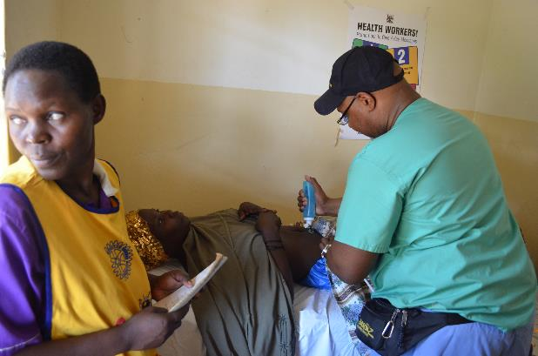
Vision… Action
A need is identified
A Vision of project develops
Pulling together the partners
Community assessments are made
A Vision evolves consistent with community assessment
Cooperating organizations are identified
Notes:
The following resources are available to assist you as you complete your global grant application:
www.rotary.org/myrotary/grants
Grant Management Manual
A handout that walks you through the steps of using the online system to apply for a global grant
Rotary’s Learning Center
Rotary Support Center
Grants staff

Slide 6
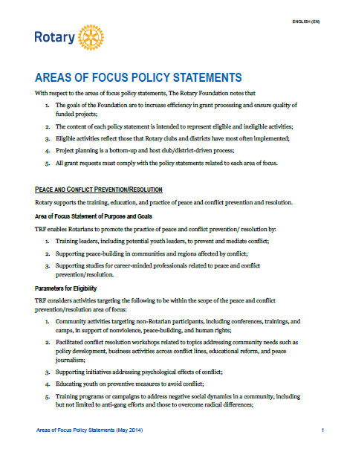
FITS At least one AREA OF FOCUS
Review areas of focus policy
statements
Identify most appropriate area of
focus based on needs assessment
Design project based on identified
area of focus
Ensure that all project activities
relate to the area of focus goals
Notes:
Review the Areas of Focus policy statements. Based on needs assessment, identify just one (or only the most appropriate) area of focus. Avoid taking a “fully-baked” project and fitting it into one of the areas of focus. Change the approach to project design. Work and think through the policy statements before designing projects. All project activities should relate directly to the area of focus goals.

Slide 7
TERMS AND CONDITIONS FOR ROTARY FOUNDATION GRANTS
Review T&C’s
Assure purchases, cooperating
organizations meet criteria
Make sure funds can be used for
specific purposes
Make sure there are no restrictions
on use of funds
Simple Schools & Low Cost Shelter
exemptions
Notes:
Review the Areas of Focus policy statements. Based on needs assessment, identify just one (or only the most appropriate) area of focus. Avoid taking a “fully-baked” project and fitting it into one of the areas of focus. Change the approach to project design. Work and think through the policy statements before designing projects. All project activities should relate directly to the area of focus goals.

Slide 8
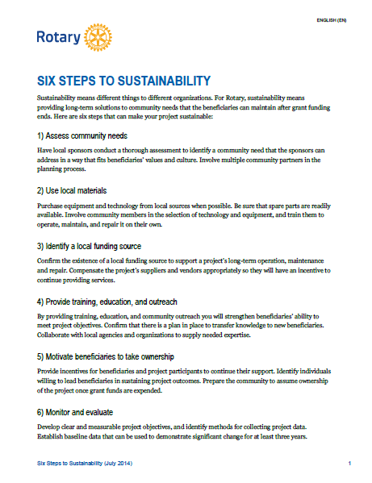
Is SUSTAINABLE
Clearly explain specific sustainability components…
Notes:
Clearly explain specific sustainability components. We have a handout entitled “Six Steps to Sustainability” that provides helpful guidance about how to make your project more sustainable.

Slide 9
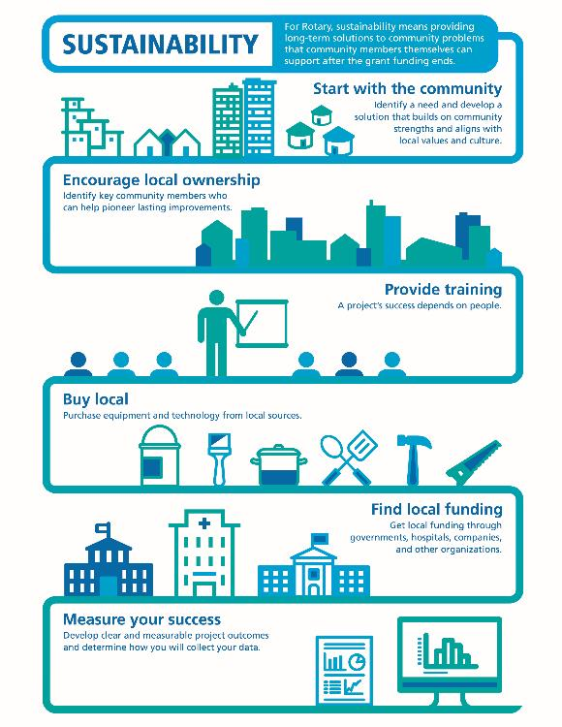
SUSTAINABILITY
Sustainability means different
things to different organizations.
For Rotary, sustainability
means providing long-term
solutions to community
needs that the beneficiaries
can maintain after grant
funding ends.
Notes:
Sustainability means different things to different organizations. For Rotary, sustainability means providing long-term solutions to community needs that the beneficiaries can maintain after grant funding ends.
To help Rotary members understand what we mean by sustainability, we’ve identified six steps that can help to ensure the long-term sustainability of a project.

Slide 10
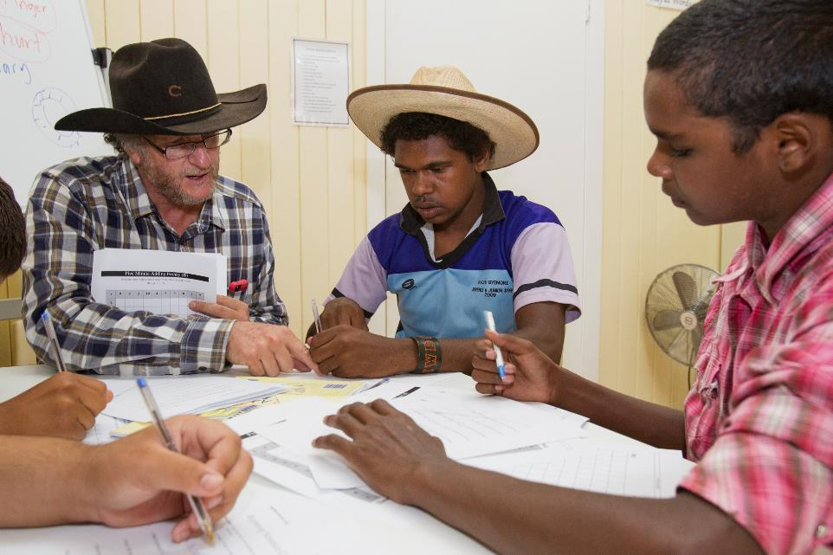
DETAILED PROJECT PLAN
Provide detailed project implementation plan
Involve beneficiaries in project design
Develop
Budget
Complete
Financing
Plan
Notes:
Provide a detailed project implementation plan that encompasses all aspects of the proposed project activity. Ensure that beneficiaries were involved in project design.

Slide 11
How to Fund a Project
Club/ Donor(s) (cash)
District(s) (cash & DDF)
Partners (cash and in-kind)
Other Sources
  Rotary Ideas
  Crowd funding sources
  Corporate
  Other Foundations – Action Groups
Build a Budget / Host-Intl partners agree
In Grant Center enter Budget & Financing

Slide 12
Proposal Steps
Club / District Grant Committee Communication
  Interest
  Plans / Outline
  Proposal Brief
Draft Proposal
  Review with Partners
  Seek Experienced Assistance
District Approval
  Club qualification & MoU
  DDF allocation / financing plan approved
Proceed to Grant Center

Slide 13
Advice & Input to Planning
District Grant Committee Experts
  District committee review and input
  District / Local “Coaching-Mentoring Teams”
Experienced Rotarians
Regional Grant Officers (28 regions)
Rotary Action Groups
Partner organizations
RI’s Tech Cadre

Slide 14
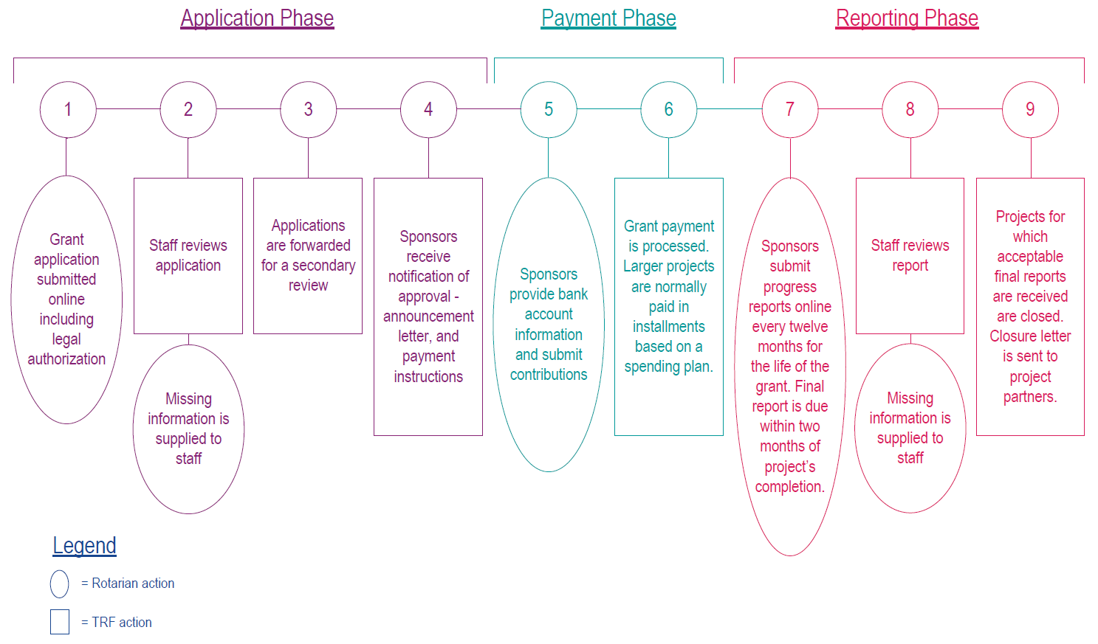
GLOBAL GRANT LIFECYCLE
Notes:
Application process -> Staff Review -> Questions -> Continued Staff Review -> Approve or Decline
If Approved, Primary contacts enter bank account information and submit to TRF. Payment staff process payment.

Slide 15
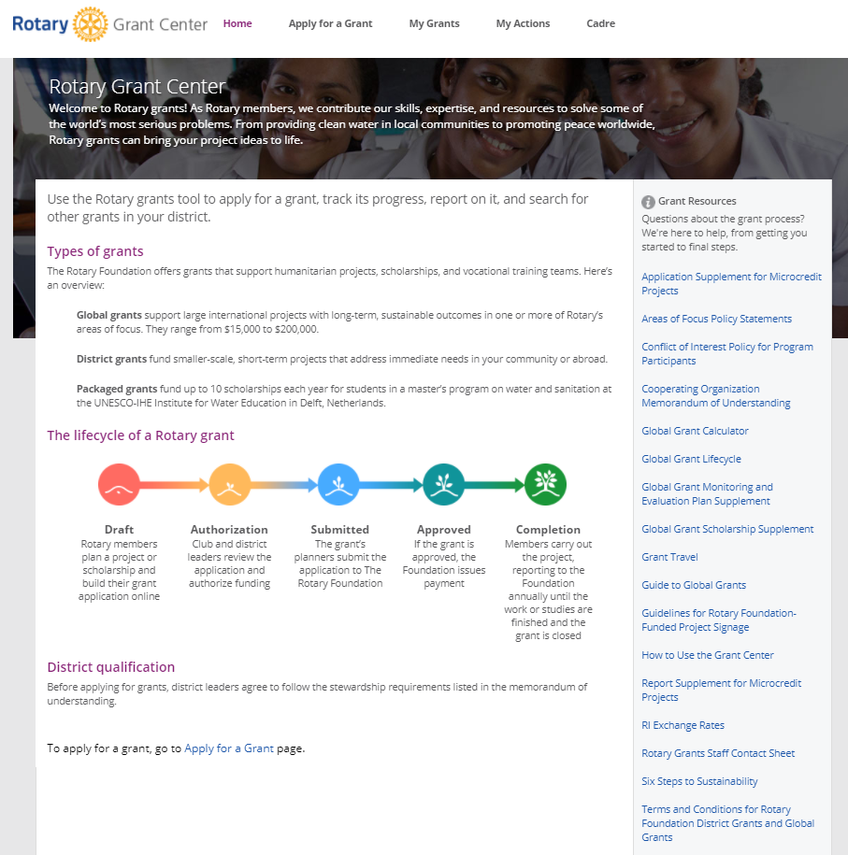
GLOBAL GRANT APPLICATION
Applications submitted online: www.rotary.org/grants
New Grant Center started 2016
No application deadlines, except for scholarships (30 June)
Submit applications at least 90
days prior to travel
Notes:
Global grant applications are submitted online. The grant application tool is accessible by going to www.rotary.org/grants. Applications are accepted on a rolling basis throughout the year; there are no application deadlines. However, if your application includes travel, please ensure that it is submitted at least 90 days before the travel is scheduled to begin.
The following slides will discuss ten ways that you can improve your global grant application.

Slide 16
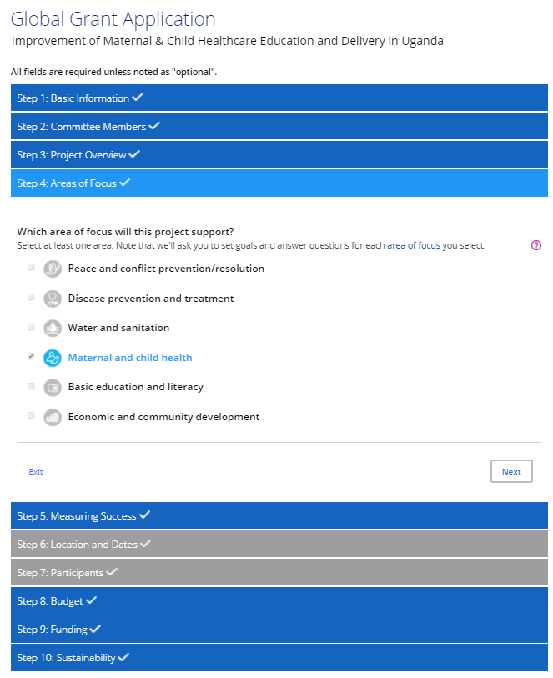
The Grant Application
A Proposal is Drafted
Proposals are approved in clubs
and districts
Global Grant application entered /
reviewed by partners
Districts Approve Global Grant /
submission
Rotary Review
Resolve Questions on Grant
Notes:
The following resources are available to assist you as you complete your global grant application:
www.rotary.org/myrotary/grants
Grant Management Manual
A handout that walks you through the steps of using the online system to apply for a global grant
Rotary’s Learning Center
Rotary Support Center
Grants staff

Slide 17
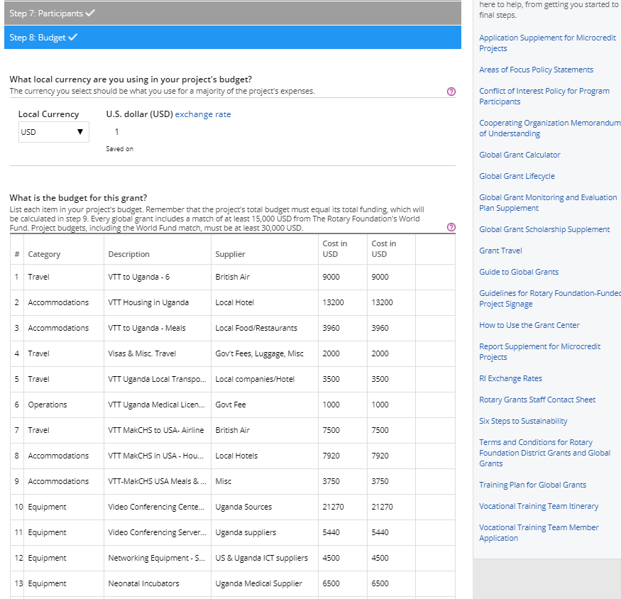
BUDGET
Provide detailed budget
Include vendor information and explain how vendors were selected
Notes:
Provide a detailed budget with vendor information and information about how these vendors were selected. The image on the screen shows where you will enter the budget information in the online application.

Slide 18
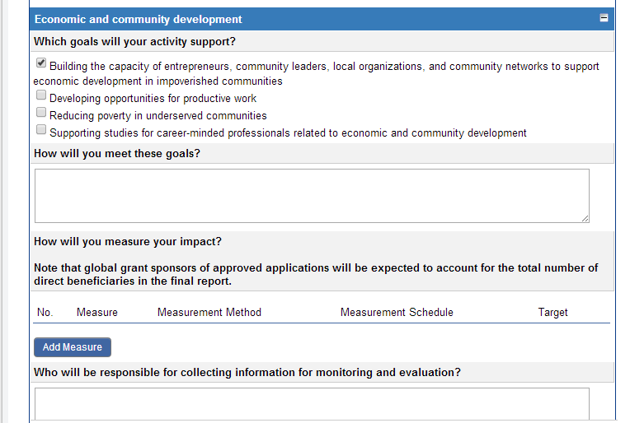
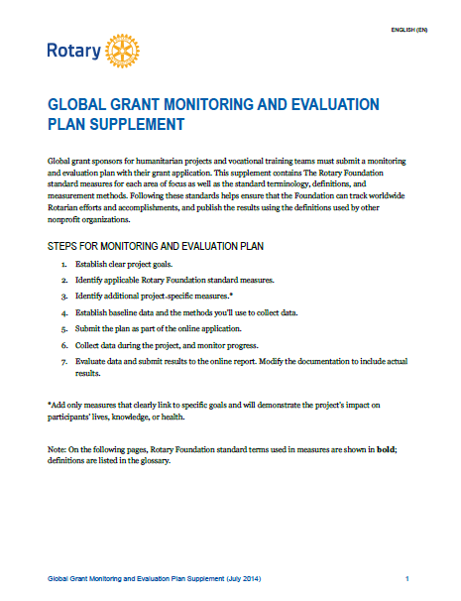
MEASUREMENT AND EVALUATION
Include specific information related to measurement and evaluation
Notes:
Include specific information related to measurement and evaluation. The image on the screen shows where you will enter this information into the online system. We have resource materials to help you design your measurement and evaluation plan for your project.

Slide 19
Application Approval Process
Application is submitted online in the Grant Center
Two Regional Grants Officers review the application in consultation with the Area of Focus Manager
If a decline is being recommended, a large group of staff meets to discuss the application and to make a decision
If an approval is being recommended, the next step is for staff to notify the sponsors via email

Slide 20
After Grant Approval
Notes:
This presentation will provide an overview of global grants and present ten ways that you can improve your global grant application.

Slide 21
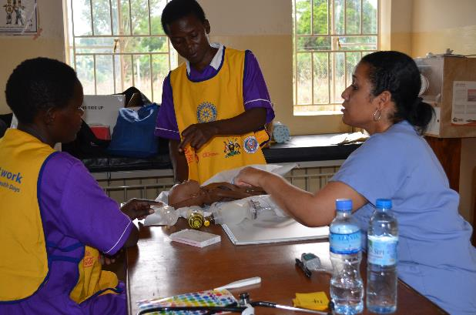
Execution
Grant Approved with
“conditions”
$$ is sent to Host Partner
after conditions met
Global Project Starts
Execution of the project
Notes:
The following resources are available to assist you as you complete your global grant application:
www.rotary.org/myrotary/grants
Grant Management Manual
A handout that walks you through the steps of using the online system to apply for a global grant
Rotary’s Learning Center
Rotary Support Center
Grants staff

Slide 22
Project Implementation
Checklist Items
Bank Accounts / Payments
Host Club Committee
  Provides detailed plan & schedule
  Provides updates and progress reports
  Sends pictures
  Int’l Club reports to partners
  Public image campaign
Host & Int’l Partners Manage Project

Slide 23
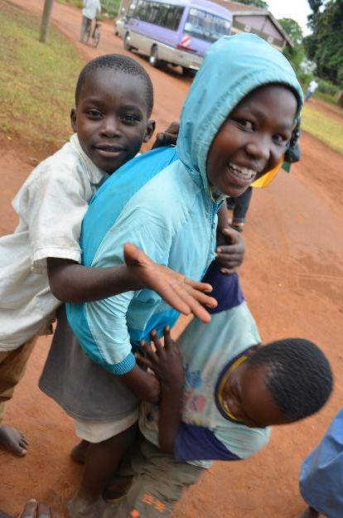
Reporting and Follow up
Progress Reporting
Measurements & evaluations
Final Reporting
Public Image / Publicity
Follow up projects.
Making it even more sustainable
Notes:
The following resources are available to assist you as you complete your global grant application:
www.rotary.org/myrotary/grants
Grant Management Manual
A handout that walks you through the steps of using the online system to apply for a global grant
Rotary’s Learning Center
Rotary Support Center
Grants staff

Slide 24
When / What / How?
Changes to budget
Changes to scope
Changes to project management
12 month progress, 60 days
Final, 60 days after final expenditures
How..
Email to Regional Grant Officer
Grant Tool / Online reporting

Slide 25
Public Image Ideas
Project Blog / Share and distribute link
Social Media – FaceBook®, Twitter®, etc
Newsletters: Club/District/Zone
Rotary “Voices”… submit to blog@rotary.org
Rotary “Showcase”… www.myrotary.org

Slide 26
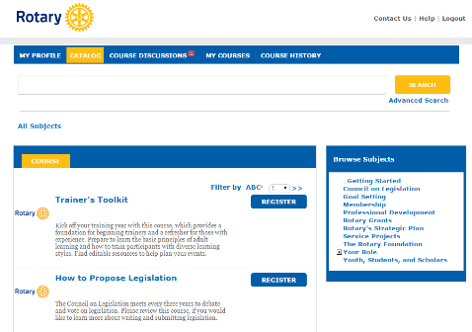


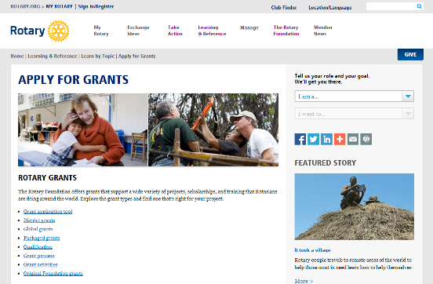
RESOURCES
  www.rotary.org/grants
  Guide to Global Grants
  Training materials
  Learning Center
  Grant staff
Notes:
Rotary has a number of resources to help you take full advantage of grant opportunities.
My Rotary has a wealth of general and detailed information about grants.
The newly updated Guide to Global Grants is a fantastic resource for anyone interested in designing and carrying out a global grant-funded project. Additional training manuals can help you successfully participate in grants, especially the district Rotary Foundation committee manual and the District Rotary Foundation Seminar Leader's Guide.
The learning center offers training resources to help you apply for Foundation grants, including a newly updated course about how to build a global grant.
And, as always, Rotary grants staff are available to answer questions.

Slide 27
Objectives
Learn how Rotarians can initiate Global Grants
Understand how to translate a grant idea into action.
Learn how the Cadre of Technical Advisors can be a resource and their role in grant approval and stewardship.
Learn how to apply for a Global Grant.
Understand the Global Grant approval process.
Learn how a Global Grant is stewarded.

Slide 28

Q & A

Slide 29
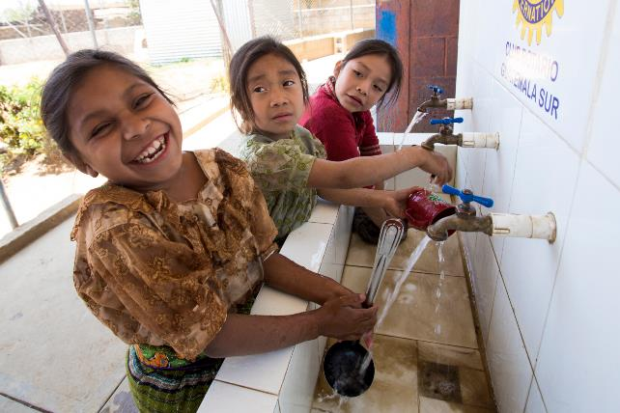
Thank You

