Slide 1
Rotary District 7430 : International Service Webinar
January 12, 2021
International Service Part 1

Slide 2
Agenda
What is International Service- the basics
Our District resources
How to find projects and areas of interest
What is going on in District 7430
Implementing and starting Projects in the Covid 19 World

Slide 3
International Service
Any type of Rotary engagement with the global community that makes a positive difference.

Slide 4
Interested in International Service and Projects– So how do you get started and even find a project?
-many many
ways…..

Slide 5
Finding Projects
Utilize District 7430 international service committee and networks
Attend other Rotary meetings
Rotary Showcase,Discussion Groups
Rotary Action Groups
Rotary Fellowships
Project Fairs
Friendship Exchanges
Intercountry Committee
Matching grants.org
Rotaplast , Shelterbox
Rotary’s partners on Service projects: Ashoka,Habitat for Humanity, Mediators Beyond Borders, Peace Corps
Rotary Learning Center, Rotary Alumni

Slide 6
District 7430 Resource Network
NAME | TOPIC/TOPICS | E-MAIL
CINDY HORNAMAN | INTERNATIONAL SERVICE GRANTS, GLOBAL GRANTS WASH RAG, GLOBAL DEVELOPMENT, FOUNDATION | HORNAMCA@PTD.NET
RON SMITH | GLOBAL GRANTS, INTERNATIONAL SERVICE, MATERNAL CHILD HEALTH, FOUNDATION | rsmith.rotary@gmail.com
FRANK ROMANO | INTERNATIONAL SERVICE, LITERACY,FOUNDATION | fjromano73@gmail.com
BOB HOBAUGH | WASHRAG | rotarianbob@hometownu.com;
JIM PALMQUIST | PEACE ACTION GROUP | jim.palmquist01@gmail.com
BILL THOMAS | PEACE AREA OF FOCUS | watclu@aol.com
LINDA MAYGER | SHELTER BOX, LITERACY | lndmayg@gmail.com
DEE ENG | FRIENDSHIP EXCHANGE | deeleng@gmail.com
SUSAN BURNETT | ROTAPLAST | burnetts@rcn.com
HERB KLOTZ | INTERNATIONAL SERVICE, GLOBAL GRANTS, FOUNDATION | herbk.rotary@gmail.com

Slide 7
Rotary Showcase
GO TO MYROTARY.ORG
UNDER TAKE ACTION- ROTARY SHOWCASE

Slide 8
Rotary Action Groups
Rotary Action Groups are independent, Rotary-affiliated groups made up of people from around the world who are experts in a particular field, such as economic development, peace, addiction prevention, the environment, or water.

Slide 9
Rotary Fellowships
Rotary Fellowships consist of members who share a common interest in recreational activities, sports, hobbies, or professions. These groups help expand skills, foster vocational development, and enhance the Rotary experience by exploring interests while developing connections around the world.
There are almost 100 Fellowships!
www.rotary.org/fellowships

Slide 10
Project Fairs
Virtual Event : PANAMA
28-30 January, 2021
https://projectfair4240-4250.org
Email Vania Barrow: vania@clubrotariodepanama.com or Ricardo Gago Salinero: ricardo@clubrotariodepanama.com
Virtual Event COLUMBIA
5-12 February, 2021
www.feriadeproyectosrotarycolombia.org
Contact PDG Alberto Londono: alberto.londono54@gmail.com
Virtual Event
18-26 September, 2021
PERU

Slide 11
Friendship Exchange
Our District has participated in 11 exchange around the world:
Projects include : Romania hospital equipment, Argentina Agriculture equipment and South African club project
What is Friendship Exchange?
Contact: Dee Eng, deeleng@gmail.com
Friendship Exchange is an international exchange program for Rotary members and friends that allows participants to take turns hosting one another in their homes and clubs. Participants may travel as individuals, couples or other depending on the district.

Slide 12
Intercountry committee
An organization within Rotary that promotes working together for joint projects, cultural activities between two countries or more. The goal is to promote peace , goodwill and fellowship.

Slide 13
Matching grants.org
A web-site that was developed prior to the new grant funding model that provides names of countries, types of international projects and the amount of funding needed.

Slide 14
Rotaplast, Shelterbox
Shelter Box
contact Linda Mayger- lndmayg@gmail.com
Rotaplast
contact Susan Burnett-burnetts@rcn.com

Slide 15
Rotary Partners
Ashoka,Habitat for Humanity, Mediators Beyond Borders,Peace Corps

Slide 16
Learning Center, Rotary Alumni
Learning Center– my rotary.org– provides tools for learning on just about any Rotary Topic
Rotary Alumni– keep in touch with Youth exchange, Group study exchange teams

Slide 17
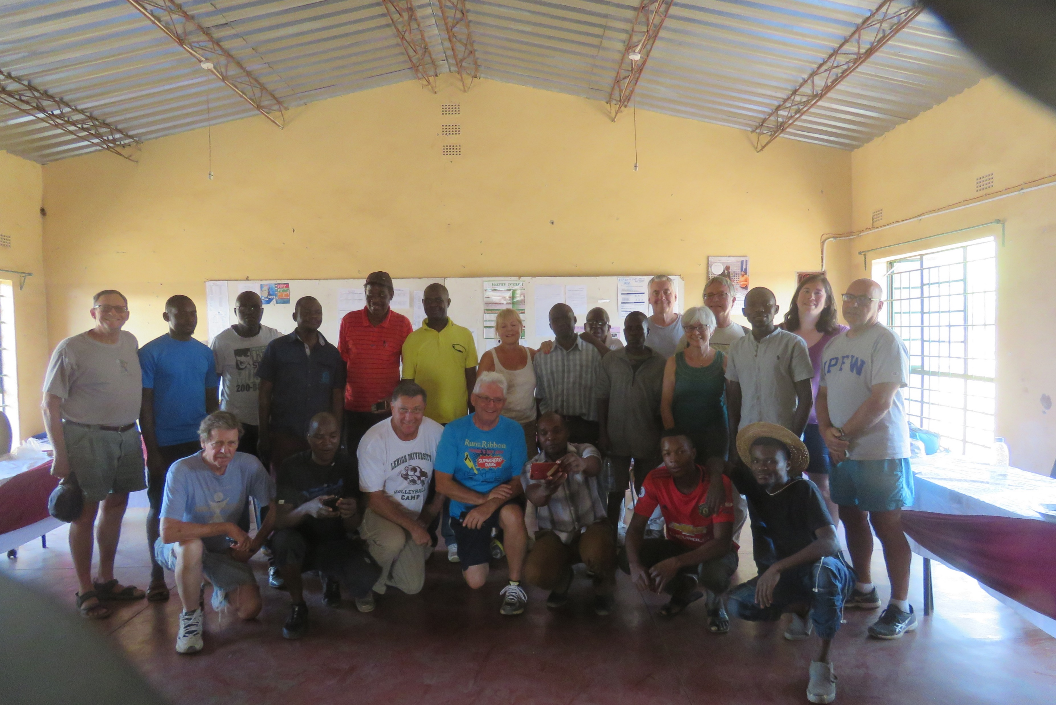
New:International Service Fun Fellowship
2019
12 Rotarians & spouses traveled to Zambia to do volunteer service by painting a school-------then fun travel with a safari!

Slide 18
Tying altogether to implement a project
Many ways: your club
Multiple clubs in the District
District Grants
Global grants

Slide 19
What is going on in our District?
Global Grant Projects waiting to start/in process
Haiti: water project
Guatemala: education
Zambia: 2 projects
Education, water & sanitation
Uganda: maternal child health
Jamaica-possible education or other
Nepal- Covid
Cambodia- Education
Additional Rotary Friendship Exchanges- once travel open
New: Club to Club Exchange
New international service/fun fellowship- once travel opens
ICC Cultural Exchange- once travel opens

Slide 20
Doing international projects in the world of COVID-19

Slide 21
Questions?– thank you for coming
MARK YOUR CALENDARS
NEXT INTERNATIONAL SERVICE TRAINING TUESDAY
TUESDAY, FEBRUARY– 7:00 PM: ROTARY ACTION GROUPS AND THEIR IMPACT
TUESDAY, MARCH – 7:00 PM GLOBAL GRANTS HOW TO

