Slide 1
Rotary District 7430 : International Service Webinar
February 16, 2021
International Service: Rotary Action Groups

Slide 2
Agenda
International Service and Rotary Action Groups– what are they
Rotary Action Groups and each area of focus
What is new
Our District 7430 Resource Network
Utilizing Action Groups to assist with international projects
Questions/comments

Slide 3
International Service
Any type of Rotary engagement with the global community that makes a positive difference.

Slide 4
Rotary Action Groups
Rotary Action Groups are independent, Rotary-affiliated groups made up of people from around the world who are experts in a particular field, such as economic development, peace, addiction prevention, the environment, or water.

Slide 5
Areas of Focus: NOW 7!

Slide 6
Rotary Action Groups supporting each Area of Focus
Promoting peace Domestic Violence Prevention Peace Refugees Slavery Prevention
Fighting disease Addiction Prevention Alzheimer's/Dementia Blindness Prevention Blood Donation Diabetes Family Health/AIDS Prevention Health Education and Wellness Hearing Hepatitis Eradication Malaria Mental Health Multiple Sclerosis Polio Survivors
Providing clean water and sanitation Water, Sanitation and Hygiene
Saving mothers and children Clubfoot Reproductive Maternal and Child Health Supporting education Basic Education and Literacy
Growing local economies Economic Community Development Disaster Assistance
Protecting the environment Endangered Species Environmental Sustainability
Action groups that work in more than one area of focus Food Plant Solutions

Slide 7
rotaryactiongroupforpeace.org
Jim Palmquist, Emmaus
Bill Thomas Fleetwood

Slide 8
The Rotary Action Group for Peace supports numerous global projects as well as provides webinar, experts, support for its members
Our District supports Peace : District 7430 Peace Project
Current Global Grant over $100,000 for Peace training of women in numerous countries in West Africa: Sponsor Club, Emmaus

Slide 9
New RAG: Refugees
Refugees from Venezuela who were helped by Rotarians
Rotary projects that provided food and improved education and health facilities for both local residents and refugees in a Colombian city near Venezuela’s border.
Rotary projects that supported refugees from Venezuela in Brazil through Operation Welcome.
The creation of a Rotaract club in the largest refugee resettlement area in Uganda.
Rotarians who helped the integration of Syrian refugees in Canada and Germany.
Rotarians who provided relief and wheelchairs as well as supported education for children in Syrian refugee camps in Turkey.
Cindy

Slide 10
ragas.online

Slide 11
Slavery is illegal everywhere, yet ... 40.3 million are enslaved … some less than 4 years old. Get engaged NOW
RAGAS working with others globally will change that by
Creating awareness: Telling Rotarians and the wider public that millions are held captive for illegal gain – MANY NEAR WHERE YOU LIVE!
Taking action: Supporting, working with and promoting global anti-slavery bodies and activities through Rotary Clubs, campaigns and projects that help protect children and adults from slavery and its consequences.
YOU can help make that change
RAGAS already has members in over 65 countries

Slide 12
In our district:
Bethlehem Rotary Project on Sex Trafficking and Education
Contact Dee Dee Foran: deedeeforan@gmail.com

Slide 13
Fighting disease Addiction Prevention Alzheimer's/Dementia Blindness Prevention Blood Donation Diabetes Family Health/AIDS Prevention Health Education and Wellness Hearing Hepatitis Eradication Malaria Mental Health Multiple Sclerosis Polio Survivors

Slide 14
As an international group of specialists in Addiction Prevention, our aim is to:
prospect all Rotarians active in prevention of substance abuse and addiction
bring their expertise together for study and exchange
learn how Rotary clubs can participate in the struggle agains addiction
disseminate this knowledge and the developed methodology
inform and stimulate Rotary Districts and clubs
integrate addiction prevention as an essential part of their service
Founded in February 2013 and recognized by Rotary International in January 2016, we now operate in more than 42 countries and 45 districts... in accordance with Rotary International policy.
www.rag-ap.org

Slide 15
rotarypoliosurvivors.org
In our District 7430, Doylestown Club : Carol Ferguson :cookieferg@gmail.com

Slide 16
Wasrag.org
DGE BOB HOBAUGH
PDG CINDY HORNAMAN

Slide 17
The Water, Sanitation & Hygiene Rotarian Action Group is a group of Rotarians whose purpose is to support Rotary clubs to effectively plan, finance, implement, monitor and evaluate water, sanitation, and hygiene programs, where they are most needed in a collaborative, cost-effective, timely, and sustainable manner.

Slide 18
THE WASH ROTARY ACTION GROUP IS: ONE OF THE ORIGINAL ACTION GROUPS FOUNDED IN 2007 WITH OVER 47,000 CONTACTS PARTNERS INCLUDE:
INTERNATIONAL EVENTS INCLUDE:
WORLD WATER SUMMIT AT
RI INTERNATIONAL CONVENTION

Slide 19
WASH Rotary Action Group Goals:
Access and connect with Experts in WASH
Provide technical guides for all stages of WASH projects including program life cycle
Seek funding outside the Rotary domain to complement internal resources
Facilitate connections with other organizations sharing Rotary goals
Alert Rotarians to the availability of expertise and financial resources
Identify and share Rotary and other resources available to Rotarians
Assist and enable clubs to seek support from other clubs, from TRF and beyond Rotary
Ensure clubs can learn of the needs of other clubs
Maintain and build a collaborative working relationship with RI and TRF
Implement appropriate processes to monitor and evaluate the impact, efficacy and sustainability of Rotary projects and programs
Facilitate the exchange of idea and information

Slide 20
Our Rotary District 7430 has implemented several WASH projects
Nicaragua-Bethlehem Morning Star- and Student Chapter of Engineers Without Borders
Sierra Leone-Allentown West and Engineers Without Borders- water and sanitation
Peru- Morrisville Yardley: water filters
India: Bore hole-Ambler, Water dam-Kutztown
Nigeria-water well/roadways-Harleysville
Dominican Republic- water/sanitation-Fleetwood with Engineers without Borders
Kenya-water well Blue Bell, Malawi –Water Well Doylestown

Slide 21
Litrag.org
PDG FRANK ROMANO

Slide 22
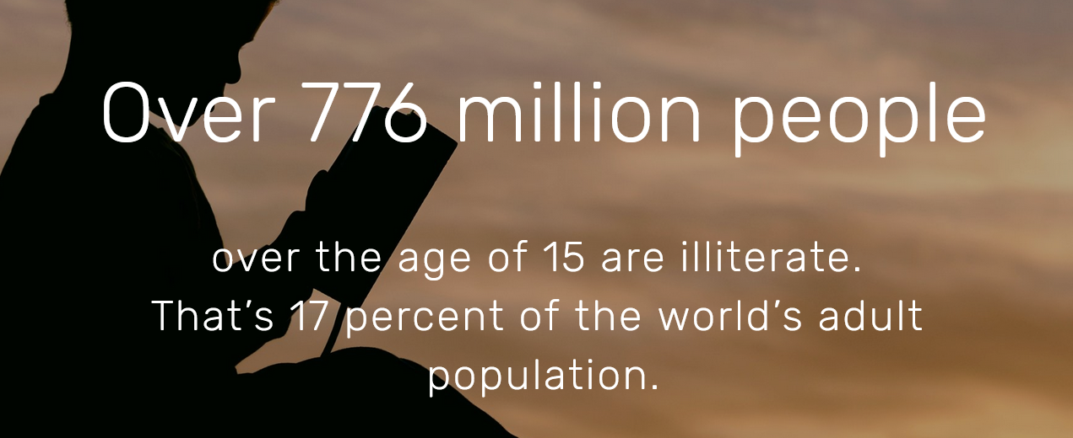
The word “BelRAG” stands for “Basic Education & Literacy Rotarian Action Group”.
We are a network of Rotarians throughout the world who have a special interest in acting upon the mission and goals of Rotary International related to
Alleviate illiteracy;
Enhancing literacy teaching and learning globally, and
Helping to provide materials and equipment for literacy education at different levels.

Slide 23
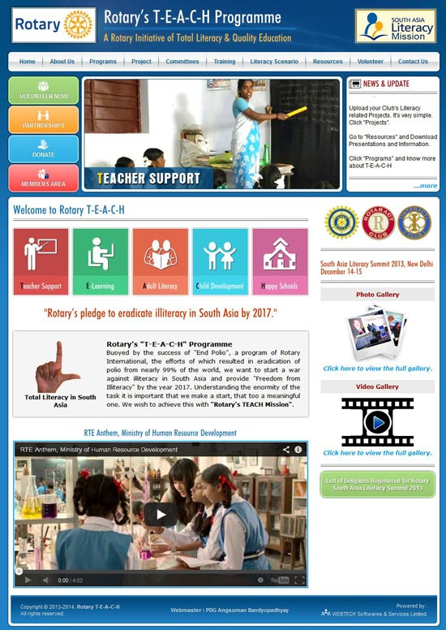
International Partners include:
BELRAG ASSISTS WITH PROJECTS,HAS LIBRARY LEARNING CENTERS, LITERACY COURSES, TRAINING EVENTS,ASSISTS WITH GLOBAL GRANTS, and HELPS WITH NETWORKING

Slide 24
Examples of projects:
In our District:
Global Grant Vocational Training Team with Secondary Education in Zambia- this grant assisted with learning/teaching technology implementation- Emmaus
Others: Working currently on Guatemala literacy project-Morrisville Yardley
School equipment Ecuador-Emmaus, Classrooms Tanzania-Ambler, Computer supplies, Zimbabwe-North Penn, Computer supplies, Sri Lanka-Emmaus.
EXAMPLES WORLD WIDE-CREATIVE PROJECTS
In Kenya - A Rotary Club had 40,000 books shipped to a region in Kenya. After books were distributed to different communities, the shipping container was repurposed as a library and community center for one village. It is now planned to repeat this project in other areas of the region and country.
In Turkey - The war in Syria forced Kurdish Turks in Southeast regions into the western city of Izmir. They came from the poorest, most backward region and were illiterate. This prevented them from integrating into the new environment, socially and economically. The Rotary Club of Karsiyaka provided Literacy Courses with the help of the Ministry of Education., which provide teachers and spaces. The initial (standard) instructional approach was only succeeding at a 25% rate. So, through the Rotary Literacy and Numeracy Task Force, a new approach, Concentrated Language Encounter (CLE) was developed and implemented. The rate of language acquisition jumped to 95%.

Slide 25
rifpd.org
PDG Ron Smith

Slide 26
Improving human well-being and dignity, women's empowerment and supporting sustainable balance between population and environment
Supports UN Sustainable Development Goals (SDGs) "reducing maternal and child mortality and ensuring universal access to sexual and reproductive health care services.“
RMCH assists Rotary clubs and districts in the planning, implementation and co-funding of projects in Rotary Area of Focus Maternal and Child Health, including family planning.

Slide 27
RMCH assists Rotary clubs and districts in the planning, implementation and co-funding of projects in Rotary Area of Focus Maternal and Child Health, including family planning.
The oldest RAG– started in 1995 has one of the largest memberships with almost 8500 Rotarian participants worldwide in over 45 countries. There are coordinators in all part of the world ( Europe, North America, Africa, India, South America)
Expert assistance with projects, networking and training are key
Support by the United Nations and others
Types of project examples: family planning, midwifery, vocational training teams, medical equipment, fistula surgery.

Slide 28
Our District’s Maternal-Child Health Projects
Kampala North- Uganda: Blue Bell Club
One of First Vocational Training Teams in Maternal Child Health
Partnering with 2 Philadelphia & 3 Uganda Universities
Developing Regional Midwife Training Centers – Distance Enabled
An ever-expanding project with significant results
Recognized by WHO and the Rotary Magazine
Bethlehem RC
Breast Milk Bank in India

Slide 30
Dna-rag.com
The Disaster Network of Assistance Rotarian Action Group (DNA RAG) Rotarian Action Groups (RAGs) provide assistance and support to Rotary clubs and districts in planning and implementing community development and humanitarian service projects.

Slide 31
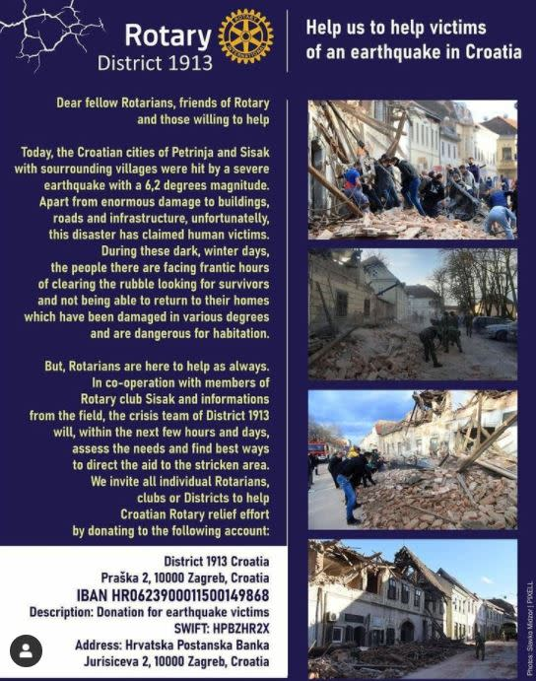
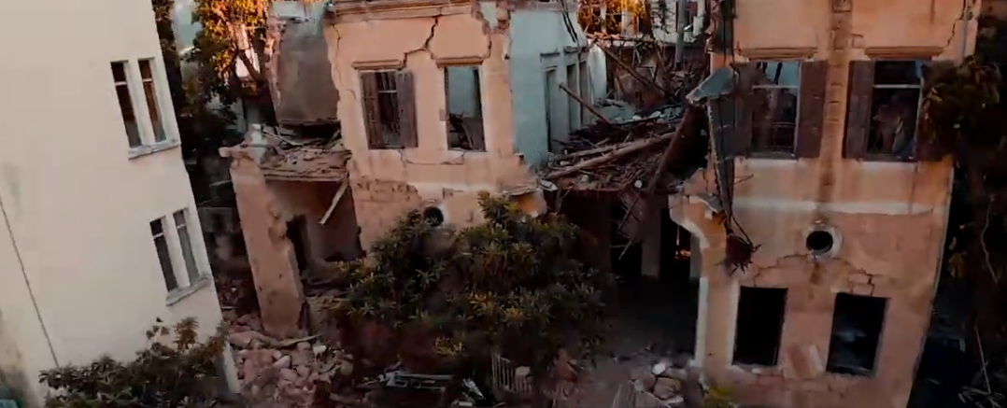
Rotarians step up in disaster response

Slide 32
Our District and Disaster Response
2020- 19 Grants awarded to clubs to address the COVID 19 disaster response
2021- 8 more grants JUST awarded to clubs to address the COVID 19 disaster response

Slide 33
BRAND NEW AREA OF FOCUS:
BRAND NEW ROTARY ACTION GROUP
BRAND NEW WEBSITE: ESRAG.COM
PDG Cindy Hornaman

Slide 34
Proactive : initiating projects, assisting with ideas, education
Project ideas:
ESRAG & UNEP World Environment Day Handbook
Connect With Nature
Reduce Energy Poverty
Tree Projects
Waterway Projects
Reduce our Ecological Footprint
Add- new idea and Sustainability project
NEW EVENT: Ian, Rotary, and the Environment, MARCH 2– REGISTER THROUGH THE ESRAG.COM WEB-SITE

Slide 35
What can we do in our district?
Let’s get this new area of focus started!
Grant applications now being accepted for support environment area of focus– grant application period through March 30 2021
Think outside the box- talk with another club- another area, a region –
i.e. your county, local governments for needed projects
Think about starting your own Rotary Club Environment Group- a new club,

Slide 36
So--------have we totally
Overwhelmed and confused
You with all this info?
This Photo by Unknown Author is licensed under CC BY-NC-ND

Slide 37
Our Rotary District 7430 Resource Network
NAME | TOPIC/TOPICS | E-MAIL
CINDY HORNAMAN | INTERNATIONAL SERVICE,FOUNDATION GRANTS, GLOBAL GRANTS WASH RAG, GLOBAL DEVELOPMENT, PEACE, ADDICTION PREVENTION,REFUGEES,ENVIRONMENT, FOOD PLANT SOLUTIONS | HORNAMCA@PTD.NET
RON SMITH | GLOBAL GRANTS, INTERNATIONAL SERVICE, MATERNAL CHILD HEALTH, FOUNDATION | rsmith.rotary@gmail.com
FRANK ROMANO | INTERNATIONAL SERVICE, LITERACY,FOUNDATION | fjromano73@gmail.com
BOB HOBAUGH | WASHRAG | rotarianbob@hometownu.com;
JIM PALMQUIST | PEACE ACTION GROUP | jim.palmquist01@gmail.com
BILL THOMAS | PEACE AREA OF FOCUS | watclu@aol.com
LINDA MAYGER | SHELTER BOX | lndmayg@gmail.com
DEE ENG | FRIENDSHIP EXCHANGE | deeleng@gmail.com
SUSAN BURNETT | ROTAPLAST | burnetts@rcn.com
HERB KLOTZ | INTERNATIONAL SERVICE, GLOBAL GRANTS, FOUNDATION | herbk.rotary@gmail.com

Slide 38
Rotary Cadre of Technical Advisors- in each area of focus
Utilize the community assessment worldwide with project planning and implementation

Slide 39
Questions?– thank you for coming
MARK YOUR CALENDARS
NEXT INTERNATIONAL SERVICE TRAINING TUESDAY
MARCH 9 , 7 PM: GLOBAL GRANTS: HOW TO

