Slide 1
Start Your Ball Rolling
To Success
MAPETS DISTRICT 7430 SESSION 2022 2023
Notes:
Welcome– introduce----------Passionate about Golf – Working on final theme around the game of golf

Slide 3
Welcome
District Governor Elect
Len Gieseler
MAPETS DISTRICT 7430 SESSION 2022 2023
Notes:
Welcome, and thank you all for attending MAPETS 2022. Whether you have been a president before or this is this is your first time, We hope that you will learn something new and take away ideas and tools that will make your year as president a success. IMAGINE what your year will be like and what great things you and your Rotary club can accomplish if you just IMAGINE/ADAPT and ENGAGE. This year we plan to have fun, get back to more in person engagement and hopefully get back to the Rotary experience we all have missed.
We have a very busy schedule, and it will be fast paced. Please write down any questions you have so that we can address them during our time together. At this time, I would like to ask our current DG Bob Hobaugh to say a few things.

Slide 4
Welcome
District Governor 2021 2022
Bob Hobaugh
MAPETS DISTRICT 7430 SESSION 2022 2023

Slide 5
Our District 7430 Leadership Team for 2022- 2023
District Executive Committee:
DG Len Gieseler, DGE Diane Donaher, DGN Katie Farrell, IPDG Bob Hobaugh and DRFC Cindy Hornaman
Treasurer: Tom Hartzell Finance Chair: Keegan Worley
AG’s Area 1 – Rick Zayaitz, Area 2 – Kathy Heller, Area 3 - Open, Area 4 - Jeremiah Sensenig
Area 5 - Michael Sloane, Area 6 – Suzie Berry, Area 7- Mike Mueller, Area 8- Gail Linenberg
Area 9 – Clint Ehlers
District Leadership Team Committee Chairs:
Membership: Dave Czarnecki
Foundation: Cindy Hornaman (plus committee sub-chairs: Grants, Annual Fund, Polio , Paul Harris- etc.)
Youth Services: Darlene Scott (plus committee sub-chairs for Youth Exchange, Camp Neidig, Stem Yea, 4-way Speech Contest and youth
protection)
Public Image: Amy Sheller
International Service: Herb Klotz (plus committee sub chairs: Rotaplast, ShelterBox, Friendship Exchange)
DEI: Co-Chairs: Daniel Watson-Bey, Peter Jones
Other Supporting committees
MAPETS DISTRICT 7430 SESSION 2022 2023
Notes:
Our team is shown here. Talk about the executive committee, Welcome 2 new AG’s, Kathy and Mike. Briefly go down the list of the committee chairs

Slide 6
Let’s talk about our District and Membership
PDG Herb Klotz
DGN Diane Donaher , 2021-2022 Membership Chair
Introduce Dave Czarnecki, 2022- 2023 Membership Chair
MAPETS DISTRICT 7430 SESSION 2022 2023
Notes:
Introduce PDG Herb

Slide 7
Public Image in our District
AG Amy Sheller
MAPETS DISTRICT 7430 SESSION 2022 2023
Notes:
Introduce Amy Sheller

Slide 8
What is Public Image?
MAPETS DISTRICT 7430 SESSION 2022 2023
.
Notes:
Rotary’s public image isn’t just what we think of ourselves. It’s also what people outside of Rotary think about us. Our public image is shaped by how we talk about Rotary, and how often. If we are not telling Rotary’s story to the public, their impressions are often made up of half-truths. This can harm our public image and weaken our brand. When people understand what your club does to make the world a better place, they’ll be motivated to support your efforts and get involved. Strengthening Rotary’s public image in your community will help you attract members, volunteers, partners, and donors

Slide 9
Why is Public Image important?
Expand people’s understanding of what we do
Increases membership, volunteers, partnerships & donors
Helps Rotary Recognition
Inspires current members
Expand our reach
Notes:
Having a strong public image can increase your membership, engage current members & community partners, Grow your fundraising

Slide 10
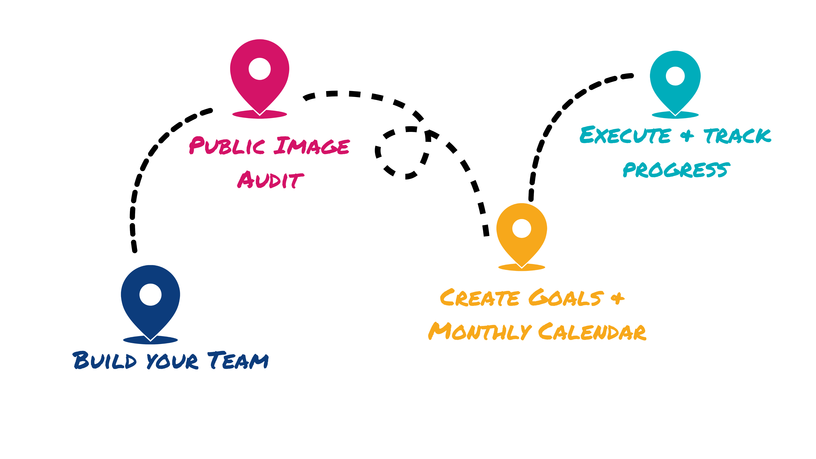
MAPETS DISTRICT 7430 SESSION 2022 2023

Slide 11
MAPETS DISTRICT 7430 SESSION 2022 2023

Slide 12
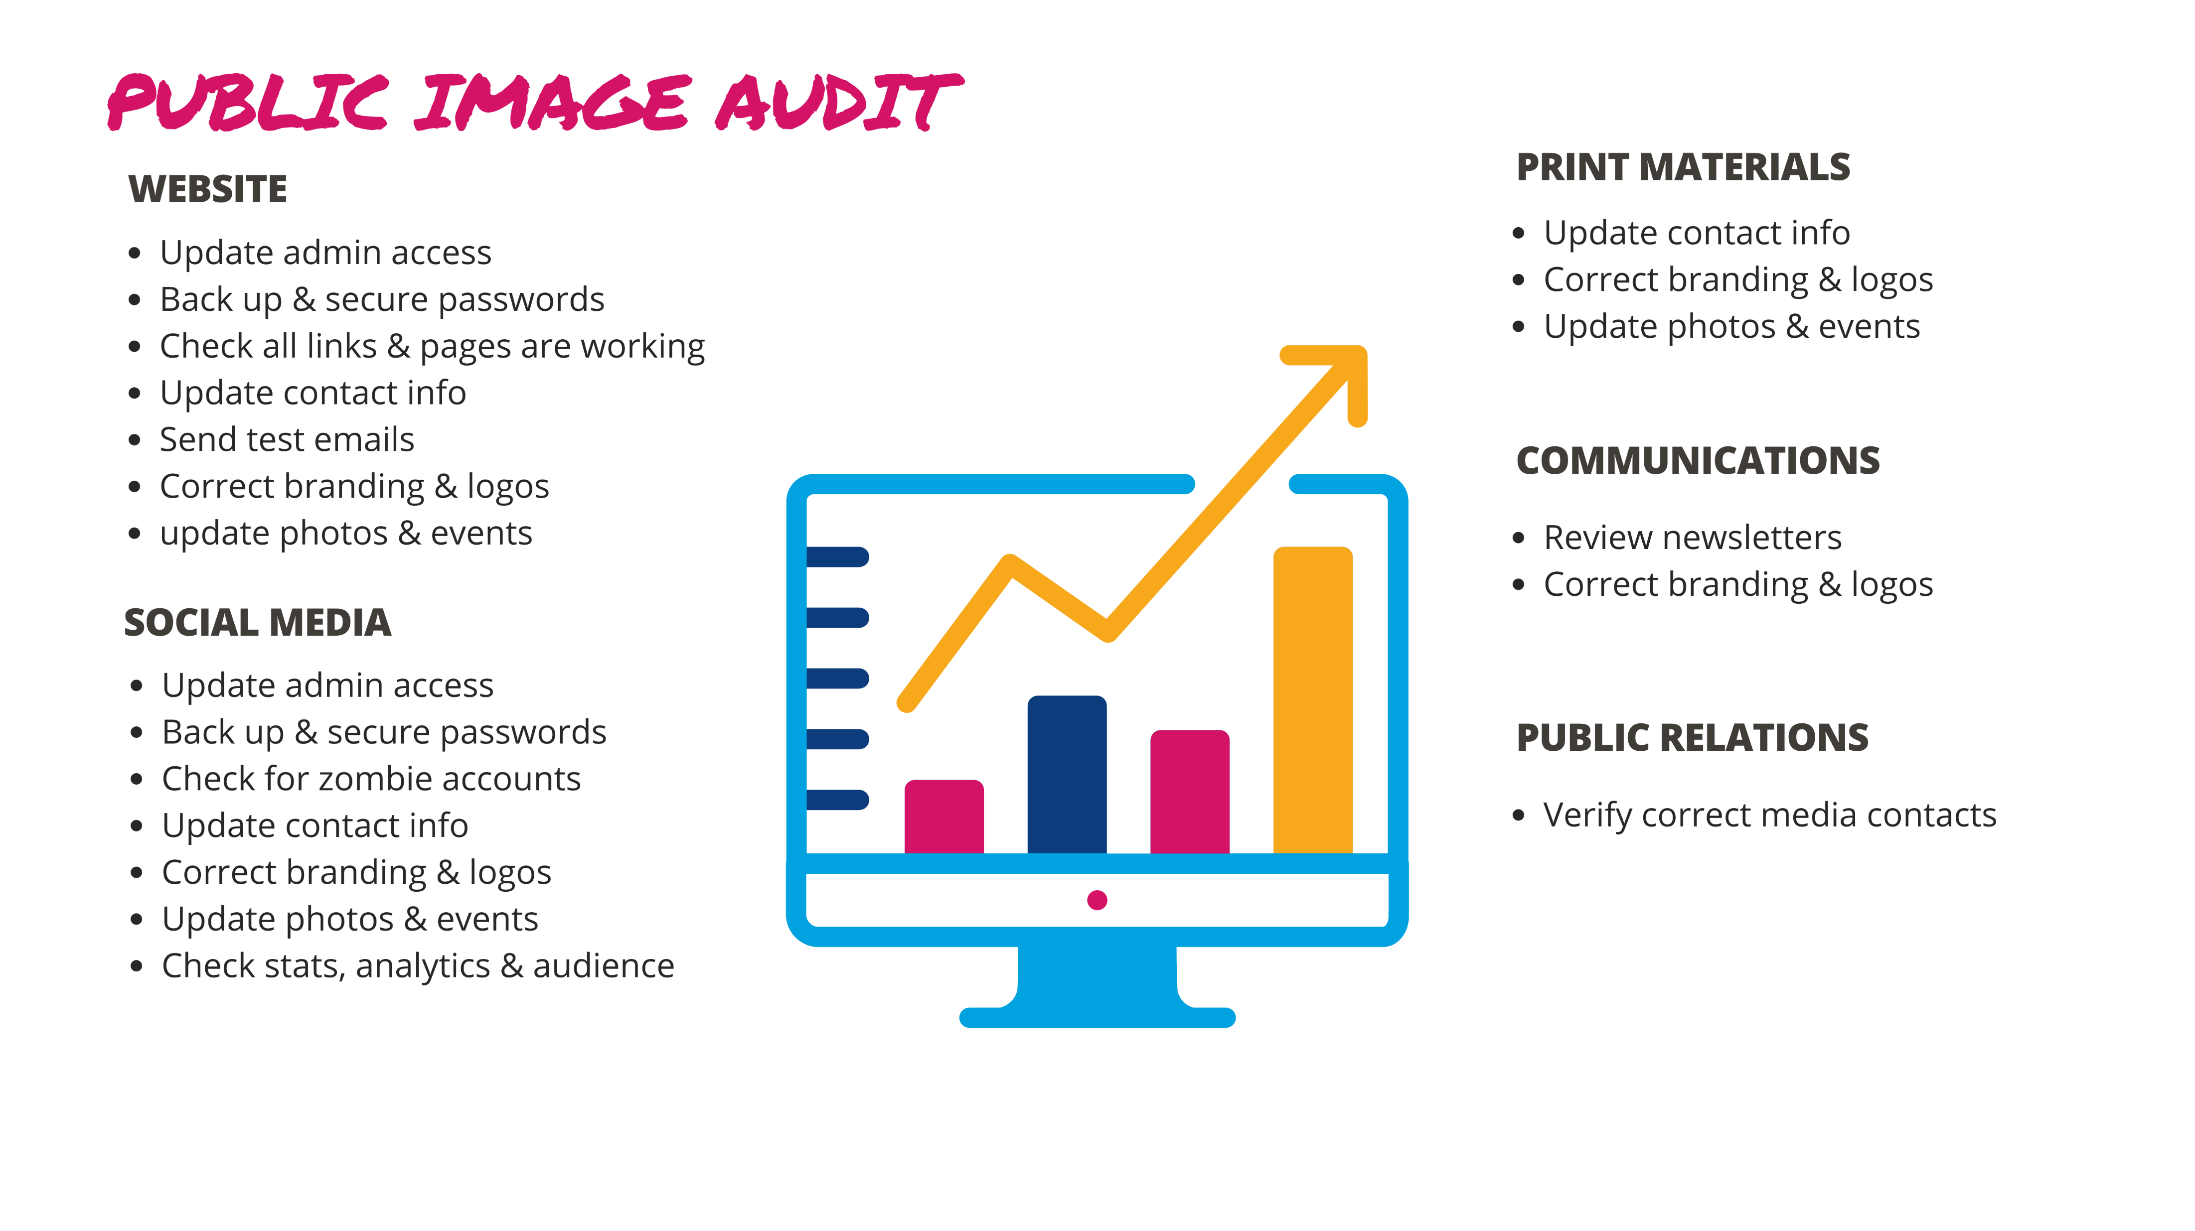
MAPETS DISTRICT 7430 SESSION 2022 2023
Notes:
Introduce Amy Sheller

Slide 13
Content Plan
MAPETS DISTRICT 7430 SESSION 2022 2023

Slide 14
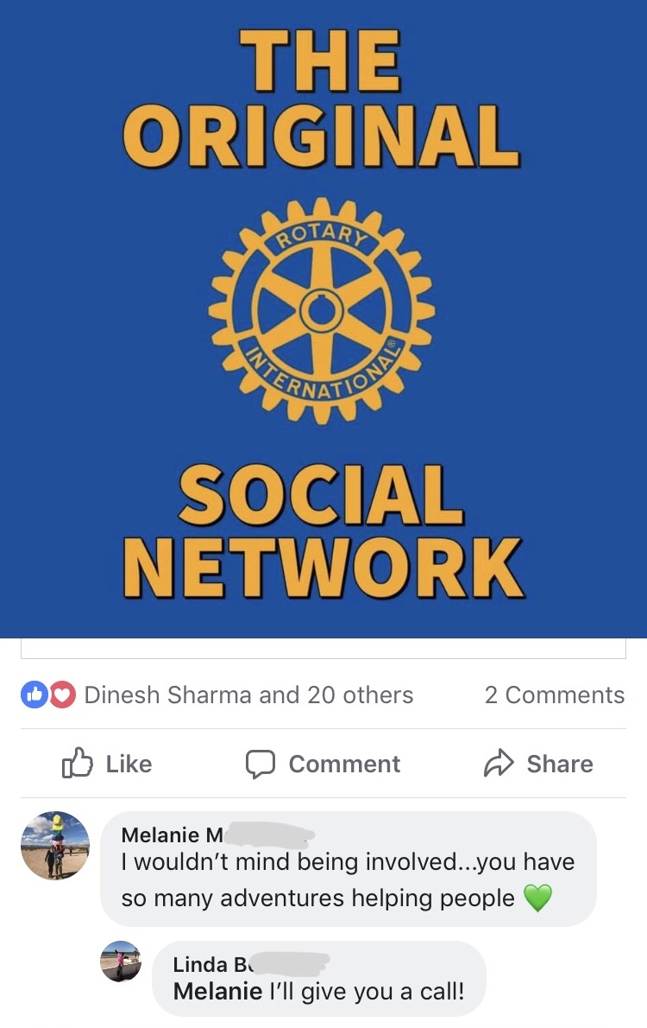
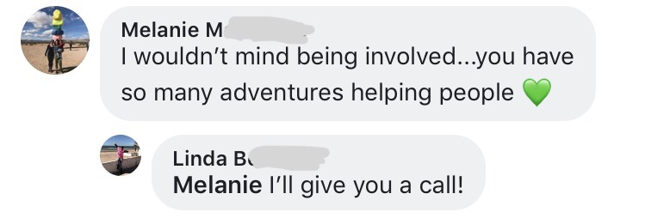
Share your Rotary Story
MAPETS DISTRICT 7430 SESSION 2022 2023
Notes:
What can you do as President
-Prioritize Public Image
-Build your Public Image Team
-Share your excitement & Rotary Story in person & online

Slide 15
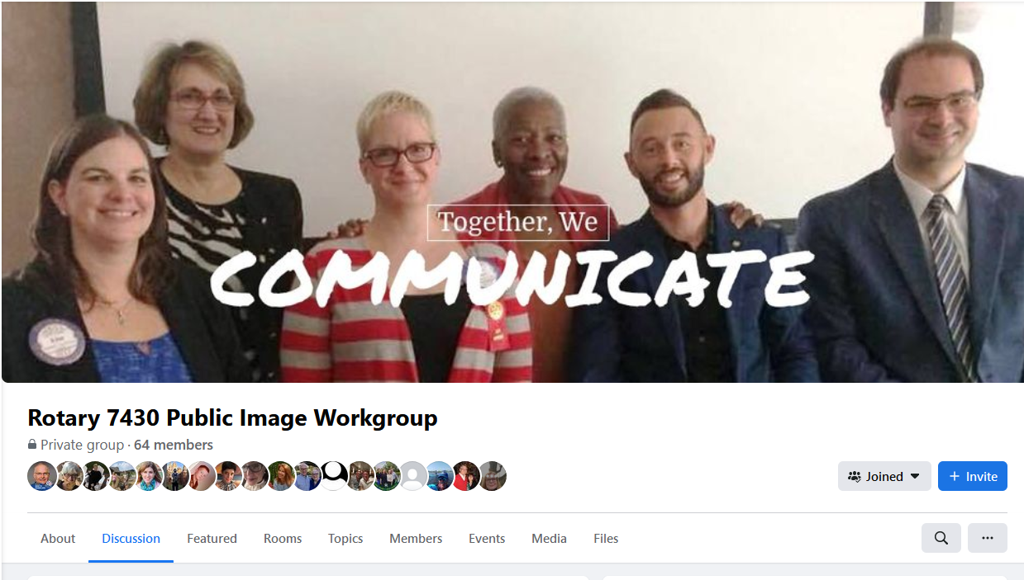
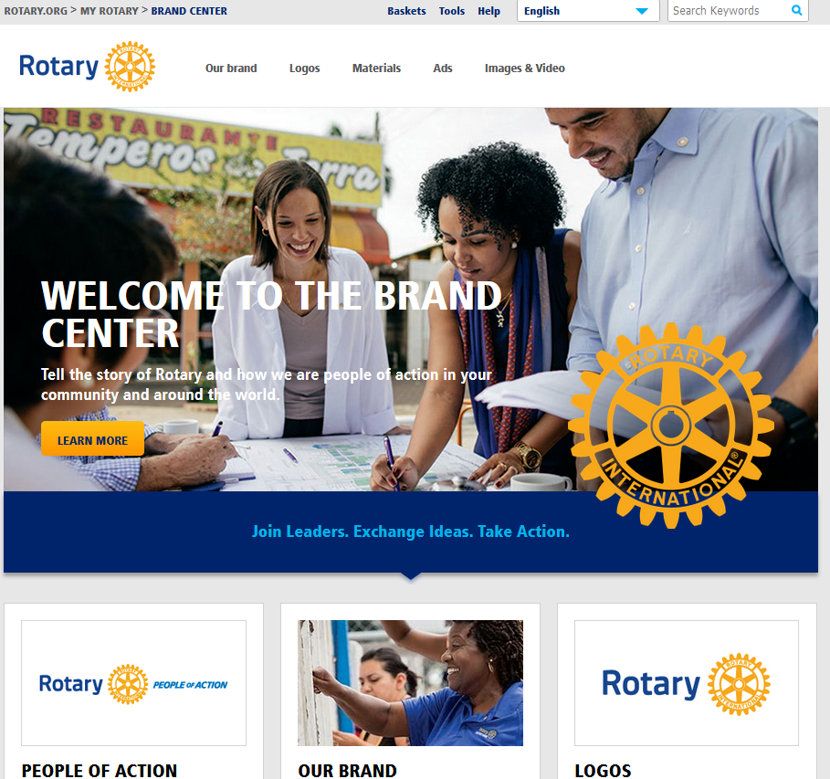
Resources
rotarydistrict7430.org/
Facebook group Rotary Public Image Workgroup
Rotary Brand Center
Follow Rotary District 7430 on Facebook, LinkedIn & YouTube
Follow Rotary International on Facebook, Instagram, twitter, LinkedIn & YouTube
MAPETS DISTRICT 7430 SESSION 2022 2023
Notes:
Introduce Amy Sheller

Slide 16
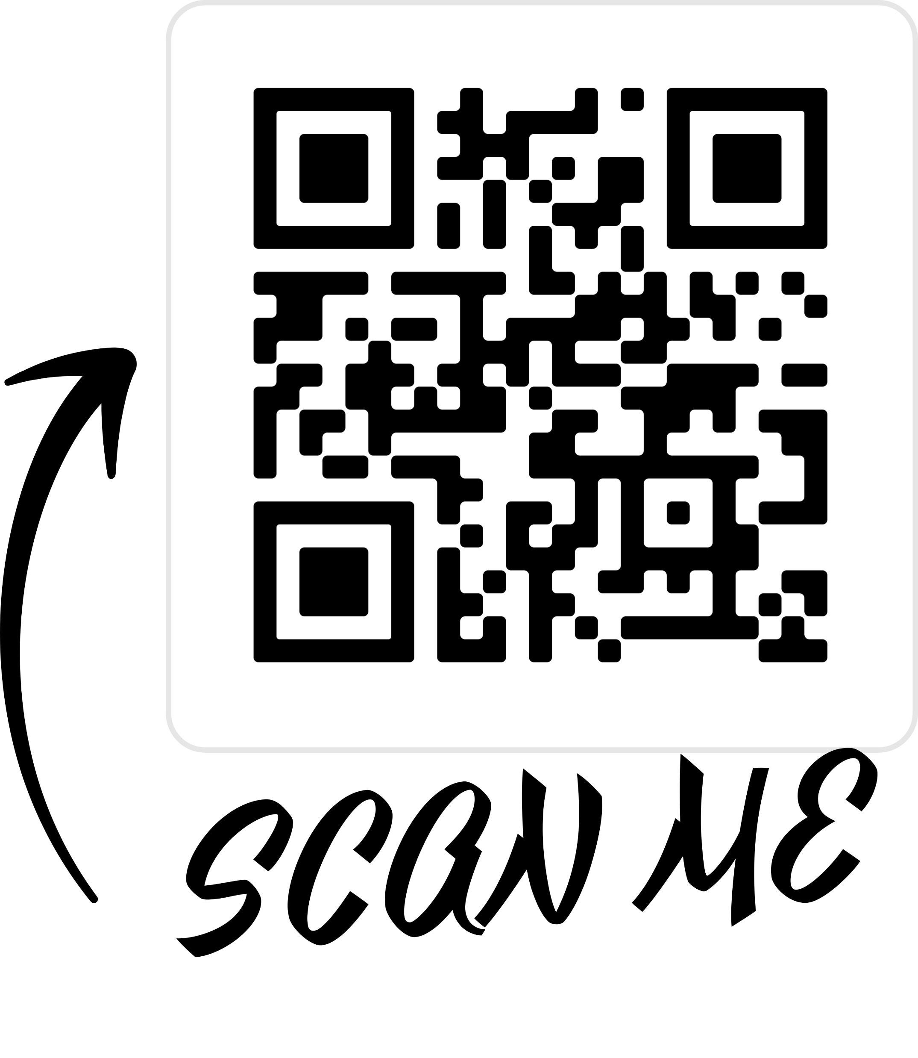
Questions
Amy Sheller
amyshellerrotary@gmail.com
610-420-7710
MAPETS DISTRICT 7430 SESSION 2022 2023
Notes:
Introduce Amy Sheller

Slide 17
Our Rotary Foundation in Our District PDG Cindy Hornaman
Using our Foundation Giving for our clubs
How Foundation Giving ties into our Club Management
Grant applications now in progress– get your MOU in!
Participate: Foundation Gala March 5
MAPETS DISTRICT 7430 SESSION 2022 2023
Notes:
Introduce Cindy

Slide 18
Let’s take a break--
Be back by
11:00 am
MAPETS DISTRICT 7430 SESSION 2022 2023

Slide 19
Our Rotary International Assembly, February 2022
Priorities and Objectives
Increase our Impact
Expand our Reach
Enhance Participant Engagement
Increase our Ability to Adapt
MAPETS DISTRICT 7430 SESSION 2022 2023
Notes:
The International Convention was a unique experience. We all had hoped to attend in person, but Omicron did not allow that to happen so for the first week in February we all gathered virtually. Nothing can take the place of meeting in person and really getting to know other people but the way it was laid out was good. We used interpreters at times and had good interaction with people all over the world.
Many of the priorities and objectives are the same as this current year. They are listed here. The underlying strategies of how we can work within these priorities have been modified which I will include in OUR goals for the district. I will announce these goals at the Assembly on April 9th.
Membership again is a major emphasis along with how to attract members for new or innovative clubs. There are no real set rules as to how we can go about getting people involved and what type of club they can be. It is time to truly think outside of the box. Along with this Rotaractors will officially be recognized as part of Rotary starting this year. Rotaract clubs will start paying dues – 5.00 for a university-based club and 8.00 for a community-based club. The 50.00 on time charter fee will be waived. As you can tell, Rotaract will be one of the ways Rotary is looking to attract new and younger members. By making them part of the organization from the beginning we are hoping that they stay in Rotary. We will be discussing more of this at the District Assembly along with more guidance.
Do you have a welcoming club? This was another underlying theme throughout the training. Understanding that question and how we can use the DEI initiatives that RI and our district have developed can help answer the question. As Rotarians, we need to be open minded to looking at our communities and see if we as clubs can be more representative.
The last emphasis was on WE ARE ROTARY! Are we telling the story? We are people of action, but do we let enough people know and if we so, do we ask them to join and be part of Rotary. Expand Our Reach is the Objective, Imagine how we can do it better. Once we expand our reach, what is Your, the Clubs, and Rotary’s legacy.
Closing it all out was all about planning. Planning is the key to success not only at the District level but at the club level. We are well on our way, but the work is not done and the greater we are prepared the more fun and success we will all have.

Slide 20
Our District Calendar 2022-2023-AND KEY CURRENT EVENTS
MARCH 5, 2022: FOUNDATION GALA
APRIL 9, 2022: DISTRICT TRAINING ASSEMBLY- DESALES UNIVERSITY
APRIL 22-24, 2022: DISTRICT CONFERENCE
APRIL 30, 2022: ROTARY DAY OF SERVICE, STEM YEA FUNDRAISER
JUNE 3-JUNE 8, 2022: RI INTERNATIONAL CONVENTION- HOUSTON
JUNE 28, 2022: DISTRICT CHANGEOVER
OCTOBER 15, 2022: RACE TO ZERO- PURPLE PINKIE EVENT
NOVEMBER 5, 2022: FOUNDATION SEMINAR
MARCH 11, 2023: FOUNDATION EVENT
MAY 5-MAY 7, 2023: DISTRICT CONFERENCE
OTHER DATES:- QUARTERLY MEETINGS WITH AREA AG’S, MONTHLY DEC MEETINGS,QUARTERLY, DLT MEETINGS – WELCOME TO ROTARY
MAPETS DISTRICT 7430 SESSION 2022 2023
Notes:
These are the highlights of our Major Activities in the next year in our District--- they will be on the web-site– I will quickly go through them

Slide 21
District Governor Visits for 2022 -2023
Goal: each club will have an in person visit by the District Governor
The Assistant Governors asked to be at each of their club visits
The DG would like to meet with the club board of directors either prior to club meeting or immediately after club meeting
Draft schedule is handed out.– Please confirm visit dates with your AGs by May 15. AG’s will send me confirmation by May 30.
Final visit dates will then be published on web-site
Remember– we are planning ahead!
MAPETS DISTRICT 7430 SESSION 2022 2023
Notes:
As you know, it is tradition that each club will have a visit by the Governor– I am really looking forward to meeting all the members of your clubs--- We are passing out our first draft schedule of Governor visits for you to review– this way we can all plan our calendars in advance.

Slide 22
Get together with AG’s and Areas
Area 1: Rick
Area 2, Area 6, Area 8: Jean and Suzie
Area 3 and Area 4: Jeremiah
Area 5 and Area 7: with Mike Mueller and Mike Sloane
All Areas ZOOM: with AG Area 8 Gail Linenberg
and AG Area 3 Amy Sheller
MAPETS DISTRICT 7430 SESSION 2022 2023
Notes:
Now we are going to “mix it up” a bit--- Each AG should move to an area around the room as above and the PE’s in those areas should go and sit by the AG’s.
We are going to do a little exercise and let’s think about our clubs and how our own experience in the club. Using club elements, what would you keep or eliminate if you were going to start a new club. For each one of the Elements go around your group with your AG and answer the questions. You have 15 minutes– we will then have the AG’s come up and summarize what we came up wiht. We will take notes and post our results.
For those that are on our ZOOM meeting you will be assigned a breakout room for the zoom meeting AG Gail Linenberg will coordinate one of the breakout rooms and AG Amy Sheller will coordinator the other.
Let’s get to it!

Slide 23
Our District 7430 Website and My Rotary
Support and information
MAPETS DISTRICT 7430 SESSION 2022 2023
Notes:
Cindy – will pull up the district web-site on the screen then as there is time do the goals will review the my rotary

Slide 24
Next “ to do’s”
Use Learning Center
Register for : Foundation Gala March 5
District Training Assembly April 9
Work on club goal setting- your calendar
MAPETS DISTRICT 7430 SESSION 2022 2023
Notes:
Here are some upcoming dates and events I would like to invite you too.
The Foundation Gala will be held at the William Penn Inn. This will be a night of fun, games, dancing and fellowship.
The District Assembly is your final tune up for the start of your year as president. Not only are we going to have some additional information, but I will be laying at the district strategy and goals for the next year. A key part of the day will be spent on working with Club Central and entering your goals.
We will also have a vey good Key Note speaker along with other fun items. I encourage you to also invite members from your club especially key people such as your Secretary, Treasurer and committee Chairs. There will something there for everyone.

Slide 25
Thank you for attending
IMAGINE IS A DREAM
ONCE you right it down it becomes a
GOAL
MAPETS DISTRICT 7430 SESSION 2022 2023
Notes:
Overall Thank you and positive statement.

Slide 26
MAPETS DISTRICT 7430 SESSION 2022 2023

