Slide 1
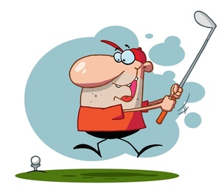
Get Ready
Get Set………
PETS TRAINING SESSION 1 2021 2022
Notes:
Welcome– introduce----------Passionate about Golf – Working on final theme around the game of golf

Slide 2
Let’s
Swing…
TOGETHER!
PETS TRAINING SESSION 1 2021 2022
Notes:
Just as you are going to be the PE for the first time, same goes for me as DG, we are in this together.
My style – Team approach, Easy going – but expect the same amount of commitment from you as I plan to give.
Communication is key to a successful year.

Slide 3
Rotary Vision Statement:
Together we see a world where people unite to take action to create lasting change – across the globe, in our communities, and in ourselves.
PETS TRAINING SESSION 1 2021 2022
Notes:
Why we are here - The Rotary theme –
This is something you will continually see. Very good mission statement.

Slide 4
Tonight’s Program
Get to know each other
What would you like to learn?
Our Structure
Tools
Planning
Expectations
How can we support you
What are key challenges
What are key good things
Expectations to do/ calendar items
PETS TRAINING SESSION 1 2021 2022
Notes:
Review
Go over some of the statics that

Slide 5
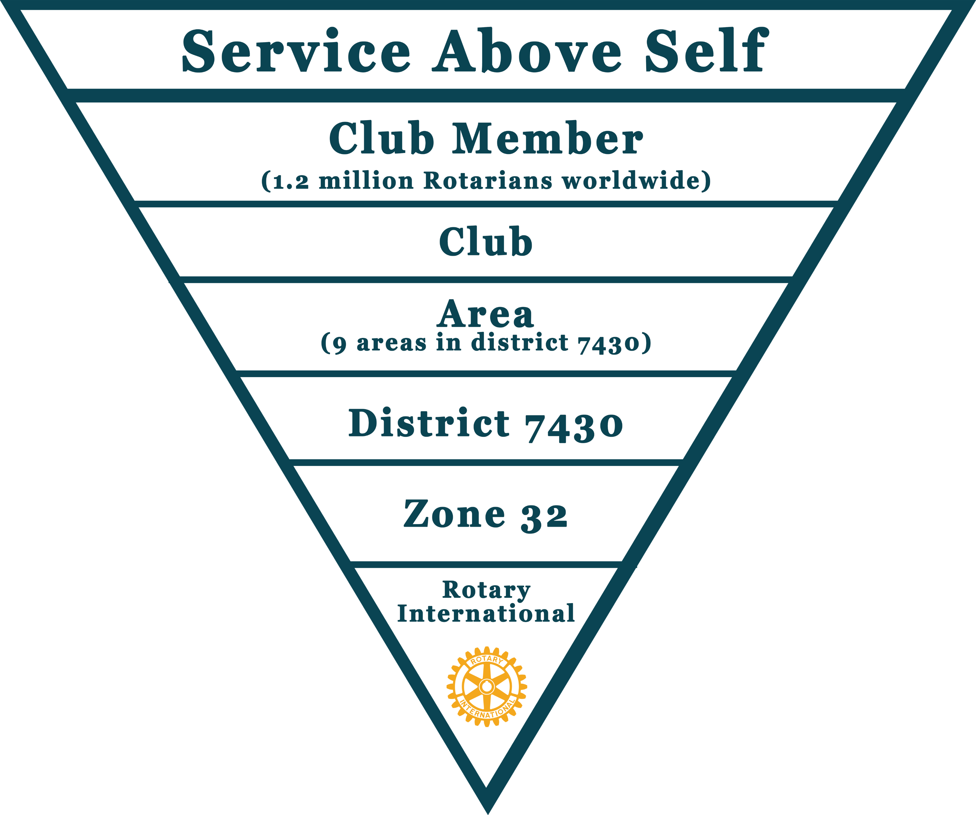
RI Structure/Organization District Structure/Organization
PETS TRAINING SESSION 1 2021 2022
Notes:
New script: Many of you know the basic RI structure– but let’s review so you also understand the support that you have.
The triangle starts with our Rotary Motto: Service Above Self. The club members and the Clubs are the basic foundation of the whole Rotary Organization- we as individuals and clubs- make it happen!
Beyond the clubs are the Districts– the districts are groups of clubs arranged by geographical region. The district are organized by areas– in our district we have 9 areas. District are then organized by what are called zones—And Rotary International and the staff support all of us around the world. Let’s look a little further.

Slide 6
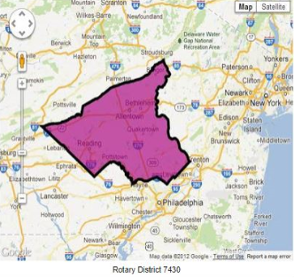
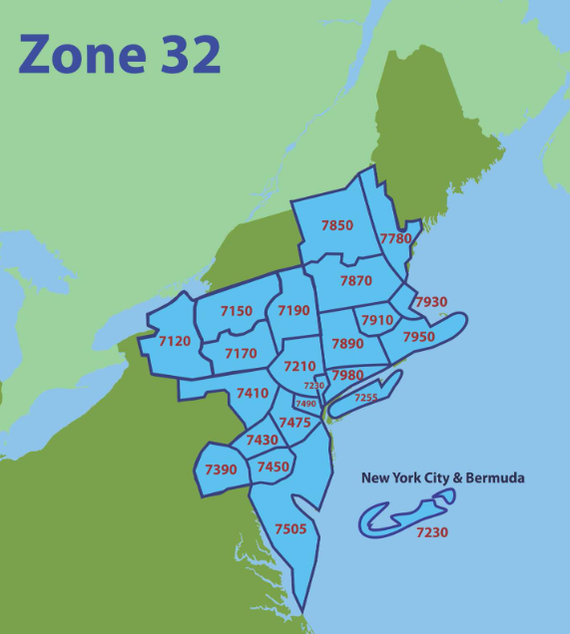
PETS TRAINING SESSION 1 2021 2022
Notes:
Our district 7430 on the left here in the pink– has about 1700 members– we cover Lehigh, Northampton, Berks, Montgomery and a part of Bucks County.– farthest north is Slatington, East- is East– west into Reading- and south into the suburbs of Philadelphia- but not Philadelphia. Our zone is number 32 . This zone is comprised of district in the whole northeastern united states and Bermuda. We also partner a lot with the neighboring zone 28 which is also all of Canada and Alaska--- Each district and zone has Rotary volunteer support staff in all of the key areas to help us.

Slide 7
Our District Structure
Notes:
Now let’s take a look at our own District and all of the support that you as a club president have available to you--- starting with the DG, Trainer, Admin Assistant– each club is divided into areas of about 5 clubs with Assistant Governor volunteers to offer support. Then we have other offices– and look at all of the support committees--- let’s now look at a couple of the basic support committees that you should also have in your club.

Slide 8
Our District Support Committees to help you
Foundation: Foundation Area Coordinators, Annual Fund, Grants Major Donors, Bequests, Polio plus, Paul Harris
Membership: Growing, adapting, new clubs, satellite clubs,
Youth Services: Interact/Rotaract,Camp Neidig, Alumni.4 Way Speech Contest, STEM
Public Image: Website, Facebook, communication, newsletter
International Service: Projects, Shelter Box, Friendship Exchange, Rotaplast
PETS TRAINING SESSION 1 2021 2022
Notes:
To get more specific– here are some of the support areas– each of these areas has a rotary volunteer that can help you and your club--- be a speaker, answer questions, help you get started with stuff. Go through these committees

Slide 9
Your Club Structure
Your Club Structure
Your board– who should be on? President, President-Elect, Treasurer, Secretary, VP– Others
Committees:
Foundation, Membership, Public Image, Community Service,Youth Services– others
What other committees do you have?
PETS TRAINING SESSION 1 2021 2022
Notes:
-- maybe this one should be interactive– go around the room and ask each one how their club is structure– we can use flip chart and write it down– then give summary the next time
How is your club structured?
How do you pick people to be on the board and in leadership roles
How does your club promote Foundation, Membership, PR, etc.. Listed on the slide

Slide 10
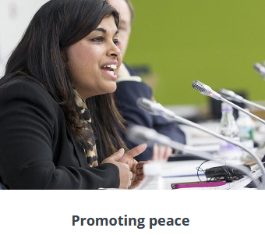
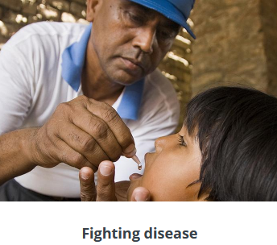
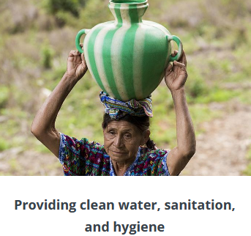
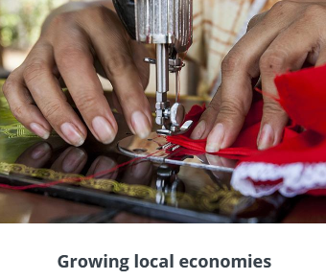
.
Causes that we fund ( Our areas of focus)
PETS TRAINING SESSION 1 2021 2022
Notes:
So you see how we are structure--- and why– these are the causes that we work on--- as you look at this– you can see every one of your club projects always falls into one of these areas.
Grants and club and international projects need to fall into one of these categories.
Newest are of focus is on the environment. We have established a District Environment committee to pursue new projects and help clubs.

Slide 11
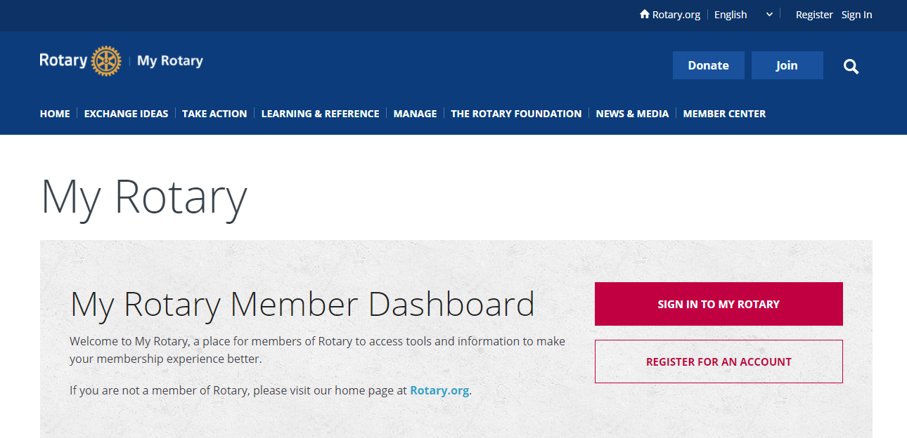
Tools to begin using
PETS TRAINING SESSION 1 2021 2022
Notes:
We will have the internet open here– to flip to the real on line– not let’s look at the on-line tools we have available to us.

Slide 12
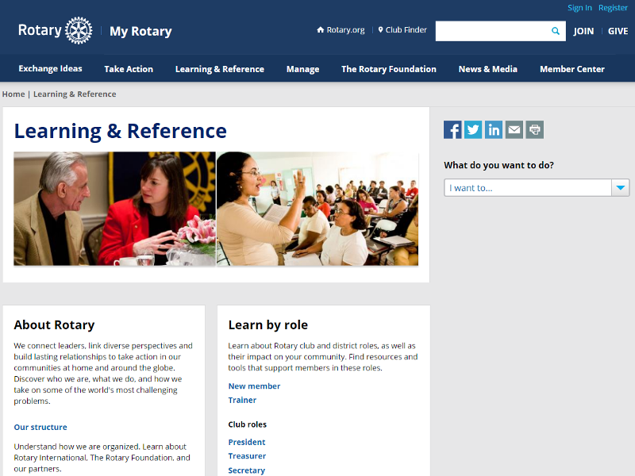
The Learning Center
PETS TRAINING SESSION 1 2021 2022
Notes:
We are now going to talk a little about the Learning Center– which is fairly new to rotary– you can learn just about any topic by taking very simple courses on line.

Slide 13
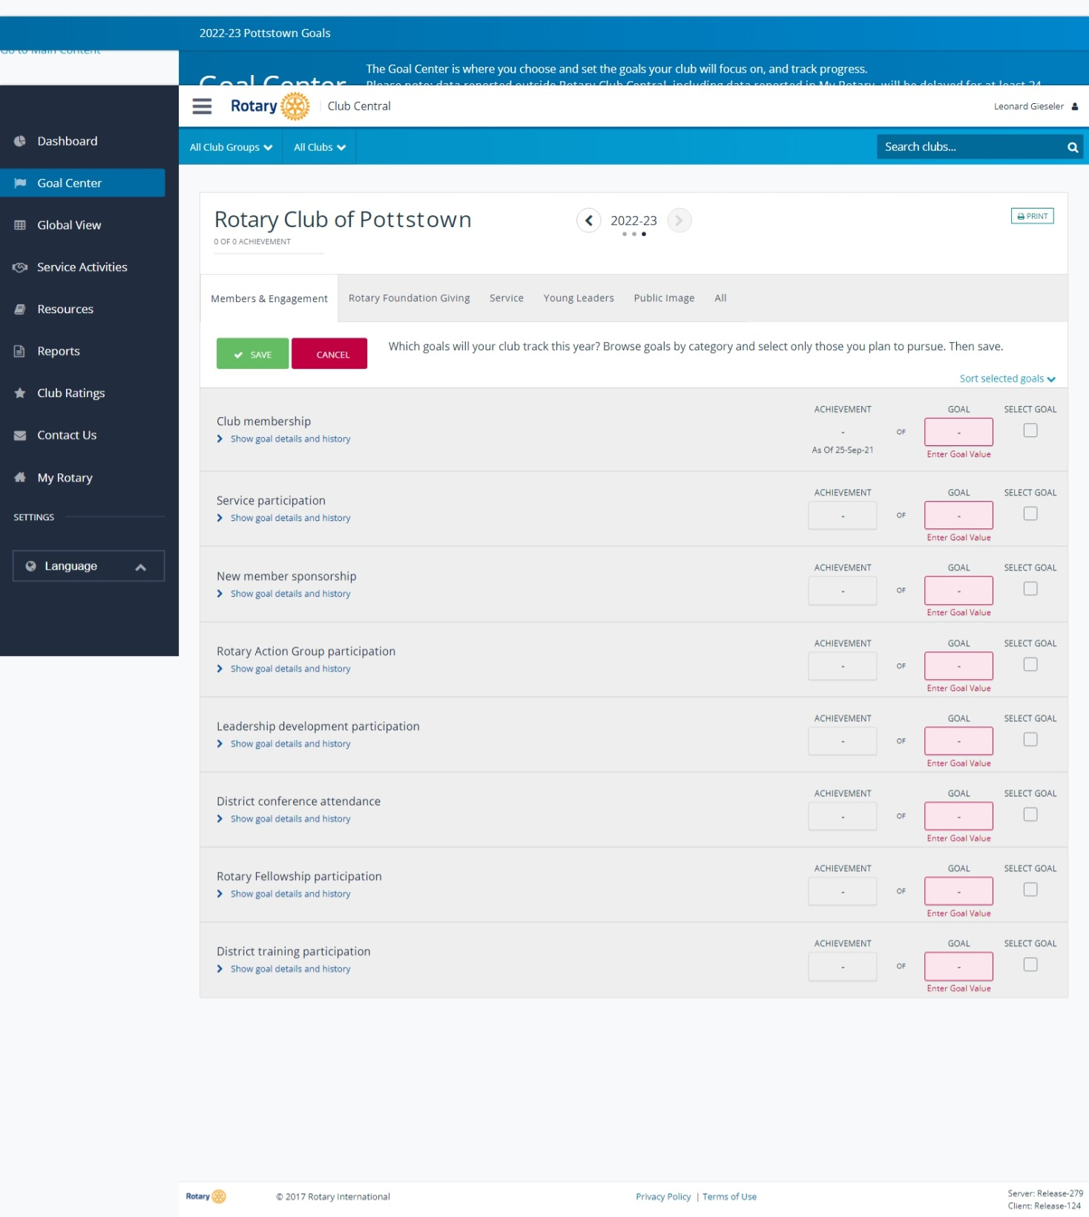
CLUB CENTRAL
PETS TRAINING SESSION 1 2021 2022
Notes:
How we do our planning and set our goals is key to our club success. Rotary Club central will be used extensively as PE to set up goals and track how things are going
Good to review the current and last year goals for your club and work with your current President to give insight.
We will use this for the Presidential Citation and any other goal related program that is introduced.

Slide 14
Start Planning Now
Your meetings– places-times: In Person, Hybrid
Goals: How can you help your club achieve them
Committees: what will this structure look like?
Events: will you add or subtract? Special dates?
Calendar: getting this to all your members ASAP
Agenda: Club meeting and board meeting Prep.
PETS TRAINING SESSION 1 2021 2022
Notes:
More Planning you do now the better and easier your President year will be.
Clubs go as the president goes. If the president is prepared and enthusiastic with goals and ways to have fun the club will follow suit.

Slide 15
Expectations
Assignments for next meeting:
Learning Center-Complete the following
Club President Basics
Leading Effective Committees
Rotary Club Central Resources
Membership--- select one module and complete
Enroll to Attend November 6, 2021-
Foundation Seminar at De Sales University
PETS TRAINING SESSION 1 2021 2022
Notes:
Not to overwhelm anyone. There are things you will need to do and be ready for.
We all have to give and prepare to be a success. All in this together
Communications are key
Team approach

Slide 16
Next Calendar Dates
November 6, 2021: Foundation Seminar, De Sales University
December 6, 2021- Pre-PETS 2 - Virtual
January 25, 2021, Pre-Pets 3 – Virtual
February 24-27 PETS – King of Prussia – Registration information will be sent
Special Guests: RIPE Jennifer Jones, Zone 32 Director – Valerie Wafer
April 9, 2022 District Training Assembly- De Sales University
( last PETS session)
PETS TRAINING SESSION 1 2021 2022
Notes:
Please add these dates your calendars.
MAPETS is required and will be some of the best training you will ever have. We will do our best to give you concise and timely information so that you are ready to hit the ground running.

Slide 17
And….
Today’s course is Finished!
Questions/comments?
Len Gieseler – Cell 610-324-9666
Work – 610-323-2201 Ext 100
lgieseler2023@gmail.com
PETS TRAINING SESSION 1 2021 2022
Notes:
Thank you all for attending . We will be sending this power point out to all of you.– a

